Slide 1
Interpretable Multi-Purpose Genotype Representation Learning
Monica Isgut and Joseph Tsenum

Slide 2
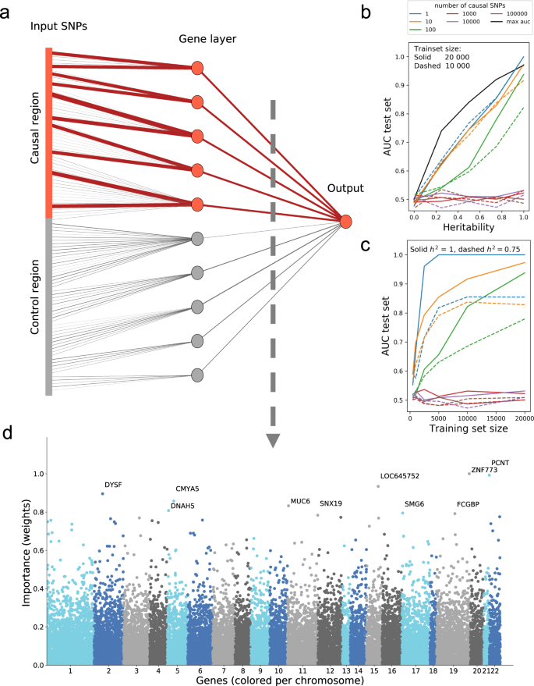
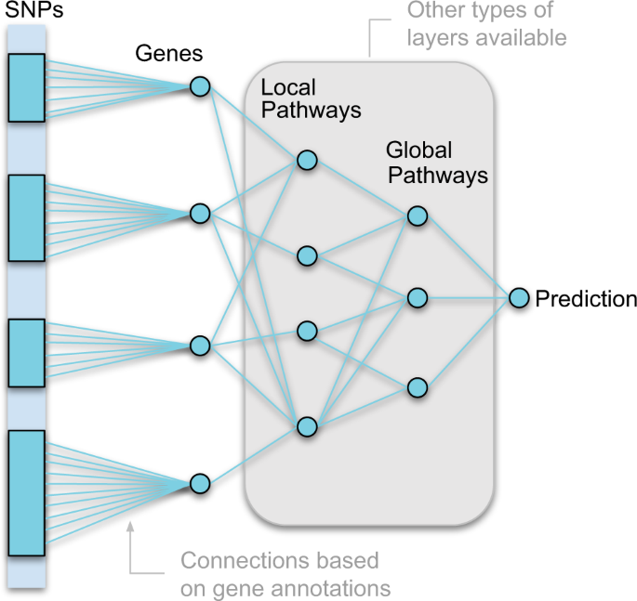
GenNet Framework: interpretable deep learning for predicting phenotypes from genetic data
September 2021
Hilten et al.

Slide 3
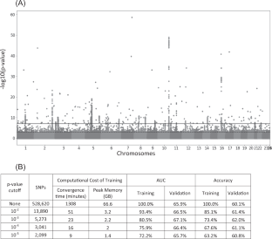
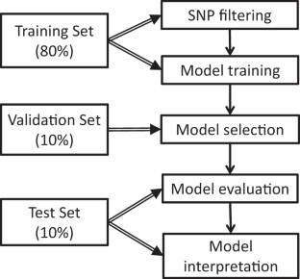
Deep neural network improves the estimation of polygenic risk scores for breast cancer
October 2020
Badre et al.

Slide 4
Problem:
Polygenic risk scores are generated by first pre-selecting features using approaches such as LD pruning or LDPred, which involve ad-hoc assumptions from the user that can bias the resulting feature selection. Moreover, the selected features do not contain potentially-rich non-linear information about the rest of the genome.

Slide 5
Objective:
Learn an interpretable, multi-purpose low-dimensional representation of genotype data with informative features that enable it to be used as a platform alternative to GWAS.
Novelty
Ability to analyze the effect of individual genes for disease prediction tasks (usually, extensive post-GWAS analyses need to be done)
Uses data from coding and non-coding regions (GenNet only uses data from coding regions). The non-coding regions of the genome make up over 99% of the total
Theoretically adaptable to different datasets. Simply get the genotype data, impute as-needed to get the desired SNPs available in UK Biobank dataset, and use in model. Can use a pre-trained model
Low dimensional feature space can facilitate use in various deep learning models
Examples of Possible Applications
Deep clustering of genotype representation to predict multi-dimensional phenotype data and generate interpretable disease phenotypes
Multivariate disease prediction using genotype representation alone
Multivariate future disease prediction using genotype & phenotype data at a given time or age
Synthetic data generation using GANs to produce more genotypes of minority ancestry individuals
Deep clustering
Medical history features
Genotype features
Future medical phenotype history / ICD-10 codes
Or binary disease prediction
Interpretable genotype dataset (representation)
Medical history (future) ICD-10 codes

Slide 6
Chromosome 6
SNPs (input)
0/1/2
Genes
SNPs (output)
0/1/2

Slide 7
Step 1 (1 day):
Finish gene location pre-processing.
Use Annovar:
dbtype refGenewithver –getinputfiles (annotate_variation.pl –downdb –buildverhg19 –webfrom annovar refgene humandb/
Joseph –
Literature search to validate the problem & solution
Notes from papers / references
Begin to outline the paper, including introduction (PROBLEM → SOLUTION)
Novelty

Slide 8
Step 2 (1-2 days):
Set up new Europeans-only autoencoder model class with sparsity. Bind specific architecture for each chromosome (consider single-node vs. multi-node genes)

Slide 9
Step 3 (3 days):
1) Train with chromosomes 9 and 6 for CAD
2) Set up feedforward neural network architecture with chromosomes 9 and 6 for CAD; run and interpret using logistic regression. Make it applicable to more chromosome

Slide 10
Step 4 (1 week):
Run the autoencoder model with sparsity for all chromosomes and concatenate the embedding for each
Set up a feedforward neural network architecture using representation for all chromosomes
Run the feedforward neural network for CAD
Run the feedforward neural network for multi-modal disease ICD-10 code prediction

Slide 11
Step 5 (1 week):
Relevance scoring for feedforward neural network for chromosomes 6 and 9 for interpretability
Relevance scoring for feedforward neural network for all chromosomes
Next steps?
Publish with just CAD example?
Deep clustering and other applications prior to publication

