Slide 1
Classification: SVM
Saurabh Sinha

Slide 2
Linear Classifiers
Note that L = {x | w^{T}x + w₀ = 0} is a hyperplane, called the “separating hyperplane”. (It separates the positive examples from the negative examples.)

Slide 3
Linear Classifiers
Solve a system of linear inequalities
“Linear programming” could be used
Note: there may not be such a hyperplane, but we’ll assume there is.

Slide 4
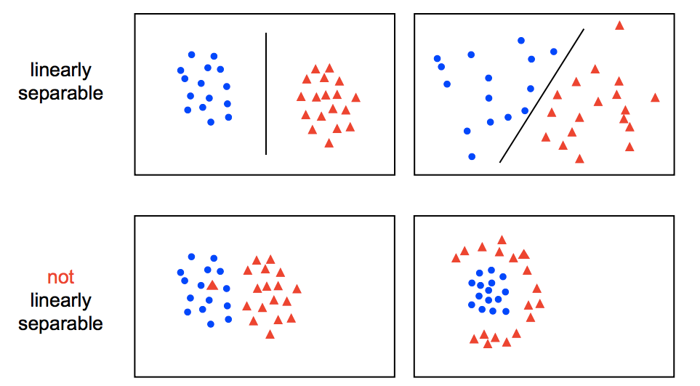
Many linear classifiers for same training data
Which one to choose?

Slide 5
Support Vector Machine

Slide 6
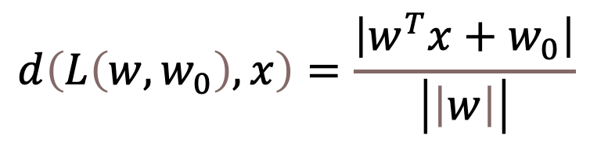
A special linear classifier
Recall that linear classifiers find a separating hyperplane
Note that the distance from a point x to a hyperplane L(w,w₀) = {x | w^{T}x + w₀ =0} is given by
$$d\left(L\left(w,w_{0}\right),x\right)=\frac{\left|w^{T}x+w_{0}\right|}{\left|\left|w\right|\right|}$$

Slide 7
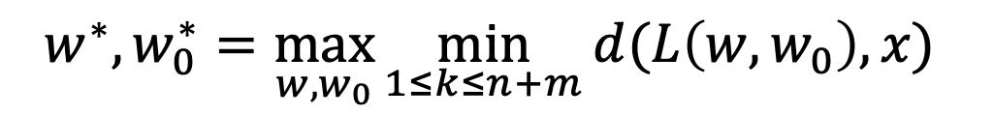
A special linear classifier
Find a linear classifier that maximizes the distance from any of the n+m points to the separating hyperplane
That is:
$$w^{∗},w_{0}^{∗}=\max_{w,w_{0}}{\min_{1≤k≤n+m}{d(L\left(w,w_{0}\right),x) }}$$
Solved using “quadratic programming”

Slide 8
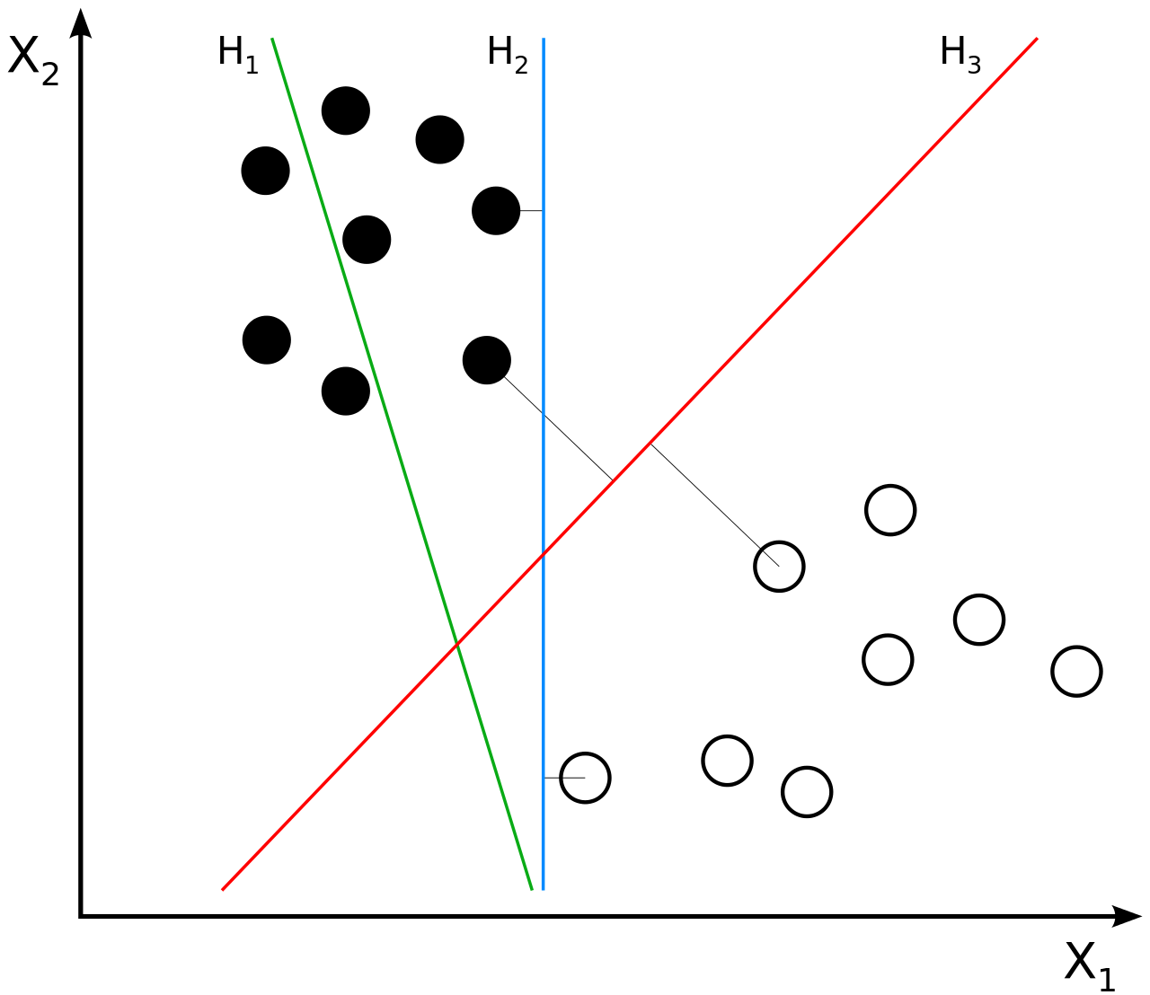
SVM: Maximum margin linear classifier
Source: wikipedia
H₁ does not separate the classes. H₂ does, but only with a small margin. H₃ separates them with the maximum margin.

Slide 9

Optimization problem
Minimize
$$\left|\left|w\right|\right| subject to y_{i}\left(w^{T}⋅x+w_{0}\right)≥1$$
for i = 1, … n+m

Slide 10
Support Vector Machine
This special classifier is called a support vector machine or SVM.
Has better properties than a “randomly chosen” linear classifier.
What does that mean?
Better “generalizability”, less “overfitting”

Slide 11
SVMs and “dot products”
Not from text
Recall that we want to find
This can be rewritten as the maximization of
Where each α_{i}>=0 and

Slide 12
Dot products
Note that the maximization only requires the dot product of pairs of data points:
The dot product reflects the cosine of the angle between two vectors

Slide 13
Kernel functions
This
can be rewritten as
Where k(x_{i},x_{j}) is called the “kernel function”

Slide 14
Kernel functions
This
can be rewritten as
Here, k(x_{i},x_{j}) is the dot product of x_{i} and x_{j}
But it doesn’t have to be. It could be the similarity of x_{i} and x_{j} in some other sense. It could be the dot product of some higher dimensional mapping of x_{i}.

Slide 15
Linear separability

Slide 16
Inseparability
Real world problems: there may not exist a hyperplane that separates cleanly
Solution to this “inseparability” problem: map data to higher dimensional space
Called the “feature space”, as opposed to the original “input space”
Inseparable training set can be made separable with proper choice of feature space

Slide 17
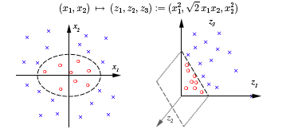
Example

Slide 18
What this means in an SVM
Input space: x = (x₁, x₂) y = (y₁, y₂)
Define kernel function k(x,y) as (x₁y₁ + x₂y₂)²
This is equal to the usual dot product of (x₁², √2x₁x₂ , x₂²), (y₁², √2y₁y₂ , y₂²)
Thus we have implicitly gone from 2-D to 3-D space, and the data is separable in the 3-D (feature) space though it was not separable in the 2-D (input) space.

Slide 19
The kernel trick in SVM
The dot product may be taken in a higher dimensional space (feature space) and the SVM algorithm is still happy
It does NOT NEED the actual vectors in the higher-dimensional (feature) space, just their dot product
The dot product in feature space is some function of the original vectors X and Y, and is called the “kernel function”

Slide 20
The art of kernel functions
Not clear a priori what mapping (to what higher dimensional space) is needed to make the data separable.
But you can focus on defining a function k(x,y) that best captures the similarity of any two data points x and y, and hope that this kernel function will lead to separability

Slide 21
Soft margins
For some data sets, SVM may not find a separating hyperplane even in the higher dimensional feature space
Perhaps the kernel function is not properly chosen, or data contains mislabeled examples
Use a “soft margin”: allow some training examples to fall on the “wrong” side of the separating hyperplane
Have some penalty for such wrongly placed examples

Slide 22
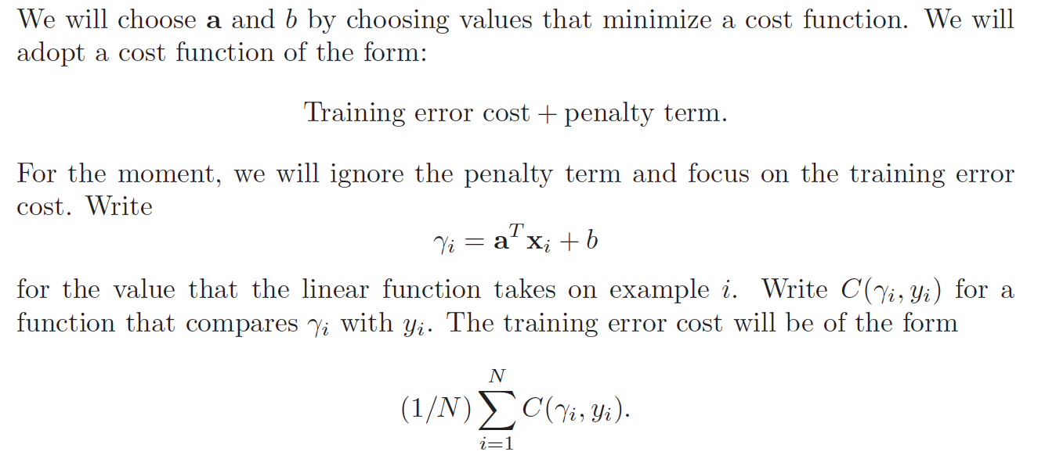
“Soft margin” and hinge loss
Optional reading
From ” Probability and Statistics for Computer Science”, David Forsyth, Springer. http://www.springer.com/us/book/9783319644097

Slide 23
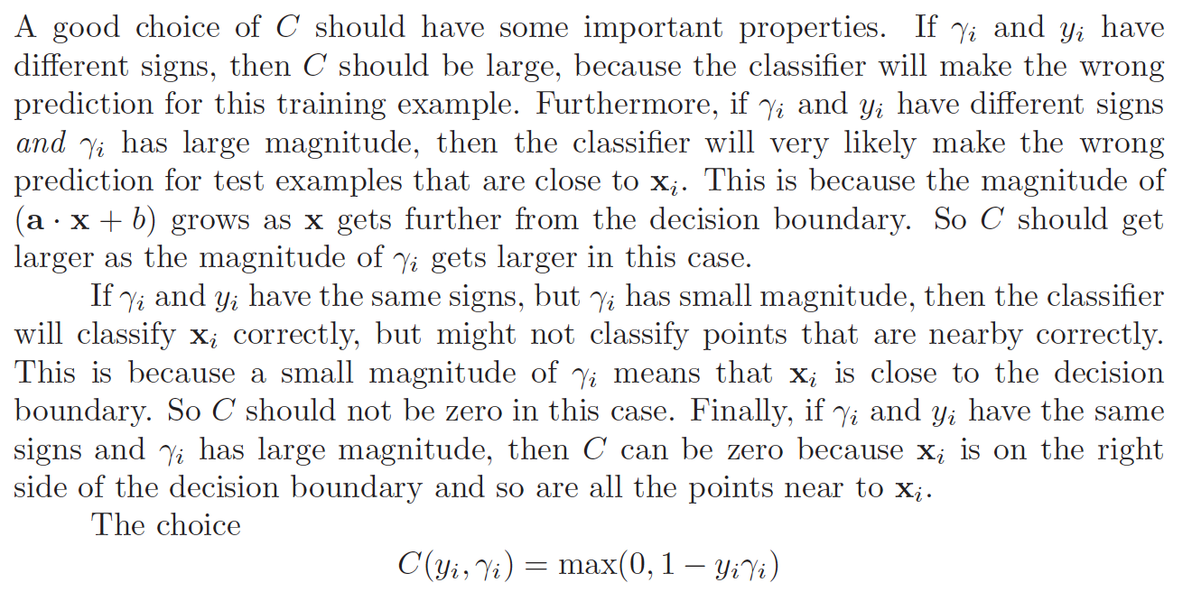
Hinge Loss
Optional reading
From ” Probability and Statistics for Computer Science”, David Forsyth, Springer. http://www.springer.com/us/book/9783319644097

Slide 24
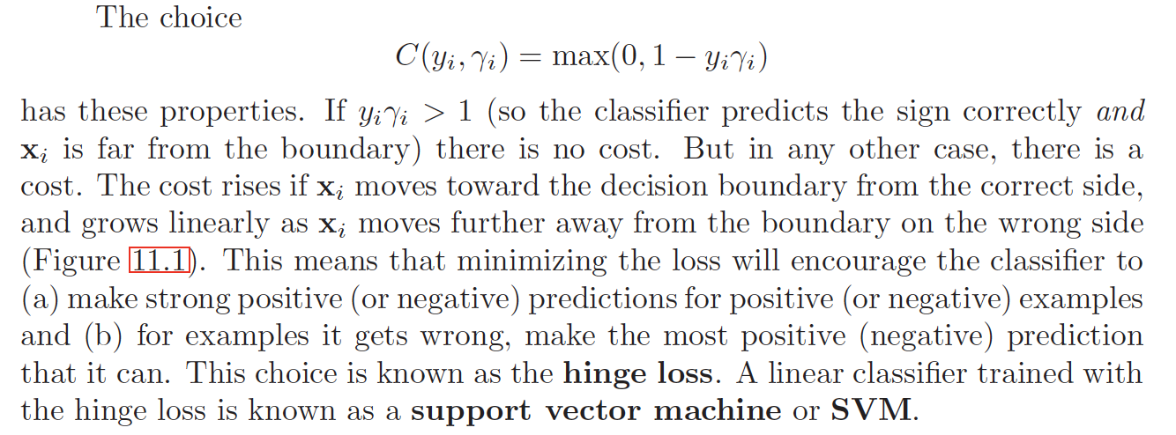
Hinge Loss
Optional reading
From ” Probability and Statistics for Computer Science”, David Forsyth, Springer. http://www.springer.com/us/book/9783319644097

Slide 25
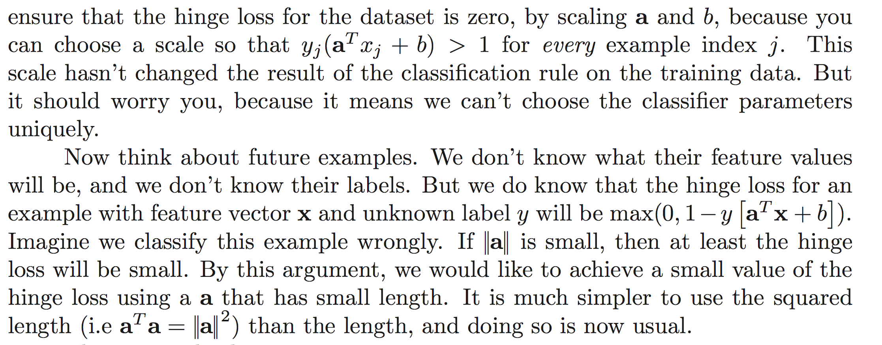
Hinge Loss
Optional reading
From ” Probability and Statistics for Computer Science”, David Forsyth, Springer. http://www.springer.com/us/book/9783319644097

Slide 26
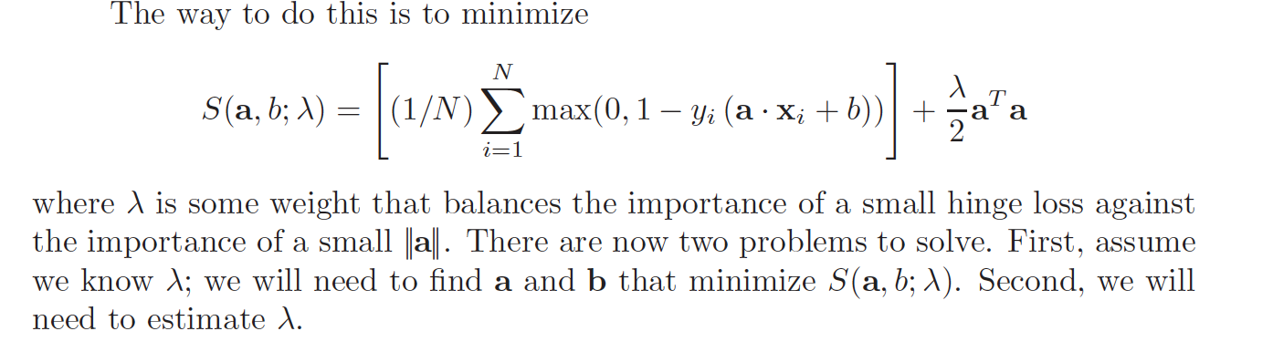
Hinge Loss
Optional reading
From ” Probability and Statistics for Computer Science”, David Forsyth, Springer. http://www.springer.com/us/book/9783319644097

