Slide 1
Classification (basics)
Saurabh Sinha

Slide 2
Example Motivation
Predicting the function of genes by using gene expression data

Slide 3
Supervised Learning
Begin with a set of genes that have a common function (the “positive set”)
… and a separate set of genes known not to be members of that functional class (the “negative set”)
The positive and negative sets form the “training data”
Training data can be assembled from the literature on gene functions

Slide 4
“Features”
Each gene (positive or negative) is described by a vector of its expression levels in different experiments/conditions. This is the “feature vector”.
For instance, maybe some experiments are in “normal growth conditions” and some are under “oxygen deprivation”. It may be possible to discern genes functioning in “stress response” based on their expression values in these experiments.

Slide 5
Genes
Class Label
Positive class
Negative class
 | + | + | + | + | + | - | - | - | - | - | -
C1
C2
C3
.
.
.
.
.
.
.
.
.
.
Cn
Conditions (features)
Feature vector

Slide 6
Supervised Learning (Classification)
A classification algorithm (also called supervised learner) will learn to discriminate between the genes in the two classes, based on their expression profiles, i.e., relate feature vectors to corresponding labels.
Once learning is done, the classifier may be presented with previously unseen genes (“test data”)
Should be able to recognize the genes as members or non-members of the functional class

Slide 7
Formally
Each entity (e.g., gene) gets a “feature vector” x_{i}
This is a k-dimensional vector; we say the “input space” is k-dimensional
Entities corresponding to class “-1” are x₁,… x_{n}
Entities corresponding to class “+1” are x_{n+1},… x_{n+m}
The (immediate) problem is to design a function f(x) on the input space such that f(x_{i})=-1 for all i=1…n and f(x_{i})=1 for all i=n+1…n+m
This is the two class (or “binary”) classification problem

Slide 8
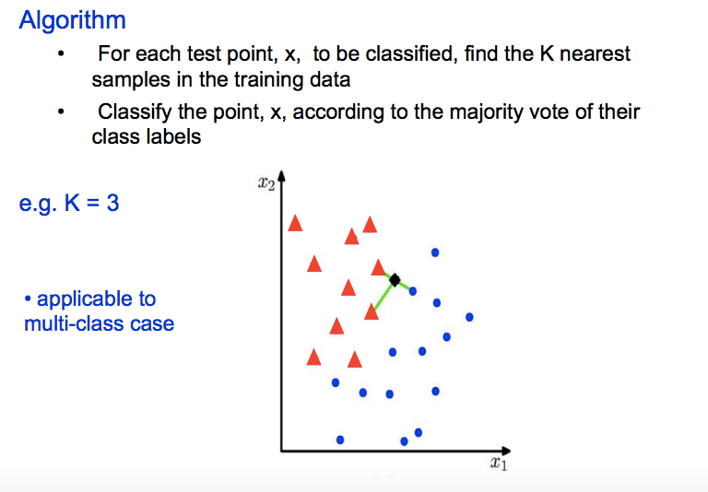
K-nearest neighbor classification

Slide 9
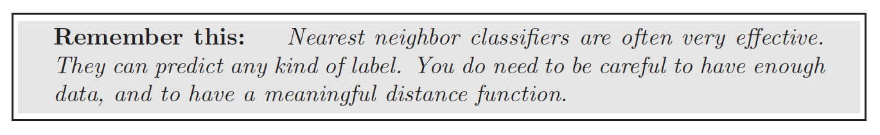

Slide 10


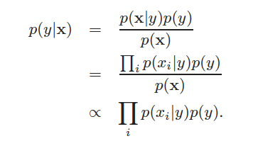

Naive Bayes Model
y
x(i-1)
x(i)
x(i+1)

Slide 11
What is P(x_{i} | y)?
From training data, compile all observed values of x_{i} (the i^{th} dimension of feature vector) within class y.
Fit a distribution to these values. Could be a Normal distribution, or, if the dimension is the count of something you could use a Poisson distribution, and if it was a binary variable, use a Bernoulli distribution.

Slide 12
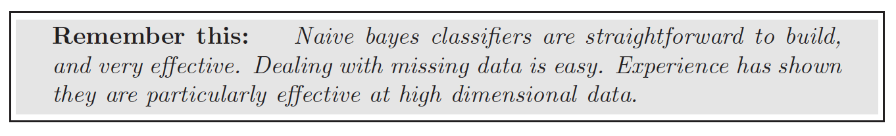

Slide 13
Linear Classifiers
sign(y) is the sign function, = 1 if y is positive, = -1 if y is negative.
w and w₀ are things (a vector and a scalar resp.) we have to find out: “free parameters”

Slide 14
Linear Classifiers
Recall goal of training step: make correct predictions on all training examples.
We want to find w^{T} and w₀ such that w^{T}x_{i} + w₀ is < 0 for i = 1..n and > 0 for i = n+1 … n+m

Slide 15
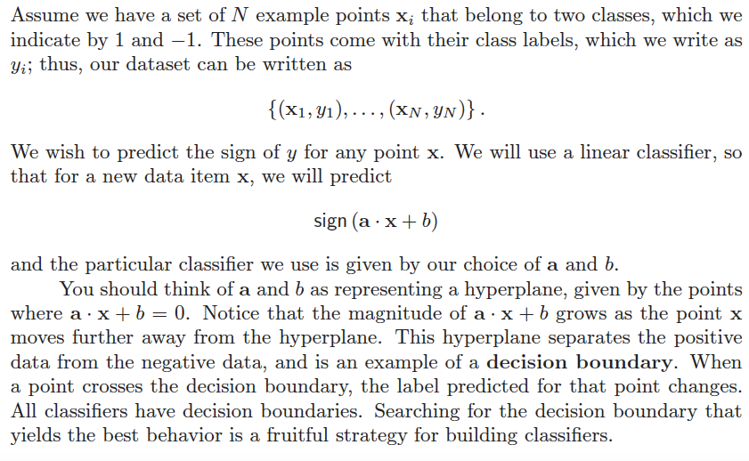
Linear classifier
From ” Probability and Statistics for Computer Science”, David Forsyth, Springer. http://www.springer.com/us/book/9783319644097

Slide 16
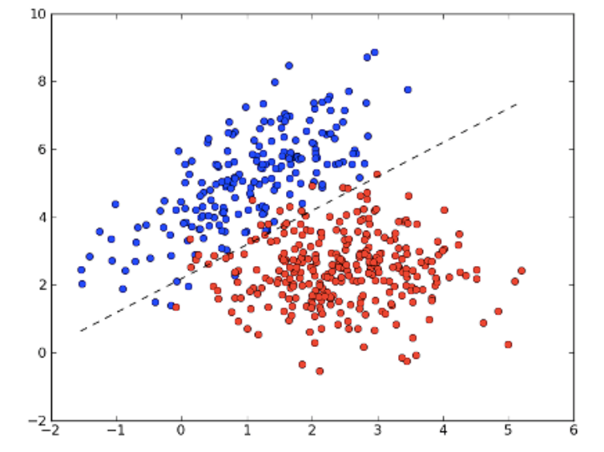
Linear Classification

Slide 17
Linear Classifiers
Note that L = {x | w^{T}x + w₀ = 0} is a hyperplane, called the “separating hyperplane”. (It separates the positive examples from the negative examples.)

Slide 18
Linear Classifiers
Solve a system of linear inequalities
“Linear programming” could be used

Slide 19
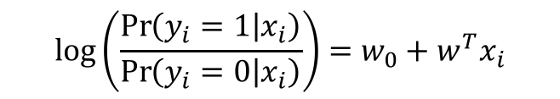
Logistic Regression Classifiers
Assume that the label y_{i} of the i^{th} data point x_{i} is drawn from a Bernoulli distribution with the property:
This is called a logistic model.
The RHS is similar to the linear classifier, but this “weighted sum”, instead of predicting y_{i}, predicts the relative probability of y=1 versus y=0.
$$\log\left(\frac{\operatorname{Pr}\left(y_{i}=1 | x_{i}\right)}{\operatorname{Pr}\left(y_{i}=0 | x_{i}\right)}\right)=w_{0}+w^{T}x_{i}$$

Slide 20
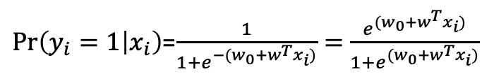
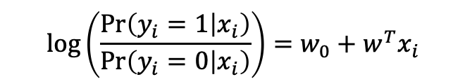

Logistic Regression Classifiers
$$\log\left(\frac{\operatorname{Pr}\left(y_{i}=1 | x_{i}\right)}{\operatorname{Pr}\left(y_{i}=0 | x_{i}\right)}\right)=w_{0}+w^{T}x_{i}$$
Same as
$\operatorname{Pr}\left(y_{i}=1 | x_{i}\right)$=$\frac{1}{1+e^{−(w_{0}+w^{T}x_{i})}}=$ $\frac{e^{(w_{0}+w^{T}x_{i})}}{1+e^{(w_{0}+w^{T}x_{i})}}$
$\operatorname{Pr}\left(y_{i}=0 | x_{i}\right)$=1- $\operatorname{Pr}\left(y_{i}=1 | x_{i}\right)=$ $\frac{1}{1+e^{(w_{0}+w^{T}x_{i})}}$

Slide 21
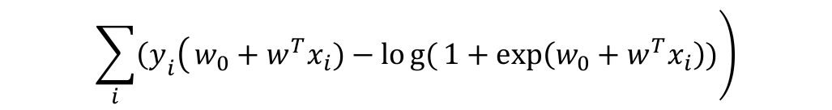
Logistic Regression Classifiers
log Likelihood of data:
Maximum likelihood estimate of w obtained by maximimzing the above function.
$$\left.\sum_{i}{\left.{\left(y\right.}_{i}\right(}w_{0}+w^{T}x_{i})−log{(}1+\exp\left(w_{0}+w^{T}x_{i}\right))\right)$$

Slide 22
Assessing classifier accuracy
False positives and false negatives
Class confusion matrix
Sensitivity, specificity, precision
Receiver Operating Curve and Precision-Recall Curve

Slide 23
Errors
False positive: Predicted to be positive, but wrong! (Real label is negative)
False negative: Predicted to be negative, but wrong! (Real label is positive)

Slide 24
Class confusion matrix
 | Predicted Positive | Predicted Negative
Real positive
Real Negative

Slide 25
Accuracy measures
Accuracy: Percentage of labels correctly classified.
Sensitivity: Percentage of real positives correctly classified.
Precision: Percentage of predicted positives correctly classified.
Specificity: Percentage of real negatives correctly classified.

Slide 26
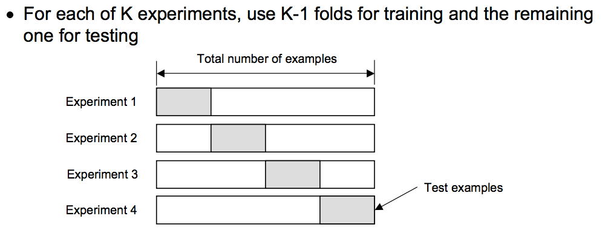
K-fold cross validation
Classification Error = Average classification error on K folds

Slide 27
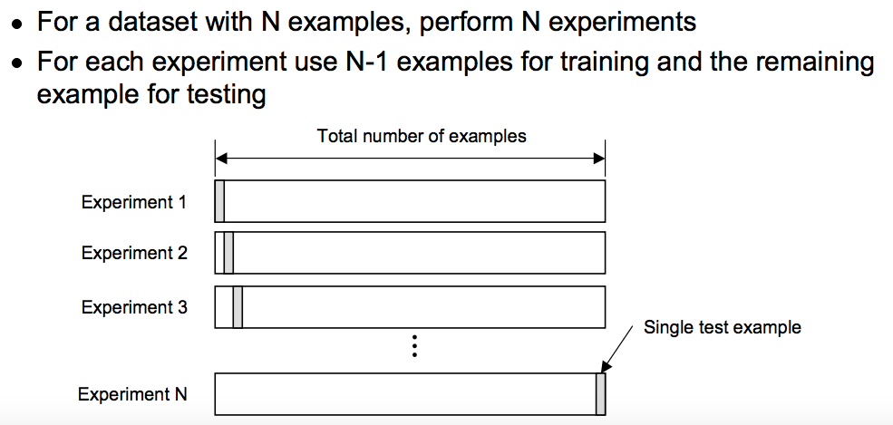
Leave-one-out cross validation

