Slide 1
Motif finding
Saurabh Sinha

Slide 2
Papers to read (on your own)
Two seminal papers in motif finding field
An Expectation Maximization (EM) Algorithm for the Identification and Characterization of Common Sites in Unaligned Biopolymer Sequences. Charles E. Lawrence and Andrew A. Reilly. PROTEINS: Structure, Function, and Genetics 7:41-51 (1990).
Unsupervised Learning of Multiple Motifs in Biopolymers Using Expectation Maximization. Bailey & Elkan 1995. Machine Learning, 21, 51-80.

Slide 3
Pre-requisites and goals
Pre-reqs:
Transcription factor motifs
Multinomial distribution
Likelihood maximization
Learn:
Expectation-Maximization
Information Content

Slide 4
An example showing the goal

Slide 5
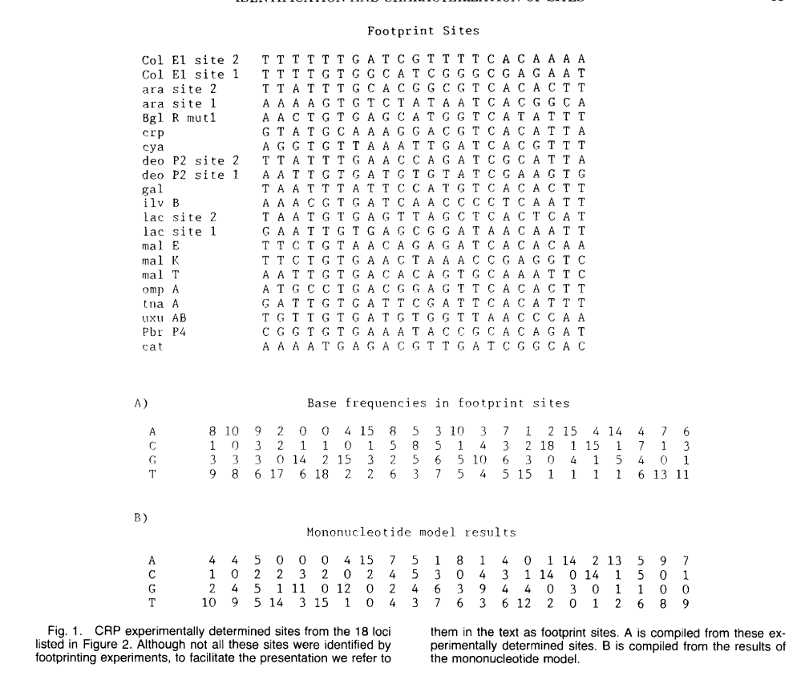
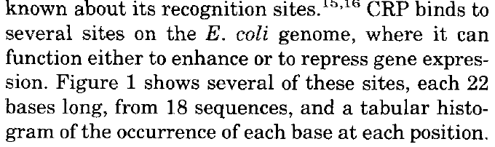
Lawrence & Reilly 1990

Slide 6
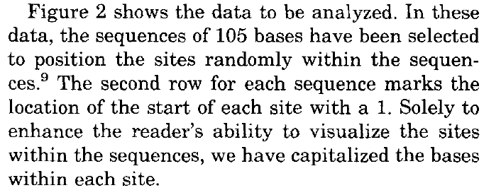

Slide 7
The Goal
Suppose there are N sequences S₁, S₂, … S_{N}
Each contains exactly one binding site of length J, at an unknown posn
If we knew these locations, we could have constructed the position weight matrix ⍴_{b,j} from those sites, representing the multinomial probability distribution of bases b (nucleotides) at each position j of the binding sites.
In this case, we would also be able to estimate base composition ⍴_{b,0} (just four probabilities) at positions outside of sites
Goal: To find ⍴_{b,j} and locations of sites, given S₁, S₂, … S_{N}

Slide 8
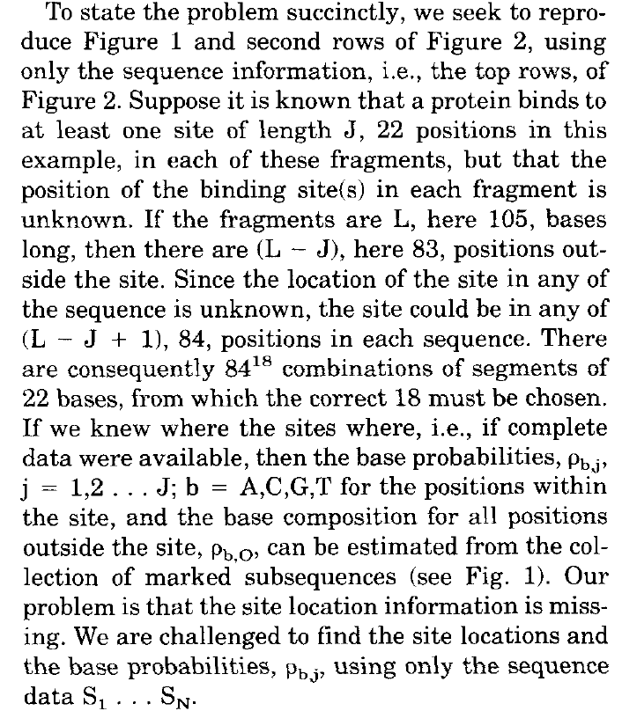

Slide 9
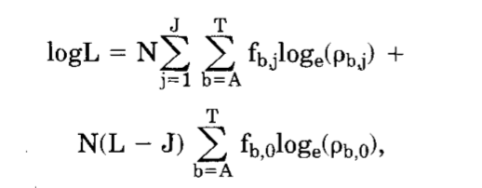
Suppose we knew the site locations and ⍴
Let n_{b,j} be the count of base b at position j among the N sites.
Let f_{b,j} = n_{b,j} /N be the corresponding (observed) frequencies.
Note: f_{b,j} is different from ⍴_{b,j}
Likelihood of data (sites and sequences outside of sites) 𝕃 given by:
log 𝕃

Slide 10
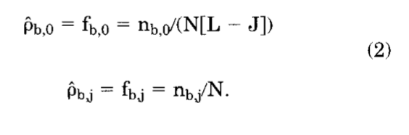
(cont’d)
log 𝕃
What is unknown (variable) in this formula?
Answer: ⍴_{b,j,} ⍴_{b,0}
Maximum likelihood estimation:

Slide 11
But the problem is …
The n_{b,j} are unknown, since site locations are in fact unknown. (We assumed they were known in arriving at the calculations.)

Slide 12
E-M algorithm
Iterative algorithm
Iteratively repeat a so-called “Expectation” (E) step and a so-called “Maximization” (M) step until some sort of convergence reached
Suppose we have performed this iteration q times. We’ll next see what happens in the (q+1)th iteration

Slide 13
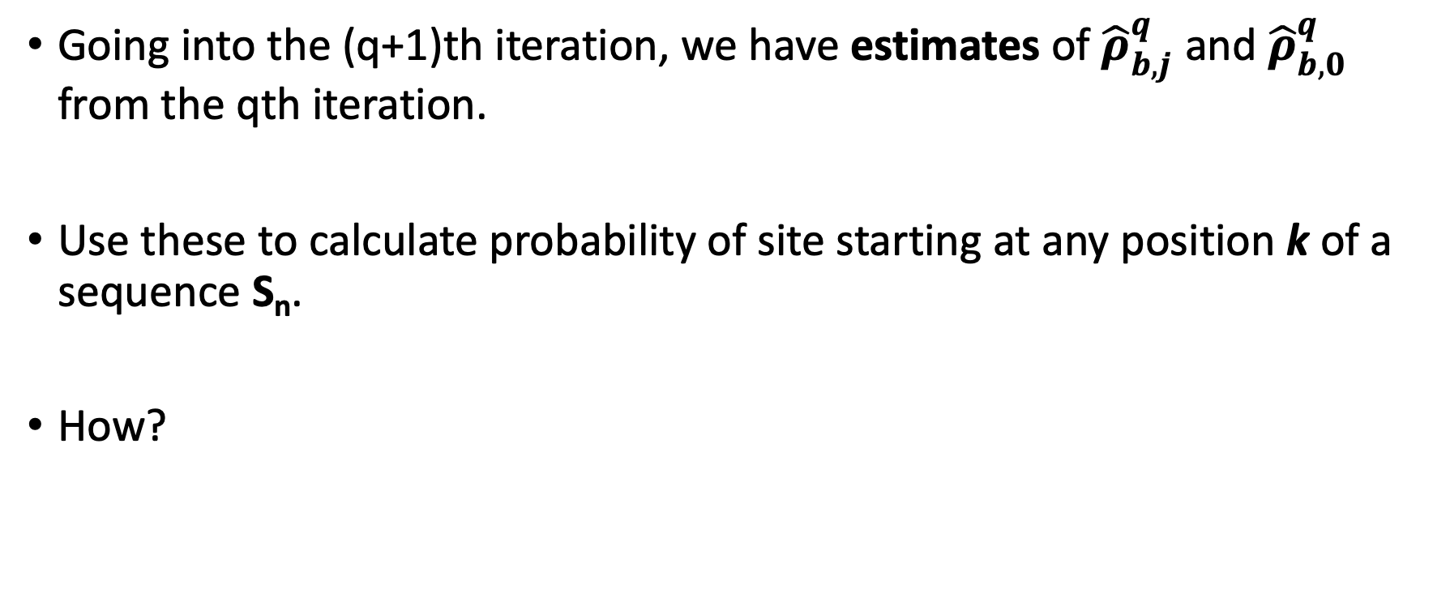
The E-step
Going into the (q+1)th iteration, we have estimates of ${\hat{ρ}}_{b,j}^{q}$ and ${\hat{ρ}}_{b,0}^{q}$ from the qth iteration.
Use these to calculate probability of site starting at any position k of a sequence S_{n}.
How?

Slide 14
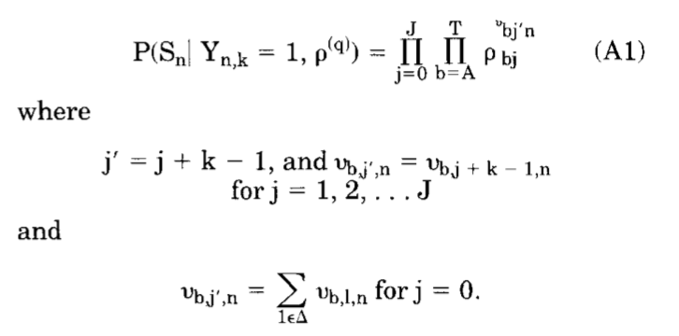
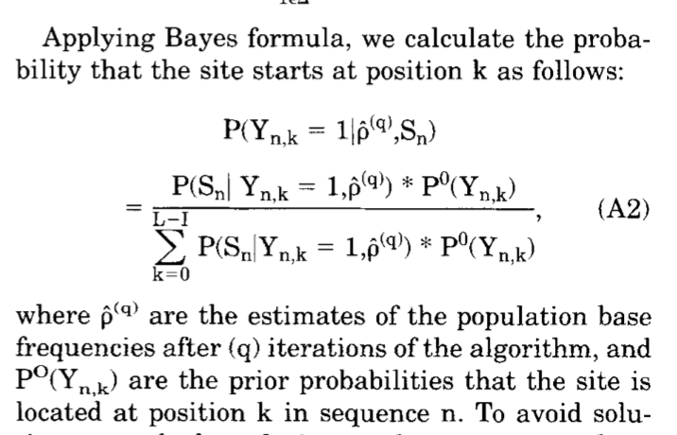
E-step (cont’d)
Binary variable Y_{n,k} =1 if site starts at any position k of a sequence S_{n}
Note: Here, we assume that site occurs exactly once in the sequence

Slide 15
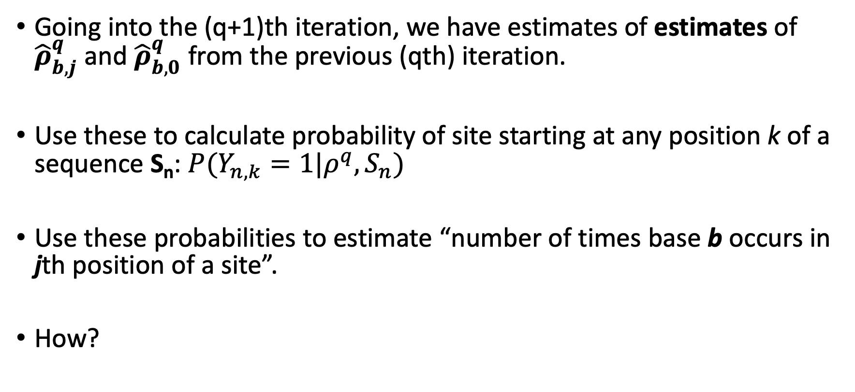
The E-step
Going into the (q+1)th iteration, we have estimates of estimates of ${\hat{ρ}}_{b,j}^{q}$ and ${\hat{ρ}}_{b,0}^{q}$ from the previous (qth) iteration.
Use these to calculate probability of site starting at any position k of a sequence S_{n}: $P(Y_{n,k}=1|ρ^{q},S_{n})$
Use these probabilities to estimate “number of times base b occurs in jth position of a site”.
How?

Slide 16
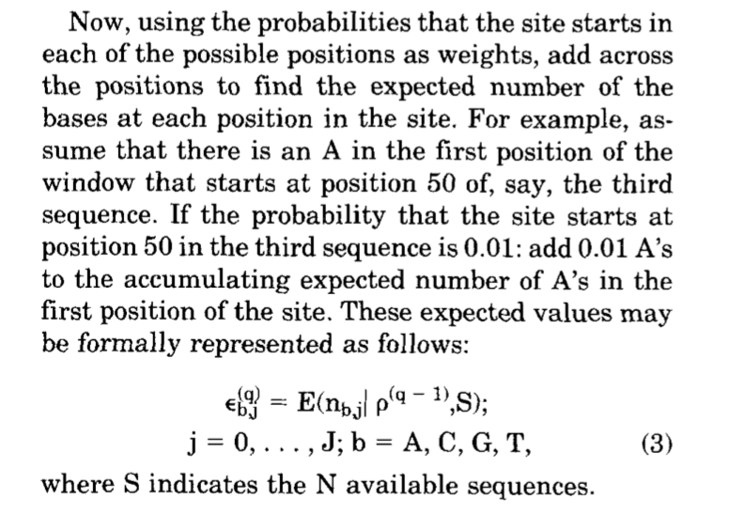
E-step (cont’d)

Slide 17
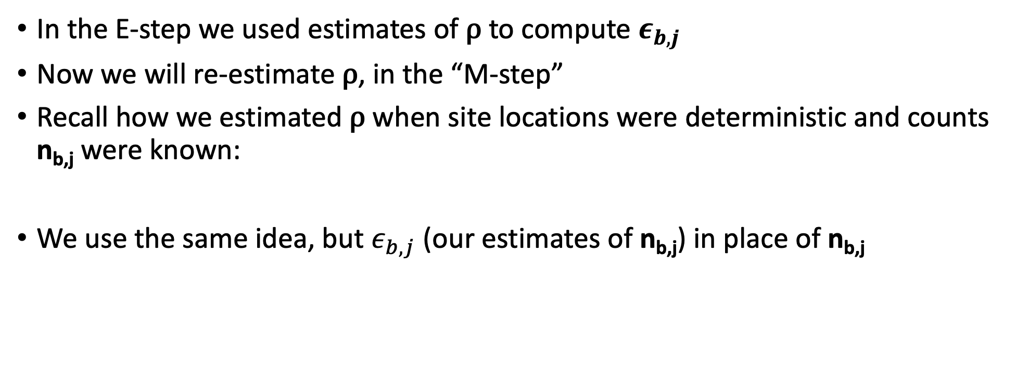

M-step
In the E-step we used estimates of ⍴ to compute $ε_{b,j}$
Now we will re-estimate ⍴, in the “M-step”
Recall how we estimated ⍴ when site locations were deterministic and counts n_{b,j} were known:
We use the same idea, but $ε_{b,j}$ (our estimates of n_{b,j}) in place of n_{b,j}
$${{{\hat{ρ}}_{b,j}^{q+1}= ε}_{b,j}^{q+1}}/N$$

Slide 18
E-M algorithm:
Initalize ⍴ (randomly?)
Repeat
E-step
M-step
Until ⍴ stops changing

Slide 19
Rest of the paper is about using the algorithm to find the motif in a particular data set

Slide 20
Read Bailey & Elkan paper on your own

