Slide 1
“Enhancers”
Saurabh Sinha

Slide 2
Enhancers
Genes form the most famous class of genomic segments.
Each gene is a subsequence of DNA (“genomic segment”) and has a function – encodes a protein.
Enhancers are another class of genomic segments
Each enhancer is a subsequence of DNA and has a function – regulates a gene’s expression.

Slide 3
A case study in gene regulation: Embryonic development

Slide 4
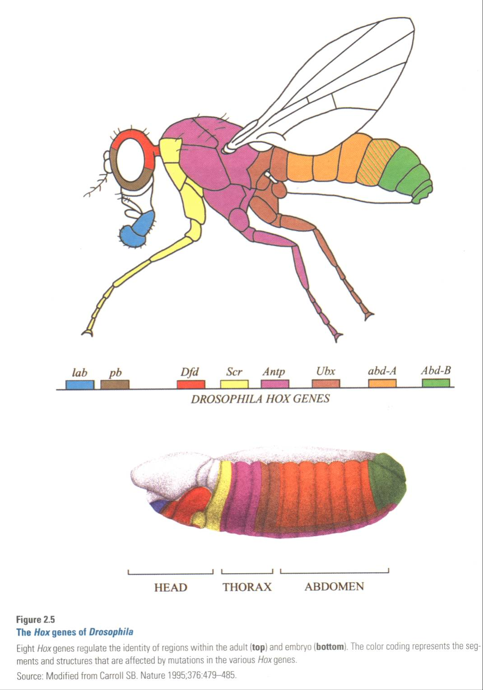
Segmentation of fruitfly embryo
Adult fruitfly
Cavity with
Single cell
Early
Embryo
Source: From DNA to Diversity, Carroll et al.

Slide 5
How does the asymmetry arise?

Slide 6
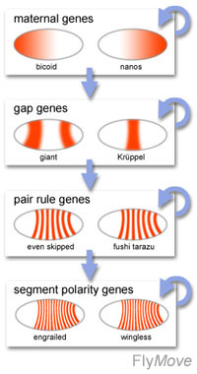
Some genes are
asymmetrically
deposited by mother
Target genes are
expressed in “gapped”
domains
Further refinement of
striped pattern.

Slide 7
Asymmetry of gap genes
Transcription Factor A
(ACTIVATOR)
Gene G

Slide 8
Asymmetry of gap genes
Transcription Factor R1
(REPRESSOR)
Transcription Factor A
(ACTIVATOR)
Gene off here
Gene G

Slide 9
Asymmetry of gap genes
Gene on here
Transcription Factor R1
(REPRESSOR)
Transcription Factor A
(ACTIVATOR)
Transcription Factor R2
(REPRESSOR)
Gene off here
Gene off here
Gene G

Slide 10
Asymmetry of gap genes
Gene on here
Gene G
“Enhancer”

Slide 11
This is how an asymmetric expression pattern arises

Slide 12
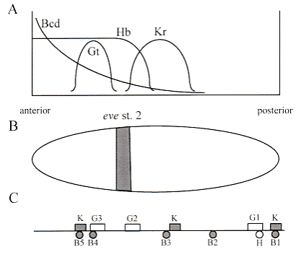
A real example: eve stripe 2 enhancer
Some other repressor here
Enhancer
Repressor binding sites
Kr
Gt
Gt
Kr
Gt
Kr
Activator binding sites
Gene
bcd
bcd
bcd
bcd
Hb
bcd
SOURCE: http://www.nyu.edu/fas/dept/biology/faculty/small/smallfig7_big.html

Slide 13
“Enhancer”
An “enhancer” has a cluster of binding sites that mediate the action of several transcription factors, to control a target gene’s expression
Enhancers are typically 200-1000 bp long
One or many occurrences of binding sites for transcription factors
Typically, 3-6 transcription factors are involved in regulating an enhancer in early development

Slide 14
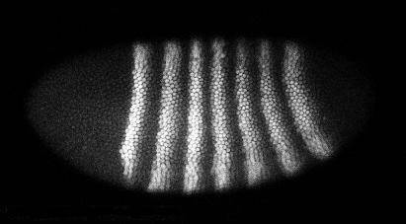
Enhancers are modular
Expression pattern of even-skipped (eve) gene
From Steve Small, NYU

Slide 15
Enhancers are modular
Expression pattern of even-skipped (eve) gene
Eve stripe 2

Slide 16
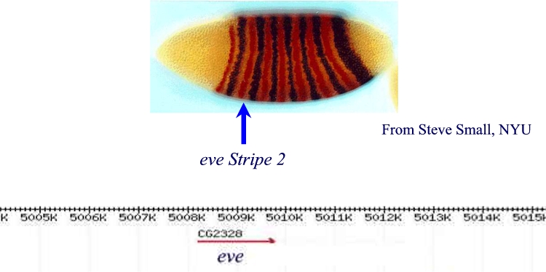
Enhancers are modular
Expression pattern of even-skipped (eve) gene
Eve Stripe 2
From Steve Small, NYU
Eve stripe 2
Eve gene on Chromosome 2R

Slide 17
Enhancers are modular
Expression pattern of even-skipped (eve) gene
Eve Stripe 2
From Steve Small, NYU
Eve stripe 2
Enhancer associated with eve Stripe 2

Slide 18

Enhancers are modular
Eve Stripe 2
From Steve Small, NYU
Enhancer associated with eve Stripe 2

Slide 19
Enhancers are modular
Eve Stripe 2
Reporter gene
From Steve Small, NYU
Enhancer associated with eve Stripe 2

Slide 20
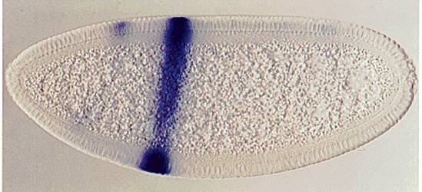
Enhancers are modular
Eve Stripe 2
Reporter gene
From Steve Small, NYU
Reporter gene shows same pattern !
Enhancer associated with eve Stripe 2

Slide 21
Summary of enhancers
An “enhancer” has a cluster of binding sites that mediate the action of several transcription factors, to control a target gene’s expression
Enhancers are typically 200-1000 bp long
One or many occurrences of binding sites for transcription factors

