Slide 1
Enhanced Regulatory Sequence Prediction Using Gapped k-mer Features.
Ghandi M, Lee D, Mohammad-Noori M, Beer M.

Slide 2
Motivation
“A fundamental step in understanding enhancers is the development of DNA sequence-based models to predict the tissue specific activity of regulatory elements”
Goal: given a sequence (of length typical of enhancers), predict if it is an enhancer. A “sequence-to-function” model for enhancers.

Slide 3
Classification
Clearly, we have a classification problem at hand.
Recall, a classifier is a function that predicts a “label” (positive/negative) from a vector.
Here, label = “functions as enhancer” / “does not function as enhancer”
What is the “vector” used to describe a sample?

Slide 4
Sequences as vectors
How to describe a sequence with a vector?
A “k-mer” refers to a k-length string of DNA
K-mer counts as features: For each k-mer (there are 4^k possible k-mers), count its occurrences in the sequence and make it a feature.
So, the sequence can be mapped to a 4^k-dimensional feature vector. (Typically, k is ~6.)

Slide 5
K-mer counts as features of an enhancer?
This way to “vectorize” a sequence is lossy. Information is lost. You may not be able to uniquely reconstruct the original sequence from its k-mer count vector.
But its simple and biologically realistic: the enhancer’s function (if it’s an enhancer) is encoded by TF binding sites present therein. TF binding sites are short (~6-10 bp) and their presence in an enhancer will be captured by k-mer counts.

Slide 6
Gapped k-mers as features?
Choosing the right ‘k’ is tricky.
TF binding sites are often 6-8 bp long, but some TFs have longer binding sites. We could use a larger ‘k’ to capture these, but large values of ‘k’ lead to very high dimensional and very sparse feature vectors.
Also, TF binding sites can often be long (say 10-20 bp) but with “don’t care” positions within them.

Slide 7
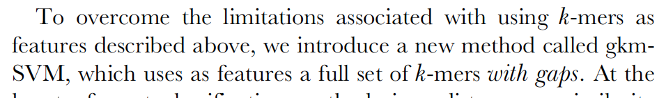
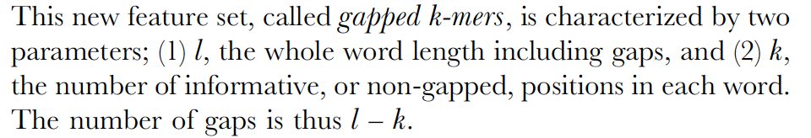

Slide 8
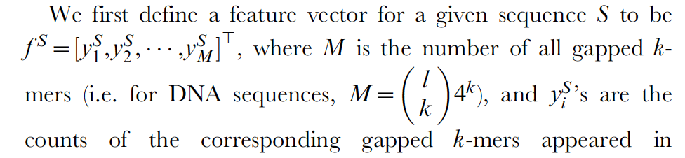

Slide 9
Remember the “dot product” in SVMs?
Note that the maximization only requires the dot product of pairs of data points:
The dot product reflects the cosine of the angle between two vectors

Slide 10
Remember the “kernel function” in SVMs?
The dot product may be taken in a higher dimensional space (feature space) and the SVM algorithm is still happy
It does NOT NEED the actual vectors in the higher-dimensional (feature) space, just their dot product
The dot product in feature space is some function of the original vectors X and Y, and is called the “kernel function”

Slide 11
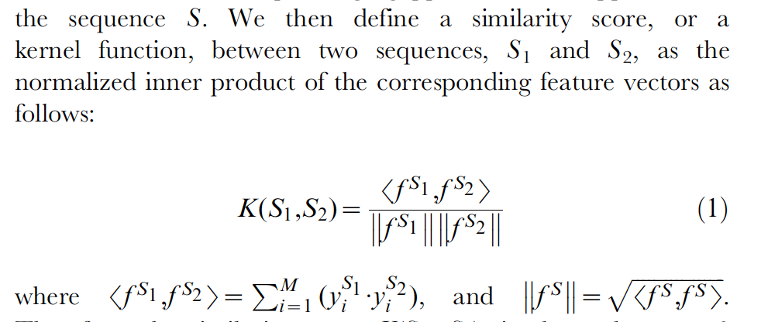
This function is also called the “cosine similarity score” of the two vectors.
It is a commonly used similarity score between vectors.
It is equal to the cosine of the angle between the two vectors.

Slide 12
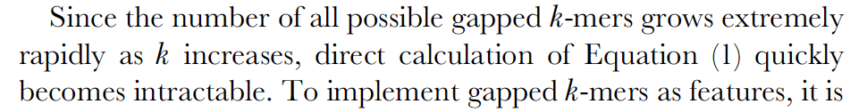
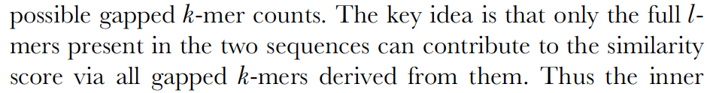
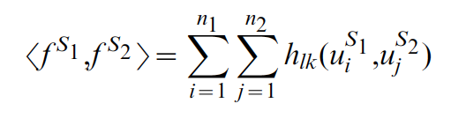
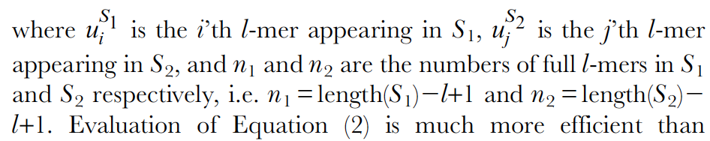
Efficient calculation of similarity score

Slide 13
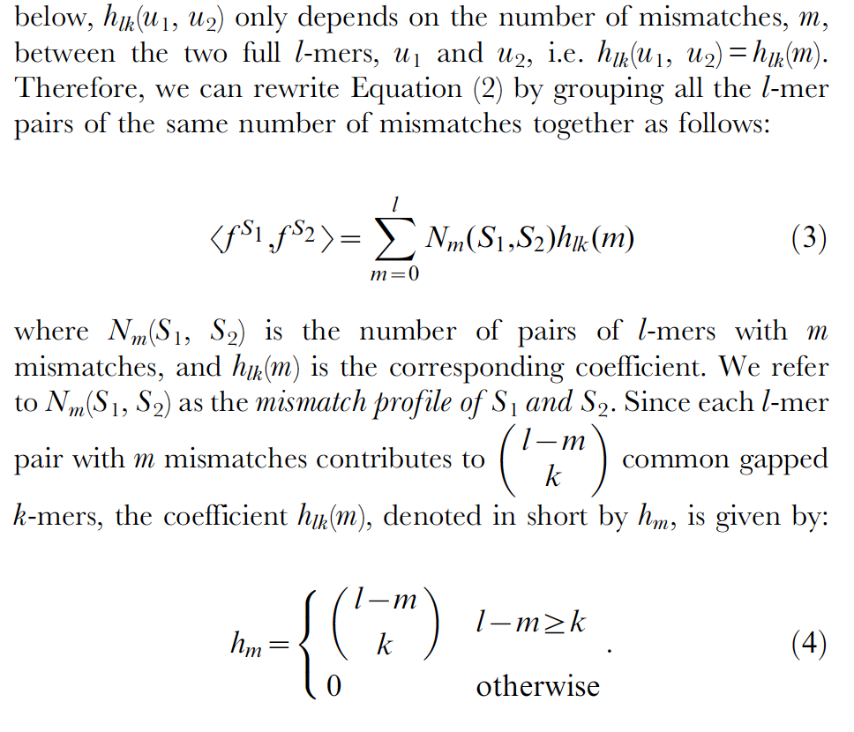
Efficient calculation of similarity score

Slide 14
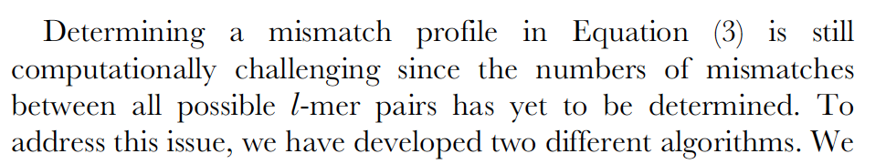
Efficient calculation of similarity score

Slide 15
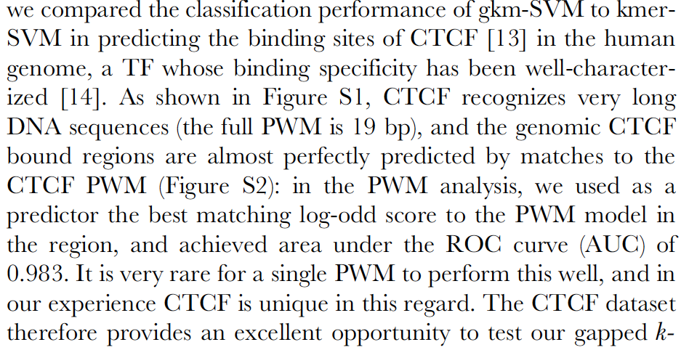
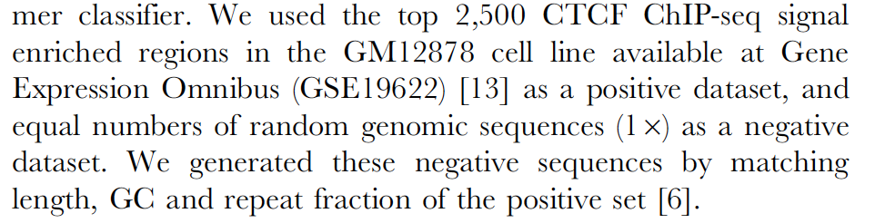
Data sets and Evaluations
Note: a “positive” is a ChIP peak for a TF.

Slide 16
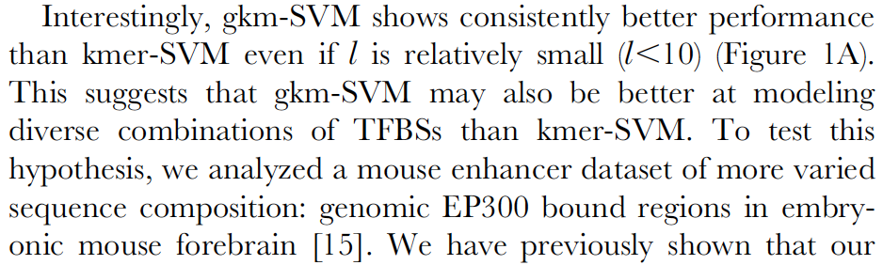
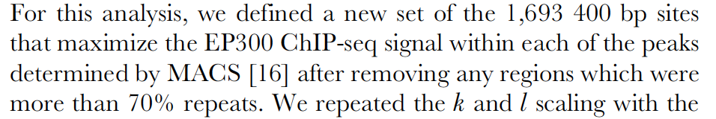
Data sets and Evaluations

Slide 17
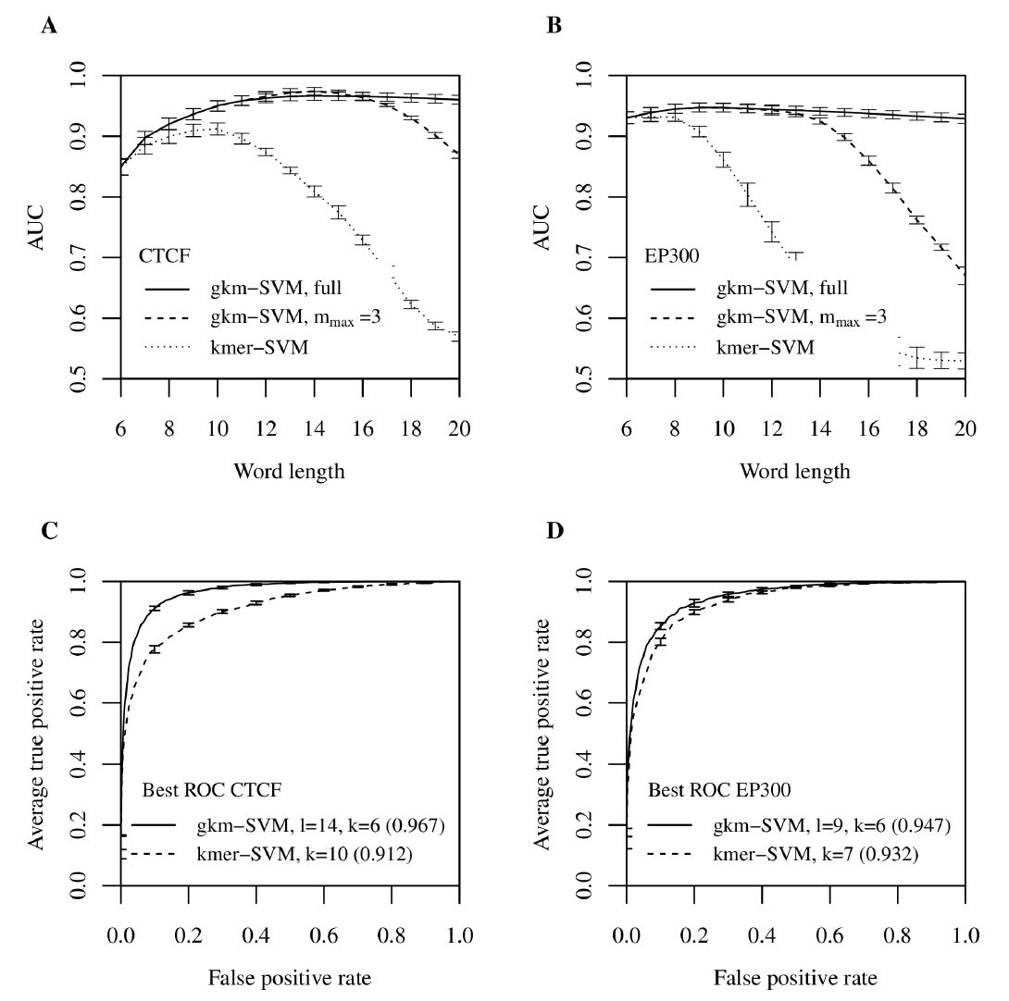
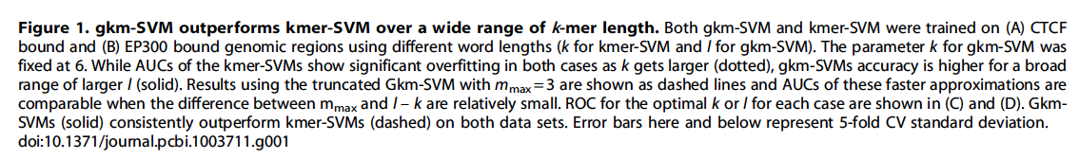
Gapped k-mer SVM outperforms k-mer SVM

Slide 18
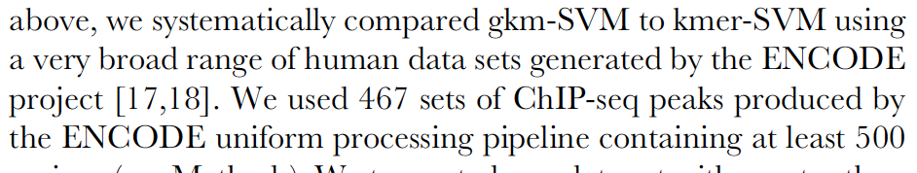
More data sets for evaluation
Note: there are 467 different data sets here. Each data set comprises a set of positives (ChIP peaks of a TF) and a set of negatives (non-peaks)

Slide 19
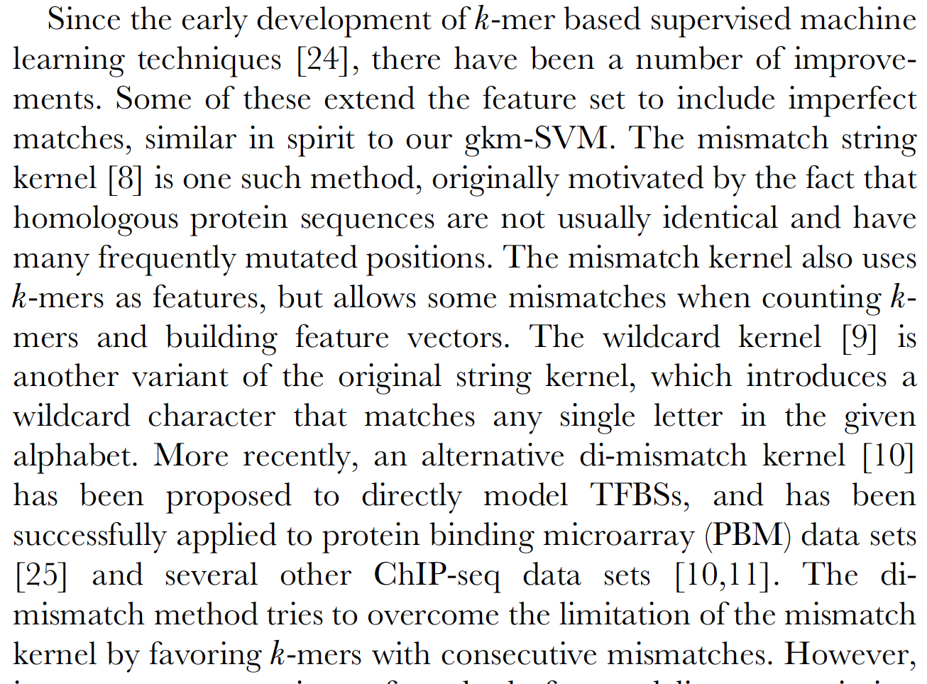
Comparison to other “kernels”

Slide 20
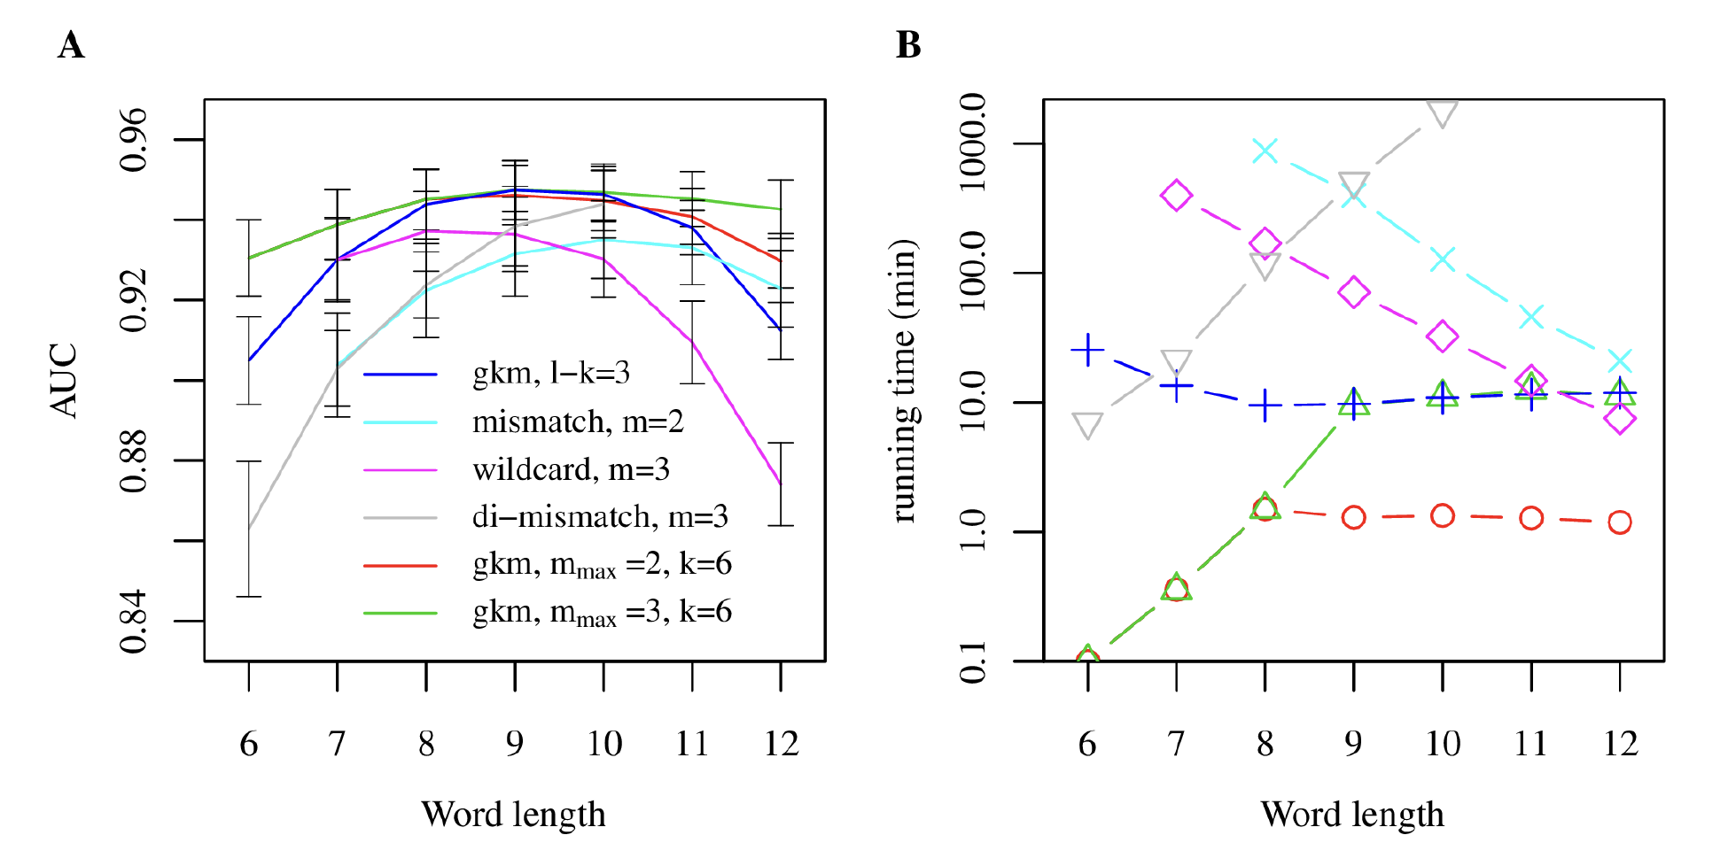
Comparison to other “kernels”

Slide 21
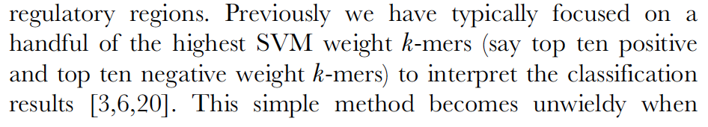
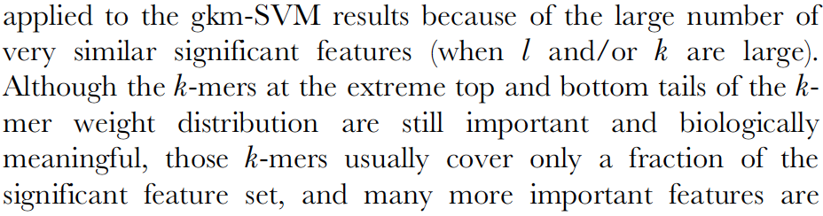
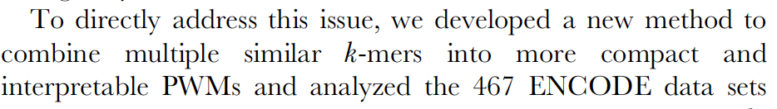
Interpreting a trained model

Slide 22
How is this model useful?
To train gkm-SVM to predict DNA-binding of a TF (say T) in some biological condition (say C), we need ChIP-seq data for that TF (T) in that condition (C).
What is the use of learning to predict something if we already know that something through experimental data?

