Slide 1
Hidden Markov Models
Ch 3.2, 3.2 of DEKM

Slide 2
“CpG islands”
The dinucleotide “CG” (called CpG) is rare
C in a “CG” often gets “methylated” and the resulting C then mutates to T
Methylation is suppressed in some areas of genome, called “CpG islands”
Such CpG islands often found around genes
Problem: find CpG islands in whole genome
Simiplification: We’ll pretend that a CpG island is a region rich in ‘C’ and ‘G’ (not necessarily the dinucleotide)

Slide 3
Markov Chains
Given a sequence, can calculate its probability under a “CpG Markov chain” and its probability under a “normal genome Markov chain”.
What does this look like?

Slide 4
“Normal” Markov Chain
A
C
CpGMarkovChain
T
0.3
G
A
0.3
C
0.3
All edges have probability 0.25
0.3
0.3
0.3
G
0.3
T
0.3
All other edges have probability 0.2

Slide 5
Markov Chains
Given a sequence, can calculate its probability under a “CpG Markov chain” and its probability under a “normal genome Markov chain”.
Then calculate

Slide 6
Markov Chains
Slide a fixed length window, say of length 100 bp
If any window x has a positive (or very positive) S(x), mark it as a (part of a) CpG island

Slide 7
Issues
Why fixed length windows?
Why 100 bp ?
Sliding windows with overlaps or not? If overlaps, then overlapping windows may have different labels?
A more satisfactory approach will be to build one model for the whole sequence, that incorporates both Markov chains.

Slide 8
high C/G
rare C/G
CG
island
normal
Two states.
Each state emits a character.
In the “CG island” state, relatively high probability of emitting a ‘C’ or ‘G’.
Concatenation of sequence emissions = genome

Slide 9
HMM vs MC
The main difference between HMM and Markov chains is that …
… in an HMM there is not a one-to-one correspondence between states visited and symbols observed.

Slide 10
HMM: Formal
The “path” or “parse” π is the sequence of states visited by the process. This is a simple Markov chain given by the following transition probabilities:
ith state visited
(i-1)th state visited

Slide 11
HMM: Formal
In each state, the model can emit a symbol according to some distribution. This is the “emission probability distribution”

Slide 12
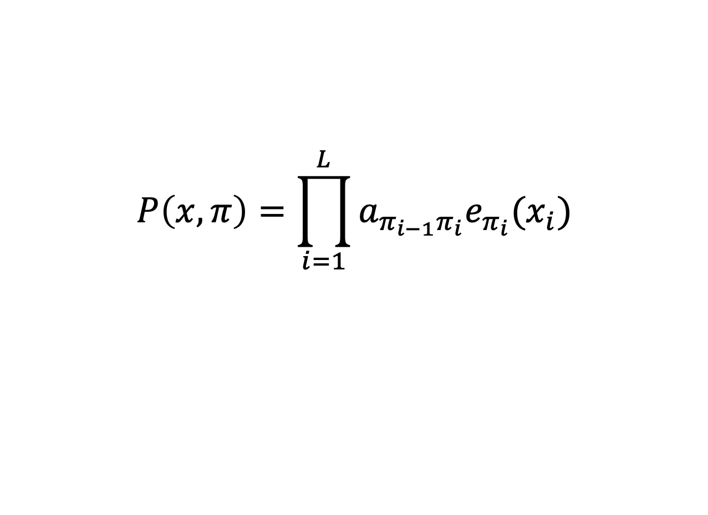
Joint probability of sequence and path
$$P\left(x,π\right)=\prod_{i=1}^{L}{a_{π_{i−1}π_{i}}e_{π_{i}}(x_{i})}$$

Slide 13
Decoding
In an HMM-generated sequence, we cant say for sure whether a particular symbol was generated from a particular state.
Yet, it is often the underlying states that we are more interested in finding out.
This is called “decoding” (from speech recognition).

Slide 14
Most probable state path
Find

Slide 15
Viterbi algorithm
Suppose v_{k}(i) is the probability of the most probable path ending in state k with observation x_{i}.
Suppose v_{k}(i) is known for all k.
Then:
Initial condition: v₀(0) = 1.

Slide 16
Viterbi algorithm
Would you implement as a recursion?
No. Use “dynamic programming”
Create a 2D array v[1 ... 4][1 … L].
Store v_{k}(i) in cell v[i][k].
For col = 1 to L
For row = 1 to 4
calculate and store v[row][col].
Run time: 4*L cells to fill in; each cell requires finding a max of 4 terms, so ~16*L steps of calculation.

Slide 17
Probability of sequence
Calculate the probability of the sequence by summing over all paths:
The number of paths increases exponentially with the sequence length

Slide 18
The Forward Algorithm
Define f_{k}(i) as the probability of the sequence up to and including x_{i} while requiring that π_{i}=k. That is:
The recurrence for this is:
P(x) is simply

Slide 19
Posterior state probabilities
We often want to know what is the most probable state for an observation x_{i}
This is not what Viterbi algorithm gives us
In general, calculate P(π_{i}=k | x).

Slide 20
Posterior state probability
Consider the probability of producing the entire sequence while requiring that the i^{th} symbol was produced by state k
The first term on the RHS is f_{k}(i).
Call the second term b_{k}(i)

Slide 21
The Backward Algorithm
Define:
Recurrence:

Slide 22
Posterior state probability

Slide 23
Parameter Estimation for HMMs
Given x, how to calculate the transition and emission probabilities so as to maximize P(x) ?
Expectation Maximization

