Slide 1
PROBABILISTIC MODELING 2
Saurabh Sinha

Slide 2
Model Comparison
Data D.
Models M1 and M2. Which is a better explanation of data?
Pr(M1|D) versus Pr(M2|D) ?
... or ...
Pr(D|M1) versus Pr(D|M2) ?

Slide 3
Comparing posterior probabilities
likelihood
likelihood
posterior prob.
prior prob.
posterior prob.
prior prob.
Note: If prior probabilities are equal, then posterior odds ratio = likelihood ratio
prior odds ratio
posterior odds ratio
Likelihood ratio

Slide 4
Comparing likelihoods: Likelihood ratio test (LRT) – a special case
Comparing M(θ) to M(θ₀), where θ is a free parameter and θ₀ is a specific value of θ
Under specific conditions, 2xlog (LR) follows a chi-squared distribution

Slide 5
Comparing likelihoods: Bayes Information Criterion
Can be used to compare models where each model has free parameter(s).
For a model M(θ):
BIC = -2[log(Pr(D|M(θ_{m}))] + klog(n) where θ_{m} is the maximum likelihood estimate, k is the number of free parameters, n is the number of samples in data
Best model is one with lowest BIC.
Can be used to compare models with different numbers of parameters, penalizes model with more parameters.

Slide 6

Comparing models of different types: ‘Bayes Factor’
Often, M1 and M2 are simply two separate settings of a parameter in the same model M
But sometimes, we are comparing two different models and each is parameterized, e.g., M1(θ) and M2(θ),
what is Pr(D|M) now?
Evidence
prior odds ratio
posterior odds ratio
Bayes Factor

Slide 7
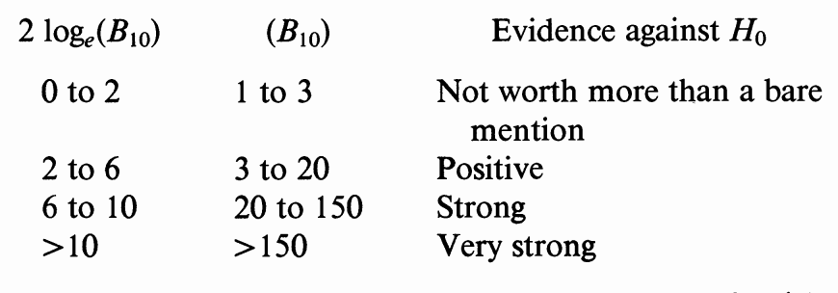
Interpreting model comparisons: Bayes Factors
From http://www.stat.cmu.edu/~kass/papers/bayesfactors.pdf

Slide 8
Some examples of probabilistic models (in class discussion)
DNA sequence (multinomial model)
DNA sequence (Markov chain)

Slide 9
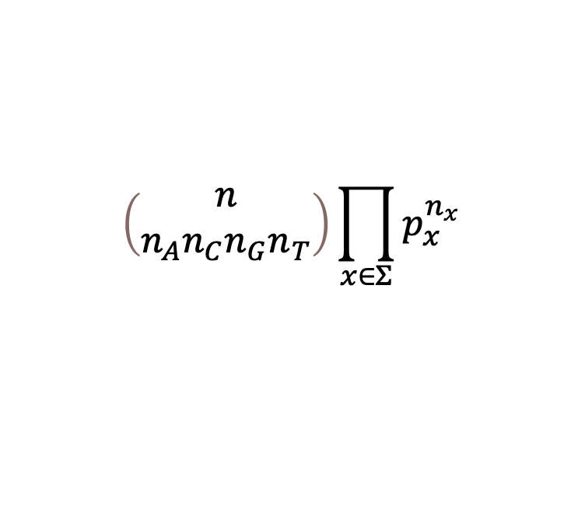
DNA Sequence Multinomial model
We saw this before. Single die with four faces, thrown repeatedly and i.i.d. to generate sequence
Case 1: Data = sequence. Probability given by:
Case 2: Data = counts {n_{x}}. Probability given by:
$$\left(\begin{matrix}n \\ n_{A}n_{C}n_{G}n_{T}\end{matrix}\right)\prod_{x∈Σ}{p_{x}^{n_{x}}}$$

Slide 10
DNA Sequence: Markov Chain model
Pr(‘A’ at position i) depends on what nucleotide is at position i-1.
Thus, instead of a single number p_{A}, we have:
p_{AA} = Pr(‘A’ at position i | ‘A’ at position i-1)
p_{CA} = Pr(‘A’ at position i | ‘C’ at position i-1)
p_{GA} = Pr(‘A’ at position i | ‘G’ at position i-1)
p_{TA} = Pr(‘A’ at position i | ‘T’ at position i-1)
These do not add to 1.
There are similarly four numbers for probability of each nucleotide at position i. Total 16 parameters.

