Slide 1
TF motifs

Slide 2
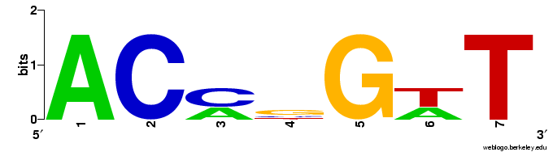
Motifs represent binding preferences of transcription factors
Binding sites of the same TF
ACCCGTT
ACCGGTT
ACAGGAT
ACCGGTT
ACATGAT
“MOTIF”
5 | 0 | 2 | 0 | 0 | 2 | 0 | A
0 | 5 | 3 | 1 | 0 | 0 | 0 | C
0 | 0 | 0 | 3 | 5 | 0 | 0 | G
0 | 0 | 0 | 1 | 0 | 3 | 5 | T

Slide 3
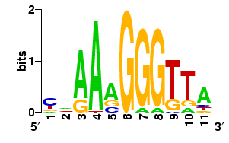
Finding motif matches in DNA
A motif match can be predicted as a binding site
Basic idea:
To score a single site s for match to a motif W, we use
Motif:
Match: CAAAAGGGTTA
Apprx. Match: CAAAAGGGGTA

Slide 4
What is Pr (s | W)?
This is a “Position Weight Matrix”, one way to represent the “motif” (pattern) of a TF’s binding sites
5 | 0 | 2 | 0 | 0 | 2 | 0 | A
0 | 5 | 3 | 1 | 0 | 0 | 0 | C
0 | 0 | 0 | 3 | 5 | 0 | 0 | G
0 | 0 | 0 | 1 | 0 | 3 | 5 | T
1 | 0 | 0.4 | 0 | 0 | 0.4 | 0 | A
0 | 1 | 0.6 | 0.2 | 0 | 0 | 0 | C
0 | 0 | 0 | 0.6 | 1 | 0 | 0 | G
0 | 0 | 0 | 0.2 | 0 | 0.6 | 1 | T
Now, say s =ACCGGTT (consensus)
Pr(s|W) = 1 x 1 x 0.6 x 0.6 x 1 x 0.6 x 1 = 0.216.
Then, say s = ACACGTT (two mismatches from consensus)
Pr(s|W) = 1 x 1 x 0.4 x 0.2 x 1 x 0.6 x 1 = 0.048.

Slide 5
Scoring motif matches with “LLR”
Pr (s | W) is the key idea.
However, some statistical mashing is done on this.
Given a motif W, background nucleotide frequencies W_{b} and a site s,
LLR score of s =
Good scores > 0. Bad scores < 0.

Slide 6
Motifs
ACCCGTT
ACCGGTT
ACAGGAT
ACCGGTT
ACATGAT
“MOTIF”
5 | 0 | 2 | 0 | 0 | 2 | 0 | A
0 | 5 | 3 | 1 | 0 | 0 | 0 | C
0 | 0 | 0 | 3 | 5 | 0 | 0 | G
0 | 0 | 0 | 1 | 0 | 3 | 5 | T

Slide 7
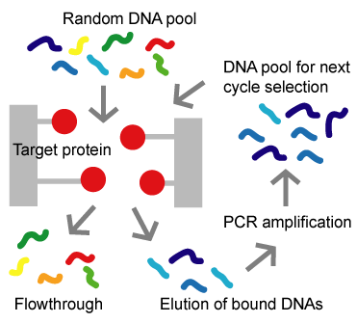
How?
Example technology: SELEX
TAACCCGTTC
TAACCCGTTC
GTACCGGTTG
GTACCGGTTG
ACACAGGATT
ACACAGGATT
AACCGGTTA
AACCGGTTA
GGACATGAT
GGACATGAT
http://altair.sci.hokudai.ac.jp/g6/Projects/Selex-e.html

Slide 8
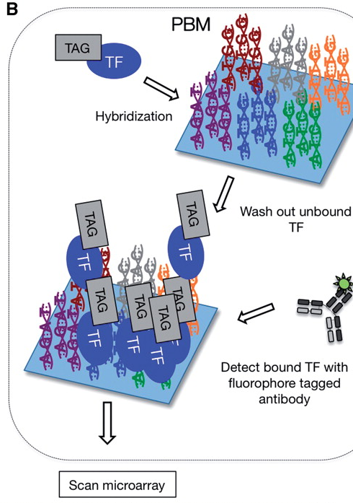
How?
Example technology: Protein binding microarrays
TAACCCGTTC
TAACCCGTTC
GTACCGGTTG
GTACCGGTTG
ACACAGGATT
ACACAGGATT
AACCGGTTA
AACCGGTTA
GGACATGAT
GGACATGAT
http://bfg.oxfordjournals.org/content/9/5-6/362/F2.large.jpg

Slide 9
Motif finding tools
How did this happen?
TAACCCGTTC
TAACCCGTTC
GTACCGGTTG
GTACCGGTTG
ACACAGGATT
ACACAGGATT
AACCGGTTA
AACCGGTTA
GGACATGAT
GGACATGAT
Run a motif finding tool (e.g., “MEME”) on the collection of experimentally determined binding sites, which could be of variable lengths, and in either orientation.
We’ll come back to motif finding tools later.

Slide 10
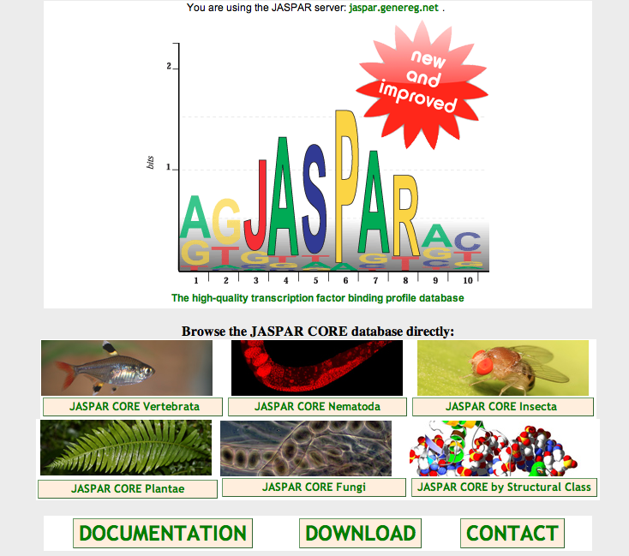
Motif Databases
JASPAR: http://jaspar.genereg.net/

Slide 11
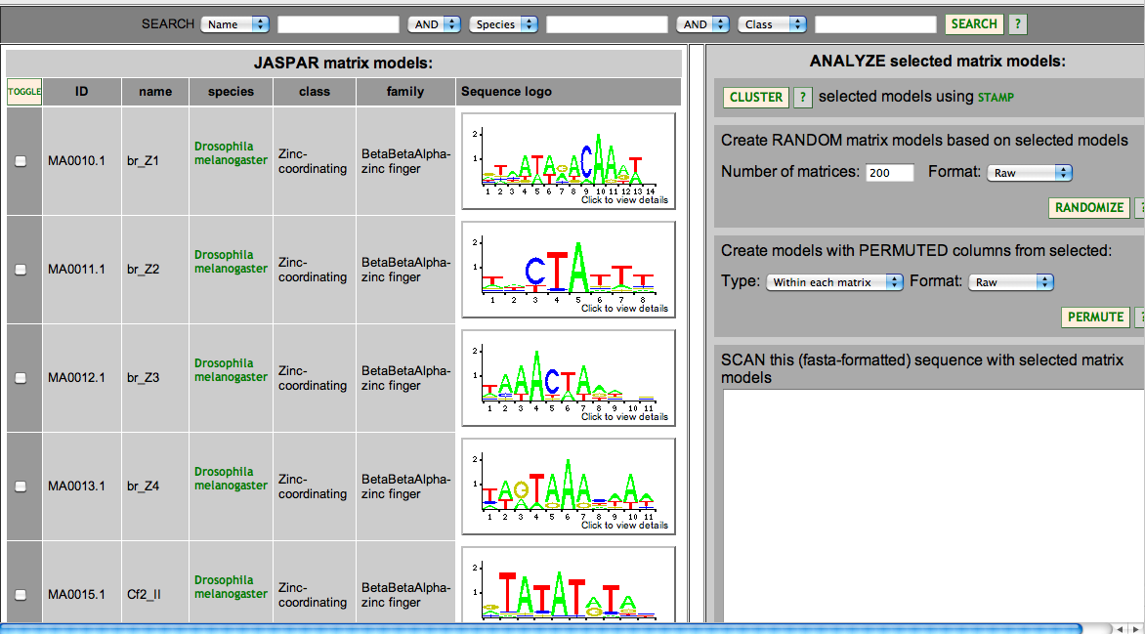
Motif Databases
JASPAR: http://jaspar.genereg.net/

Slide 12
Motif Databases
TRANSFAC
Public version and License version
Hocomoco: http://hocomoco.autosome.ru/
Human and mouse motifs
UniProbe: http://the_brain.bwh.harvard.edu/uniprobe/
variety of organisms, mostly mouse and human

Slide 13
Computational motif discovery

Slide 14
Why?
We assumed that we have experimental characterization of a transcription factor’s binding specificity (motif)
What if we don’t?
There’s a couple of options …

Slide 15
Option 1
Suppose a transcription factor (TF) regulates five different genes
Each of the five genes should have binding sites for TF in their promoter region
Gene 1
Gene 2
Gene 3
Gene 4
Gene 5
Binding sites for TF

Slide 16
Option 1
Now suppose we are given the promoter regions of the five genes G1, G2, … G5
Can we find the binding sites of TF, without knowing about them a priori ?
This is the computational motif finding problem
To find a motif that represents binding sites of an unknown TF

Slide 17
Option 2
Suppose we have ChIP-chip or ChIP-Seq data on binding locations of a transcription factor.
Collect sequences at the peaks
Computationally find the motif from these sequences
This is another version of the motif finding problem

Slide 18
Motif finding algorithms
Version 1: Given promoter regions of co-regulated genes, find the motif
Version 2: Given bound sequences (ChIP peaks) of a transcription factor, find the motif
Idea: Find a motif with many (surprisingly many) matches in the given sequences

Slide 19
Motif finding algorithms
Gibbs sampling (MCMC) : Lawrence et al. 1993
MEME (Expectation-Maximization) : Bailey & Elkan 94
CONSENSUS (Greedy search) : Stormo lab.
Priority (Gibbs sampling, but allows for additional prior information to be incorporated): Hartemink lab.
Many many others …

