Slide 1
Basic Molecular Biology

Slide 2
Life, Cells, Proteins
The study of life ≈ the study of cells
Cells are born, do their job, duplicate, die
What is “their job”?
Break down nutrients, produce energy, produce required molecules, communicate with each other
All these processes are controlled by proteins

Slide 3
Protein functions
“Enzymes” (catalysts)
Control chemical reactions in cell
Transfer of signals/molecules between and inside cells
E.g., sensing of environment
Regulate production of other proteins

Slide 4
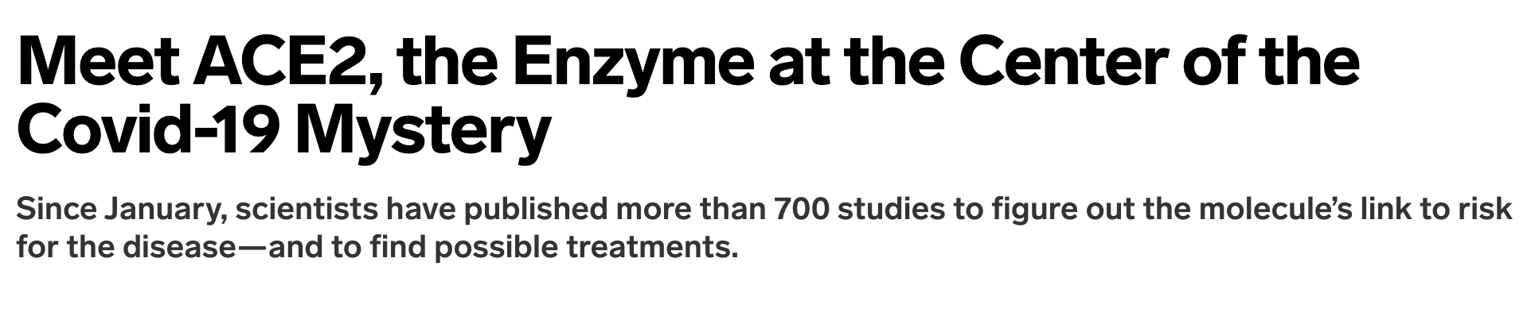
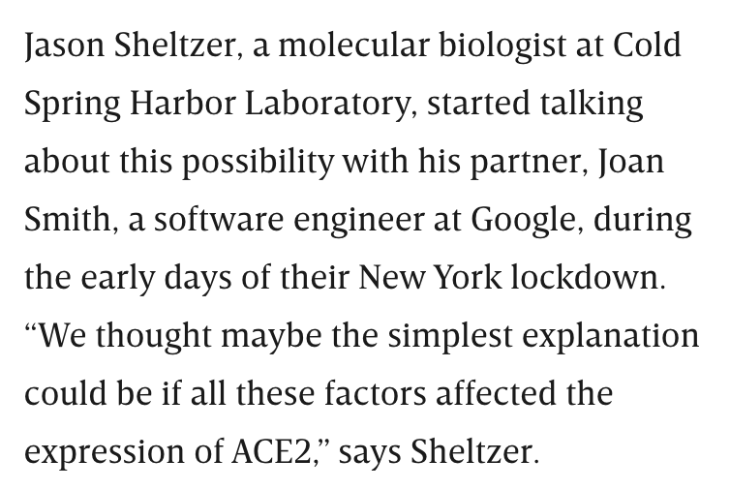
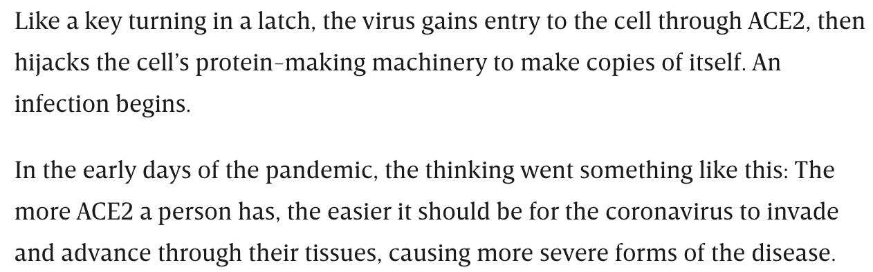
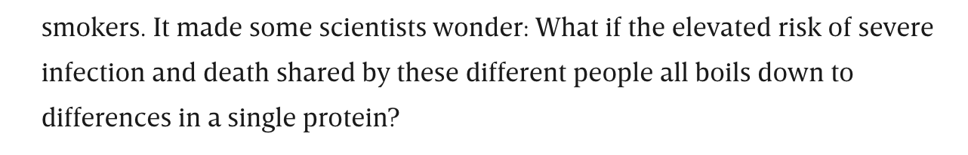
Detour
https://www.wired.com/story/meet-ace2-the-enzyme-at-the-center-of-the-covid-19-mystery/

Slide 5
Protein molecule
Protein is a sequence of amino-acids
20 possible amino acids
The amino-acid sequence “folds” into a 3-D structure called protein

Slide 6
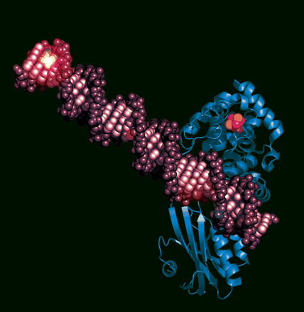
Protein Structure
Protein
PNAS cover, courtesy Amie Boal
DNA
The DNA repair protein MutY (blue) bound to DNA (purple).

Slide 7
DNA
Deoxyribonucleic acid: a molecule that is involved in production of proteins
Double helical structure (discovered by Watson, Crick, Wilkins & Franklin)
Chromosomes are densely coiled and packed DNA

Slide 8
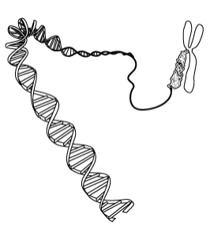
Chromosome
DNA
SOURCE: http://www.microbe.org/espanol/news/human_genome.asp

Slide 9
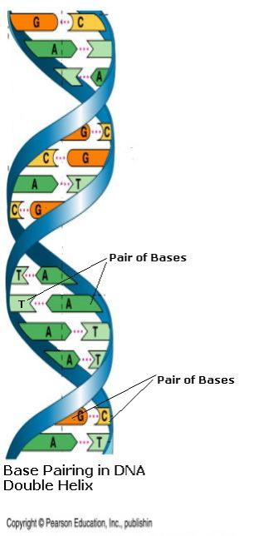
The DNA Molecule
5’
G -- C A -- T T -- A G -- C C -- G G -- C T -- A G -- C T -- A T -- A A -- T A -- T C -- G T -- A
≅
3’
Base = Nucleotide

Slide 10
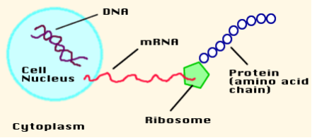
From DNA to Amino-acid sequence
Cell
SRC:http://www.biologycorner.com/resources/DNA-RNA.gif

Slide 11
From DNA to Protein: In words
DNA = nucleotide sequence
Alphabet size = 4 (A,C,G,T)
DNA ➔ mRNA (single stranded)
Alphabet size = 4 (A,C,G,U)
mRNA ➔ amino acid sequence
Alphabet size = 20
Amino acid sequence “folds” into 3-dimensional molecule called protein

Slide 12
DNA and genes
DNA is a very “long” molecule
DNA in human has 3 billion base-pairs
String of 3 billion characters !
DNA harbors “genes”
A gene is a substring of the DNA string

Slide 13
Genes code for proteins
DNA ➔ mRNA ➔ protein can actually be written as Gene ➔ mRNA ➔ protein
A gene is typically few hundred base-pairs (bp) long

Slide 14
Transcription
Process of making a single stranded mRNA using double stranded DNA as template
Only genes are transcribed, not all DNA
Gene has a transcription “start site” and a transcription “stop site”

Slide 15
Step 1: From DNA to mRNA
Transcription
2:23-4:14

Slide 16
Translation
Process of making an amino acid sequence from (single stranded) mRNA
Each triplet of bases translates into one amino acid
Each such triplet is called “codon”
The translation is basically a table lookup

Slide 17
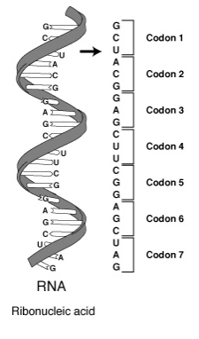

Slide 18
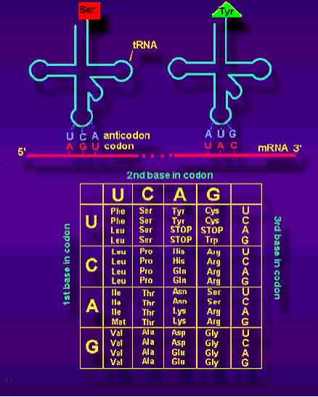
The Genetic Code
SOURCE: http://www.bioscience.org/atlases/genecode/genecode.htm

Slide 19
Step 2: mRNA to Amino acid sequence
Translation
Notes:
covered to here.

Slide 20
Review so far
Proteins: important molecules, amino acid sequences
DNA: structure, base-pairing.
Genes: substrings of DNA
Gene --> mRNA (transcription)
mRNA --> amino acid sequence (translation), genetic code.

Slide 21
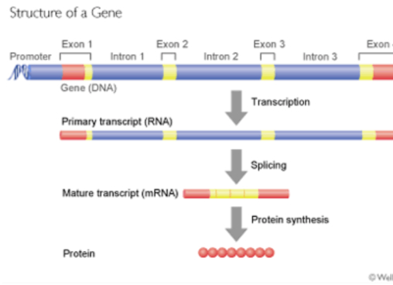
Gene structure
SOURCE: http://www.wellcome.ac.uk/en/genome/thegenome/hg02b001.html

Slide 22
Gene structure
Exons and Introns
Introns are “spliced” out, and are not part of mRNA
Promoter (upstream) of gene

Slide 23
Gene expression
Process of making a protein from a gene as template
Transcription, then translation
Can be regulated

Slide 24
Transcriptional regulation
TRANSCRIPTION
FACTOR
GENE
ACAGTGA
PROTEIN

Slide 25
Transcriptional regulation
TRANSCRIPTION
FACTOR
GENE
ACAGTGA
PROTEIN

Slide 26
The importance of gene regulation

Slide 27
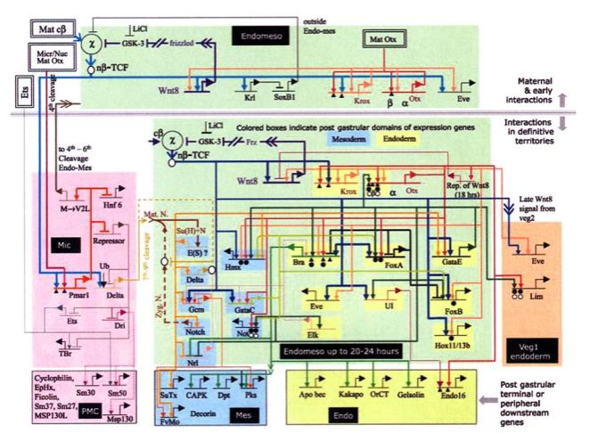
Genetic regulatory network controlling the development of the body plan of the sea urchin embryo
Davidson et al., Science, 295(5560):1669-1678.

Slide 28
That was the “circuit” responsible for development of the sea urchin embryo
Nodes = genes
Switches = gene regulation
Change the switches and the circuit changes
Gene regulation significance:
Development of an organism
Functioning of the organism
Evolution of organisms

Slide 29
Gene Regulation
Chromosomal activation/deactivation
Transcriptional regulation
Splicing regulation
mRNA degradation
mRNA transport regulation
Control of translation initiation
Post-translational modification

Slide 30
Genome
The entire sequence of DNA in a cell
All cells have the same genome
All cells came from repeated duplications starting from initial cell (zygote)
Human genome is 99.9% identical among individuals
Human genome is 3 billion base-pairs (bp) long

Slide 31
Genome features
Genes
Regulatory sequences
The above two make up 5% of human genome
What’s the rest doing?
We don’t know for sure
“Annotating” the genome
Task of bioinformatics

Slide 32
Some genome sizes
Organism Genome size (base pairs)
Virus, Phage Φ-X174; 5387 - First sequenced genome
Virus, Phage λ 5×10⁴
Bacterium, Escherichia coli 4×10⁶
Plant, Fritillary assyrica 13×10¹⁰ Largest known genome
Fungus,Saccharomyces cerevisiae 2×10⁷
Nematode, Caenorhabditis elegans 8×10⁷
Insect, Drosophila melanogaster 2×10⁸
Mammal, Homo sapiens 3×10⁹
Note: The DNA from a single human cell has a length of ~1.8m.

Slide 33
Evolution
A model/theory to explain the diversity of life forms
Some aspects known, some not
An active field of research in itself
Bioinformatics deals with genomes, which are end-products of evolution. Hence bioinformatics cannot ignore the study of evolution

Slide 34
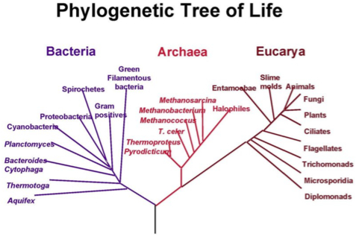
“… endless forms most beautiful and most wonderful …”
- Charles Darwin

Slide 35
Evolution
All organisms share the genetic code
Similar genes across species
Probably had a common ancestor
Genomes are a wonderful resource to trace back the history of life
Got to be careful though -- the inferences may require clever techniques

Slide 36
Home work (preparation for next lecture)
Read Basic probability and statistics: Bayes rule, Random variables, Expectation and moments, Discrete distributions, Continuous distributions.
Source: Slides ‘lect2_probstats-short.pdf’ posted on web page.
Source: Chap. 2 of Polanski & Kimmel (free ebook through library), or Chap. 11 of DEKM or any other source.

