Slide 1
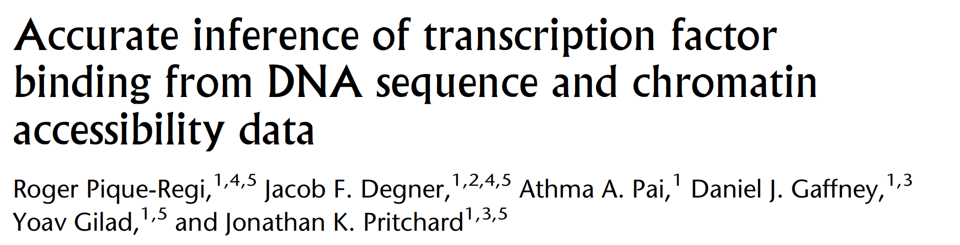

Slide 2
Motivation
Goal is to “map bound TF binding sites” genome-wide in a biological sample.
Do we know a method to do this?
Yes: use the PWM W of the motif and calculate likelihood Pr(s|W) for every subsequence s of the genome. Predict all s with LLR score above some threshold as sites.
Problem: this leads to far too many predictions, large numbers of false positives.

Slide 3
Motivation (cont’d)
Our simple method is based purely on DNA sequence. Note that sequence doesn’t change from one sample to another, yet TF binding can change. We are missing something!
Suppose we have sample-specific epigenomic data, e.g., DNA accessibility genome-wide. This can probably help, since a high-scoring motif-match in an open DNA region is more likely to be TF-bound.
This is the premise of the work. The paper shows a way to predict TF-bound sites genome-wide by using sequence as well as epigenomic data.

Slide 4
The informatics setup
“Our method starts by scanning the genome for all positions with substantial similarity to a known sequence motif or position weight matrix (PWM).” These are the “candidate sites”.
“We then … infer which candidate sites for each motif are likely to be bound by a TF”
“assuming that sites that are bound will tend to differ in multiple ways from sites that are not bound”

Slide 5
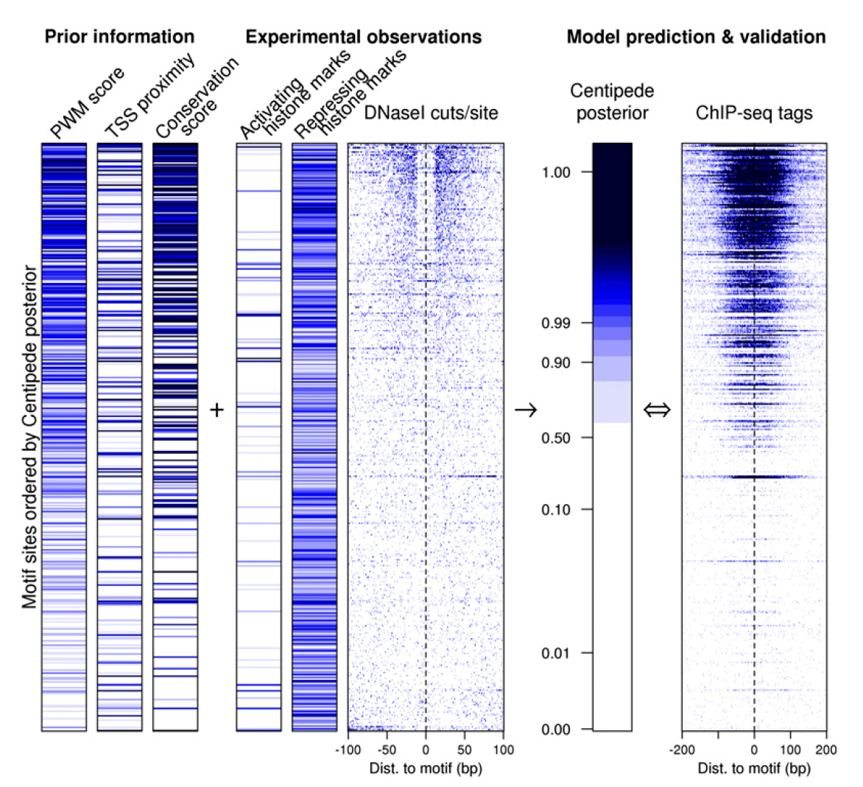
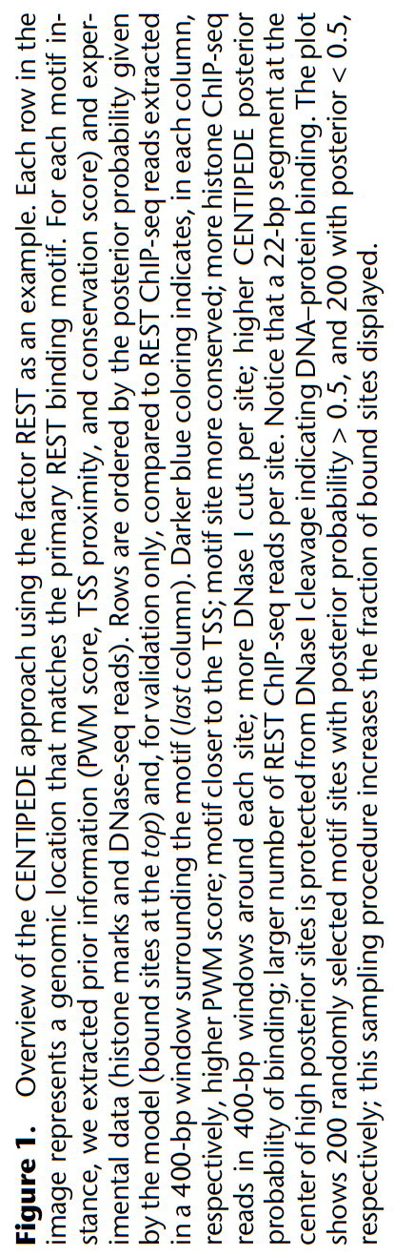
Predicted score
True score
What do we see here?

Slide 6
Each row is a “candidate site”
Each has five numeric “features”
Want to combine these features into one prediction (bound/not-bound) for each .
How?
We’ve seen linear classifiers. Can we train one?
No! We don’t have “training data”. This is not a “supervised learning” scenario.

Slide 7
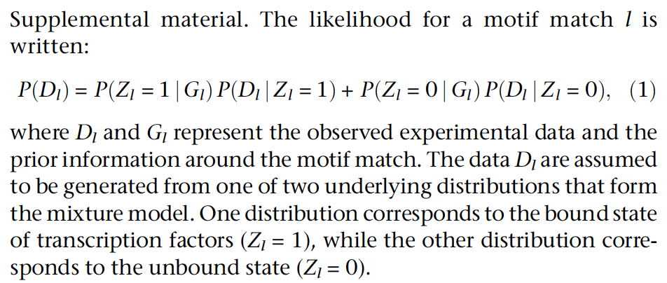
The model (Hierarchical Mixture Model)
G_{l} = (PWM score, TSS proximity, Evolutionary conservation)
D_{l} = (Activ. Histone mark, Repr. Histone mark, DNA accessibility)

Slide 8
Intuition about the model?
Hidden variable
Observed variable
Observed variable
G_{l}
Z_{l}
D_{l}
Model must prescribe a Probability calculation based on (D_l, G_l)

Slide 9
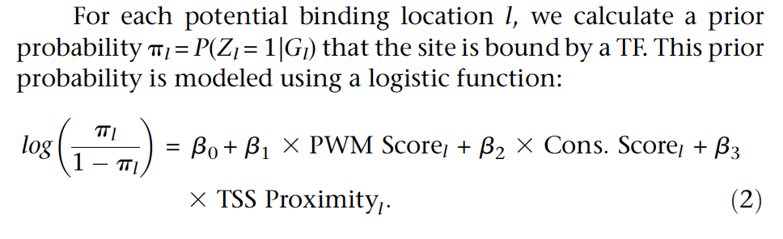
Details of model
G_{l}
Z_{l}
D_{l}
Recall logistic regression!

Slide 10
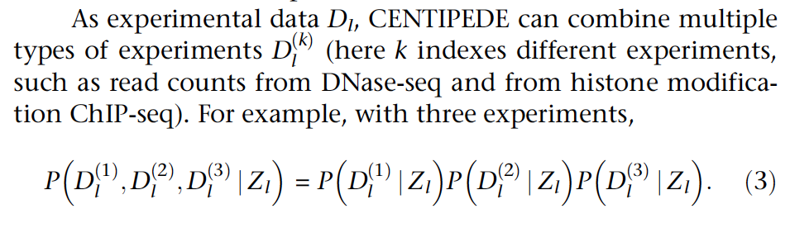
Details of model
G_{l}
Z_{l}
D_{l}
Note: D_{l} = (Actv Histone marks, Repr Histone marks, DNA accessibility)
= (D_{l}¹ , D_{l}² , D_{l}³ )

Slide 11
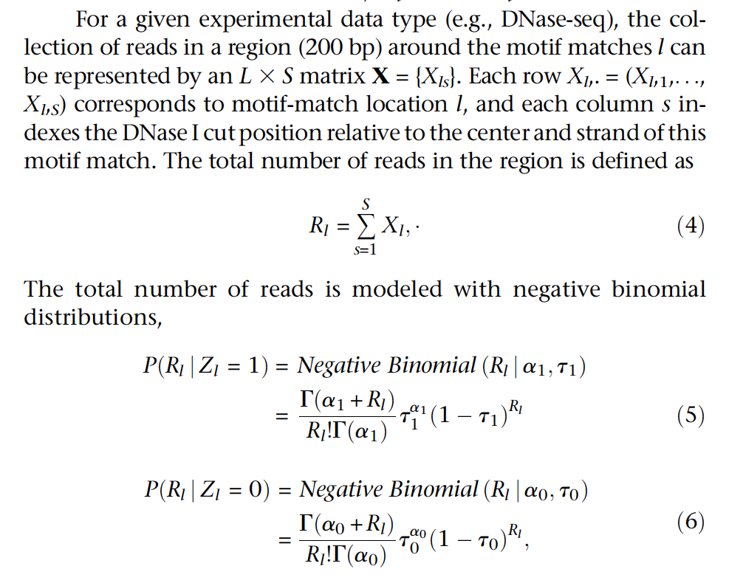
Pr(D_{l}^{k} | Z)
Skip equations 7,8 (details)

Slide 12
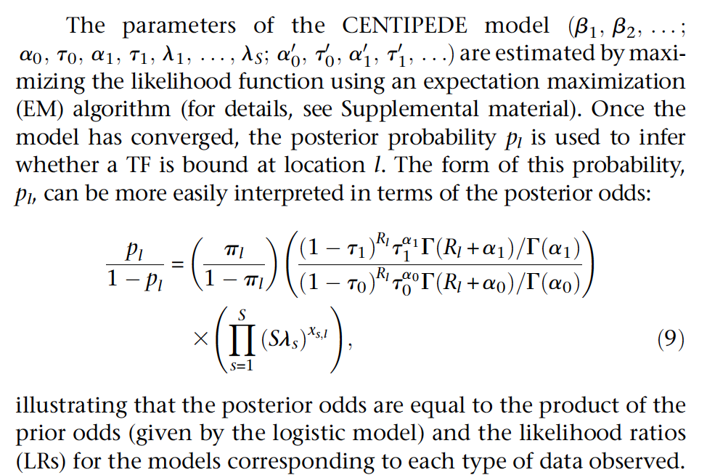

Slide 13
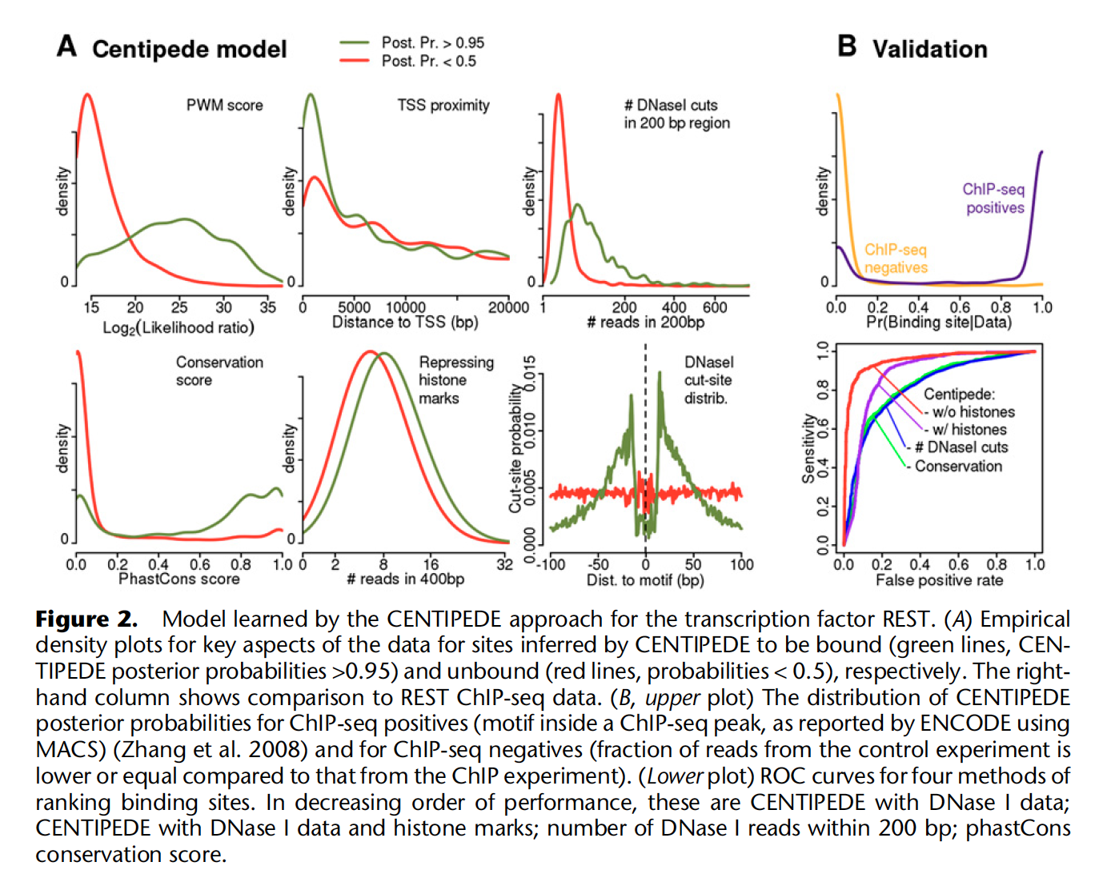
Which features seem to be more discriminative?

Slide 14
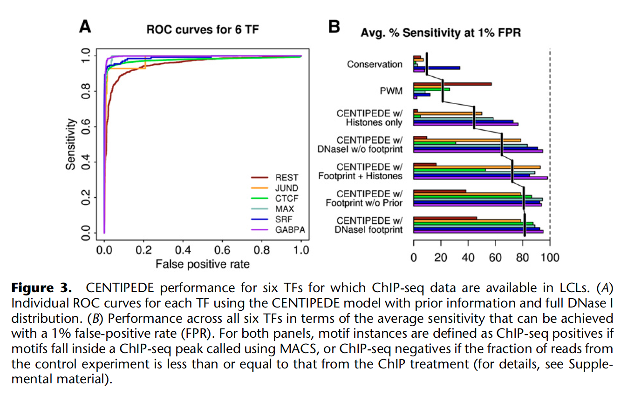
Which parts of the data are most helpful?

