Slide 1
SkinCNN
CNN-Based Acne Detection from Dermatological Images
BME6938: Medical AI · Project 2 · Group 6
Joseph Luper Tsenum · Maria C. Horey · Benjamin D. Tondre
University of Florida · Spring 2026

Slide 2
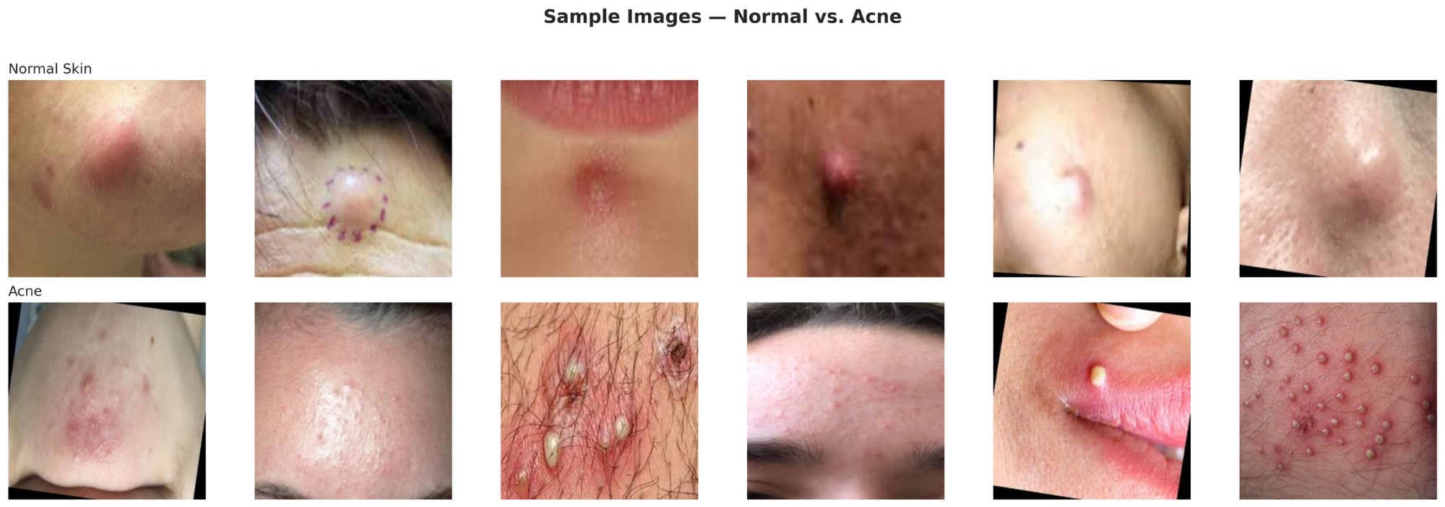
Clinical Motivation
Acne vulgaris affects ~85% of adolescents worldwide
Visual diagnosis requires dermatologist access — limited in many settings
Automated classification could support primary care triage & remote screening
CNN-based approaches show promise for dermatological image analysis
Project Goal
Compare CNN from scratch vs. transfer learning (ResNet-18, DenseNet-121, EfficientNet-B0) for acne vs. normal classification with Grad-CAM interpretability.

Slide 3
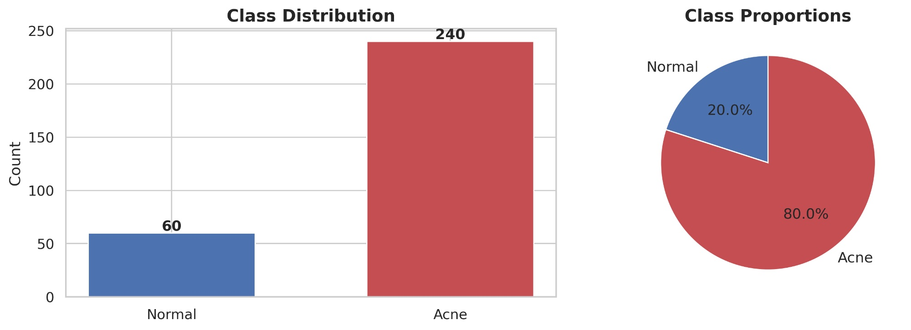
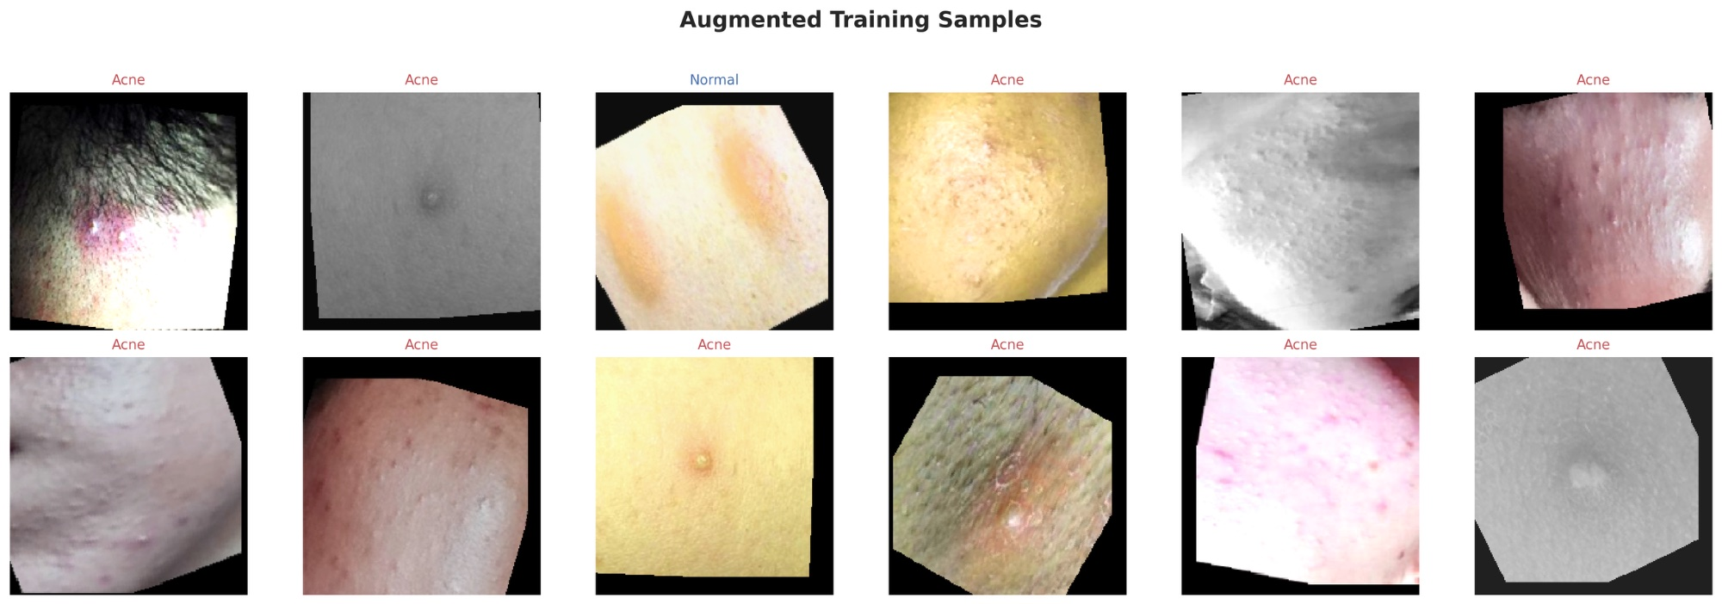
Dataset Overview
300 skin lesion images (244×244 RGB)
Acne: 240 images (80%)
Normal: 60 images (20%)
70/15/15 stratified split (train/val/test)
Class-weighted CrossEntropyLoss for imbalance
Data augmentation: flip, rotation, affine, ColorJitter, grayscale

Slide 4
Model Architectures
Custom CNN
ResNet-18
DenseNet-121
EfficientNet-B0
3-block from scratch
32→64→128 channels
~600K params
Pretrained ImageNet
Residual connections
11.2M params
Pretrained ImageNet
Dense connections
7.0M params
Pretrained ImageNet
Compound scaling
4.0M params
Training: Adam optimizer · ReduceLROnPlateau · Early stopping · Class-weighted loss
Evaluation: Accuracy, Precision, Recall, F1, ROC-AUC, Confusion Matrix, Grad-CAM

Slide 5
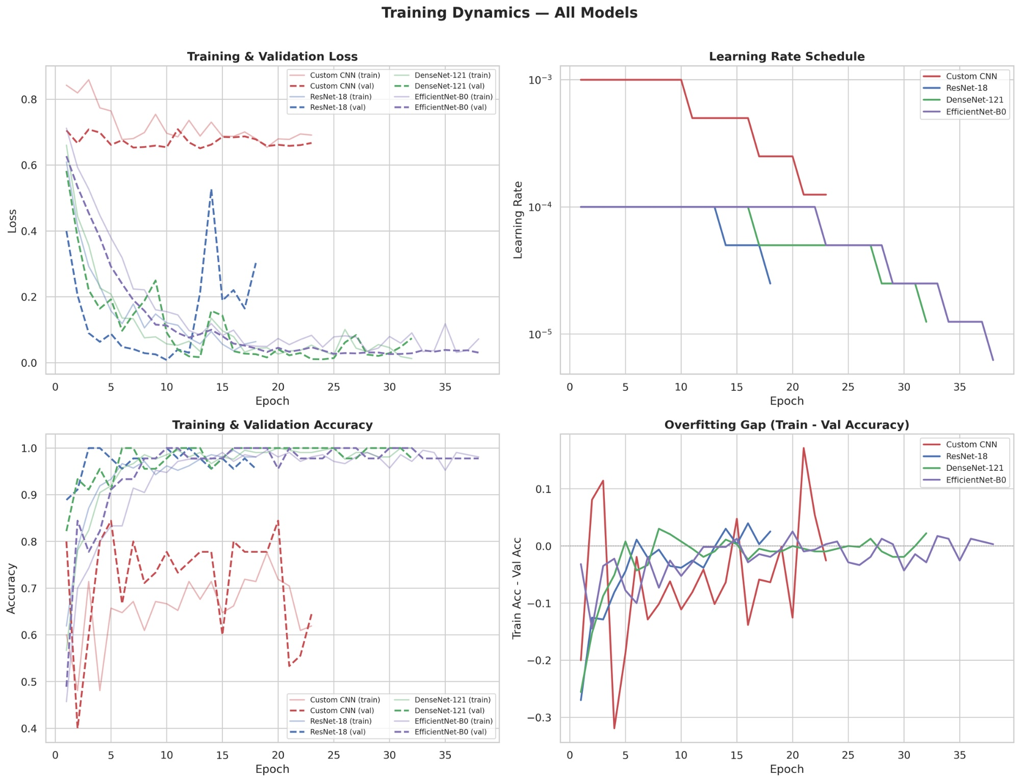
Training Dynamics

Slide 6
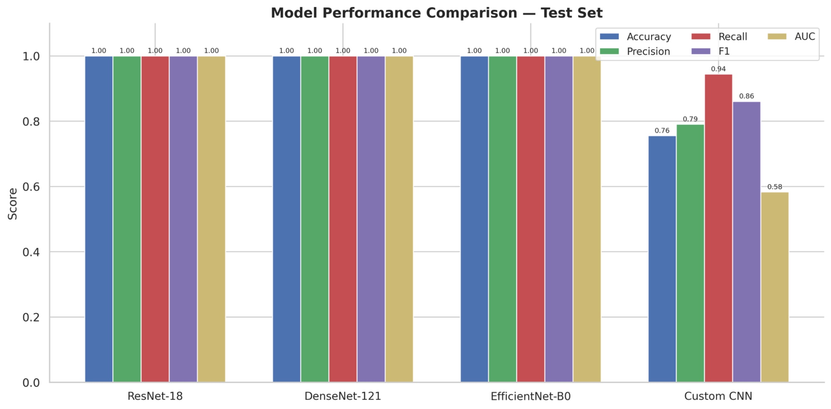
Test Set Results
Model | Accuracy | Precision | Recall | F1 | AUC
ResNet-18 | 1.000 | 1.000 | 1.000 | 1.000 | 1.000
DenseNet-121 | 1.000 | 1.000 | 1.000 | 1.000 | 1.000
EfficientNet-B0 | 1.000 | 1.000 | 1.000 | 1.000 | 1.000
Custom CNN | 0.756 | 0.791 | 0.944 | 0.861 | 0.583

Slide 7
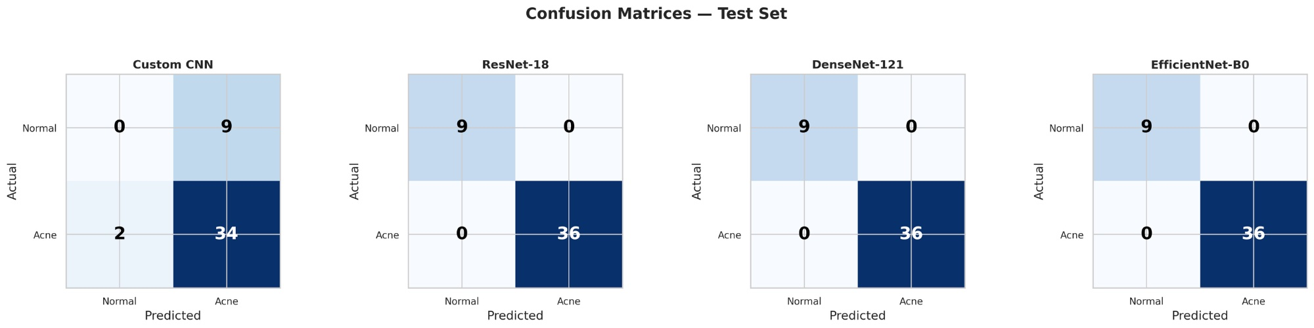
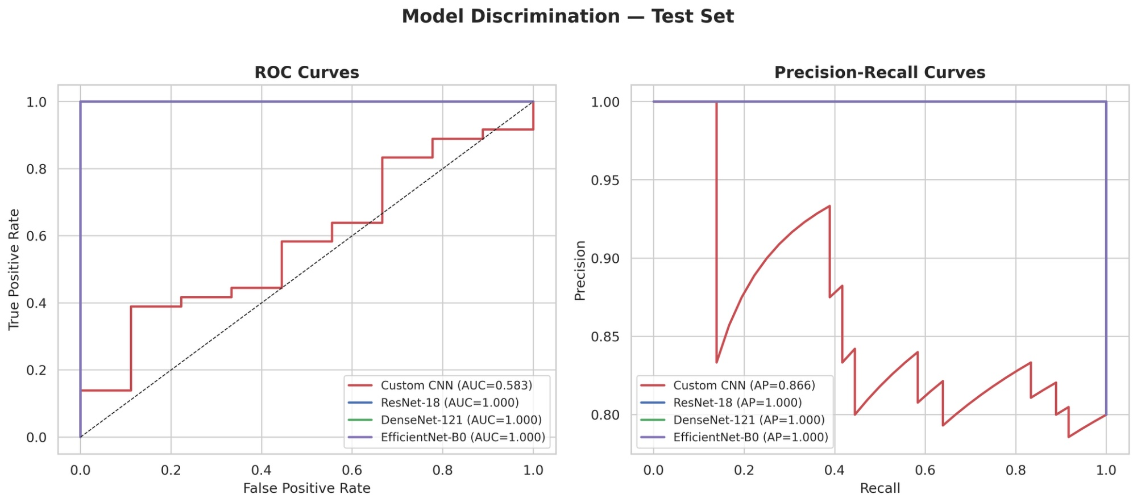
Confusion Matrices & ROC Curves

Slide 8
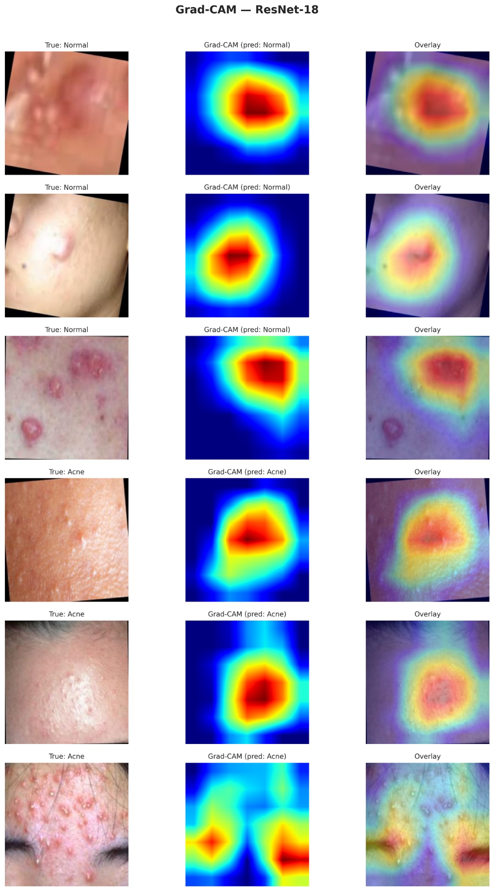
Grad-CAM Interpretability
Grad-CAM highlights diagnostically relevant skin regions — model focuses on lesion areas for acne and smooth texture for normal.

Slide 9
From Scratch vs. Transfer Learning
Custom CNN (From Scratch)
Transfer Learning (Best: All 3)
Accuracy: 75.6%
AUC: 0.583
~600K parameters
23 epochs (early stopped)
Struggled with limited data
Accuracy: 100%
AUC: 1.000
4M–11M parameters
ImageNet features transfer well
Perfect classification on test set
Transfer learning is essential for small medical image datasets — pretrained features from ImageNet generalize remarkably well to dermatological classification.

Slide 10
Discussion & Limitations
Key Findings
Transfer learning achieves perfect test accuracy vs. 75.6% from scratch
All 3 pretrained architectures perform identically — ImageNet features are sufficient
Grad-CAM confirms models focus on lesion regions, not background artifacts
Data augmentation critical for the 300-image dataset
Limitations
Small dataset (300 images) — perfect test scores may reflect overfitting to limited test diversity
Binary task only (acne vs. normal) — multi-class severity grading would be more clinically useful
4:1 class imbalance (80% acne) limits evaluation of normal-class detection
No external validation on independent dermatological datasets

Slide 11
Team Contributions
Joseph Luper Tsenum
Maria C. Horey
Benjamin D. Tondre
Pipeline architecture, model training,
Grad-CAM, report, GitHub
Data exploration, augmentation,
literature review, evaluation
Transfer learning, hyperparameter
tuning, training dynamics, presentation
Thank you!
BME6938: Medical AI · Project 2 · University of Florida · Spring 2026

