Slide 1
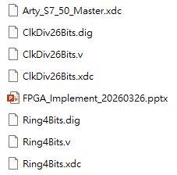
/FPGA_Implement_2026
原始 constrain file
26 位元除頻器電路圖
26 位元除頻器 .v 檔
26 位元除頻器 constrain file
說明檔
Ring Counter 電路圖
Ring Counter. v 檔
Ring Counter constrain file

Slide 2
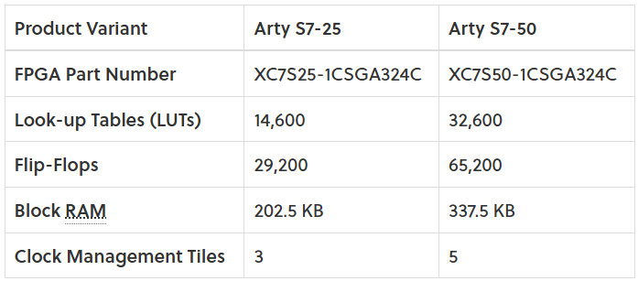
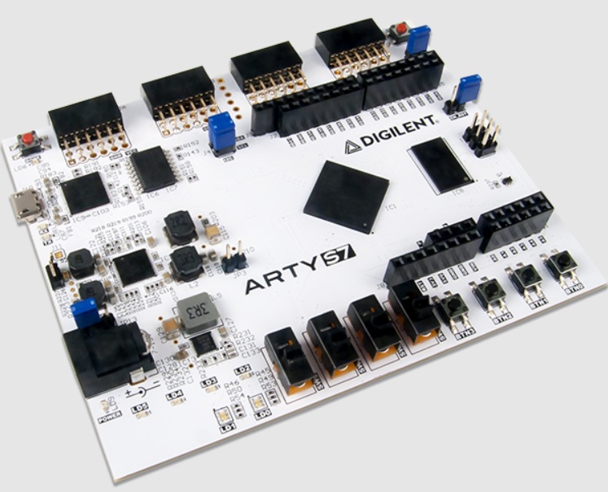
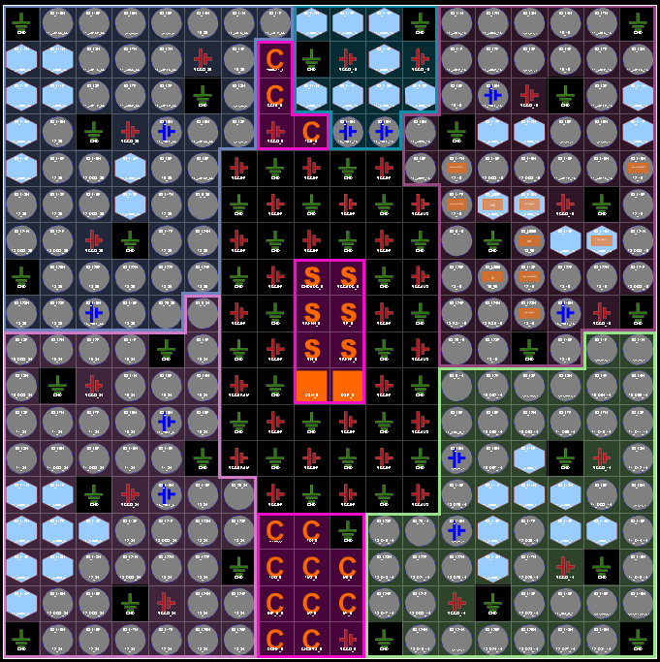
FPGA configuration: using DIGILENT ARTY S7
Reference:
https://digilent.com/reference/programmable-logic/arty-s7/reference-manual?srsltid=AfmBOorzbXbcaCx2YBEzwtKWQFyjFJ2-ehX9uNFsndON17hN3UM-zHf5

Slide 3
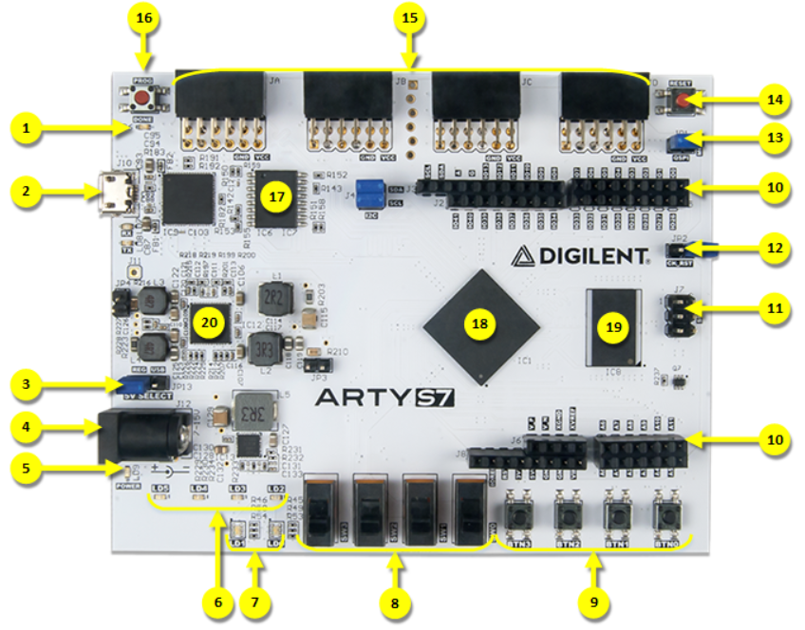
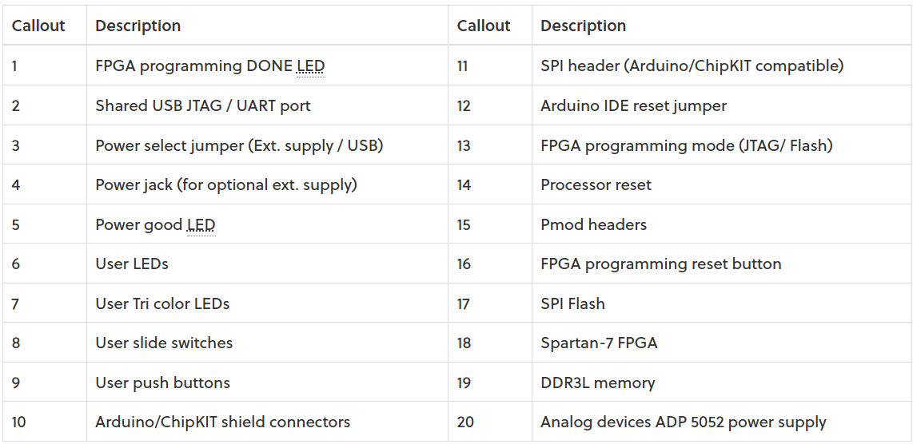

Slide 4
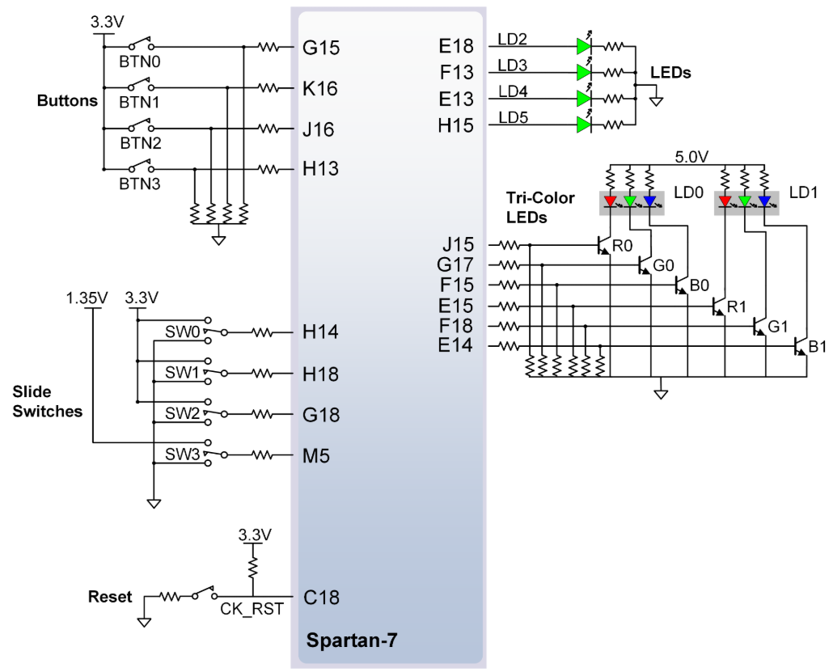

Slide 5
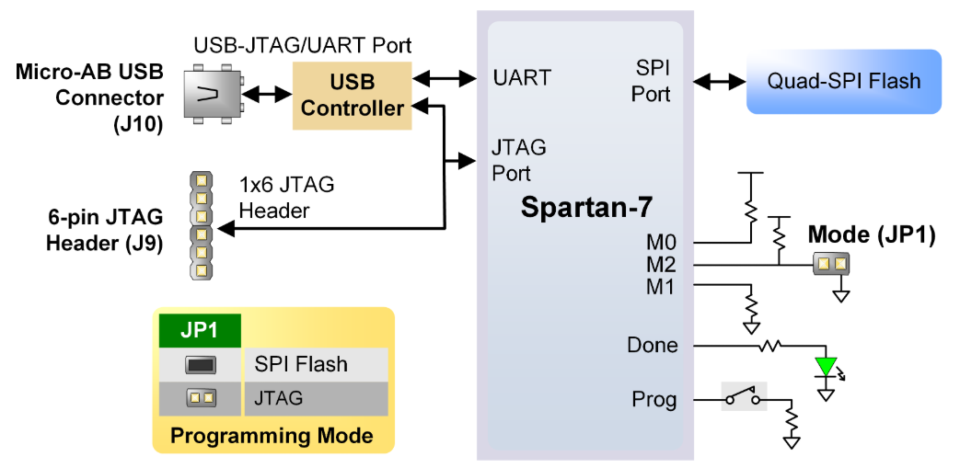
The Arty S7 board includes:
One 12 MHz crystal oscillator connected to pin F14
One 100 MHz crystal oscillator connected to pin R2

Slide 6
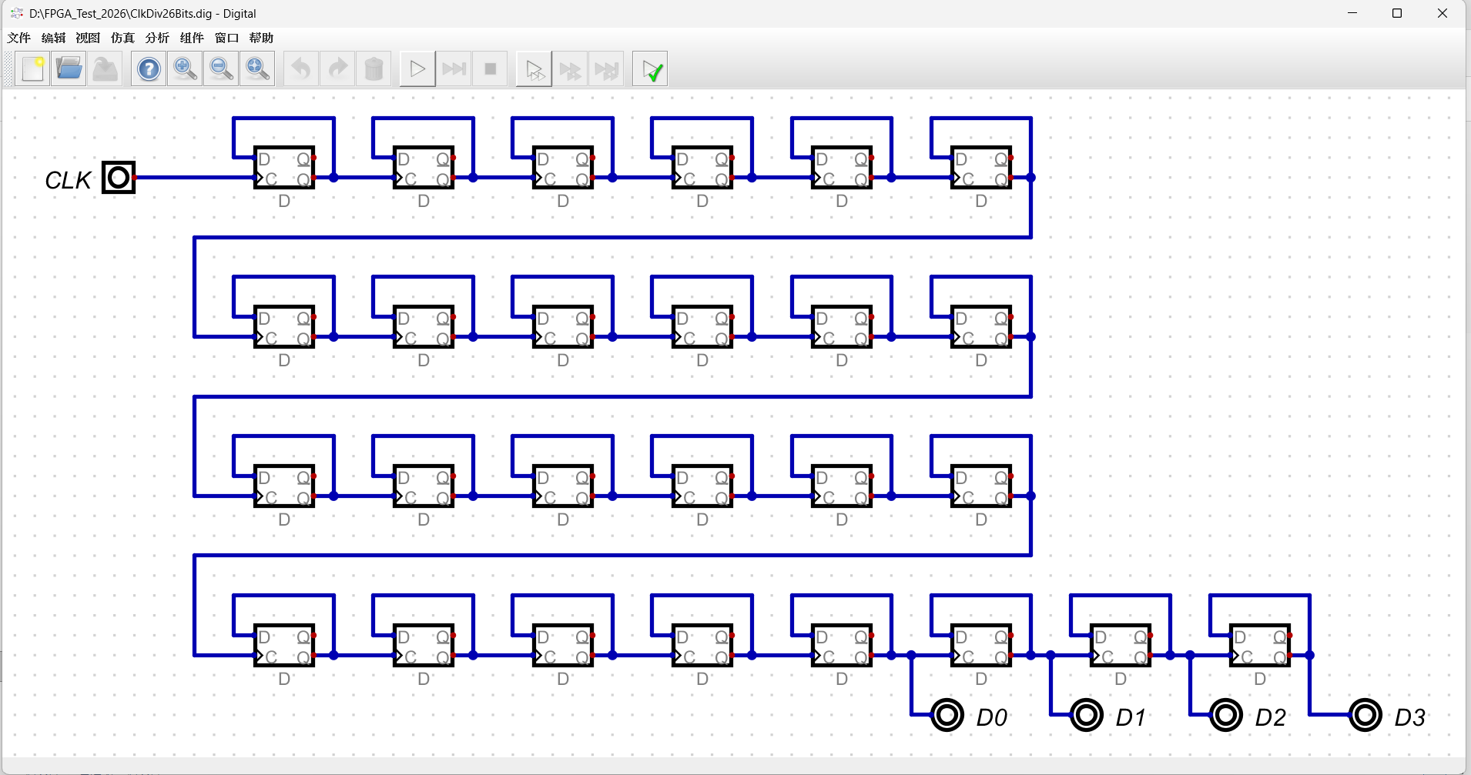
Using “Digital” to construct the circuit schematic:
26bit clock divider, CLK is connected to a 12MHz OSC.

Slide 7
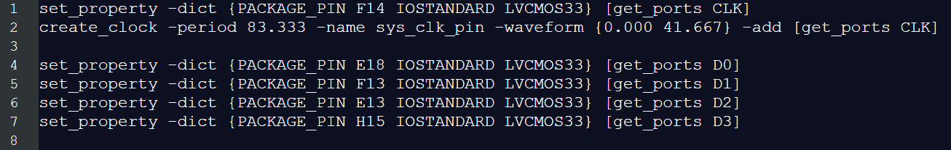
.xdc constrain file for 26-bit clock divider:

Slide 8
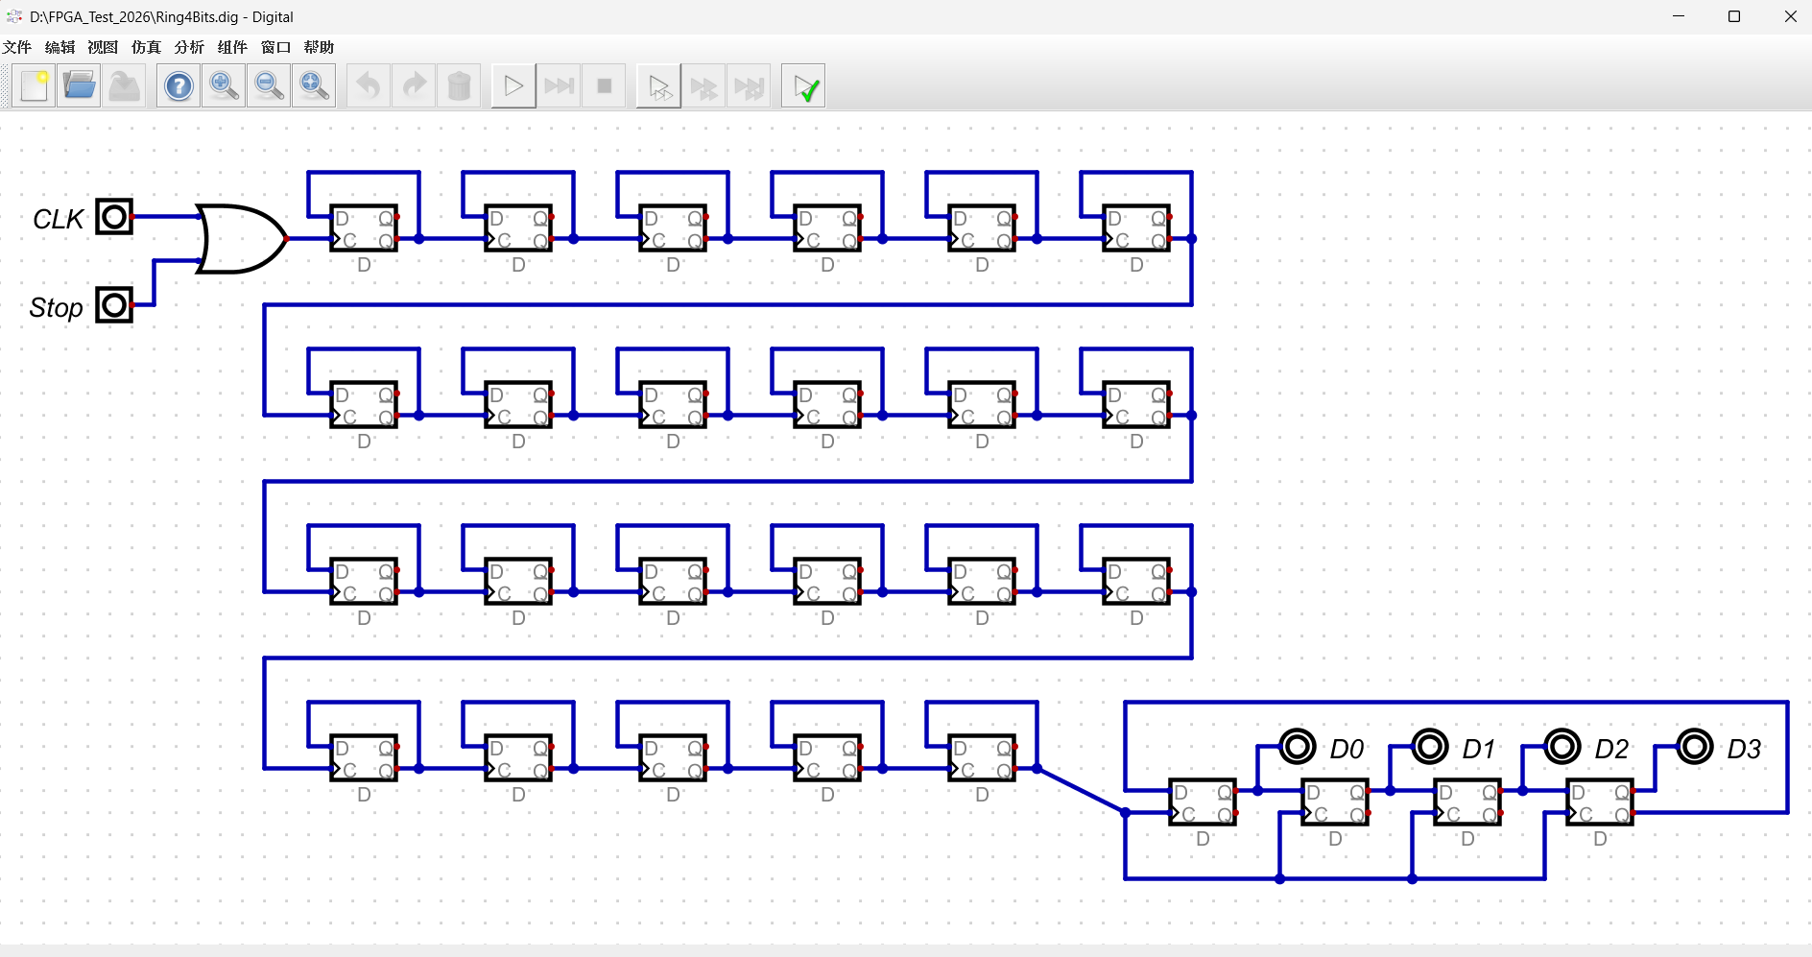
Ring Counter:

Slide 9
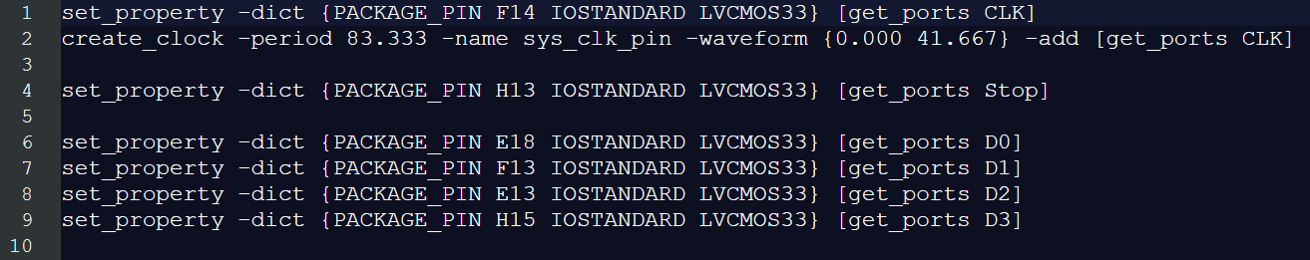
.xdc constrain file for 26-bit clock divider:

Slide 10
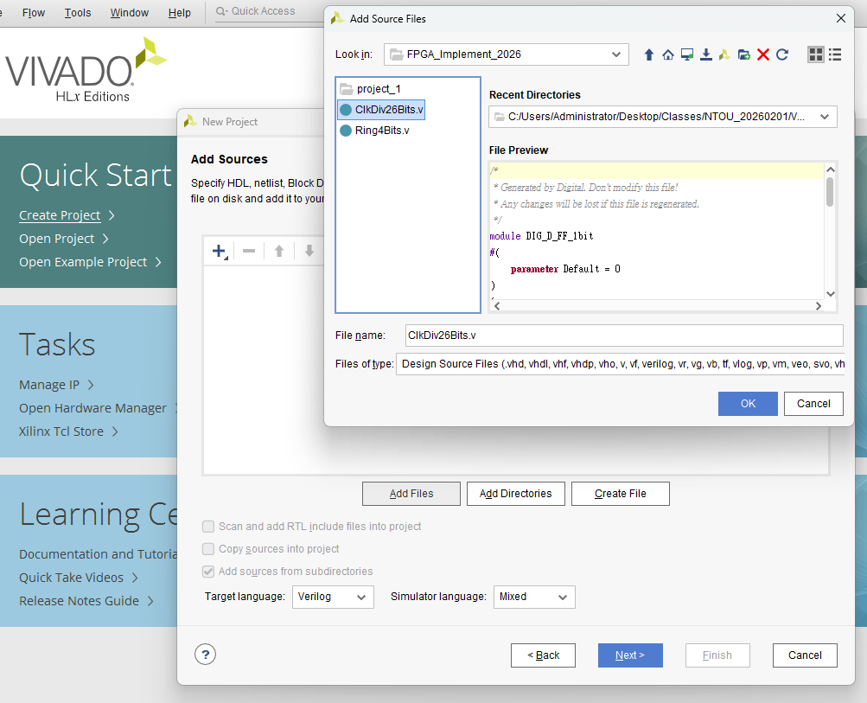
Add *.v file for circuit

Slide 11
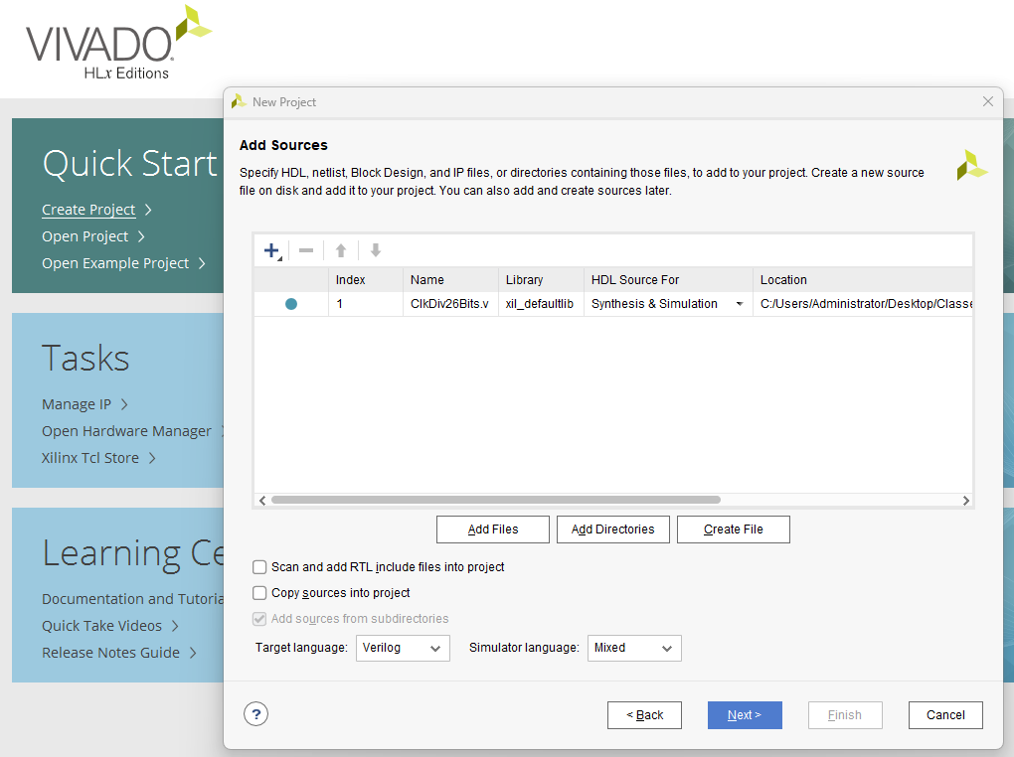

Slide 12
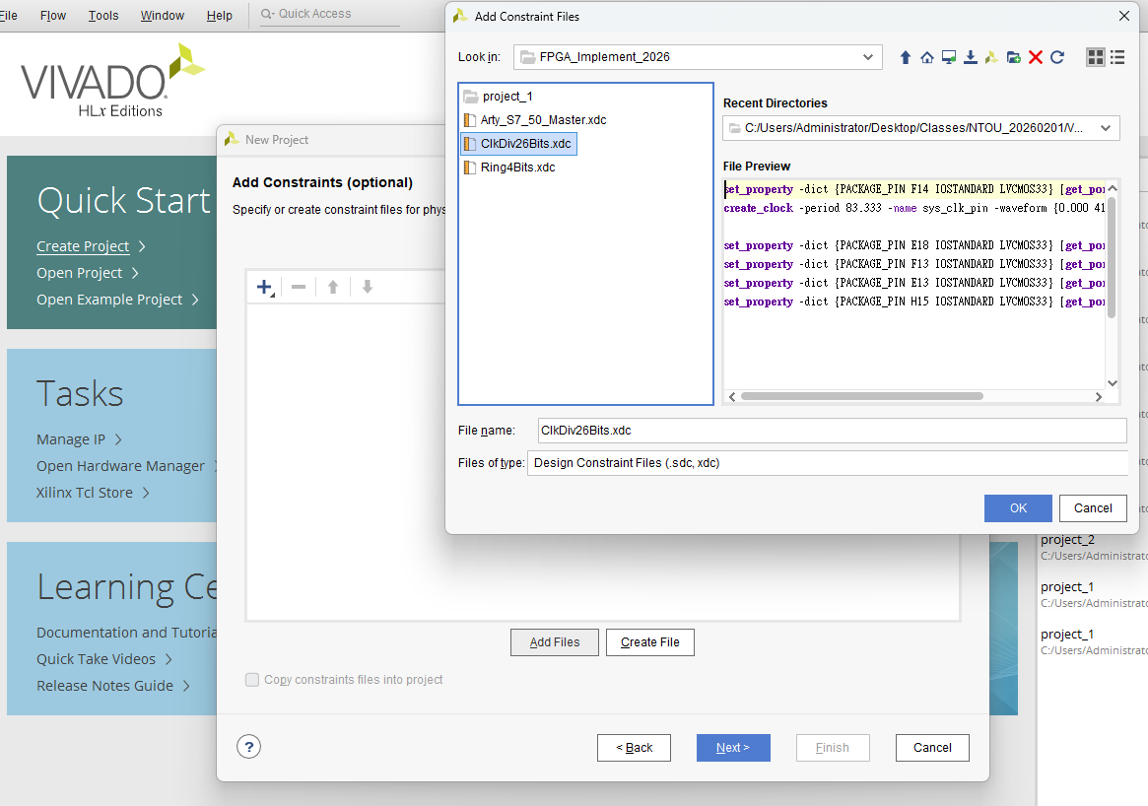
Add *.xdc file for constraint

Slide 13
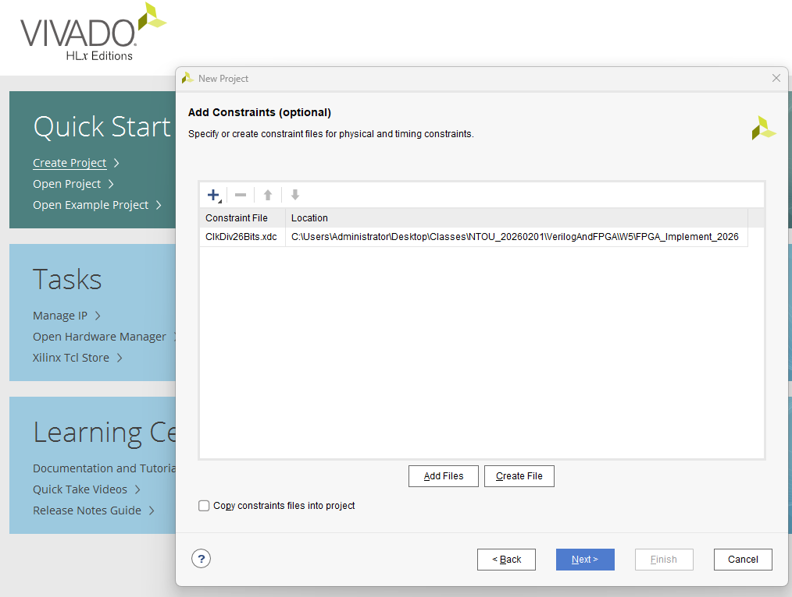

Slide 14
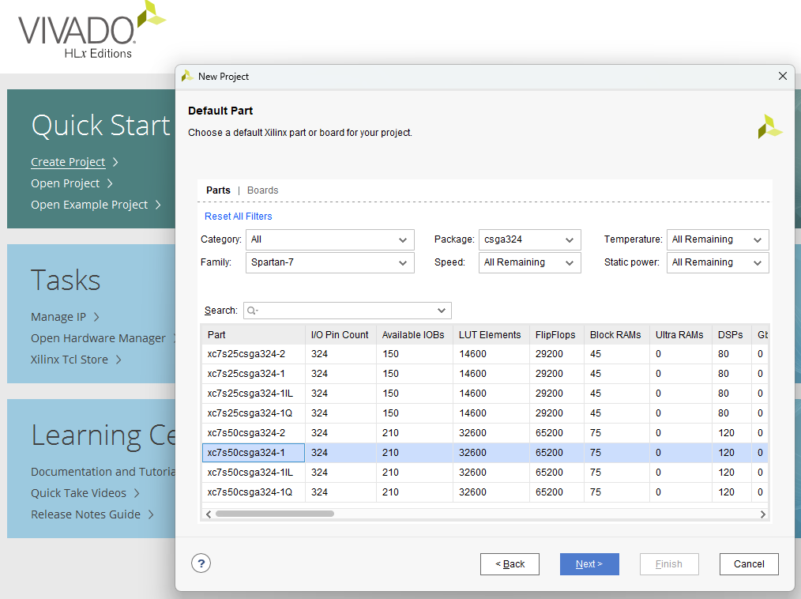
Select FPGA type as
xc7s50csga324-1 or xc7s50csga324-1
Quick search using
“Spartan-7” and “csga324”

Slide 15
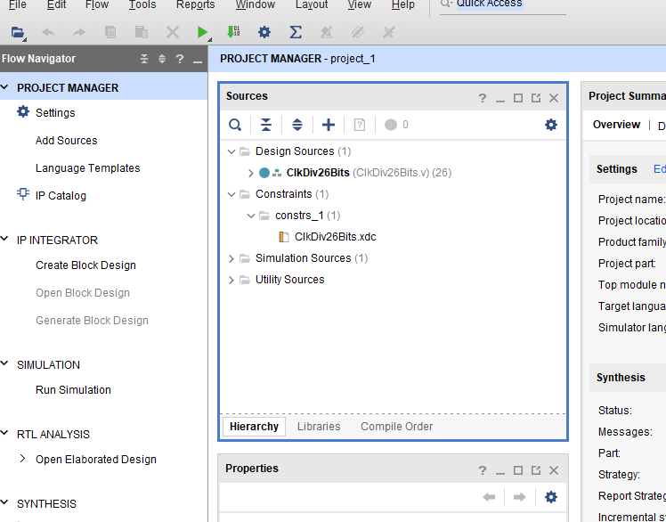
The constraint file can be found in the “Sources”

Slide 16
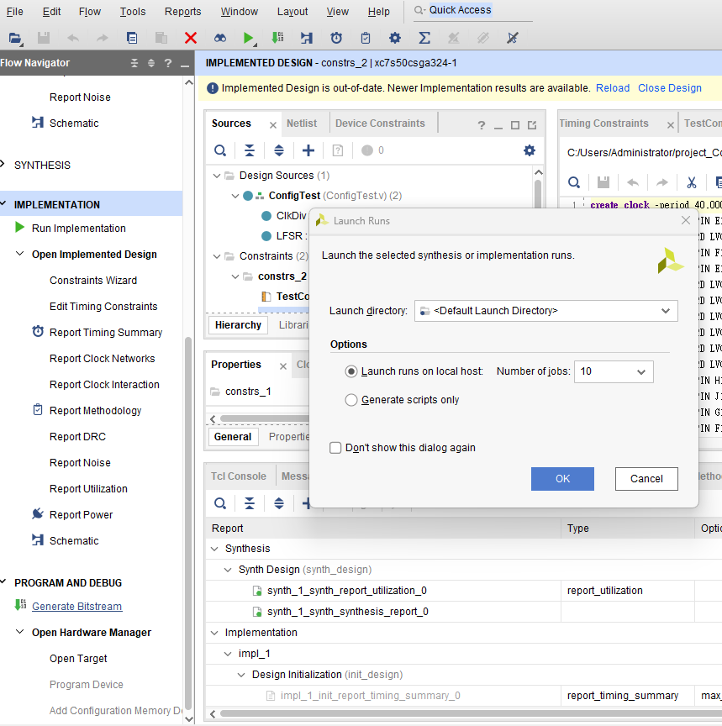
Run Implementation:
PROGRAM AND DEBUG >> Generate Bitstream

Slide 17
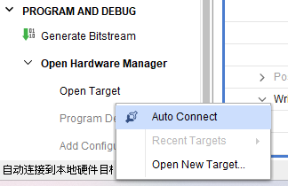
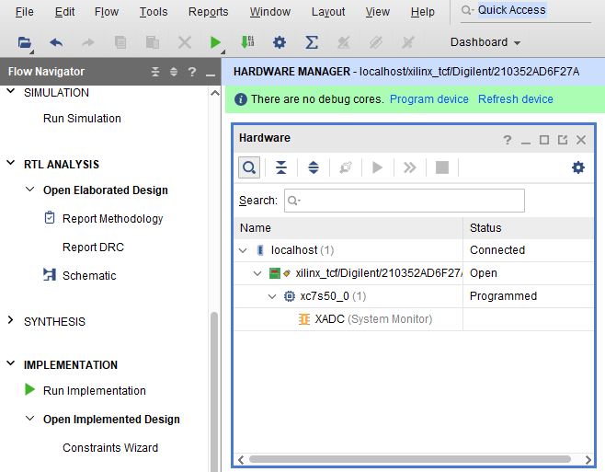
Connect the develop board via USB wire, and
Open Hardware Manager >> Open Target >> Auto Connected
The hardware is successfully connected

Slide 18
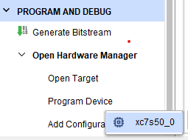
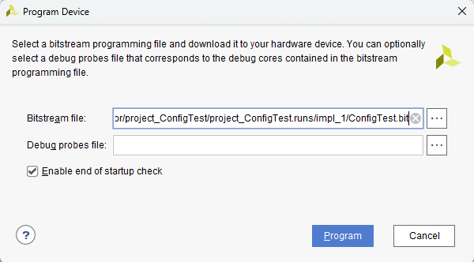
Program Device
Done~!

Slide 19
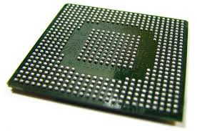
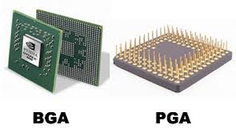
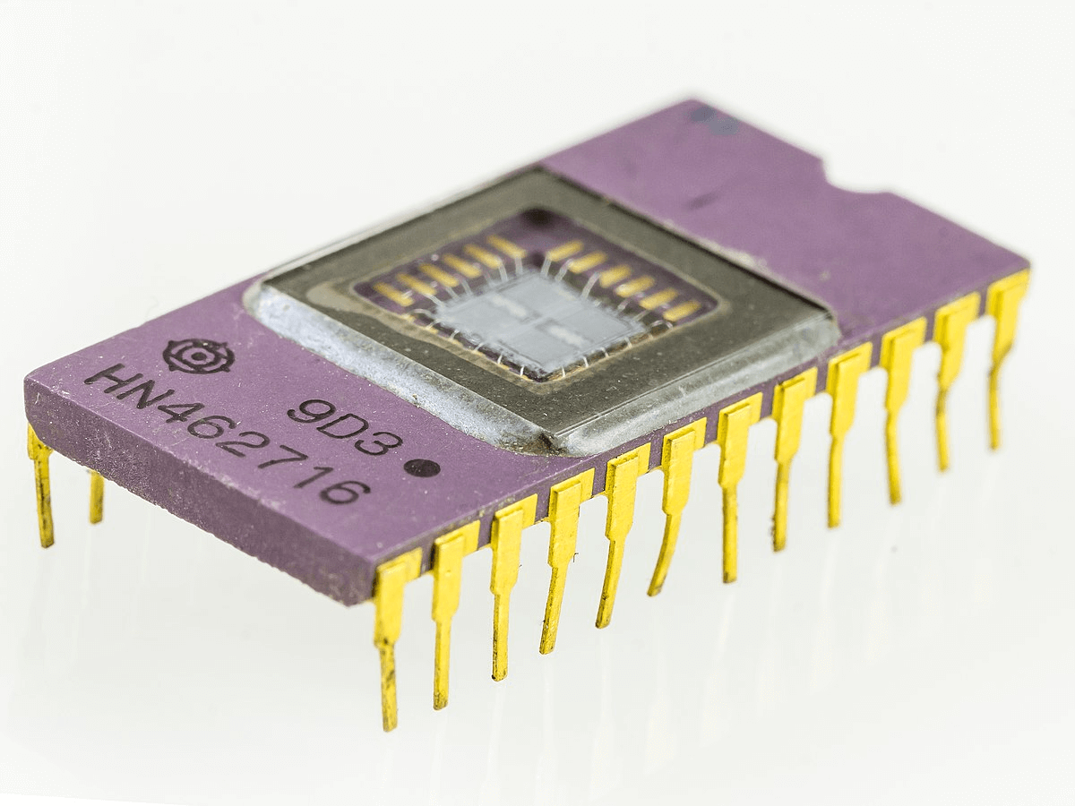
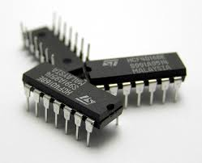
Ball Grid Array package: (BGA)
Dual In-line Package (DIP)

Slide 20
