Slide 1

Python Programming: Super Mario Game
Prof. Xin Wang, PhD, SMIEEE
Department of Electrical Engineering

Slide 2
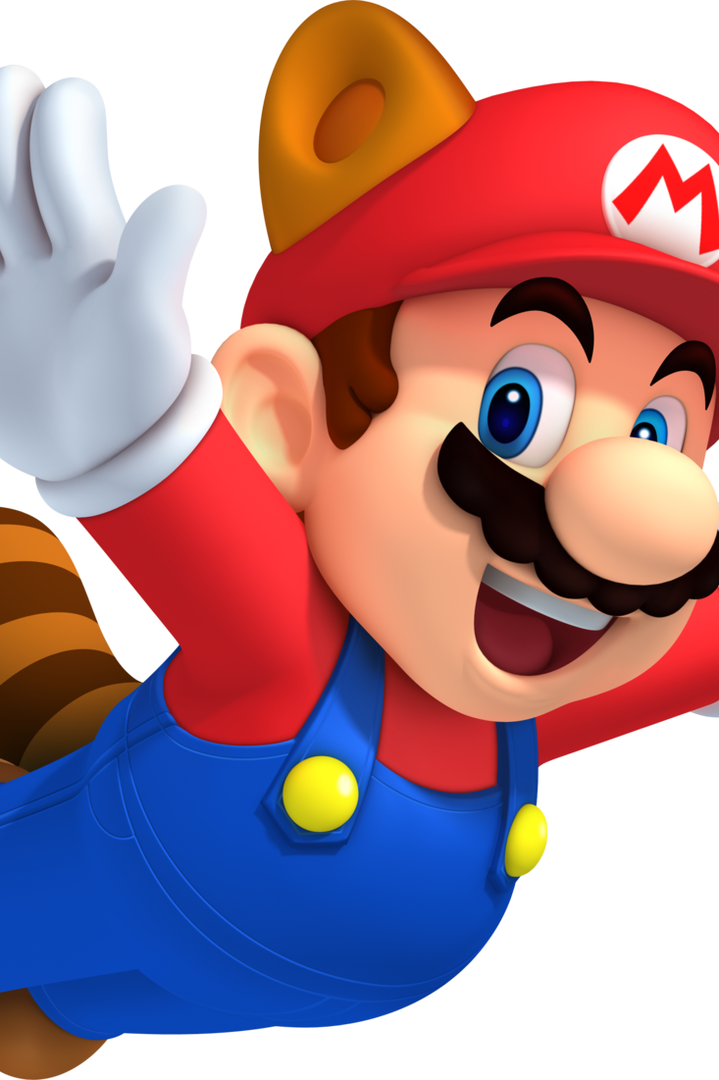

Overview

Slide 3

Super Mario

Slide 4
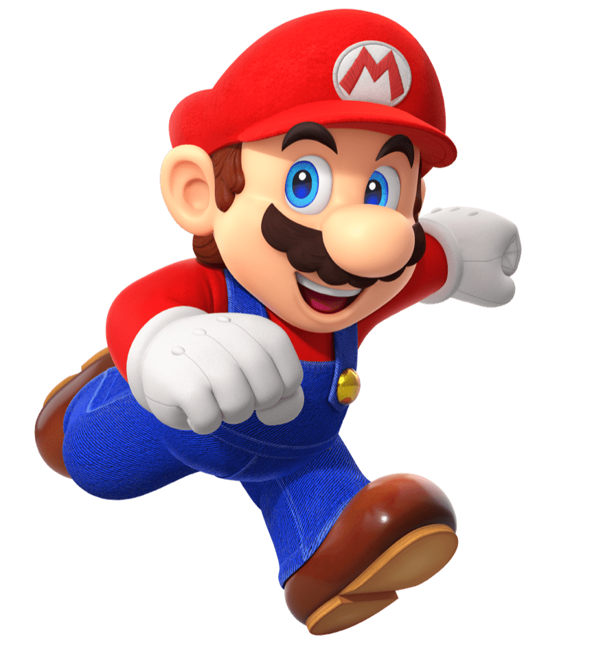
Super Mario
Take control of flying Mario and try to avoid the obstacles including Flying Birds, Pipes and Houses as Mario flies.

Slide 5
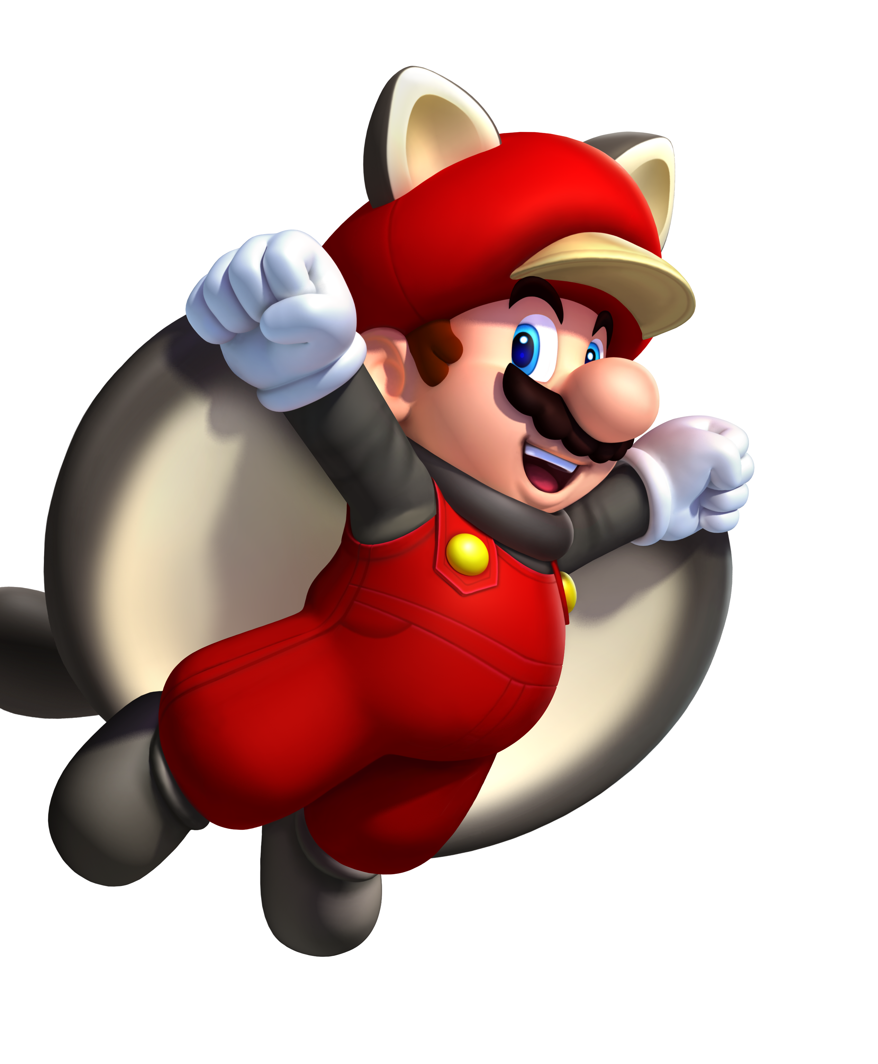
When the game starts, a flying Mario appears in the middle of the screen. You need to use the mouse button to make Mario rise or fall. The challenge is to keep Mario in the air without hitting any birds, houses, or pipes. For every obstacle you avoid, you’ll score one point. But as soon as you hit one, the game is over.

Slide 7
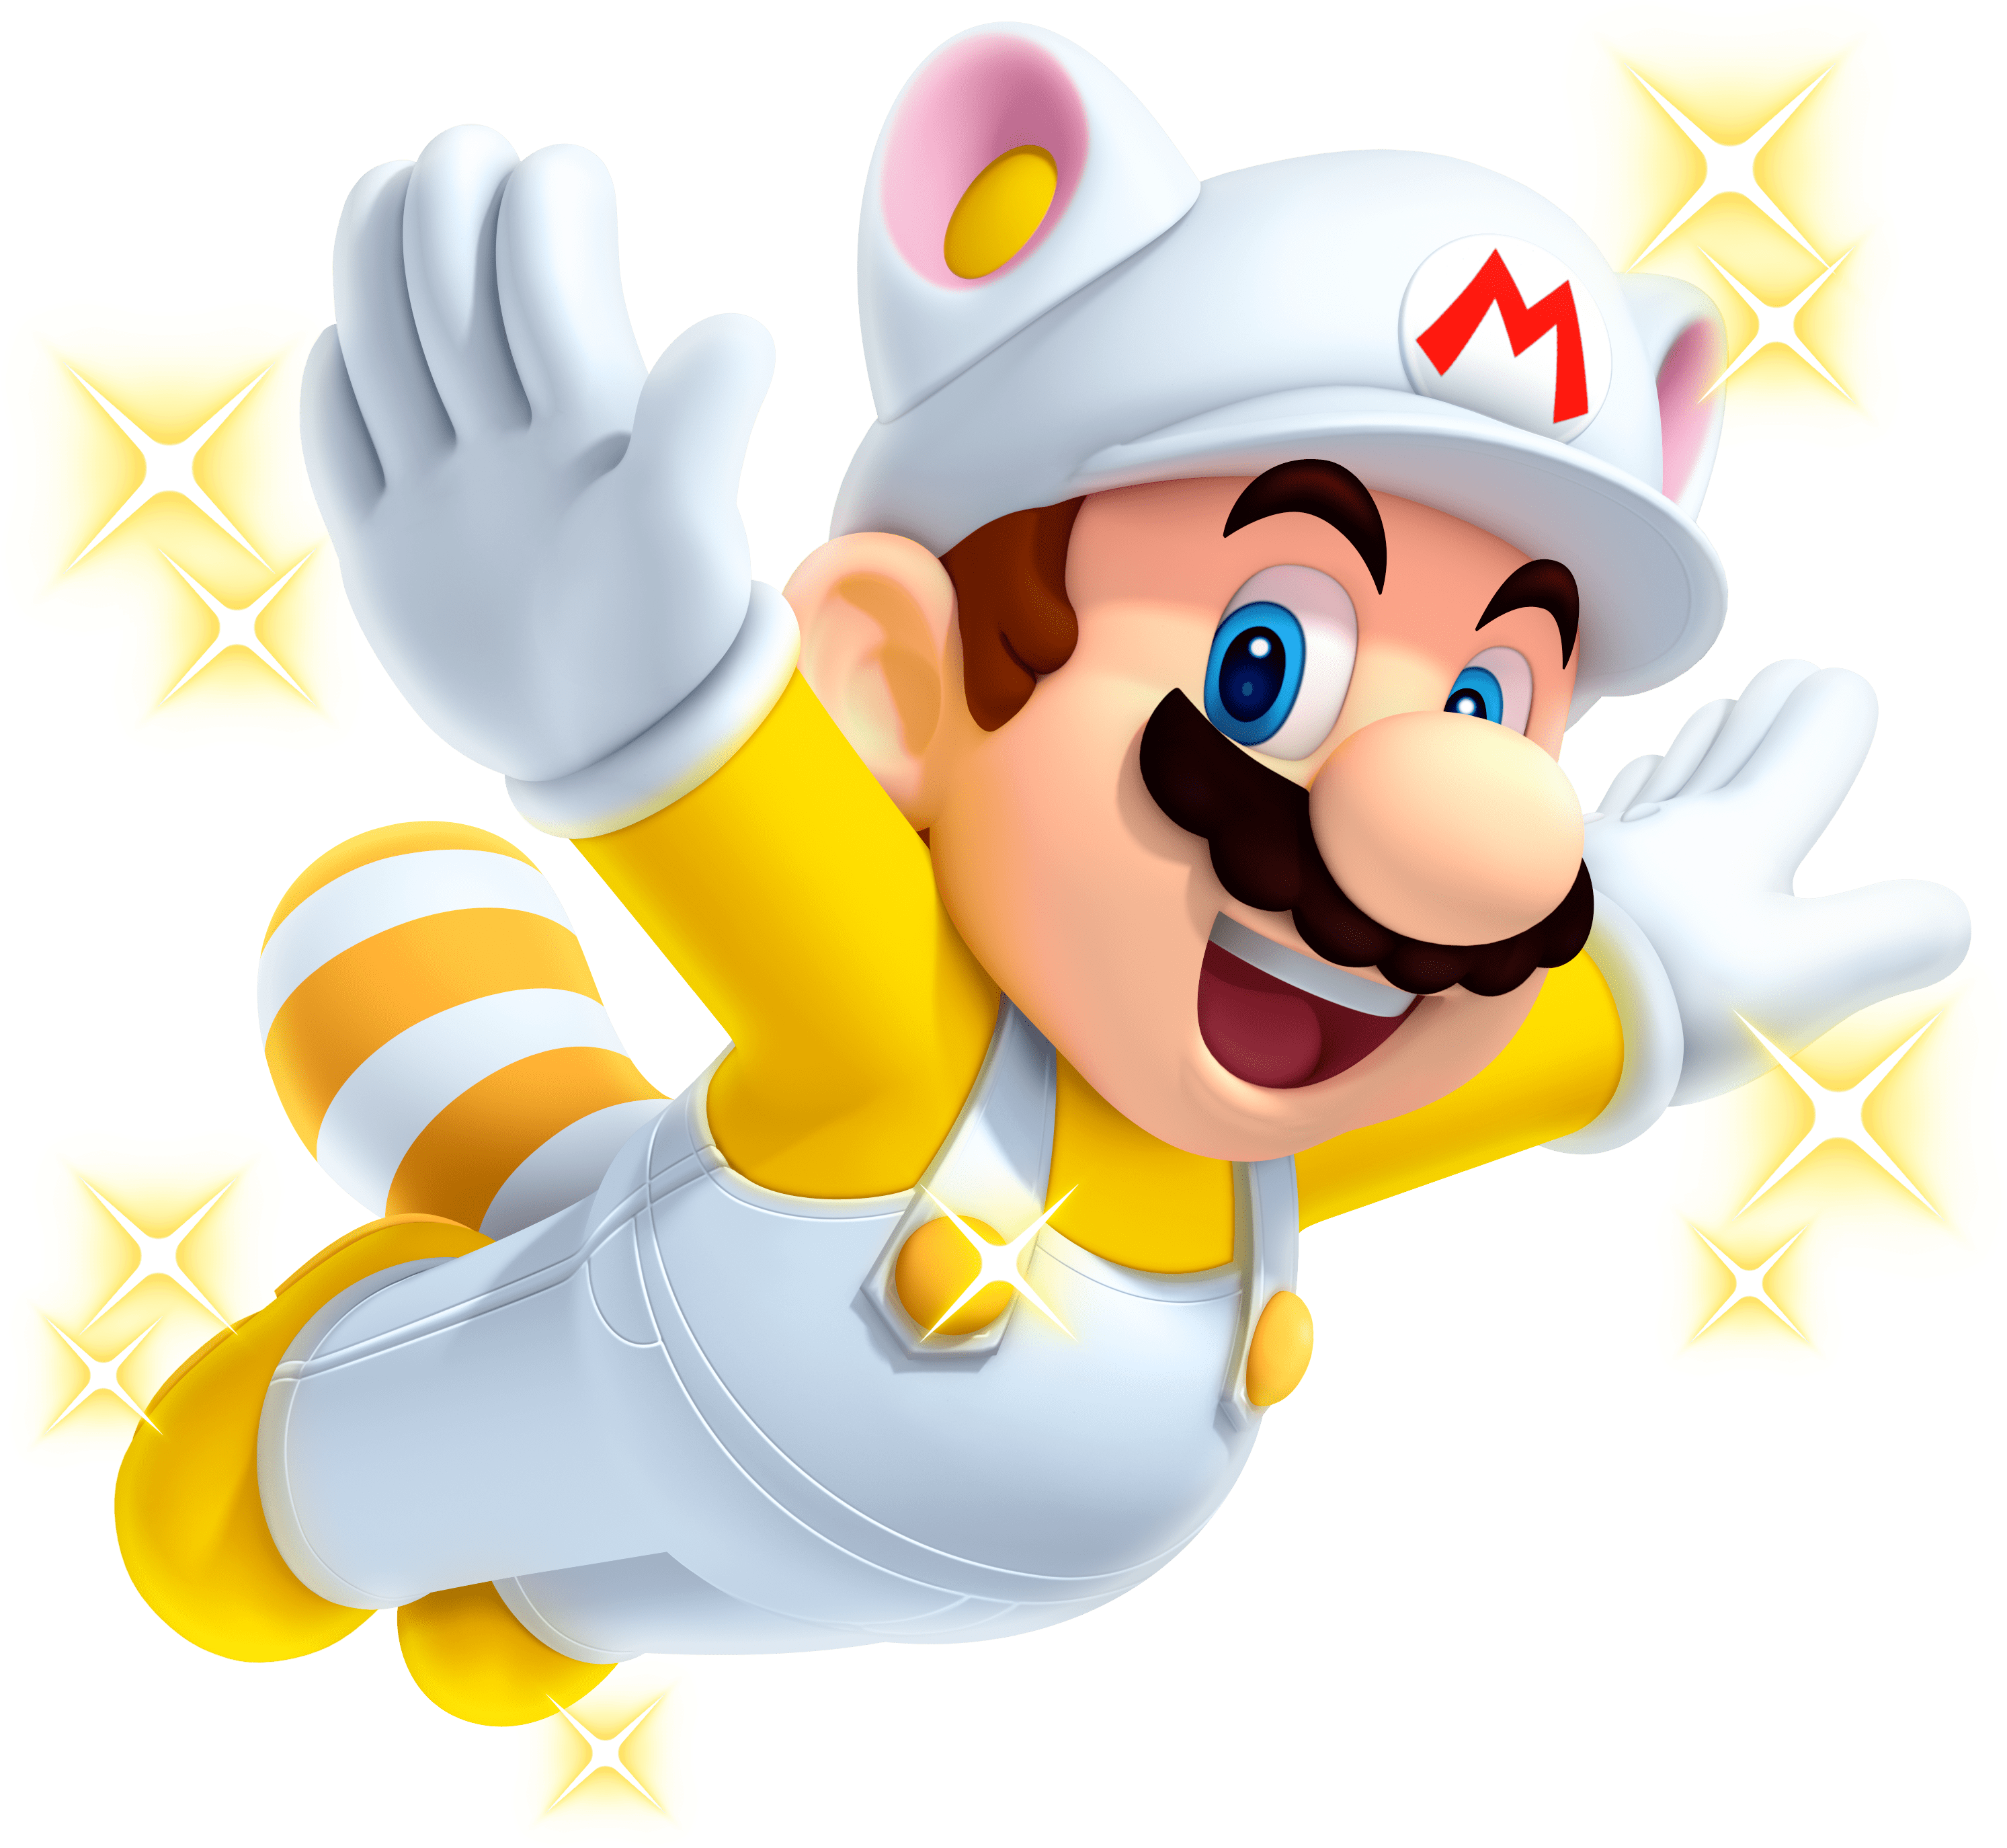
Summary

Slide 8
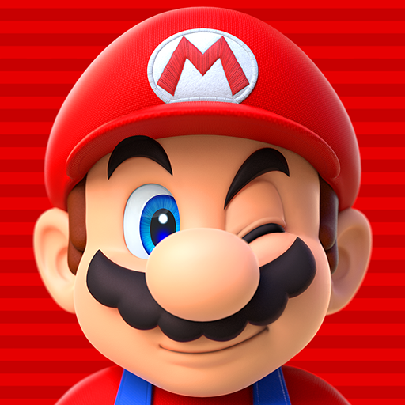
Any Questions?

