Slide 1

MAXIMISE MACHINE LEARNING

Slide 2

MAXIMISE MACHINE LEARNING

Slide 3
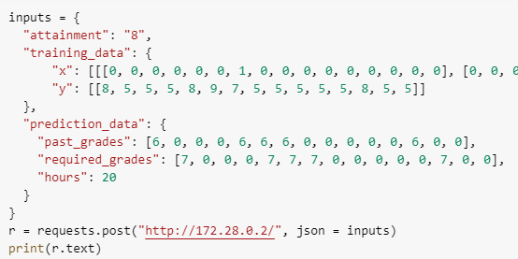
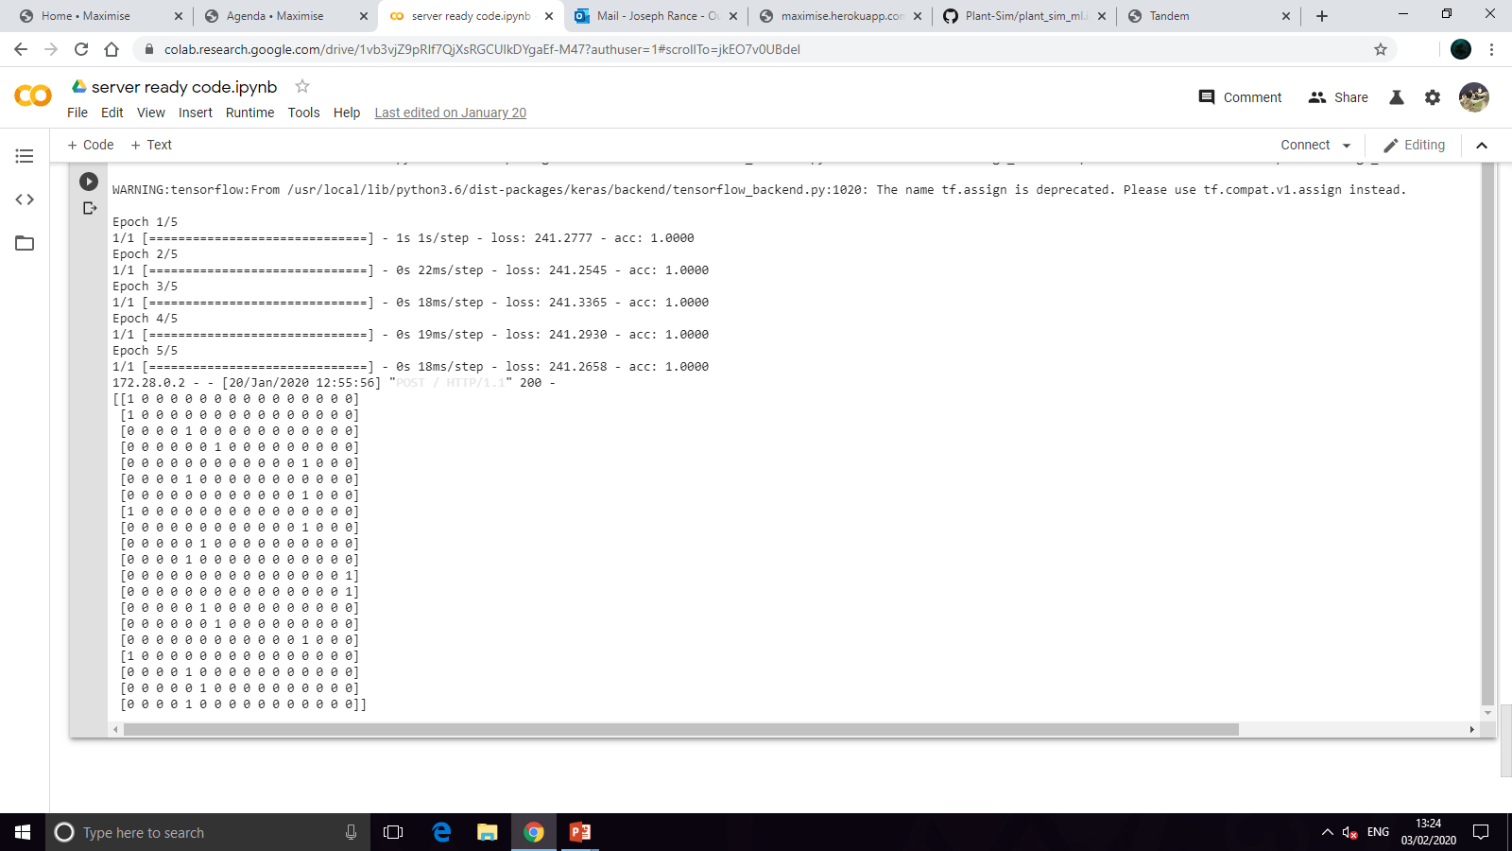
MAXIMISE MACHINE LEARNING
Aim:
To generate timetables for users by filling in timeslots they select given the data on the right.
Output:
Returns a OneHotEncoded array of what subject to revise for each timeslot

Slide 4
MAXIMISE MACHINE LEARNING
A closer look at the input
- Each time the model is used, we use a base model which is retrained with the data we have gathered on the user so we can personalize the experience
- The input data is a selection of the past and required grades for each subject the user is revising for
- The number of hours to revise for is also given
Base model selection data
Training data
Input data
Hours to generate for

Slide 5

MAXIMISE MACHINE LEARNING
A closer look at the output
- Each row in the array corresponds to one timeslot.
- each column corresponds to a subject (last one is a break)
- for each prediction

Slide 6
MAXIMISE MACHINE LEARNING
The Generator
The generator is what generates the timetable that we give the user. We have approached this as a reinforcement learning problem by making a value function (more on that later) that evaluates the effectiveness of any given timetable.
The generator’s job is to somehow find a highly effective timetable out of the billions of possible timetables.
This was achieved with evolutionary learning – a type of ML model that mimics natural selection to maximise the reward. This is definitely not the most effective solution but it is able to be cut down to a program that is quick to run but not as effective

Slide 7
MAXIMISE MACHINE LEARNING
The Generator
def predict(model, previous_grades, required_grades, timesteps):
variation = 0.1
generations = 3
best = [0 if required_grades[i] == 0 else required_grades[i] - previous_grades[i] for i in range(15)]
best.append(1)
variations = [0 if i == 0 else variation for i in previous_grades]
variations.append(variation)
random_outputs, no_tries = [], 30
for output in range(no_tries):
temp = []
for i in range(timesteps):
index = np.argmax(np.random.normal(best, variations))
temp.append(np.array([0 if i != index else 1 for i in range(16)]))
random_outputs.append(np.asarray(temp))
errors = []
for output in random_outputs:
y_true, y_pred = required_grades, model.predict(np.array([output]))[0]
error = sum([((y_true[i] - y_pred[i] + abs(y_true[i] - y_pred[i])) ** 2) / 4 for i in range(len(y_true))])
errors.append(error)
best = random_outputs[np.argmin(errors)]
for i in range(generations - 1):
random_outputs, no_tries = [best], 30
for output in range(no_tries):
temp = []
for i in range(timesteps):
index = np.argmax(np.random.normal(best[i], variations))
temp.append(np.array([0 if i != index else 1 for i in range(16)]))
random_outputs.append(np.asarray(temp))
errors = []
for output in random_outputs:
y_true, y_pred = required_grades, model.predict(np.array([output]))[0]
error = sum([((y_true[i] - y_pred[i] + abs(y_true[i] - y_pred[i])) ** 2) / 4 for i in range(len(y_true))])
errors.append(error)
best = random_outputs[np.argmin(errors)]
return best
Compute 30 timetables in the 1st generation
Evaluate & select best timetable
Randomly mutate best from previous generation
Evaluate & select best timetable. Then repeat.

Slide 8
MAXIMISE MACHINE LEARNING
The Critic
The role of the critic is to determine the value of each of the randomly generated or mutated timetables. This is where most of the real machine learning happens.
The critic trains from old timetables and the grades that the student achieved with them. It can then produce predicted grades from new timetables produced. The predicted grades can be passed through the below function to get a value for each timetable:
sum([((y_true[i] - y_pred[i] + abs(y_true[i] - y_pred[i])) ** 2) / 4 for i in range(len(y_true))])

Slide 9
MAXIMISE MACHINE LEARNING
The Critic architecture
Number of revision ‘periods’
Loss: Categoircal Crossentropy
Optimiser: Adam
Accuracy: 81%
Subject to revise
Subject to revise
Subject to revise
Subject to revise
Bidirectional LSTM
Bidirectional LSTM
Bidirectional LSTM
Bidirectional LSTM
Dense
Required Grades
Predicted grades
Value function
For training
For prediction

Slide 10





















MAXIMISE MACHINE LEARNING
We used the keras functional API as it provides a more flexible interface for model creation.
TensorFlow
TensorFlow is an open source platform for machine learning. We used TensorFlow as it allows us to quickly iterate over different solutions/hyperparameters as well as because TensorFlow models compile to C++, meaning they are better optimized than python code can be.
Companies that use TensorFlow
TensorFlow example dataflow from their GitHub Repo
>>> input_image = tf.constant([[[[1.], [1.], [2.], [4.]],
... [[2.], [2.], [3.], [2.]],
... [[4.], [1.], [1.], [1.]],
... [[2.], [2.], [1.], [4.]]]])
>>> output = tf.constant([[[[1], [0]],
... [[0], [1]]]])
>>> model = tf.keras.models.Sequential()
>>> model.add(tf.keras.layers.MaxPooling2D(pool_size=(2, 2),
... input_shape=(4,4,1)))
>>> model.compile('adam', 'mean_squared_error')
>>> model.predict(input_image, steps=1)
array([[[[2.],
[4.]],
[[4.],
[4.]]]], dtype=float32)
Get input
Define model
Compile & train model
Make predictions

Slide 11
MAXIMISE MACHINE LEARNING
Final code
from keras.layers import Dense, LSTM, Input, Dropout, Bidirectional
from keras.models import Model, load_model
import numpy as np
import random as rand
from math import log10, log
import datetime
import firebase_admin
from firebase_admin import credentials, storage
from urllib.request import urlretrieve
from flask import Flask, request
import json
import threading
import requests
def retrain(model, data, epochs):
x_train = data[0]
y_train = data[1]
model.fit(np.array(x_train), np.array(y_train), epochs=epochs)
return model
def predict(model, previous_grades, required_grades, timesteps):
variation = 0.1
generations = 3
best = [0 if required_grades[i] == 0 else required_grades[i] - previous_grades[i] for i in range(15)]
best.append(1)
variations = [0 if i == 0 else variation for i in previous_grades]
variations.append(variation)
random_outputs, no_tries = [], 30
for output in range(no_tries):
temp = []
for i in range(timesteps):
index = np.argmax(np.random.normal(best, variations))
temp.append(np.array([0 if i != index else 1 for i in range(16)]))
random_outputs.append(np.asarray(temp))
errors = []
for output in random_outputs:
y_true, y_pred = required_grades, model.predict(np.array([output]))[0]
error = sum([((y_true[i] - y_pred[i] + abs(y_true[i] - y_pred[i])) ** 2) / 4 for i in range(len(y_true))])
errors.append(error)
best = random_outputs[np.argmin(errors)]
for i in range(generations - 1):
random_outputs, no_tries = [best], 30
for output in range(no_tries):
temp = []
for i in range(timesteps):
index = np.argmax(np.random.normal(best[i], variations))
temp.append(np.array([0 if i != index else 1 for i in range(16)]))
random_outputs.append(np.asarray(temp))
errors = []
for output in random_outputs:
y_true, y_pred = required_grades, model.predict(np.array([output]))[0]
error = sum([((y_true[i] - y_pred[i] + abs(y_true[i] - y_pred[i])) ** 2) / 4 for i in range(len(y_true))])
errors.append(error)
best = random_outputs[np.argmin(errors)]
return best
def start(subjects):
attainments = [5,6,7,8]
models = []
for attainment in attainments:
x_train, y_train, x_test, y_test = simulate_users(attainment, subjects)
input_shape = None, x_train.shape[2]
output_shape = y_train.shape[1]
model = build_model(input_shape, output_shape)
model.fit(x_train, y_train, epochs=250, batch_size=2800, validation_data=(x_test, y_test))
models.append(model)
return models
def simulate_users(attainment, subjects):
variation = 0
datapoints, periods = 3000, 10
x, subject_idxs = generate_input_data(subjects, periods, datapoints, attainment)
y = generate_output_data(x, attainment, variation, subject_idxs)
y = format_output_data(y)
x_test, x_train = x[:200], x[200:]
y_test, y_train = y[:200], y[200:]
return x_train, y_train, x_test, y_test
def build_model(input_shape, output_shape):
input_subject = Input(shape=(input_shape))
layer_1 = Bidirectional(LSTM(128, recurrent_dropout=0.7))(input_subject)
output = Dense(output_shape, activation='sigmoid')(layer_1)
model = Model(input_subject, output)
model.compile(loss="categorical_crossentropy", optimizer='adam', metrics=['accuracy'])
return model
def generate_input_data(subjects, periods, datapoints, attainment):
x, list_of_subject_idxs = [], []
for i in range(datapoints):
subject_idxs = rand.sample(range(15), subjects)
subject_idxs_with_rests = [i for i in subject_idxs]
subject_idxs_with_rests.append(15)
list_of_subject_idxs.append(subject_idxs)
datapoint = []
for i in range(periods):
subject_idx = rand.choice(subject_idxs_with_rests)
subject_ohe = np.linspace(0, 0, 16)
subject_ohe[subject_idx] = 1
datapoint.append(subject_ohe)
datapoint = np.asarray(datapoint)
x.append(datapoint)
x = np.asarray(x)
return x, list_of_subject_idxs
def generate_output_data(x, attainment, variation, subject_idxs):
dist_weighting = -0.02
adj_break_weighting = 0.6
adj_subj_weighting = -0.2
y = []
for j, datapoint in enumerate(x):
length = len(datapoint)
efficient_time_studied, grade = [0 for i in range(16)], [0 for i in range(15)]
for i, period in enumerate(datapoint):
distance = length - i
rest, same = 0, 0
if np.argmax(datapoint[i - 1]) == 15:
rest = 1
elif np.argmax(datapoint[i - 1]) == np.argmax(period):
same = 1
efficient_time_studied[np.argmax(period)] += 1 + dist_weighting * distance + adj_break_weighting * rest + adj_subj_weighting * same
for i in subject_idxs[j]:
grade[i] = np.random.normal((2.37089 + 0.602646 * attainment + (3.63039 - 0.330035 * attainment) * log(0.3 + 0.9 * efficient_time_studied[i])), variation)
for i in range(len(grade)):
if grade[i] == 0.:
grade[i] = 5.
y.append(grade)
y = np.asarray(y)
return y
def format_output_data(y_unformatted):
y_formatted = y_unformatted / 9
return y_formatted
def generate_timetable(inputs):
epochs = len(inputs["training_data"]["x"]) * 5 ## this multiplier can be optimised
if inputs["training_data"]["x"] != []:
model = retrain(load_model("model_attainment_" + inputs["attainment"] + ".h5"), (inputs["training_data"]["x"], inputs["training_data"]["y"]), epochs)
else:
model = load_model("model_attainment_" + inputs["attainment"] + ".h5")
output = predict(model, inputs["prediction_data"]["past_grades"], inputs["prediction_data"]["required_grades"], inputs["prediction_data"]["hours"])
return output
## To make the models (they should be in firebase so this is commented out)
'''
models = start(8)
for i in range(4):
filename = "model_attainment_" + str(i + 5) + ".h5"
models[i].save(filename)
'''
## firebase credentials
credentials_for_json = {
"type": "service_account",
"project_id": "maximise-uk",
"private_key_id": " REMOVED ",
"private_key": " REMOVED ",
"client_email": “ REMOVED ",
"client_id": " REMOVED ",
"auth_uri": " REMOVED ",
"token_uri": " REMOVED ",
"auth_provider_x509_cert_url": " REMOVED ",
"client_x509_cert_url": " REMOVED "
}
with open("credentials.json", "w") as write_file:
json.dump(credentials_for_json, write_file)
## load models from firebase on startup
cred = credentials.Certificate("credentials.json")
app = firebase_admin.initialize_app(cred, {
'storageBucket': 'maximise-uk.appspot.com',
}, name='storage')
bucket = storage.bucket(app=app)
for i in range(5, 9):
blob = bucket.blob(f"model_attainment_{i}.h5")
urlretrieve(blob.generate_signed_url(datetime.timedelta(seconds=300), method='GET'), f'model_attainment_{i}.h5')
## run flask program that runs the ml function
#print(socket.gethostbyname(socket.getfqdn(socket.gethostname())))
app = Flask(__name__)
@app.route("/", methods=["POST"])
def generate_ml():
inputs = request.get_json()
output = generate_timetable(inputs)
return str(output)
threading.Thread(target=app.run, kwargs={'host':'0.0.0.0','port':80}).start()
## make a request
inputs = {
"attainment": "8",
"training_data": {
"x": [[[0, 0, 0, 0, 0, 0, 1, 0, 0, 0, 0, 0, 0, 0, 0, 0], [0, 0, 0, 0, 0, 0, 0, 0, 0, 0, 0, 0, 1, 0, 0, 0], [0, 0, 0, 0, 0, 1, 0, 0, 0, 0, 0, 0, 0, 0, 0, 0], [1, 0, 0, 0, 0, 0, 0, 0, 0, 0, 0, 0, 0, 0, 0, 0], [0, 0, 0, 0, 0, 1, 0, 0, 0, 0, 0, 0, 0, 0, 0, 0], [0, 0, 0, 0, 1, 0, 0, 0, 0, 0, 0, 0, 0, 0, 0, 0], [1, 0, 0, 0, 0, 0, 0, 0, 0, 0, 0, 0, 0, 0, 0, 0], [0, 0, 0, 0, 0, 1, 0, 0, 0, 0, 0, 0, 0, 0, 0, 0], [0, 0, 0, 0, 1, 0, 0, 0, 0, 0, 0, 0, 0, 0, 0, 0], [0, 0, 0, 0, 0, 0, 0, 0, 0, 0, 0, 0, 1, 0, 0, 0]]],
"y": [[8, 5, 5, 5, 8, 9, 7, 5, 5, 5, 5, 5, 8, 5, 5]]
},
"prediction_data": {
"past_grades": [6, 0, 0, 0, 6, 6, 6, 0, 0, 0, 0, 0, 6, 0, 0],
"required_grades": [7, 0, 0, 0, 7, 7, 7, 0, 0, 0, 0, 0, 7, 0, 0],
"hours": 20
}
}
r = requests.post("http://172.28.0.2/", json = inputs)
print(r.text)

