Slide 1


Introduction to Rust
Not the chemical compound, not the video game…
the programming language.

Slide 2
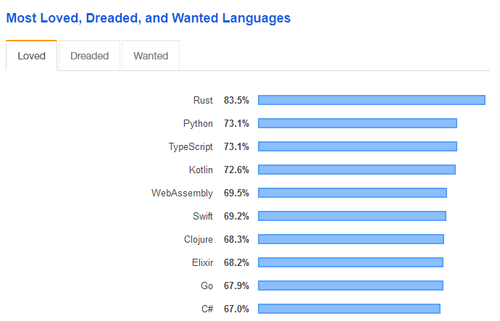
StackOverflow Developer Survey
? ? ? ? ?

Slide 3
StackOverflow Developer Survey
? ? ? ? ?

Slide 4
StackOverflow Developer Survey
For the fourth year in a row, Rust is the most loved programming language among our respondents, followed close behind by Python, the fastest-growing major language today. This means that proportionally, more developers want to continue working with these than other languages.

Slide 5
Why is Rust so loved?
It compiles to a binary executable – no slow fancy runtime like the JVM and no time wasted interpreting like Python.
No garbage collector (more on that soon).
Memory and thread safety.
Intelligent compiler and borrow checker identify errors before they happen (runtime errors in other languages become compile time errors in Rust).
Cargo
Older C and C++ developers who have grown sick and tired of use-after-frees and segfaults absolutely love it

Slide 6
Rust is not garbage

Slide 7
Rust is not garbage (collected)
If you don’t get rid of unused variables, they will sit around in memory and cause it to fill up with “garbage”.
Variables in memory can either be created in the stack or the heap.
In languages like C and C++, variables on the stack are automatically freed once they go out of scope (the curly brackets inside which they were defined). Example

Slide 8
Rust is not garbage (collected)
But that only works if the size of the variable is known in advance. So in C#, it would work for an array of fixed length, but not for a List.
So variables like Lists are stored on the heap instead of the stack. These variables can change size as needed, but it all has to be done manually.
Sometimes the programming language is smart enough to do it for you – this is called garbage collection, and it’s the reason that you don’t need to worry too much about memory safety in Python or C#.

Slide 9
Rust is not garbage (collected)
Garbage collection is pretty slow compared to manual memory management.
Rust takes a different approach – it hasn’t got manual memory management but it also doesn’t have garbage collection.
Instead, it uses ownership. With this system, dynamically sized variables are owned by the function they are declared in. When a function is called with a dynamically sized argument, the receiving function takes ownership of the variable, meaning that the original function can’t use it anymore. Example

Slide 10
Why does it have to be so hard?!
Rust is notoriously a difficult language to learn, because it uses complex concepts like ownership.
The genius of ownership is that after the Rust developers implemented it in order to avoid having garbage collection, they realised they had “accidentally” solved another problem – data races.
Rust does not have Object Oriented Programming. Instead, it uses structs combined with a traits (interfaces).

Slide 11
Why I use Rust
As powerful and performant as C++, but with syntax comparable to C# or Java.
You can use it like you use Python, knowing that you’ll never have unsafe code; or you can use it like C – you can even have assembly code inside a Rust file!
Very active development – somehow the Rust developers can still come up with new powerful concepts to add to the language, years after it was first released.
I still haven’t learnt it all – I’m yet to explore features such as lifetimes, closures and macros.

Slide 12
Top projects using Rust
Servo – a browser engine (like Chromium) which Mozilla is developing for the purpose of integrating it in Firefox
Amethyst – a fully featured game engine
Rocket – a web framework (like Django/Flask/Express)
Redox – an entire operating system written completely in Rust, with a modern GUI
TensorFlow bindings – official WIP Rust bindings to TensorFlow
Maximise – fantastic REST API written in Rust by me for a Young Enterprise project

Slide 13
The future of Rust
WebAssembly – JavaScript is slow and boring in the browser, so why not use Rust?
Firefox – Mozilla is the organisation behind Rust in the first place.
Verona – Microsoft has a habit of copying languages. First it copied Java, which resulted in C#. Now it’s copying Rust.
Games – Some guy who made a game called “Ready at Dawn” said he’d be switching to Rust from C/C++, which has a lot of game developers excited.
Embedded systems

