Slide 1


How to implement and train a cognitive chatbot using the Bluemix cloud platform
Uwe Fassnacht
November 15, 2016

Slide 2
Filing a claim online

Slide 3
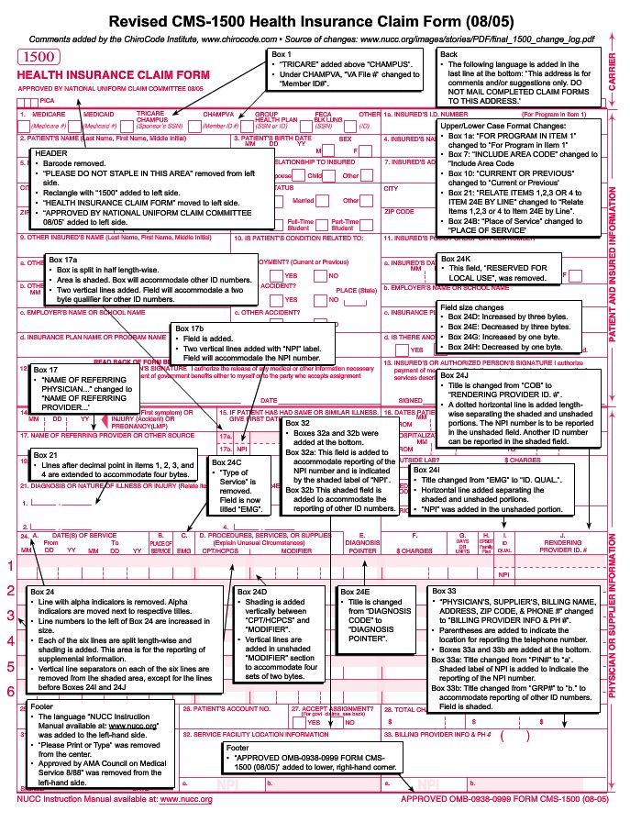
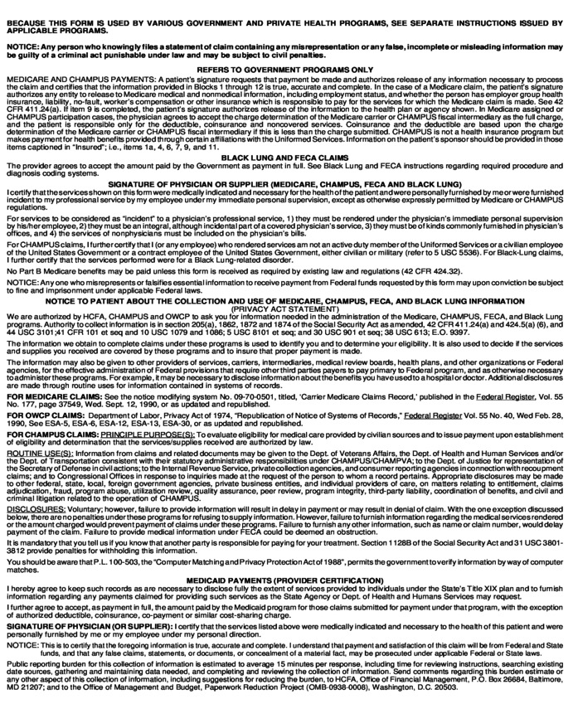
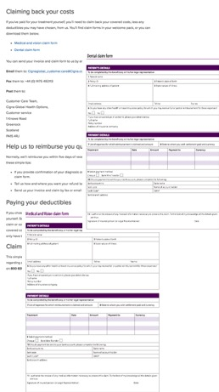
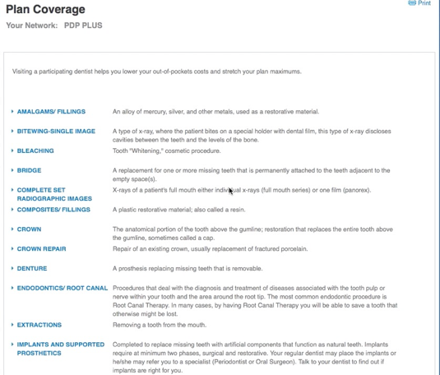

Slide 4

How about a chatbot instead?

Slide 5





CUSTOMER
iOS APP SWIFT
BOT APPLICATION
DATABASE
CONVERSATION
APPLICATION

Slide 6
IBM Bluemix
Domain
Services
Block Chain
Mobile
Cognitive
IoT
Health
Video
Developer
Services
App Services
Integration
Data & Analytics
Dev Ops Tooling
Security & Compliance
Virtual Machines
Containers
Cloud Foundry
Event-Driven
Methods & Services
Infrastructure
Services
Compute
Storage
Network
Physical Infrastructure
Public
Dedicated
Local
Multi-Tenant
Single-Tenant
Client DC & HW

Slide 7
Bluemix live

Slide 8

CUSTOMER
iOS APP SWIFT
BOT MICROSERVICE
MONGO DB
WATSON CONVERSATION

Slide 9
Let’s chat

Slide 10

CUSTOMER
iOS APP SWIFT
BOT MICROSERVICE
DASHBOARD MICROSERVICE
DASHBOARD
ADMIN
MONGO DB
WATSON CONVERSATION

Slide 11
Admin dashboard live

Slide 12
But when do we hand off to a human?
The bot hands off when it’s stumped
We monitor the customers emotions

Slide 13
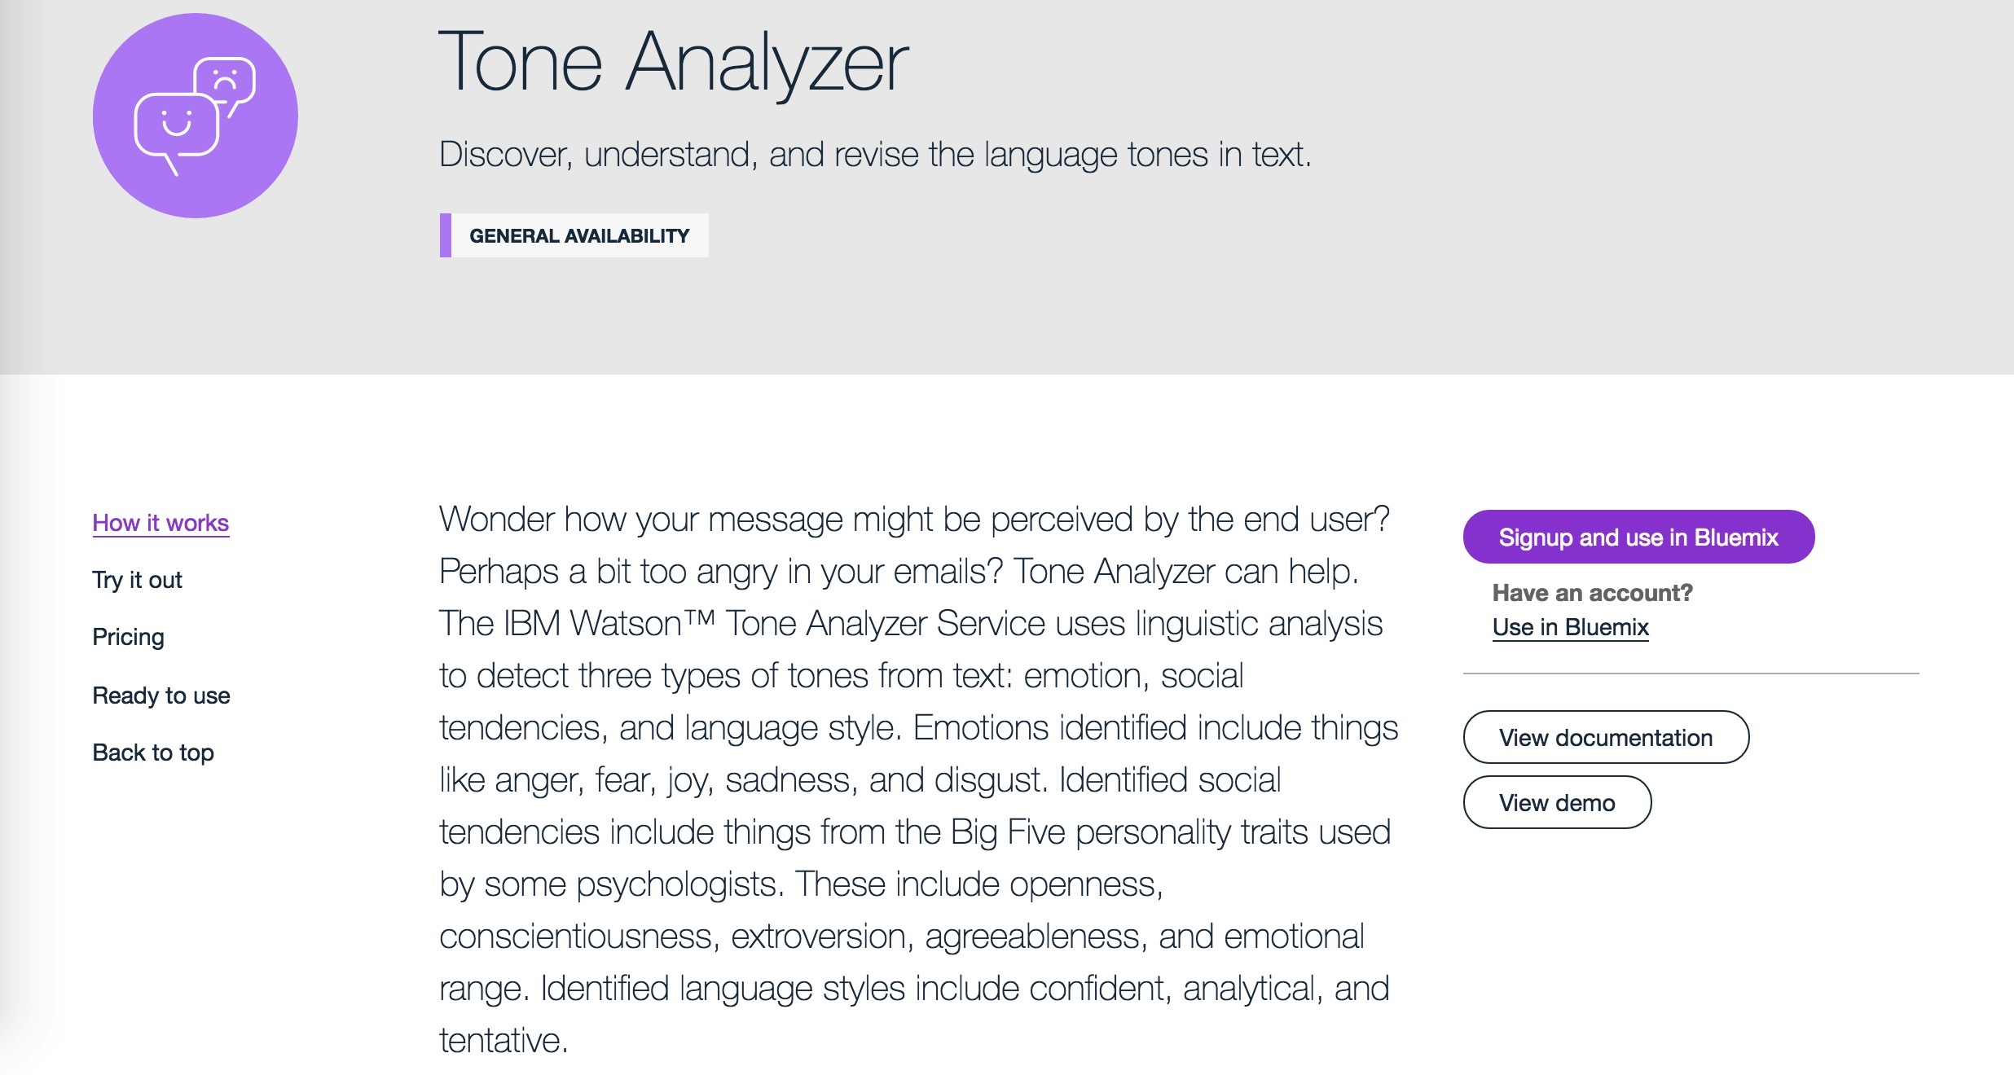

Slide 14

CUSTOMER
iOS APP SWIFT
BOT MICROSERVICE
DASHBOARD MICROSERVICE
DASHBOARD
ADMIN
MONGO DB
WATSON CONVERSATION
WATSON TONE ANALYSIS

Slide 15
Tone Analysis live

Slide 16
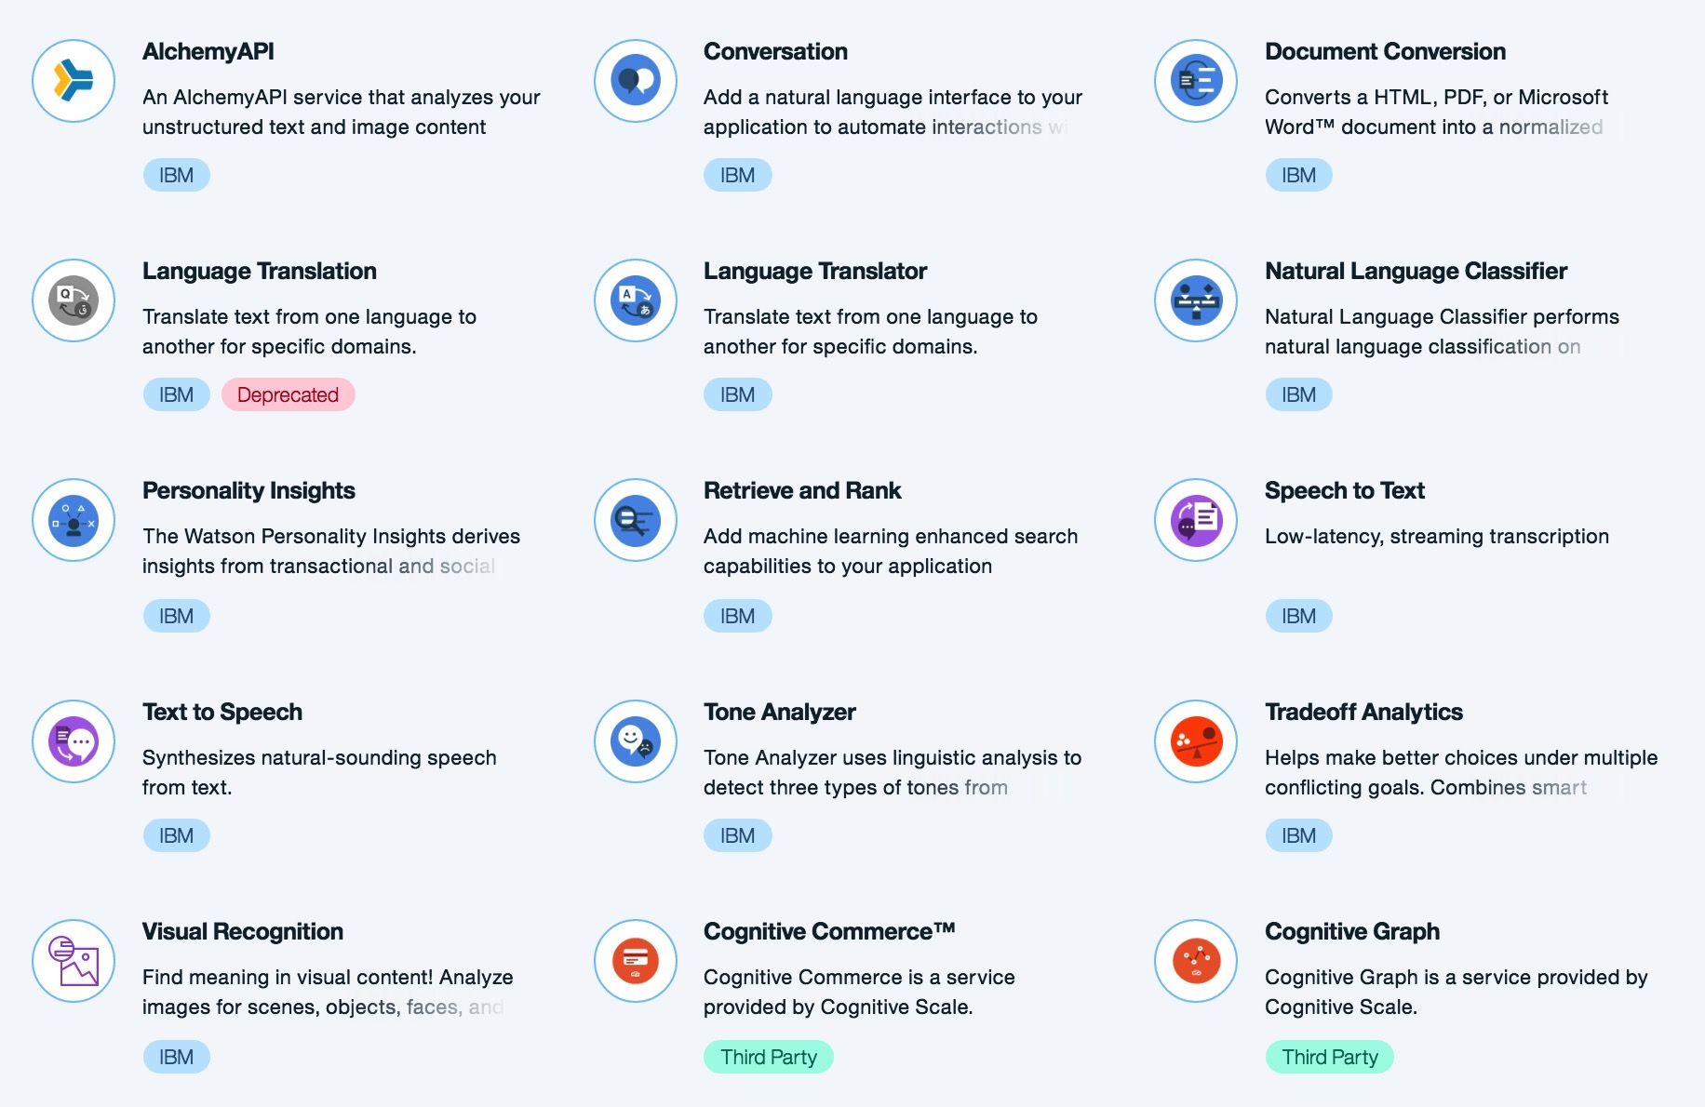
What’s next?

Slide 17
In Conclusion
Bluemix allows very rapid assembly of cloud and mobile apps
Services can be used “off the shelf” and combined easily
Cognitive services can free human support from routine work and allow them to concentrate on higher business value

Slide 18
Learn More
IBM Bluemix:
https://www.ibm.com/bluemix
Code for the Demo:
https://github.com/IBM-Bluemix/cloudco-insurance
Watson Conversation Service:
https://www.ibm.com/watson/developercloud/conversation.html
Watson Tone Analyzer:
https://www.ibm.com/watson/developercloud/tone-analyzer.html

Slide 19

Thank You

