Slide 1
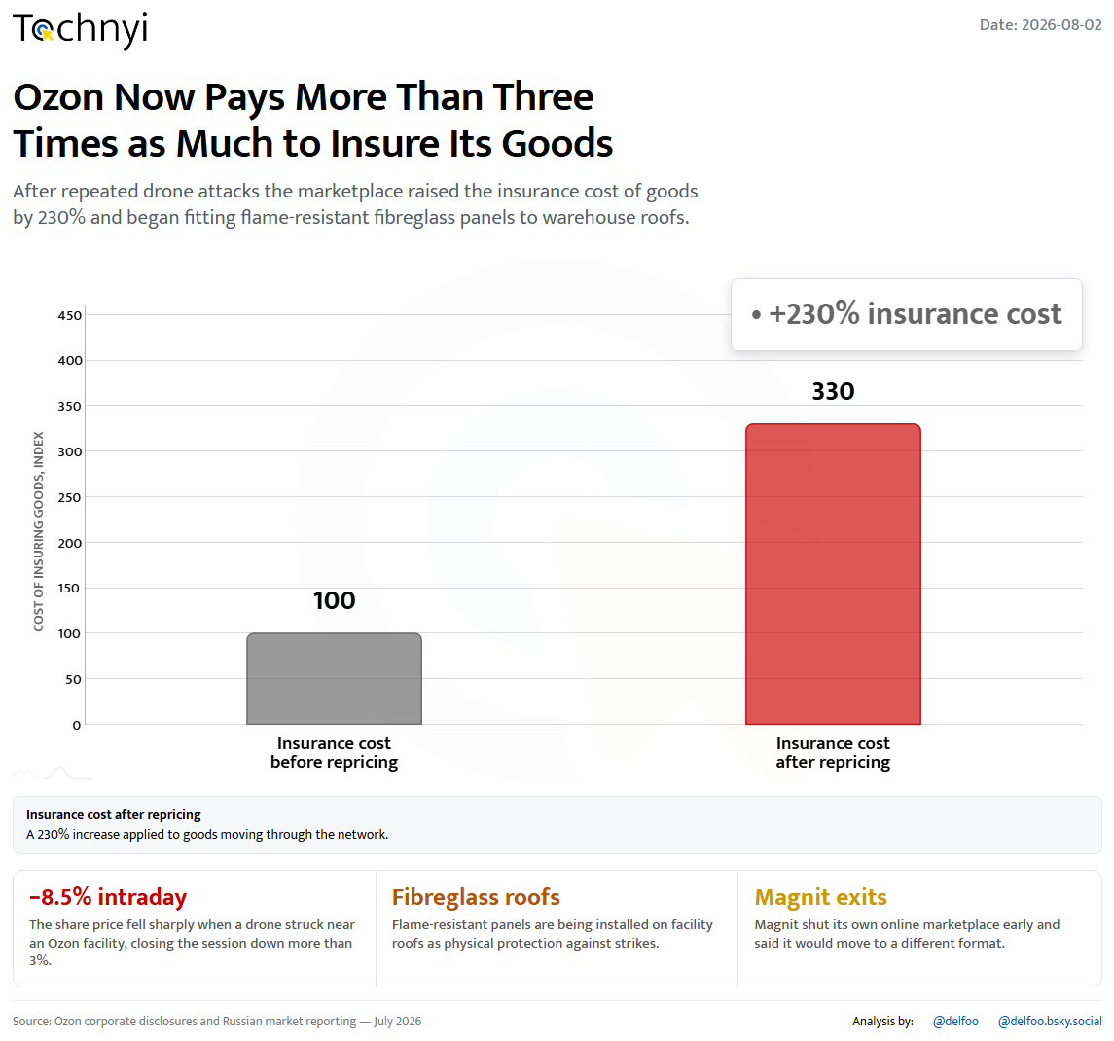
01 / 25
Tochnyi · Week 31, 2026
Notes:
Ozon reprices war risk

Slide 2
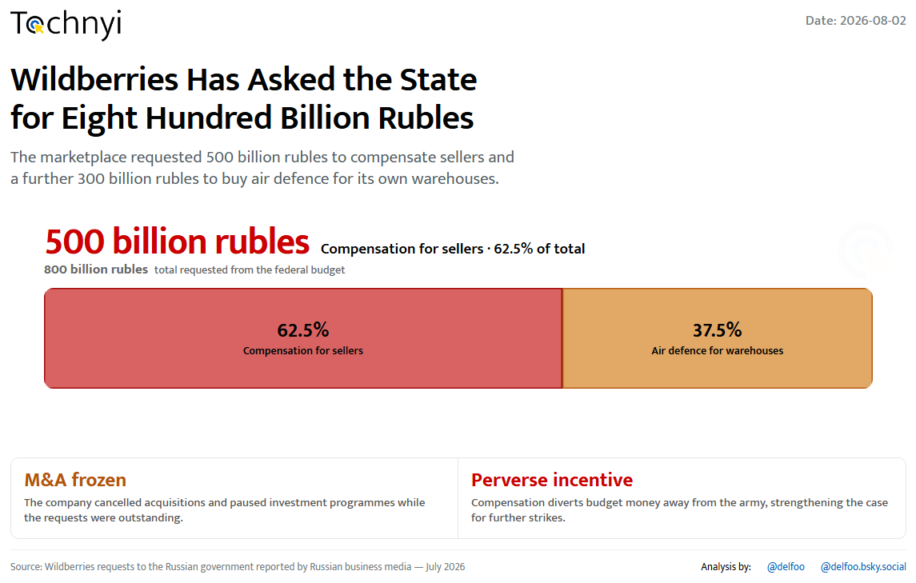
02 / 25
Tochnyi · Week 31, 2026
Notes:
Wildberries asks for 800 billion

Slide 3
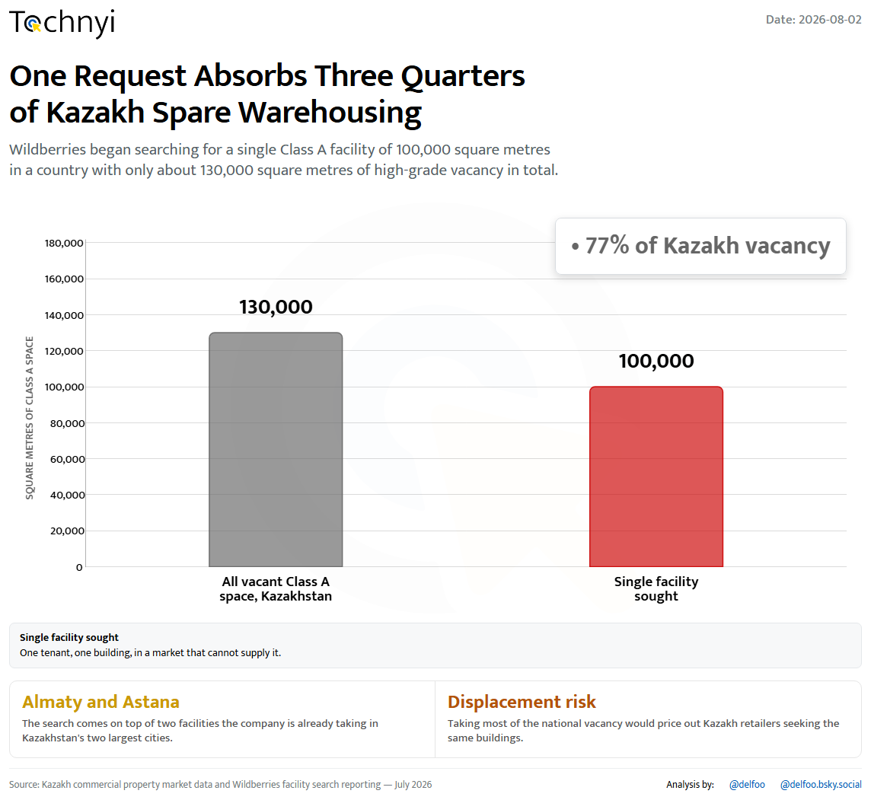
03 / 25
Tochnyi · Week 31, 2026
Notes:
A request Kazakhstan cannot fill

Slide 4
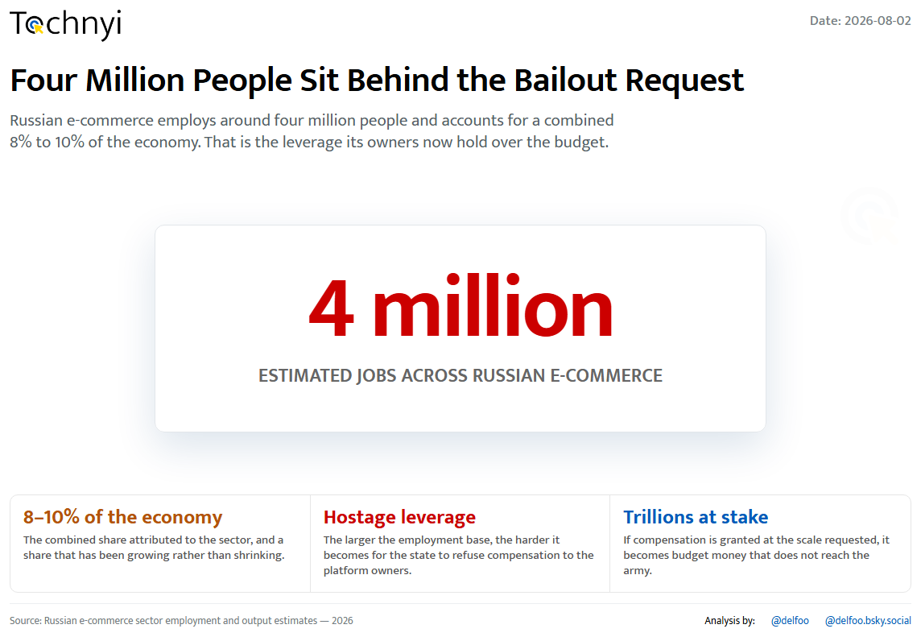
04 / 25
Tochnyi · Week 31, 2026
Notes:
Four million jobs behind the ask

Slide 5
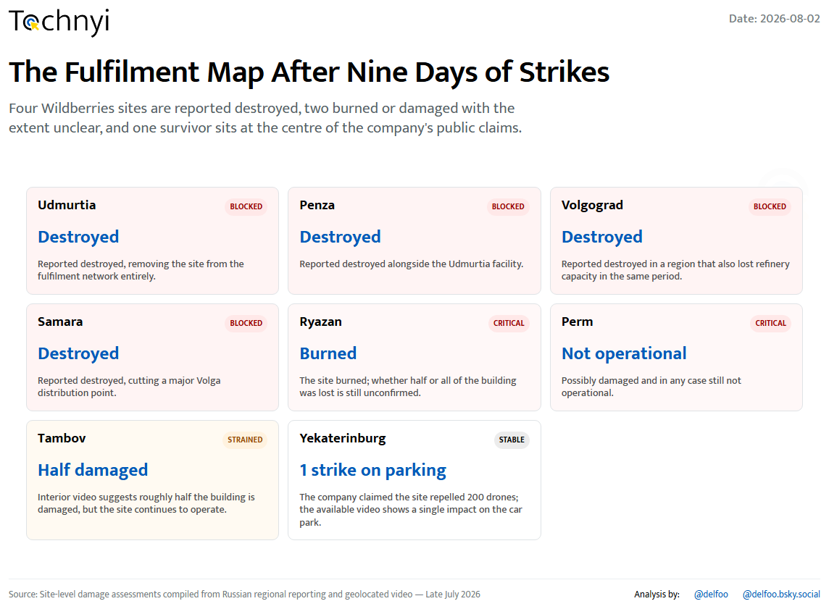
05 / 25
Tochnyi · Week 31, 2026
Notes:
The fulfilment map after the strikes

Slide 6
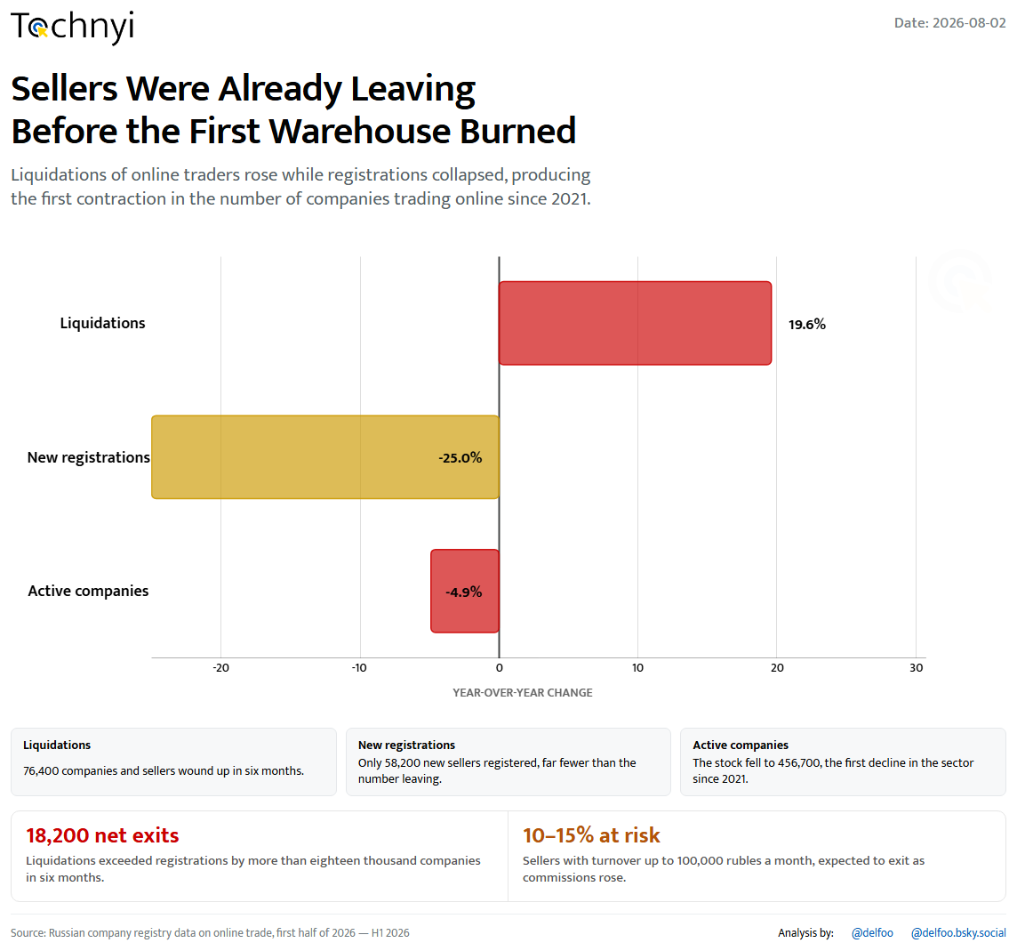
06 / 25
Tochnyi · Week 31, 2026
Notes:
Sellers were already leaving

Slide 7
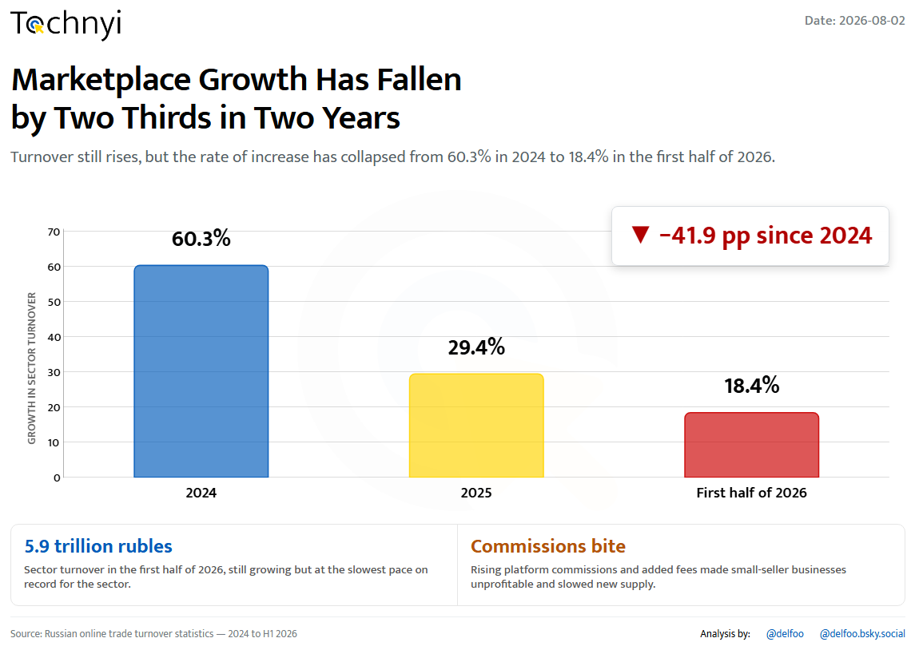
07 / 25
Tochnyi · Week 31, 2026
Notes:
Marketplace growth collapses

Slide 8
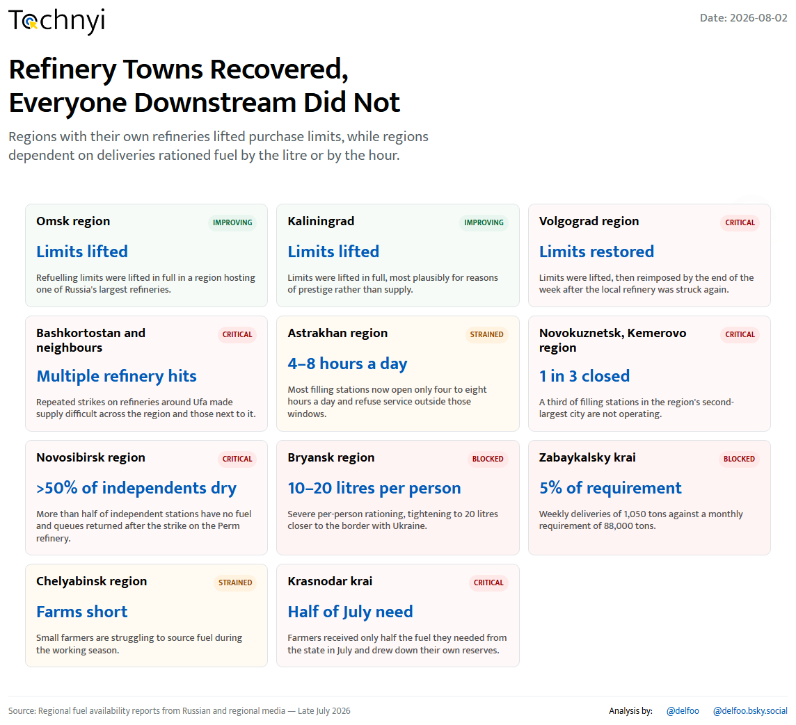
08 / 25
Tochnyi · Week 31, 2026
Notes:
Fuel: refinery towns vs everyone else

Slide 9
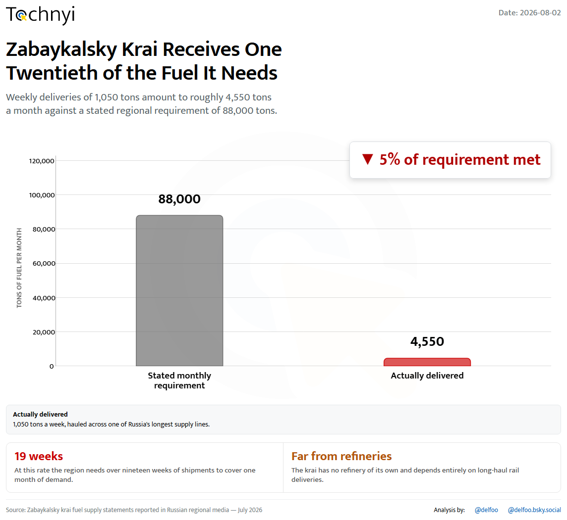
09 / 25
Tochnyi · Week 31, 2026
Notes:
Zabaykalsky krai runs dry

Slide 10
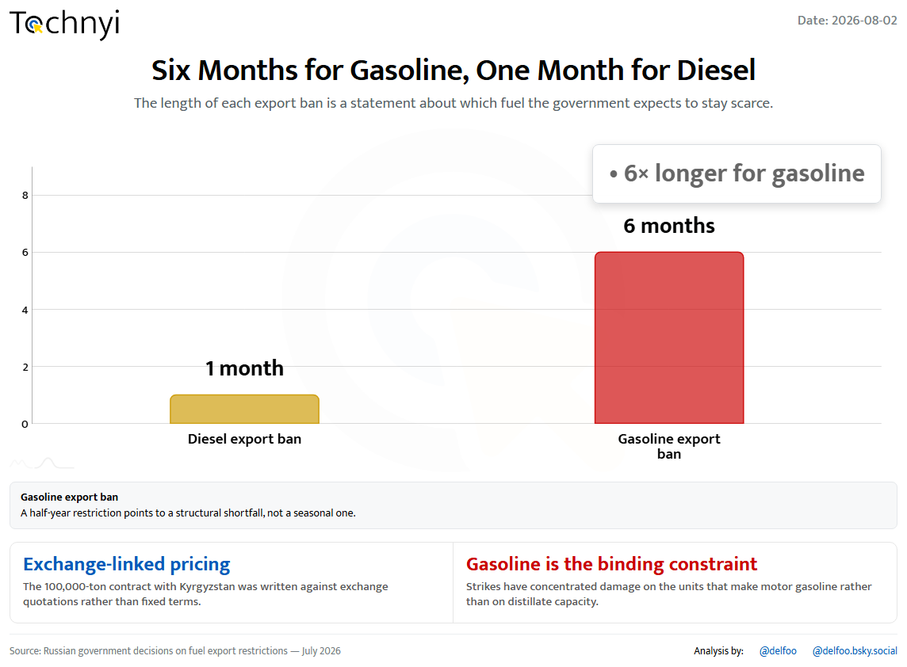
10 / 25
Tochnyi · Week 31, 2026
Notes:
Six months for gasoline, one for diesel

Slide 11
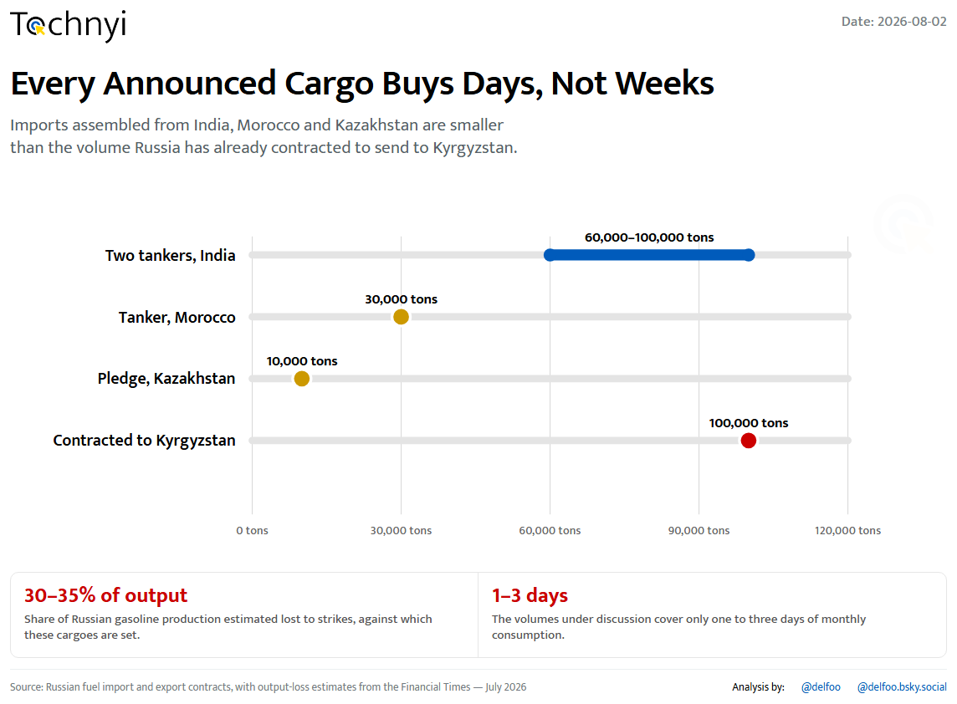
11 / 25
Tochnyi · Week 31, 2026
Notes:
Imports that buy days, not weeks

Slide 12
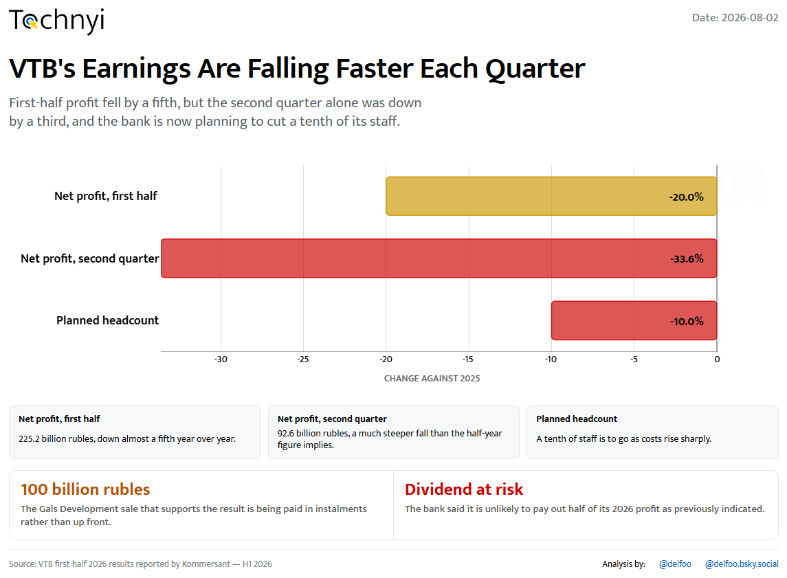
12 / 25
Tochnyi · Week 31, 2026
Notes:
VTB earnings fall faster

Slide 13
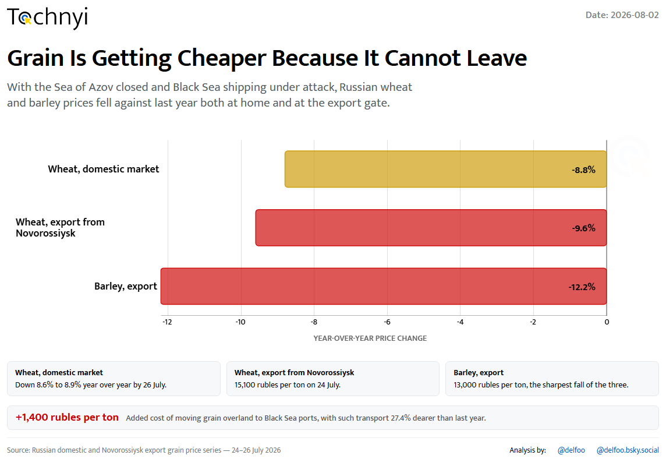
13 / 25
Tochnyi · Week 31, 2026
Notes:
Grain cheapens as routes close

Slide 14
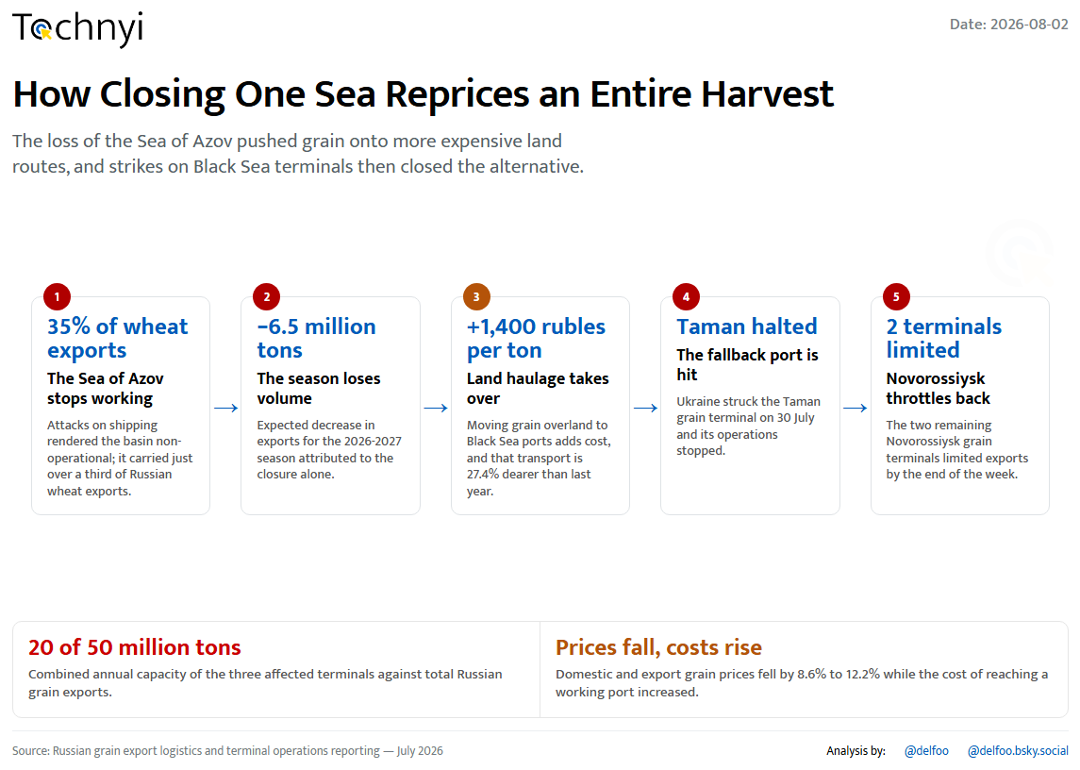
14 / 25
Tochnyi · Week 31, 2026
Notes:
Closing one sea reprices a harvest

Slide 15
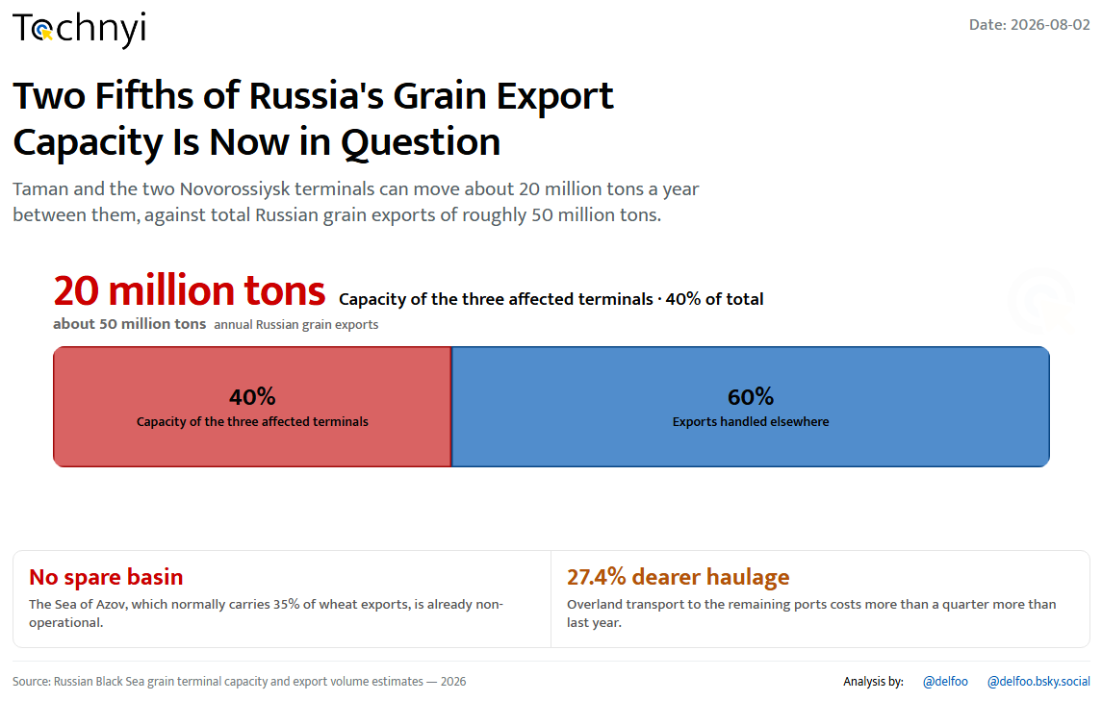
15 / 25
Tochnyi · Week 31, 2026
Notes:
Two fifths of export capacity

Slide 16
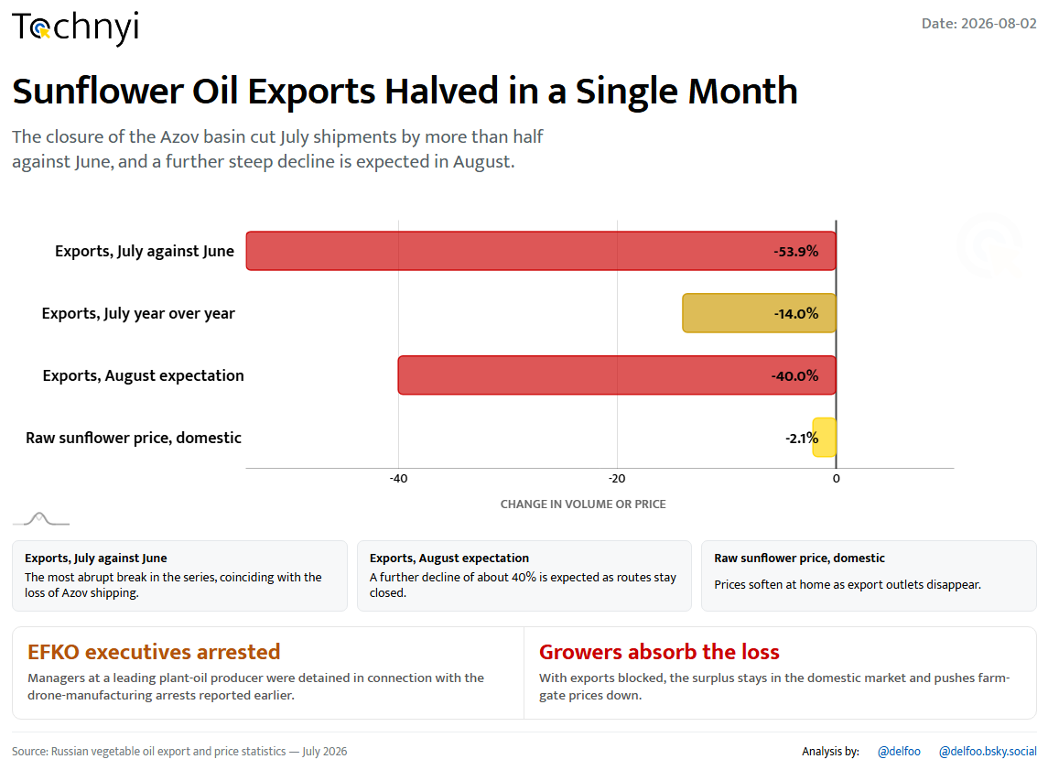
16 / 25
Tochnyi · Week 31, 2026
Notes:
Sunflower oil exports halve

Slide 17
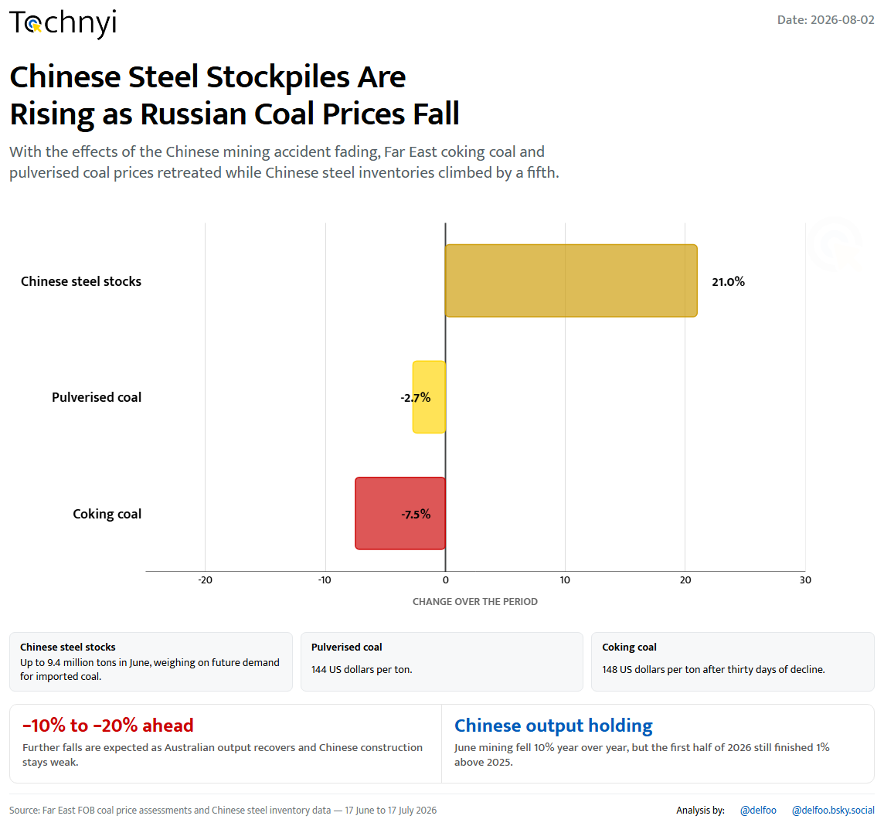
17 / 25
Tochnyi · Week 31, 2026
Notes:
Coal prices fall, Chinese stocks rise

Slide 18
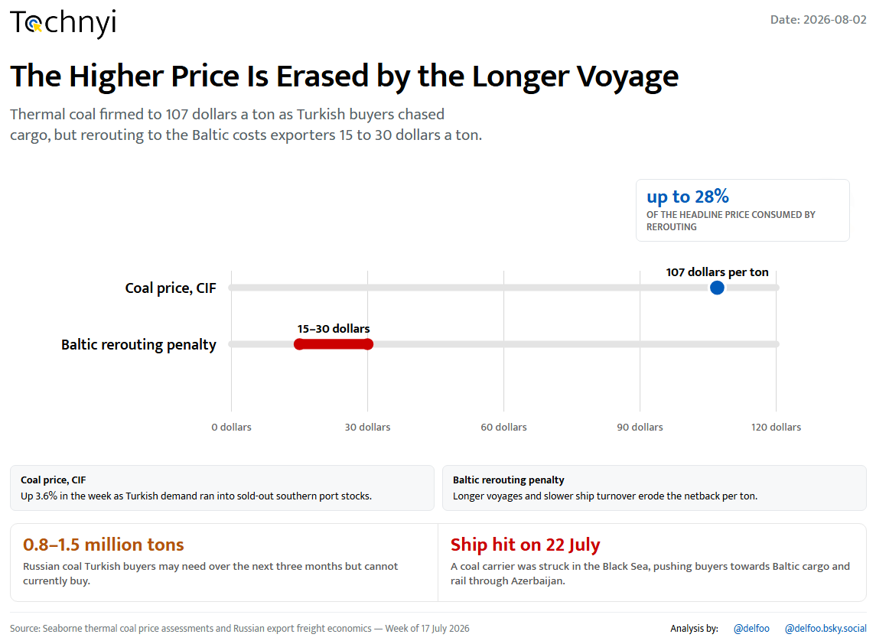
18 / 25
Tochnyi · Week 31, 2026
Notes:
The Baltic detour eats the price

Slide 19
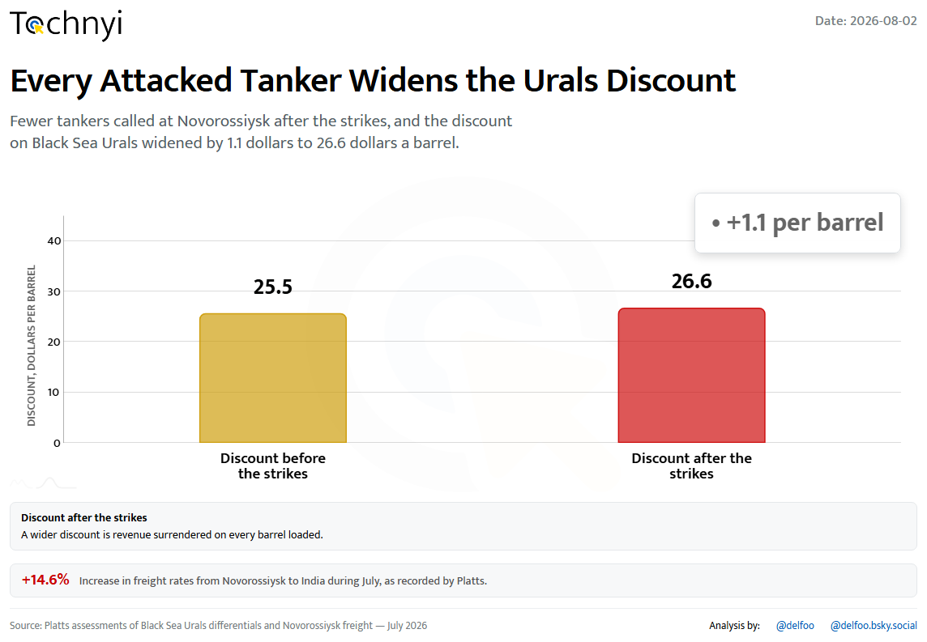
19 / 25
Tochnyi · Week 31, 2026
Notes:
The Urals discount widens

Slide 20
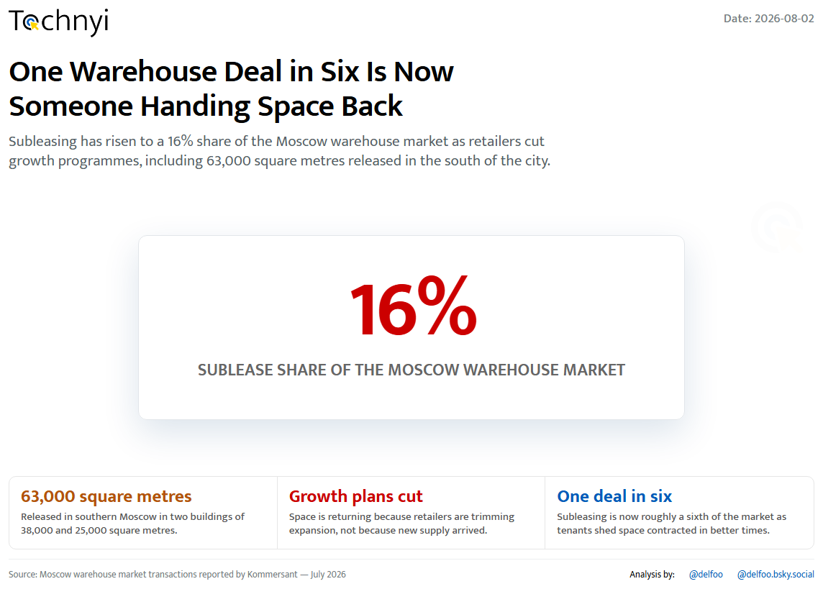
20 / 25
Tochnyi · Week 31, 2026
Notes:
Moscow warehouses handed back

Slide 21
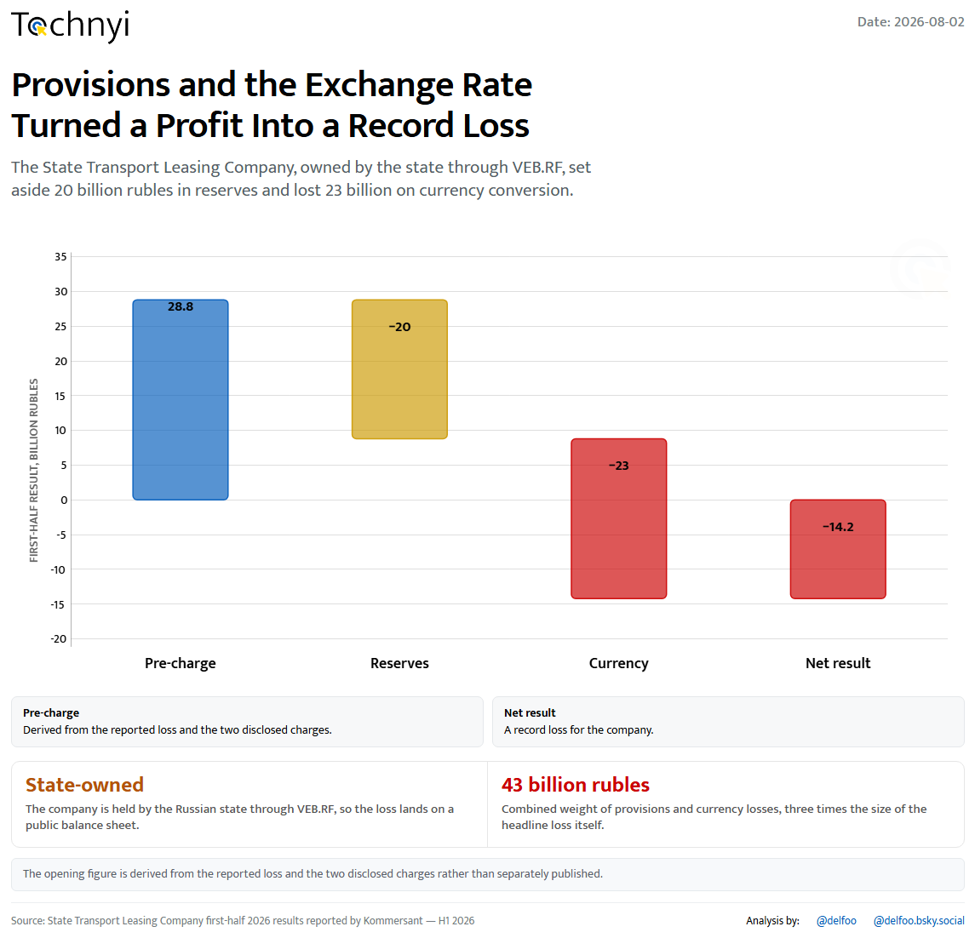
21 / 25
Tochnyi · Week 31, 2026
Notes:
A record loss at state leasing

Slide 22
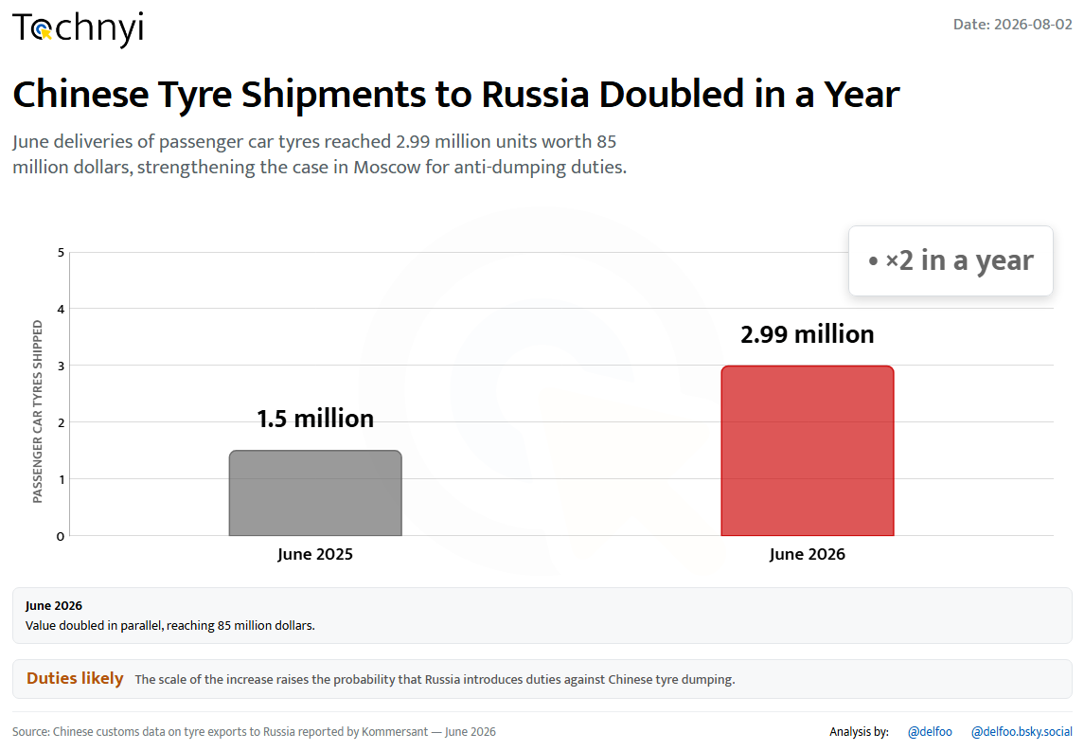
22 / 25
Tochnyi · Week 31, 2026
Notes:
Chinese tyre shipments double

Slide 23
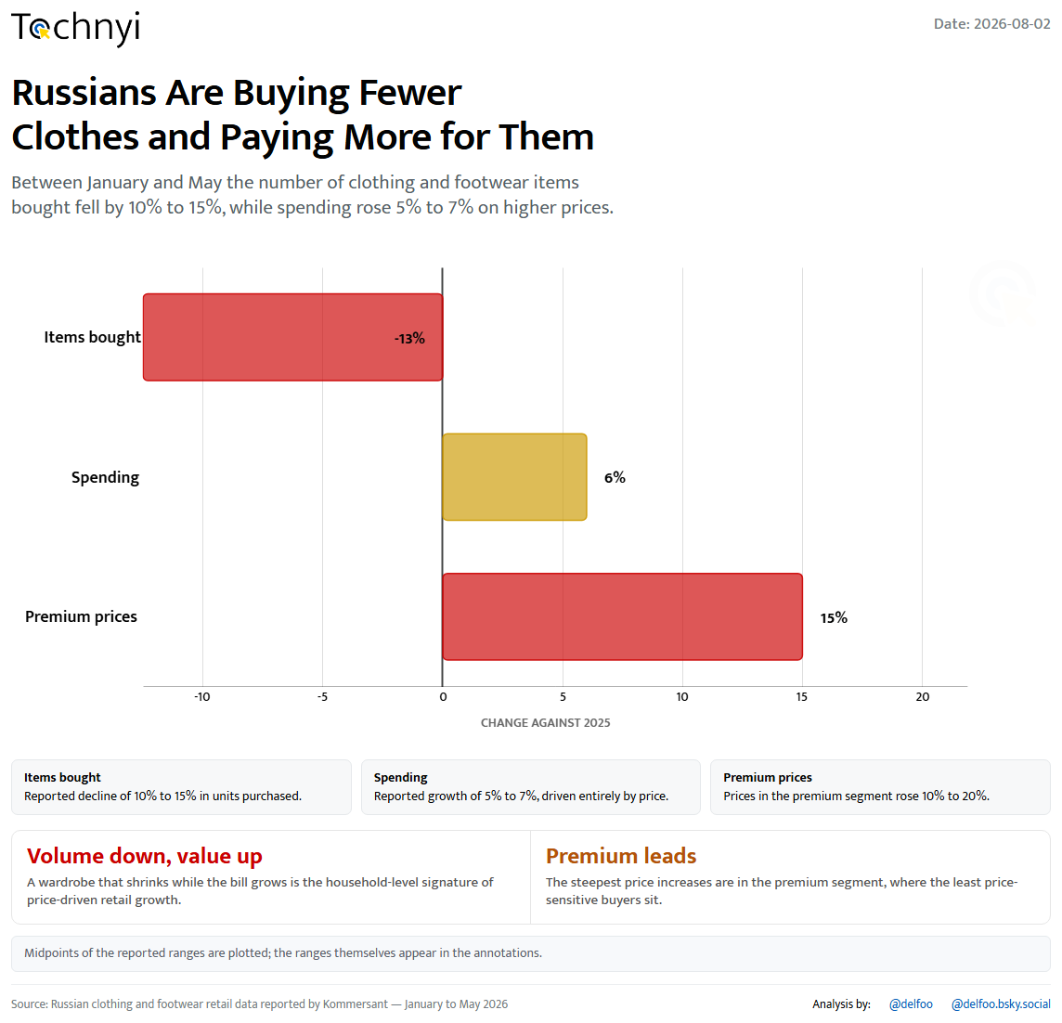
23 / 25
Tochnyi · Week 31, 2026
Notes:
Fewer clothes, higher bills

Slide 24
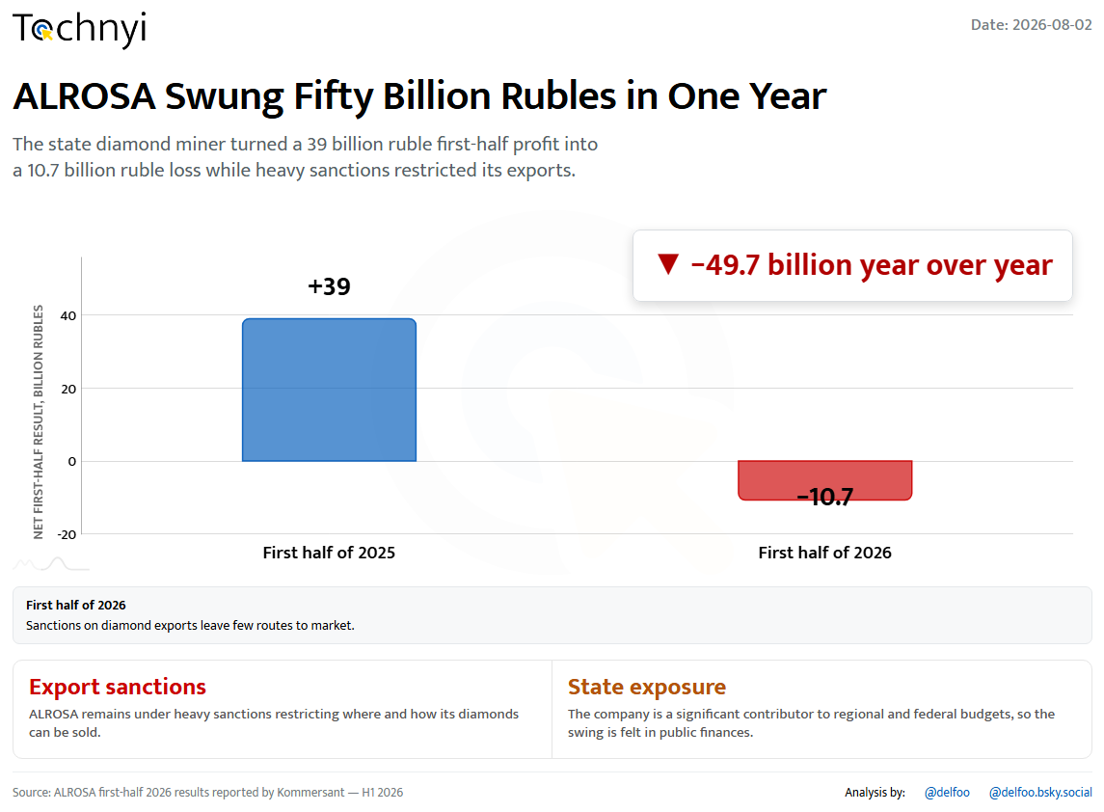
24 / 25
Tochnyi · Week 31, 2026
Notes:
ALROSA swings fifty billion

Slide 25
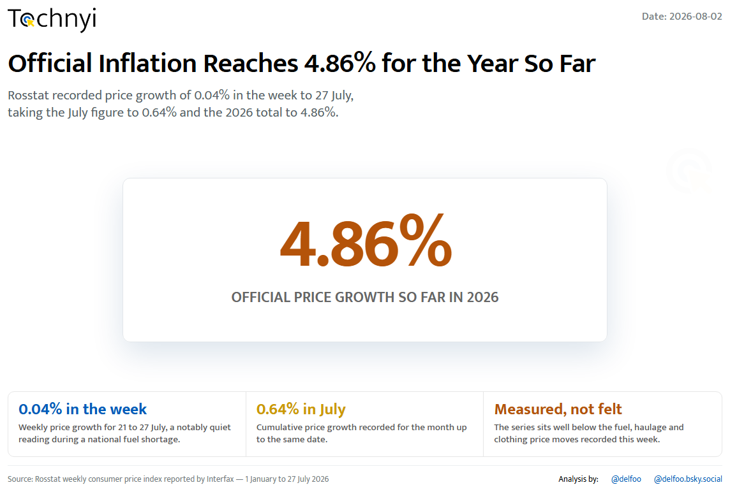
25 / 25
Tochnyi · Week 31, 2026
Notes:
Official inflation at 4.86%

