Slide 1
Russian Economy
Week 31, 2026
Twenty-five charts on e-commerce under attack, the fuel shortage, grain and coal logistics, and the balance sheets absorbing the damage.
Tochnyi · 2 August 2026

Slide 2
Contents
01
Ozon reprices war risk
14
Closing one sea reprices a harvest
02
Wildberries asks for 800 billion
15
Two fifths of export capacity
03
A request Kazakhstan cannot fill
16
Sunflower oil exports halve
04
Four million jobs behind the ask
17
Coal prices fall, Chinese stocks rise
05
The fulfilment map after the strikes
18
The Baltic detour eats the price
06
Sellers were already leaving
19
The Urals discount widens
07
Marketplace growth collapses
20
Moscow warehouses handed back
08
Fuel: refinery towns vs everyone else
21
A record loss at state leasing
09
Zabaykalsky krai runs dry
22
Chinese tyre shipments double
10
Six months for gasoline, one for diesel
23
Fewer clothes, higher bills
11
Imports that buy days, not weeks
24
ALROSA swings fifty billion
12
VTB earnings fall faster
25
Official inflation at 4.86%
13
Grain cheapens as routes close

Slide 3
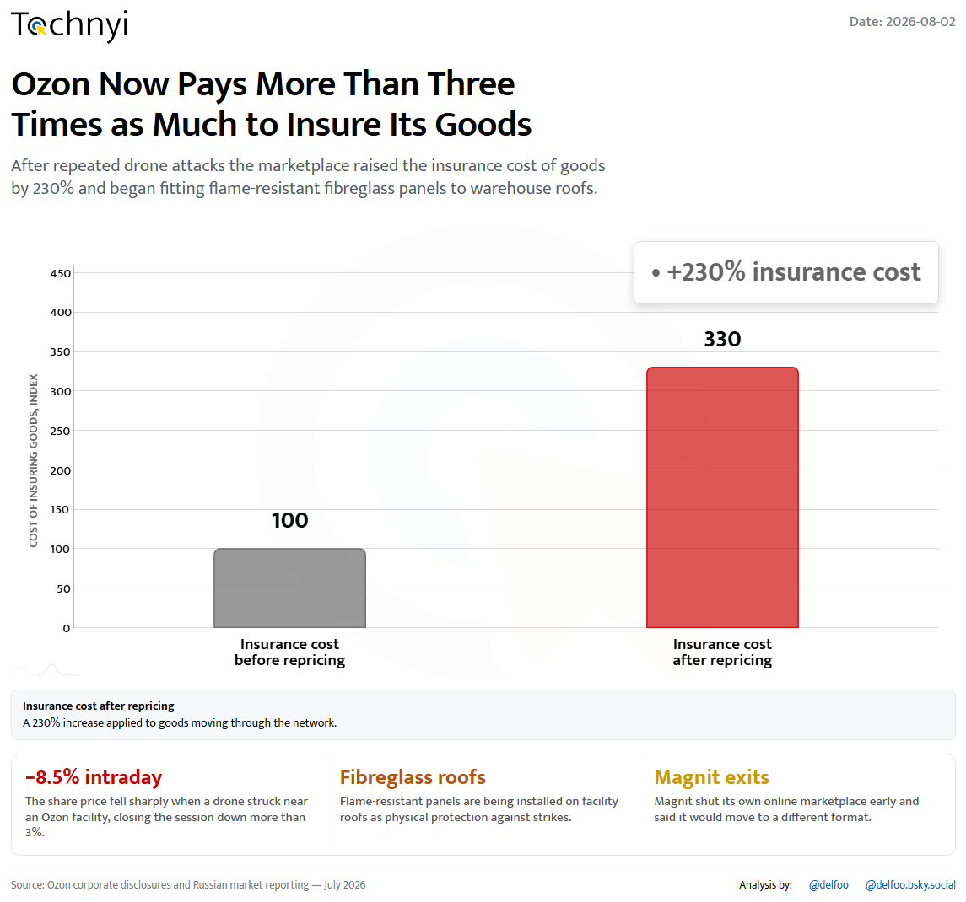
01 / 25
Tochnyi · Week 31, 2026
Notes:
Ozon reprices war risk

Slide 4
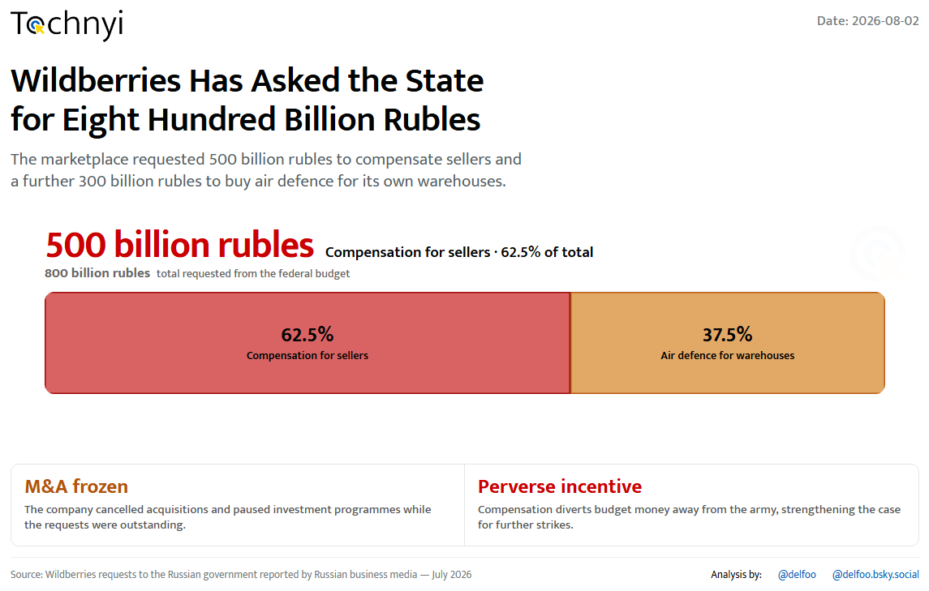
02 / 25
Tochnyi · Week 31, 2026
Notes:
Wildberries asks for 800 billion

Slide 5
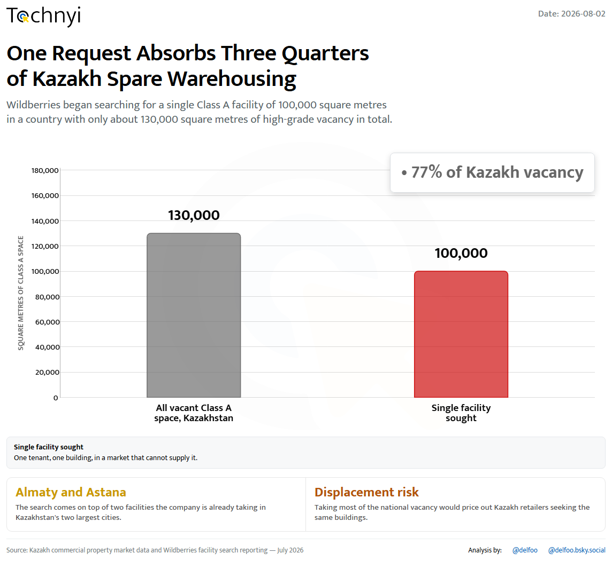
03 / 25
Tochnyi · Week 31, 2026
Notes:
A request Kazakhstan cannot fill

Slide 6
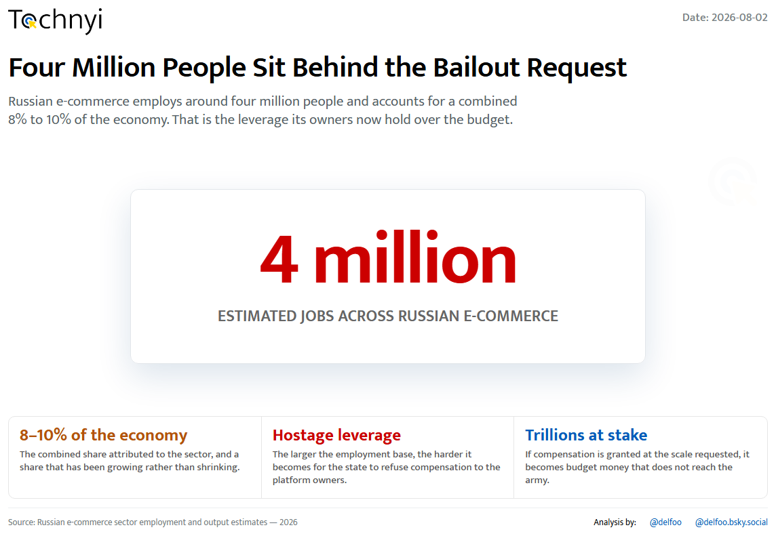
04 / 25
Tochnyi · Week 31, 2026
Notes:
Four million jobs behind the ask

Slide 7
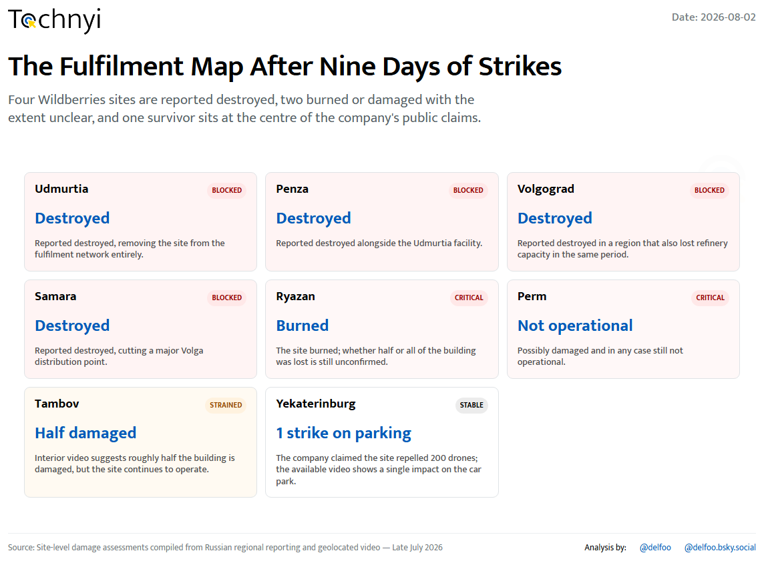
05 / 25
Tochnyi · Week 31, 2026
Notes:
The fulfilment map after the strikes

Slide 8
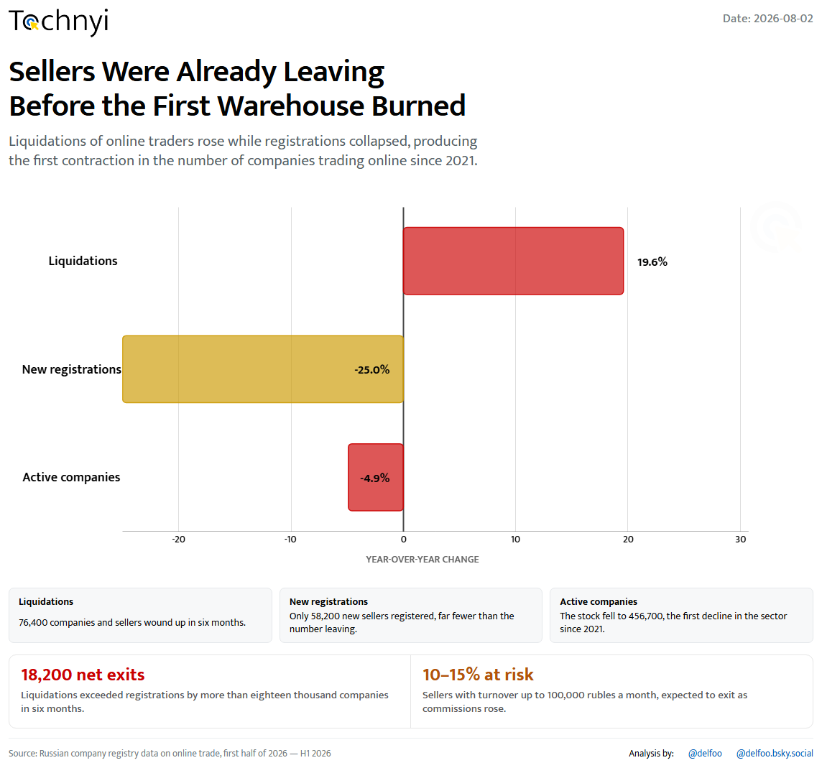
06 / 25
Tochnyi · Week 31, 2026
Notes:
Sellers were already leaving

Slide 9
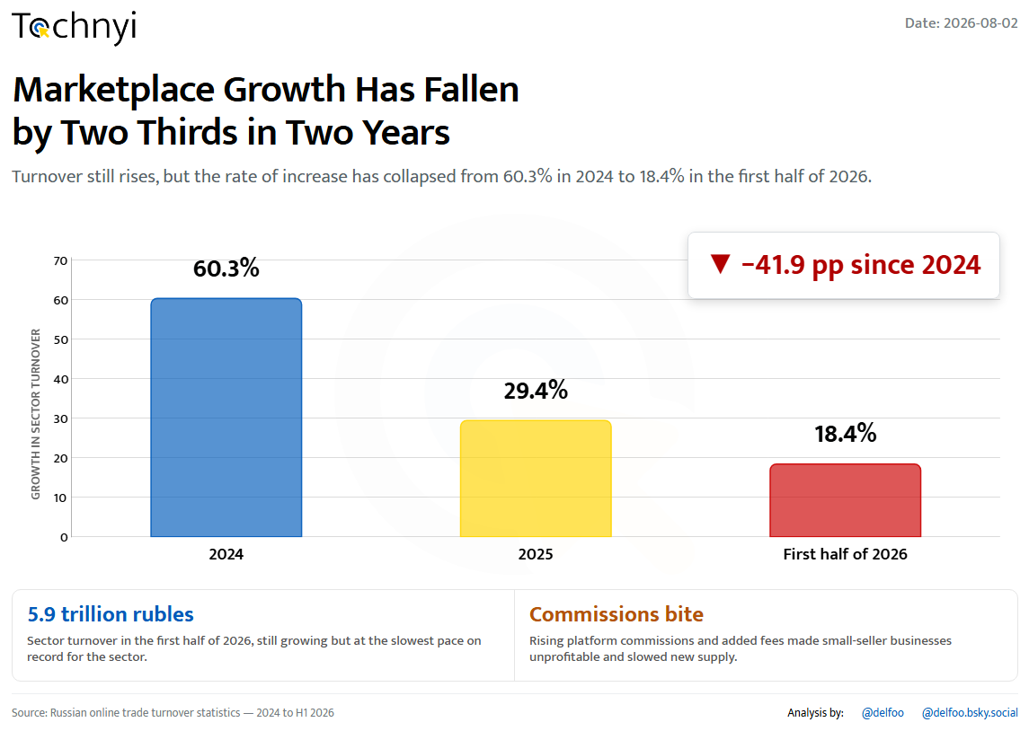
07 / 25
Tochnyi · Week 31, 2026
Notes:
Marketplace growth collapses

Slide 10
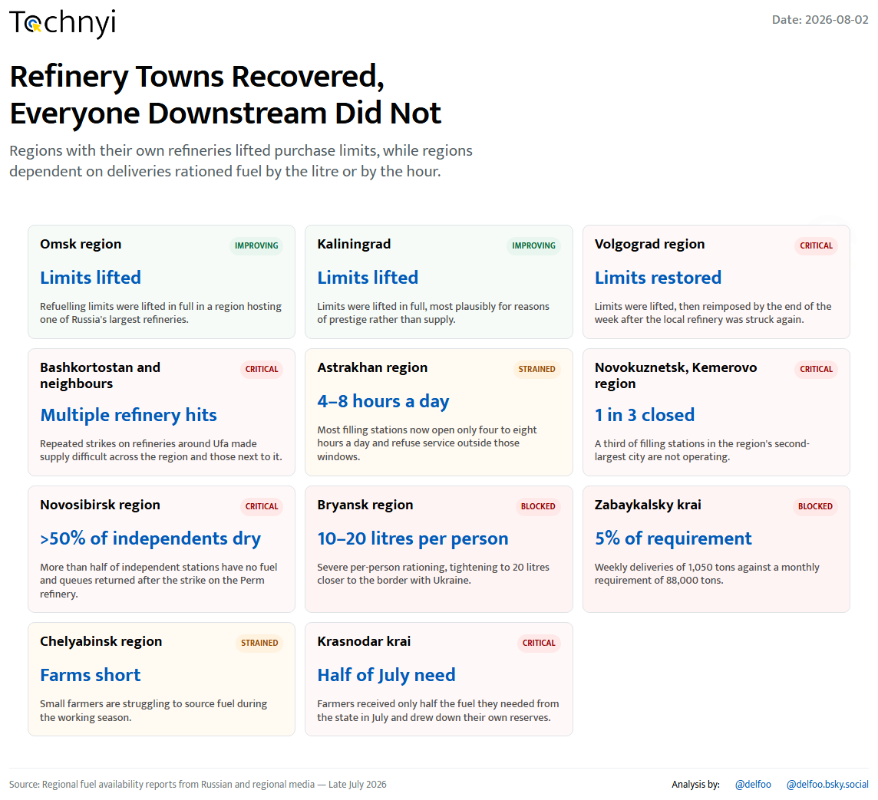
08 / 25
Tochnyi · Week 31, 2026
Notes:
Fuel: refinery towns vs everyone else

Slide 11
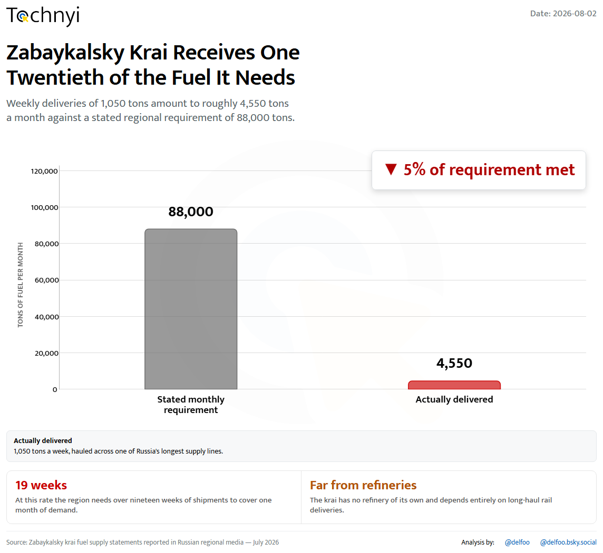
09 / 25
Tochnyi · Week 31, 2026
Notes:
Zabaykalsky krai runs dry

Slide 12
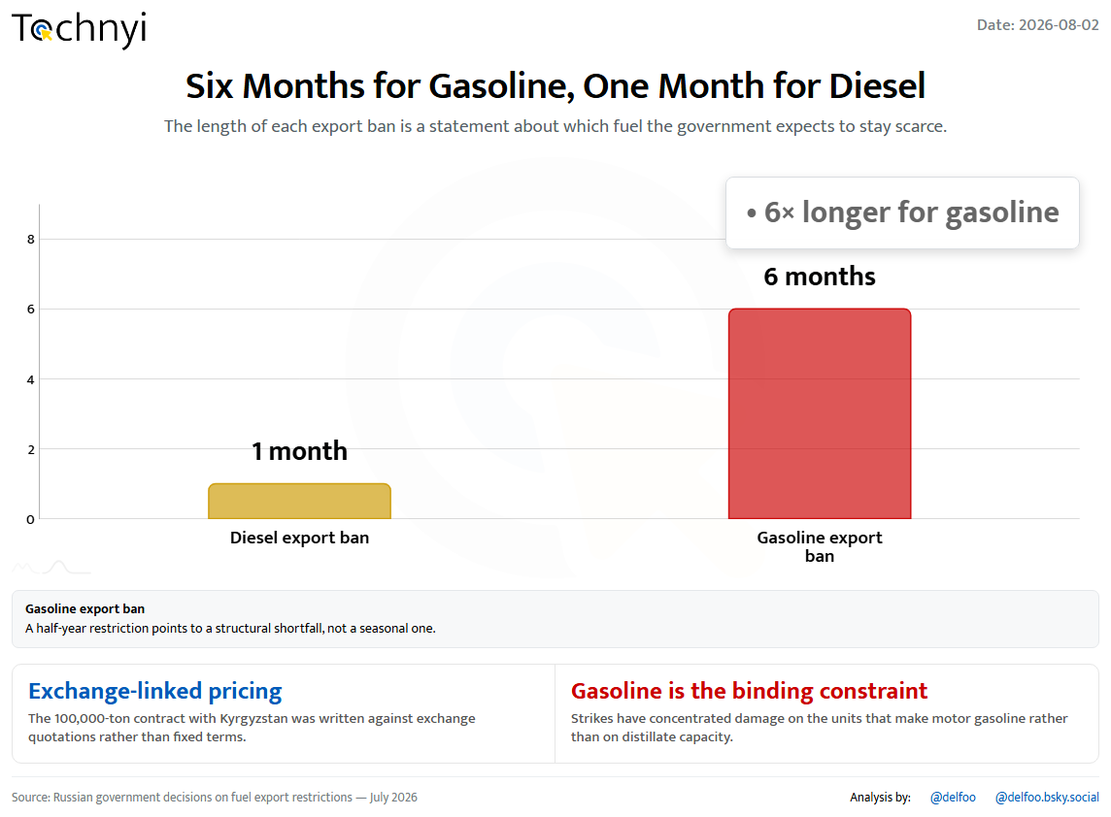
10 / 25
Tochnyi · Week 31, 2026
Notes:
Six months for gasoline, one for diesel

Slide 13
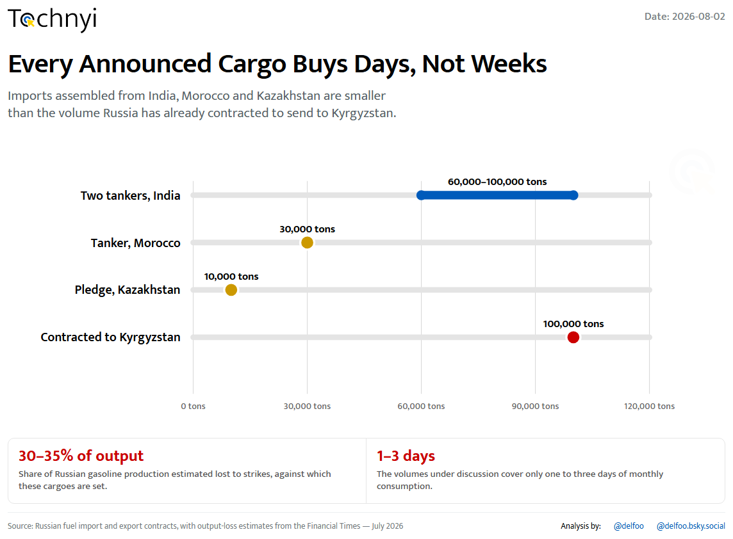
11 / 25
Tochnyi · Week 31, 2026
Notes:
Imports that buy days, not weeks

Slide 14
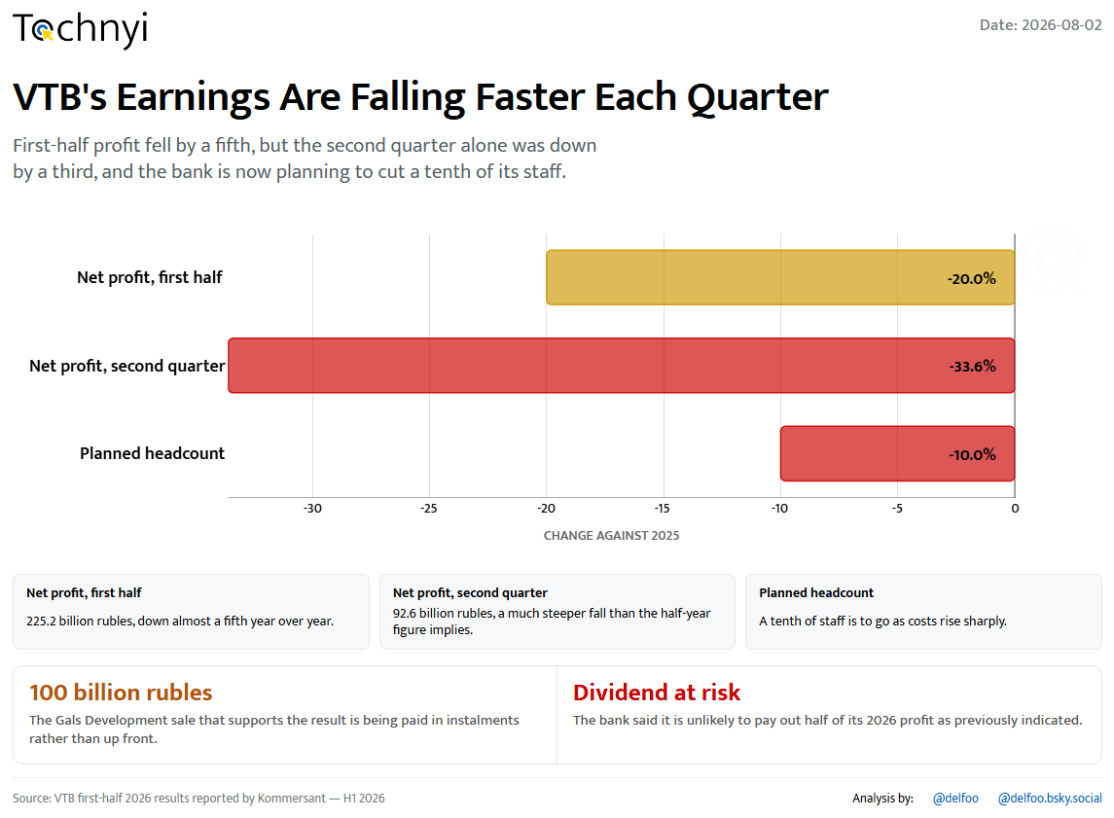
12 / 25
Tochnyi · Week 31, 2026
Notes:
VTB earnings fall faster

Slide 15
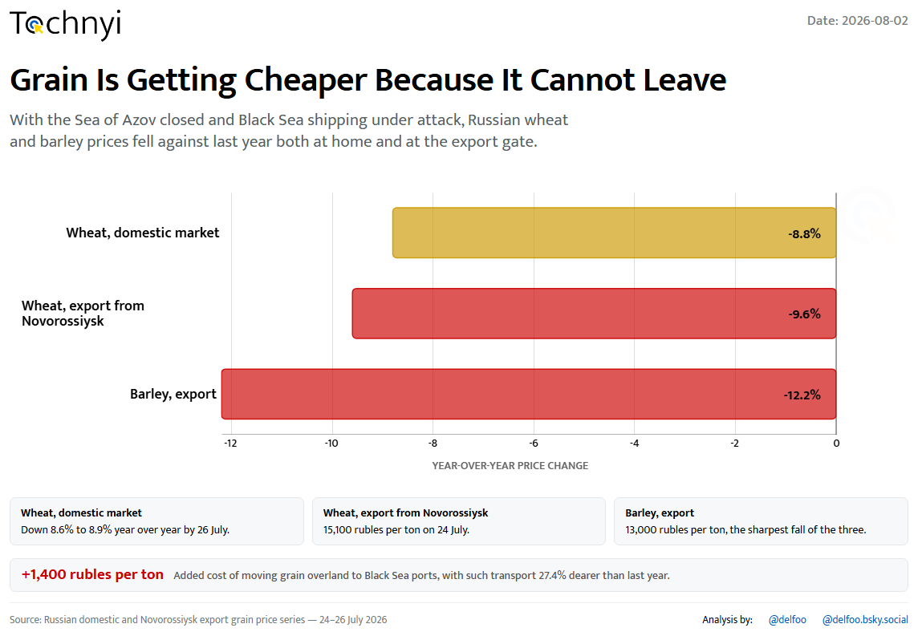
13 / 25
Tochnyi · Week 31, 2026
Notes:
Grain cheapens as routes close

Slide 16
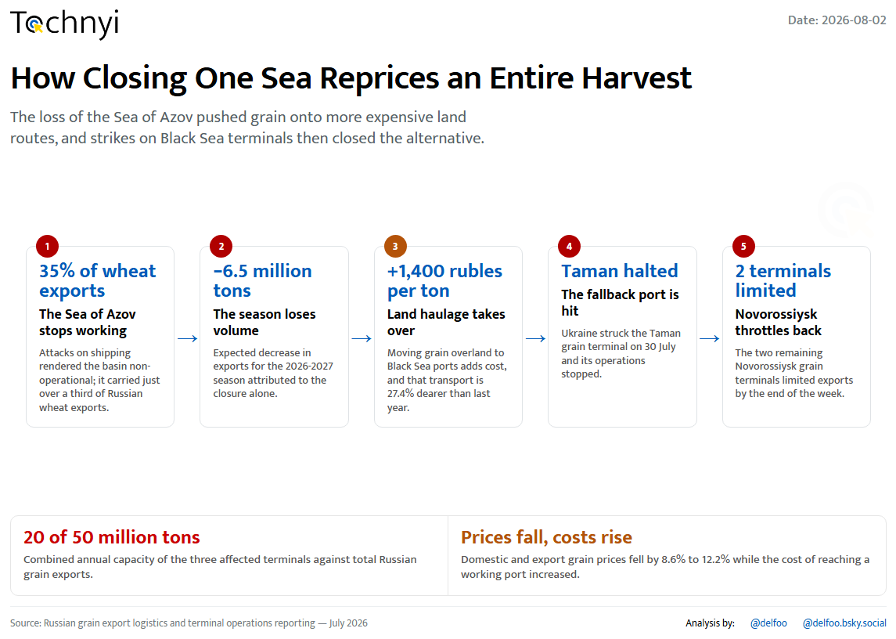
14 / 25
Tochnyi · Week 31, 2026
Notes:
Closing one sea reprices a harvest

Slide 17
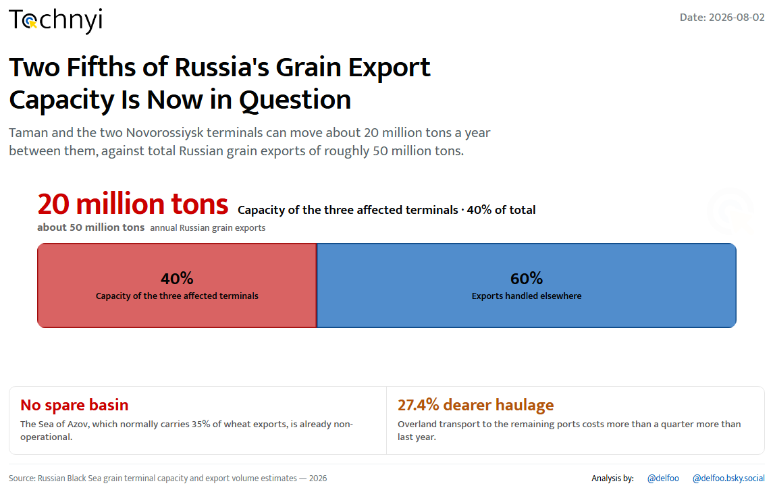
15 / 25
Tochnyi · Week 31, 2026
Notes:
Two fifths of export capacity

Slide 18
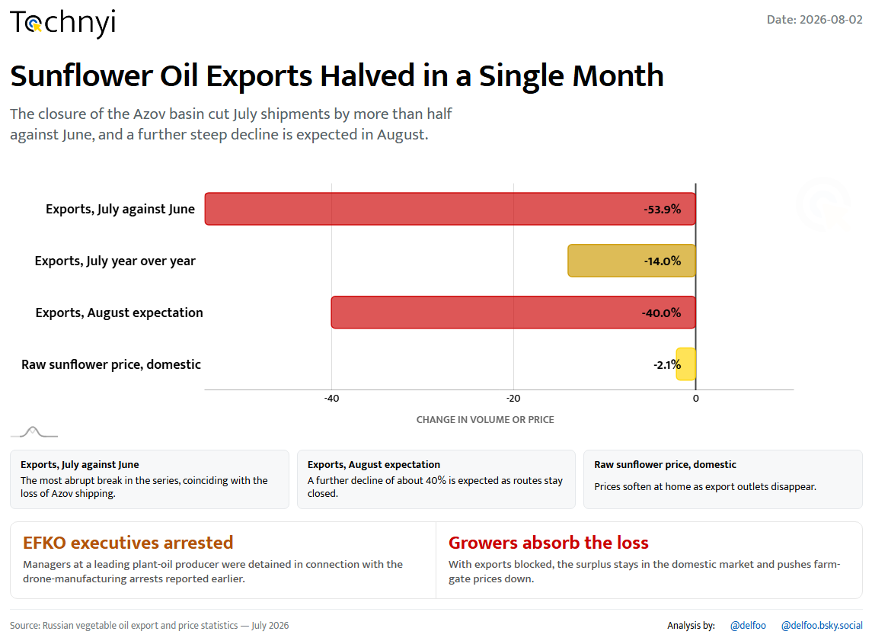
16 / 25
Tochnyi · Week 31, 2026
Notes:
Sunflower oil exports halve

Slide 19
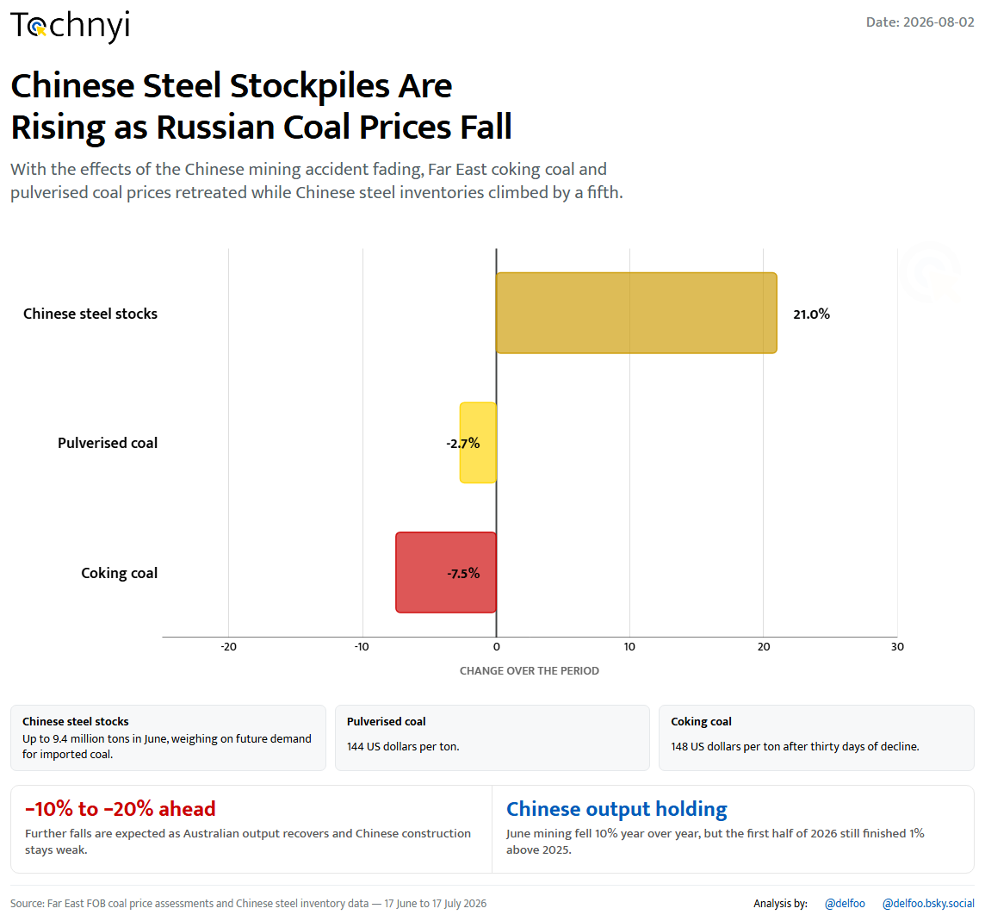
17 / 25
Tochnyi · Week 31, 2026
Notes:
Coal prices fall, Chinese stocks rise

Slide 20
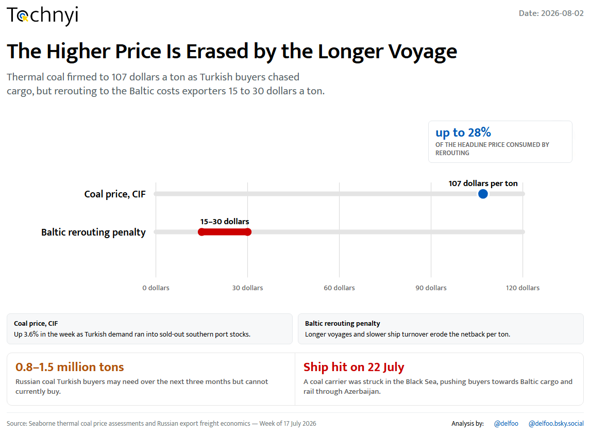
18 / 25
Tochnyi · Week 31, 2026
Notes:
The Baltic detour eats the price

Slide 21
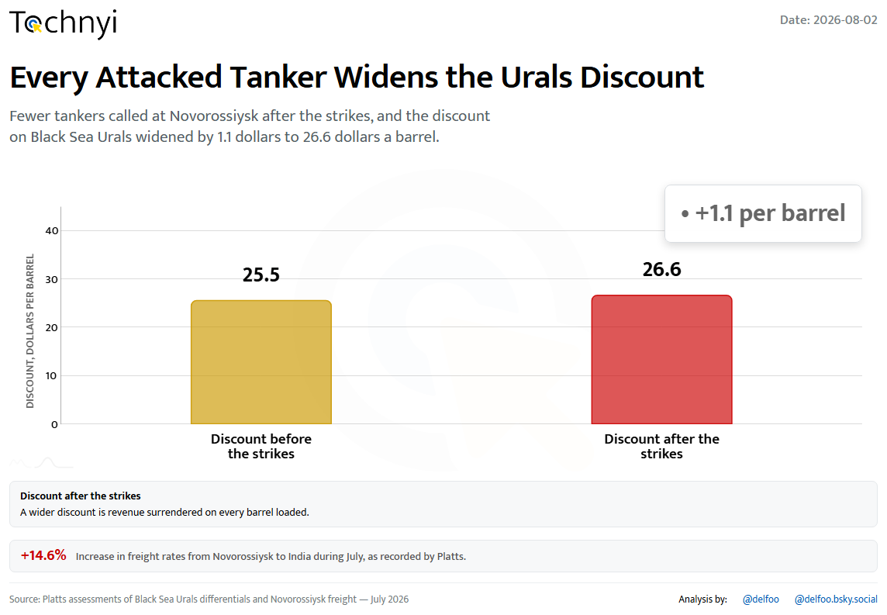
19 / 25
Tochnyi · Week 31, 2026
Notes:
The Urals discount widens

Slide 22
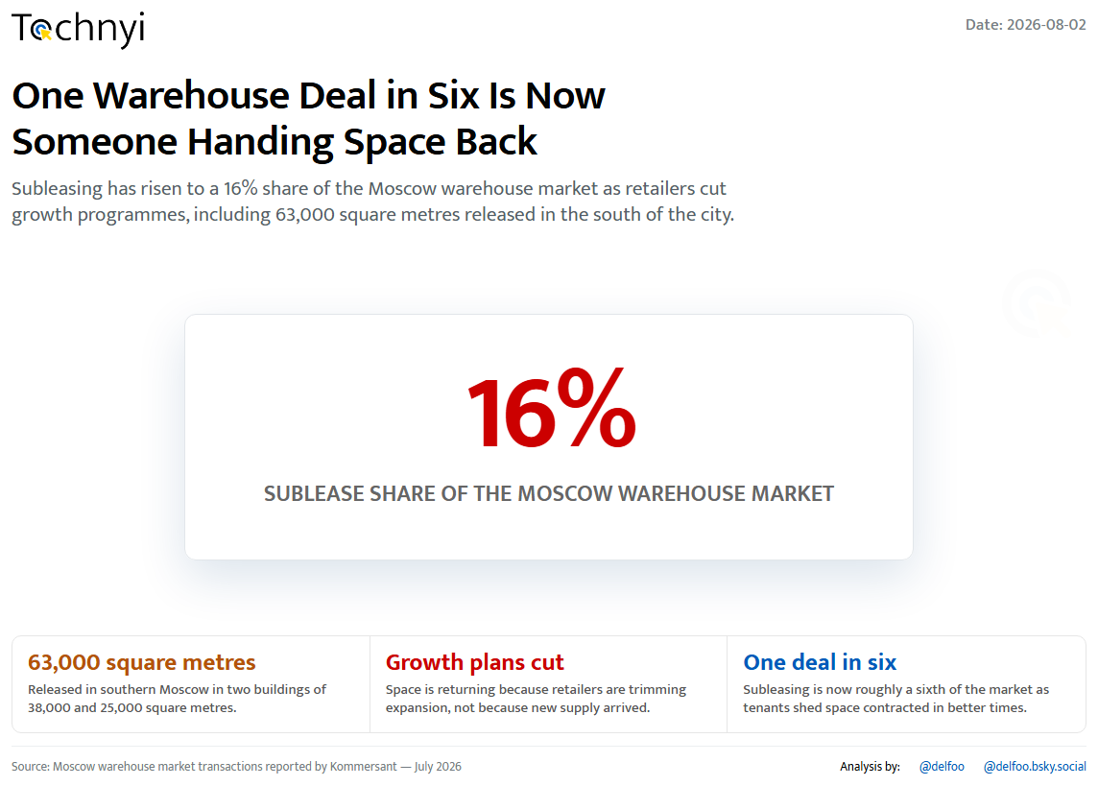
20 / 25
Tochnyi · Week 31, 2026
Notes:
Moscow warehouses handed back

Slide 23
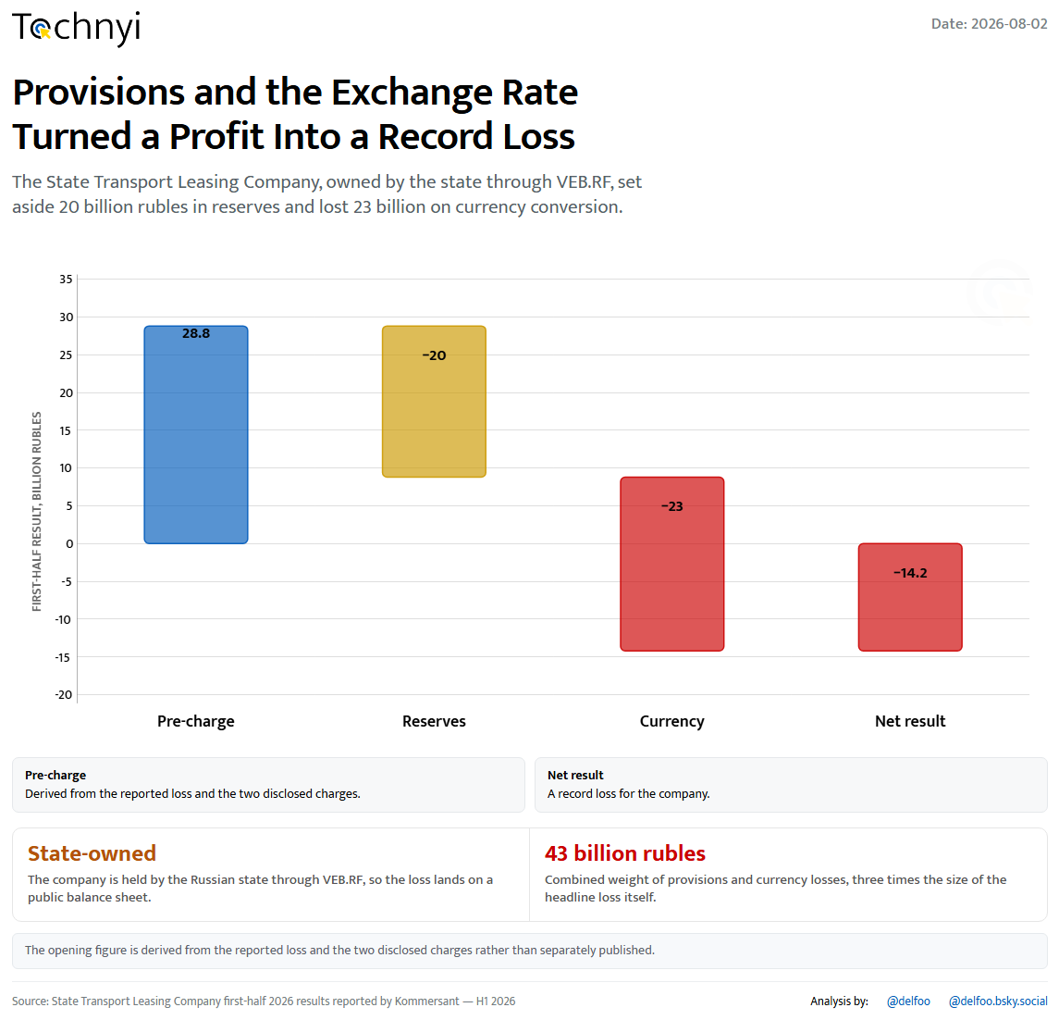
21 / 25
Tochnyi · Week 31, 2026
Notes:
A record loss at state leasing

Slide 24
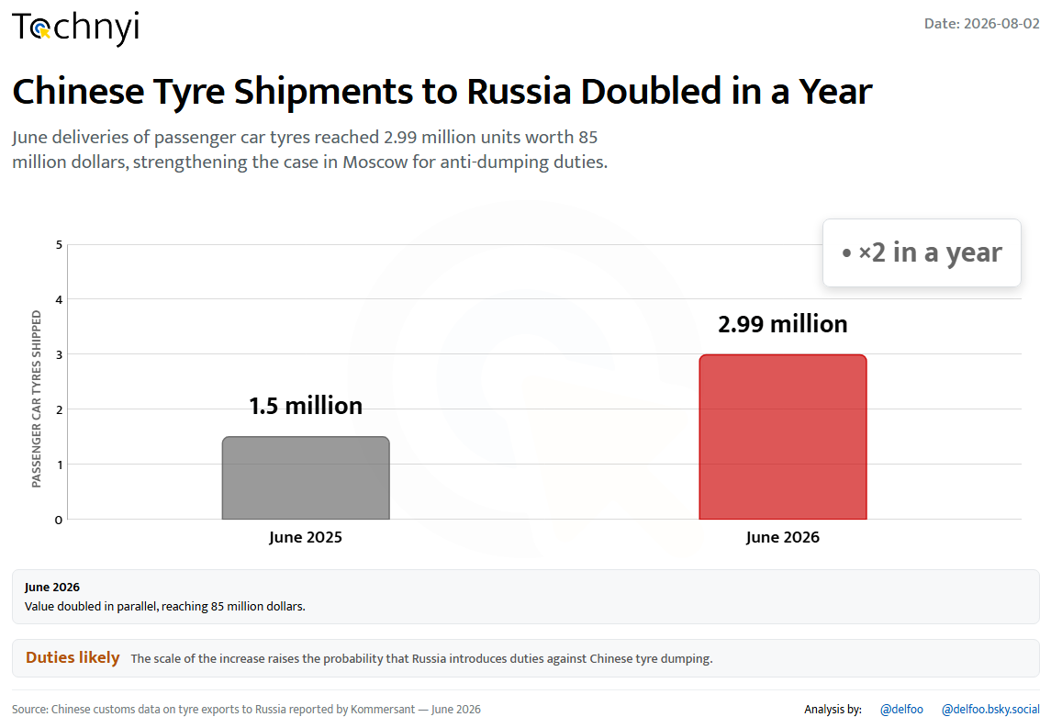
22 / 25
Tochnyi · Week 31, 2026
Notes:
Chinese tyre shipments double

Slide 25
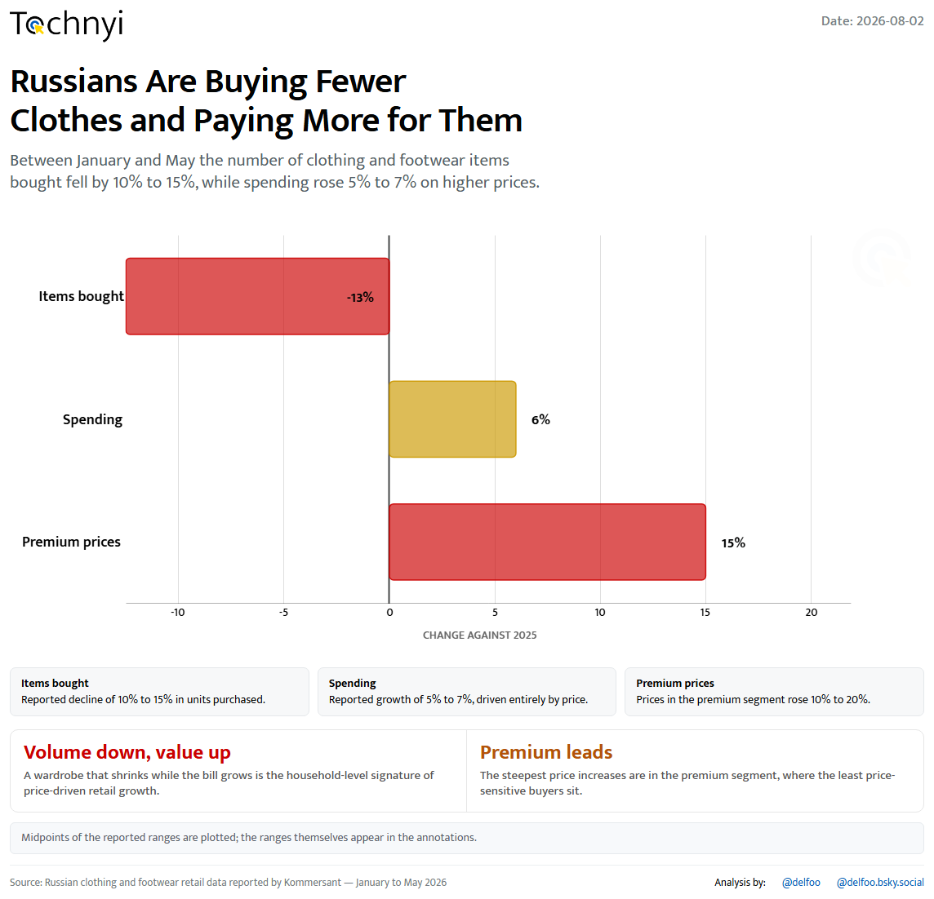
23 / 25
Tochnyi · Week 31, 2026
Notes:
Fewer clothes, higher bills

Slide 26
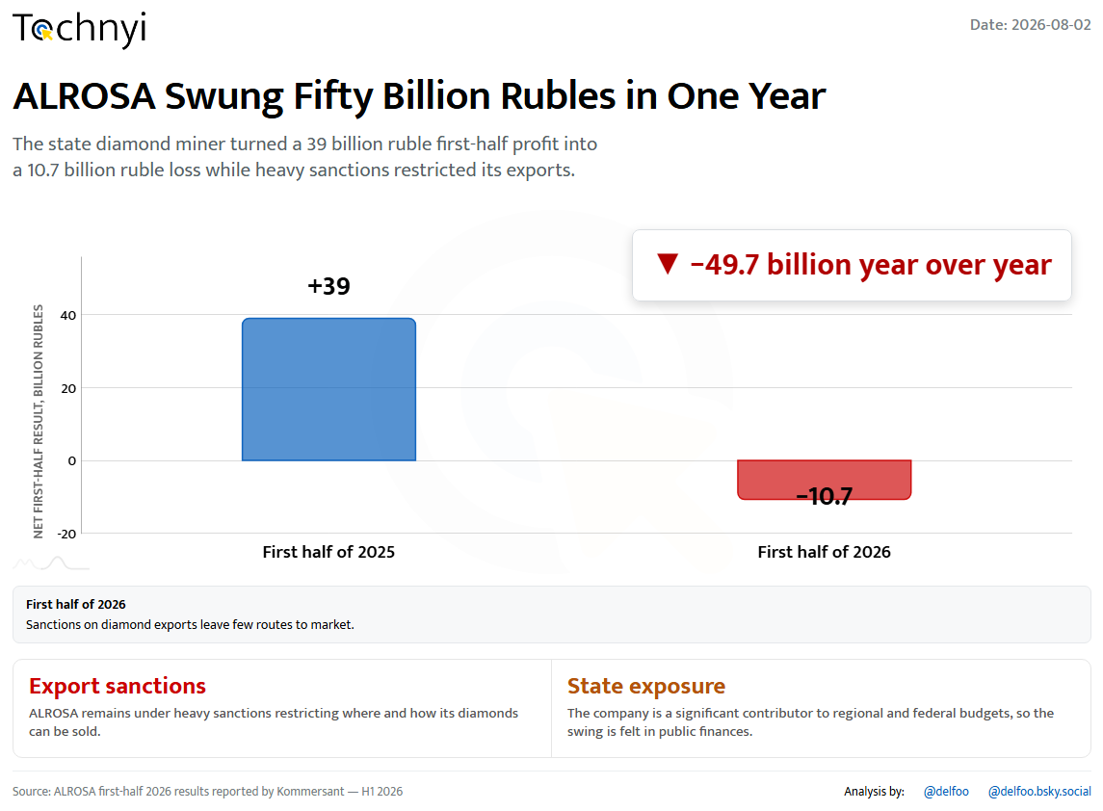
24 / 25
Tochnyi · Week 31, 2026
Notes:
ALROSA swings fifty billion

Slide 27
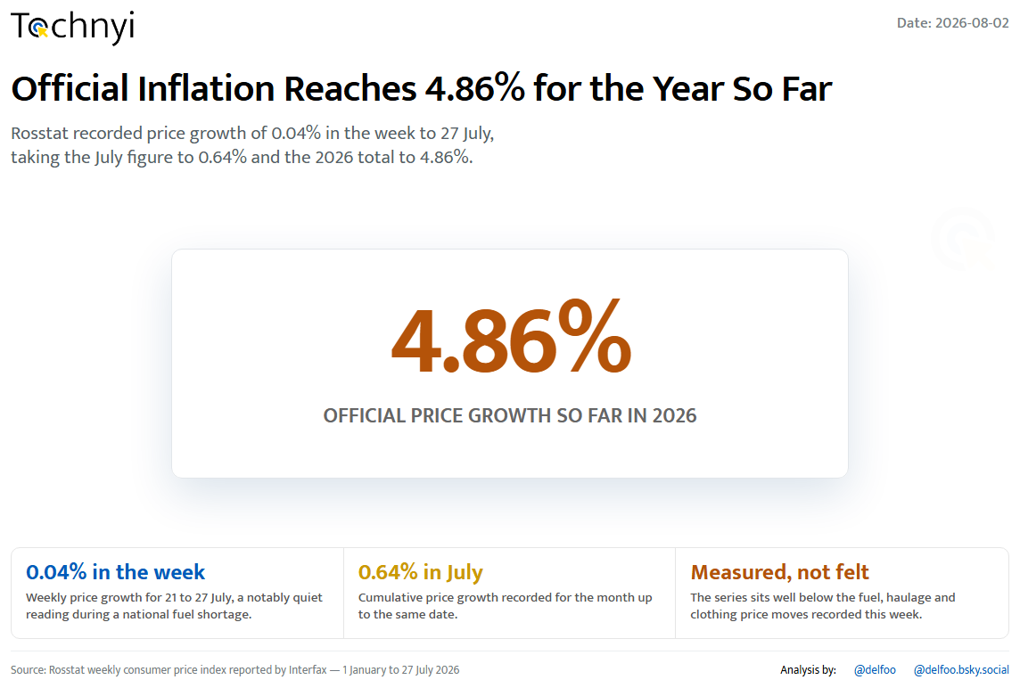
25 / 25
Tochnyi · Week 31, 2026
Notes:
Official inflation at 4.86%

Slide 28
Sources
Kommersant, Interfax and Rosstat releases; Platts price assessments; Financial Times output estimates; Russian company registry data; and regional Russian media on fuel availability and warehouse damage.
Derived figures are flagged on the charts that use them. Reported ranges are plotted at their midpoint where a single value is required.

