Slide 1
Citizen Complaints System
Prepared by: joseph desire nshimyumukiza

Slide 2
Project overview
What is the Citizen Complaints System? A web-based website designed to facilitate communication between citizens and government authorities.
Purpose: To provide citizens with an easy and effective way to submit complaints, report issues, and express ideas while enabling authorities to manage and respond to these concerns efficiently.
Main Features:
User registration and login
Complaint submission with categorization
Real-time tracking of complaint status
Admin dashboard for complaint management and responses

Slide 3
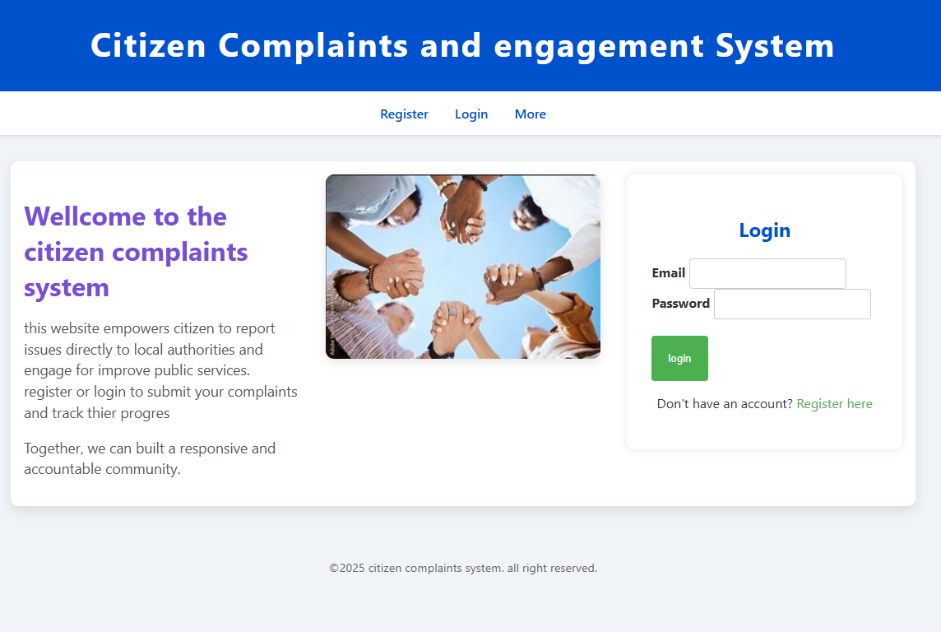

Slide 4
Functional requirements
For Citizens:
Register and login to the system
Submit complaints, specify desires, and make emergency calls
Track the status of their submissions
View responses from authorities
Logout securely
For Admin / Government Authorities:
View all submitted complaints
Update complaint status
Generate and send responses to citizens
Logout securely

Slide 5

How the System Works

Slide 6
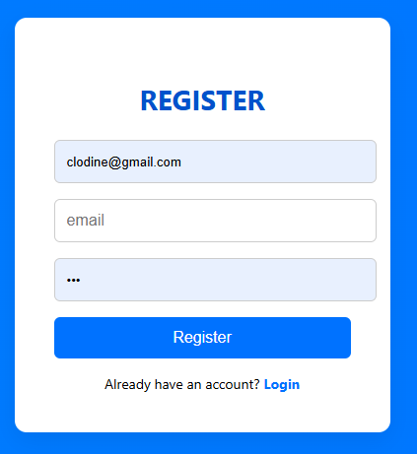
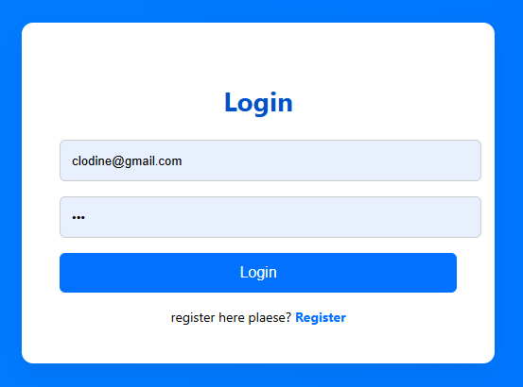
User Registration & Login
Citizen must register first into system so as to be able to login
If user registered into database his allowed to login

Slide 7
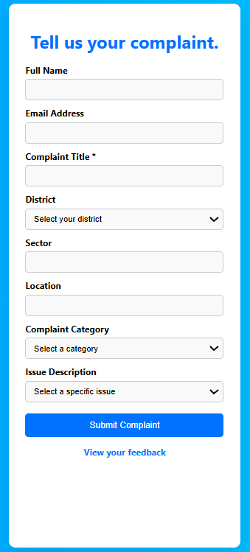
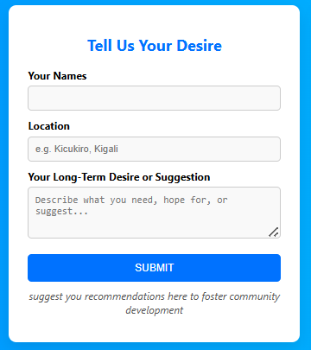
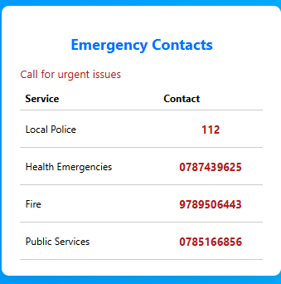
Complaint Submission
Specify a desire/request
Make an emergency contact
Submit a complaint

Slide 8
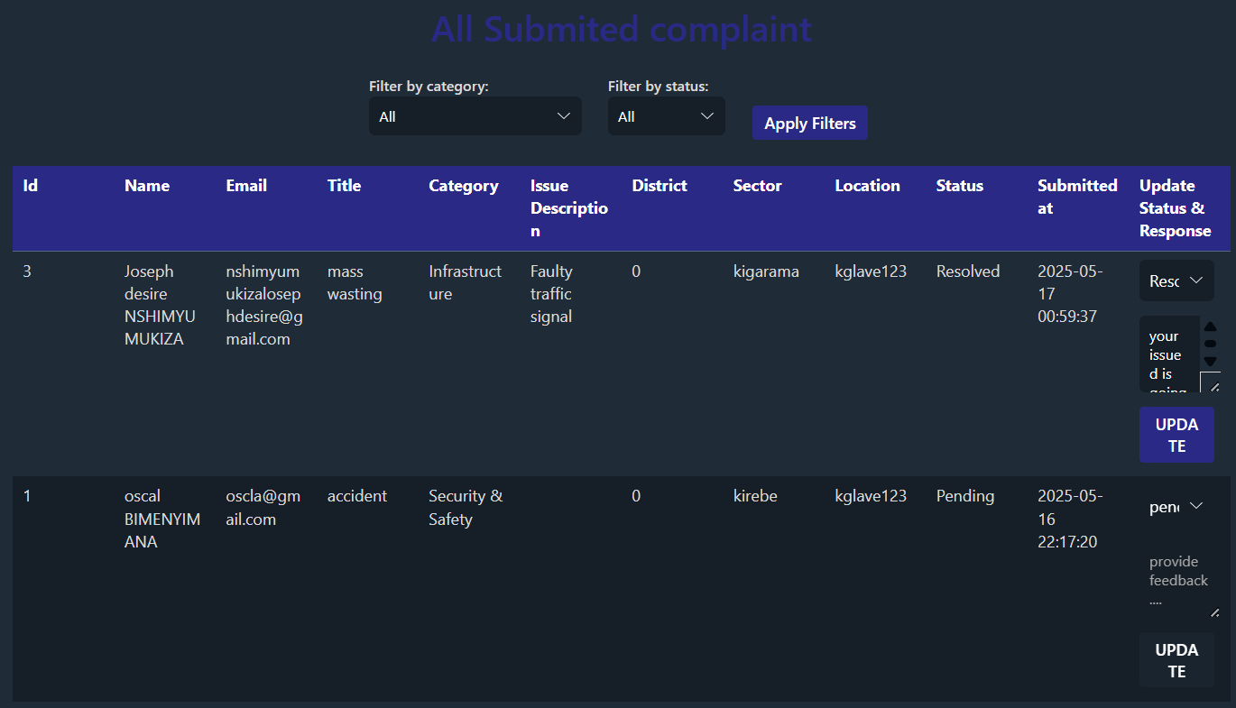
Admin Access
Filter by category/status
Update complaint status (e.g., "In Progress", "Resolved")
Add feedback/response

Slide 9
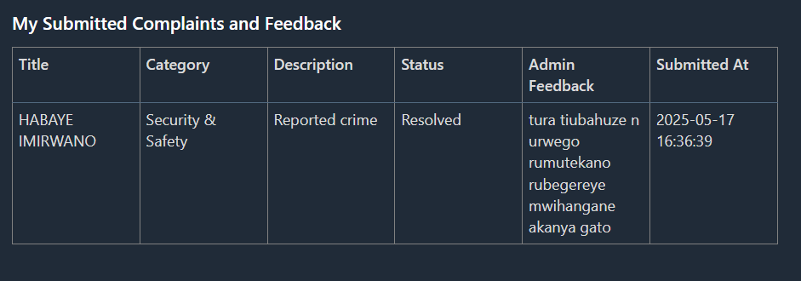
Citizen Feedback
Citizens log in anytime to:
Track the progress of their submission
View admin responses

Slide 10
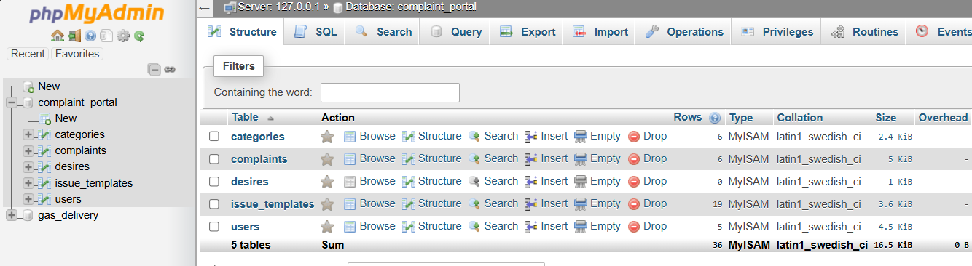
Database section

Slide 11
Project Setup & Requirements Guide
Go through this link:
https://drive.google.com/file/d/14c_YhHWmXNk0t2A5iSMIfqRpPRYDg6Il/view?usp=drive_link
And this for more project info:
https://drive.google.com/file/d/1tKR_FfOcrqrdwdn336kVtLiwg4bbnsTb/view?usp=drive_link

Slide 12
Thank you!!

