Slide 1

Sketch Recognizers from
the End-User’s,
the Designer’s, and
the Programmer’s Perspective
Jason Hong
James Landay
A. Chris Long
Jennifer Mankoff

Slide 2
Overview
Lots of existing work on recognizers
  Focus on accuracy and robustness
Not as much out there on using recognizers in practice
  End-users, designers, programmers
Outline our group's experiences
  Building and evaluating sketching apps
  Tools for designers and programmers
Notes:
Cookbook of things that we've learned over the past few years

Slide 3
Roles in Developing Sketching Apps
Role | Goals | Concerns
End-User | Accomplish some task with the technology | Useful Usable Desirable
Designer | Create and iteratively evaluate and improve an interface | Interaction Feedback Look and Feel Prototyping
Programmer | Write good code and debug it | Recognizers Reusability APIs Debugging
Notes:
Briefly describe roles of end-user, designer, and programmer
Subtle distinction in this context:
End-user means end-user of sketching technology
And designer means designer of the sketching technology
(not to be confused with web designer)
(confusion arises because a sketch designer may design a tool for a web designer to use)

Slide 4
Overview of Apps and Tools
Role | Applications and Tools
End-User | SILK, Burlap, DENIM
Designer | Quill
Programmer | SATIN and OOPS
Notes:
Each of these applications has some elements of all three (end-user, designer, programmer)

Slide 5
Overview of Apps and Tools
Role | Applications and Tools
End-User | SILK, Burlap, DENIM
Designer | Quill
Programmer | SATIN and OOPS
Notes:
Each of these applications has some elements of all three (end-user, designer, programmer)

Slide 6
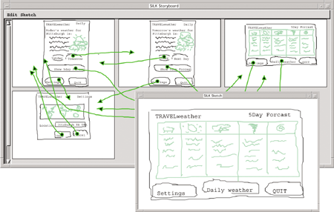
SILK
Landay (1996)
Notes:
What it does
Lets designers draw out GUI screens
Recognize standard interactive widgets (buttons, checkboxes, scrollbars)
Draw arrows to link different screens together
"Run" the sketches
What we learned
Immediate recognition (but keeping strokes the same) still causes problems (fight the recognizer)
Caused by fact SILK needed "correct state" to work
Creating sketching interfaces is hard (programming)
Defining gestures and recognized strokes difficult
Provided an idea of the importance of sketching in early design

Slide 7
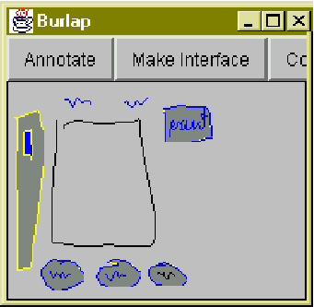
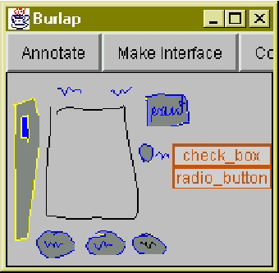
Burlap
Mankoff, Hudson, Abowd (CHI2000)
Notes:
What it does
Burlap also lets designers sketch out GUIs
Burlap because it's a rougher version of SILK
Strategy here is to defer recognition until needed
Key here is mediators
One type of mediator is list-choice
Represents a shift in how recognizers are used
Errors are a fundamental part of recognizers, provide support for interactively dealing with them (mediators)
What we learned
Mediation is a useful technique for resolving ambiguity
With the right data structure, stroke recognition can be deferred until absolutely needed

Slide 8
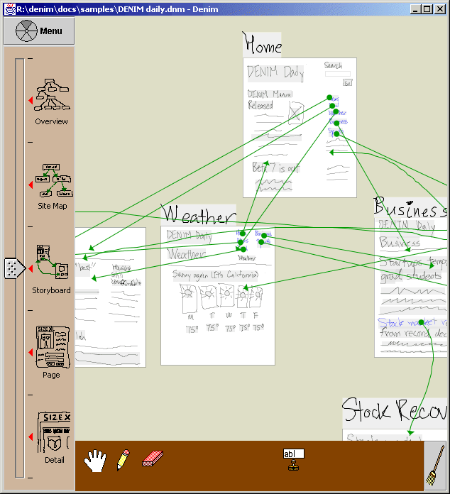
DENIM
Lin, Newman, Hong, Landay (CHI2000)
Notes:
What it does
Sketch out web pages, focus more on information architecture (overall organization) as well as screen layout
Minimal recognition
"Run" web pages
What we learned
Can go far even with very little stroke recognition
Group strokes that might be letters
Arrow recognizer
Documenting user interface, recognition by people, as opposed to recognition by computers
Feedback from end-users indicates that this is an effective strategy for this domain
Still have problems though
"Invisible" interface, not always clear what is and is not possible
Not sure if the system is doing the "right thing"
Individual variation in drawings (gesture recognition like cut, copy, paste)

Slide 9
Overview of Apps and Tools
Role | Applications and Tools
End-User | SILK, Burlap, DENIM
Designer | Quill
Programmer | SATIN and OOPS
Notes:
Each of these applications has some elements of all three (end-user, designer, programmer)

Slide 10
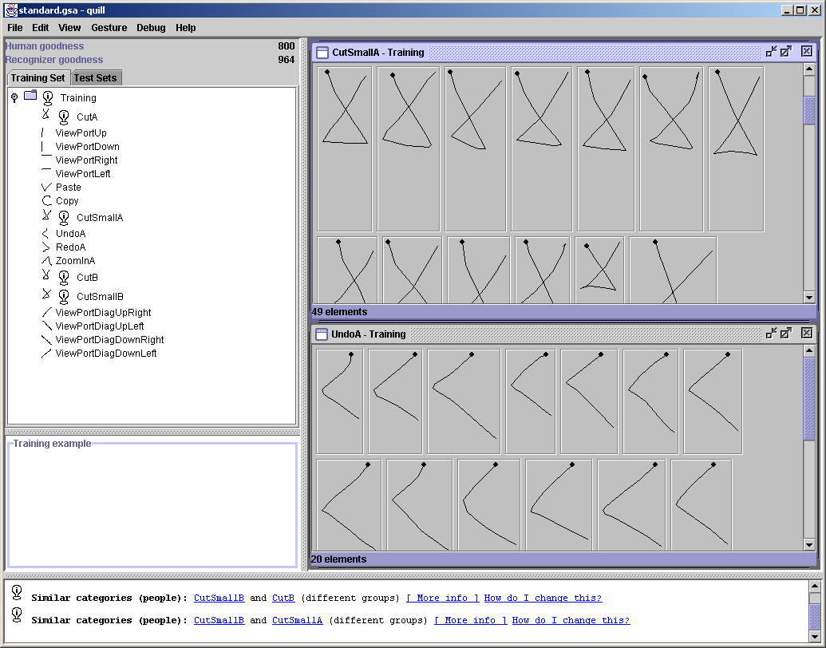
Quill
Long, Landay, Rowe, Michiels (CHI2000)
Notes:
Defining what sketched objects are recognized
SILK and DENIM use a variation of Rubine's recognizer
When SILK was being implemented, there was only a simple user interface for defining gestures
Made it difficult to experiment with gestures
Made it difficult to see if some gestures would be misrecognized (by people and by computers)
What it does
Lets designers quickly create several gesture sets by creating categories and drawing example gestures for each category
Analyze it for potential computer misrecognition errors (two gesture categories are too similar)
Analyze it for potential end-user perceptual errors (memorable)
Store test sets and run regression tests to see how effective people are at drawing the gesture
What we learned

Slide 11
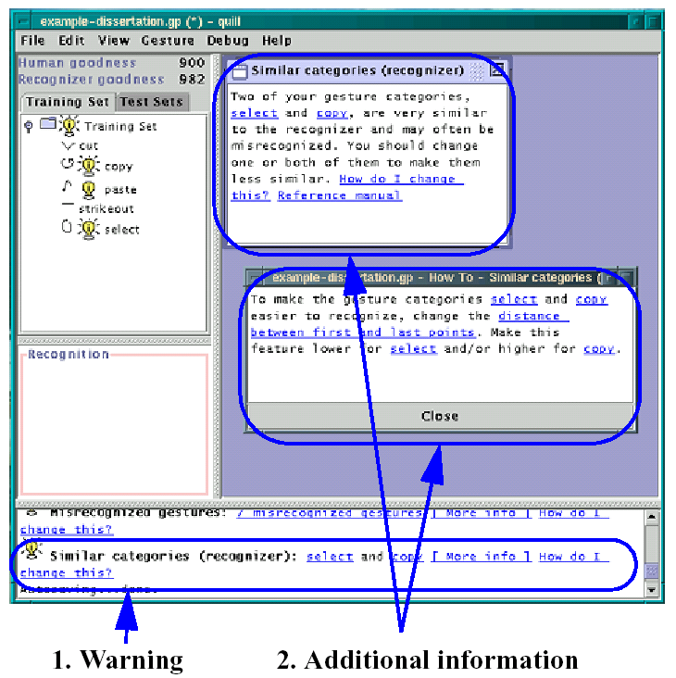
Quill

Slide 12
Overview of Apps and Tools
Role | Applications and Tools
End-User | SILK, Burlap, DENIM
Designer | Quill
Programmer | SATIN and OOPS
Notes:
Each of these applications has some elements of all three (end-user, designer, programmer)

Slide 13
SATIN and OOPS
Clear need for APIs and algorithms for strokes and recognizers
Two different toolkits
  Focus on pluggability and reusability

Slide 14
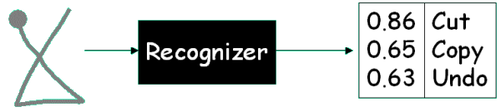
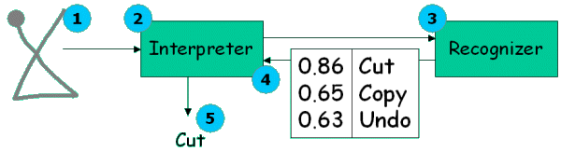
SATIN

Slide 15
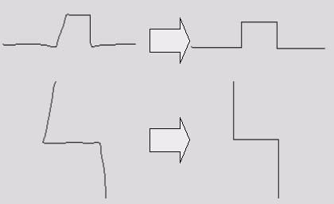
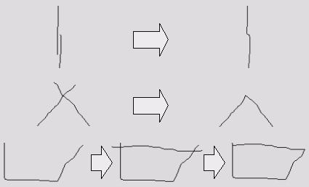
SATIN Libraries
Straighten
Merge

Slide 16
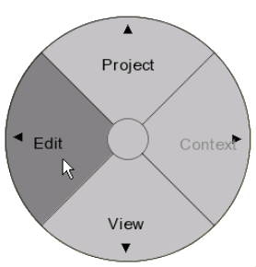
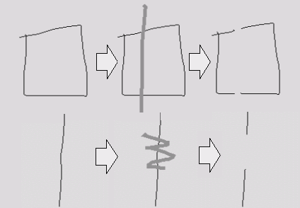
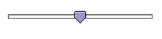
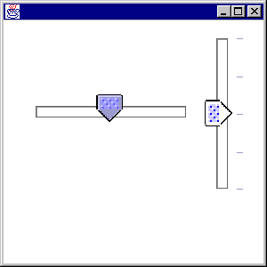
SATIN Libraries
Split
Pen Widgets

Slide 17
OOPS
Toolkit-level support for handling ambiguity and recognition errors
  Library of mediators
  Architectural support
    hierarchical events, mediation, and event dispatching

Slide 18

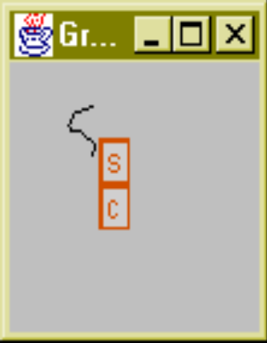
OOPS
down
• • •
drag
• • •
up
stroke
s
c

Slide 19
Takeaway Ideas
Still need many tools for creating useful and usable sketching apps
  Designers need more prototyping and evaluation tools
  Programmers need more toolkits and libraries for making robust applications
Informal user interfaces
  Creative or communication tasks
Ambiguity and errors will always occur
  Minimize, hide, or defer (and mediate)

Slide 20
Sketch Recognizers from
the End-User’s,
the Designer’s, and
the Programmer’s Perspective
Jason Hong
James Landay
A. Chris Long
Jennifer Mankoff

Slide 21
Backup Slides

Slide 22
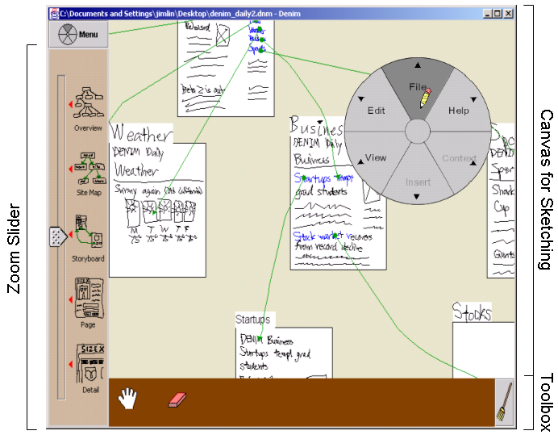
Backup Slides

Slide 23
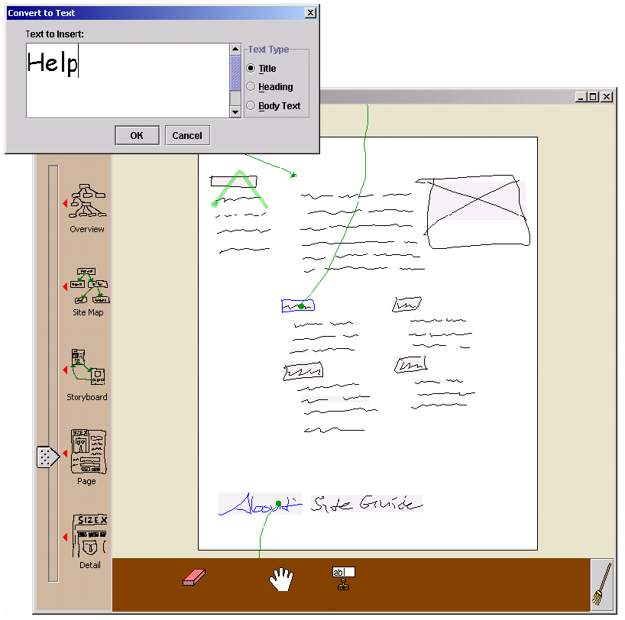
Backup Slides

Slide 24
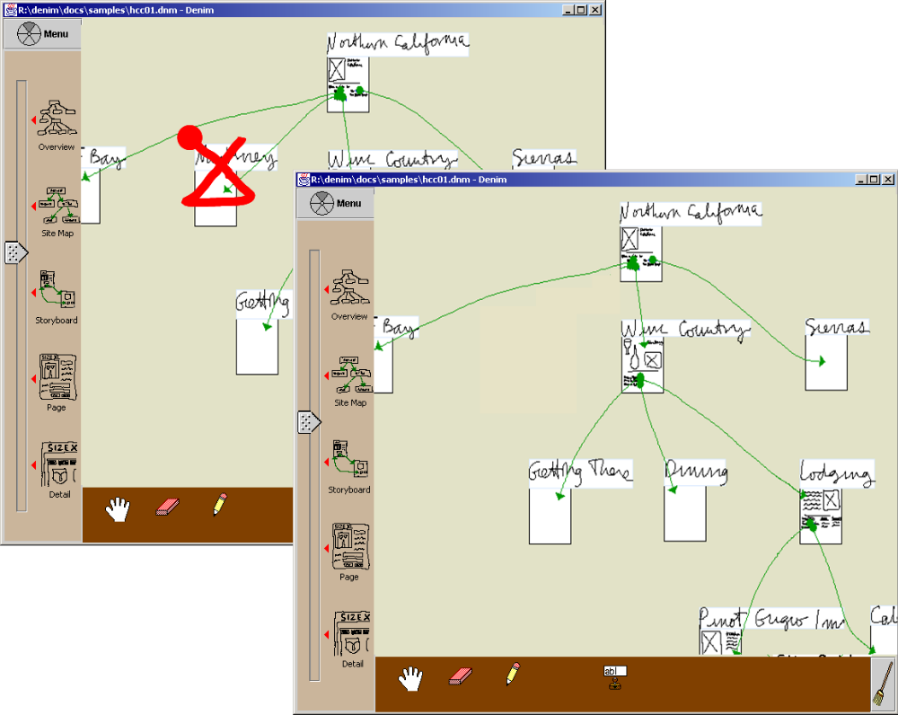
Backup Slides

Slide 25
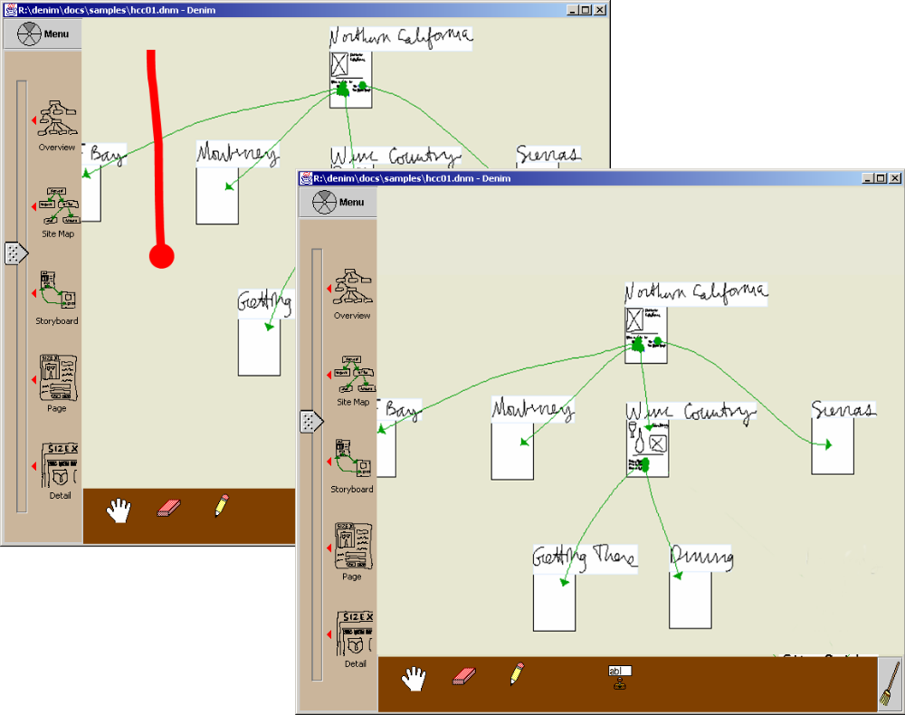
Backup Slides

Slide 26
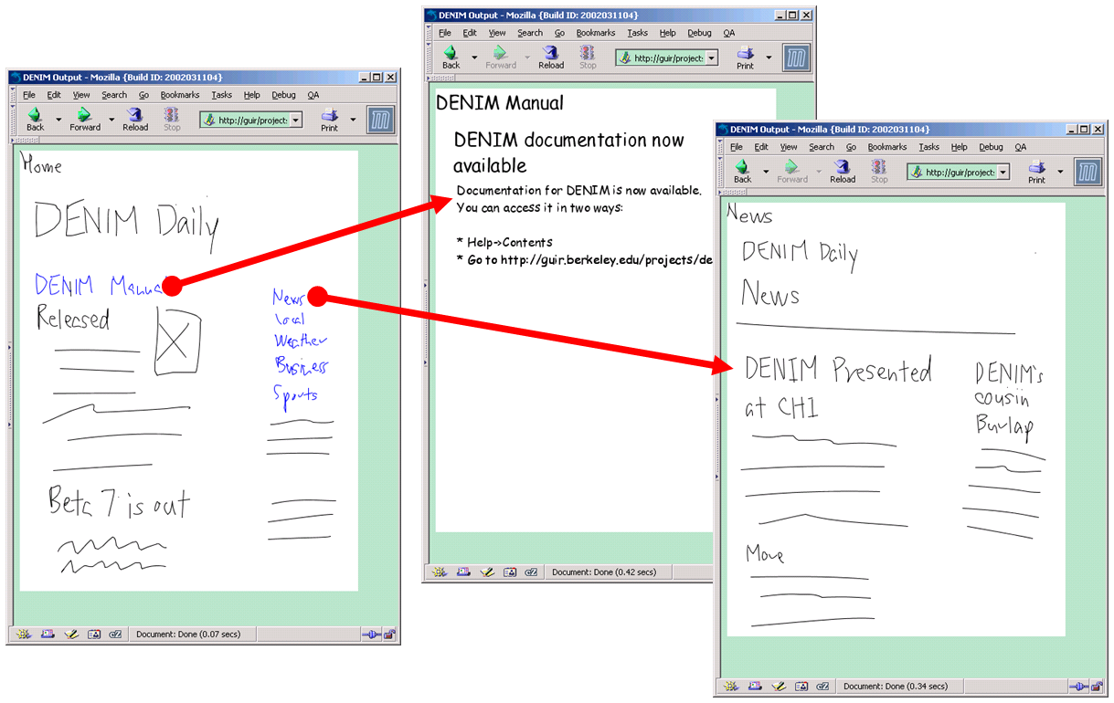
Backup Slides

Slide 27
Defining Multistrokes
(and (contains-p container containee)
(rectangle-p container)
(rectangle-p containee)
(skinny-p container :vertical)
versus

