Slide 1
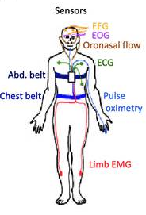
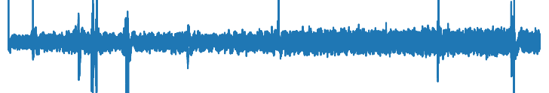
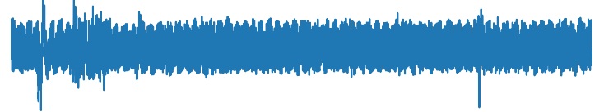
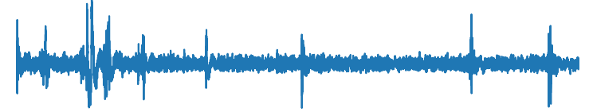
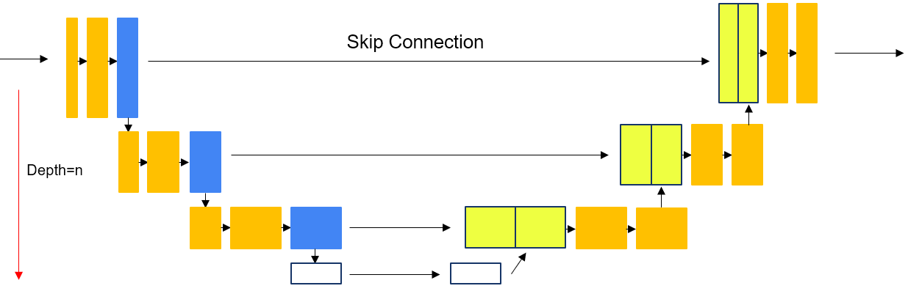
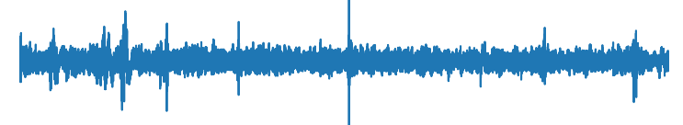
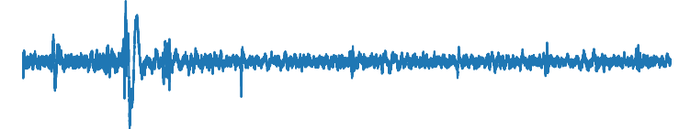
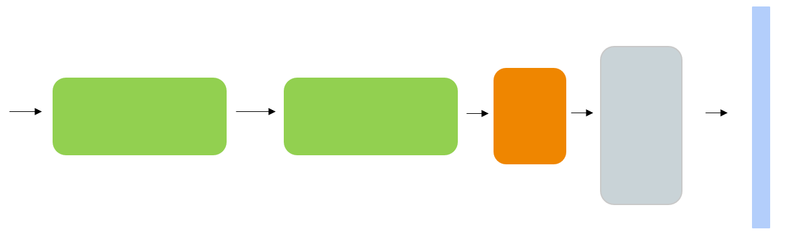
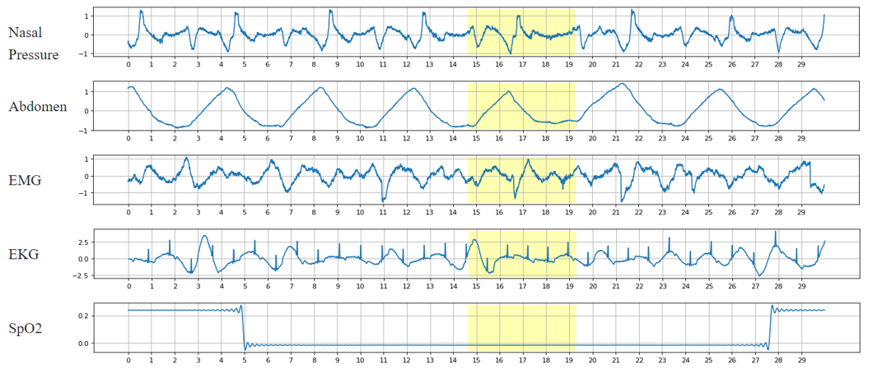
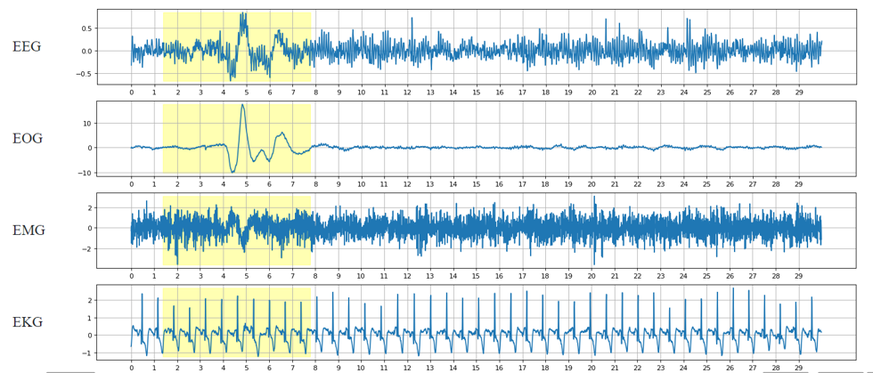
Conv1d
MaxPool1d
ConvTranspose1d
LSTM
Linear
Sigmoid
Output
5 min EEG, EMG, EOG, ECG epochs
Whole Night PSG
Sleep Encoder:U-net
Sleep Decoder: LSTM stacks. Linear layer
5 min Nasal Pressure, Abdomen, EMG, EKG, SpO2 epochs
Apnea Label
Arousal Label

Slide 2
Encoder: U-net architecture
Conv1d
MaxPool1d
ConvTranspose1d
Skip Connection
Depth=n

Slide 3
Decoder: LSTM stacks
LSTM
Linear
Sigmoid
Output
(Batchx1x60000)

