Slide 1
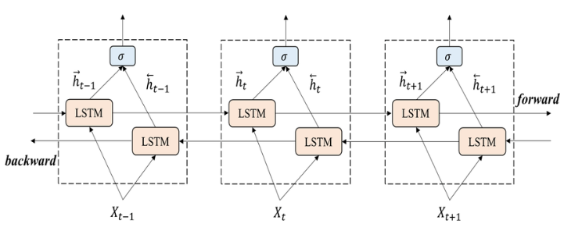
SCAM – Small-Cap Analysis Model For Forecasting Cryptocurrency
Joe Ferguson, Om Jadhav, Jeff Hock, Roshan Baskaran
Background
Method
Preliminary Results
Bi-Directional LSTM
Cryptocurrency is a digital currency that is not reliant on central authorities like other currencies, instead relying on decentralized networks. Popular coins you may have heard of include Bitcoin, Ethereum, Dogecoin, and XRP.
Challenge
Cryptocurrency is incredibly volatile, i.e., the data is noisy
Most models fail to learn the underlying shifts in the market and learn the randomness instead
Additionally, our target of small-cap coins is even noisier than coins like Bitcoin, Ethereum etc., as they do not have the media presence those coins have, which tends to make them slightly more predictable than small-cap coins
Aim
Future Work
Forecast whether price will go up or down at next timestep
We will leverage multi-modal methods involving variations of Long Short-Term Memory Models (LSTM), Graph Neural Networks (GNN), as well as Generalized Auto Regressive Conditional Heteroskedasticity (GARCH).
Try this approach on regular stocks with economic indicators
Evaluate the rate of return this model can produce using a variation of trading strategies
Compare and contrast with other efforts produced by OpenAI, Grok, etc.
Notes:
(PDF) Evaluation of statistical climate reconstruction methods based on pseudoproxy experiments using linear and machine-learning methods (For LSTM)

