Slide 1
SubleasesInc. Presentation
Joe Ferguson, Jason Bellerjeau, GarretT Gerver, Ali El Homayssi, Ameya Saraf, Anas Khairy

Slide 2
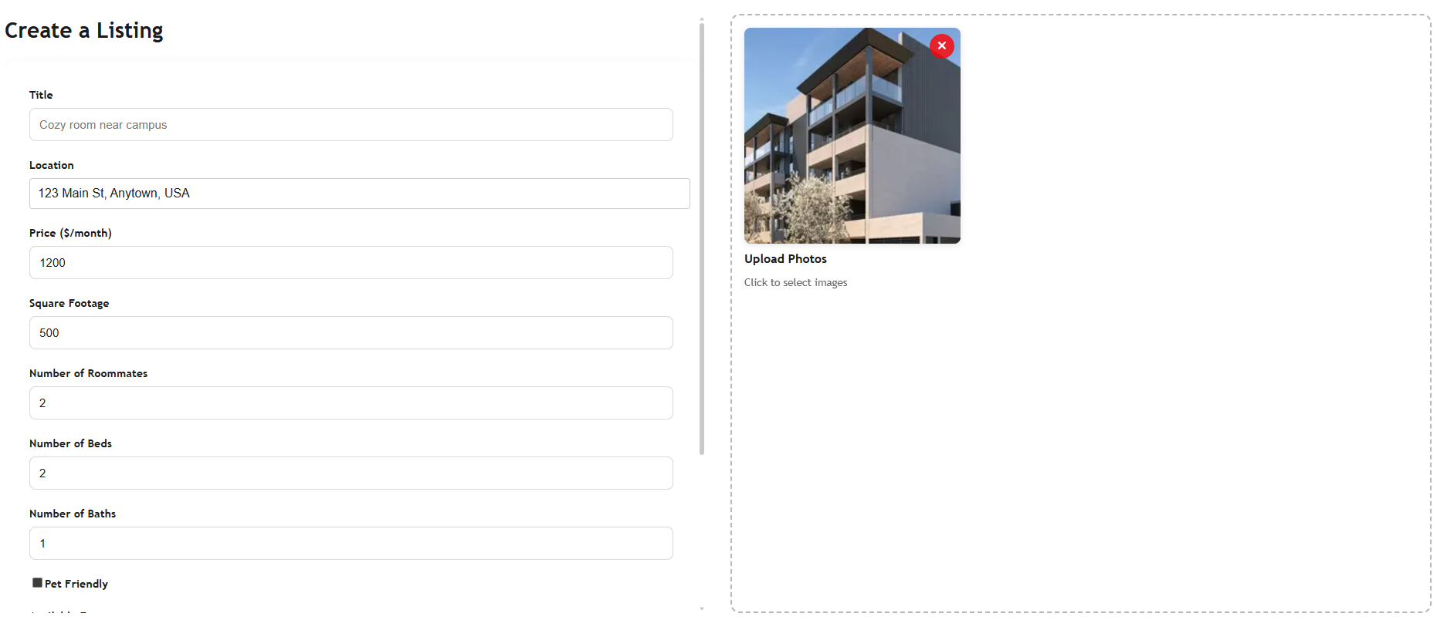
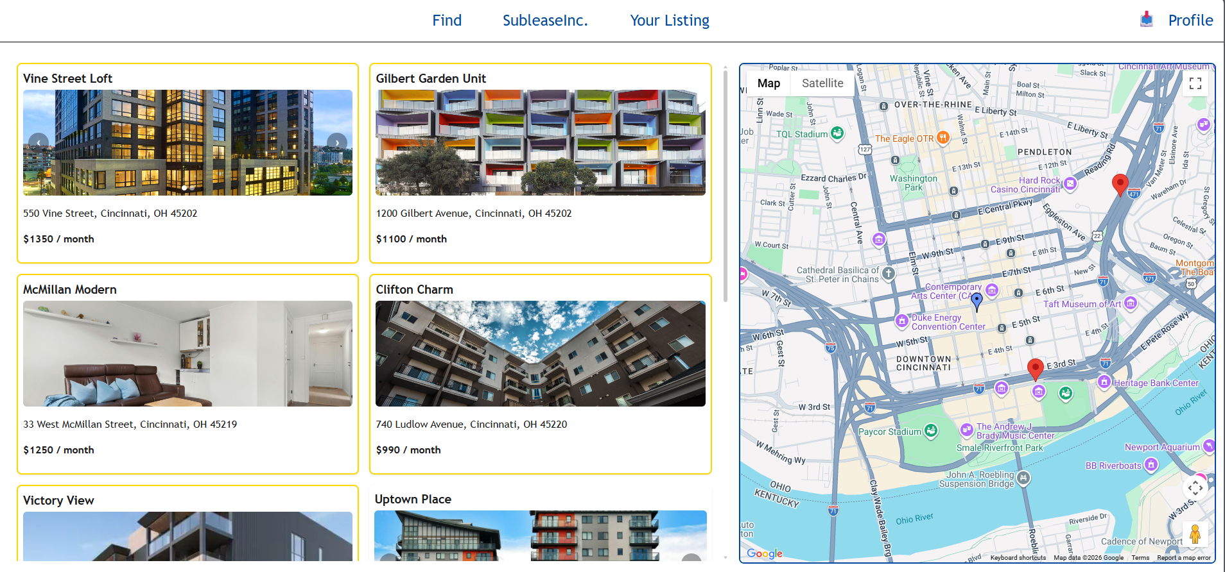
Introduction
SubleasesInc. allows students at a university to host or find subleases. Currently there is no service that does this. Students have to resort to UC Snap Story, Facebook Page, or known friends.
Hosters: Can post their apartment by listing the price, availability, other apartment details, and including photos.
Finders: Can find subleases based on their profile preferences, and SubleasesInc. Original recommendation system.
Notes:
Introduction (2-3 Minutes): 5 points➢ What the Project will do? Why is it important? (Extract from Project Selection and Project Charter)➢ What are the major Requirements and use case? (Extract from Requirements document)➢ How the priorities for the Requirements changed?➢ Include any assumptions or constraints

Slide 3
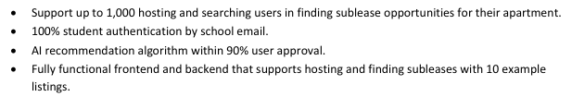
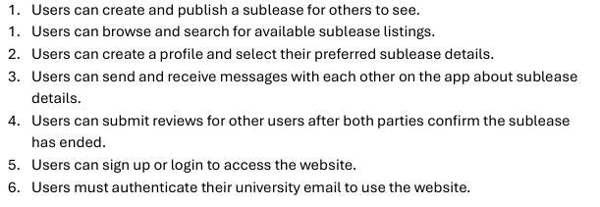
Project Charter & Requirements
Project Goals:
Requirements:

Slide 4
Assumptions & Constraints
Assumption: Not many concurrent users, so median latency (P50) matters more than tail latency (P99). Prioritized end-to-end latency.
Obvious Constraint: Time, we are students with heavy class load and other non-academic responsibilities. So not plausible to have a full-fledged production ready app.
Another Obvious Constraint: Money, we are students so although we have integrated Google Maps API and AWS S3 bucket for photo storage, we have done so using free or trial accounts. We have also not hosted our application as a public service, only run on local machines currently.

Slide 5
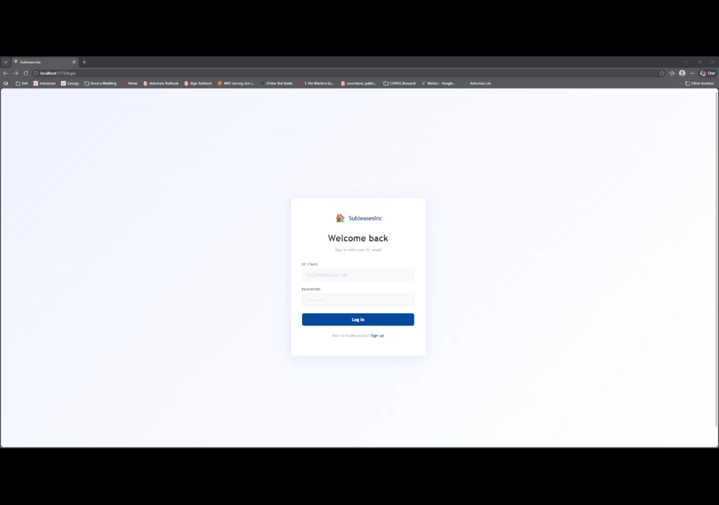
Demonstration

Slide 6
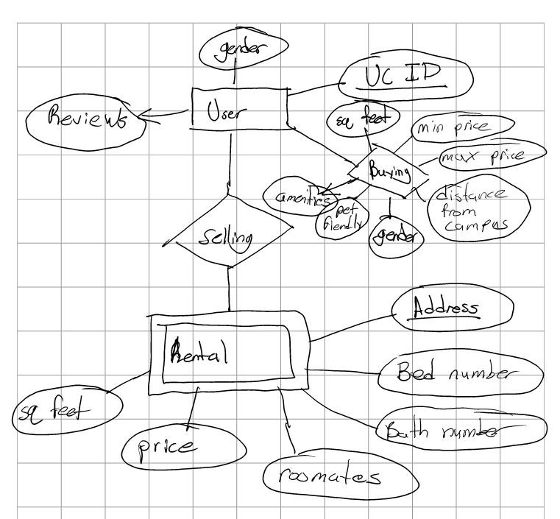
Backend
This is an early ERD for the design of the backend
Each rental as an address and set of features
Each user is connected to their UC ID
A user can buy or sell
If buying, many preferences are taken account of
If selling, a rental address is associated with that user

Slide 7
Algorithms Used – ML Recommendation System
Goal: recommend the top 5 subleases that best match a user’s preferences.
Input Data
User preferences (price, roommates, pets, etc.)
Available listings (price, sqft, beds, amenities)
Feature Matching
Convert user preferences + listing attributes into structured features
Logistic Regression Model
Predicts probability that a user will be interested in a listing
Output = score between 0 and 1
Ranking
Sort listings by predicted score
Return Top N recommendations (max 5)
Why Logistic Regression?
Fast and lightweight (real-time inference)
Interpretable (feature impact is understandable)
Works well for binary preference prediction (like vs not like)

Slide 8
Conclusion and Future Additions
Successfully implemented a full-stack subleasing website for UC students with features such as listing creations, user profiles, ML recommendation system, AWS S3 photo storage, and Google Maps integration. This was all through a React + Vite frontend tied together with a Flask backend.
Adopted the Agile project workflow: responsibilities were divided evenly with each member in charge of a certain domain in the project. The core challenge was balancing scope versus the time we actually had to develop planned features, which meant that some features were sacrificed to deliver the project on time.
Future additions that we plan on fully implementing: In-app messaging, review system, public cloud hosting, and payment facilitation.

