Slide 1
Research Paper Presentation – Group 15
Joe Ferguson, Ali El Homayssi, Garrett Gerver, Anas Khairy, Ameya Saraf, Jason Bellerjeau

Slide 2
Introduction
Release Planning Of Mobile Apps Based on User Reviews by Lorenzo Villarroel, Gabriele Bavota, Barbara Russo, Rocoo Oliveto, Massimiliano Di Penta
This paper introduces CLAP (Crowd Listener for releAse Planning)
An automated tool designed to help developers plan their next mobile app release by importing and mining user reviews.
The approach categorizes user reviews into three specific buckets:
Bug reports
Suggestions for new features
Other.
Clusters related reviews together, such as grouping all reviews that report the exact same bug.
Automatically prioritizes these clusters, recommending to developers which bugs or features should be addressed in the subsequent app release.

Slide 3
Introduction – Software Engineering Problem
To stay competitive, developers must constantly improve their apps by fixing critical bugs and implementing desired features.
App store user reviews are a precious source of information for this, as they explain what users like, dislike, and want.
Manually analyzing these reviews is not doable because popular apps often receive hundreds of reviews per day.
Developers experience information overload and struggle to manually extract actionable requirements from this massive volume of unstructured text.
While previous tools could sort "informative" from "non-informative" reviews, they lacked the ability to specifically separate bug reports from feature requests or learn from past release history to prioritize them.

Slide 4
Introduction – Why is it important
The mobile app market is experiencing tangible growth and enormous competition.
User reviews and ratings are highly important assets for the evolution of an app.
If developers ignore relevant user suggestions, it is very likely that their app will lose its market share.
Conversely, satisfactorily addressing the requests users make in their reviews is likely to increase the app's overall rating.
Providing an automated solution saves hundreds of hours of manual labor, translating user feedback directly into a prioritized roadmap for the next release.

Slide 5
MOTIVATION
[ AR-MINER ] App-Review Mining
(i) extracting informative user reviews by filtering noisy and irrelevant ones
(ii) grouping the informative reviews automatically using topic modeling
(iii) further prioritizing the informative reviews by an effective review ranking scheme
(iv) presenting the groups of most “informative” reviews via an intuitive visualization approach
> But what's next? Why not automate the whole process?
(e.g. categorization, self-learning)
Notes:
AR-MINER Circa 2014, our paper came out in 2016.

Slide 6
NOVELTY
"Unlike AR-Miner, CLAP classifies reviews into bug report and feature suggestion, providing additional insights to the developer about the nature of the review. Also, while AR-Miner simply provides a ranking of the user reviews based on their importance as assessed by a pre-defined formula, CLAP learns from past history of the same app or of other apps to determine the factors that contribute to determining whether a review should be addressed or not."

Slide 7
METHOD - Overview
CLAP works in a 3-step process
Categorizing User Reviews
Clustering Related Reviews
Prioritizing Review Clusters

Slide 8
Method – Step 1 – Categorizing User reviews
Multi-Class classification – Bug Report, New Feature Suggestion, Other (non-informative)
Preprocessing: Stanford Parser, Stop Word Removal, Stemming, Unifying Synonyms, N-grams Extraction
After preprocessing they are left with 3 features: Rating, N-Grams, Bag-Of-Words
Uses Random Forest ML algorithm
Classification also uses some pre-assigned values for dependent variable (not explicitly shown)

Slide 9
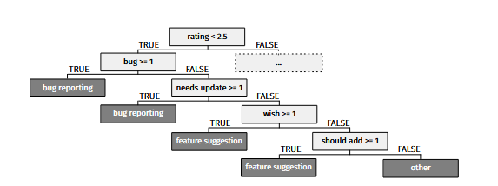
Method – Step 1 – Categorizing User reviews
Example Regression Tree when categorizing

Slide 10
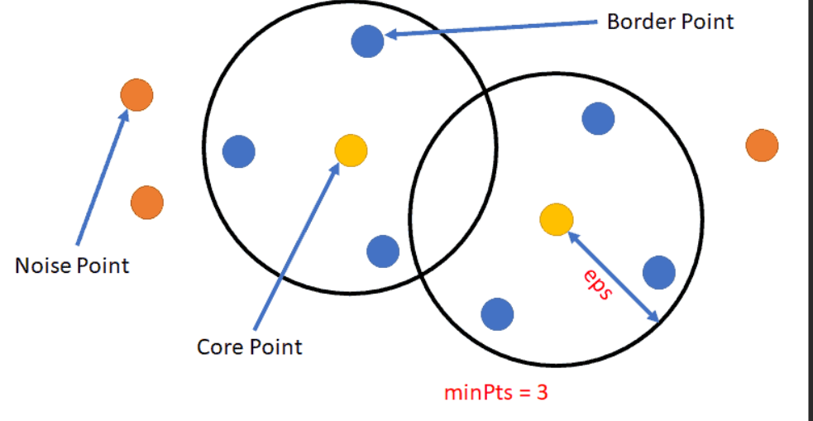
Method – Step 2 – Clustering Related Reviews
Only use the informative classifications from previous step (no “others”)
Clustering done by applying DBSCAN, which utilizes the distance between reviews computed using Vector Space Model
Two-parameters here: Minimum Number of Points for a cluster to form, Maximum Distance between points to consider them part of the same cluster
Example DBSCAN

Slide 11
Method – Step 3 – Prioritizing Review clusters
Binary Classification – Is review high or low priority?
Uses Random Forest Again
Features:
Number of Reviews (# in cluster)
Average Rating of Cluster
Difference between Average rating of Cluster and average rating of the app
Average Difference of the ratings assigned by users in the Cluster who reviewed older versions
Number of hardware devices in Cluster

Slide 12
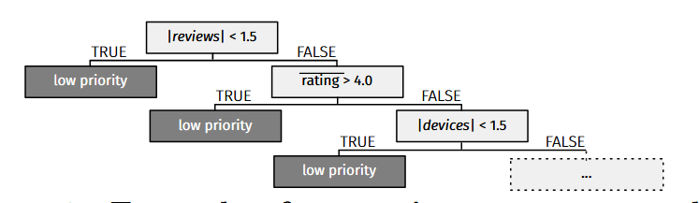
Method – Step 3 – Prioritizing Review clusters
Example Regression Tree when prioritizing

Slide 13
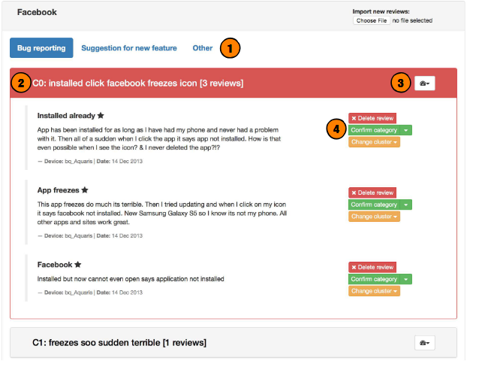
CLAP - UI

Slide 14
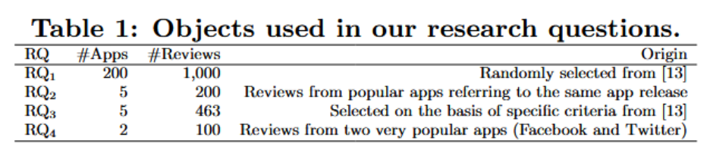
results
To answer research questions, the author listed the objects used to further conduct their research.

Slide 15
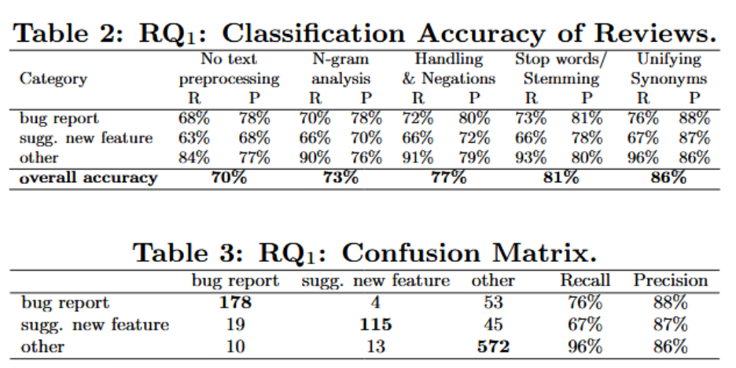
Rq 1 – Classification Accuracy
Research Question: How accurate is CLAP in classifying user reviews in the considered categories?
Using 1000 manually labeled reviews and applying text preprocessing techniques, performance improved from 70% to an overall accuracy of 86%.
CLAP is reliable in terms of distinguishing between bug reports, feature requests, and other reviews

Slide 16
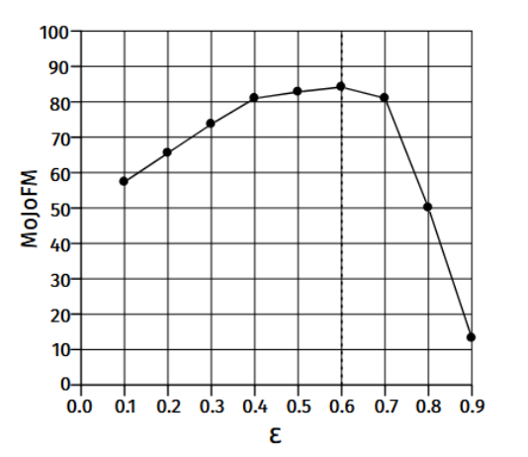
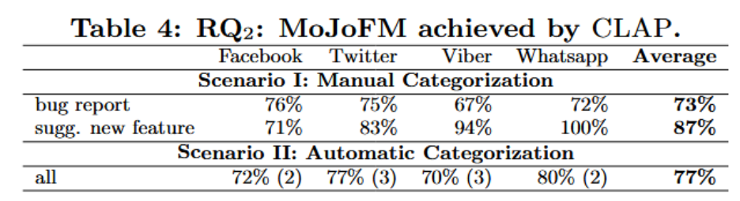
Rq 2 – clustering quality
Research Question: How meaningful are the clusters of reviews generated by CLAP?
Experienced developers manually clustered a set of bug reports/features (called an Oracle).
Those clusters were used alongside clusters produced by CLAP to tune the epsilon parameter for step 2, and achieved an 87% similarity for feature requests and an overall similarity of 77%.

Slide 17
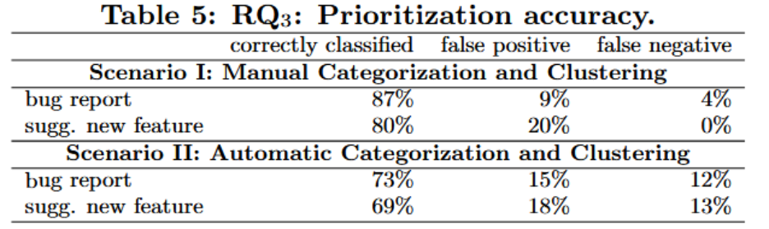
Rq 3 – prioritization accuracy
Research Question: How accurate is the new features / bug fixing prioritization recommended by CLAP?
They used an Android user reviews dataset to make another Oracle of varying levels of priority
For manually corrected categorization and clustering, CLAP achieved an accuracy of 87% and 80% for bugs and features respectively.
In a fully automated setting, the accuracy stuck around the 70% mark.

Slide 18
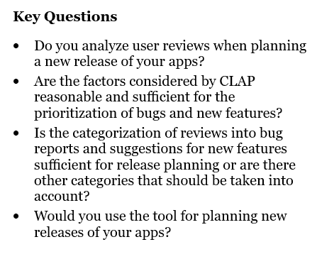
Rq 4 - applicability
Research Question: Would actual developers use CLAP for release planning?
The authors interviewed project managers from 3 different software companies that develop Android apps. They all worked with a demo of CLAP using Twitter and Facebook reviews to avoid bias.
4 key questions were asked
As a result, all project managers concluded the questions with "yes" or "absolutely yes". One of them stated that their company doesn't use user reviews.

Slide 19
conclusion
The paper introduces CLAP, a model that helps developers analyze large numbers of mobile app reviews.
CLAP improves existing approaches by classifying reviews, clustering related feedback, and prioritizing which bugs or features should be addressed first.
The evaluation showed strong performance, with 86% classification accuracy, 77% meaningful clustering, and 72% recommendation accuracy.
Feedback from industry developers was positive, suggesting the tool could support real release planning.
They discuss future work as:
Mining reviews from similar, competition apps as well as the target app
Multi-store support
Automatic translation to English to overcome language limitation

