Slide 1

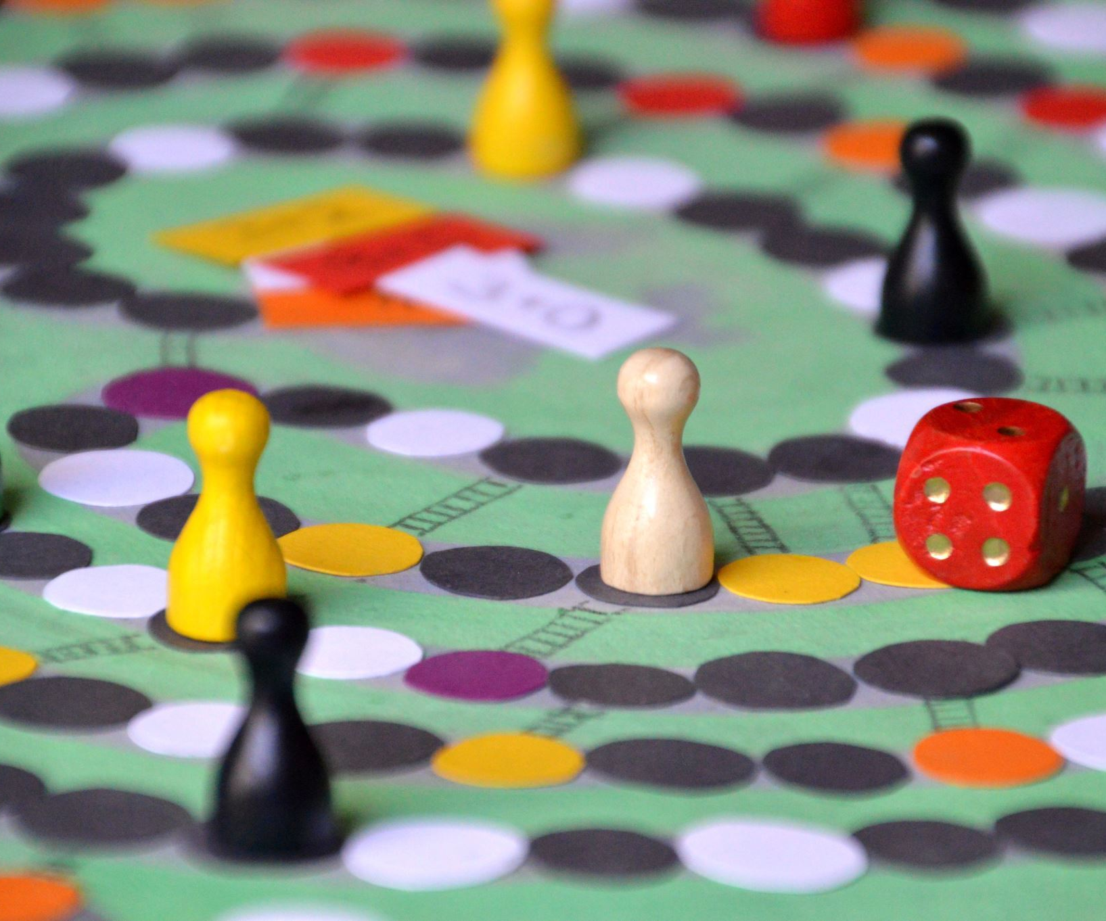
Library Database
Jason Miller, Kaleb Brunt, Marcus Stephens, Joseph May

Slide 2
Abstract
We have focused on a sample problem featuring a library, which must keep many records like its book catalog, library patrons, customers, employee records, and other related data.
We have created a database to record this data, and in the future, a user interface to manipulate the database to do certain predefined SQL operations like adding, deleting, and modifying the data.

Slide 3
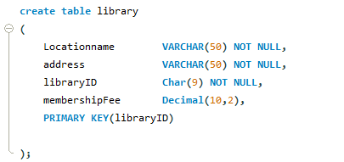
Table Overview: Library This represents the physical library.

Slide 4
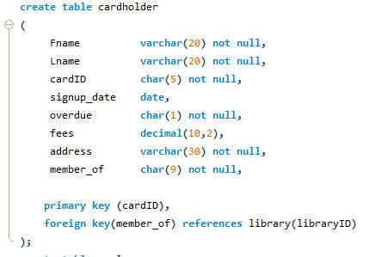
Table Overview: CardHolder This represents library users (people with library cards)

Slide 5
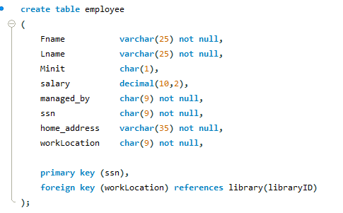
Table Overview: Employee Represents people who work at the library

Slide 6
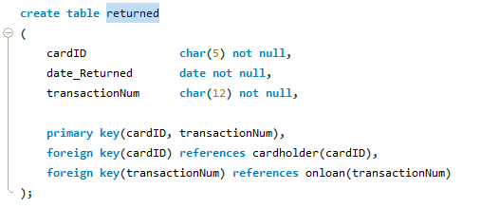
Table Overview: Returned This represents items that have been returned to the library and must be processed.

Slide 7
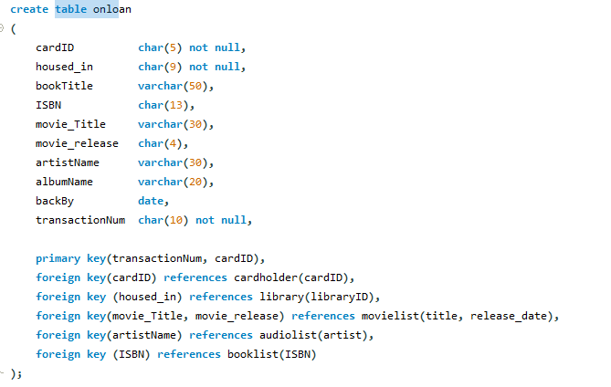
Table Overview: OnLoan Represents items that are currently being loaned out

Slide 8
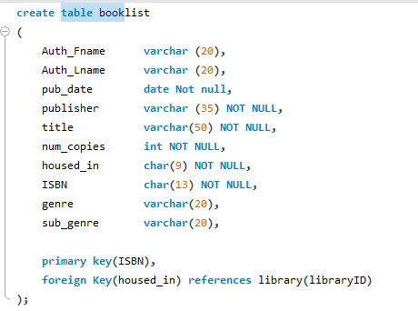
Table Overview: Booklist Represents books housed in a library

Slide 9
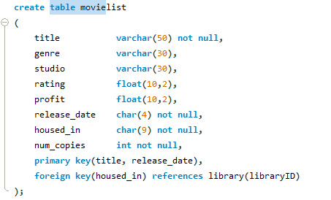
Table Overview: Movielist Represents Movies kept in the library

Slide 10
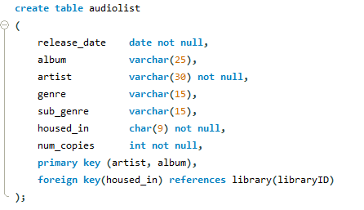
Table Overview: Audiolist Represents music records kept in the library

Slide 11
Where we are going:
Finish uploading all data into the database.
Build out database safety features. Add in checking on things like salary where the employee doesn’t make more than the manger
Add in triggers where once a book has been cleared from returned list the number of copies left in the database goes up by 1.
Make sure items can't be borrowed if the number of copies is 0
Assign a fee if the returned date is past the due by date

Slide 12
Where we are going:
Build out our front end so that users can query the database.
Create views per authorized database users. We currently have 3 users prototypes:
Renter - can see library catalog and what they have borrowed and returned
Employee - has renter access, plus they can see employee information (minus ssn, salary, address) all onloan information and returned information
Manager- maximum accessibility. Can see all the tables

Slide 13
SQL demo of database & Front end

Slide 14
Useful Queries & functions: Search
Library
By address
By name
By rating
By book (does it have a book)
Library card holder
By name (first or last or both)
If they have overdue books
If they owe a fine
Employee
By SSN
By role
By salary

Slide 15
Useful Queries & Functions: Search:
Book
By year
By author
By rating
By genre
Availability
Book quantity to loan
Library
Name
Address
Membership fee

Slide 16
Useful Queries & functions: Update
Employee
Name
Salary
Manager Status
Card holder
Name
Loaned books
Fees Due – Y/N and amount due
Books Requested
Overdue books next to the fees
Card ID

Slide 17
Citations
A. Dahlan and F. W. Wibowo, "Design of Library Data Warehouse Using SnowFlake Scheme Method: Case Study: Library Database of Campus XYZ," 2016 7th International Conference on Intelligent Systems, Modelling and Simulation (ISMS), 2016, pp. 318-322, doi: 10.1109/ISMS.2016.71.
https://ieeexplore-ieee-org.ezproxy.mtsu.edu/document/7877232
Deshpand, J. (2018, March). Digital Libraries: An overview of standards, protocols and formats. Digital Libraries: An overview of Standards, Protocols and Formats. Retrieved August 31, 2022, from https://www.ijlis.org/articles/digital-libraries-an-overview-of-standards-protocols-and-formats.pdf
Sara Tabaei, Yitzchak Schaffer, Gregory McMurray & Bashe Simon (2013) Building a Faculty Publications Database: A Case Study, Public Services Quarterly, 9:3, 196-209, DOI: 10.1080/15228959.2013.816127
https://www-tandfonline-com.ezproxy.mtsu.edu/doi/full/10.1080/15228959.2013.816127
N. A. Azlan, Z. Zulkifli, H. Hussin, S. Samsuri and A. M. Ali, "Undergraduate Students' Acceptance of Library Online Database System to Support Studies and Research," 2016 6th International Conference on Information and Communication Technology for The Muslim World (ICT4M), 2016, pp. 53-58, doi: 10.1109/ICT4M.2016.023.
Undergraduate Students' Acceptance of Library Online Database System to Support Studies and Research | IEEE Conference Publication | IEEE Xplore (mtsu.edu)
L. Lin and C. Lei, "Research on University Library Information database under Digital Information Environment," 2022 IEEE 2nd International Conference on Power, Electronics and Computer Applications (ICPECA), 2022, pp. 446-449, doi: 10.1109/ICPECA53709.2022.9718975.
Research on University Library Information database under Digital Information Environment | IEEE Conference Publication | IEEE Xplore (mtsu.edu)

