Slide 1

Scratch VHDL Hands-on FPGA Experience Education Tool
Philip & Joseph Abbey
https://house-of-abbey.github.io/scratch_vhdl/

Slide 2
Design Process
Design Entry
Scratch to generate VHDL
Simulation
Stimulate the design to test functionality
Synthesis
Place & Route (Implementation)
Elaboration
Synthesis
Programming
BIT file generation
Program and Test
Choose a project
Button GUI rather than VHDL test bench
Experience the end-to-end design entry and build process without having to learn VHDL

Slide 3
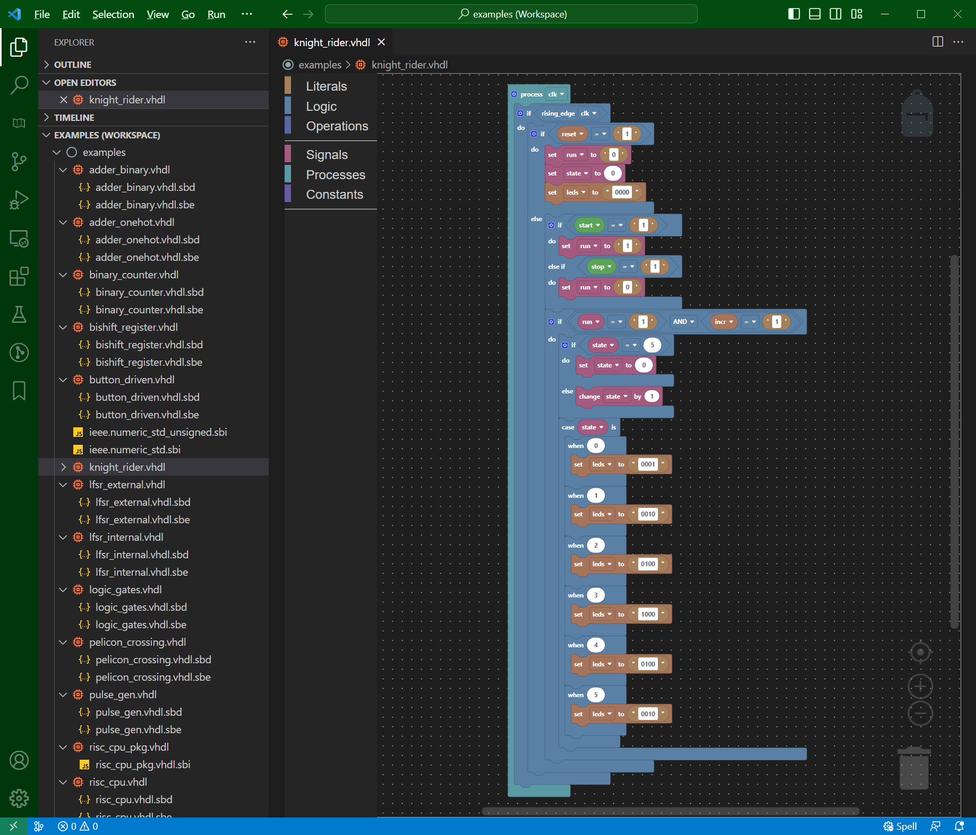
Design Entry – Scratch in VSCode
library ieee;
use ieee.std_logic_1164.all;
architecture scratch of led4_button4 is
constant button_tab_c : natural := 1;
signal run : std_logic;
signal state : integer range 0 to 5 := 0;
alias start is buttons(0);
alias stop is buttons(1);
begin
process(clk)
begin
if rising_edge(clk) then
if reset = '1' then
run <= '0';
state <= 0;
leds <= "0000";
else
if start = '1' then
run <= '1';
elsif stop = '1' then
run <= '0';
end if;
if run = '1' and incr = '1' then
if state = 5 then
state <= 0;
else
state <= state + 1;
end if;
case state is
when 0 =>
leds <= "0001";
when 1 =>
leds <= "0010";
:
Generates VHDL

Slide 4
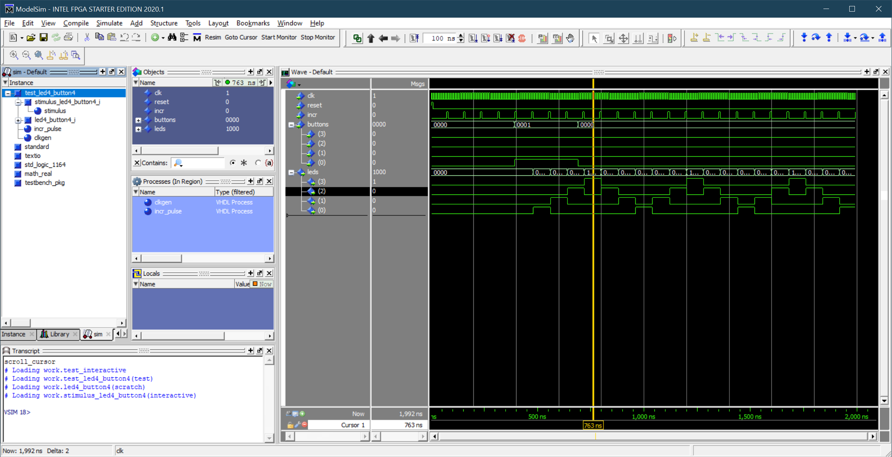
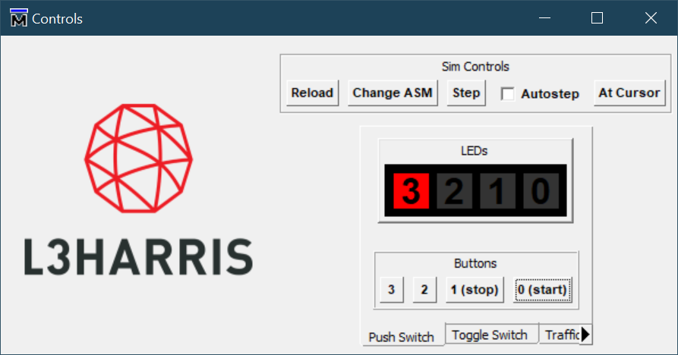
VHDL Simulation - ModelSim

Slide 5
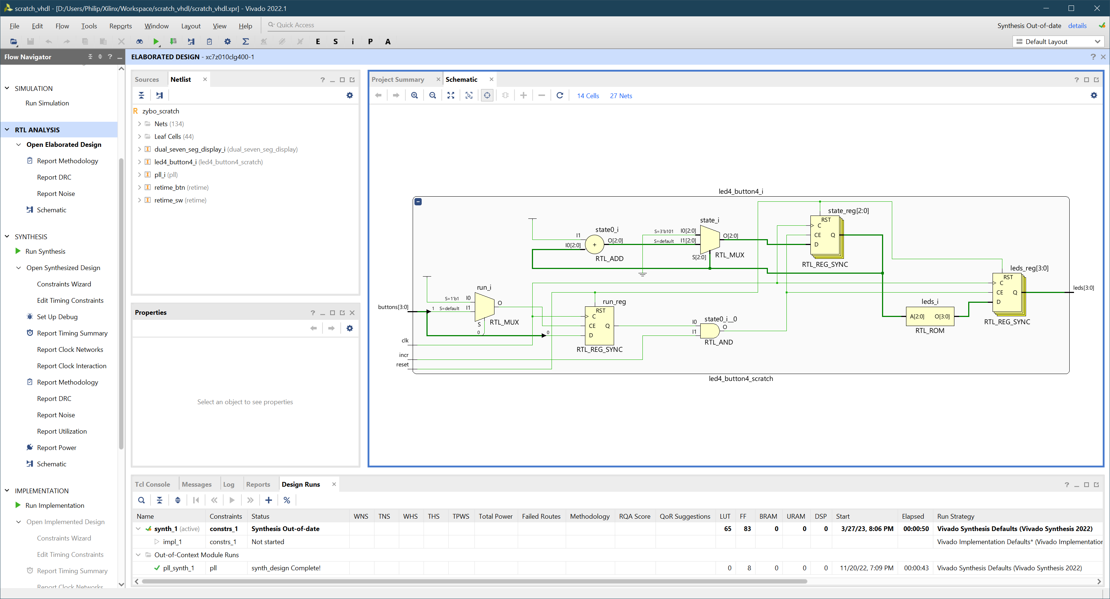
Elaboration to Generic Gates - Vivado
Simplified to “buttonology”

Slide 6
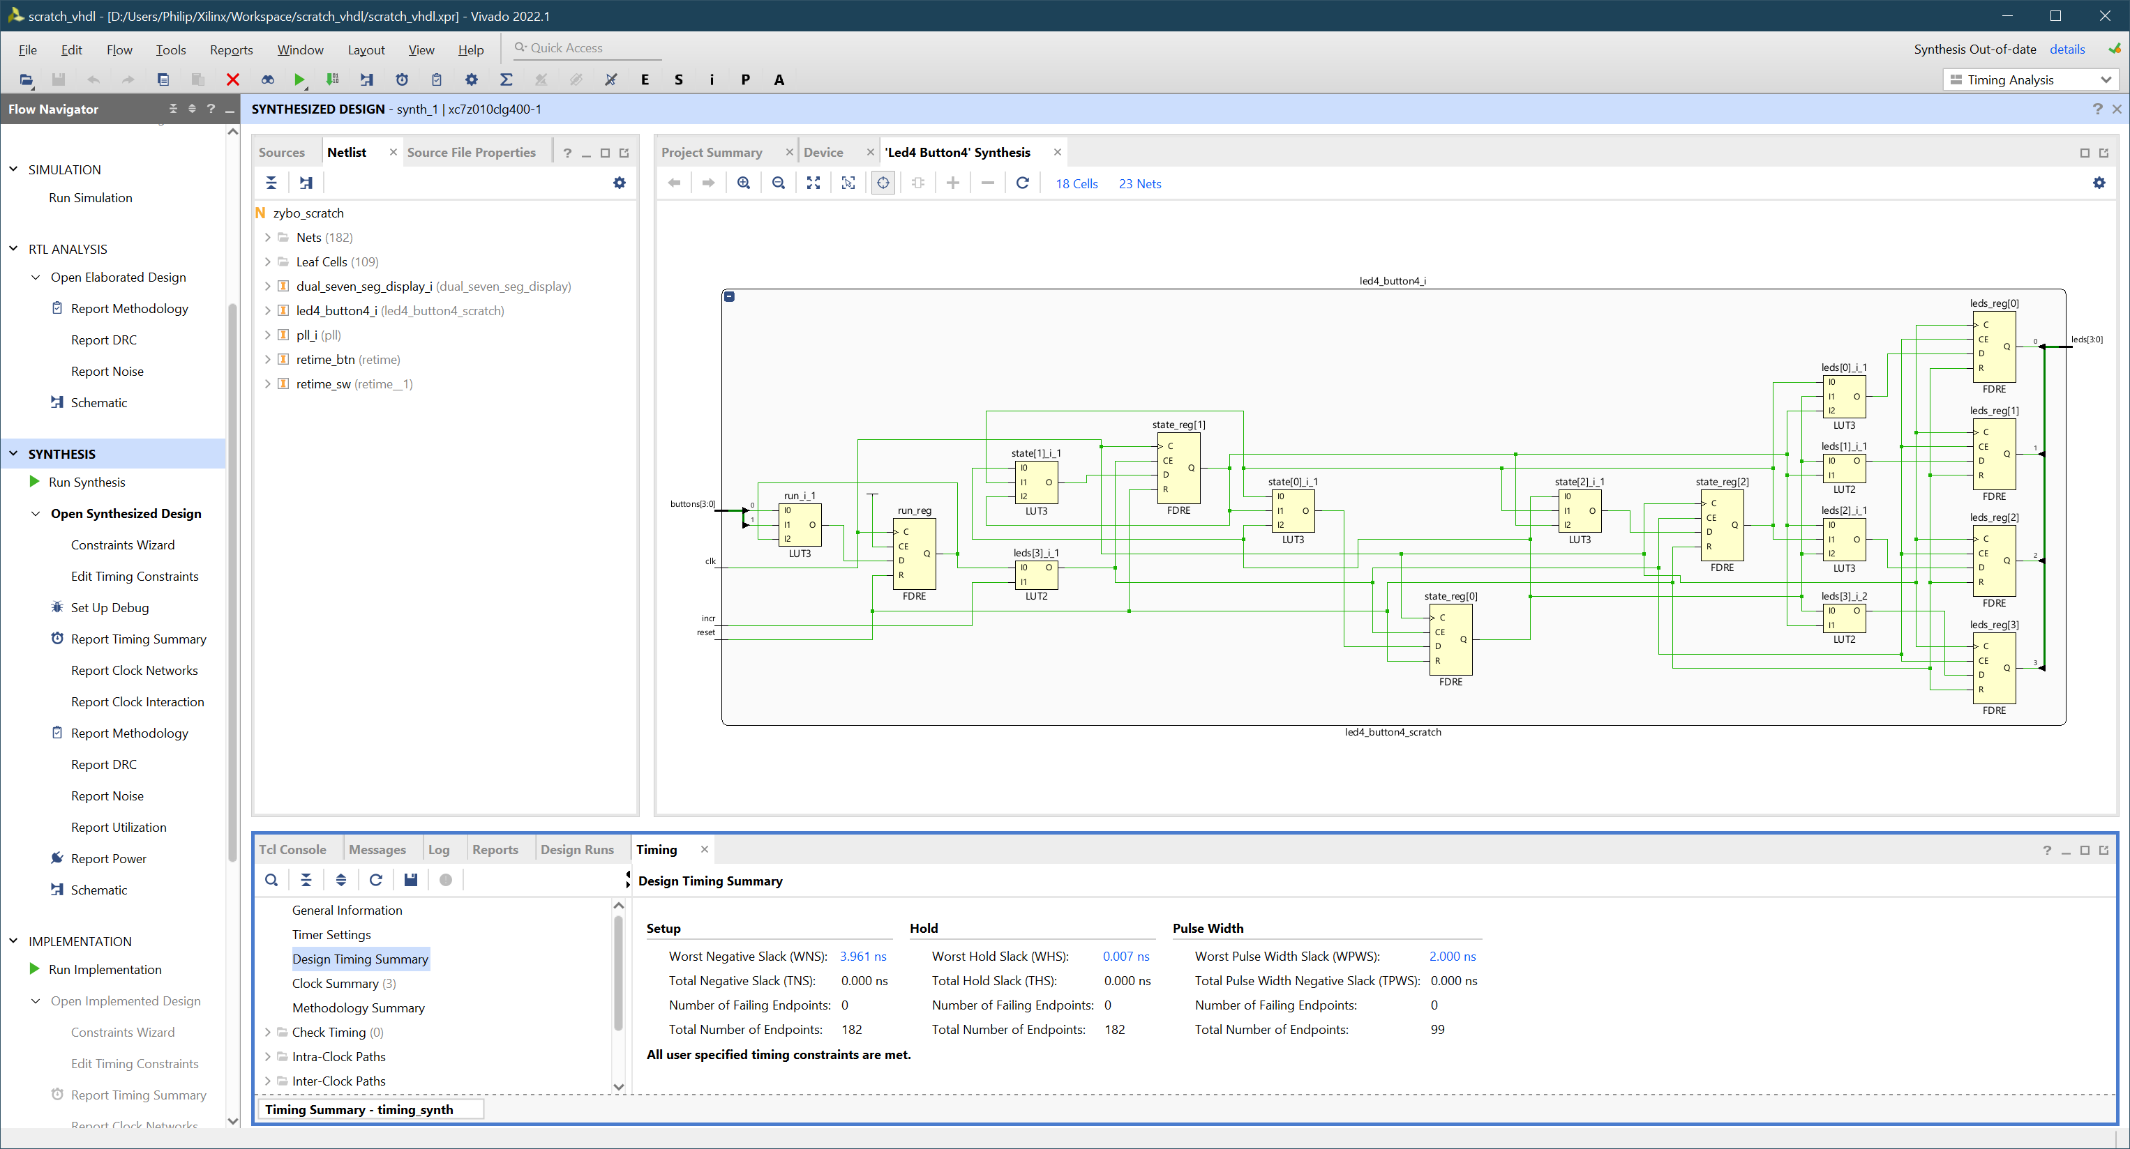
Synthesis to Xilinx Device - Vivado

Slide 7

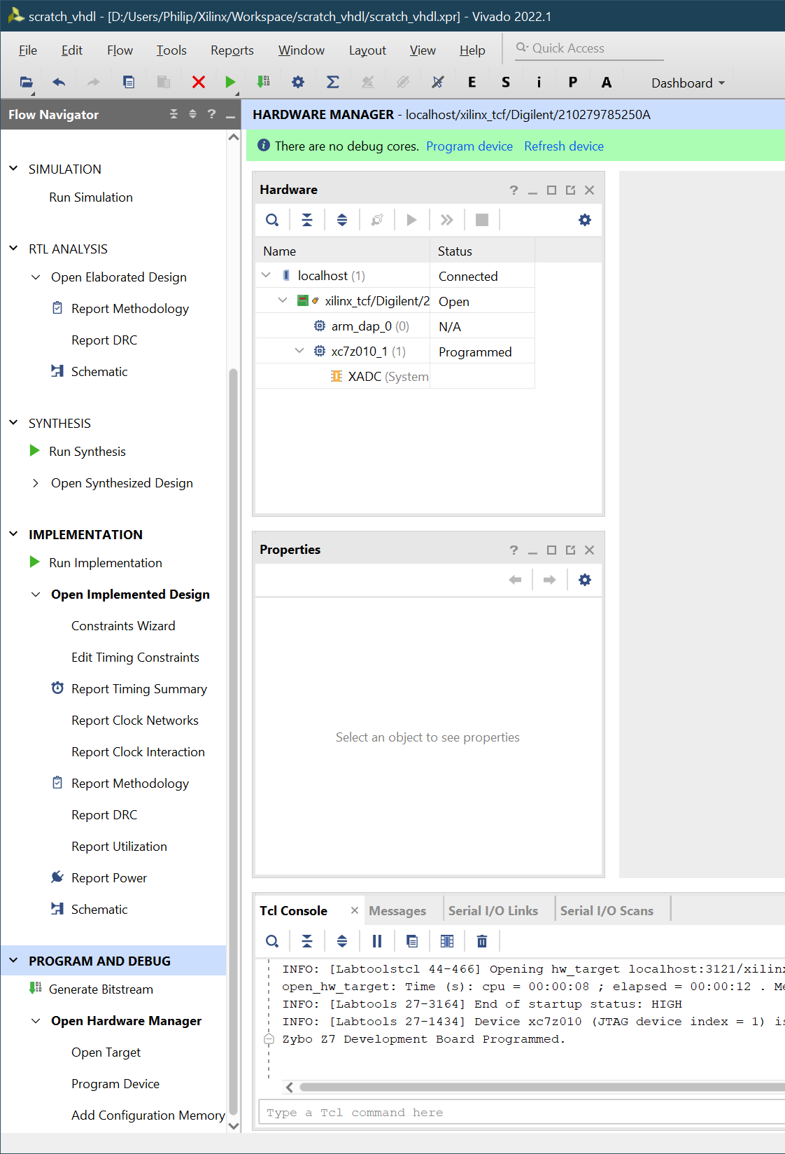
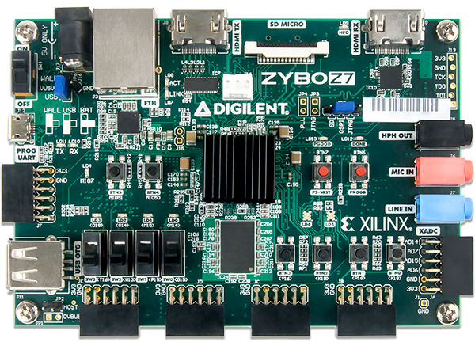
Execution – Zybo Z7
LEDs
Toggle Buttons
Push Buttons

Slide 8
Concept
Simple range of designs
Bite-sized to make you think a little
Testing reduced to ‘interactive play’
Skip the self-checking test benches for this exercise
Full Design Process Introduction
Simulation
Synthesis
Development Board
Superficial but hands-on

Slide 9
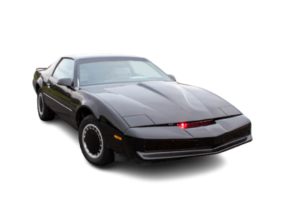

Example Projects
Foundation
State Machines
One LED per button
Hello World
Logic gates
Truth tables
Pulse Generator
Shift Register
4-bit binary counter
Sum of buttons pressed
The Knight Rider KITT car
Bonnet light sequence from the 1980’s television series
Traffic lights
Standard junction
Pelican crossing
Dimmer Controller
Linear Feedback Shift Register
RISC CPU

Slide 10
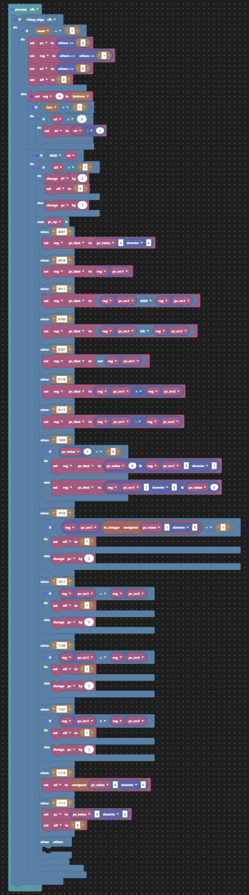
Finally - 4-Bit RISC CPU
Custom CPU instruction set
Designed for “4 buttons and 4 LEDs”
Custom assembler
Modified from existing Open Source project
#include "./ruledef.asm"
pelicon_crossing:
.s0:
leds <- 0b0001
wincr
r0 <- 0b0001 ; start
.s0_loop:
r1 <- btns and r0
if r1 eq r0
goto .s1
goto .s0_loop
.s1:
leds <- 0b0011
wincr
.s2:
leds <- 0b0000
wincr
.s3:
leds <- 0b0010
wincr
.s4:
leds <- 0b0000 ; Left filter this time
wincr
.s5:
leds <- 0b0010
wincr
.s6:
leds <- 0b0100
wincr
r0 <- 0b0010 ; stop
.s6_loop:
r1 <- btns and r0
if r1 eq r0
goto .s7
goto .s6_loop
.s7:
leds <- 0b0010
wincr
goto pelicon_crossing

Slide 11
Instruction Set
#once
#bits 13
; Define a register
#subruledef reg
{
btns => 6`3 ; equivalent to r6
leds => 7`3 ; equivalent to r7
r{r:u3} => r`3
}
; Safely assign the output register, make sure it is not r6, which is
; read-only for the buttons inputs.
#subruledef sreg
{
{o:reg} => {
assert(o != 6)
o`3
}
}
#subruledef condition ; VHDL references
{ ; op @ dest @ src1 @ src2
{a:reg}[{b:u2}] => 0xa @ 0`3 @ a`3 @ 0`1 @ b`2 ; op_ifbit
{a:reg} eq {b:reg} => 0xb @ 0`3 @ a`3 @ b`3 ; op_ifeq
{a:reg} gt {b:reg} => 0xc @ 0`3 @ a`3 @ b`3 ; op_ifgt
{a:reg} ge {b:reg} => 0xd @ 0`3 @ a`3 @ b`3 ; op_ifge
}
; In general: o = fn(a, b)
;
#ruledef ; VHDL references
{ ; op @ dest @ src1 @ src2
noop => 0x0 @ 0`9 ; noop
{o:sreg} <- {v:u4} => 0x1 @ o`3 @ 0`2 @ v`4 ; op_set
{o:sreg} <- {a:reg} => 0x2 @ o`3 @ a`3 @ 0`3 ; op_copy
{o:sreg} <- {a:reg} and {b:reg} => 0x3 @ o`3 @ a`3 @ b`3 ; op_and
{o:sreg} <- {a:reg} or {b:reg} => 0x4 @ o`3 @ a`3 @ b`3 ; op_or
{o:sreg} <- not {a:reg} => 0x5 @ o`3 @ a`3 @ 0`3 ; op_not
{o:sreg} <- {a:reg} + {b:reg} => 0x6 @ o`3 @ a`3 @ b`3 ; op_add
{o:sreg} <- {a:reg} - {b:reg} => 0x7 @ o`3 @ a`3 @ b`3 ; op_sub
{o:sreg} <- {b:u1} > {a:reg} => 0x8 @ o`3 @ a`3 @ 0`2 @ b`1 ; op_shft
{o:sreg} <- {a:reg} < {b:u1} => 0x8 @ o`3 @ a`3 @ 1`2 @ b`1 ; op_shft
if {c:condition} => c`13
wait until {c:condition} => asm {
if {c}
noop
goto $ - 2
}
wait while {c:condition} => asm {
if {c}
goto $ - 1
noop
}
wincr => 0xe @ 1`9 ; op_wi
wincr {l:u9} => 0xe @ l`9 ; op_wi
goto {l:u9} => 0xf @ l`9 ; op_goto
}
Forked from https://github.com/hlorenzi/customasm
See https://github.com/JosephAbbey/customasm
Assemble code for your own instruction set

Slide 12
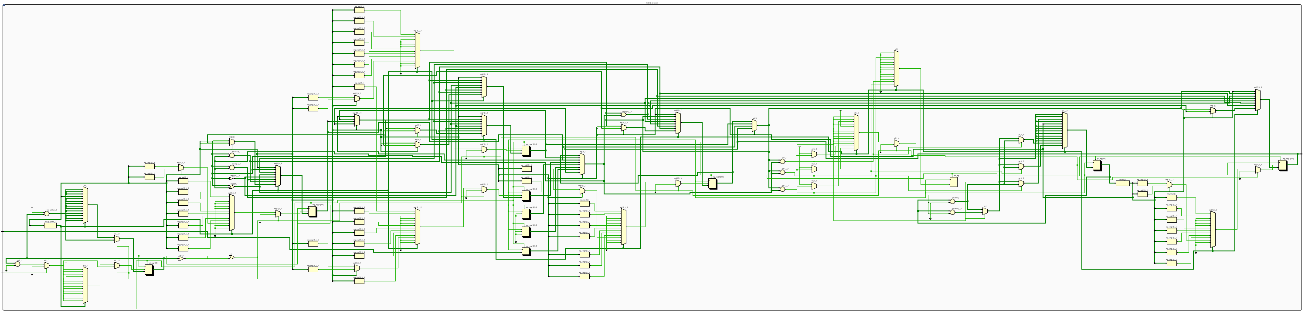
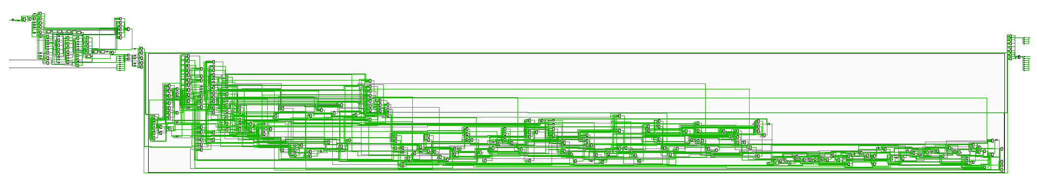
4-Bit RISC CPU Synthesis & Implementation

Slide 13
Any Interest?
Need to prove this project works as an educational tool.

Slide 14
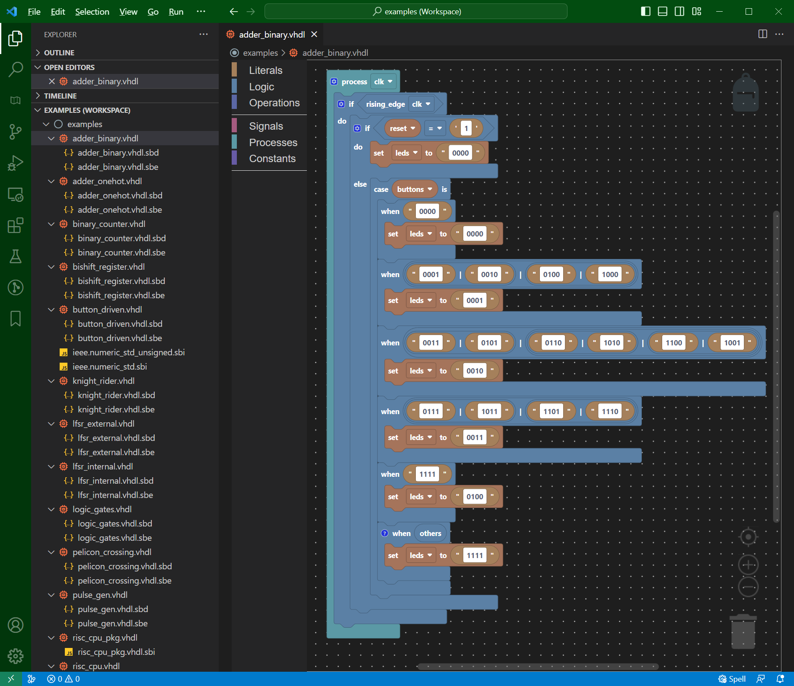
Design Entry - Scratch
library ieee;
use ieee.std_logic_1164.all;
architecture scratch of led4_button4 is
constant button_tab_c : natural := 2;
begin
process(clk)
begin
if rising_edge(clk) then
if reset = '1' then
leds <= "0000";
else
case buttons is
when "0000" =>
leds <= "0000";
when "0001" | "0010" | "0100" | "1000" =>
leds <= "0001";
when "0011" | "0101" | "0110" | "1010" | "1100" | "1001" =>
leds <= "0010";
when "0111" | "1011" | "1101" | "1110" =>
leds <= "0011";
when "1111" =>
leds <= "0100";
-- Cover the other bit values: 'U', 'X', 'Z', 'W', 'L' & 'H'
when others =>
leds <= "1111";
end case;
end if;
end if;
end process;
end architecture;
Generates VHDL

Slide 15
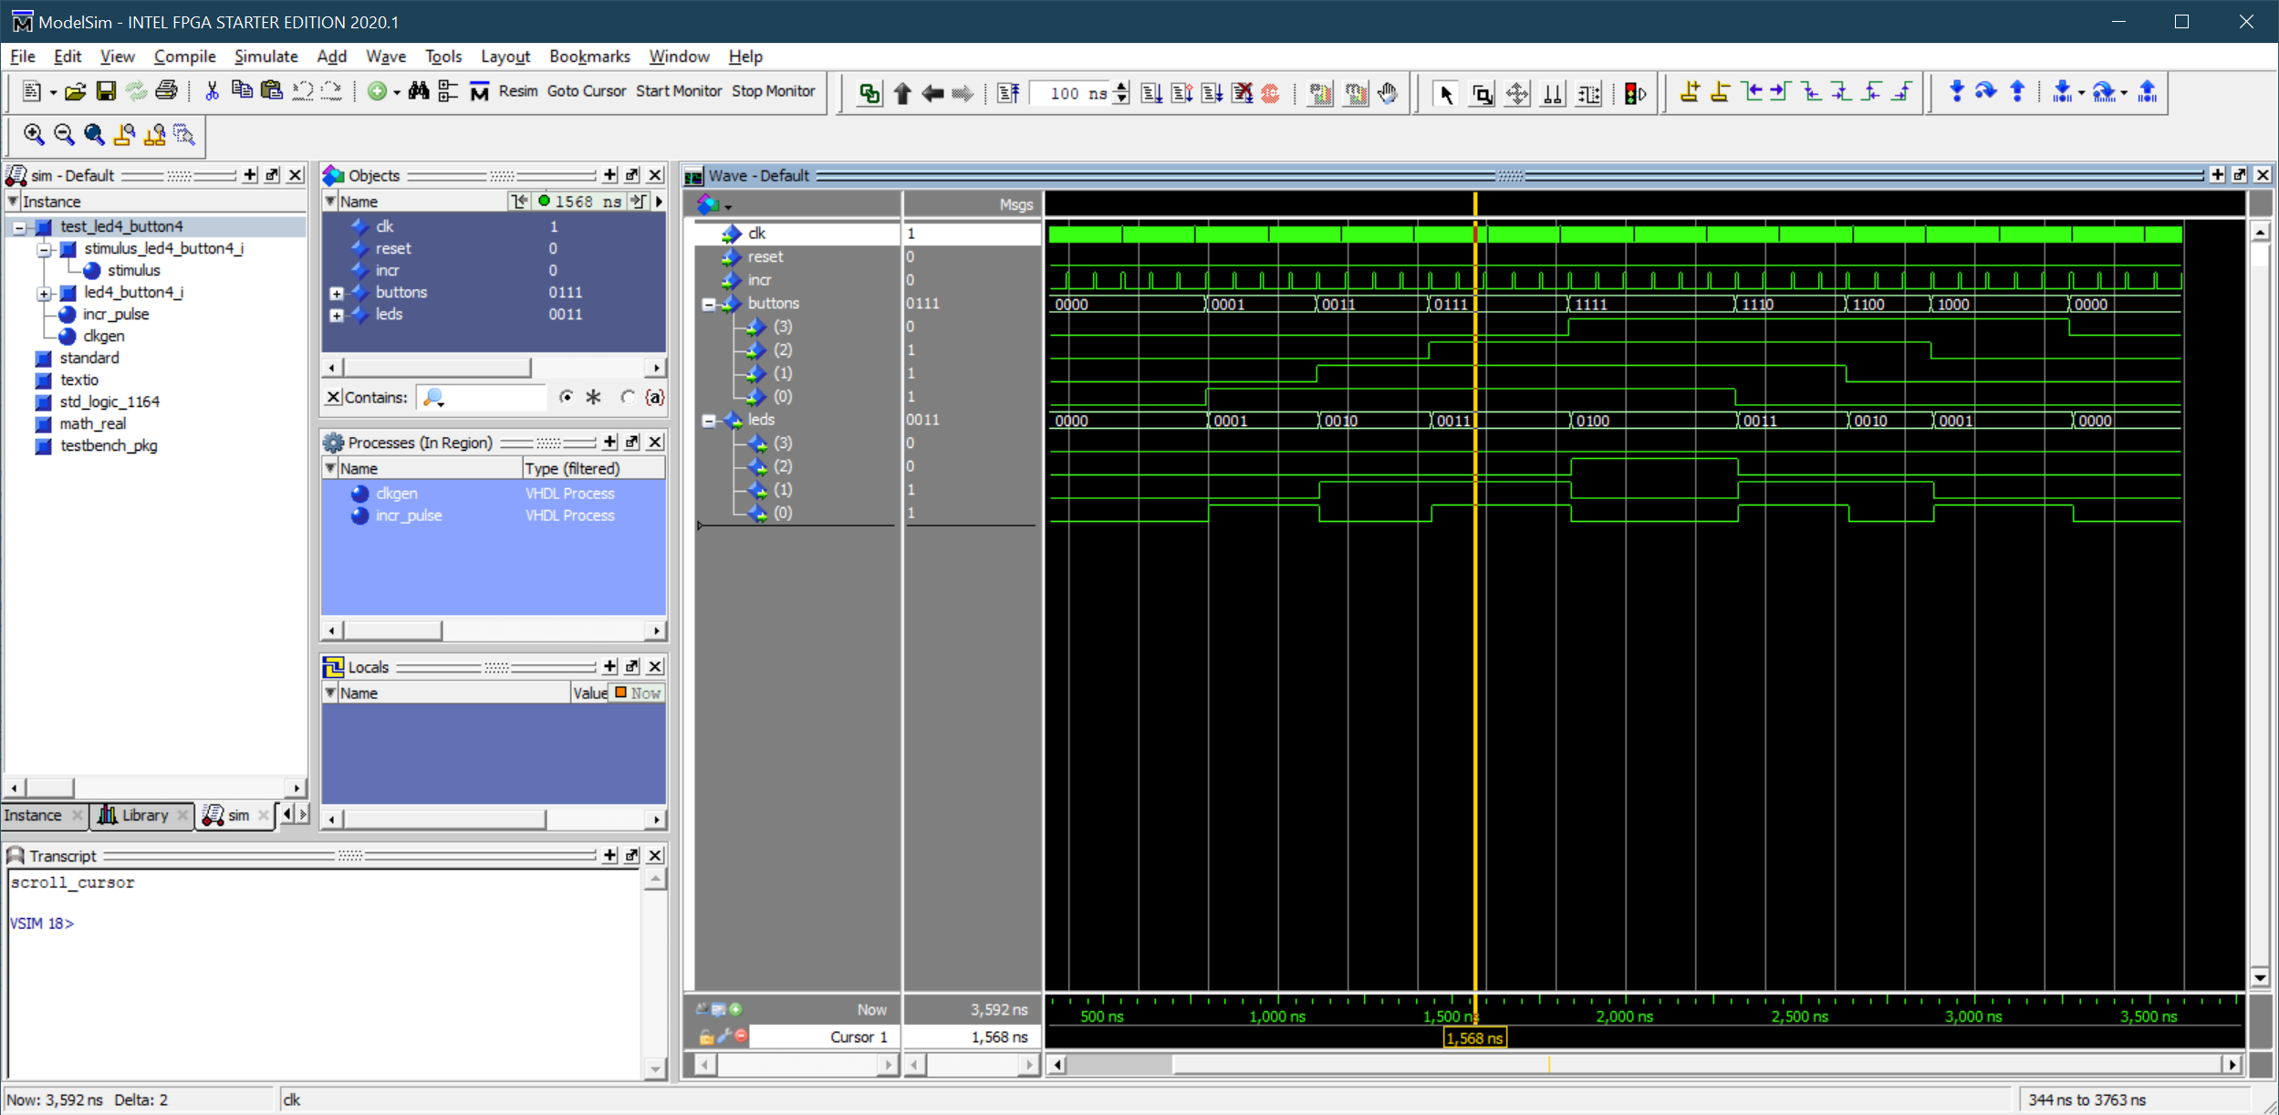
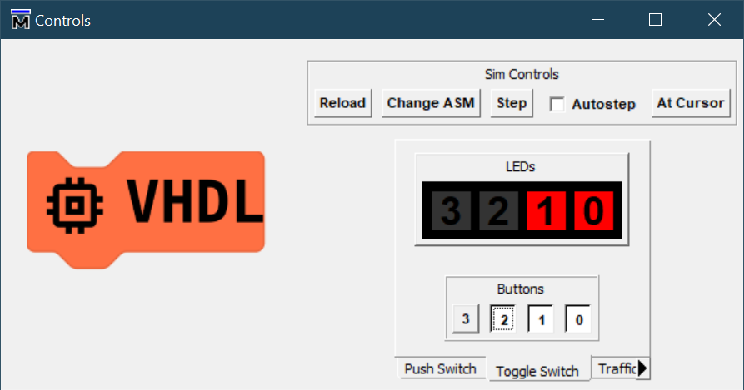
VHDL Simulation - ModelSim

