Slide 1

Scratch VHDL Hands-on FPGA Experience Education Tool
Philip & Joseph Abbey
https://house-of-abbey.github.io/scratch_vhdl/

Slide 2
Taxonomy of Silicon Chips
Full-Custom
Hand crafted and chiselled, e.g. x86 µP
Semi-Custom
E.g. “Standard Cell” where gates are predefined in a library and have to be tessellated.
Programmable
Size
Complex Programmable Logic Device (CPLD) - small
Field Programmable Gate Arrays (FPGA) - large
Re-use
Programme once (fuse-based)
Re-programmable (SRAM-based)
ASIC
Full-Custom ASIC
Semi-Custom ASIC
Programmable IC PLD & FPGA
Gate Arrays
Cell Based
Channelled
Channel-less
Standard Cell
Macro Cell
Introduction to ASIC Technology | Different Types, Design Flow, Applications
https://www.electronicshub.org/introduction-to-asic-technology/
Notes:
ASIC = Application Specific Integrated Circuit
In Gate Array based ASICs, p and n types transistors are predefined on a silicon wafer as arrays.
In channelled gate arrays, the interconnections between the logic cells are performed within the predefined channels between the rows of the logic cells.
In channel-less gate arrays, the connections are made on an upper metal layer on top of the logic cells.
A Standard Cell based ASIC uses predesigned logic cells like Gates, Multiplexers, Flip-flops, Adders etc.
These logic cells are known as Standard Cells that are already designed and stored in a library.
This library is imported into the CAD tool and the design can performed using the components of the library as inputs.
The standard cell design may also contain a larger and more complex predesigned cells like Microcontrollers or Microprocessors. These larger cells of “hard IP” are called as Megacells or Macrocells.

Slide 3
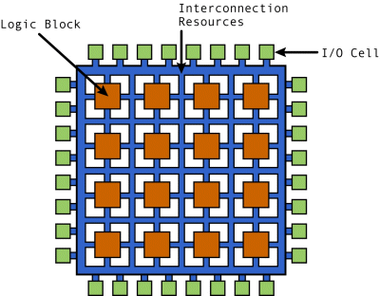
Field Programmable Gate Array (FPGA)
A “sea of gates” waiting to be connected up
Each gate needs to be given a function
Typically a 6-input lookup table (LUT)
Register (D-Flop)
Each gate needs to be connected
Paths between gates need to be defined for inputs and outputs
Clock and reset nets connected
See “Interconnection Resources”
Runtime definitions held in SRAM
Dumb at power on
Until programmed with a BIT file
Forgotten at power off
Needs to be re-programmed next time
E.g. Xilinx UltraScale+ FPGA:
8,938 k system logic cells
3,840 multipliers, each 27 bits x 18 bits
224 Mb memory
2577 I/O pins
They're Big!
https://www.eetimes.com/all-about-fpgas/

Slide 4
FPGA Applications
Video imaging
Military technologies, including
Cryptography
Missile guidance systems
Automotive computing
Aerospace applications
Search engine algorithms
Networking and data center management
Digital Signal Processing (DSP)
Medical devices
Ability to perform many data operations simultaneously
A general-purpose processor normally does one task and moves on to the next
Custom computation to exploit parallelism in algorithms
Special-purpose hardware without the costs associated with fixed logic silicon chips (ASICs ^{ⴕ})
But not as ‘fast’
i.e. lower clock speed
Middle ground between software and ASIC
^{ⴕ}Application Specific Integrated Circuit (ASIC)

Slide 5
Scratch VHDL Full Design
Reprogramme this component
zybo_z7_10
Power-on Reset
Synchroniser (retime)
sw(3:0)
4
reset
led4_button4
buttons(3:0)
leds(3:0)
led(3:0)
Synchroniser (retime)
4
clk
btn(3:0)
7 Segment Display Decoder
leds(3:0)
External clock
PLL
clk
sevseg(6:0)

Slide 6
led4_button4 Specification
The only part of the design you need to work is this component
clk, reset and incr, are given to you
Use incr as a condition in order to slow down a sequence of actions for the naked eye
4 button in buttons(3:0)
4 LEDs in leds(3:0)
clk
led4_button4
reset
leds(3:0)
incr
buttons(3:0)

Slide 7
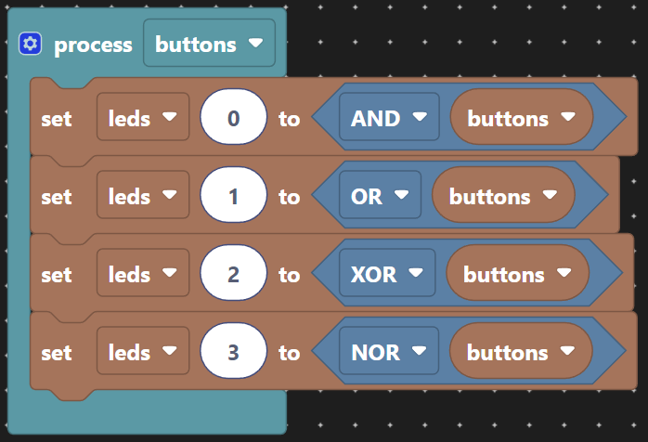
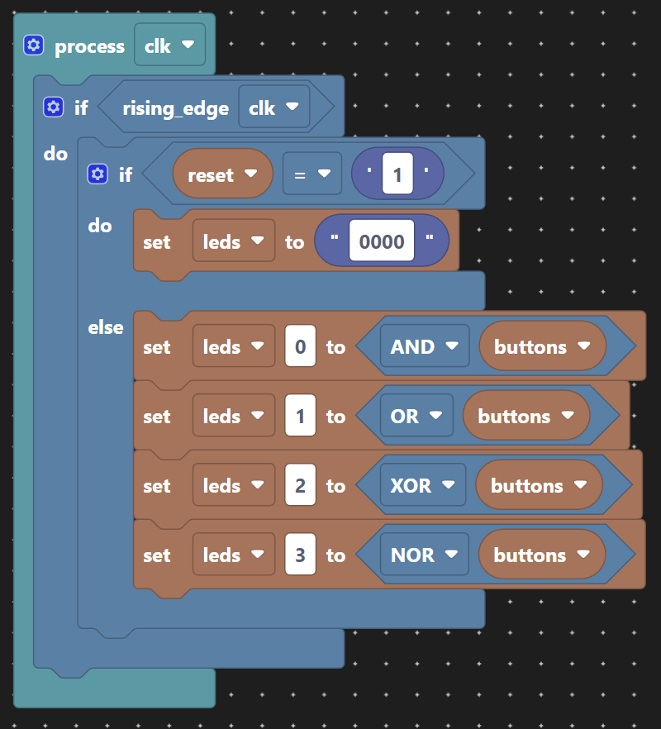
Essential Knowledge
{
Process sensitivity list
Purely combinatorial logic
Combinatorial logic
{
Clock specification
Registered logic
Reset state
{
{
D
Q
Combinatorial logic
CE
Actions

Slide 8
Code Your 1st Scratch VHDL Example
E.g. Logic gates
Code & Compile
Simulate & Test
Synthesise
Programme & Test

Slide 9
Design Process
✓
Design Entry
Scratch to generate VHDL
Simulation
Stimulate the design to test functionality
Synthesis
Place & Route (Implementation)
Elaboration
Synthesis
Programming
BIT file generation
Program and Test
Choose a project
Button GUI rather than VHDL test bench
Experience the end-to-end design entry and build process without having to learn VHDL

Slide 10
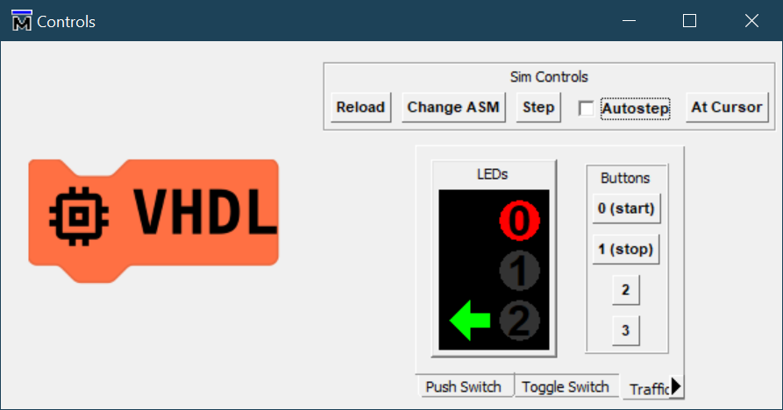
Simulation Setup
The main test stimulus is provided by a clickable GUI
4 buttons
3 LEDs
The GUI interacts with a VHDL test bench
But you don’t need to see it.
The simulation wave window then needs to be used to debug the design
test_zybo_z7_10
reset
clk
Stimulus
clk
reset
led4_button4
buttons(3:0)
leds(3:0)

Slide 11
Simulation Controls
Restart the simulation and reset the GUI
Set Assembly File for ROM
Step Emulation
Continuously Step Emulation
Make the display reflect the state under the cursor
Four buttons
Three tabs for different displays and button types

Slide 12
Design Process
✓
✓
Design Entry
Scratch to generate VHDL
Simulation
Stimulate the design to test functionality
Synthesis
Place & Route (Implementation)
Elaboration
Synthesis
Programming
BIT file generation
Program and Test
Choose a project
Button GUI rather than VHDL test bench
Experience the end-to-end design entry and build process without having to learn VHDL

Slide 13
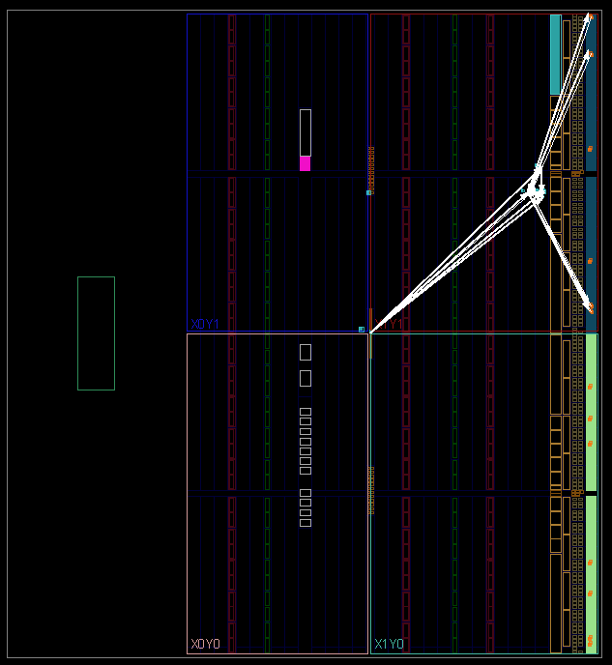
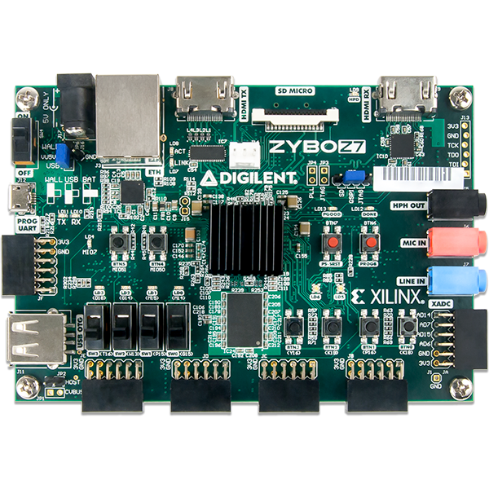
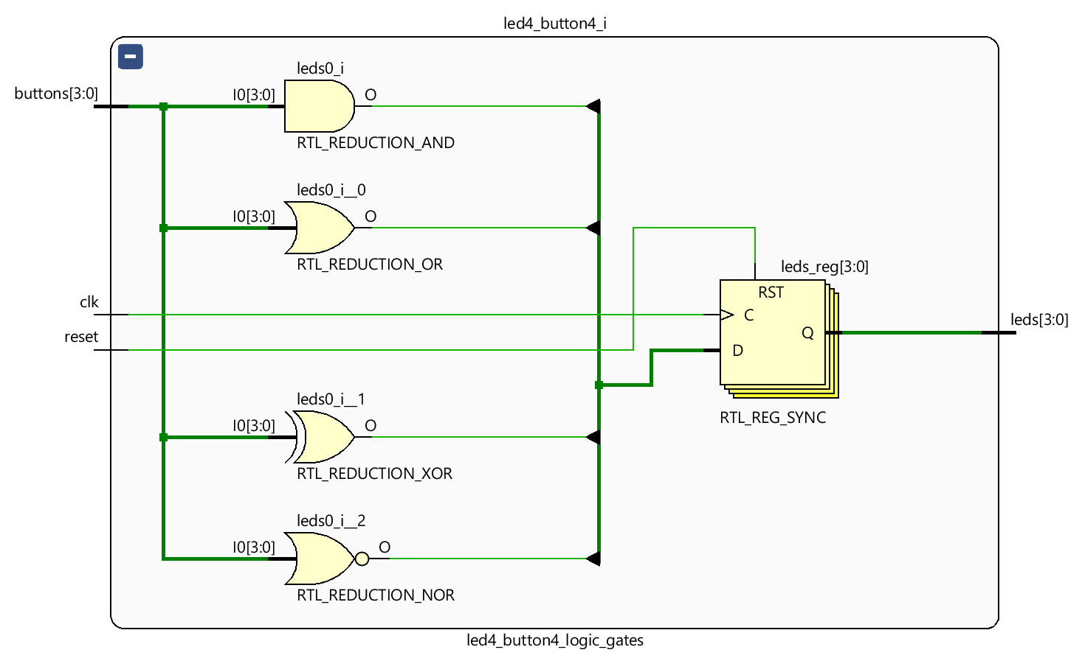
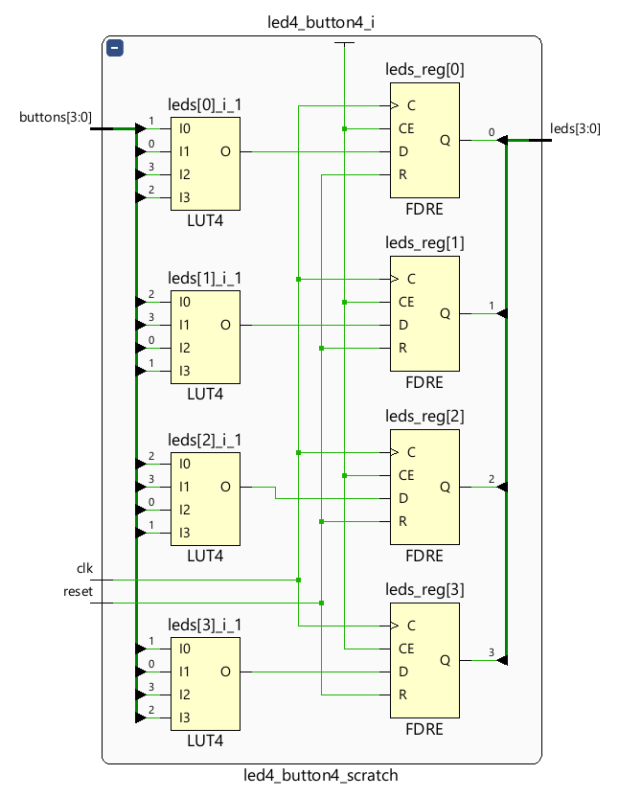
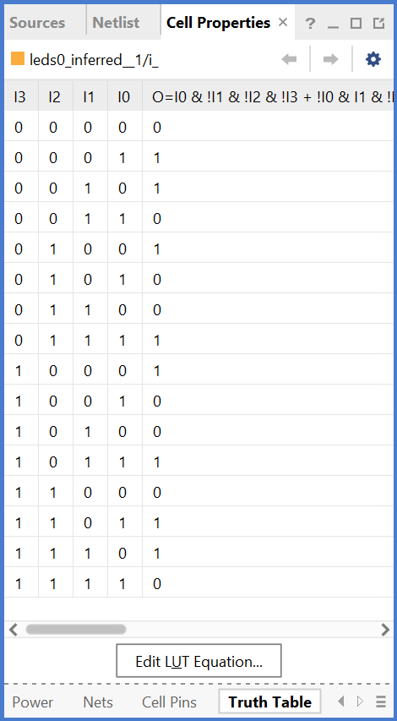
Create the FPGA Programming File
Use the Vivado ‘synthesis’ tool as instructed:
Elaborate
Verify gates
Synthesise
Verify LUT truth tables
Implement
Check timing
Check timing
Program FPGA
Test design
Verify gate placement

Slide 14
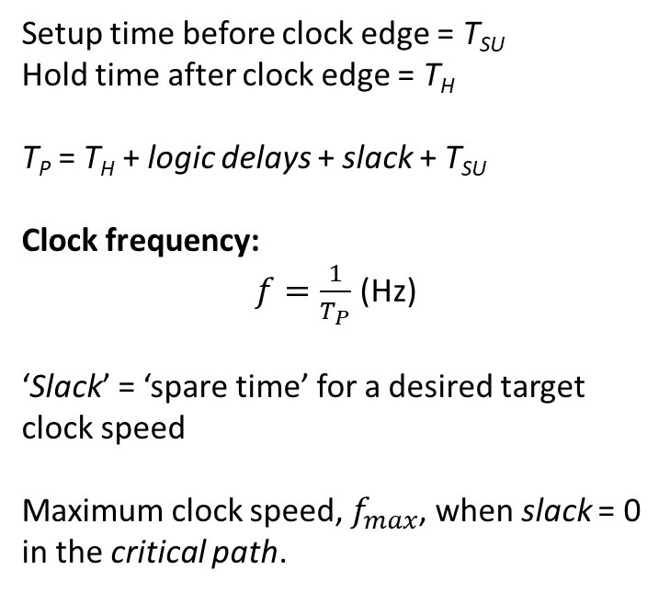
What does “Check Timing” mean?
These exercises are constructed so that achieving “timing closure” is not an issue.
Setup time before clock edge = T_{SU}
Hold time after clock edge = T_{H}
T_{P} = T_{H} + logic delays + slack + T_{SU}
Clock frequency:
$f=\frac{1}{T_{P}}$ (Hz)
‘Slack’ = ‘spare time’ for a desired target clock speed
Maximum clock speed, $f_{max}$, when slack = 0 in the critical path.
Clock
Data
T_{H}
Logic & Nets
Slack
T_{SU}
D
Q
D
Q
Arrival Time
Clock Period (s) = T_{P}
Notes:
If the arrival time is after the setup time T_{SU} then we have failed to meet timing for the desired clock period T_{P}.

Slide 15
Exercise 2
Repeat the previous steps for a more involved example.
Pick an example with ‘state’ from:
Pulse Generator, shortening a long pulse to a short one.
Shift Register, use a button to choose the status of LED 0, all the LEDs continue to scroll to the left.
This can be developed into sequences that go back and forth for a bi-directional shift register controlled by two buttons, each inserting a lit LED into one end and changing the direction of shift.
4-bit binary counter with start and stop buttons.
Sum of buttons pressed.
This come in two variations, one-hot and binary.
The former lights a single LED based on the number of buttons pressed at any one time.
The latter represent the number of buttons in binary 0-4.
The Knight Rider
KITT car bonnet light sequence from the 1980’s television series.
Traffic lights
Comes in two variations; the standard junction and the Pelican crossing.
The latter (of course ;-) includes a flashing yellow stage.
Dimmer Controller
Two buttons increase or decrease a control value, e.g. the brightness of a room light
The LEDs signifying the size of the value being controlled.
Linear Feedback Shift Register
GF(2^{n}) mathematics! (GF = Galois Field)
Here, used for pseudo random sequences (fake random numbers on a computer)

Slide 16
Final Example
Take the parts given to you to simulate and synthesise an embedded ‘software’ design.
Compile the 4-bit RISC CPU
Choose a software instruction file
Simulate & synthesise the design
Test it on hardware
Modify the software instruction file
Edit the instructions
Assemble the code
Re-simulate, re-synthesise, re-test on hardware

Slide 17
4-bit RISC CPU
file. asm
The 4-bit CPU is specialised to 4 buttons and 4 LEDs
The instructions are compiled into the FPGA design
Uses a ROM not RAM
CPU ‘registers’ will hold your state
Develop software to light LEDs and react to the buttons
customasm
led4_button4
ROM
file.o
RISC CPU
buttons(3:0)
reg(6)
reg(7)
leds(3:0)
reset
clk

Slide 18
Our ALU Design
o <- a op b
op
o
a
b
Assembled instructions are 13-bits long
12:9
8:6
5:3
2:0
In the given design:
Only 16 instructions
6 working registers
2 special registers for
Reading the button state
Writing the LED state
Executes ‘operations’
On 2 input registers
Writing back to an output register
E.g. r5 = r3 AND r4
6 registers, but no RAM. 2 “special” registers
r0
r1
r2
r3
ALU
r4
r5
btns
leds

Slide 19
Assembly of Instructions
Easiest to code by reviewing examples given
Then refer to the reference when you have familiarity
https://house-of-abbey.github.io/scratch_vhdl/risc_cpu.html#candidate-instructions
add.asm
add.o
#include "./ruledef.asm"
r0 <- 3
r1 <- 0b0000
loop:
leds <- r0 + btns
wincr 3
leds <- btns and r1
wincr 1
goto loop
Assembly
customasm.exe
0001000000011
0001001000000
0110111000110
1110000000011
0011111110001
1110000000001
1111000000010

Slide 20
Appendices

Slide 21
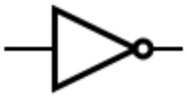
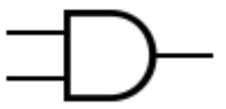
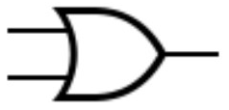
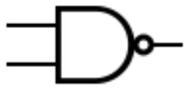



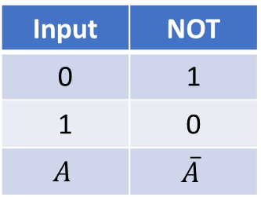
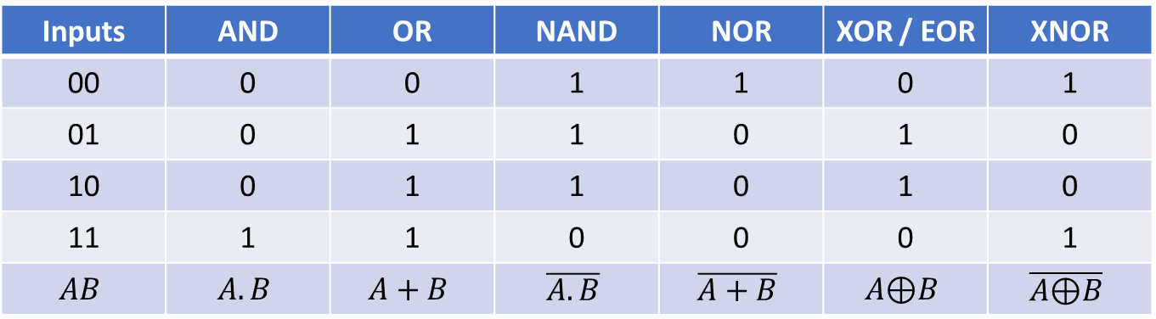
2 Input Logic Gates
Input | NOT
0 | 1
1 | 0
$$A$$ | $$\overline{A}$$
Inputs | AND | OR | NAND | NOR | XOR / EOR | XNOR
00 | 0 | 0 | 1 | 1 | 0 | 1
01 | 0 | 1 | 1 | 0 | 1 | 0
10 | 0 | 1 | 1 | 0 | 1 | 0
11 | 1 | 1 | 0 | 0 | 0 | 1
$$AB$$ | $$A.B$$ | $$A+B$$ | $$\overline{A.B}$$ | $$\overline{A+B}$$ | $$A\text{⊕}B$$ | $$\overline{A\text{⊕}B}$$
2 input “eXclusive OR” = one or the other but not both
2 input XNOR is also a “parity” gate
n-input gates are less obvious

Slide 22
3-Input XOR & XNOR
Inputs | XOR odd number of inputs high | XNOR even number of inputs high
000 | 0 | 1
001 | 1 | 0
010 | 1 | 0
011 | 0 | 1
100 | 1 | 0
101 | 0 | 1
110 | 0 | 1
111 | 1 | 0
How do these extend to 4 inputs?

Slide 23
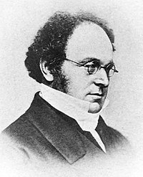
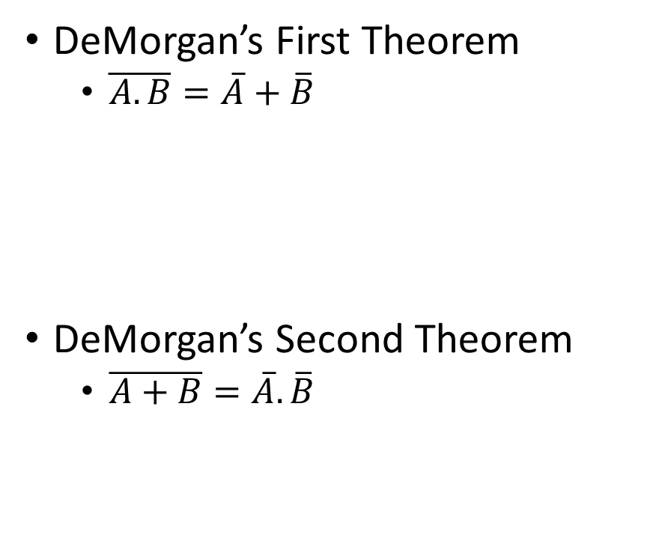
DeMorgan’s Theorems
Augustus De Morgan
27 June 1806 - 18 March 1871
was a British mathematician and logician.
DeMorgan’s First Theorem
$\overline{A.B}=\overline{A}+\overline{B}$
DeMorgan’s Second Theorem
$\overline{A+B}=\overline{A}.\overline{B}$
≡
We never actually need this as our tools create the LUT contents for us!
≡

