Slide 1
Opportunity Map Stability Analysis
April 19, 2024
Joe Ahrenholtz
Othering & Belonging Institute
Notes:
Present a few slides on the draft stability analysis I shared with the group yesterday. Will step through each section first then we can open it up for discussion;.

Slide 2
Context
Frustration expressed during public comment period due to changes in mapping designations
Research Objectives
1) Investigate the drivers of year-to-year instability in the Opportunity Map under the new threshold scoring approach.
2) Apply test for statistically significant change between ACS estimates used in the 2024 Opportunity Map to those used in the 2025 Opportunity Map, and demonstrate how stability could be increased using this technique.
Notes:
Context for this analysis is that public comment we receive often expresses frustration over year-to-year instability of the map. The funding programs that reference the map do have a grandfathering clause allowing applicants to claim the mapping category either at the time of application or at the time of site control. This partly addresses the issue, but we know from previous analysis on this topic that some of the changes we see in the map from one year to another are more do to issues with data reliability than true changes in the population.
With that context, the objectives here were to 1) investigate the drivers of year-to-year instability. 2) apply a test for statistically significant change in ACS estimates, then demonstrate how this approach can increase stability.

Slide 3
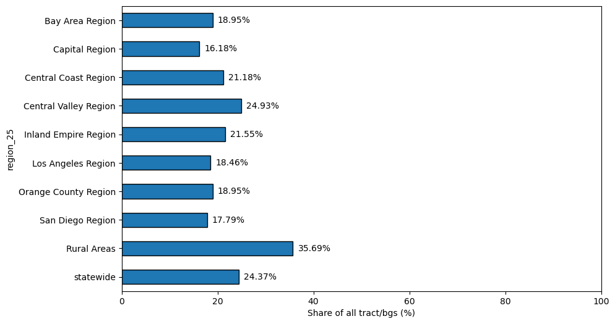
2024-2025 Designation Change
2024 to 2025 resource designation change
Notes:
First step was to develop the draft 2025 map so that we could level set by measuring designation change compared to last year’s map. Highest instability is in rural areas, as we have in past years, and statewide 24% of tracts/bgs shifted designations. Overall the map, is slightly less stable than it when we were using the previous index-based approach.

Slide 4
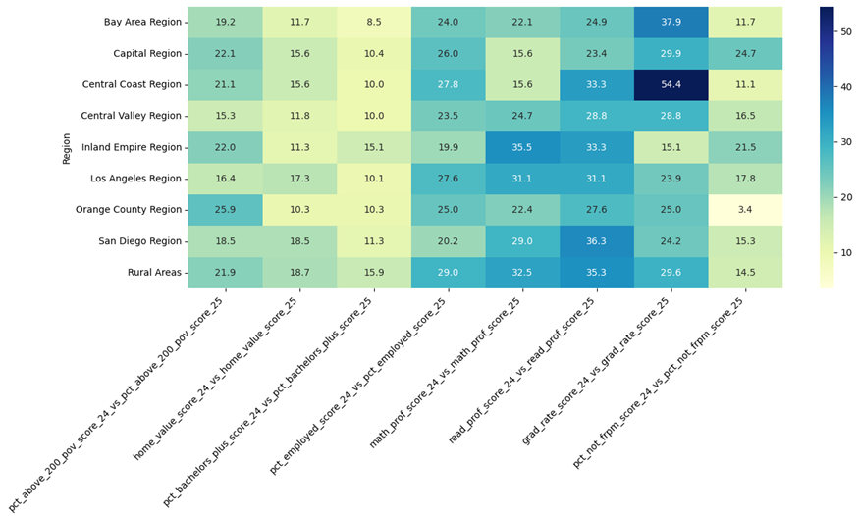
2024-2025 Indicator Score Change
2024 to 2025 percentage of indicator score changes in tracts/block groups with designation change
Notes:
To understand what indicators are contributing most to instability, I drilled own into indicator score changes, specifically for tracts/bgs that changed resource designations. If you’re looking at the home value indicator in the Bay Area, you can interpret it as 11% of tracts that shifted designations had a different home value score compared to last year. The main takeaway for me is that the math, reading, and grad scores are often contributing most to designation changes. Why this is the case is going to be another line of questioning that we’ll need to follow up on. The focus of this analysis leaned more heavily to the economic indicators.

Slide 5
2024-2025 Significant Change in ACS
Test for statistically significant difference in ACS estimates:
Significance test recommended by US Census:
This test shows whether the observed difference between estimates likely represents a true difference that exists within the full population (is statistically significant) or instead has occurred by chance because of sampling (is not statistically significant). Statistical significance means that there is strong statistical evidence that a true difference exists within the full population.
Notes:
One way to increase stability is to apply a test for statistically significant difference in ACS estimates from one year to the next. The test used here is provided by census, it essentially captures the probability that the difference in ACS estimates from one year to another is likely real and not due to sampling error. Significance in this context means there is strong statistical evidence that true difference exists within the full population.

Slide 6
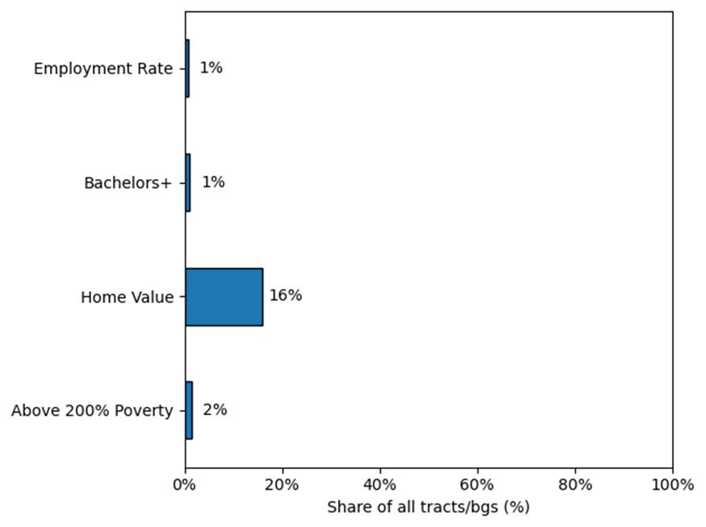
2024-2025 Significant Change in ACS
2024 to 2025 resource designation change into or out of High/Highest Resource
Notes:
After applying the test, very few ACS estimates are found to be statistically different from the 2021 to 2022 ACS 5-year. This is expected because of how the ACS 5-Year Estimates are cronsucted by combine multiple years of samples. In other words, the two sets of estimates we’re comparing have 4 out of 5 sample years in common.

Slide 7
2024-2025 Significant Change in ACS
Operationalizing significant change test:
If change in an ACS estimate for a given tract/block group is found to be significant, the estimate is updated to the most current value (e.g. the 2022 5-year estimate).
If change is found to be insignificant, the estimate falls back to the value used in the 2024 map (e.g. the 2021 5-year estimate).
Resource designations are then recalculated, and change between the 2024 and alternative draft 2025 map is assessed to demonstrate how year-to-year stability might be increased.
Notes:
To demonstrate how we might use the test, I implemented it in the following way: If change in a given tract/bg is significant, it gets update to the new estimate, otherwise it falls back to the previous year’s estimate. And then I recalculated the resource designations to assess how this approach compares to one with no methodology changes.

Slide 8
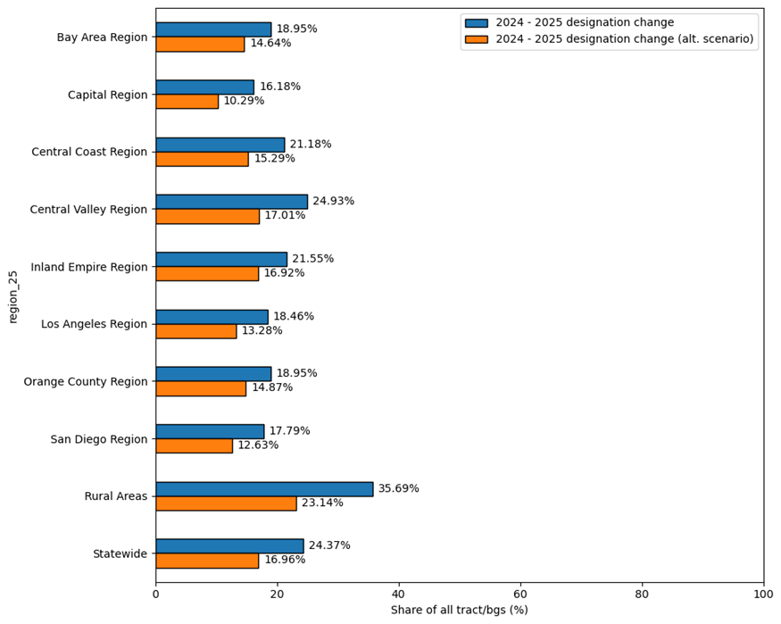
2024-2025 Significant Change in ACS – Alt. Scenario
2024-2025 resource designation change with alternative scenario
Notes:
This chart compares resource designation change under a scenario with no methodology changes (blue), to an alternative scenario where we control for significant change in ACS estimates (orange). As expected, we see 2024-to-2025 instability decrease under the alternative scenario.

Slide 9
Takeaways
Without controlling for significant change, shifting of resource categories from the 2024 to the draft 2025 map can be summarized as follows:
24% shift statewide
36% shift in rural areas
19% shift in urban areas
Controlling for significant change in ACS estimates increases stability from the 2024 to draft 2025 map:
17% shift statewide
23% shift in rural areas
14% shift in urban areas
Controlling for significant change requires plan to implement over multiple updates
Instability and data quality of education indicators requires further analysis
Notes:
Takeaways are that we can increase stability by controlling for significant change of ACS estimates. Statewide, we decrease the share of tracts/bgs shifting designations from 24 to 17%. An important consideration is that controlling for significant change requires a plan for how it would be implemented over the course of multiple updates, since testing for significant change requires a baseline year. Last takeaway is that there was more year-to-year variability in the education indicators than was expected, and this is something that I believe requires further analysis to better understand potential data quality issues as it relates to the education data.
There’s a few different proposal options on this topic, but lets open it up for discussion before we get to that.

Slide 10
Proposal Options
Option 1: No proposed methodology change for 2025, but signal to HCD we’ve identified an approach to minimizing instability in economic indicators that needs to be further developed (e.g. a plan implementing over multiple updates)
Option 2: Propose implementing the significant change (rolling averages?) approach in the 2025 map
Notes:
Option 1: No proposed methodology change for 2025, but signal to HCD we’ve identified an approach to minimizing instability in economic indicators that needs to be further developed (e.g. a plan implementing over multiple updates)
Option 2: Propose implementing the significant change approach in the 2025 map (could be rolling averages as Chrisiti suggested); in my mind that would require developing a plan (in the very near term) for implementing the approach over multiple updates.

Slide 12
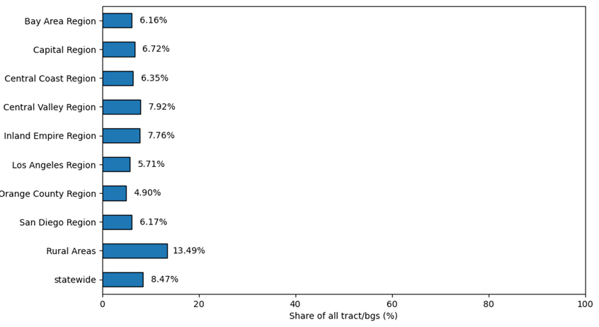
2024-2025 Designation Change
2024 to 2025 resource designation change into or out of High/Highest Resource

Slide 13
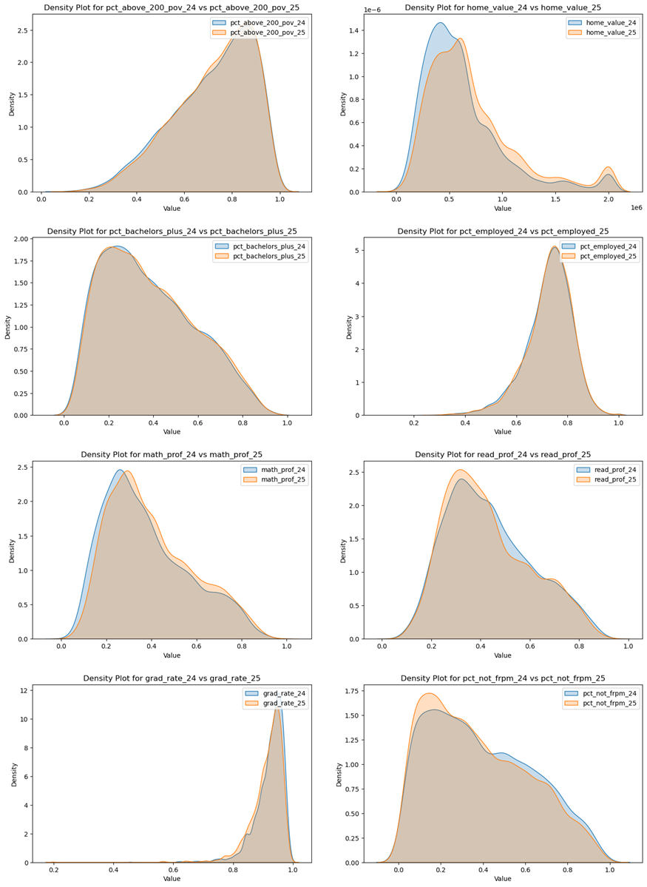
2024-2025 Score Change
2024 to 2025 resource designation change into or out of High/Highest Resource

Slide 14
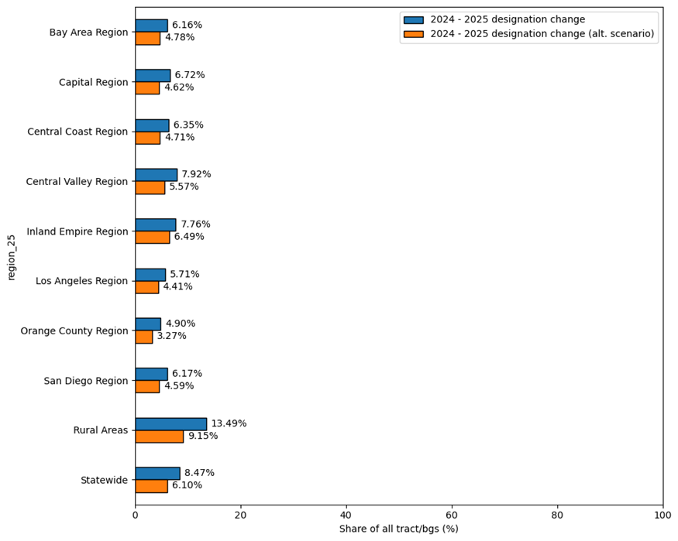
2024-2025 Designation Change
2024-2025 resource designation change into and out of High/Highest Resource with alternative scenario

Slide 15
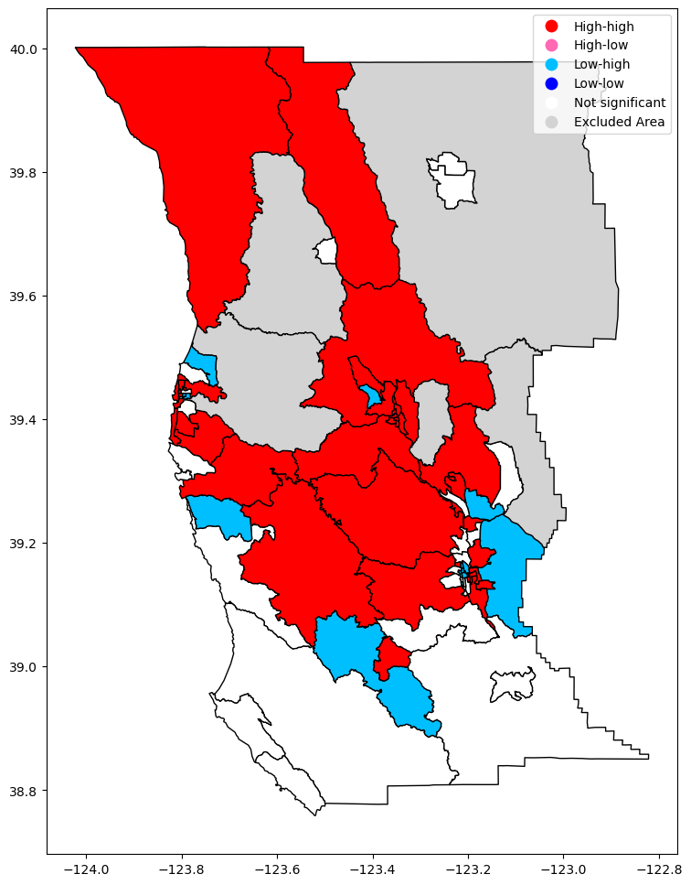
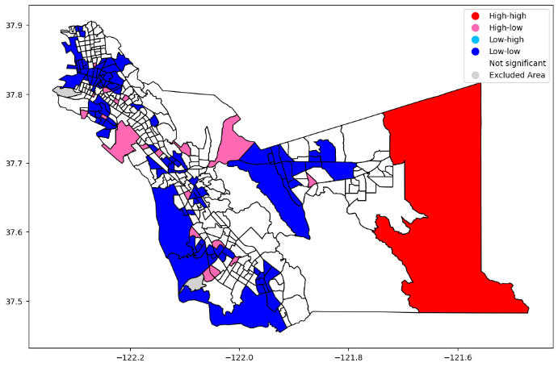
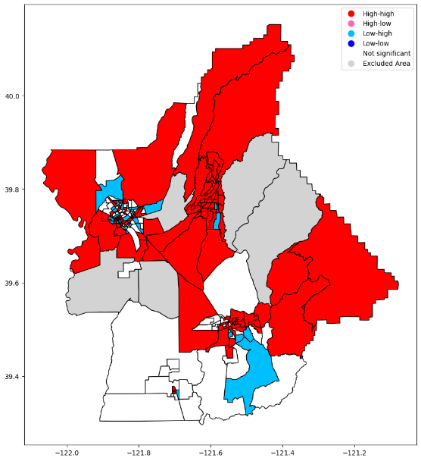
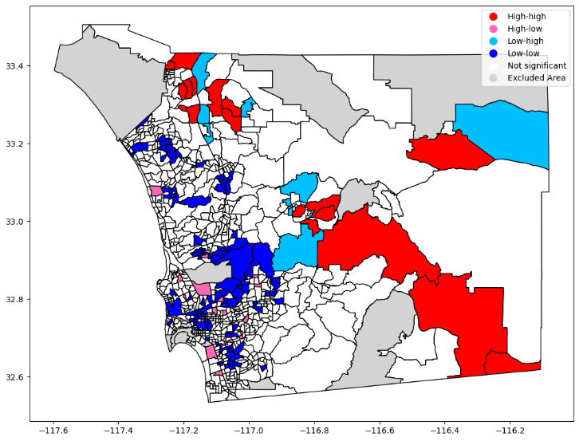
ACS Reliability
Local Moran's I - CVs of percent employed population in Mendocino (top-left), Alameda (top-right), San Diego (bottom-left), and Butte (bottom-right) counties

