Slide 1
SPINE B2B REFERRAL ENGINE
Status · Plan · Deployment
July 22, 2026 · Joe MacLean + Kristen Jones
Data: B2B appointments through Jul 10 · MMC field activity through Jul 16 · attributed records, deterministically matched (82.5%) · pending Analytics validation
Notes:
One caveat line, said once: operational best estimate, Santosh hardens it. Then never repeat it.

Slide 2
You set the direction — it's executed
The 30-day experiments from the Jul 8 call, eight working days later
Direction (Gautam, Jul 8) | Status today
Count the spine account universe, expand 100% | 404-account baseline → 808 loaded (2×), scored 0–100 on real 2026 referrals ✓
Prioritize one tiered list across all feeder types | Tier 1 = 146 proven · Tier 2 = 156 ortho · 469 prospects · Wave 1 = 90 ✓
Organize by geography and opportunity | 85 route days built (≤10 stops) · scheduled week-by-week Jul 22 → Oct 2 ✓
Double spine field time | Protect blitz running since Wed · 4 spine days/PL/wk W2–W4 · capacity ask today
Weekly learning loop + scorecard | Scorecard live (11 weeks) · field app in PL hands · PL validation sprint Jul 23–31
Notes:
Land execution before any math. Kristen presents rows 1-4.

Slide 3
What the real referral data taught us
Three findings that changed the plan
THE LEAK
THE CONCENTRATION
THE CORRECTION
32 of 54
1 in 5
Kessia
repeat spine referrers had zero visits in 4+ weeks — 120 patients of annual production undefended.
Recovery sweep started Wednesday; all 36 lapsed covered by Jul 31.
of all B2B spine comes from one law firm. 14 attorney accounts = 31%; Kristen's book = 63%.
Now run as key accounts with named coverage — and a de-risking plan.
was the real departure (~6 spine/mo; ~290 companies unowned) — not Sean. Sean is active but unlogged since Jun 9.
Decision today: verify or reassign to Coty.
Notes:
Present the correction as proof the loop finds truth. No blame framing on Sean.

Slide 4
The 808-account book — evidence over hope
Every account scored on attributed 2026 referrals; prospects ride along on every route day
808
146
365
90
ACCOUNTS LOADED (2×)
PROVEN SPINE (TIER 1)
ATTRIBUTED SPINE PATIENTS
WAVE-1 PRIORITY
Why this order matters: a repeat referrer produces ~0.8 spine/mo; a one-spine account ~0.16; a cold prospect must be earned. The plan spends field time in exactly this order — protect, convert, then test.
Notes:
The bar chart is the whole strategy in one picture: the book is mostly prospects, the value is mostly at the top.

Slide 5
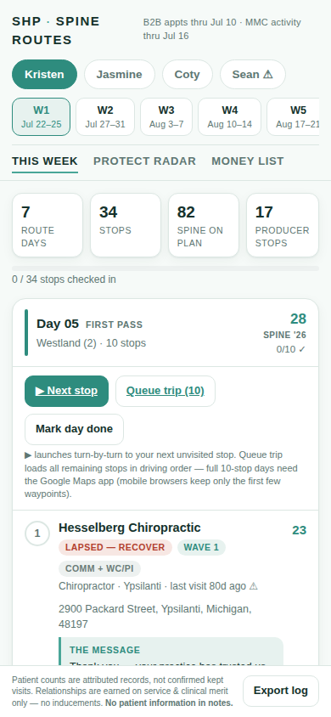
The plan on a page — protect first, prospect always
Jul 22 → Oct 2, scheduled stop-by-stop; prospects are pre-mixed into every route day
W1 · Jul 22–25 — PROTECT
W2–W4 — EXPANSION BLITZ
W5+ — RHYTHM
All 36 lapsed repeat referrers re-visited (22 this week, 14 next). Hesselberg, Michigan Auto Law, the attorney set. 9 of the 10 most valuable visits are recoveries.
4 spine days/PL/week. Morse enters key-account rotation. ~183 prospect first-touches ride along with producer coverage.
3–3.5 spine days/wk on the Jul 22 cadence: Wave 1 biweekly, Tier 1 every 3 weeks, ortho every ~30 days (achieved medians exactly on spec), Wave-2 sweeps every 3rd week.
Rules the calendar enforces: no proven referrer waits past Jul 31 · producer revisits preempt prospecting · a prospect that produces nothing in 2 touches is dropped for the next one · ortho field days are preserved (spine gets 3–4 of ~5).
Delivered in the PLs' hands: the Spine Routes app — ranked stops, the message per account, payer flags, one-tap Google Maps trip queueing, check-ins.
Notes:
If asked for detail: pm/spine-pl-weekly-visit-plan.md has the full calendar; every stop is traceable to source data.

Slide 6
The path from 79 to the target
Built account-by-account from observed yield — not divided down from a goal
Move | Mechanism | 60–90 day yield
Hold the base | protect 79/mo run-rate (fragile core: 60 repeat accounts ≈ 46/mo) | 79 held
Reactivate the quiet 27 | service-recovery visits on producers silent since mid-May | +4–8
Convert one-spine → repeat | 92 accounts; every 15 conversions ≈ +10/mo | +15–20
Cover Sean + Kessia books | 40 routed priorities + ~290 orphaned companies re-owned | +4–6
Attorney tier-2 (service-based) | 12 small firms + lookalikes behind Morse | +3–6
Prospect pipeline | 469 cold accounts, 31-day lag — pays from Sept/Oct | +3–8
COMMIT
95–115/mo
by October
STRETCH 150 — true only if:
• field capacity back ≥200 visit-days/wk (Mar 863 → Jun 668/mo)
• Sean active or backfilled
• 30+ one-spine conversions land
Notes:
The capacity condition is the ask: that lever belongs to leadership (Sean decision, 4th-PL trigger, protected field days).

Slide 7
Agree the scoreboard before the game
Median visit→first-appointment lag is 31 days; 83% of patients appear within 60 days of the visit
Weeks 1–2 (now)
Mid-Aug → Sept
September
Judge ACTIVITY: lapsed producers → 0 · visit-days/wk per PL · Wave-1 on-cadence %
Patient line starts moving (W1 work lands ~Aug 20+). August will look SOFT — the June–July activity dip is already baked in.
The verdict month. B2B spine vs the 95–115 ramp; re-plan only then.
Weekly scorecard (already built): B2B spine NPs · active spine accounts (69 baseline) · visit-days/PL · protect-list lapses (target 0) · NP per 100 visit-days by PL · match-rate integrity (82.5% → 90%+ after Santosh's pass).
The one commitment we ask of this room: don't re-plan on a flat August patient line. The leading indicators are the early truth.
Notes:
Kristen owns the lag line. If only marketing says it, it sounds like an excuse.

Slide 8
Five decisions to leave with
Everything else is execution we already own
1
Sean — Verified by Thu Jul 24 — logging gap or stall. If out: Coty absorbs his 4 route days; backfill trigger per PL-C.4.
Kristen
2
Measurement contract — Activity now, patients from mid-Aug, verdict in September. August soft patch pre-accepted.
Gautam
3
The number — 95–115/mo committed by Oct; 150 = stretch with the three named conditions (capacity is the binding one).
Gautam
4
Data hardening — Top-15 source disambiguations · MMC People export · MMC plan-sync import · validation date for the B2B/B2C split.
Santosh
5
Payer verification — Tier-1 (146 accounts) payer pass by Jul 31 — protects every same-week promise the PLs make.
Kelly
Notes:
Close here. A nodding meeting with no owners is a no.

Slide 9
Deployment — the rhythm that runs itself
One tool for the field, one loop for the team
1
2
3
4
5
Open app
▶ Next stop
Check in
Export Fri
Radar Mon
pick name → week; days ranked by value
turn-by-turn; message + payer flag on the card
tap done; business-only note
one tap → log to Joe → scorecard
protect lapses = 0? that's the meeting
Who | Owns
Kristen + PLs | The app · scrub sign-off · field execution · message voice (Kristen red-pens v2)
Joe | Scorecard · weekly data refresh · this deck's follow-ups
Joel | Validation sprint consolidation (Jul 23–31) · route regeneration
Santosh | MMC plan-sync import · match fixes · People export · split validation
Kelly | Tier-1 payer verification (by Jul 31)
Notes:
PLs only ever see the app. Everything else is back office. Adoption by subtraction.

Slide 10
This week: the validation sprint (Joel)
PLs confirm the universe with market knowledge before we scale outreach
Wed Jul 23
Review workbooks distributed (per-PL queues, pre-flagged: 54 auto-flags — pediatric, in-house spine, competitor, addiction)
Thu Jul 24
Walk-through at team debrief · Sean decision lands
Tue Jul 29
PL dispositions complete (Keep / Remove / Reassign, ~60–90 min/day office time — protect sweep unaffected)
Thu Jul 31
Approved universe locked · routes regenerated · summary to Joe + Kristen · coverage-mode decision (protect-first vs full-coverage)
Aug 3 → Sep 30
Execution on the cleaned universe, tracked on the scorecard
Starting universe: Kristen 180 · Jasmine 310 · Coty 318 · Sean 40 (= 848). Acceptance: every account dispositioned with a reason · one owner per account · Tier 1/2 stay on cadence throughout · final mix + route-day count reported.
Notes:
Validation runs in parallel with protection - the sweep never pauses for the paperwork.

