Slide 1
Joseph Barber
IMDCGD339-17YRD Final Project
Assessment 2

Slide 2
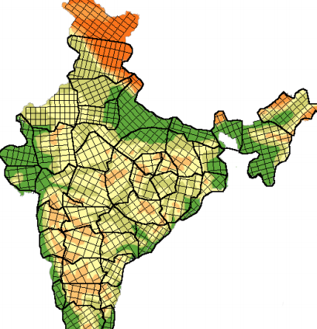
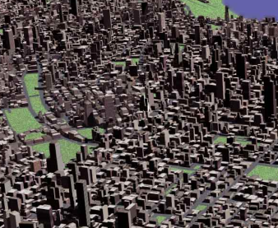
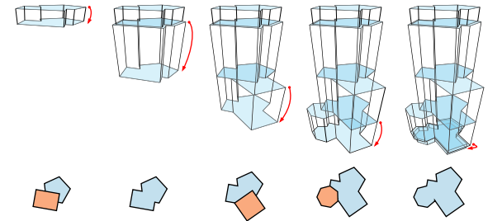
Project proposal
An investigation into techniques for procedurally generating realistic cities.
Road Generation
Data Generation
Population
Terrain
Building generation
Stretch goals:
3D Renderer
Unity library
Sun, J. Yu, X. Baciu, G. Green, M. (2002). "Template-based generation of road networks for virtual city modeling". In Proceedings of the ACM symposium on Virtual reality software and technology (VRST '02). Acm, New Work, NY, USA, 33 - 40.
Greuter, S. Parker, J. Stewart, N. Leach, G. (2003). "Real-time procedural generation of 'pseudo infinite' cities". In *Proceedings of the 1st international conference on Computer graphics and interactive techniques in Astralasia and South East Asia* (GRAPHITE '03) Acm, New York, Ny, USA, 87 - ff.
Muller, P and Parish, Y, I, H. (2001). "Procedural modeling of cities". In Proceedings of the 28th annual conference on Computer graphics and interactive techniques (SIGGRAPH '01). Acm, New York, NY, USA. 301 - 308.

Slide 3
Preliminary reading
Roads:
Template based generation
L-systems
Minimum spanning tree
Population:
Noise
Terrain:
Fractal
Buildings:
L-systems
Shape grammars
Eppstein, D. (1996). Design and Analysis of Algorithms – Minimum Spanning Trees. [Online] 6th Feburary 1996. Available online: https://www.ics.uci.edu/~eppstein/161/960206.html [Date of access: 29 October 2017]
Greuter, S. Parker, J. Stewart, N. Leach, G. (2003). "Real-time procedural generation of 'pseudo infinite' cities". In *Proceedings of the 1st international conference on Computer graphics and interactive techniques in Astralasia and South East Asia* (GRAPHITE '03) Acm, New York, Ny, USA, 87 - ff.
Ilangovan, K, P. (2009) Procedural City Generaror, MSc thesus, Bournemouth University. Available at: https://nccastaff.bournemouth.ac.uk/jmacey/MastersProjects/MSc09/Ilangovan/Thesis_i7834000.pdf (Accessed: 30 May 2017).
Kelly, G and McCabe, H. (2006). "Interactive generation of cities for real-time applications" In Proceedings of SIGGRAPH '06 ACM SIGGRAPH 2006 Research Posters - SIGGRAPH ‘06
Martz, P. (1997). *Generating Random Fractal Terrain*. [Online] 1997. Available Online: http://www.gameprogrammer.com/fractal.html [Date of access: 09 May 2016]
Muller, P and Parish, Y, I, H. (2001). "Procedural modeling of cities". In Proceedings of the 28th annual conference on Computer graphics and interactive techniques (SIGGRAPH '01). Acm, New York, NY, USA. 301 - 308.
Sun, J. Yu, X. Baciu, G. Green, M. (2002). "Template-based generation of road networks for virtual city modeling". In Proceedings of the ACM symposium on Virtual reality software and technology (VRST '02). Acm, New Work, NY, USA, 33 - 40.

Slide 4
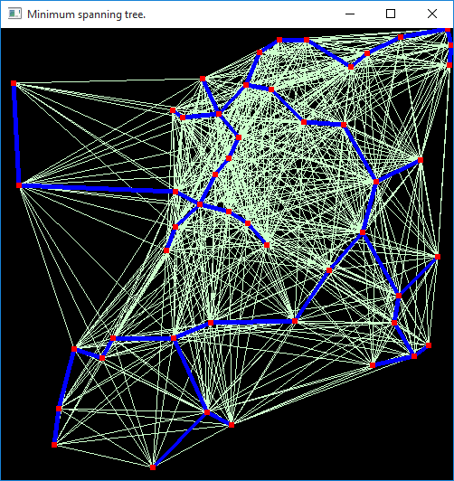
Minimum Spanning Tree
Areas of high population in a virtual environment can be connected using a Minimum Spanning Tree (Matrek C, 2012).
A city is composed of both major roads (highways) and minor roads (streets). Highways connect areas of high population whilst streets cover the area between highways, creating neighbourhoods and offering access to the main highways. (Muller P and Parish Y I H, 2001).
Brown, B. (2011). Prim’s Algorithm: Minimal Spanning Tree. [Online] 15th May 2011. Available online: https://www.youtube.com/watch?v=YyLaRffCdk4 [Date of access: 02 October 2017].
Eppstein, D. (1996). Design and Analysis of Algorithms – Minimum Spanning Trees. [Online] 6th Feburary 1996. Available online: https://www.ics.uci.edu/~eppstein/161/960206.html [Date of access: 29 October 2017]
Martek, C. (2012). “Procedural generation of road networks for large virtual environments.” Rochester Institute of Technology.
Red Blob Games. (2014) Introduction to A*. [Online] June 2016. Available online: http://www.redblobgames.com/pathfinding/a-star/introduction.html [Date of access: 29 October 2017].

Slide 5
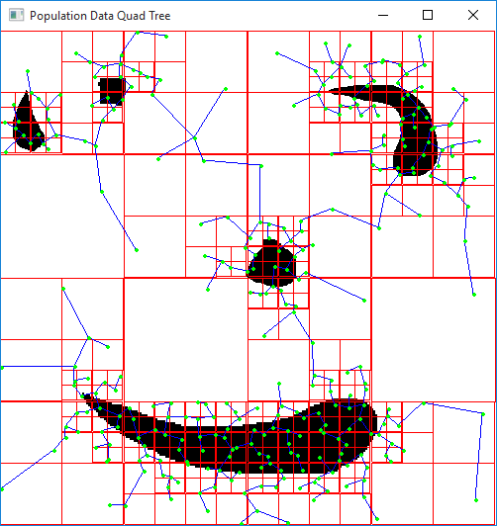
Introducing population data
Population data is considered when generating street maps.
(Sun, J. Yu, X. Baciu, G. Green, M. 2002)
(Muller, P and Parish, Y, I, H. 2001).
Martek, C. (2012). “Procedural generation of road networks for large virtual environments.” Rochester Institute of Technology.
Muller, P and Parish, Y, I, H. (2001). "Procedural modeling of cities". In Proceedings of the 28th annual conference on Computer graphics and interactive techniques (SIGGRAPH '01). Acm, New York, NY, USA. 301 - 308.
Sun, J. Yu, X. Baciu, G. Green, M. (2002). "Template-based generation of road networks for virtual city modeling". In Proceedings of the ACM symposium on Virtual reality software and technology (VRST '02). Acm, New Work, NY, USA, 33 - 40.

Slide 6
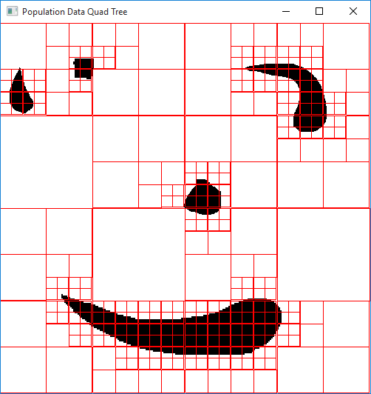
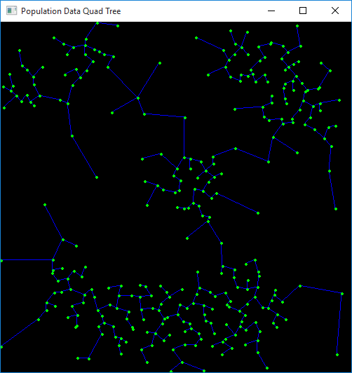
Introducing population data
Martek, C. (2012). “Procedural generation of road networks for large virtual environments.” Rochester Institute of Technology.
Muller, P and Parish, Y, I, H. (2001). "Procedural modeling of cities". In Proceedings of the 28th annual conference on Computer graphics and interactive techniques (SIGGRAPH '01). Acm, New York, NY, USA. 301 - 308.
Sun, J. Yu, X. Baciu, G. Green, M. (2002). "Template-based generation of road networks for virtual city modeling". In Proceedings of the ACM symposium on Virtual reality software and technology (VRST '02). Acm, New Work, NY, USA, 33 - 40.

Slide 7
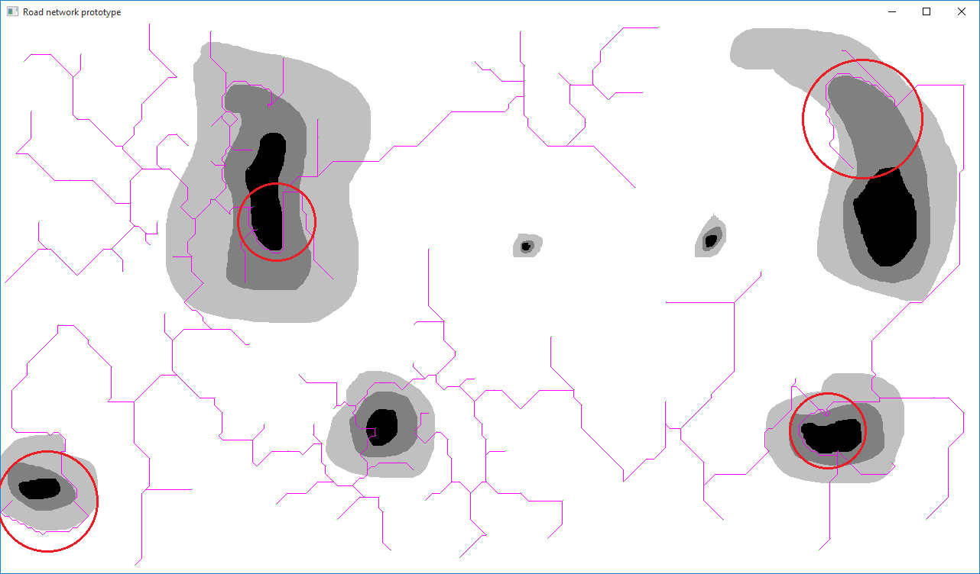
Road Pathfinding
Highways using pathfinding to follow the path of least elevation. (Muller, P and Parish, Y, I, H. 2001)
Euclidean distance and elevation costs are two costs that can be taken into considering when path finding the roads. (Martek, C. 2012).
Martek, C. (2012). "Procedural generation of road networks for large virtual environments." Rochester Institute of Technology.
Muller, P and Parish, Y, I, H. (2001). "Procedural modeling of cities". In Proceedings of the 28th annual conference on Computer graphics and interactive techniques (SIGGRAPH '01). Acm, New York, NY, USA. 301 - 308.
Red Blob Games. (2014) Introduction to A*. [Online] June 2016. Available online: http://www.redblobgames.com/pathfinding/a-star/introduction.html [Date of access: 29 September 2017].

Slide 8
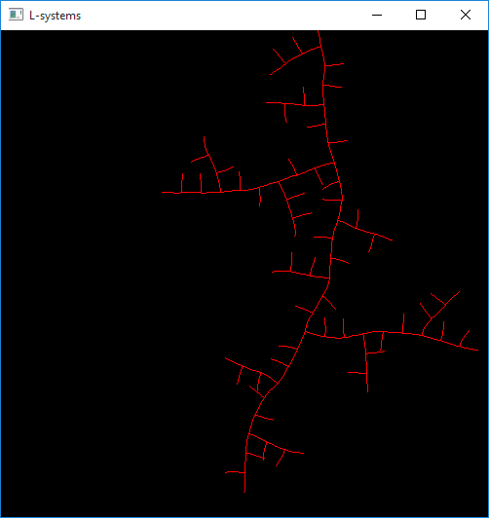
L-Systems
L-systems are a procedural generation technique that can be used in the procedural generation of cities; L-systems can be used to generate road networks and generate buildings. (GameDevStackExchange, 2014), (Kelly G, Mccave H, 2006), (Ilangovan K, P, 2009), (Parish Y I H, Muller P, 2001).
L-Systems are prevalent for the procedural generation of plants (Prusinkiewicx, P and Janan, J, 1992), however there has been some work in using and adapting L-systems to work within procedural city generation.
Goldman, R., Schaefer, S. and Ju, T. (2004). Turtle geometry in computer graphics and computer-aided design. *Computer Aided Design*, 36(14), pp.1471-1482.
Ilangovan, K, P. (2009) Procedural City Generaror, MSc thesus, Bournemouth University. Available at: https://nccastaff.bournemouth.ac.uk/jmacey/MastersProjects/MSc09/Ilangovan/Thesis_i7834000.pdf (Accessed: 30 May 2017).
Kelly, G. Mccave, H. (2006). “A Survey of Procedural Techniques for City Generation”. In ITB Journal, No. 14.
Parish, Y, I, H. Muller, Pascal. (2001). “Procedural modeling of cities”. In Proceedings of the 28th annual conference on Computer graphics and interactive techniques (SIGGRAPH ’01). Acm, New York, NY, USA, 301 – 308.
Prusinkiewicx, P. and Janan, J. (1992). “Lindenmayer systems, fractals, and plants.” New York, N.Y.: Springer-Verlag.

Slide 9
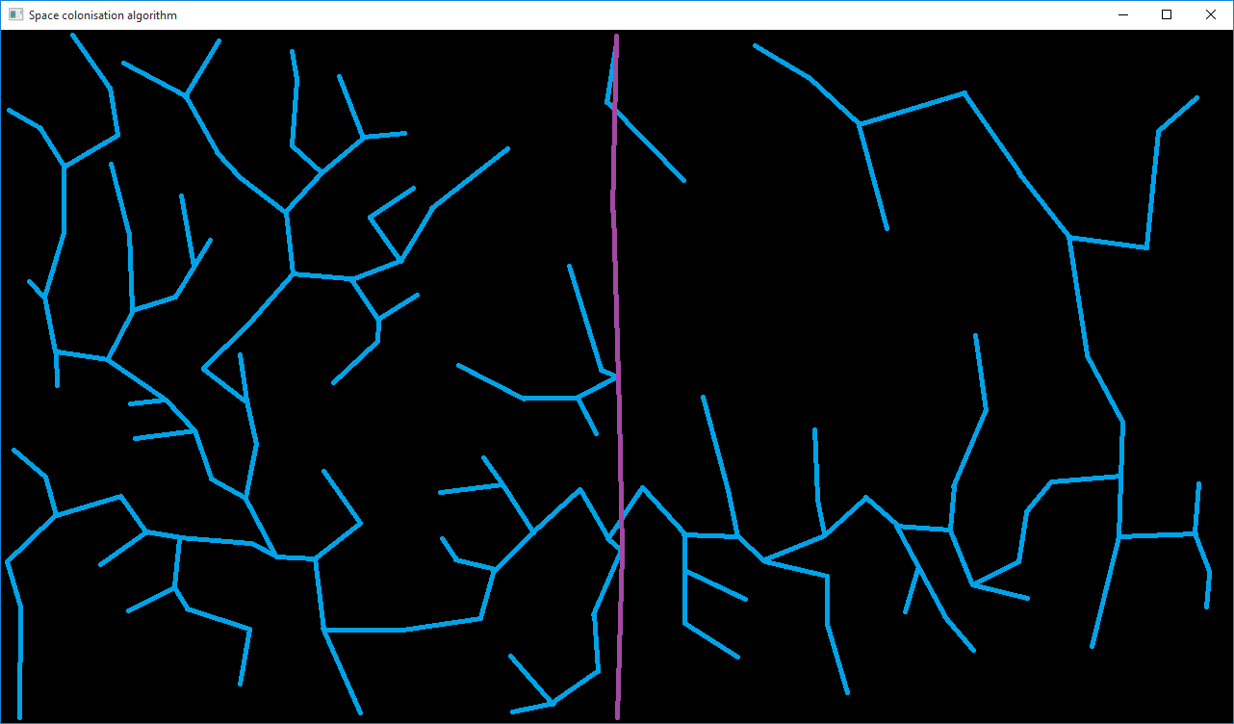
Space colonisation
Procedurally generating by using a recursive branching structure (Runions A. Lane,B and Prusinkiewicz P, 2007).
Initial data points
Connecting based on heuristic values
Post-generation modification
Runions, A. Lane, B and Prusinkiewicz, P. (2007) “Modeling trees with a space colonization algorithm” In Proceedings of the Third Eugographics conference on Natural Phenomena. Prague, Czech Republic. pp 63 – 70.
Samet, H. (1995). Spatial Data Structures. Addison-Wesley.

Slide 10
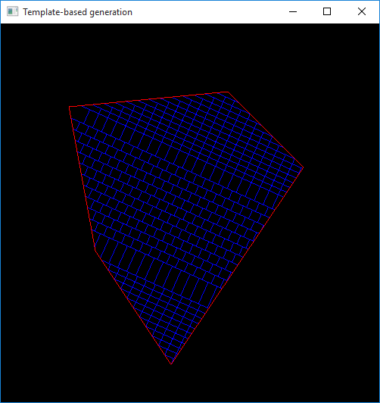
Raster template generation
Many systems use a grid template to produce minor roads inside of areas created by major roads. These minor roads can all follow a global angle or this can be local to the encapsulated area. Maximum and minimum boundaries for block width and length can also be provided. (Muller P, Parish Y I H, 2001).
Major and minor roads are laid out in a grid pattern. (Sun, J. Yu, X. Baciu, G. Green, M, 2002).
Kelly, G. McCabe, H. (2006). “A Survey of Procedural Techniques for City Generation”. In ITB Journal, No. 14.
Muller, P and Parish, Y, I, H. (2001). “Procedural modeling of cities”. In Proceedings of the 28th annual conference on Computer graphics and interactive techniques (SIGGRAPH ’01). Acm, New York, NY, USA. 301 – 308.
Sun, J. Yu, X. Baciu, G. Green, M. (2002). “Template-based generation of road networks for virtual city modeling”. In Proceedings of the ACM symposium on Virtual reality software and technology (VRST ’02). Acm, New Work, NY, USA, 33 – 40.

Slide 11
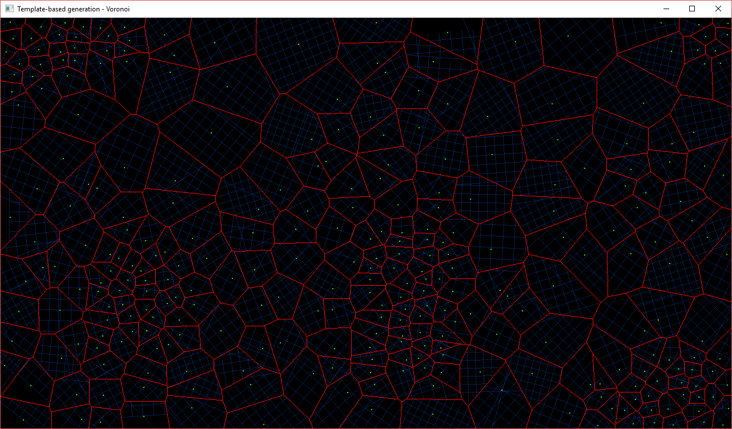
Population template generation
"It is reasonable that roads in a higher populated area should be also denser to alleviate the traffic flow burden and people everywhere should have easy acess to the road. Taking these tw3o aspects into consideration, we use Voronoi diagram as the rule of population-based template" (Sun, J. Yu, X. Baciu, G. Green, M, 2002)
"Using density points extracted from maps as input sites of Voronoi diagram, the Voronoi edges we get are the resulting roads." (Sun, J. Yu, X. Baciu, G. Green, M, 2002).
Kelly, G. McCabe, H. (2006). “A Survey of Procedural Techniques for City Generation”. In ITB Journal, No. 14.
Muller, P and Parish, Y, I, H. (2001). “Procedural modeling of cities”. In Proceedings of the 28th annual conference on Computer graphics and interactive techniques (SIGGRAPH ’01). Acm, New York, NY, USA. 301 – 308.
Samet, H. (1995). Spatial Data Structures. Addison-Wesley.
Sun, J. Yu, X. Baciu, G. Green, M. (2002). “Template-based generation of road networks for virtual city modeling”. In Proceedings of the ACM symposium on Virtual reality software and technology (VRST ’02). Acm, New Work, NY, USA, 33 – 40.

Slide 12
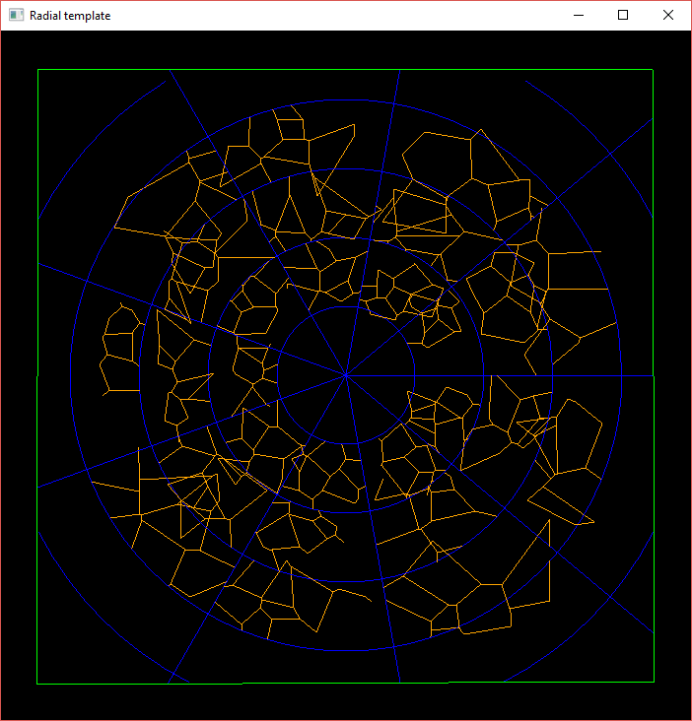
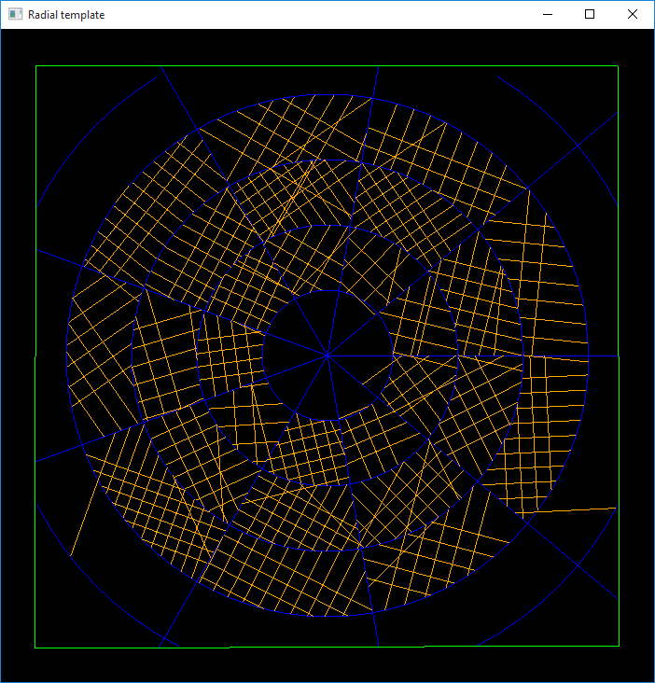
Radial template generation
The radial pattern often represents highways, or major roads, whilst streets (minor roads) often appear in raster form. (Muller P and Parish Y I H, 2001).
Kelly, G. McCabe, H. (2006). “A Survey of Procedural Techniques for City Generation”. In ITB Journal, No. 14.
Muller, P and Parish, Y, I, H. (2001). “Procedural modeling of cities”. In Proceedings of the 28th annual conference on Computer graphics and interactive techniques (SIGGRAPH ’01). Acm, New York, NY, USA. 301 – 308.
Sun, J. Yu, X. Baciu, G. Green, M. (2002). “Template-based generation of road networks for virtual city modeling”. In Proceedings of the ACM symposium on Virtual reality software and technology (VRST ’02). Acm, New Work, NY, USA, 33 – 40.

Slide 13
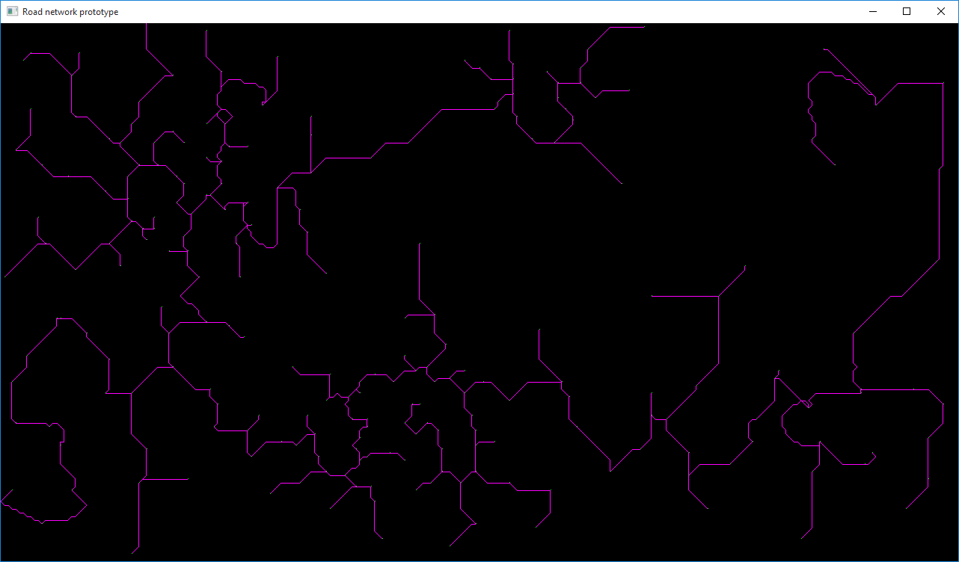
Roads evaluation

Slide 14
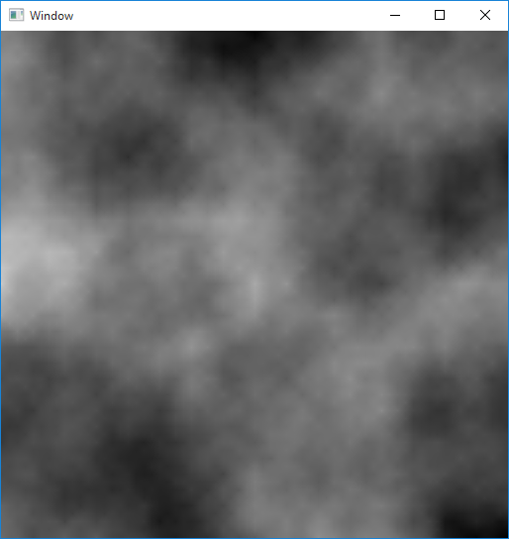
Diamond-Square terrain generation
The Diamond-square algorithm is a noise function that is commonly used to generate terrain data (Rose, T and Bakaoukas, A, 2016).
A three-dimensional implementation of the midpoint displacement algorithm; an algorithm used to generate two dimensional height maps. (Martz, P, 1997).
Gabin S P Miller, 1998. “The definition and rendering of terrain maps”. SIGGRAPH ’86 Proceedings of the 13th annual conference on Computer graphics and interactive techniques, ACM, New York, NY, USA, pp. 39 – 48
Martz, P. (1997). Generating Random Fractal Terrain. [Online] 1997. Available Online: http://www.gameprogrammer.com/fractal.html
Omar, A. (2017). Unity Tutorials: Diamond-Square Procedural Terrain. [Online] 26th January 2017. Available online: https://www.youtube.com/watch?v=1HV8GbFnCik [Date of access: 14 December 2017].
Rose, T and Bakaoukas, A. (2016). “Algorithms and Approaches for Procedural Terrain Generation – A Brief Review of Current Techniques”. 2016 8th International Conference on Games and Virtual Worlds for Serious Applications (VS-GAMES). 1-2.

Slide 15
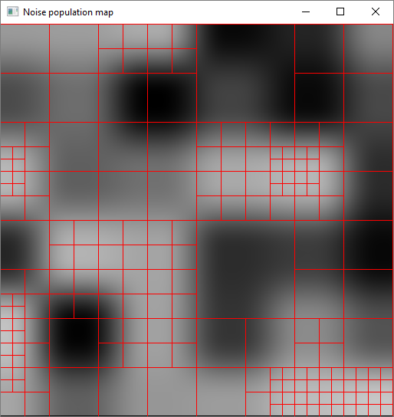
Population noise
Fluctuation in population can be controlled by how coarse the noise output is (Peck J, 2017).
Interpolation methods can determine how smooth the transition is between noise values (Peck J, 2017).
Kelly, G. McCabe, H. (2006). “A Survey of Procedural Techniques for City Generation”. In ITB Journal, No. 14.
Peck, J (2017). FastNoise [Repository]. Available online: https://github.com/Auburns/FastNoise [Date of access: 18 December 2017]
Rose, T and Bakaoukas, A. (2016). “Algorithms and Approaches for Procedural Terrain Generation – A Brief Review of Current Techniques”. 2016 8th International Conference on Games and Virtual Worlds for Serious Applications (VS-GAMES). 1-2.

Slide 16
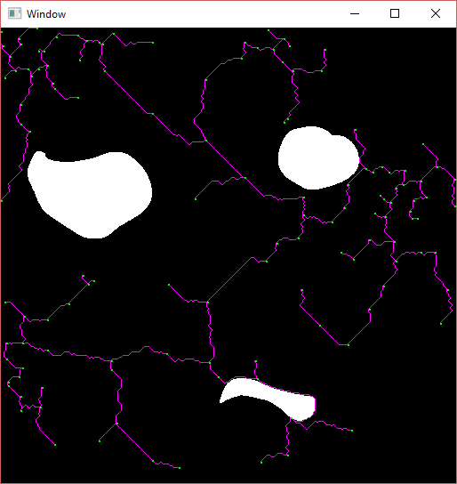
Water boundary maps and bridges
Water boundary maps, or land-water maps, specify which parts of the terrain are land and which are water. (Ilangoban K P, 2009), (Kelly G, McCabe H, 2006), (Muller P, Parish Y I H, 2001).
Validity control for roads in a city generation often allows for roads to cross over water when appropriate conditions are met (Sun J, Yu X, Baicu G, Green M, 2002).
Ilangovan, K, P. (2009) Procedural City Generaror, MSc thesus, Bournemouth University. Available at: https://nccastaff.bournemouth.ac.uk/jmacey/MastersProjects/MSc09/Ilangovan/Thesis_i7834000.pdf (Accessed: 30 May 2017).
Kelly, G. McCabe, H. (2006). “A Survey of Procedural Techniques for City Generation”. In ITB Journal, No. 14.
Muller, P and Parish, Y, I, H. (2001). “Procedural modeling of cities”. In Proceedings of the 28th annual conference on Computer graphics and interactive techniques (SIGGRAPH ’01). Acm, New York, NY, USA. 301 – 308.
Sun, J. Yu, X. Baciu, G. Green, M. (2002). “Template-based generation of road networks for virtual city modeling”. In Proceedings of the ACM symposium on Virtual reality software and technology (VRST ’02). Acm, New Work, NY, USA, 33 – 40.

Slide 17
Water boundary maps and bridges

Slide 18
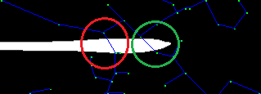

Water boundary maps and bridges

Slide 19
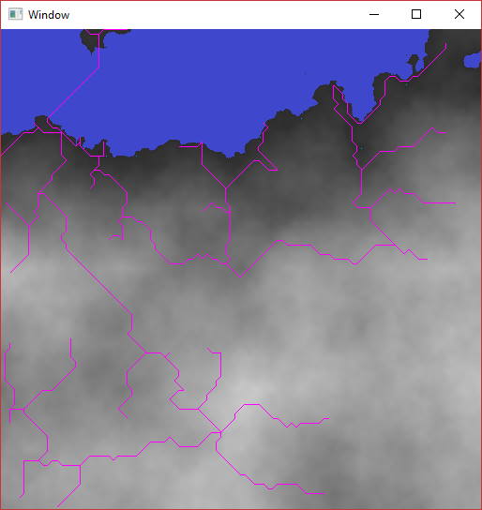
Natural water boundaries from terrain
Height maps can be searched after generation to search for potential streams in which rivers can be generated. (Smelik, R Et al., 2014).
Ilangovan, K, P. (2009) Procedural City Generaror, MSc thesus, Bournemouth University. Available at: https://nccastaff.bournemouth.ac.uk/jmacey/MastersProjects/MSc09/Ilangovan/Thesis_i7834000.pdf (Accessed: 30 May 2017).
Kelly, G. McCabe, H. (2006). “A Survey of Procedural Techniques for City Generation”. In ITB Journal, No. 14.
Muller, P and Parish, Y, I, H. (2001). “Procedural modeling of cities”. In Proceedings of the 28th annual conference on Computer graphics and interactive techniques (SIGGRAPH ’01). Acm, New York, NY, USA. 301 – 308.
Sun, J. Yu, X. Baciu, G. Green, M. (2002). “Template-based generation of road networks for virtual city modeling”. In Proceedings of the ACM symposium on Virtual reality software and technology (VRST ’02). Acm, New Work, NY, USA, 33 – 40.
Smelik, R., Tutenel, T., Bidarra, R. and Benes, B. (2014). A survey on Procedural Modelling for Virtual Worlds. Computer Graphics Forum, 33(6), pp.31-50.

Slide 20
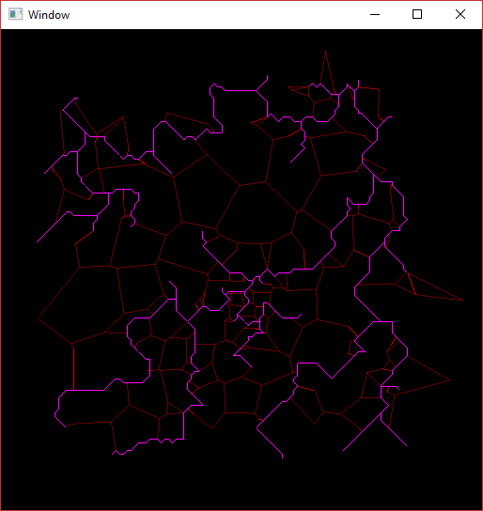
Road network improvements
Highways connect areas of high population whilst streets cover the area between highways, creating neighborhoods and offering access to the main highways. (Muller P and Parish Y I H, 2001).
“Highways are like main arteries in a body while streets like capillary vessels”. (Sun, J Et al. 2002).
Kelly, G. McCabe, H. (2006). “A Survey of Procedural Techniques for City Generation”. In ITB Journal, No. 14
Martek, C. (2012). “Procedural generation of road networks for large virtual environments.” Rochester Institute of Technology.
Muller, P and Parish, Y, I, H. (2001). “Procedural modeling of cities”. In Proceedings of the 28th annual conference on Computer graphics and interactive techniques (SIGGRAPH ’01). Acm, New York, NY, USA. 301 – 308.
Sun, J. Yu, X. Baciu, G. Green, M. (2002). “Template-based generation of road networks for virtual city modeling”. In Proceedings of the ACM symposium on Virtual reality software and technology (VRST ’02). Acm, New Work, NY, USA, 33 – 40.

Slide 21
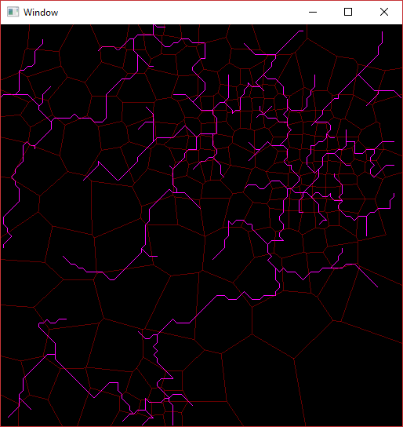
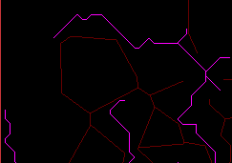
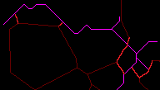
Road network improvements

Slide 22
Road network improvements

Slide 23
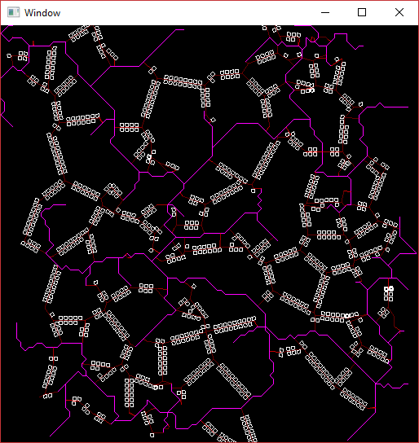
Building lot generation
“Computing a village skeleton is not sufficient for generating the layout of a village: we also need to tessellate the terrain into individual parcels of land, where houses, gardens or fields will be defined.” (Emilien A, Bernhardt A, Peytavie A, Cani M, Galin E, 2012).
Building lots can be created along the road by recursively dividing the areas along a road until a threshold area is reached.(Muller P, Parish Y I H, 2001).
Emilien, A., Bernhardt, A., Peytavie, A., Cani, M. and Galin, E. (2012). Procedural generation of villages on arbitrary terrains. The Visual Computer, 28(6-8), pp.809-818.
Muller, P and Parish, Y, I, H. (2001). “Procedural modeling of cities”. In Proceedings of the 28th annual conference on Computer graphics and interactive techniques (SIGGRAPH ’01). Acm, New York, NY, USA. 301 – 308.
Smelik, R., Tutenel, T., de Kraker, K. and Bidarra, R. (2011). A declarative approach to procedural modeling of virtual worlds. Computers & Graphics, 35(2), pp.352-363.

Slide 24
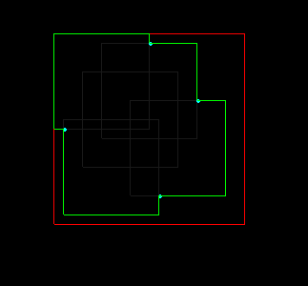
Generating building shapes
“Floor plans are two-dimensional polygons. Each floor plan consists of randomly selected and merged regular polygons and rectangles.” (Greuter S. et al., 2003).
“Combining several primitive shapes into a floor plan and extruding these to different heights” (Smelik R, Tutenel T, Bidarra R, Benes B, 2014).
Greuter, S. Parker, J. Stewart, N. Leach, G. (2003). “Real-time procedural generation of ‘pseudo infinite’ cities”. In *Proceedings of the 1st international conference on Computer graphics and interactive techniques in Astralasia and South East Asia* (GRAPHITE ’03) Acm, New York, Ny, USA, 87 – ff.
Muller, P and Parish, Y, I, H. (2001). “Procedural modeling of cities”. In Proceedings of the 28th annual conference on Computer graphics and interactive techniques (SIGGRAPH ’01). Acm, New York, NY, USA. 301 – 308.
Muller, P. Wonka, P. Haegler, S. Ulmer, A. Goo, L, V. (2006). “Procedural modeling of buildings” In Proceedings of SIGGRAPH 06′ ACM SIGGRAPH 2006. Acm, New York, NY, USA. 614 – 623.
Smelik, R., Tutenel, T., Bidarra, R. and Benes, B. (2014). A survey on Procedural Modelling for Virtual Worlds. *Computer Graphics Forum*, 33(6), pp.31-50.

Slide 25
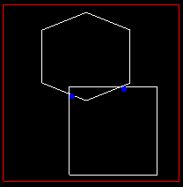
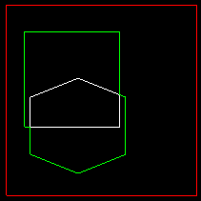
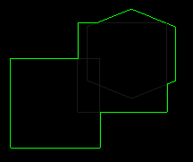
Generating building shapes

Slide 26
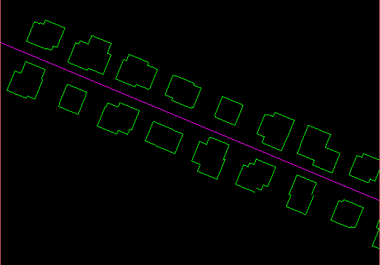
Generating building shapes

Slide 27
Future goals
Unity Library
Terrain generation
Land
Water
Roads plotted
Major roads
Minor roads
Bridges
Buildings placed
Building lot placement
Building mesh generation

Slide 28
Questions

