Slide 1
Joseph Barber
IMDCGD339-17YRD Final Project
Assessment 2

Slide 2
Project proposal
aa
bibliography

Slide 3
Preliminary reading
aa
bibliography

Slide 4
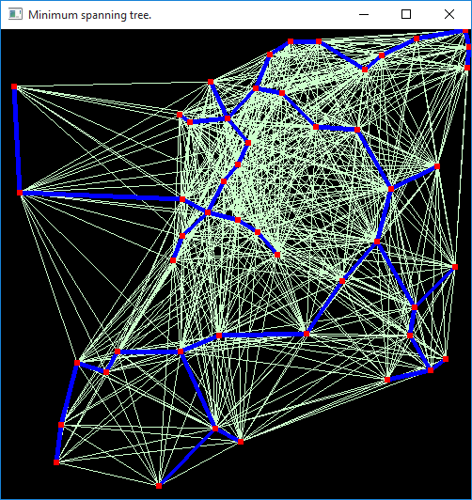
Minimum Spanning Tree
aa
Brown, B. (2011). Prim’s Algorithm: Minimal Spanning Tree. [Online] 15th May 2011. Available online: https://www.youtube.com/watch?v=YyLaRffCdk4 [Date of access: 02 October 2017].
Eppstein, D. (1996). Design and Analysis of Algorithms – Minimum Spanning Trees. [Online] 6th Feburary 1996. Available online: https://www.ics.uci.edu/~eppstein/161/960206.html [Date of access: 29 October 2017]
Martek, C. (2012). “Procedural generation of road networks for large virtual environments.” Rochester Institute of Technology.
Red Blob Games. (2014) Introduction to A*. [Online] June 2016. Available online: http://www.redblobgames.com/pathfinding/a-star/introduction.html [Date of access: 29 October 2017].

Slide 5
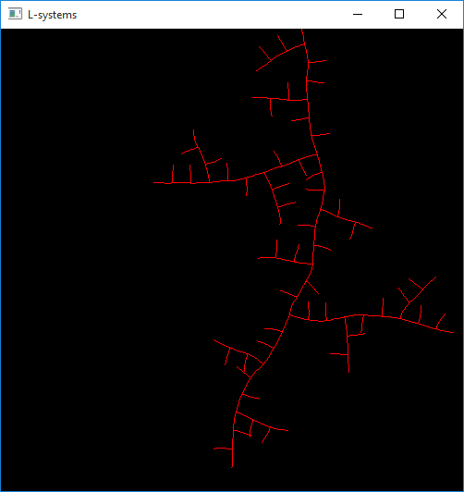
L-Systems
aa
Goldman, R., Schaefer, S. and Ju, T. (2004). Turtle geometry in computer graphics and computer-aided design. *Computer Aided Design*, 36(14), pp.1471-1482.
Ilangovan, K, P. (2009) Procedural City Generaror, MSc thesus, Bournemouth University. Available at: https://nccastaff.bournemouth.ac.uk/jmacey/MastersProjects/MSc09/Ilangovan/Thesis_i7834000.pdf (Accessed: 30 May 2017).
Kelly, G. Mccave, H. (2006). “A Survey of Procedural Techniques for City Generation”. In ITB Journal, No. 14.
Parish, Y, I, H. Muller, Pascal. (2001). “Procedural modeling of cities”. In Proceedings of the 28th annual conference on Computer graphics and interactive techniques (SIGGRAPH ’01). Acm, New York, NY, USA, 301 – 308.
Prusinkiewicx, P. and Janan, J. (1992). “Lindenmayer systems, fractals, and plants.” New York, N.Y.: Springer-Verlag.

Slide 6
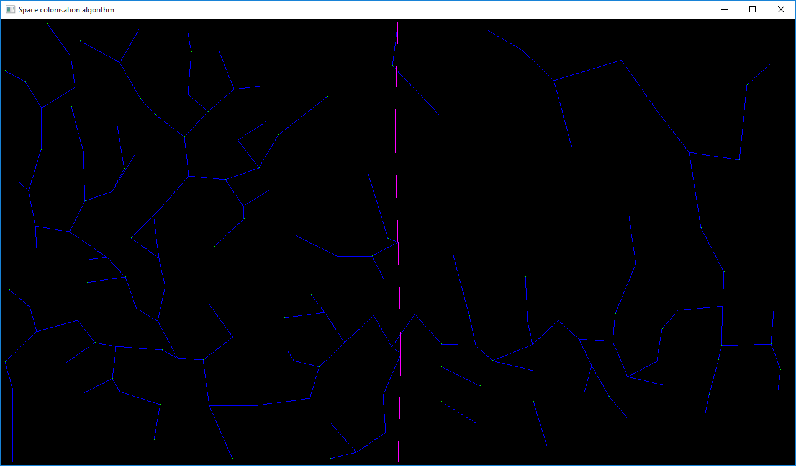
Space colonisation
aa
Runions, A. Lane, B and Prusinkiewicz, P. (2007) “Modeling trees with a space colonization algorithm” In Proceedings of the Third Eugographics conference on Natural Phenomena. Prague, Czech Republic. pp 63 – 70.
Samet, H. (1995). Spatial Data Structures. Addison-Wesley.

Slide 7
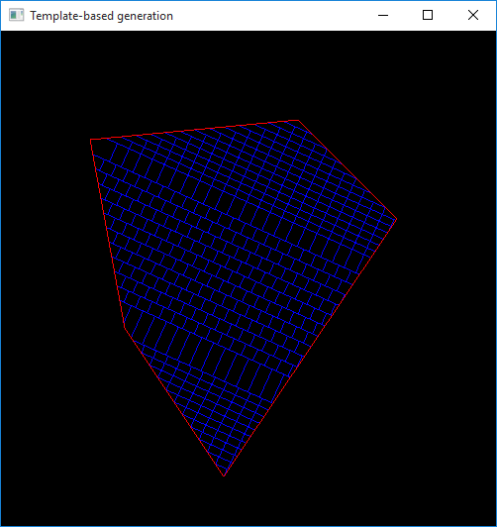
Raster template generation
aa
Kelly, G. McCabe, H. (2006). “A Survey of Procedural Techniques for City Generation”. In ITB Journal, No. 14.
Muller, P and Parish, Y, I, H. (2001). “Procedural modeling of cities”. In Proceedings of the 28th annual conference on Computer graphics and interactive techniques (SIGGRAPH ’01). Acm, New York, NY, USA. 301 – 308.
Sun, J. Yu, X. Baciu, G. Green, M. (2002). “Template-based generation of road networks for virtual city modeling”. In Proceedings of the ACM symposium on Virtual reality software and technology (VRST ’02). Acm, New Work, NY, USA, 33 – 40.

Slide 8
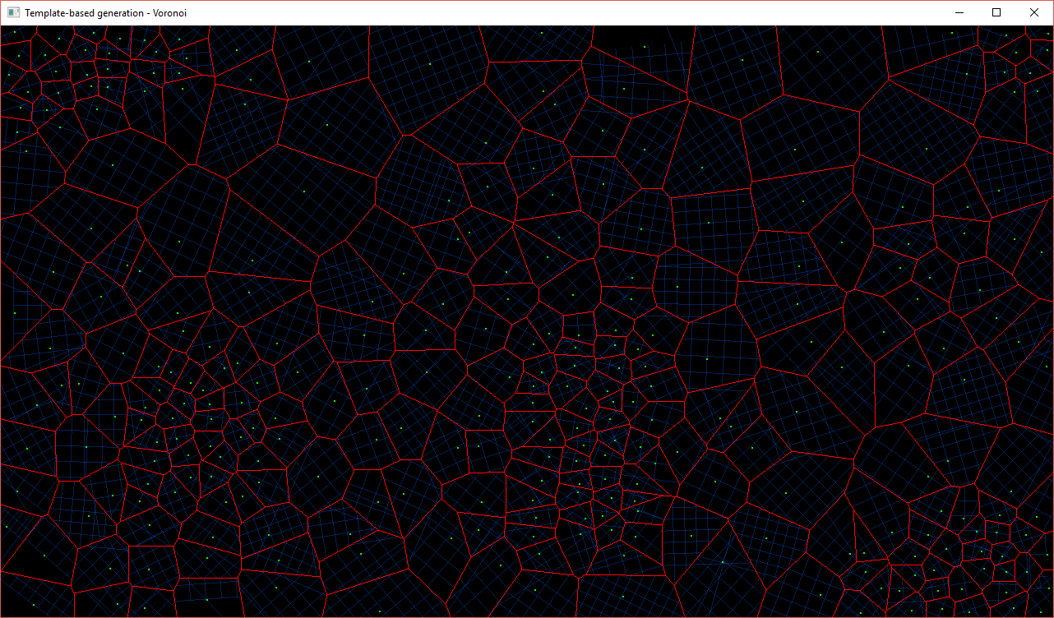
Population template generation
aa
Kelly, G. McCabe, H. (2006). “A Survey of Procedural Techniques for City Generation”. In ITB Journal, No. 14.
Muller, P and Parish, Y, I, H. (2001). “Procedural modeling of cities”. In Proceedings of the 28th annual conference on Computer graphics and interactive techniques (SIGGRAPH ’01). Acm, New York, NY, USA. 301 – 308.
Samet, H. (1995). Spatial Data Structures. Addison-Wesley.
Sun, J. Yu, X. Baciu, G. Green, M. (2002). “Template-based generation of road networks for virtual city modeling”. In Proceedings of the ACM symposium on Virtual reality software and technology (VRST ’02). Acm, New Work, NY, USA, 33 – 40.

Slide 9
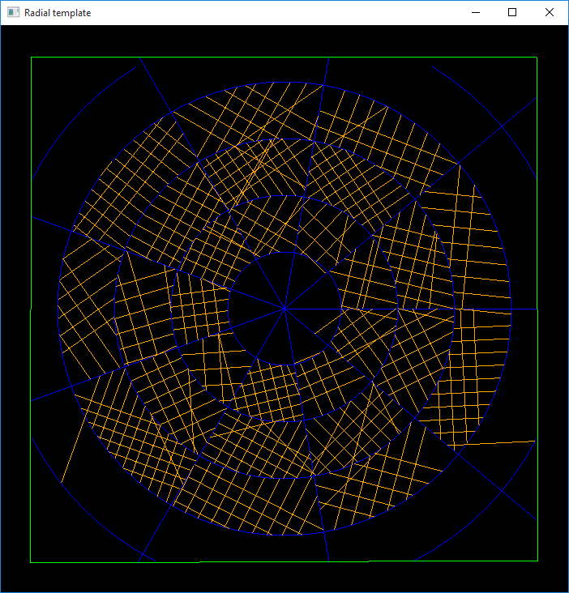
Radial template generation
aa
Kelly, G. McCabe, H. (2006). “A Survey of Procedural Techniques for City Generation”. In ITB Journal, No. 14.
Muller, P and Parish, Y, I, H. (2001). “Procedural modeling of cities”. In Proceedings of the 28th annual conference on Computer graphics and interactive techniques (SIGGRAPH ’01). Acm, New York, NY, USA. 301 – 308.
Sun, J. Yu, X. Baciu, G. Green, M. (2002). “Template-based generation of road networks for virtual city modeling”. In Proceedings of the ACM symposium on Virtual reality software and technology (VRST ’02). Acm, New Work, NY, USA, 33 – 40.

Slide 10
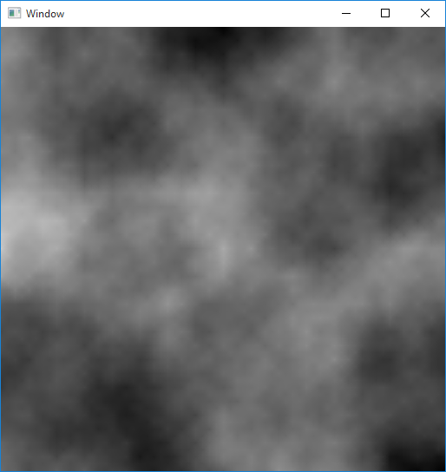
Diamond-Square terrain generation
aa
Gabin S P Miller, 1998. “The definition and rendering of terrain maps”. SIGGRAPH ’86 Proceedings of the 13th annual conference on Computer graphics and interactive techniques, ACM, New York, NY, USA, pp. 39 – 48
Martz, P. (1997). Generating Random Fractal Terrain. [Online] 1997. Available Online: http://www.gameprogrammer.com/fractal.html
Rose, T and Bakaoukas, A. (2016). “Algorithms and Approaches for Procedural Terrain Generation – A Brief Review of Current Techniques”. 2016 8th International Conference on Games and Virtual Worlds for Serious Applications (VS-GAMES). 1-2.

Slide 11
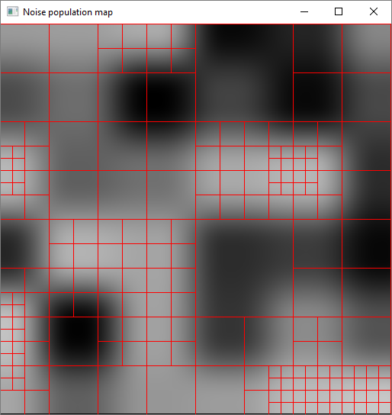
Population noise
aa
Kelly, G. McCabe, H. (2006). “A Survey of Procedural Techniques for City Generation”. In ITB Journal, No. 14.
Peck, J (2017). FastNoise [Repository]. Available online: https://github.com/Auburns/FastNoise [Date of access: 18 December 2017]
Rose, T and Bakaoukas, A. (2016). “Algorithms and Approaches for Procedural Terrain Generation – A Brief Review of Current Techniques”. 2016 8th International Conference on Games and Virtual Worlds for Serious Applications (VS-GAMES). 1-2.

Slide 12
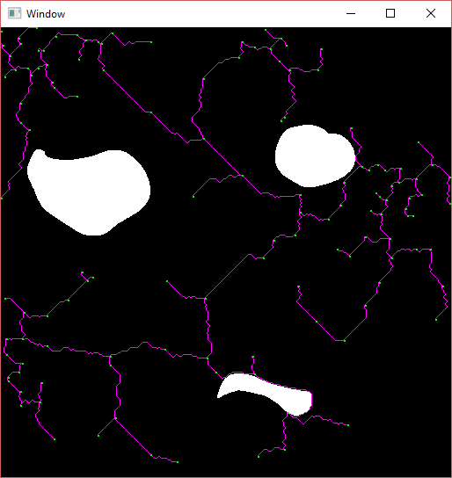
Water boundary maps
aa
Ilangovan, K, P. (2009) Procedural City Generaror, MSc thesus, Bournemouth University. Available at: https://nccastaff.bournemouth.ac.uk/jmacey/MastersProjects/MSc09/Ilangovan/Thesis_i7834000.pdf (Accessed: 30 May 2017).
Kelly, G. McCabe, H. (2006). “A Survey of Procedural Techniques for City Generation”. In ITB Journal, No. 14.
Muller, P and Parish, Y, I, H. (2001). “Procedural modeling of cities”. In Proceedings of the 28th annual conference on Computer graphics and interactive techniques (SIGGRAPH ’01). Acm, New York, NY, USA. 301 – 308.
Sun, J. Yu, X. Baciu, G. Green, M. (2002). “Template-based generation of road networks for virtual city modeling”. In Proceedings of the ACM symposium on Virtual reality software and technology (VRST ’02). Acm, New Work, NY, USA, 33 – 40.

Slide 13
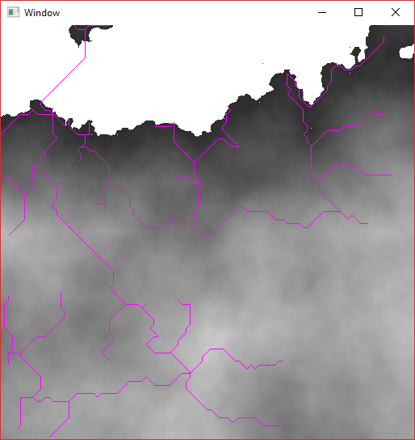
Natural water boundaries from terrain
aa
Smelik, R., Tutenel, T., Bidarra, R. and Benes, B. (2014). A survey on Procedural Modelling for Virtual Worlds. Computer Graphics Forum, 33(6), pp.31-50.

Slide 14
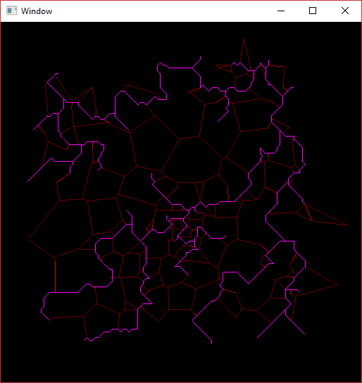
Road network improvements
aa
Kelly, G. McCabe, H. (2006). “A Survey of Procedural Techniques for City Generation”. In ITB Journal, No. 14
Martek, C. (2012). “Procedural generation of road networks for large virtual environments.” Rochester Institute of Technology.
Muller, P and Parish, Y, I, H. (2001). “Procedural modeling of cities”. In Proceedings of the 28th annual conference on Computer graphics and interactive techniques (SIGGRAPH ’01). Acm, New York, NY, USA. 301 – 308.
Sun, J. Yu, X. Baciu, G. Green, M. (2002). “Template-based generation of road networks for virtual city modeling”. In Proceedings of the ACM symposium on Virtual reality software and technology (VRST ’02). Acm, New Work, NY, USA, 33 – 40.

Slide 15
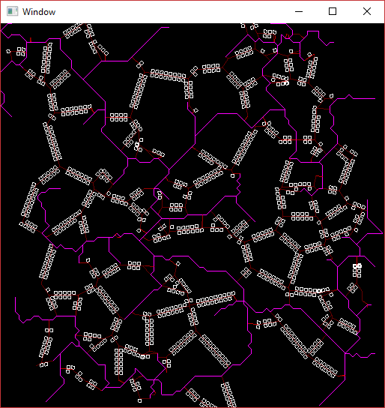
Building lot generation
aa
Emilien, A., Bernhardt, A., Peytavie, A., Cani, M. and Galin, E. (2012). Procedural generation of villages on arbitrary terrains. The Visual Computer, 28(6-8), pp.809-818.
Muller, P and Parish, Y, I, H. (2001). “Procedural modeling of cities”. In Proceedings of the 28th annual conference on Computer graphics and interactive techniques (SIGGRAPH ’01). Acm, New York, NY, USA. 301 – 308.
Smelik, R., Tutenel, T., de Kraker, K. and Bidarra, R. (2011). A declarative approach to procedural modeling of virtual worlds. Computers & Graphics, 35(2), pp.352-363.

Slide 16
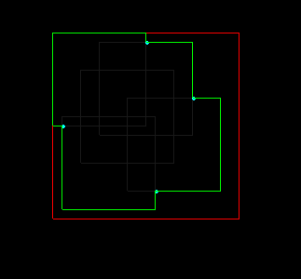
Generating building shapes
aa
Greuter, S. Parker, J. Stewart, N. Leach, G. (2003). “Real-time procedural generation of ‘pseudo infinite’ cities”. In *Proceedings of the 1st international conference on Computer graphics and interactive techniques in Astralasia and South East Asia* (GRAPHITE ’03) Acm, New York, Ny, USA, 87 – ff.
Muller, P and Parish, Y, I, H. (2001). “Procedural modeling of cities”. In Proceedings of the 28th annual conference on Computer graphics and interactive techniques (SIGGRAPH ’01). Acm, New York, NY, USA. 301 – 308.
Muller, P. Wonka, P. Haegler, S. Ulmer, A. Goo, L, V. (2006). “Procedural modeling of buildings” In Proceedings of SIGGRAPH 06′ ACM SIGGRAPH 2006. Acm, New York, NY, USA. 614 – 623.
Smelik, R., Tutenel, T., Bidarra, R. and Benes, B. (2014). A survey on Procedural Modelling for Virtual Worlds. *Computer Graphics Forum*, 33(6), pp.31-50.

