Slide 1
Math/InfAs/CprE 535 Digital Image Forensics and Steganalysis
Chi square test for steganalysis
Dr. Jennifer Newman
Department of Mathematics
Electrical & Computer Engineering
Spring 2018

Slide 2
Today
Chi square test

Slide 3
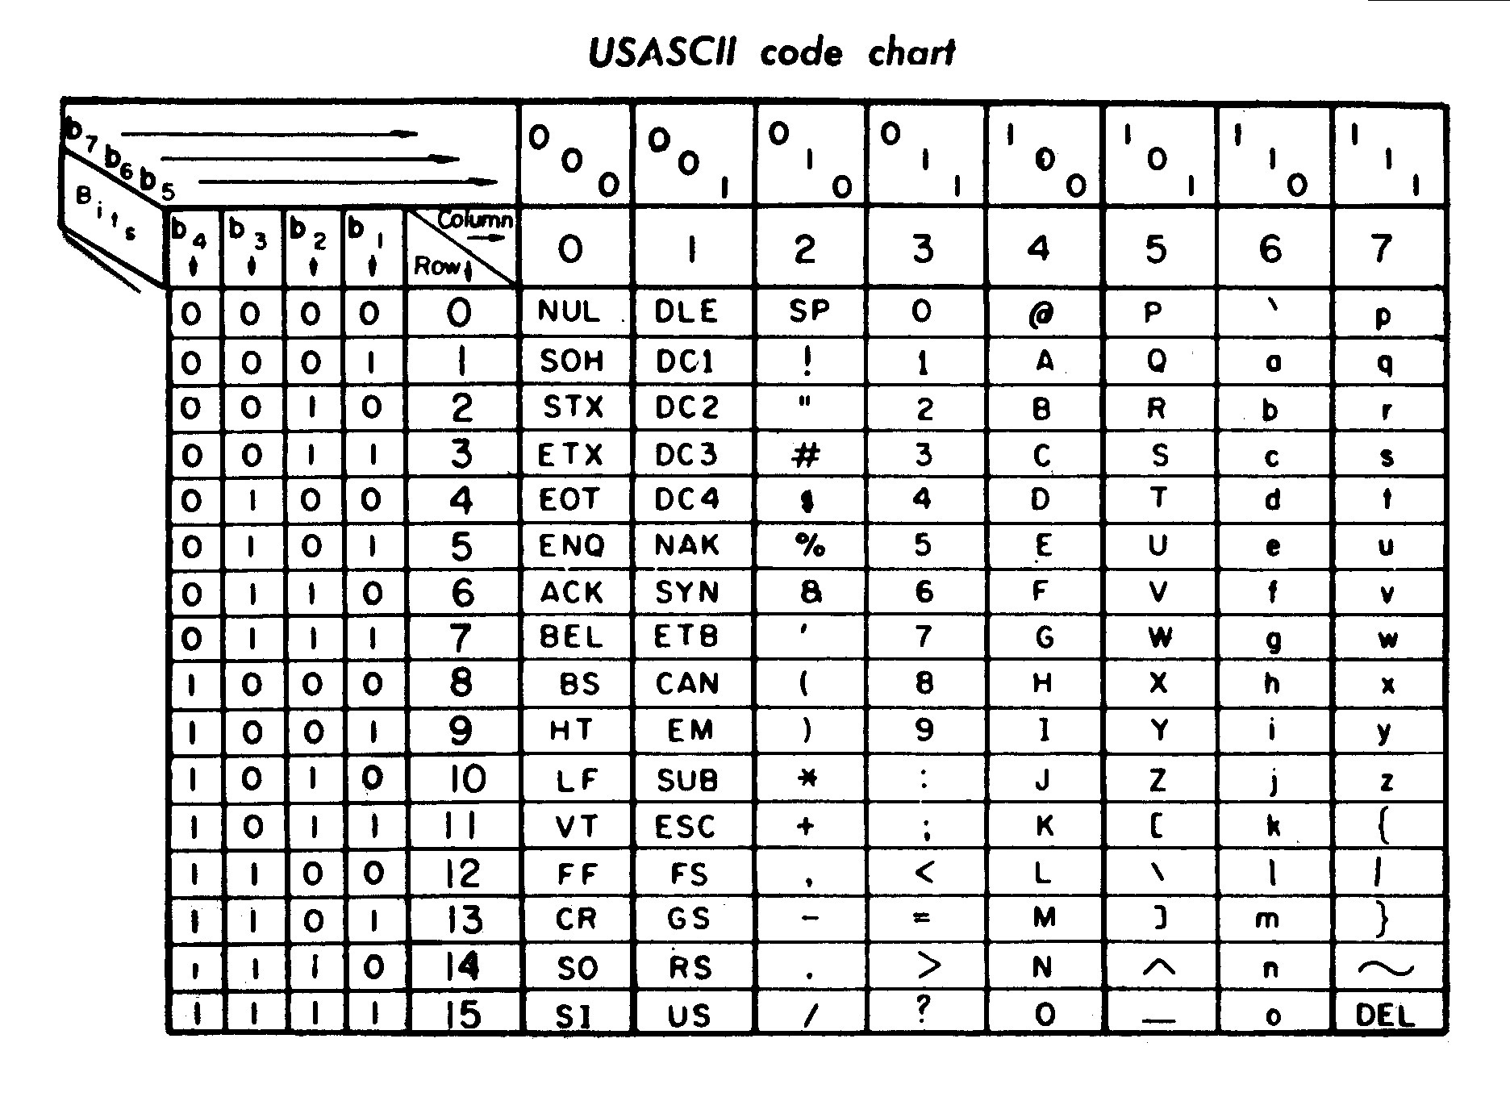
How a text message gets encrypted
Plaintext (message in English)
ASCII (message in ascii code)
HERE ARE THE ANSWERS…
HERE ARE THE ANSWERS…
010010000100010101010010010001010010000001000001010100...
Since ASCII code is well-known, encryption is used to transform and scramble the 0s and 1s so that one could not use statistical frequency of common letters to make educated guesses at the context of the plaintext and thus decode the message
Notice that the frequency of 0s and 1s in the ASCII string appears to be asymmetric
There are many more 0s than 1s
character | ASCII
H | 01001000
E | 01000101
R | 01010010
E | 01000101
 | 00100000
A | 01000001
R | 01010010
E | 01000101
 | 00100000
T | 01010100
H | 01001000
E | 01000101
 | 00100000
A | 01000001
… | …

Slide 4
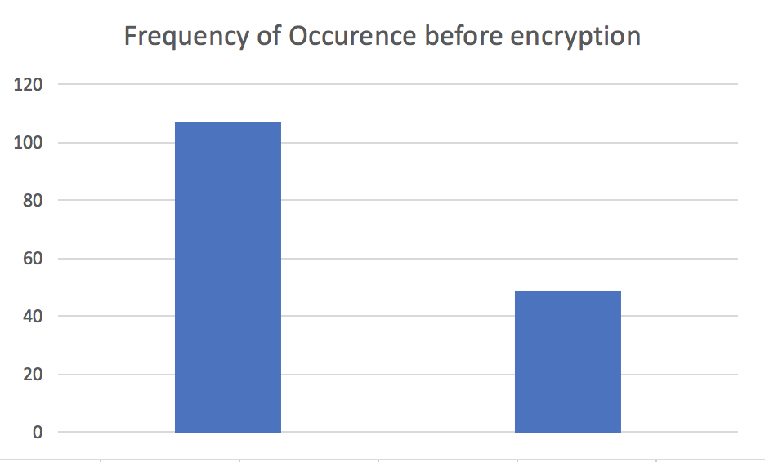
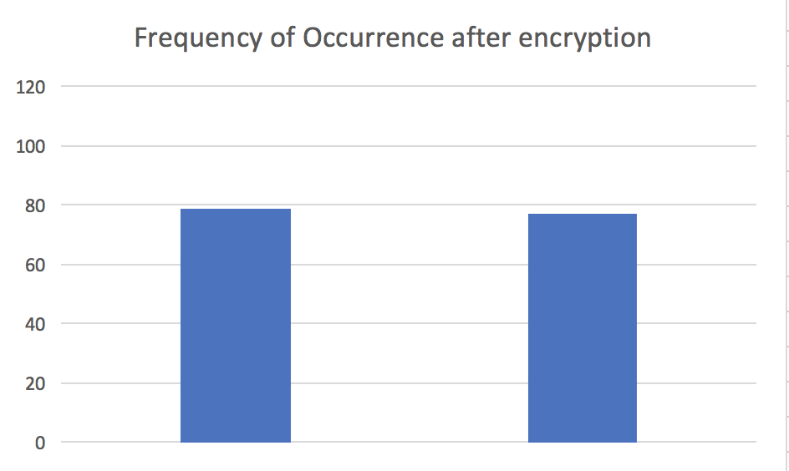
Encryption
Encryption changes the frequency of 0s and 1s from that appearing in the original bit string occurrence
The input to an encryption algorithm is a bit string (from ASCII codes) and the output is another bit string consisting of 0s and 1s, but the number of 0s and 1s are approximately the same
Encryption is used when logging in to a website, to password-protect a file, etc.; the algorithm is based on a mathematical algorithm
0
1
0
1

Slide 5
Concepts
If the frequency of occurrence of values in a collection has the property that they occur at the same constant rate, we say that distribution of values is uniform
Example
156 bits total
Before encryption: 107 zeros, 49 ones (rate is 0.6859 zeros and 0.3141 ones)
After encryption: 79 zeros, 77 ones (rate is 0.5064 zeros and 0.4936 ones)
So encryption produces a set of 0s and 1s that has (approximately) a uniform distribution
Each encrypted message has an approximately uniform distribution of 0s and 1s
Common encryption algorithms include DES, triple DES, RSA, AES
All methods need at least one key to perform the encryption/decryption
The key (a password) locks and unlocks the message

Slide 6
Observe
When we overwrite the bit, we often follow a lexicographical path, starting at the top leftmost location in the image array, and proceeding left to right, top to bottom of the array, sequentially visiting the pixel locations in this manner
If the payload string is shorter than the image array size, we can:
Embed the payload bits, and stop there, leaving the remaining bits of the cover image untouched
We can change the remaining bits to either 0 or 1
If the payload string is longer than the image array size, we can:
Embed only the portion of the payload that fits into the array; in this case, the payload cannot be recovered
Return an error to the process and stop the algorithm
The percentage of bits used for embedding out of the total available for embedding is called the embedding rate
If we embed in 10 out of 100 bit locations, that is 10 % embedding rate, or 0.1 bits per pixel: 0.1 bpp

Slide 7
Variation on LSB embedding: +/- algorithm
Instead of overwriting a bit, we can change the cover bit to match the payload bit in a random manner:
Let’s say that a cover gray value is 127₁₀ = 01111111₂
Let’s say the payload bit is 0: so we need to change the cover bit
Overwriting gives us: 01111110₂ = 126₁₀
We could change the gray value to 128 = 10000000 as its LSB is zero (but not by overwriting)
So instead of overwriting, flip a coin: if it’s heads, add one to 127; if it’s zero, then subtract one to 127:
Add one to 127 gives 128 = 10000000
Subtract one from 127 gives 126: 01111110
Which one changes more bits?

Slide 8
Random site visitation for embedding
Another way to change the bits
Instead of choosing the next pixel to embed the payload in in a lexicographical manner, pick the next site in a random manner from the ones left that you have not yet used for embedding
This disperses the embedded pixels throughout the image
It also spreads the uniform distribution of 0s and 1s throughout the image
This makes it more difficult to apply our targeted test (later)

Slide 9
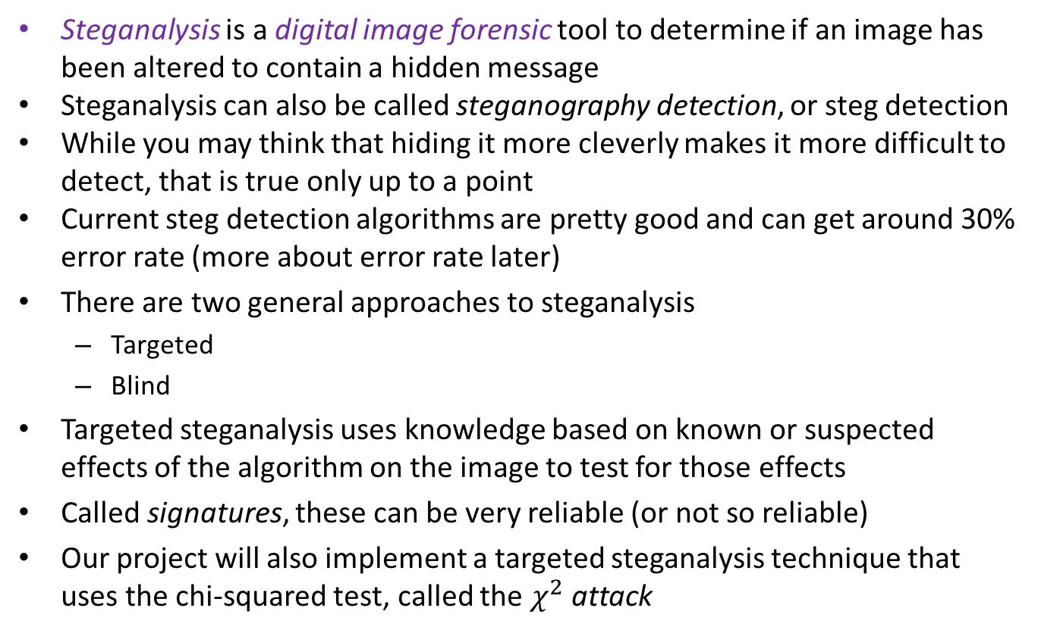
What is steganalysis?
Steganalysis is a digital image forensic tool to determine if an image has been altered to contain a hidden message
Steganalysis can also be called steganography detection, or steg detection
While you may think that hiding it more cleverly makes it more difficult to detect, that is true only up to a point
Current steg detection algorithms are pretty good and can get around 30% error rate (more about error rate later)
There are two general approaches to steganalysis
Targeted
Blind
Targeted steganalysis uses knowledge based on known or suspected effects of the algorithm on the image to test for those effects
Called signatures, these can be very reliable (or not so reliable)
Our project will also implement a targeted steganalysis technique that uses the chi-squared test, called the $χ^{2}$ attack

Slide 10

Steganalysis and Machine Learning
Many steg detection algorithms use machine learning (ML) framework for detection
We will not be performing ML techniques in class, but I give one slide on it because it is the preferred method of steg detection and widely used
ML steganalysis can be tested on images embedded using many more algorithms than targeted steganalysis techniques, as ML does not depend on the specific characteristics of one embedding algorithm
For ML steganalysis, the set of training images gives rise to the features that the classifier uses to distinguish between cover and stego images: the training dataset is very important
“good”
“smart”
“wise”
STEGO
Extract statistical features
Classifier
COVER
Lots of cover+stego pairs
“Database”

Slide 11
Steganalysis
Premises on which steganalysis is based:
Changing the bits of the image changes the statistical profile of the image
Changing more bits has a greater effect on the changed statistical profile
Payload bit string has a uniform distribution of 0s and 1s
This is true for targeted or non-targeted approaches

Slide 12
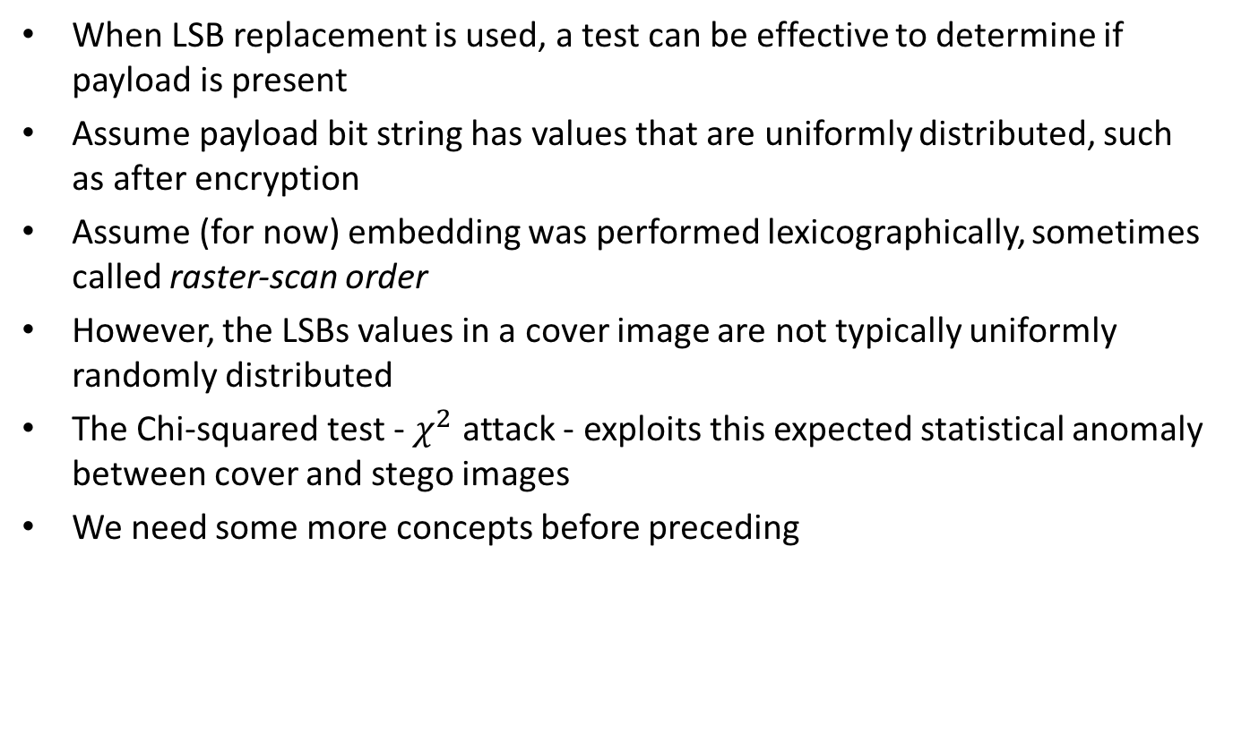
Detecting LSB embedding in an image
When LSB replacement is used, a test can be effective to determine if payload is present
Assume payload bit string has values that are uniformly distributed, such as after encryption
Assume (for now) embedding was performed lexicographically, sometimes called raster-scan order
However, the LSBs values in a cover image are not typically uniformly randomly distributed
The Chi-squared test - $χ^{2}$ attack - exploits this expected statistical anomaly between cover and stego images
We need some more concepts before preceding

Slide 13
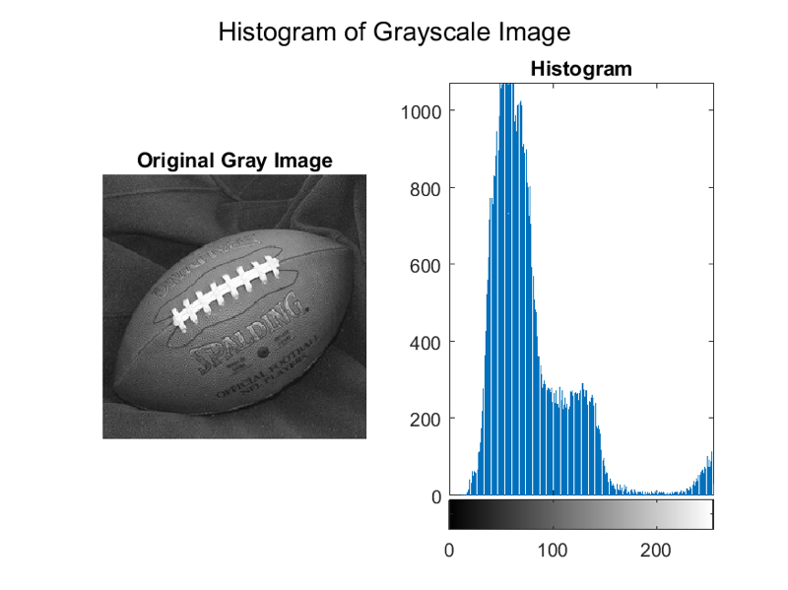
Histograms
If we take an innocent grayscale image and count the number of 0 values and store that value in h(0), count the number of 1 values, h(1), etc., number of 255 values h(255), and then plot it in a bar graph, we might see the graph below:
Frequency of occurrence
Gray value

Slide 14
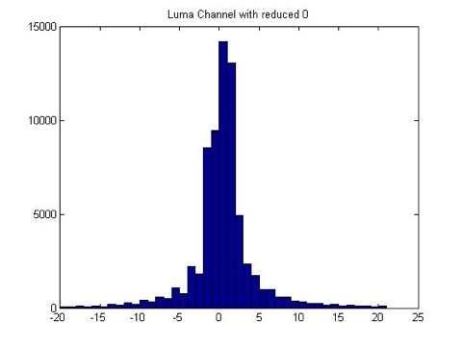
Stego histogram
If we take a stego image (LSB embedding) histogram plot we might see the graph below:
Frequency of occurrence
Gray value

Slide 15
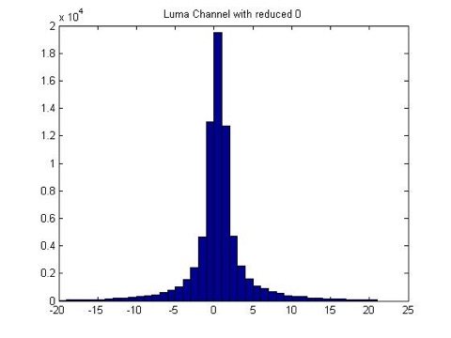
Two histograms
Cover left, stego right
There is a clear pattern here
Cover
Stego
Frequency of occurrence
Frequency of occurrence
Gray value
Gray value

Slide 16
How LSB replacement changes the distribution of even and odd values
Cover Stego
ave
ave
0
0
1
1
2
2
3
3
2
3
2
3
.
.
.
.
.
.
Cover histogram
Stego histogram
254
254
255
255
|# of 2s – ave|: large
|# of 2s – ave|: small

Slide 17
Change of 0-1 distribution from cover to stego
It can be shown that given a cover image’s LSBs, that its pairs of specified original LSB values will, on average, change from its original distribution to one that is uniformly distributed, after embedding a uniform random string of 0s and 1s (try it!)
Why are pairs of values in a stego image produced by LSB replacement approximately the same?

Slide 18
Why are histogram values in Stego similar?

Slide 19
Why are histogram values in Stego similar?

Slide 20
Why are histogram values in Stego similar?

Slide 21
Conducting a statistically well-defined test for LSB embedding
To conduct a well-defined statistical test, we use our knowledge gained from the difference between the cover and stego histograms
We can compare data from cover and stego histograms
The test we use to compare is: how far from the average value is the even-valued gray value in the appropriate pair of gray values
We want to use this information to infer a claim about the data we tested
We need to construct a test of significance about our claims: did we find something statistically significant? That is, does the statistic we computed tell us that a relationship exists?

Slide 22
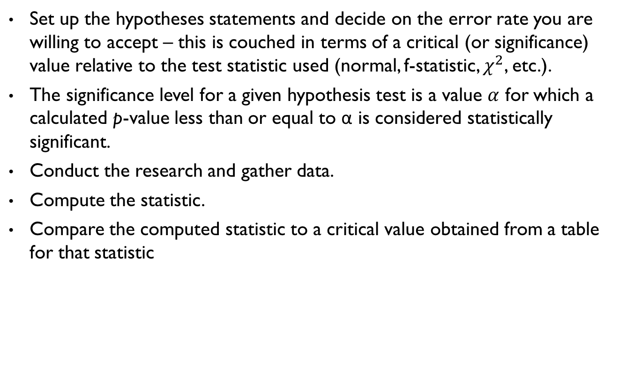
How to conduct a statistically significant test
Set up the hypotheses statements and decide on the error rate you are willing to accept – this is couched in terms of a critical (or significance) value relative to the test statistic used (normal, f-statistic, $χ^{2}$, etc.).
The significance level for a given hypothesis test is a value $α$ for which a calculated p-value less than or equal to α is considered statistically significant.
Conduct the research and gather data.
Compute the statistic.
Compare the computed statistic to a critical value obtained from a table for that statistic

Slide 23
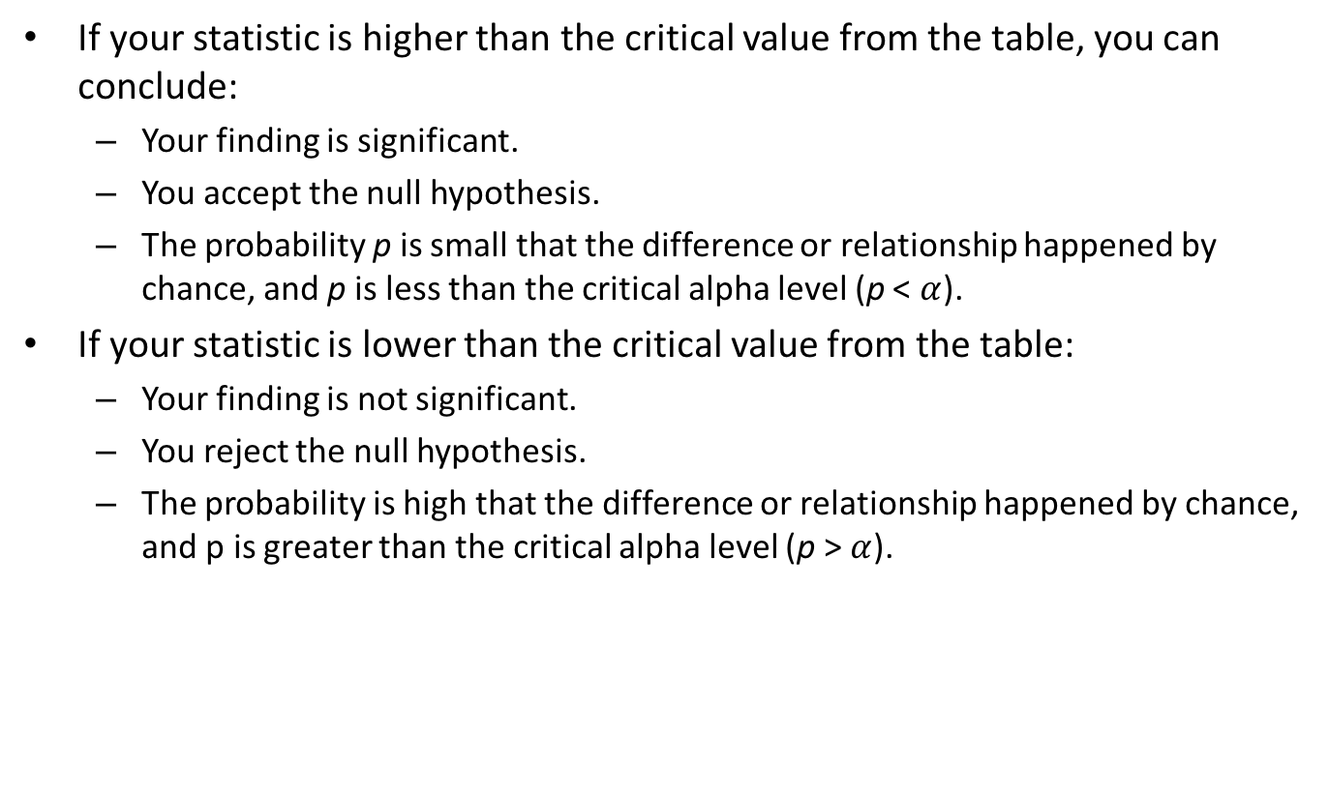
Interpreting the result
If your statistic is higher than the critical value from the table, you can conclude:
Your finding is significant.
You accept the null hypothesis.
The probability p is small that the difference or relationship happened by chance, and p is less than the critical alpha level (p < $α$).
If your statistic is lower than the critical value from the table:
Your finding is not significant.
You reject the null hypothesis.
The probability is high that the difference or relationship happened by chance, and p is greater than the critical alpha level (p > $α$).

Slide 24
Null and alternative hypotheses
A null hypothesis H₀: is a statement of what the statistical hypothesis test is set up to establish
The alternative hypothesis H_{a} is a statement or theory that is believed to be true but has not yet been proven
The final conclusion is stated in terms of the null hypothesis: we can conclude either
Reject H₀ in favor of H_{a} or
Accept H₀ .
If we conclude “accept H₀ “ it means only that there is not enough evidence against H₀ in favor of H_{a}
If we conclude “reject H₀ in favor of H_{a} “ it suggests that the alternative hypothesis H_{a} may be true

Slide 25
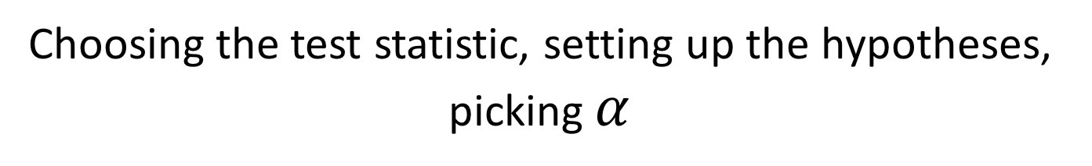
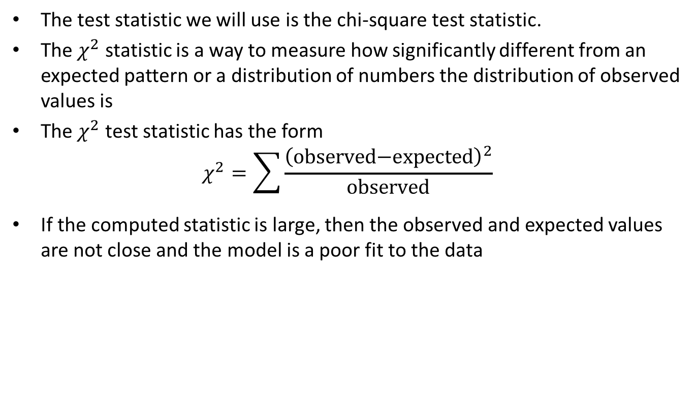
Choosing the test statistic, setting up the hypotheses, picking $α$
The test statistic we will use is the chi-square test statistic.
The $χ^{2}$ statistic is a way to measure how significantly different from an expected pattern or a distribution of numbers the distribution of observed values is
The $χ^{2}$ test statistic has the form
$$χ^{2}=\sum{\frac{{\left(\text{observed}\text{−}\text{expected}\right)}^{2}}{\text{observed}}}$$
If the computed statistic is large, then the observed and expected values are not close and the model is a poor fit to the data

Slide 26
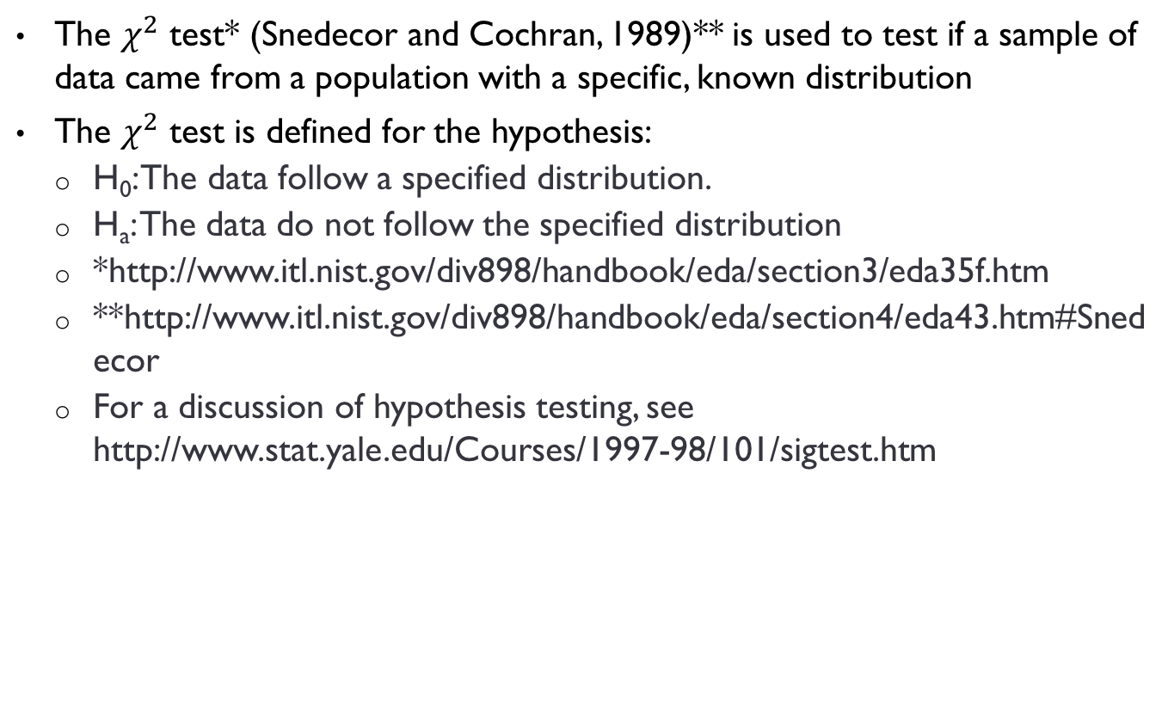
What is the chi-square test?
The $χ^{2}$ test* (Snedecor and Cochran, 1989)** is used to test if a sample of data came from a population with a specific, known distribution
The $χ^{2}$ test is defined for the hypothesis:
H₀: The data follow a specified distribution.
H_{a}: The data do not follow the specified distribution
*http://www.itl.nist.gov/div898/handbook/eda/section3/eda35f.htm
**http://www.itl.nist.gov/div898/handbook/eda/section4/eda43.htm#Snedecor
For a discussion of hypothesis testing, see http://www.stat.yale.edu/Courses/1997-98/101/sigtest.htm

Slide 27
Our hypotheses statements
H₀: The data follow a specified distribution, namely, the difference between the even valued gray values and their respective averages is small (this corresponds to a stego image)
H_{a}: The data do not follow the specified distribution (this could correspond to a cover image, or not)
Note: this is slightly different than how a hypothesis test is usually used:
The null hypothesis is the statement being tested and is usually a statement of "no effect" or "no difference".
The alternative hypothesis is the statement you want to be able to conclude is true based on evidence provided by the sample data
Here we set up the test to look for a stego image using H₀ although a cover image could have the distribution of a stego, by chance
We could frame the problem statement as we are looking for data that is not stego-like, i.e. cover data, as most data is not stego

Slide 28
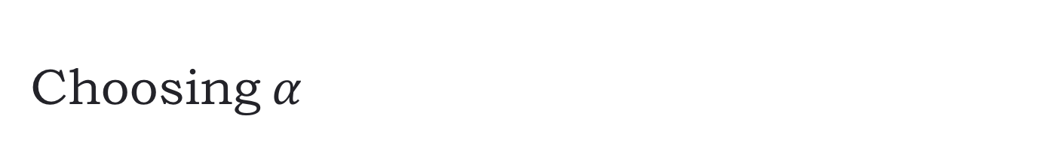
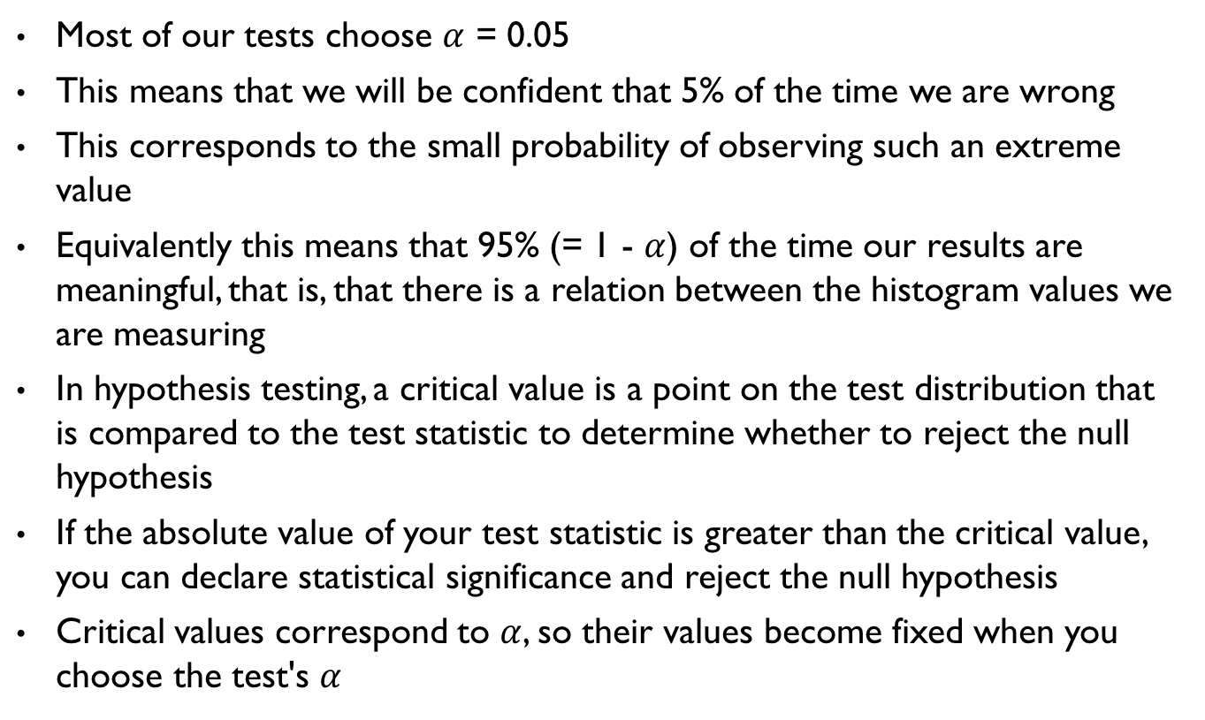
Choosing$α$
Most of our tests choose $α$ = 0.05
This means that we will be confident that 5% of the time we are wrong
This corresponds to the small probability of observing such an extreme value
Equivalently this means that 95% (= 1 - $α$) of the time our results are meaningful, that is, that there is a relation between the histogram values we are measuring
In hypothesis testing, a critical value is a point on the test distribution that is compared to the test statistic to determine whether to reject the null hypothesis
If the absolute value of your test statistic is greater than the critical value, you can declare statistical significance and reject the null hypothesis
Critical values correspond to $α$, so their values become fixed when you choose the test's $α$

Slide 29
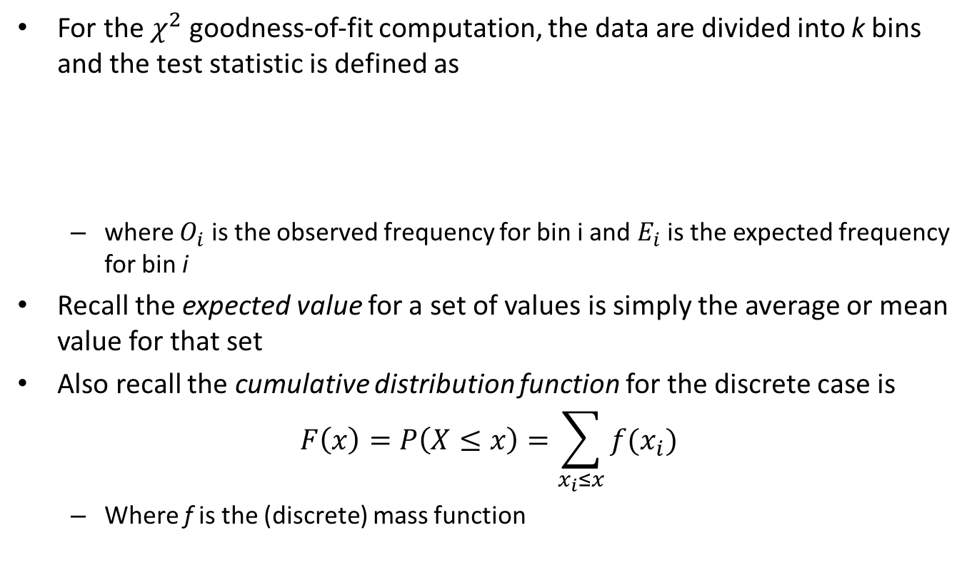

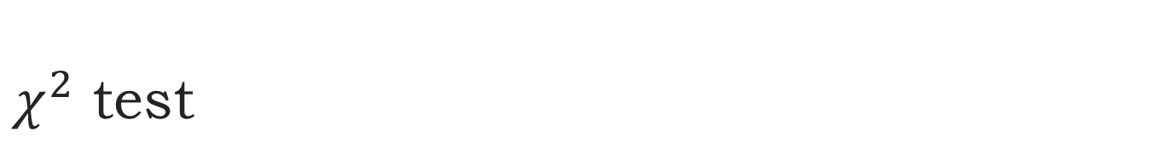
$χ^{2}$ test
For the $χ^{2}$ goodness-of-fit computation, the data are divided into k bins and the test statistic is defined as
where $O_{i}$ is the observed frequency for bin i and $E_{i}$ is the expected frequency for bin i
Recall the expected value for a set of values is simply the average or mean value for that set
Also recall the cumulative distribution function for the discrete case is
$$F\left(x\right)=P\left(X≤x\right)=\sum_{x_{i}≤x}{f(x_{i})}$$
Where f is the (discrete) mass function
$$χ^{2}=\sum_{i=1}^{k}{\frac{{\left(O_{i}−E_{i}\right)}^{2}}{E_{i}}}$$

Slide 30
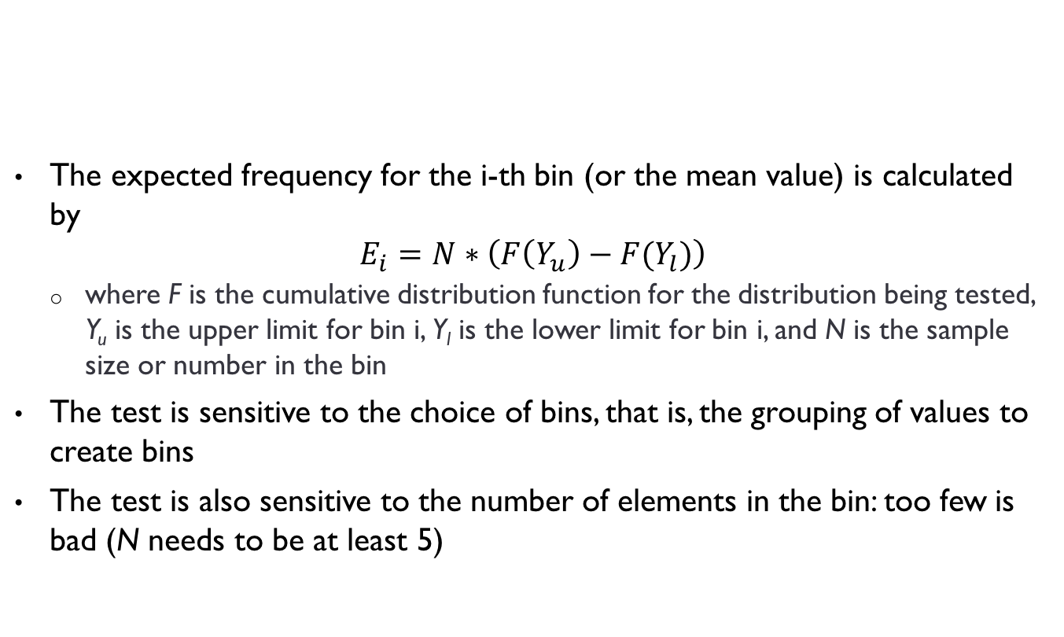

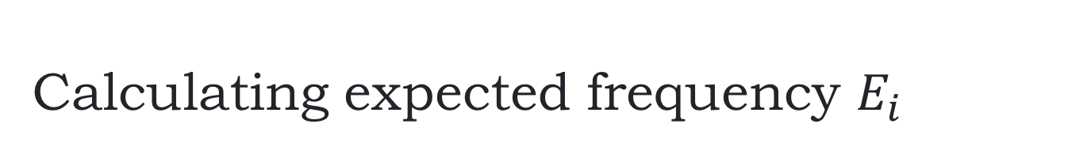
Calculating expected frequency $E_{i}$
$$χ^{2}=\sum_{i=1}^{k}{\frac{{\left(O_{i}−E_{i}\right)}^{2}}{E_{i}}}$$
The expected frequency for the i-th bin (or the mean value) is calculated by
$$E_{i}=N∗\left(F\left(Y_{u}\right)−F(Y_{l})\right)$$
where F is the cumulative distribution function for the distribution being tested, Y_{u} is the upper limit for bin i, Y_{l} is the lower limit for bin i, and N is the sample size or number in the bin
The test is sensitive to the choice of bins, that is, the grouping of values to create bins
The test is also sensitive to the number of elements in the bin: too few is bad (N needs to be at least 5)

Slide 31
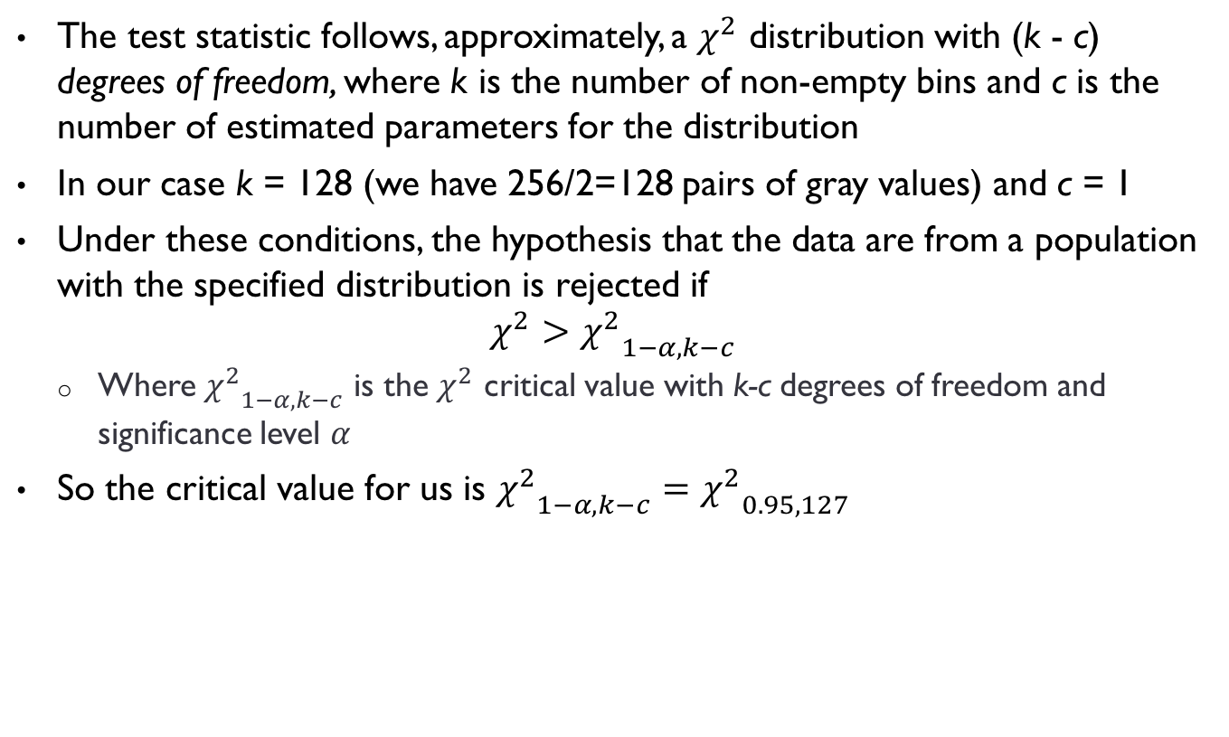
For our case
The test statistic follows, approximately, a $χ^{2}$ distribution with (k - c) degrees of freedom, where k is the number of non-empty bins and c is the number of estimated parameters for the distribution
In our case k = 128 (we have 256/2=128 pairs of gray values) and c = 1
Under these conditions, the hypothesis that the data are from a population with the specified distribution is rejected if
$$χ^{2}>{χ^{2}}_{1−α,k−c}$$
Where ${χ^{2}}_{1−α,k−c}$ is the $χ^{2}$ critical value with k-c degrees of freedom and significance level $α$
So the critical value for us is ${χ^{2}}_{1−α,k−c}={χ^{2}}_{0.95,127}$

Slide 32
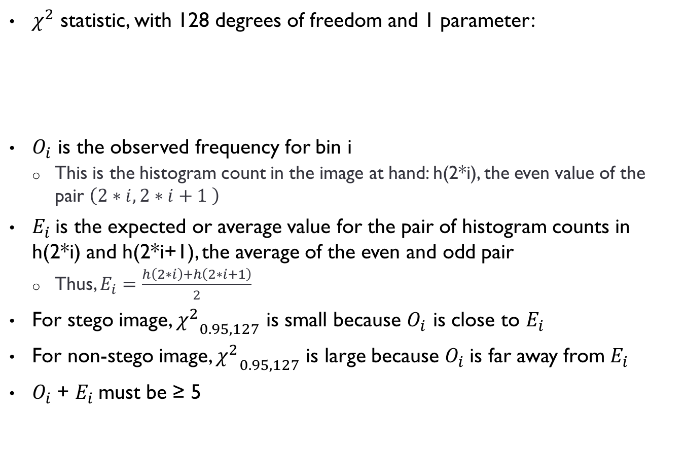
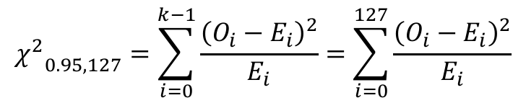
Our case
$χ^{2}$ statistic, with 128 degrees of freedom and 1 parameter:
$O_{i}$ is the observed frequency for bin i
This is the histogram count in the image at hand: h(2*i), the even value of the pair $\left(2∗i,2∗i+1 \right)$
$E_{i}$is the expected or average value for the pair of histogram counts in h(2*i) and h(2*i+1), the average of the even and odd pair
Thus, $E_{i}=\frac{h\left(2∗i\right)+h\left(2∗i+1\right)}{2}$
For stego image, ${χ^{2}}_{0.95,127}$ is small because $O_{i}$ is close to $E_{i}$
For non-stego image, ${χ^{2}}_{0.95,127}$ is large because $O_{i}$is far away from $E_{i}$
$O_{i}$+ $E_{i}$must be ≥ 5
$${χ^{2}}_{0.95,127}=\sum_{i=0}^{k−1}{\frac{{\left(O_{i}−E_{i}\right)}^{2}}{E_{i}}}=\sum_{i=0}^{127}{\frac{{\left(O_{i}−E_{i}\right)}^{2}}{E_{i}}}$$

Slide 33

Goal
Our goal is to calculate ${χ^{2}}_{0.95,127}$ for a given image

Slide 34
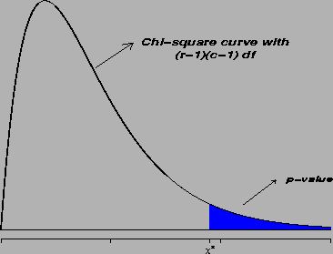



What you do with test statistic $χ^{2}$
The ${χ^{2}}_{0.95,127}$ value thus computed is then used to calculate the area under the tail end of a curve for a $χ^{2}$ distribution:
$$p=1−\frac{1}{2^{\frac{k−1}{2}}Γ\left(k−1\right)}\int_{0}^{{χ^{2}}_{1−α,k−c }}{e^{−\frac{x}{2}}x^{\left(\frac{k−1}{2} −1\right)}dx}$$
p is called a “p-value” for the test
$${χ^{2}}_{0.95,127}$$

Slide 35
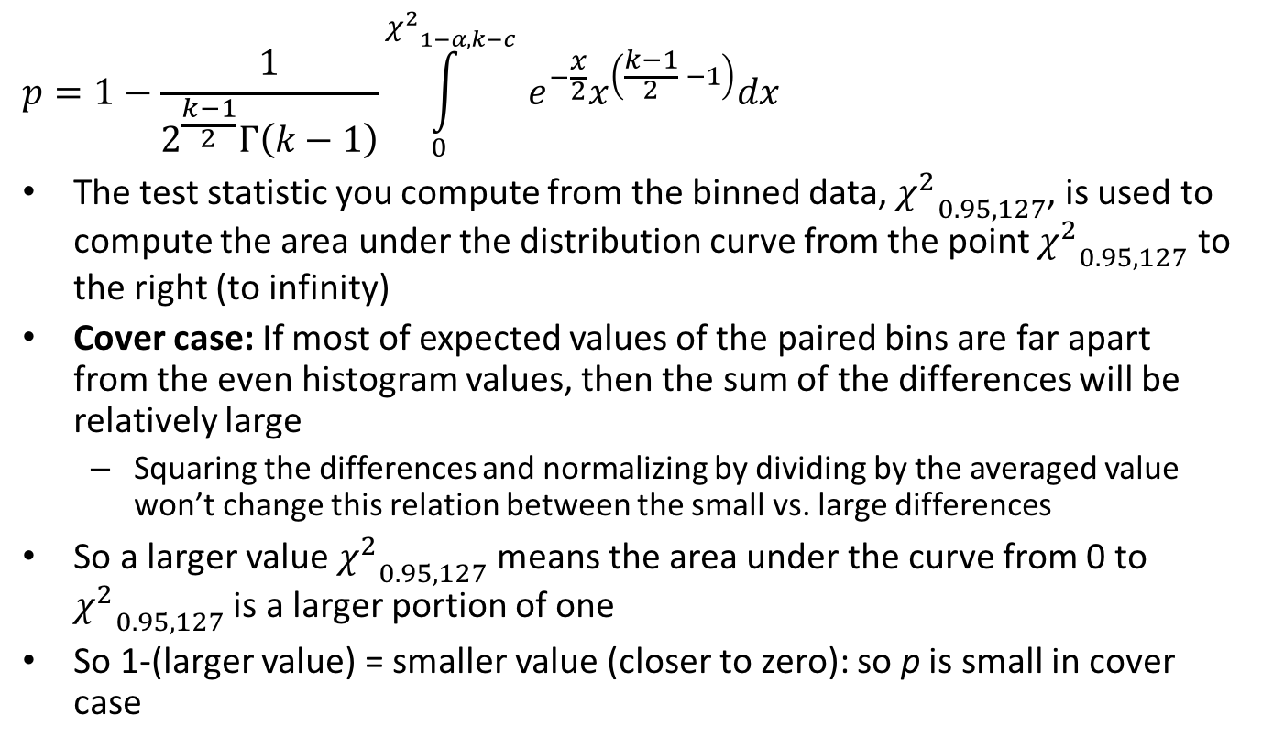
What you do with test statistic $χ^{2}$
$$p=1−\frac{1}{2^{\frac{k−1}{2}}Γ\left(k−1\right)}\int_{0}^{{χ^{2}}_{1−α,k−c }}{e^{−\frac{x}{2}}x^{\left(\frac{k−1}{2} −1\right)}dx}$$
The test statistic you compute from the binned data, ${χ^{2}}_{0.95,127}$, is used to compute the area under the distribution curve from the point ${χ^{2}}_{0.95,127}$ to the right (to infinity)
Cover case: If most of expected values of the paired bins are far apart from the even histogram values, then the sum of the differences will be relatively large
Squaring the differences and normalizing by dividing by the averaged value won’t change this relation between the small vs. large differences
So a larger value ${χ^{2}}_{0.95,127}$ means the area under the curve from 0 to ${χ^{2}}_{0.95,127}$ is a larger portion of one
So 1-(larger value) = smaller value (closer to zero): so p is small in cover case

Slide 36
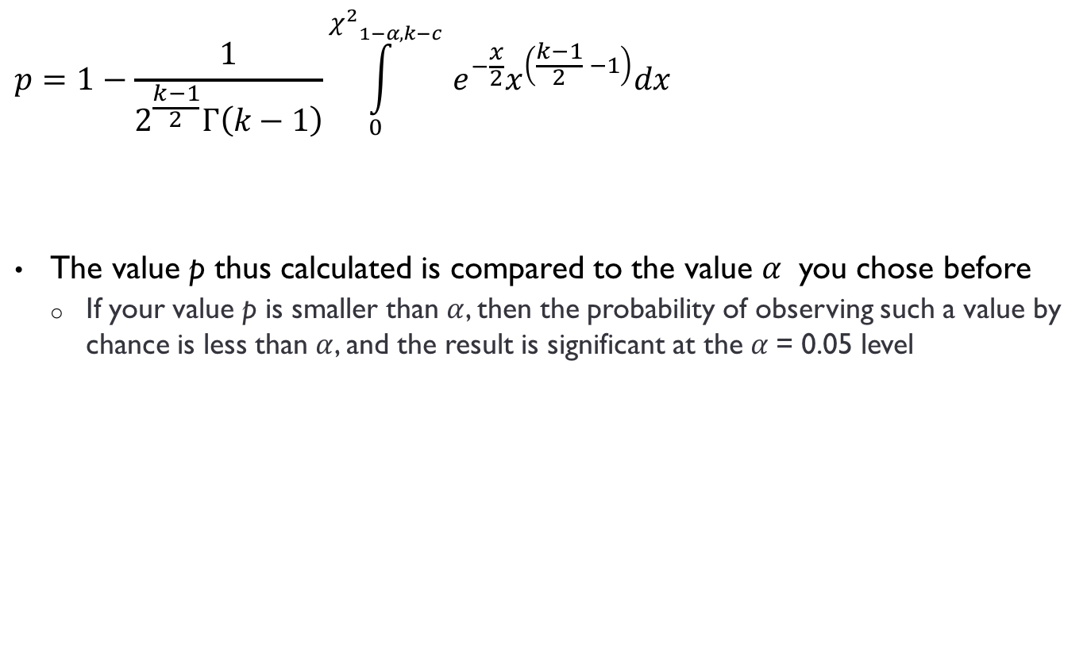
What you do with test statistic $χ^{2}$
$$p=1−\frac{1}{2^{\frac{k−1}{2}}Γ\left(k−1\right)}\int_{0}^{{χ^{2}}_{1−α,k−c }}{e^{−\frac{x}{2}}x^{\left(\frac{k−1}{2} −1\right)}dx}$$
The value p thus calculated is compared to the value $α$ you chose before
If your value p is smaller than $α$, then the probability of observing such a value by chance is less than $α$, and the result is significant at the $α$= 0.05 level

Slide 37
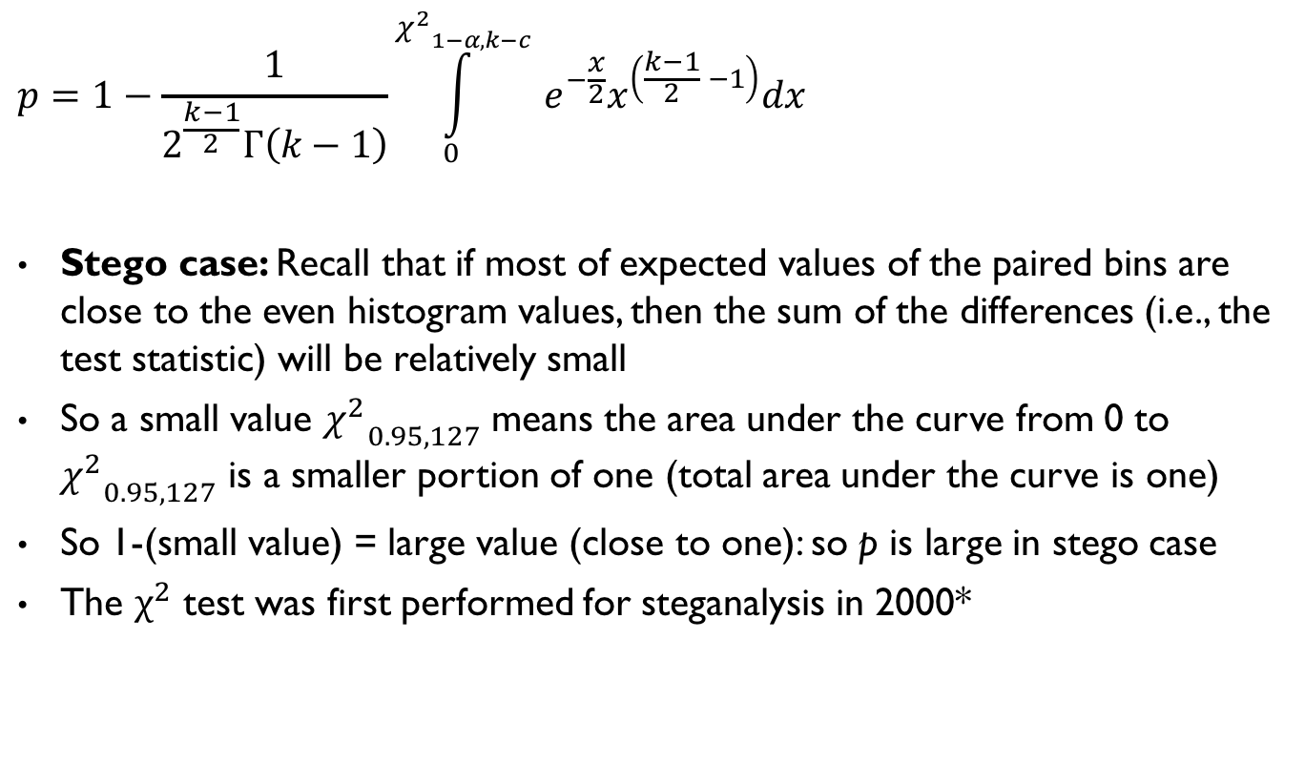
What you do with test statistic $χ^{2}$
$$p=1−\frac{1}{2^{\frac{k−1}{2}}Γ\left(k−1\right)}\int_{0}^{{χ^{2}}_{1−α,k−c }}{e^{−\frac{x}{2}}x^{\left(\frac{k−1}{2} −1\right)}dx}$$
Stego case: Recall that if most of expected values of the paired bins are close to the even histogram values, then the sum of the differences (i.e., the test statistic) will be relatively small
So a small value ${χ^{2}}_{0.95,127}$ means the area under the curve from 0 to ${χ^{2}}_{0.95,127}$ is a smaller portion of one (total area under the curve is one)
So 1-(small value) = large value (close to one): so p is large in stego case
The $χ^{2}$ test was first performed for steganalysis in 2000*
*Attacks on Steganographic Systems, A. Westfeld and A. Pfitzmann. In 3rd International Workshop on Information Hiding. Lecture Notes in Computer Science, Vol.1768. Springer-Verlag, Berlin (2000) pp. 61-75.

Slide 38

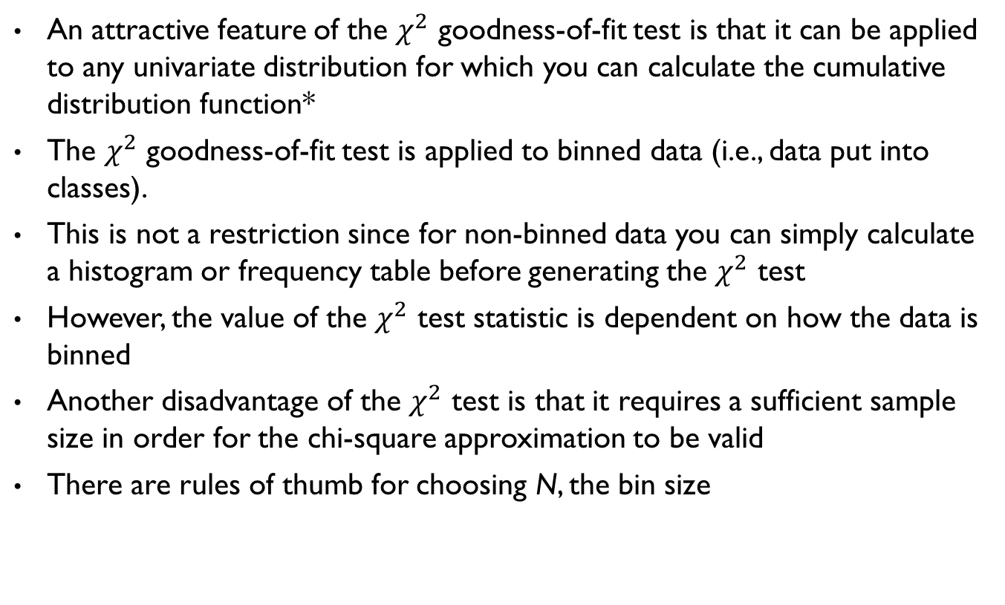
Pros and cons of the $χ^{2}$test
An attractive feature of the $χ^{2}$ goodness-of-fit test is that it can be applied to any univariate distribution for which you can calculate the cumulative distribution function*
The $χ^{2}$ goodness-of-fit test is applied to binned data (i.e., data put into classes).
This is not a restriction since for non-binned data you can simply calculate a histogram or frequency table before generating the $χ^{2}$ test
However, the value of the $χ^{2}$ test statistic is dependent on how the data is binned
Another disadvantage of the $χ^{2}$ test is that it requires a sufficient sample size in order for the chi-square approximation to be valid
There are rules of thumb for choosing N, the bin size
*http://www.itl.nist.gov/div898/handbook/eda/section3/eda35f.htm

Slide 39
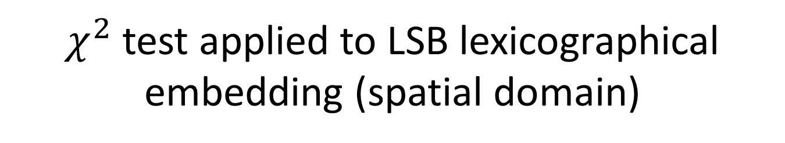
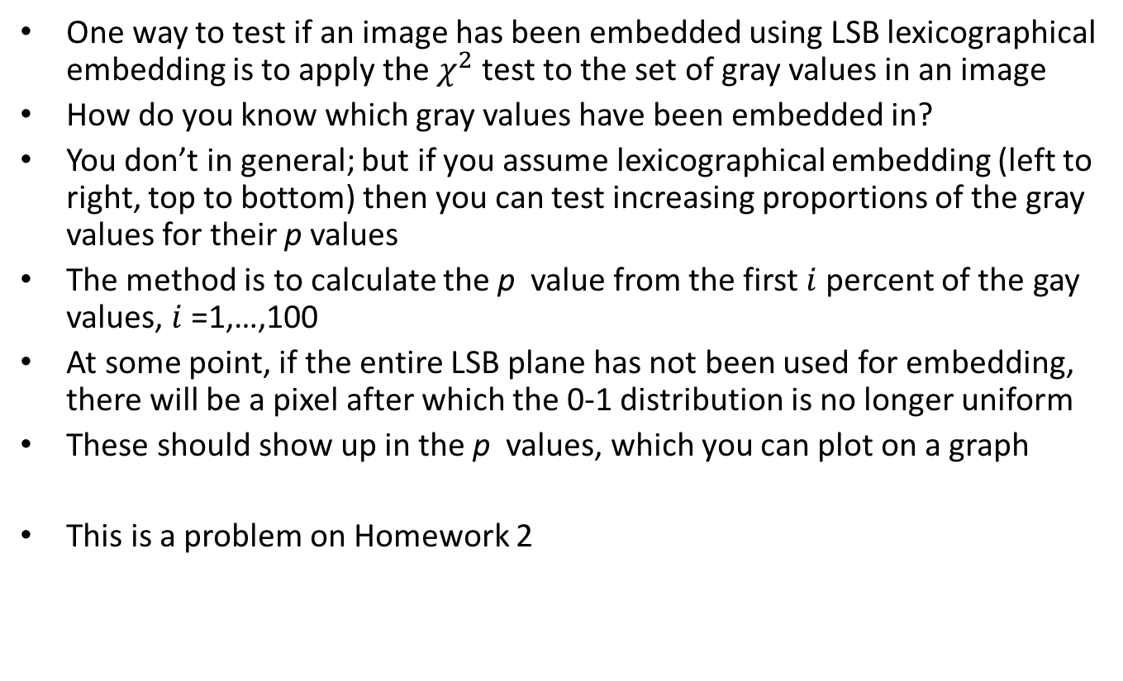
$χ^{2}$ test applied to LSB lexicographical embedding (spatial domain)
One way to test if an image has been embedded using LSB lexicographical embedding is to apply the $χ^{2}$ test to the set of gray values in an image
How do you know which gray values have been embedded in?
You don’t in general; but if you assume lexicographical embedding (left to right, top to bottom) then you can test increasing proportions of the gray values for their p values
The method is to calculate the p value from the first $i$ percent of the gay values, $i$ =1,…,100
At some point, if the entire LSB plane has not been used for embedding, there will be a pixel after which the 0-1 distribution is no longer uniform
These should show up in the p values, which you can plot on a graph
This is a problem on Homework 2

Slide 40
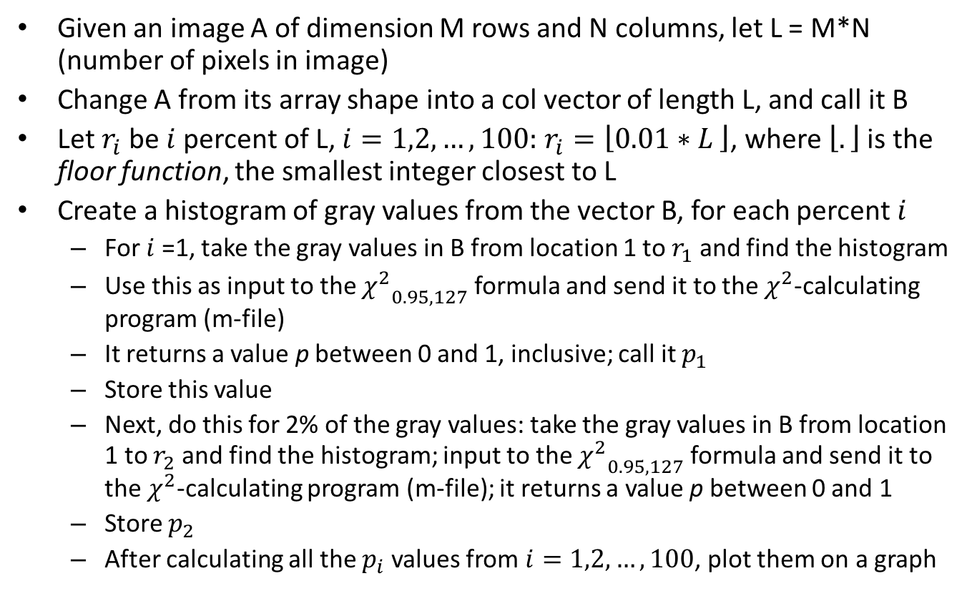
$χ^{2}$ test applied to LSB lexicographical embedding (spatial domain)
Given an image A of dimension M rows and N columns, let L = M*N (number of pixels in image)
Change A from its array shape into a col vector of length L, and call it B
Let $r_{i}$ be $i$ percent of L, $i=1,2,…,100:$ $r_{i}=\left\lfloor 0.01∗L \right\rfloor$, where $\left\lfloor .\right\rfloor$ is the floor function, the smallest integer closest to L
Create a histogram of gray values from the vector B, for each percent $i$
For $i$ =1, take the gray values in B from location 1 to $r_{1}$ and find the histogram
Use this as input to the ${χ^{2}}_{0.95,127}$ formula and send it to the $χ^{2}$-calculating program (m-file)
It returns a value p between 0 and 1, inclusive; call it $p_{1}$
Store this value
Next, do this for 2% of the gray values: take the gray values in B from location 1 to $r_{2}$ and find the histogram; input to the ${χ^{2}}_{0.95,127}$ formula and send it to the $χ^{2}$-calculating program (m-file); it returns a value p between 0 and 1
Store $p_{2}$
After calculating all the $p_{i}$ values from $i=1,2,…,100$, plot them on a graph

Slide 41
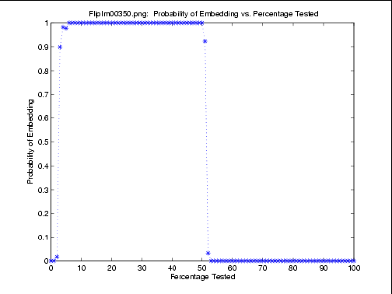
Results (C. Stanley’s thesis, ISU, 2005)

Slide 42
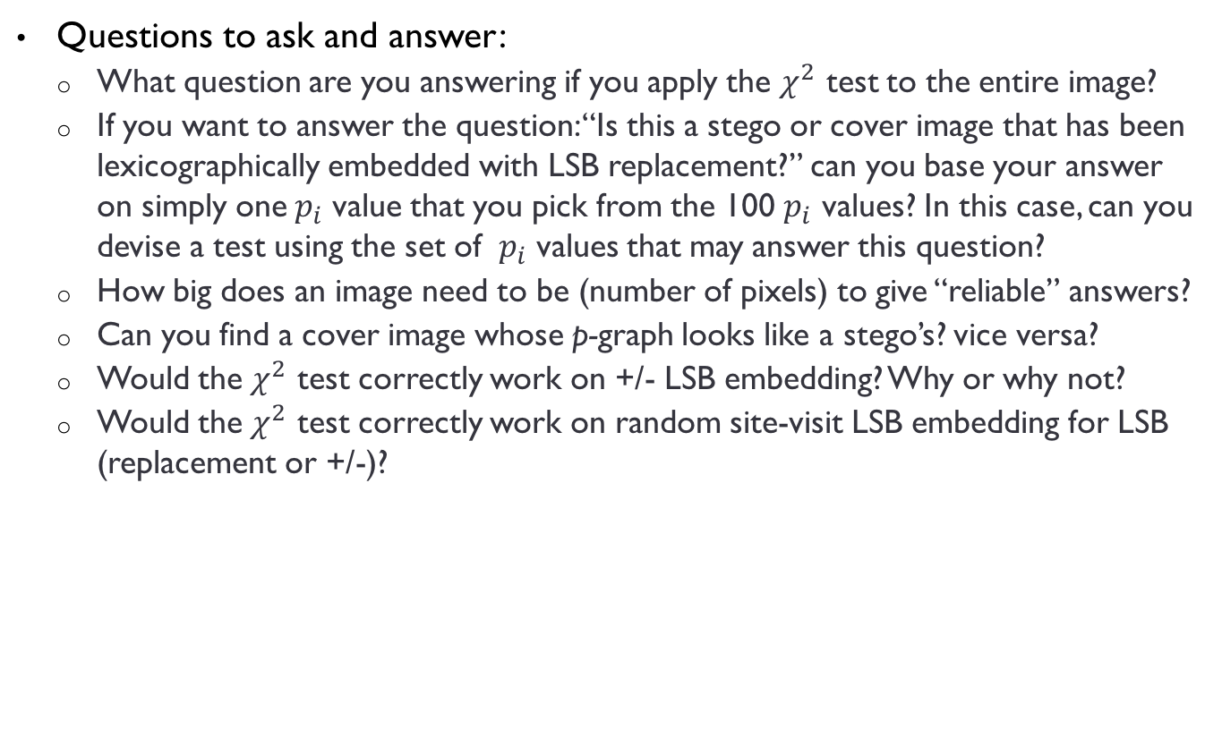
Questions to ask yourself
Questions to ask and answer:
What question are you answering if you apply the $χ^{2}$ test to the entire image?
If you want to answer the question: “Is this a stego or cover image that has been lexicographically embedded with LSB replacement?” can you base your answer on simply one${ p}_{i}$ value that you pick from the 100 $p_{i}$ values? In this case, can you devise a test using the set of ${ p}_{i}$ values that may answer this question?
How big does an image need to be (number of pixels) to give “reliable” answers?
Can you find a cover image whose p-graph looks like a stego’s? vice versa?
Would the $χ^{2}$ test correctly work on +/- LSB embedding? Why or why not?
Would the $χ^{2}$ test correctly work on random site-visit LSB embedding for LSB (replacement or +/-)?

Slide 43
Weaknesses of chi-square test
If two first order distributions (histograms of coefficient values) are very similar, the chi-square test will not discriminate between them
If the order of embedding is not known and is less than the full size of image, then test can also be very inaccurate
Must have at least 5 in a bin in order to perform test
In this case, we combine bins in order to produce results

Slide 44
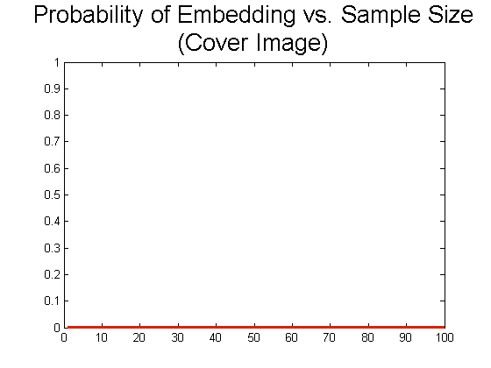
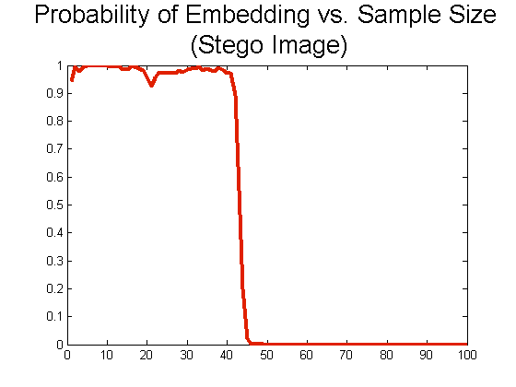
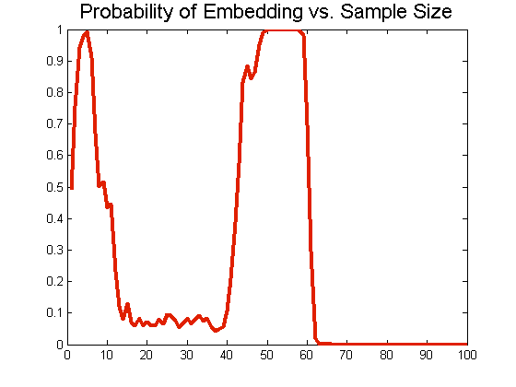
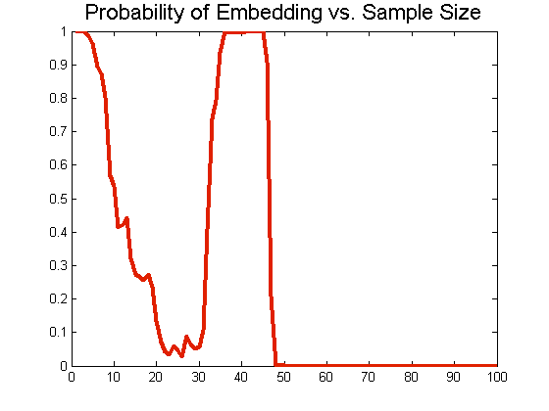
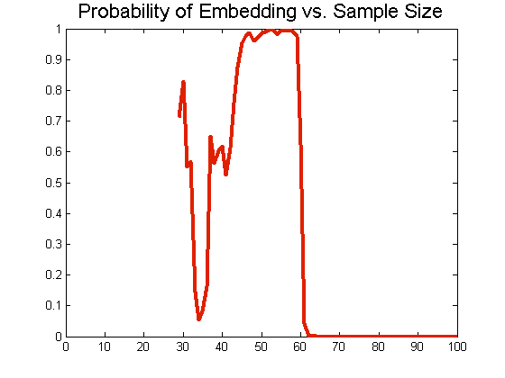
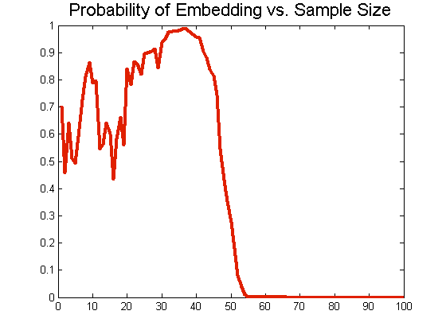
Graphs from other images

Slide 45
To increase detection of payload
If a different scan order is used to produce the p values, then correlations between pixel locations are different
Pick a scanning order so that correlations are higher than with row-by-row scanning
Westfeld tried a Hilbert curve for scanning and computing a similar “Pairs Analysis” on data
Following material is from
A. Westfeld, Space Filling Curves in Steganalysis, in Proc. of SPIE, Security, Steganography, and Watermarking of Multimedia Contents VII, San Jose (2005), pp. 28-37.
.

Slide 46
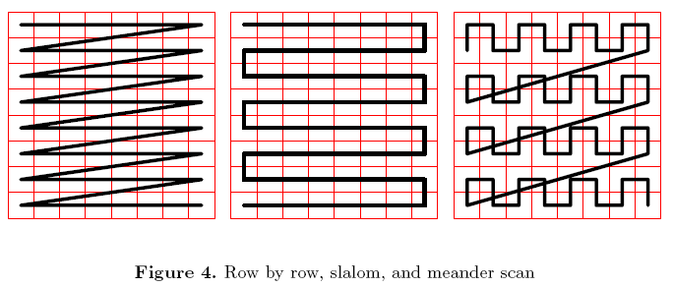
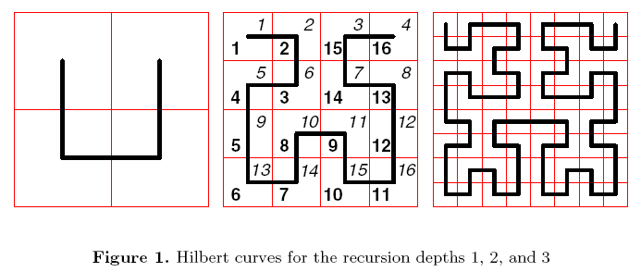
Different scanning orders

Slide 47
Results
Using a Hilbert curve to scan did increase the rate of detecting a payload hidden in the LSBs by ¼ - 1/3
Question: other better scan orders?
Further papers discuss this

Slide 48

Class project
If you get bored:
Implement +/- LSB embedding and apply the $χ^{2}$ test; does it work? Why or why not?
Implement random site-visit LSB embedding for +/- LSB

