Slide 1

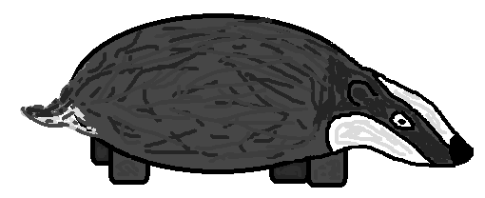
UPPER
MEDIAN
LOWER
Notes:
BC: 0.028 0.069 0.045
CB: 0.00021 0.017 0.0044

