Slide 1
TDOT Aeronautics LCCA Framework
Review of v1.1.2 and the v1.2.0 update
Airport pavement type selection with runway-closure lost revenue
Applied Research Associates, Inc. | Task 005935.00000.00000.TASK2 | September 2026
Notes:
Cover. Two deliverables: the patched framework workbook (v1.2.0) and a companion decision workbook with the MBT and SRB runs.

Slide 2
What we reviewed
Five files from the Neel-Schaffer review package, read line by line down to the VBA
Files
Scope
Method
Framework v1.1.2 base (ARA, 18 Aug 2026)
MBT run: Runway 18-36 reconstruction, HMA vs PCC with lost revenue
SRB run: runway reconstruction, PCC vs HMA with lost revenue
NS user-manual review and annotated screenshots (24 Aug 2026)
Every formula in the five alternative templates and the General Information sheet
The VBA that builds alternatives and the Summary
What the reviewer experienced on a locked-down TDOT machine
Whether the results sheets can support a pavement-type decision
Fixes applied inside the workbook XML so the VBA project, 192 ActiveX comboboxes, charts and validations are untouched
Every result reproduced by an independent engine
Full recalculation of every workbook with LibreOffice Calc before release
Notes:
The MBT and SRB files are older builds than the base file; they still carry a visible Indirect Cost Items sheet.

Slide 3
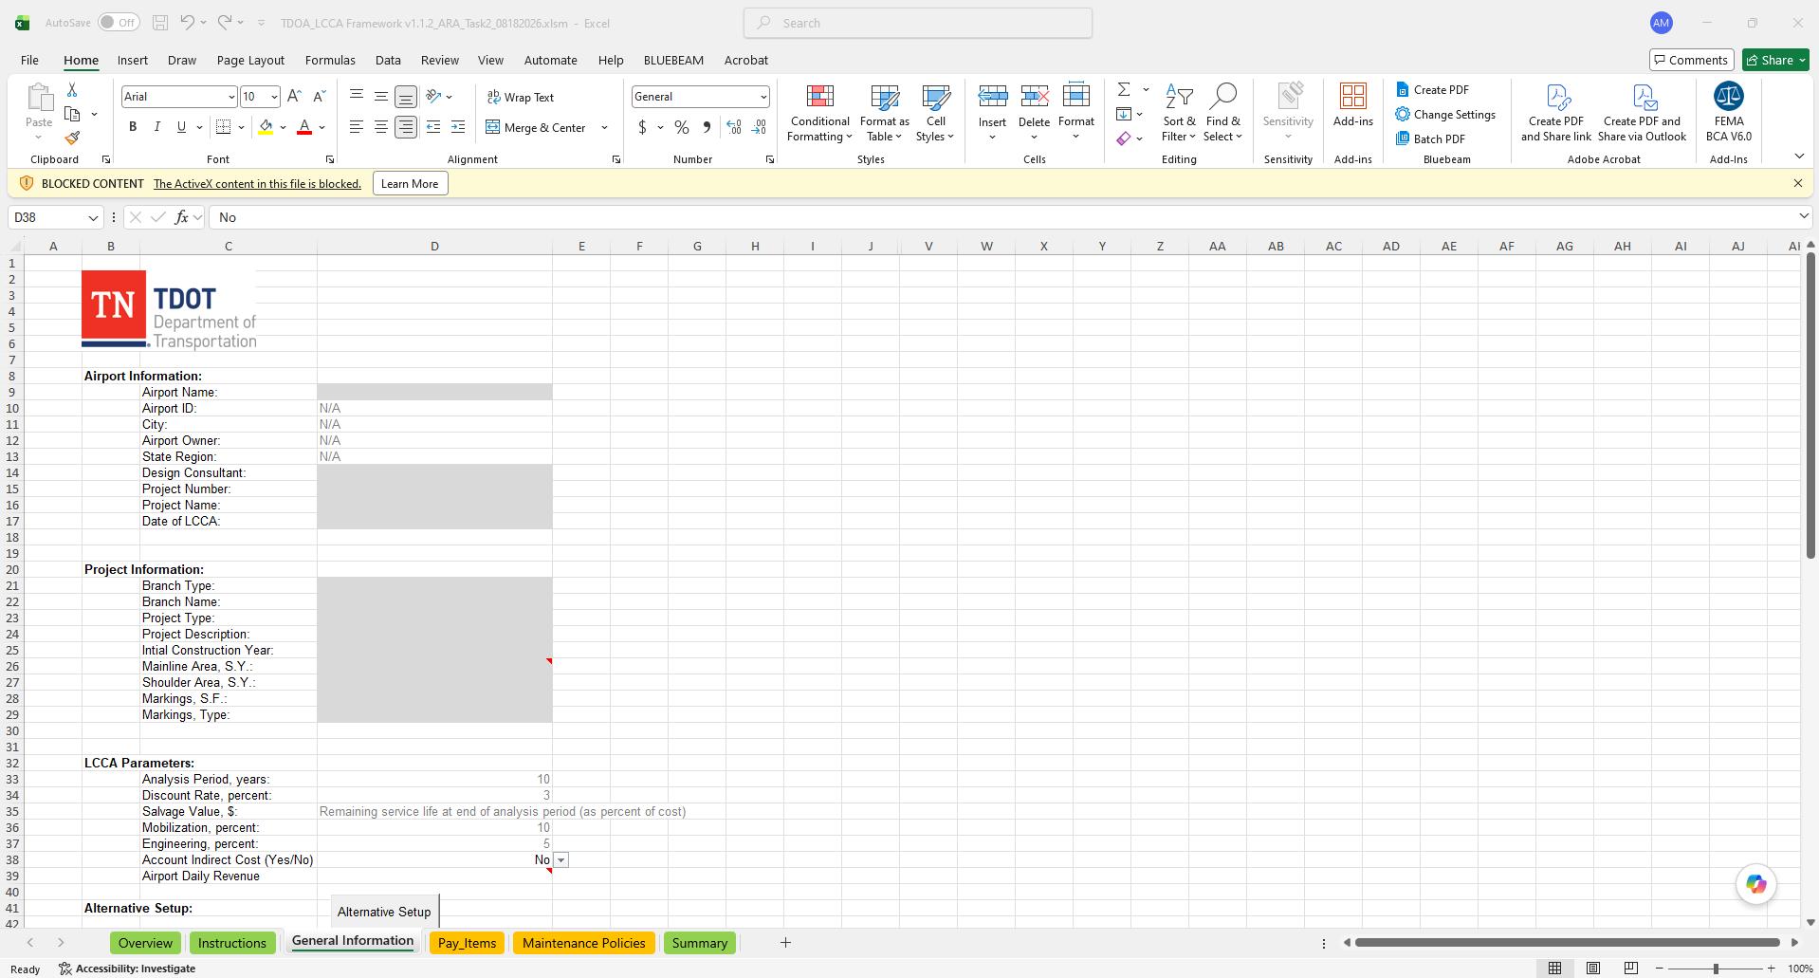
What the reviewer hit first
Wes Mittlesteadt (Neel-Schaffer) never reached the calculations
ActiveX blocked with no prompt; instructions assumed one would appear
A new pay item (prime coat) typed at the bottom of Pay_Items never showed in the dropdown
RevenueData is hidden and the manual never says how to unhide a sheet
Choosing an airport outside the 17 with revenue data produced #N/A in the alternative and the Summary
Cells D33:D37 use gray text, not gray fill, so users cannot tell what is editable
FAA rate rule changed in 2022 (OMB A-94 real rate, 2.0% for 2026, not the old 7%); the tool defaults to 3 percent and 30 years
TDOT IT blocks ActiveX outright. There is no "Enable Content" prompt, so the pay-item dropdowns and the Alternative Setup button are dead on arrival.
Notes:
Every item here is from the NS review docs. The last one is a real policy conflict for AIP-funded projects.

Slide 4
Calculation defects in v1.1.2
Found in the audit, not in the review. Each one changes the answer.
Defect | Where | Effect
Pay item 1 excluded from initial construction subtotal | Non-indirect HMA, PCC and Rehab templates | Construction cost understated by the first line item, often the largest
Engineering percent not applied to initial construction | All templates | Only maintenance and rehab carry engineering; biases toward the construction-heavy alternative
Analysis period only sets the salvage year | All templates | A 20-year run still counts maintenance at years 24 and 28
Default period 10 while Overview says 30 | General Information D33 | Salvage discounted at year 10 unless the user notices
Bare XLOOKUP for airport revenue | Indirect templates, D39 | #N/A for any airport outside the 17; #NAME? on Excel 2019
No blank guard on PCC pay-item rows 14 to 22 | PCC templates | #N/A in Item Cost and Total once a row is left empty
Four pay items described "Separation Geotextile" | Pay_Items | Lookup by description always returns the first, wrong unit cost
Airport dropdown stops at row 84 of 88 | General Information D9 | Four airports cannot be selected
Closure days ship as zero | Indirect templates F4:F10 | Each analyst re-invented production-rate formulas by hand
Notes:
Two more latent bugs sit in the disabled HMA Rehab template: a year-applied cell that adds the construction year, and a salvage reference to an empty cell.

Slide 5
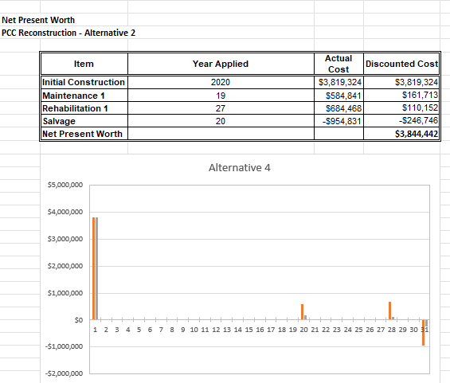
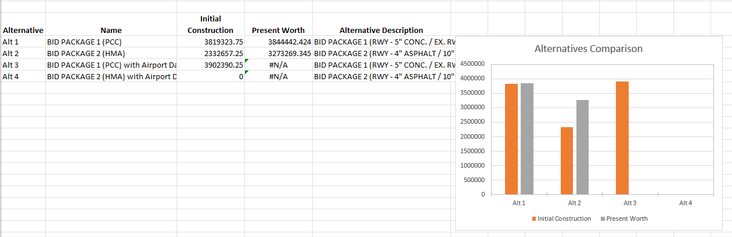
Outputs could not support a decision
What Aeronautics saw at the end of an analysis in v1.1.2
Summary: two bars per alternative on a raw-number axis, #N/A for any airport outside the revenue list. Nothing about where the difference comes from, whether it holds at 7 percent, or how many days the runway closes.
The whole reason for the 2026 update, runway closures and lost revenue, appears nowhere in the outputs.
Alternative chart: positions 1 to 31 instead of years, discounted and undiscounted bars on one axis, and a title that says "Alternative 4" on the Alt 1 sheet because VBA sets it once.
Notes:
Screenshots from the NS review package.

Slide 6
Policy questions the tool was hiding
Not bugs. Assumptions that decide the answer and were invisible in the outputs.
$3.9M vs $0.4M
Which FAA rate?
SRB salvage credit, PCC vs HMA. PCC recovers 25% of total initial cost; HMA 12.5% of one mill-and-overlay. That single line is larger than the NPW gap.
PGL 22-01 (2022) replaced the fixed 7% with the OMB A-94 real rate, 2.0% for 2026. TDOT uses 3% over 30 years. MBT changes winner at 4.5%, so the rule decides the answer.
100% of gross
17 of 79 airports
Lost revenue counts gross fuel sales, hangar rent and tenant revenue as lost on every closure day. Margin-based revenue would be far lower.
RevenueData covers 17 airports. MBT and MQY rows are identical; XNX and M54 hold text where numbers belong.
v1.2.0 does not change any of these. It makes each one visible and testable so Aeronautics can decide them deliberately.
Notes:
Recommend a per-category "share lost during closure" factor on RevenueData and a funding-source switch for the AIP rule.

Slide 7
Root cause: five copies of one template
Why the defects exist, and why they sit in some templates and not others
How the workbook is built
What that produced
Each pavement type has a hidden template sheet of about 1,600 near-identical formulas. VBA copies the template to create an alternative.
The 2026 lost-revenue feature was added by cloning two templates and editing the clones. There is no shared formula source, so a fix made in one copy never reaches the others.
New inputs (analysis period, revenue lookup) were wired to one cell each rather than through the whole template.
Pay item 1 dropped in three templates, correct in the two 2026 clones
Blank guard on row 13 in every template, missing on rows 14 to 22 of the PCC templates only
Analysis period wired to the salvage row and nothing else
Revenue guard present on General Information, lost when the lookup was copied into the templates
Chart helper rows placed by hand at row 37 plus the policy year, with the category reference removed
Notes:
Recommendation for the next revision: one template per pavement type with the lost-revenue option as a switch, plus a consistency check macro across templates.

Slide 8
The four defects that move money
Defect | Root cause (evidence in the file) | Exact change
Pay item 1 excluded | Subtotal G24 = SUM(G14:G23) while items occupy rows 13 to 22 (A13 = 1). The indirect clones read SUM(G13:G22), so the range was corrected there and never propagated. | G24 = SUM(G13:G22) in TMP(NewHMA), TMP(NewPCC), TMP(HMARehab)
No engineering on initial cost | Row 26 is formatted and included in the Total (G27 = SUM(G24:G26)) but empty. The M&R blocks all carry Mobilization then Engineering; the initial block stopped after Mobilization. | B26 = "Engineering"; G26 = (D37/100) x G24 in all five templates
Analysis period ignored | D33 is referenced once per template, by the salvage row. Every activity year comes straight from Maintenance Policies with no comparison to D33. | Each discounted cost: IF(year > D33, 0, cost / (1+r)^year); default D33 = 30
#N/A on missing airport | General Information D39 guards the lookup with COUNTIF; the templates copied only the inner SUM(XLOOKUP(...)). XLOOKUP also fails on Excel 2019 (#NAME?). | F2 = IF(D38="Yes", SUMIF chain over RevenueData columns B:H, 0); G2 warning text when F2 = 0
Notes:
Full cell-by-cell record, 463 cells, is Appendix A of the Technical Change Record.

Slide 9
v1.2.0: calculation fixes
Same workbook, same workflow, same VBA. Only the arithmetic changed.
Item | v1.1.2 | v1.2.0
Initial construction subtotal | SUM(G14:G23) | SUM(G13:G22), pay item 1 included
Engineering on initial construction | not applied | Engineering row added, same percent as M&R
Analysis period | salvage year only | Activities beyond the period drop to $0; default 30
Airport revenue lookup | XLOOKUP, #N/A if missing | SUMIF chain, $0 plus a visible warning when the airport has no data
PCC pay-item rows 14 to 22 | no blank guard | guarded like row 13
Geotextile pay items | four identical descriptions | suffixed with the spec number
Closure durations | zero | production-rate defaults from the MBT and SRB runs, still editable
Airport dropdown | rows 9 to 84 | rows 10 to 88
HMA Rehab template | two latent bugs | fixed in case the option is re-enabled
Notes:
All edits made in the sheet XML. openpyxl or a re-save would have stripped the ActiveX controls and charts.

Slide 10
v1.2.0: usability and charts
Area | What changed
Instructions | ActiveX "blocked content" steps (Trust Center, then restart Excel, or ask IT); correct button name; D9:D39; how to unhide RevenueData and the 17-airport rule
Alternative chart | Year-indexed data keyed on Year Applied; calendar years on the axis; undiscounted direct and lost revenue stacked; mixed discounted series removed
Chart axes | Every chart in both workbooks now names its x and y axis
Summary sheet | Formula-driven, no macro: results table with PW by category, delta to lowest, closure days and runway availability; a RealCost-style comparison block (agency and user cost as PW and EUAC); five charts; navigation buttons that work with macros blocked
Pavement section | New on the Summary: each layer's thickness read back from the quantities, the section as a string for the description, a cross-check against the excavation quantity, and two stacked charts (mainline, and mainline plus shoulder when entered)
Look and first-run UX | How-to card and a live "still needed" status line on General Information; navigation row on every alternative sheet; lowest-cost row highlighted on the Summary; tab colours; General Information prints on one page
Method sheet | New reference sheet: every calculation once, with the formula, the rule in plain English and its source; a live block reading the current rate, period and capital recovery factor; and the assumptions a reviewer will ask about
Typical Values sheet | New reference sheet: what TDOT manages, typical runway geometry and areas, workbook unit costs beside 2025 bids, closure production rates, FAA and OMB discount-rate rules, service lives, live daily revenue for the 17 airports; hints beside the General Information inputs
Housekeeping | Personal names removed from cell notes and document properties; dead links, cached printer settings, Power Query stub and SharePoint path removed; sources on Typical Values as plain text; full recalculation on open
Not changed | Overview wording (NS rewrite pending Mat's approval); salvage, lost-revenue and AIP policy
Nothing to install: the workbook is self-contained. The VBA project is untouched; Alternative Setup still writes columns A:E of the Summary as before.
Notes:
The Summary formulas read the Database sheet the form writes, so they follow whatever alternatives exist.

Slide 11
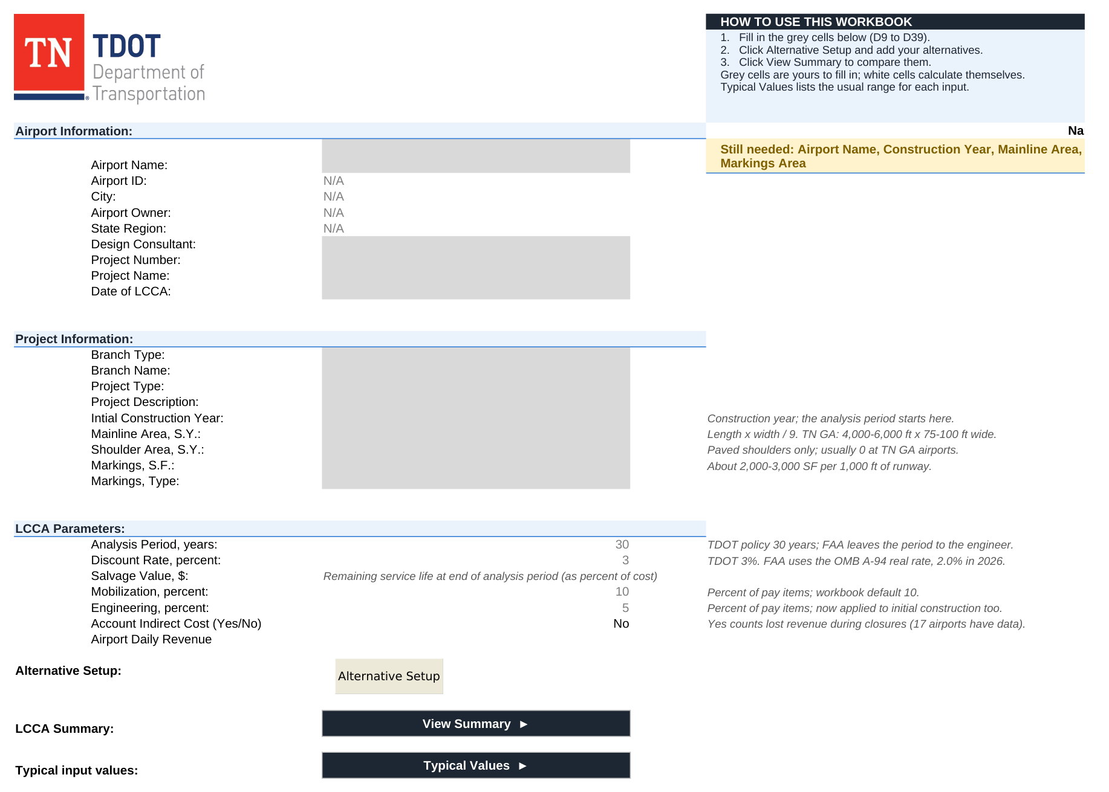
The page users start on
Same form, same grey cells. What is new is the guidance around them.
A how-to card beside the logo, a status line that names whatever input is still empty and turns green when the form is complete, banded section headings, and buttons to the Summary and the Typical Values sheet.

Slide 12
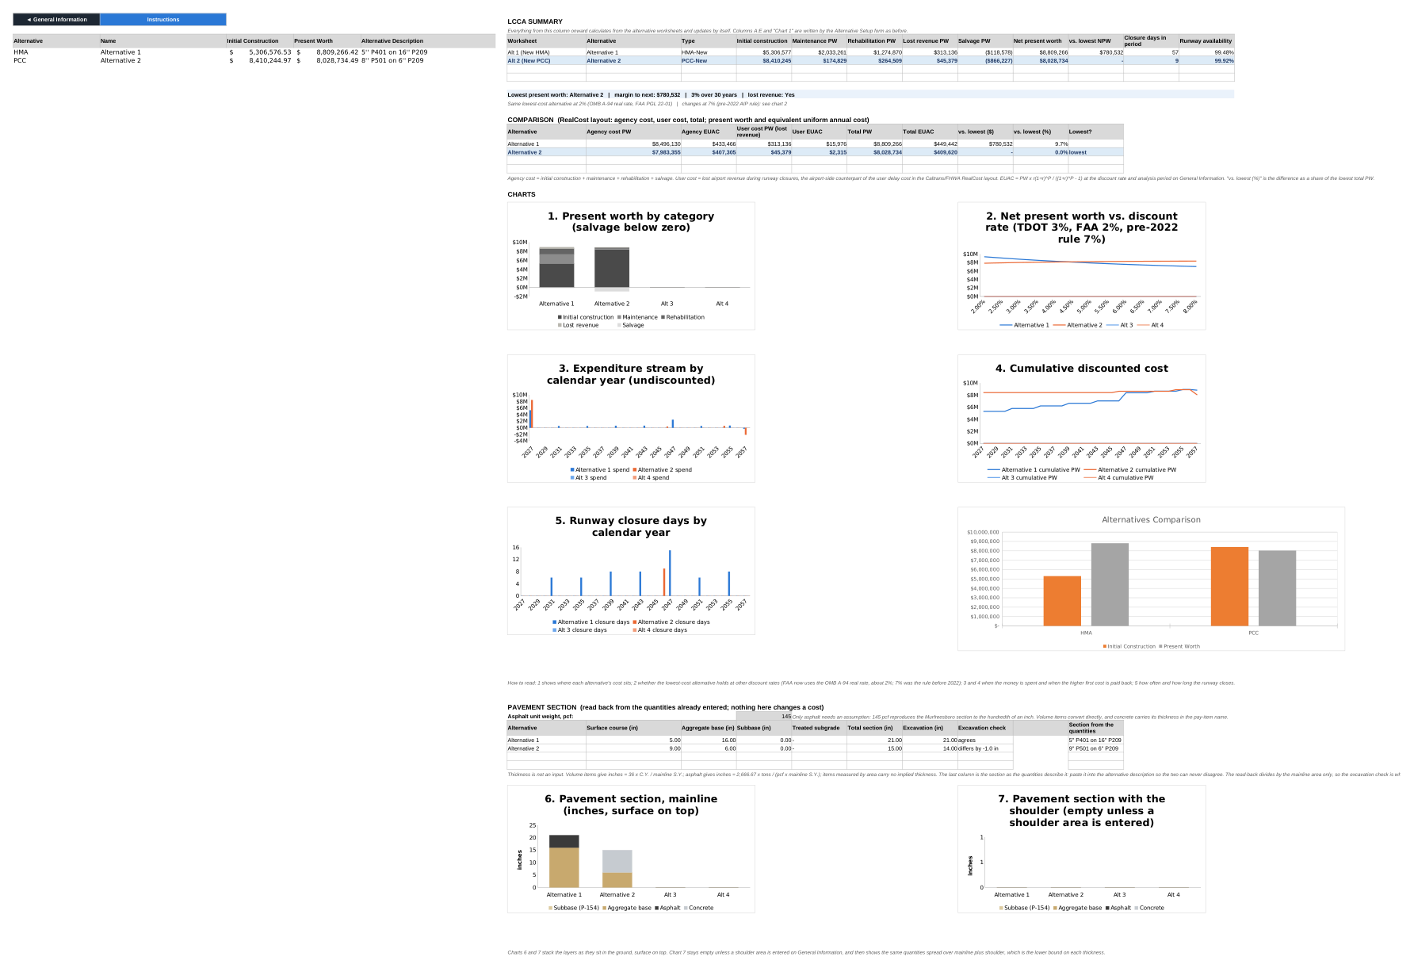
The new Summary sheet
MBT data loaded. Table, verdict line, RealCost-style comparison block, five charts, all live formulas.
The comparison block under the verdict line follows the RealCost layout: agency and user cost, each as present worth and EUAC.

Slide 13
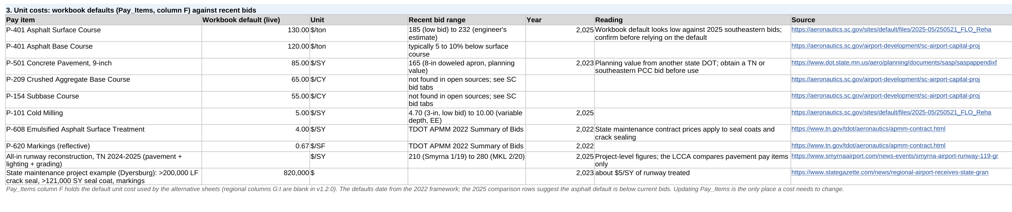
Typical values for the inputs
A reference sheet answering "is this number reasonable" while filling in General Information.
Section 3: each Pay_Items default read live from the workbook, beside recent bid prices and what they mean. Six more sections cover system context, runway geometry, closure rates, discount rates and service lives.
TDOT Aeronautics manages 78 public-use airports; 69 are in the NPIAS and about 70 are in the pavement management network
Typical TN general aviation runway: 4,000 to 6,000 ft by 75 or 100 ft, which is 33,000 to 67,000 SY of mainline
The $130 per ton asphalt default sits below 2025 southeastern bids of $185 to $232
Discount rate: TDOT 3 percent; FAA now points to the OMB A-94 real rate, 2.0 percent for 2026, not the old 7 percent
Notes:
Every row has a source; the research note in the repo says which figures still need the primary PDF.

Slide 14
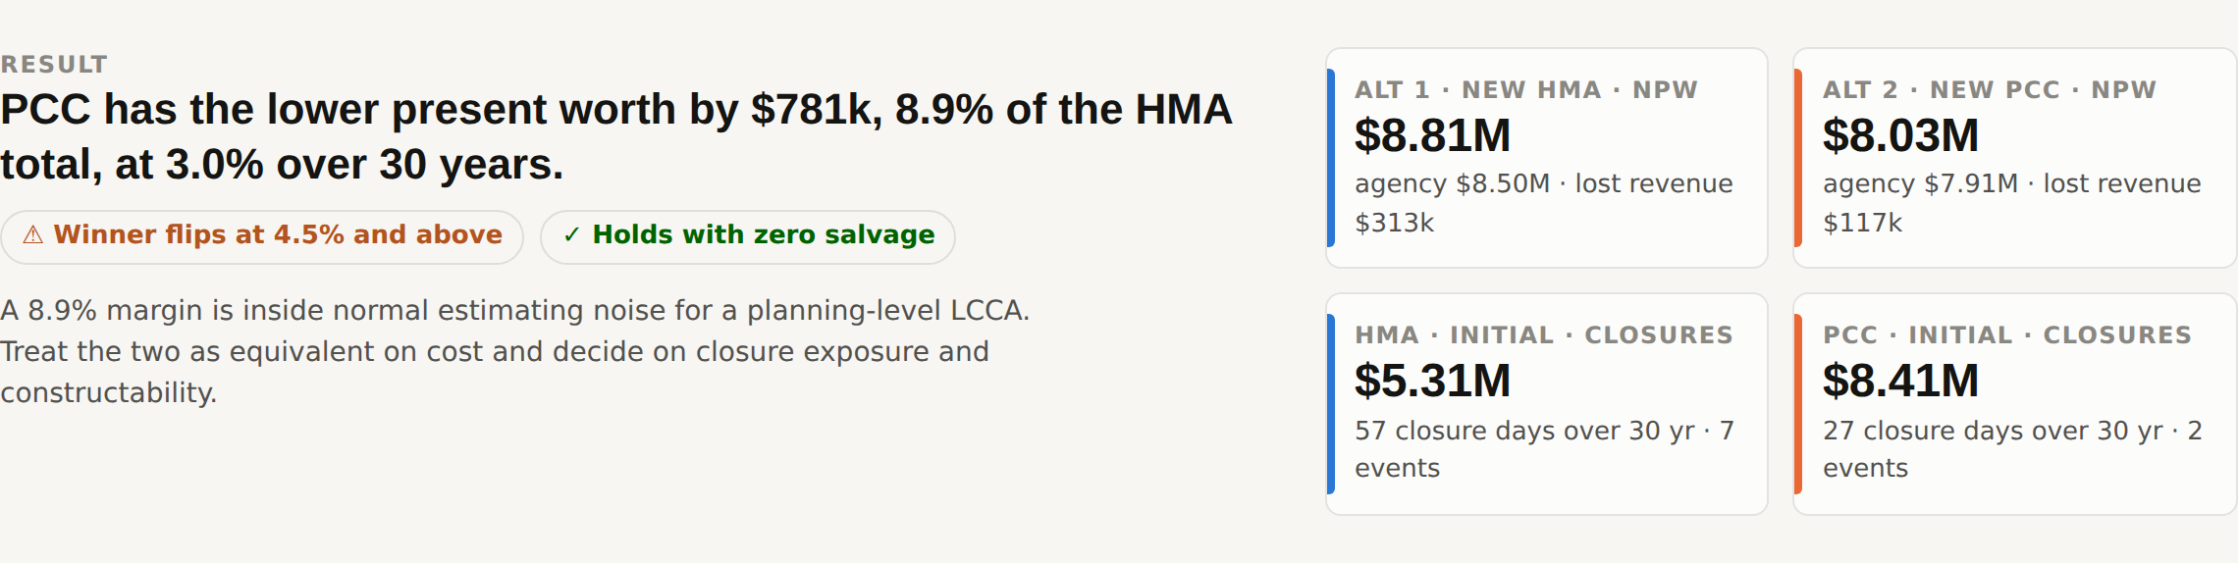
The decision workbook
MBT and SRB already loaded, plus a blank TEMPLATE sheet. Yellow cells drive every table and chart.
The verdict line: which alternative is lower, by how much, and two robustness flags a reviewer can read in five seconds. Shown here for MBT at TDOT settings.
RESULTS: present worth by category, EUAC, cost per SY, closure days, runway availability
BREAK-EVEN VALUES: the daily revenue, bid level, salvage fraction and discount rate at which the two tie
Twelve pre-run scenarios, a rate-by-salvage decision map, a tornado, and a live 1,000-draw simulation
A TEMPLATE sheet: copy it, paste the next project's costs and closure days, done
Notes:
Everything is a formula. Change the discount rate cell and the sensitivity, tornado, map and charts all move.

Slide 15
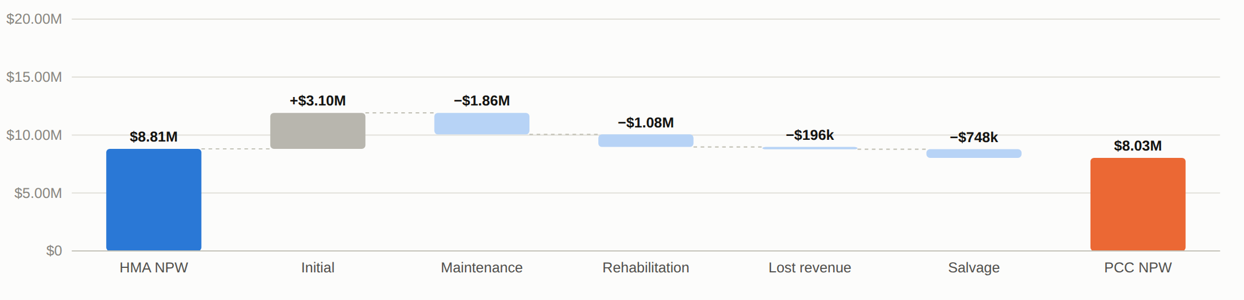
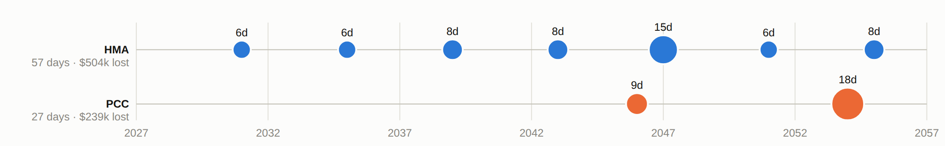
Where the difference comes from
MBT bridge from HMA to PCC present worth. PCC costs $3.1M more to build and earns it back through $1.9M less maintenance and $1.1M less rehabilitation; salvage and lost revenue are small here.
Closure timeline, bubble size is days closed. HMA closes the runway seven times for 57 days; PCC twice for 27 days.
Notes:
This is the chart Aeronautics asked for when they commissioned the lost-revenue update.

Slide 16
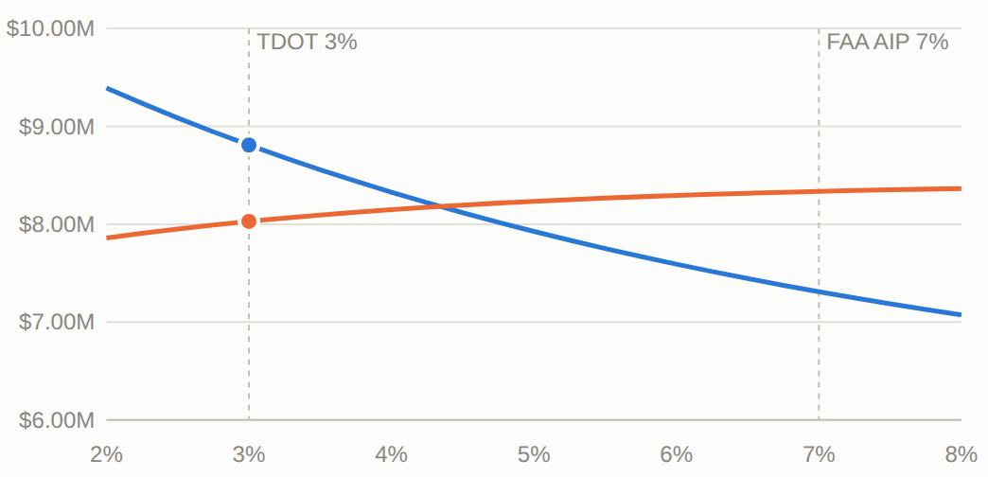
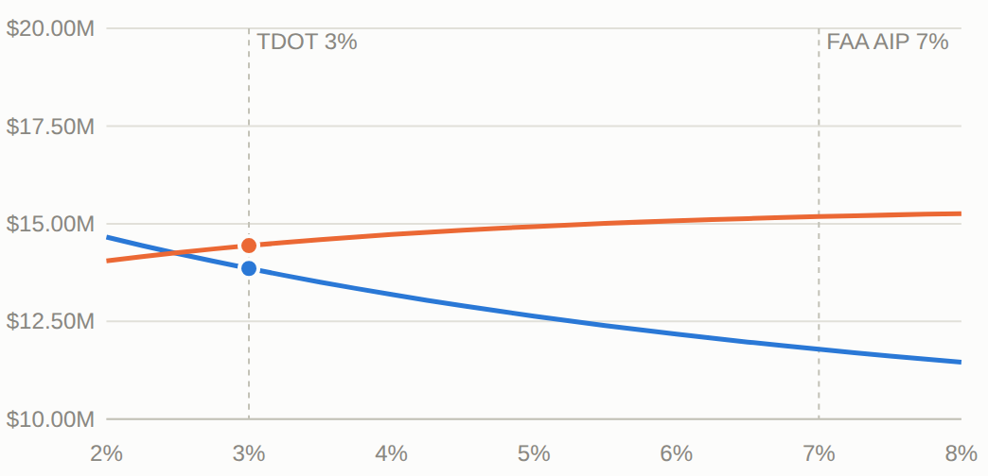
Will the answer hold?
Net present worth against discount rate. Blue is HMA, orange is PCC. TDOT 3 percent and FAA AIP 7 percent are marked.
MBT: PCC wins below 4.5 percent, HMA above. At the FAA AIP rate the answer reverses.
SRB: HMA wins at every rate above 2.5 percent. The gap widens as the rate rises.
Live simulation: 1,000 joint draws on rate, bids, closures, salvage and revenue share. Probability PCC is the cheaper alternative: 52 percent at MBT, 18 percent at SRB. Press F9 in the workbook to redraw.
Notes:
Break-even table on the sheet gives the exact tie points: PCC bids +9.9% or salvage below 2.5% of initial cost flips MBT.

Slide 17
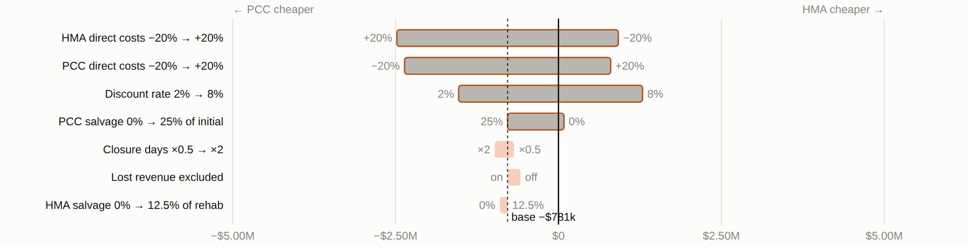
What could flip the answer
MBT. PCC minus HMA present worth when one input moves across its plausible range. Bars crossing zero change the winner.
Bid prices and the discount rate can flip MBT; closure durations, lost revenue, the analysis period and HMA salvage cannot. The same view for SRB shows only bids and the discount rate matter.
Break-even, MBT | Value | Current
PCC bid level that ties the two | +9.9% | base estimate
PCC salvage credit that ties the two | 2.5% of initial | 25%
Discount rate at which the winner changes | 4.5% | 3%
Notes:
Break-even values come from the BREAK-EVEN VALUES block on the sheet, computed in closed form, no goal seek.

Slide 18
What the two runs say
TDOT settings: 3 percent, 30 years, lost revenue on, policy salvage
 | MBT (Murfreesboro) | SRB (Upper Cumberland)
Lower present worth | PCC by $781k (8.9%) | HMA by $586k (4.1%)
Holds at FAA 7%? | No, flips at 4.5% | Yes
Holds with zero salvage? | By $33k only | Yes
Closure days over 30 years, HMA / PCC | 57 / 27 | 75 / 31
PCC bid change that ties the two | +9.9% | -4.1%
Probability PCC is lower (simulation) | 52% | 18%
MBT: both margins are inside estimating noise. The answer is a discount-rate and salvage-policy call, not an engineering one.
SRB: HMA wins on cost, PCC halves the closure days, and no plausible daily revenue closes the gap. The decision is what a runway-day is worth.
Notes:
SRB break-even daily revenue is about $23,000 per day against $4,344 actual.

Slide 19
Verification before release
Check | Result
Framework v1.2.0, full recalculation in LibreOffice Calc | 2,240 formulas incl. the new Summary, 0 errors (v1.1.2 shows 99 error cells under the same recalc)
Patch applied to the populated MBT workbook | NPW unchanged: $8,809,266 and $8,028,734; PCC blank rows now 0, not #N/A
New year-indexed chart columns | Direct plus lost revenue reconciles to activity totals; discounted column sums to NPW to the dollar
Decision workbook, full recalculation | 47,265 formulas, 0 errors
Decision workbook against an independent engine | NPW, categories, break-evens, sensitivity, tornado, 12 scenarios and the decision map agree to the dollar
New Summary sheet on the MBT data | Table, verdict, categories and closure days match; six charts render; template reads "No alternatives yet" with no errors
New project run end to end | CKV Runway 17-35 built on the blank template: framework, decision TEMPLATE and an independent engine agree to the dollar
Two worked examples | GKT Runway 10-28 (three alternatives, no shoulders) and MKL Runway 2-20 (four alternatives, 25 ft shoulders): 104 independent checks pass; section read-back returns the designed sections
Scripted click-through (LibreOffice API) | Buttons land where they should; 7% flips the verdict as flagged; 20 years drops late closures; unknown airport gives $0 lost revenue with a warning; deleting an alternative shifts the table with no #REF!; ties and four alternatives read cleanly
Not yet verified | The alternative-sheet charts in Excel itself (no Excel here); a first-open check is in the notes
Notes:
The first-open check: pick an airport, set Yes, add one HMA and one PCC alternative, confirm Summary and Alt sheet columns L:N.

Slide 20
How TDOT uses it
Excel only. No add-ins. The decision workbook has no macros at all.
1
2
3
Run the framework as before
Copy the TEMPLATE sheet
Read the decision blocks
Open v1.2.0, enable content, fill General Information, build alternatives with Alternative Setup. Click View Summary: categories, closures, the 7 percent flag and five charts, no import needed.
In the decision workbook, right-click TEMPLATE, Move or Copy, rename. Paste the base costs and closure days from each Alt sheet into the yellow cells.
RESULTS, BREAK-EVEN VALUES, the scenario scorecard and the decision map. Change any yellow cell and every chart follows. F9 redraws the simulation.
Notes:
Two alternatives per sheet, HMA against PCC, is how the framework is used; policy years are editable if TDOT revises the maintenance tables.

Slide 21
Open items
Decisions for Aeronautics
Next steps
Salvage policy: keep 25% of initial for PCC and 12.5% of one overlay for HMA, or move both to a remaining-life basis
Lost revenue basis: gross receipts or a per-category share lost during closure
FAA AIP projects: enforce 7% and 20 years, or show both
RevenueData: confirm MBT vs MQY, fix XNX and M54, add the other 62 airports or state the rule
Overview text: adopt the NS rewrite
First open in Excel: run the first-open check in the notes
Send v1.2.0 and the decision workbook to NS for a second pass
PCC rehabilitation template is still "Coming soon" if TDOT wants rehab alternatives
Optional later: a no-macro web version would remove the ActiveX problem entirely
Notes:
Keep it Excel-first; the web option is noted only because IT blocking was the reviewer's first obstacle.

Slide 22
In one line
The tool now computes what it says it computes, shows why one alternative wins, and shows how many runway days that costs.
Deliverables: TDOA_LCCA_Framework_v1.2.0_ARA_09112026.xlsm | TDOT_LCCA_Decision_Workbook.xlsx | Technical Change Record | change notes

