Slide 1
Project 4
By Emily Green, Joseph Eckl, Ryan Logue, Caleb DeSpain
Notes:
Ryan

Slide 2
Introduction
Methodology
Owner of the computer
Evidence of illegal activity
Evidence of possible destruction of evidence
Evidence of fleeing the country
Evidence of possible accomplices
Additional hardware
Other pieces of potentially relevant information
Notes:
Ryan

Slide 3
Methodology
Started with FTK Imager
Confirmed the integrity of the image
Found basic information
Autopsy
More detailed search
Carving
Used other tools to find bits and pieces
RegExplorer
$IParse
HxD
XML Notepad
USB Detective
Notes:
Ryan

Slide 4
Owner of the Computer
Evidence of ownership in the registry hives
System
Software
SAM
SID - S-1-5-21-3461440871-1589894493-1829873476-1000
Profile list
Recycling bin
Hard Drive
PERRYWINKLER-PC
Notes:
Ryan

Slide 5
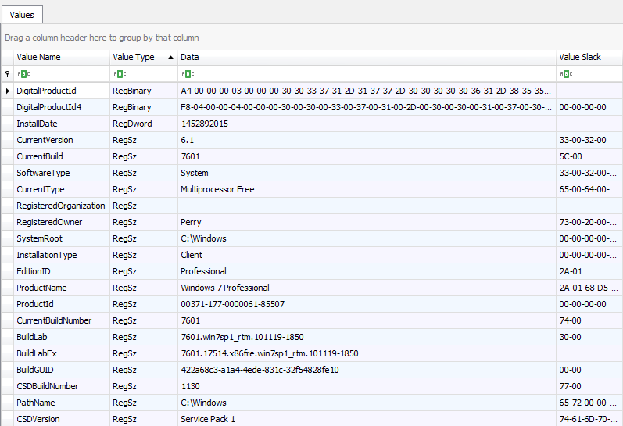
The Owner of the Computer
SOFTWARE\Microsoft\Windows NT\CurrentVersion
Notes:
Ryan

Slide 6
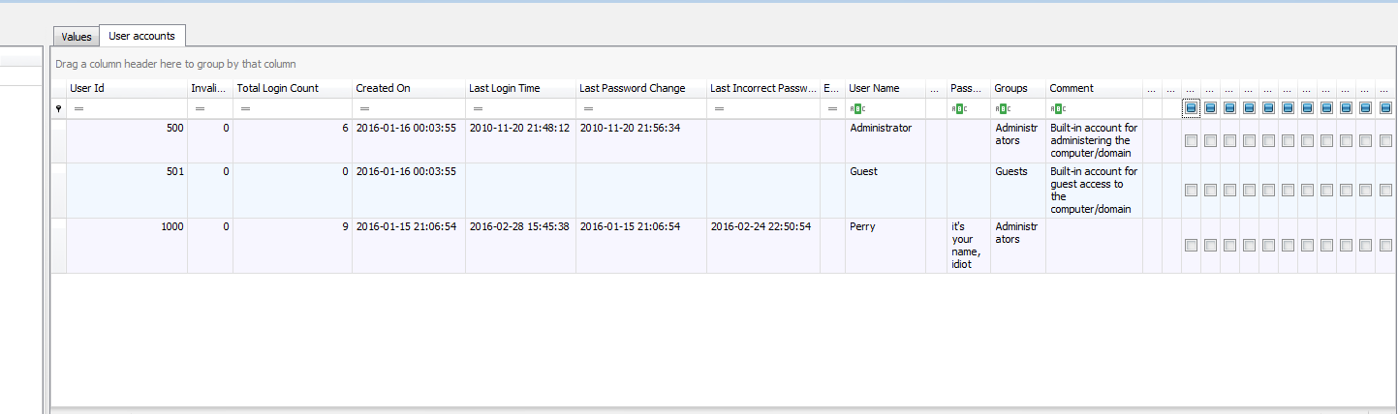
The Owner of the Computer
SAM\Domains\ Account\Users
Notes:
Ryan

Slide 7
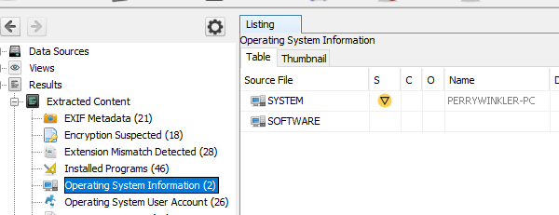
The Owner of the Computer
Results > Operating System Information > System
Notes:
Ryan

Slide 8
Evidence of Illegal Activity
Typed URLs
How to skim credit cards
How to steal tax returns
Pictures of drugs
List of clients
TOR on his desktop
Notes:
Emily

Slide 9
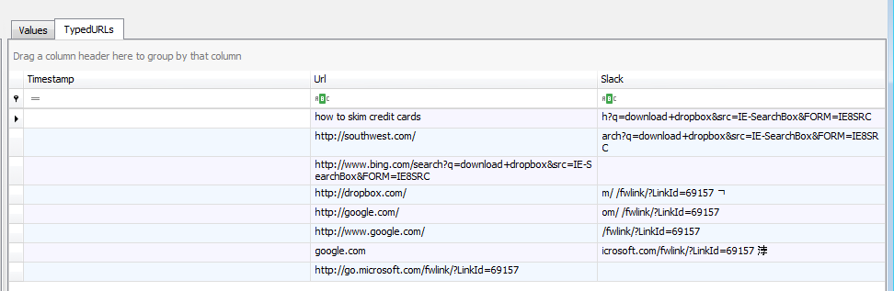
Evidence of Illegal Activity
NTUSER.DAT\Software\Microsoft\Internet Explorer\TypedUrls
Notes:
Emily

Slide 10
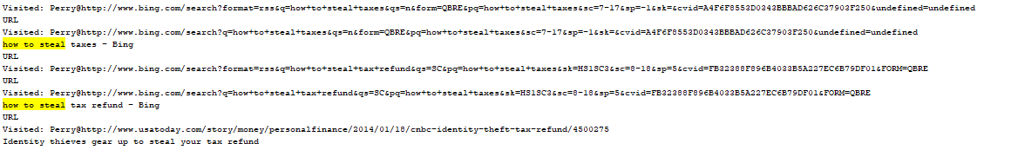
Evidence of Illegal Activity
Notes:
Emily

Slide 11
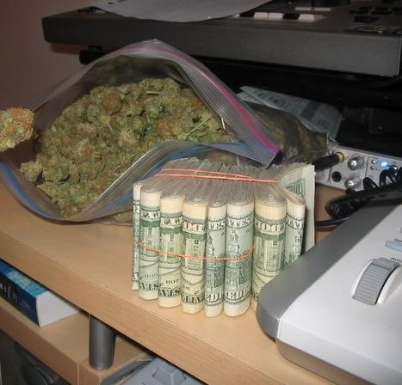
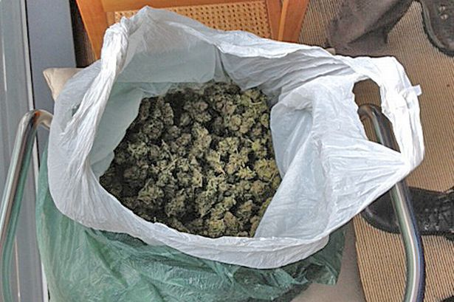
Evidence of Illegal Activity
C:\Users\Perry\Pictures
Notes:
Emily

Slide 12
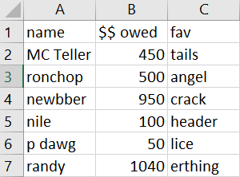
Evidence of Illegal Activity
/img_LMPD-436243-001.E01/vol_vol3/Users/Perry/Documents/Book2.xlsx
Notes:
Emily

Slide 13
Evidence of Attempts to Possibly Destroy Evidence
Wiping programs
Autopsy Web Search
“being watched by cops”
“how to get rid of evidence”
“schedule tasks”
“how to run batch files”
Letter 2
‘It’s time’ Letter
Notes:
Emily

Slide 14
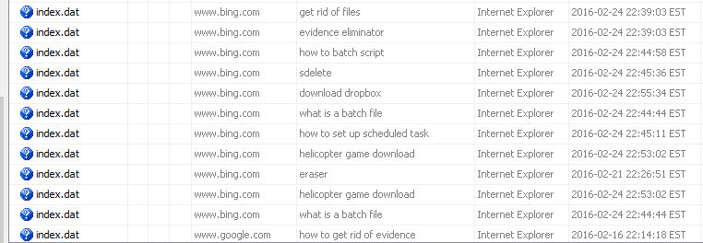
Evidence of Attempts to Possibly Destroy Evidence
$Delete and Eraser
Results > Web Search
Notes:
Emily
Found using autopsy web search

Slide 15
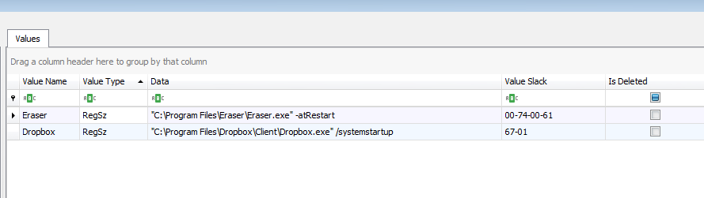
Evidence of Attempts to Possibly Destroy Evidence
SOFTWARE\Microsoft\Windows\CurrentVersion\Run
Notes:
Emily

Slide 16
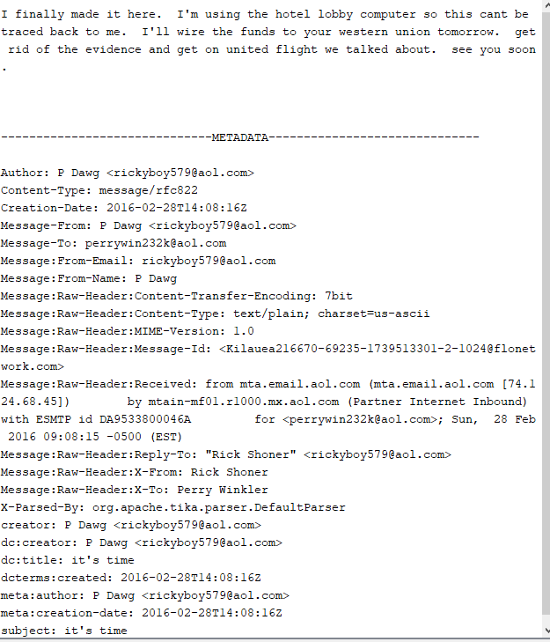
Evidence of Attempts to Possibly Destroy Evidence
‘It’s time’ Letter
/img_LMPD-436243-001.E01/vol_vol3//$CarvedFiles/f0252768.mbox
Notes:
Emily

Slide 17
Evidence of Attempting to Flee the Country
Contact with Rick Shoner
Typed URLs
Pictures on computer
Notes:
3

Slide 18
Evidence of Attempting to Flee the Country
/img_LMPD-436243-001.E01/vol_vol3//$CarvedFiles/f0252768.mbox
Notes:
3

Slide 19
Evidence of Attempting to Flee the Country
NTUSER.DAT\Software\Microsoft\Internet Explorer\TypedUrls
Notes:
3

Slide 20

Evidence of Attempting to Flee the Country
C:Users\Perry\Documents\nice
Notes:
3

Slide 21
Evidence of Possible Accomplices
Perry’s Contacts
Partition 2 > root > Users > Perry
Rick Shoner aka Master Rick aka P Dawg
Larry Spitz and Mary Reister
Notes:
4

Slide 22
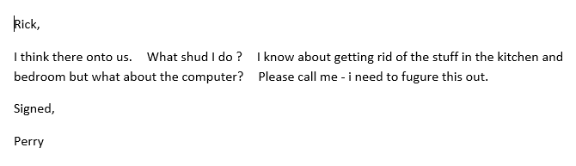
Evidence of Possible Accomplices
/img_LMPD-436243-001.E01/vol_vol3/Users/Perry/Documents/Letter.rtf
created 2/16/2016 at 5:04 PM
Notes:
4

Slide 23
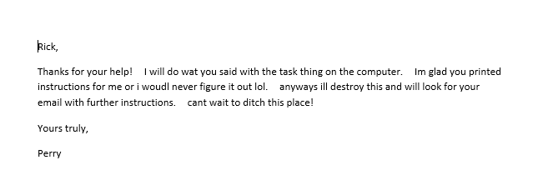
Evidence of Possible Accomplices
/img_LMPD-436243-001.E01/vol_vol3//$CarvedFiles/f0078632.lnk
Created 2/21/2016 at 5:22 PM
Sent to the recycling bin at 2/28/2016 10:47 AM
Notes:
4

Slide 24
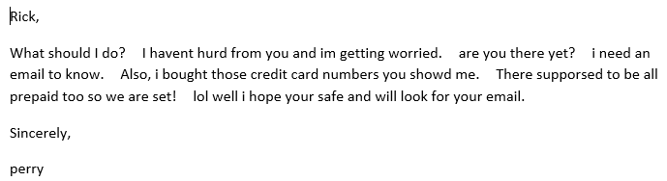
Evidence of Possible Accomplices
/img_LMPD-436243-001.E01/vol_vol3/Users/Perry/Documents/Letter3.rtf
created 2/27/2016 at 10:13 AM
Notes:
4

Slide 25
Additional Relevant Hardware
Two USB devices
SanDisk Cruzer - 20035001811625714CA7
Kingston DT 100 G2 - 0013729B678DEB20C51F0216
May contain relevant info to the case
Notes:
4
/img_LMPD-436243-001.E01/vol_vol3/Users/Perry/AppData/Roaming/Microsoft/Windows/Recent/files (E).lnk
2016-01-26 16:48:35

Slide 26


Additional Evidence
/img_LMPD-436243-001.E01/vol_vol3//$CarvedFiles/f0259224.jpg
/img_LMPD-436243-001.E01/vol_vol3//$CarvedFiles/f2080560.jpg
Notes:
4

Slide 27
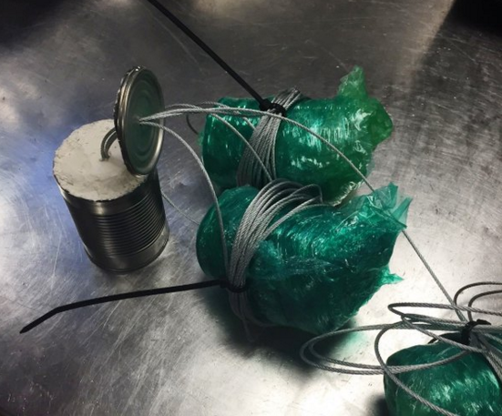
Additional Evidence
Notes:
4

Slide 28
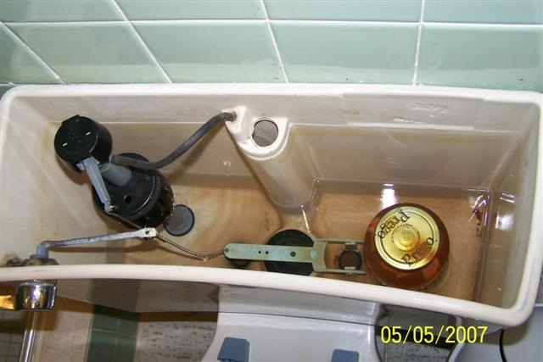
Additional Evidence
/img_LMPD-436243-001.E01/vol_vol3/Users/Perry/Documents/100_6317 (Small).JPG
Notes:
4
MODEL: KODAK Z650 ZOOM DIGITAL CAMERA
MAKE: EASTMAN KODAK COMPANY

Slide 29
Conclusion
This is Perry Winkler’s PC
He’s been involved in illegal activity
Steps forward:
Identify woman in mugshot and possibly man and woman in second photo
Locate flash drives
Check Southwest and United Airlines Flights leaving on the 2/28/2016
Perry may be armed and dangerous

