Slide 1
DATA SCIENCE CASE STUDY
Customer Churn
Analysis & Prediction
Telecommunications Industry | End-to-End Machine Learning Project
7,043
21
3
Presented by Joseph Elijah
Customers
Features
ML Models

Slide 2
Project Roadmap
01
Business Problem
05
Modelling
Why is churn critical for telecom?
Logistic Reg, Random Forest, XGBoost
02
Data Understanding
06
Evaluation
7,043 customers, 21 features
Confusion matrix, ROC, Feature importance
03
Data Cleaning
07
Deployment
Missing values, type fixes, encoding
Live Streamlit prediction app
04
EDA
Univariate, Bivariate, Multivariate

Slide 3
The Business Problem
What is Customer Churn?
Project Objectives
Churn is when a customer stops using a company's service and moves to a competitor.
Understand WHO is churning and WHY
Acquiring a new customer costs 5x more than retaining one
Identify key drivers of churn through EDA
A 5% increase in retention can increase profits by 25-95%
Build a model to predict future churners
Telecom industry has one of the highest churn rates: 15-25% annually
Deploy a live prediction tool
Give actionable business recommendations

Slide 4
Dataset Overview
7,043
21
26.5%
11
Total Customers
Feature Columns
Churn Rate
Missing Values
Demographics
Services
gender, SeniorCitizen, Partner, Dependents
PhoneService, MultipleLines, InternetService, OnlineSecurity, OnlineBackup, DeviceProtection, TechSupport, StreamingTV, StreamingMovies
Account Info
Target Variable
tenure, Contract, PaperlessBilling, PaymentMethod, MonthlyCharges, TotalCharges
Churn — Yes (1) or No (0)

Slide 5
Data Cleaning & Preparation
1
Fixed Missing Values (TotalCharges)
11 rows had null TotalCharges. Investigation revealed all had tenure = 0 — brand new customers with no bills yet. Filled with 0 (not median — that would be factually wrong).
2
Fixed Data Types (SeniorCitizen)
SeniorCitizen was stored as 0/1 integers but is actually a Yes/No category. Converted to 'Yes'/'No' for consistency before encoding.
3
Handled 'No Internet Service' Values
7 columns had a 3rd value 'No internet service' — these customers simply had no internet. Treated as 'No' and binary encoded to 0/1.
4
Encoded Categorical Columns
Binary columns (Yes/No) mapped to 1/0. Multi-category columns (Contract, InternetService, PaymentMethod) one-hot encoded. CustomerID dropped — no predictive value.

Slide 6
Exploratory Data Analysis
Getting to know the data before making any decisions
01 Univariate
02 Bivariate
03 Multivariate
One column at a time
Understand shape & distribution
Each feature vs Churn
Find what drives customers to leave
All features together
Correlation heatmap
Key Question: What makes a customer churn?

Slide 7
EDA — Univariate: Churn Distribution
Class Imbalance: 73.5% stayed vs 26.5% churned. SMOTE used to balance before modelling.

Slide 8
EDA — Univariate: Numeric Features
Tenure Distribution
Monthly Charges
Total Charges
Two clear spikes: month 0-1 (new customers) and month 70-72 (very loyal). Customers either leave early or stay forever. Mean = 32.4 months.
Large spike at ~$20 (basic plan customers). Secondary bump at $70-$80. Wide spread suggests two customer types: budget vs premium. Mean = $64.8.
Heavily left-skewed. Most customers paid very little — confirming many are new. Long tail of loyal, high-paying customers. Mean = $2,279.

Slide 9
EDA — Bivariate: Tenure & Monthly Charges vs Churn
Churners leave at median 10 months vs 38 months for loyal customers. First 10 months = danger zone.
Churners pay $13.17 more per month on average. Higher charges = higher churn risk.

Slide 10
EDA — Bivariate: Contract Type & Internet Service vs Churn
Key Finding: Month-to-month customers churn at 42.7% — 15x higher than two-year contract customers (2.8%). Fiber Optic churn mirrors this at 41.9%.

Slide 11
EDA — Bivariate: Senior Citizen & Gender vs Churn
Senior citizens churn at 41.7% vs 23.6% for non-seniors — nearly double. Dedicated support programmes needed.
Gender has virtually NO impact on churn (26.9% vs 26.2%). Gender is a low-importance feature for our model.

Slide 12
EDA — Multivariate: Correlation with Churn
Positively Correlated with Churn
Negatively Correlated with Churn
Contract Month-to-month
+0.41
tenure
-0.35
Fiber Optic Internet
+0.31
Contract Two Year
-0.30
Electronic Check Payment
+0.30
TotalCharges
-0.20
Monthly Charges
+0.19
InternetService No
-0.23
Paperless Billing
+0.19
Contract One Year
-0.18
Senior Citizen
+0.15
Tech Support
-0.16
Insight: tenure (-0.35) and Contract_Month-to-month (+0.41) are the strongest churn signals in the entire dataset.

Slide 13
The High Risk Customer Profile
Combining all EDA findings — this is who is most likely to churn
!
New Customer
!
Month-to-Month
Tenure < 10 months
No contract commitment
!
Fiber Optic
!
Electronic Check
41.9% churn rate
+0.30 correlation with churn
!
High Monthly Bill
!
Senior Citizen
Avg $74.44 vs $61.27
41.7% churn rate

Slide 14
Modelling Approach
Split 80/20
StandardScaler
SMOTE
5,634 train / 1,409 test
Stratified to maintain churn ratio
tenure, MonthlyCharges,
TotalCharges normalised to mean=0
Balanced training set
4,142 → 8,284 samples (50/50)
Logistic Regression
BASELINE
Random Forest
ENSEMBLE
XGBoost
BOOSTING
Simple linear model. Draws a boundary between churners and non-churners. Great baseline — fast and interpretable.
Ensemble of 100 decision trees. Each tree votes — majority wins. Handles non-linear patterns well.
Gradient boosting — each tree corrects the previous tree's mistakes. Industry's most popular algorithm.

Slide 15
Model Results Comparison
Model | Accuracy | Churn Recall | Churn Precision | ROC-AUC | Winner?
Logistic Regression | 76% | 72% | 54% | 0.8356 | WINNER
Random Forest | 77% | 64% | 56% | 0.8228 | 2nd
XGBoost | 77% | 68% | 55% | 0.8076 | 3rd
Surprising Finding
Logistic Regression won on the metrics that matter most — Recall (72%) and ROC-AUC (0.8356). More complex does not always mean better. With a dataset of 7,043 rows and fairly linear relationships between features and churn, the simple model captured the pattern best. XGBoost and Random Forest may improve with hyperparameter tuning.

Slide 16
Model Evaluation — Confusion Matrix & Feature Importance
Confusion Matrix — Logistic Regression
Top Feature Importances (Random Forest)
Predicted: No Churn
Predicted: Churn
True Negative
802
Correctly said STAY
False Positive
233
Wrongly said CHURN
tenure
21%
MonthlyCharges
18%
TotalCharges
17%
False Negative
104
Missed churners ⚠️
True Positive
270
Caught churners ✅
Contract_Month-to-month
9%
InternetService_Fiber optic
7%
PaymentMethod_Elec check
5%
SeniorCitizen
4%
gender
1%

Slide 17
Business Recommendations
1
Convert Month-to-Month Customers
HIGH IMPACT
2
Investigate Fiber Optic Quality
HIGH IMPACT
Offer discounts to upgrade to annual contracts. A customer on a 1-year contract is 4x less likely to churn.
41.9% churn suggests a service quality or pricing problem. Conduct customer satisfaction surveys for Fiber users.
3
Early Intervention Programme
HIGH IMPACT
4
Incentivise Auto-Payment Setup
MED IMPACT
Flag new customers in months 1-10. Proactively reach out with onboarding support and loyalty rewards.
Electronic check users churn more. Offer billing credits for switching to automatic bank transfer or credit card.
5
Senior Citizen Support
MED IMPACT
6
Review High-Charge Pricing
MED IMPACT
Assign dedicated senior support agents. Simplify billing and offer senior-specific plan bundles.
Churners pay $13 more/month. Review value proposition for customers paying over $70/month.

Slide 18
Live Deployment
Streamlit Prediction App
Tech Stack
Input any customer's details via a live form
Python 3.12
Instantly predicts churn probability (0-100%)
Pandas & NumPy
Flags which risk factors are driving the prediction
Scikit-learn
Gives specific retention recommendations
Streamlit
Matplotlib / Seaborn
Built with Logistic Regression — our best model
XGBoost
Runs on streamlit run app.py — no web dev needed
imbalanced-learn
Joblib

Slide 19
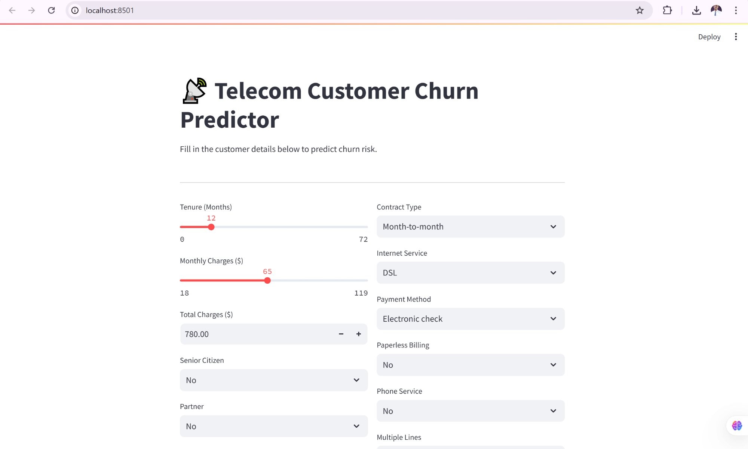
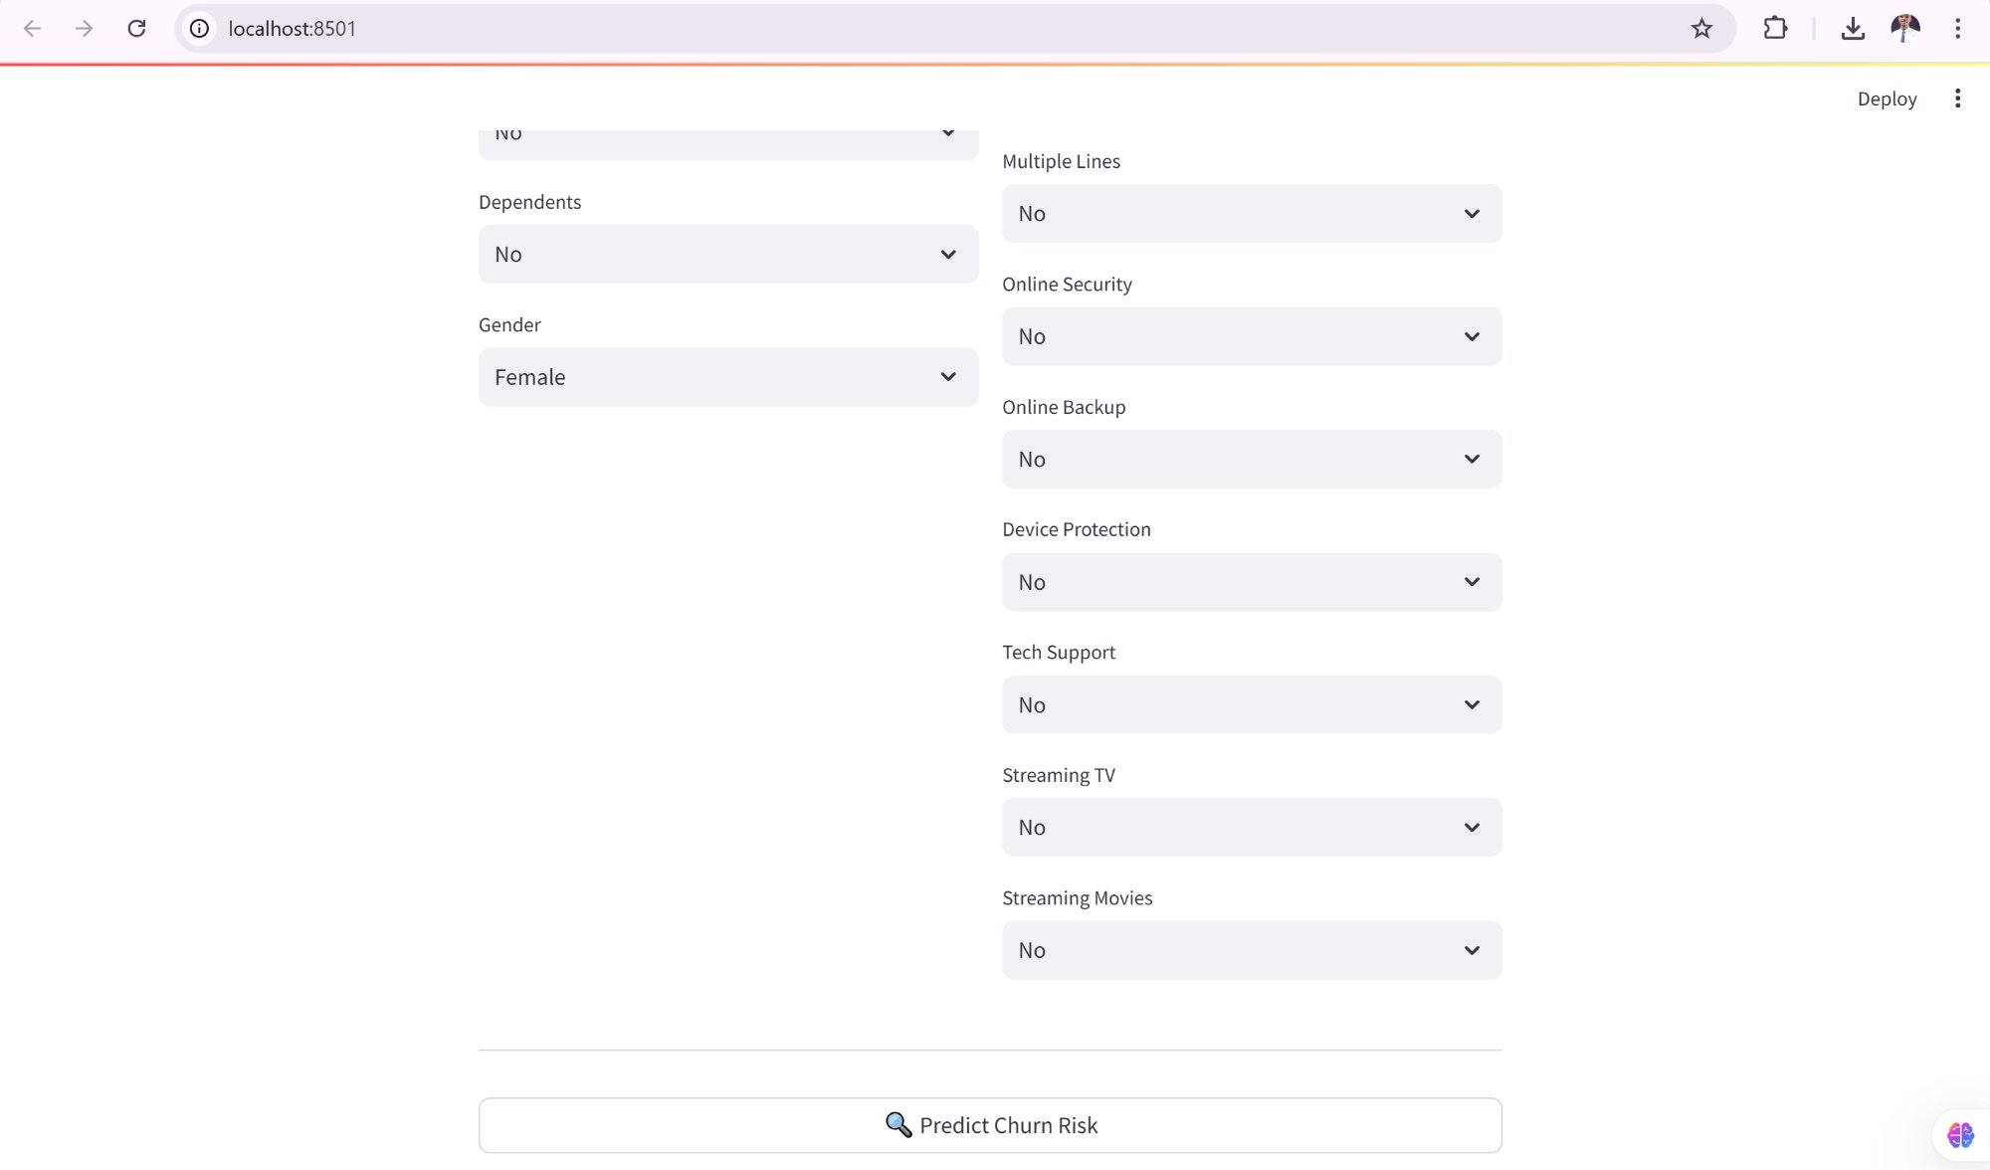
Live Streamlit App — Deployed Prediction Tool
Customer Input Form
Full Form + Predict Button
Input customer details
Instant churn probability
Risk factor flags
Retention recommendations
localhost:8501 | streamlit run app.py

Slide 20
Thank You
Joseph Elijah
Customer Churn Analysis & Prediction
End-to-End Machine Learning Project
7,043
72%
0.84
LIVE
Customers Analysed
Churners Caught
ROC-AUC Score
Streamlit App
Questions & Discussion

