Slide 1
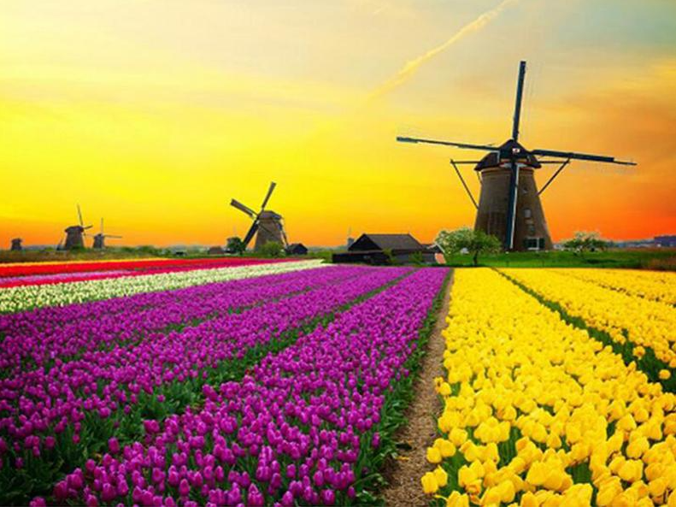
Data Augmentation and Neural Networks to Improve Image Classification
Presented by Joseph Francis & Srilatha Lakka.

Slide 2
Problem Statements
1. Want to Prevent Overfitting ?
2. Initial Dataset is too small to train on ?
3. Want to squeeze better performance from the model ?

Slide 3
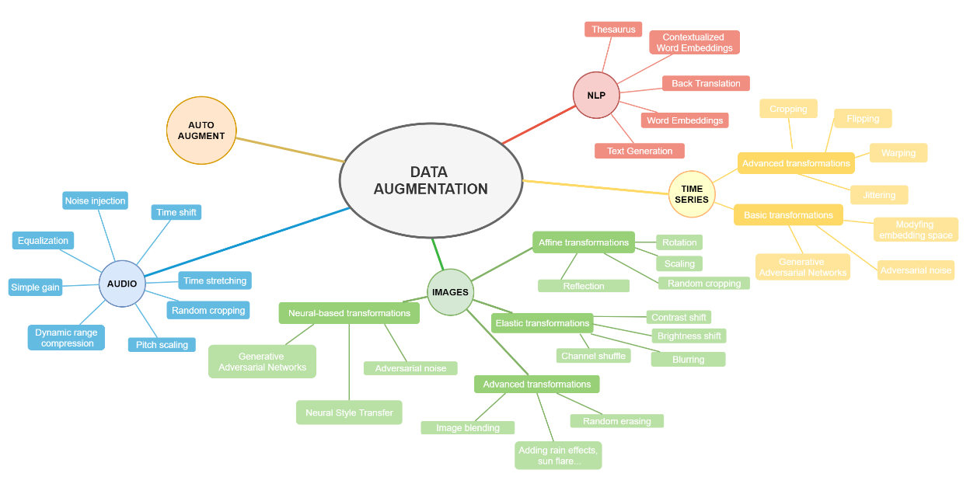
Background
Images
Audio
NLP
Time Series
AutoAugment

Slide 4
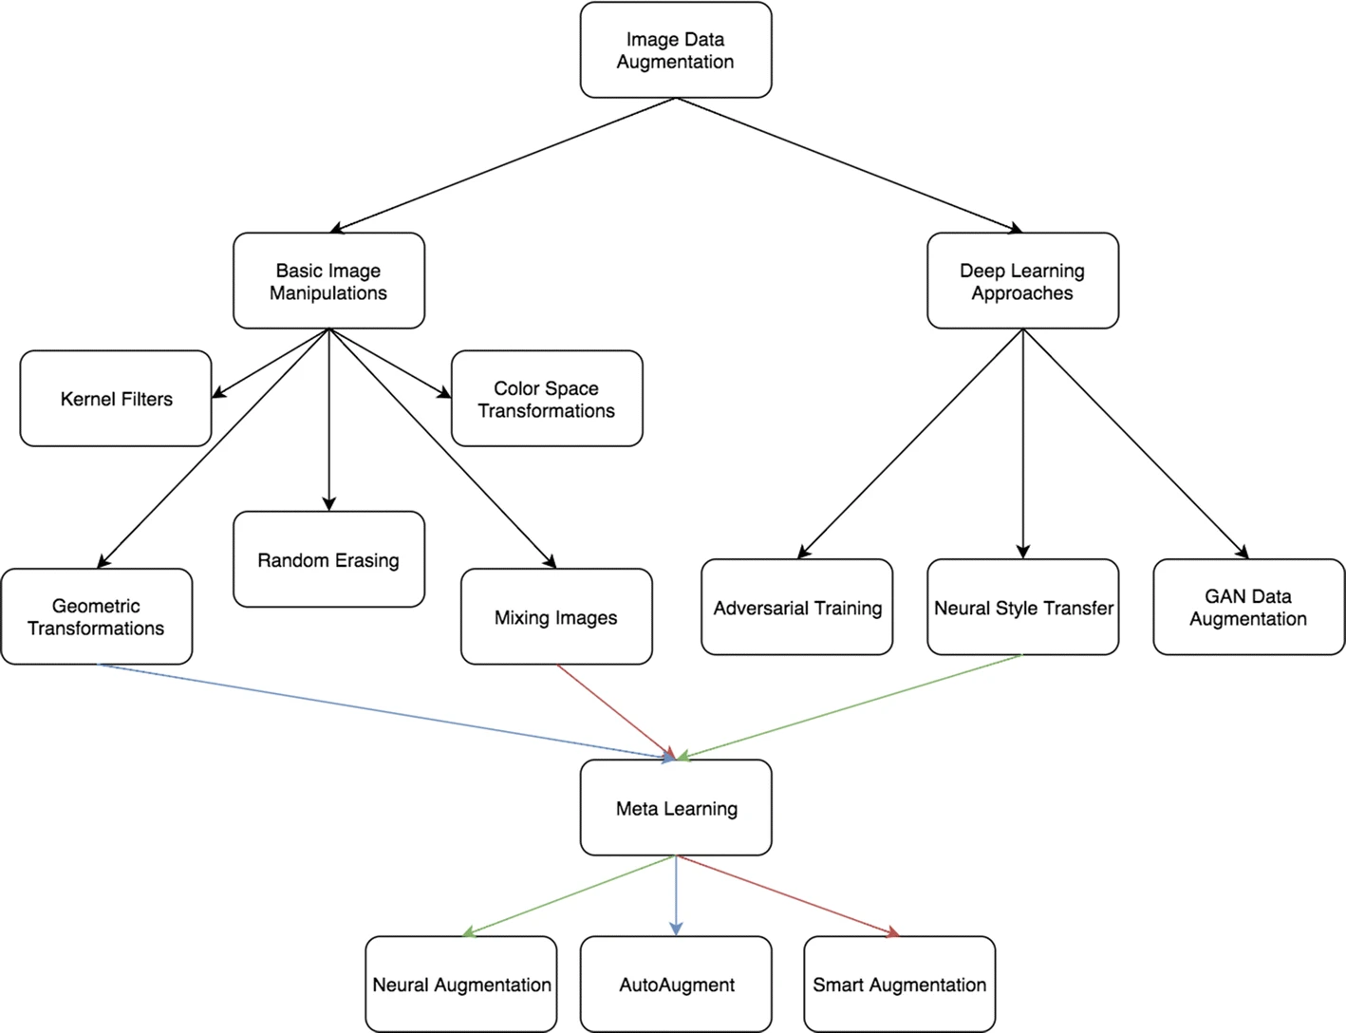
Data Augmentation: Images
BUILT IN
Affine transformations
Elastic transformations
Advanced transformations
Neural-based transformations
CUSTOM
Augmentor
Albumentations
Imgaug
AutoAugment (Deep Augment)
Source: https://link.springer.com/article/10.1186/s40537-019-0197-0

Slide 5
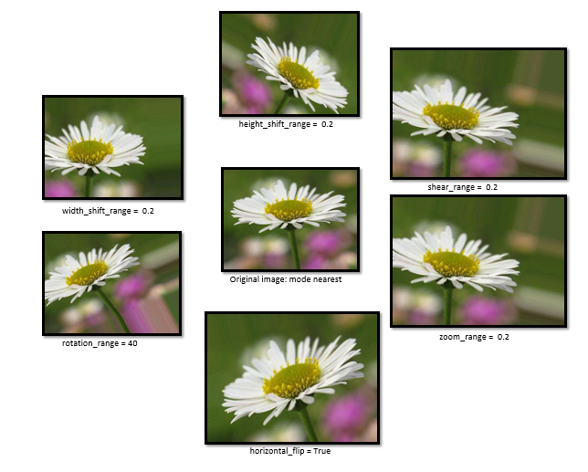
Data Augmentation
Common Technique.
Different Computational libraries.
Trial and Error Process.

Slide 6
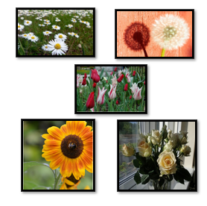
FLOWER Recognition Dataset
Data sourced from Kaggle
4242 Images observations from 5 classes of flowers (classes)
Daisy
Tulip
Rose
Sunflower
Dandelion.

Slide 7
Distribution Of Classes
Daisy -769
Tulip - 984
Rose - 784
Sunflower - 734
Dandelion - 1055

Slide 8
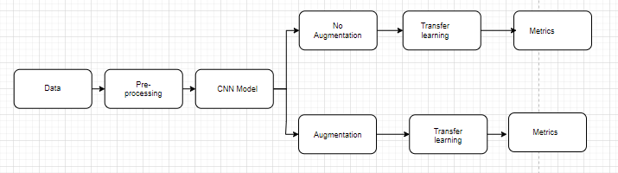
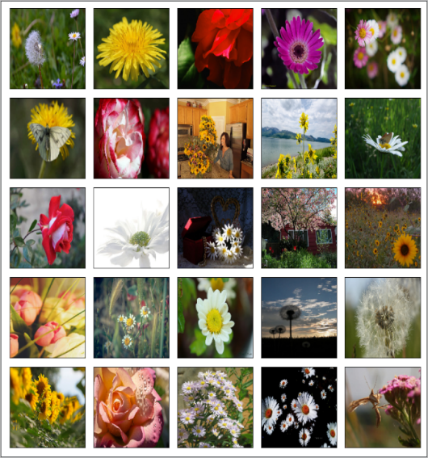
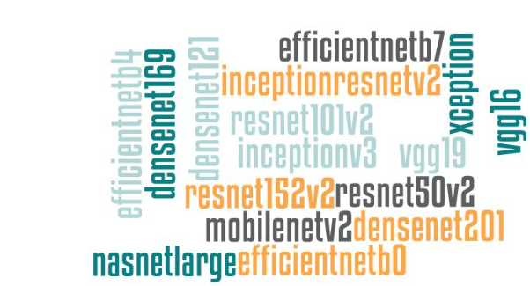
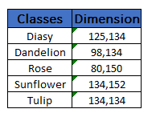
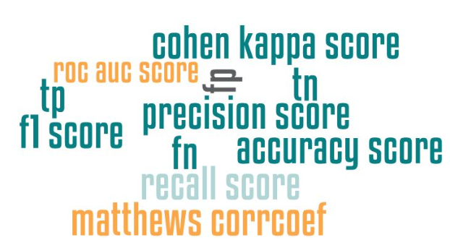
Project Workflow

Slide 9
CNN Architectures
InceptionV3
VGG16
VGG19
Xception
ResNet50V2
ResNet101V2
ResNet152V2
InceptionResNetV2
MobileNetV2
DenseNet121
DenseNet169
DenseNet201

Slide 10
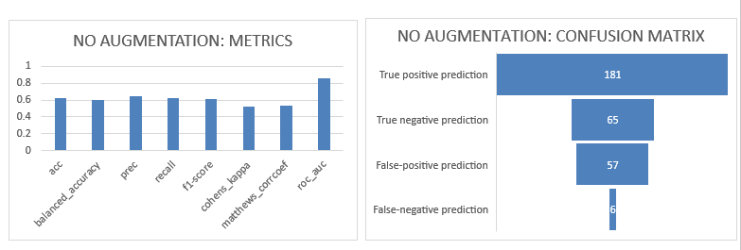
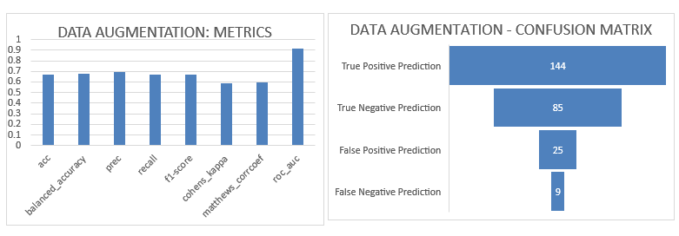
Metrics

Slide 11
Accuracy Report

Slide 12
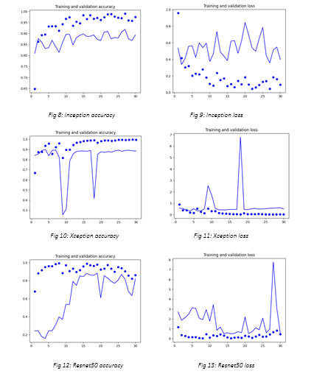
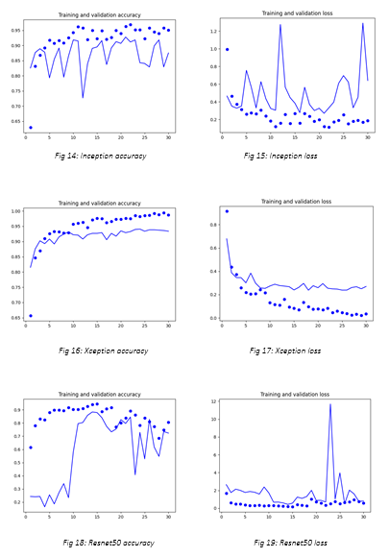
Accuracy and loss curves
NO AGUMENTATION
DATA AUGMENTAION

Slide 13
Final Thoughts!
KEY INSIGHTS
Dataset demonstrate the effectiveness of the proposed Data Augmentation framework.
Not much significant difference in results.
Powerful tool use it wisely!
FUTURE PROSPECTS
Neural-based transformations
Model Patching

Slide 14
References
[1] keras.io
[2] Pratt, L. Y. (1993). “Discriminability-based transfer between neural networks” (PDF). NIPS Conference: Advances in Neural Information Processing Systems 5. Morgan Kaufmann Publishers. pp. 204–211. [3] Olga Russakovsky et al. “ImageNet Large Scale Visual Recognition Challenge”. IJCV, 2015. [4] LeCun, Y. et al., 1998. “Gradient-based learning applied to document recognition.” Proceedings of the IEEE, 86(11):2278–2324 [5] Han X., Kashif R., and Roland V., 2017. Fashion-MNIST: a Novel Image Dataset for Benchmarking Machine Learning Algorithms arXiv preprint [6] Chollet F., 2016. Xception: Deep Learning with Depthwise Separable Convolutions arXiv preprint [7] Simonyan K. and Zisserman A., 2014. Very Deep Convolutional Networks for Large-Scale Image Recognition arXiv preprint

Slide 15
References
[8] Szegedy C. et al., 2016. Inception-v4, Inception-ResNet and the Impact of Residual Connections on Learning arXiv preprint [9] Sandler M. et al., 2019. MobileNetV2: Inverted Residuals and Linear Bottlenecks arXiv preprint [10] Zoph B. et al., 2018. Learning Transferable Architectures for Scalable Image Recognition arXiv preprint [11] He K. et al., 2016. Deep Residual Learning for Image Recognition arXiv preprint [12] Huang G. et al., 2017. Densely Connected Convolutional Networks arXiv preprint [13] Szegedy C[8] Szegedy C. et al., 2016. Inception-v4, Inception-ResNet and the Impact of Residual Connections on Learning arXiv preprint

Slide 16


