Slide 1
Web Fundamentals
RESPONSIVE WEB DESIGN (RWD)

Slide 2
Learning Objectives
Understand why ‘Mobile First’ and ‘Responsive Web Design’
Be able to apply RWD principles
Be able to use Media Queries
Understand and implement grid systems
Understand flexbox
Be able to create and use responsive images

Slide 3
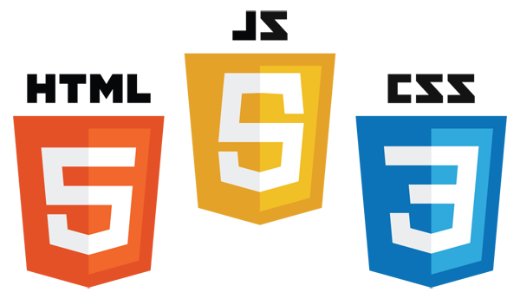
Responsive Web Design
Mobile First and Responsive Design
Viewports
Media Queries
Grids
Flex Box
Responsive Images

Slide 4
Mobile First and Responsive Web Design
Responsive Web Design

Slide 5
Mobile First
UI design idea first coined by Luke Wroblewski in 2011
Encourages UI to be designed for a mobile device before a large screen
Helps to identify what most important content is
Ensures that this content is displayed prominently on a mobile device
Why ‘Mobile First’?
Prepares you for the explosive growth and new opportunities emerging on mobile today
Forces you to focus and prioritise your products by embracing the constraints inherent in mobile design
Allows you to deliver innovative experiences by building on new capabilities native to mobile devices and modes of use
Taken from Mobile First, L Wroblewski, P1

Slide 6
Responsive Web Design
Pioneered by Ethan Marcotte in 2010
Ensures that web pages render well regardless of device/screen/window size
Adapts the layout by using fluid, proportion-based grids, flexible images and media queries
Fluid grid concept requires sizing to be in relative units (percentages rather than pixels or points)
Flexible images sized in relative units
Media queries allow different rules to be applied usually dependent on width of screen available
Only uses HTML and CSS
Notes:
https://abookapart.com/products/responsive-web-design

Slide 7
Content First - Manipulate
RWD is more than changing layouts
Media queries do not just change layouts
Allow designers to manipulate content dependent on viewport size and device type
Make sure main content is visible on phone when user views homepage
Hamburger navigation, move ads down, etc
Changing content is common
Lower resolution videos for small screens, etc
Removing content completely is last resort
General Rules for Manipulating Content
Reorder
Reposition
Replace
Remove (last resort)

Slide 8
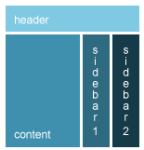

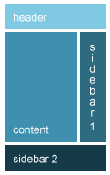
Responsive is not just smaller text
Responsive development is about re-envisioning content
Relative sizing can make content too big on mobile devices and too small on desktop sized screens and above
Notes:
Response design starts with the concept of mobile first which means you start with the smallest device and consider the devices that may view website. You build from this smallest device adding new content and taking advantage of the larger website as you develop.
Working from the mobile first perspective we must consider what information is essential to the site.

Slide 9
The Viewport
User’s visible area of the page
Varies from device to device
Small on a mobile phone, larger on a full size screen
Setting the viewport
Done in a meta tag with the head of the HTML page
Has to be included for responsiveness to work
Size content to the viewport
Users should only scroll vertically – never horizontally
Content should not rely on a particular viewport size
Media queries should be used to apply different styles on different sized screens
<meta name="viewport" content="width=device-width, initial-scale=1.0">

Slide 10
max-width
Will solve most problems with images
Sets the maximum width of a given element (if % it is that of the parent element)
Elements will not appear wider than the maximum specified for the element
img {
max-width: 100%
}
img.biggest {
max-width: 300px
}

Slide 11
Media Queries
Responsive Web Design

Slide 12
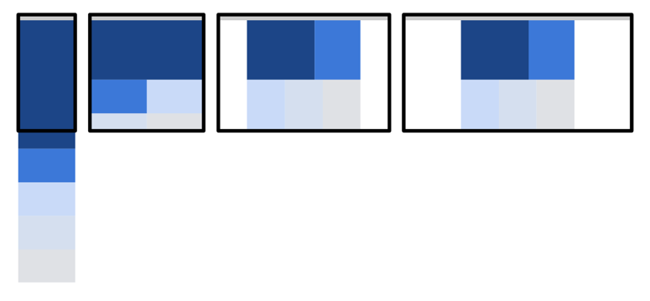
Media Queries
Modify the layout of your site based on different criteria
Same layout not necessarily appropriate for every device
Might have
Single column on phone
Two columns on tablet
Three columns on desktop
etc
@media (max-width: 480px){
/* layout for phones */
}
@media (max-width: 720px) {
/* layout for tablets */
}

Slide 13
Match Breakpoints to Content
Devices are constantly changing
Viewports getting bigger and smaller
Pixel density, pixel shape display quality
Designers should not be forced to make change every time new viewport appears
Follow rules opposite
General Rules for Creating Breakpoints in Content
Start small
Add major breakpoints
Add minor breakpoints if necessary
Optimise for reading: 70-80 characters per line
Notes:
Start the design process with the smallest form factor.
Then add the major breakpoints for the form factors that you will work with: phone, tablets, laptops and wide screen devices.
You can then create minor breakpoints to handle specific changes to elements that don’t affect all elements.
The final detail to keep in mind is to optimize the content for reading. Ideally keep the width of your content to 70 to 80 characters. Wider than that value makes content harder to read.

Slide 14
Mobile First Media Queries
Look at the minimum width of a device to display content in particular way instead
No fixed rule about whether to include media queries inline or use a separate file
Might want to consider using ems or rems
/* small by default */
@media (min-width: 480px){
/* medium */
}
@media (min-width: 720px) {
/* large */
}

Slide 15
Quick Lab 11 – Media Queries
Create some media queries to make a page adapt to the width available.

Slide 16
Grids
Responsive Web Design
Notes:
Objectives:
To understand the use of changing layout and responsive grids
To be able to use CSS Grid Layout Module
To have knowledge CSSGrid Frameworks

Slide 17
Changing Layouts – Grid View
Modern websites often based on a grid-view
Pages are divided into (usually 12) equal columns
Helpful when designing pages for different devices as easier to place elements on page
Total width is 100% and will shrink and expand as the browser window is resized
1 | 2 | 3 | 4 | 5 | 6 | 7 | 8 | 9 | 10 | 11 | 12

Slide 18
Responsive Grids
All HTML elements have to have box-sizing set to border-box
Ensures padding and border are included in total width and height of elements
Can create simple responsive page with 2 columns
* { box-sizing: border-box; }
.left 25% | .right 75%
.left { width: 25%; float: left; }
.right { width: 75%; float: left; }
Notes:
For a 12 column grid, each would take up 8.33%.
We could create 12 classes, prefixed with “col-” and then the number of columns the section should span. The width property would then be set, as a percentage, to the number of columns multiplied by 8.33.
The number of columns inside each container labelled as a row should always add up to 12

Slide 19
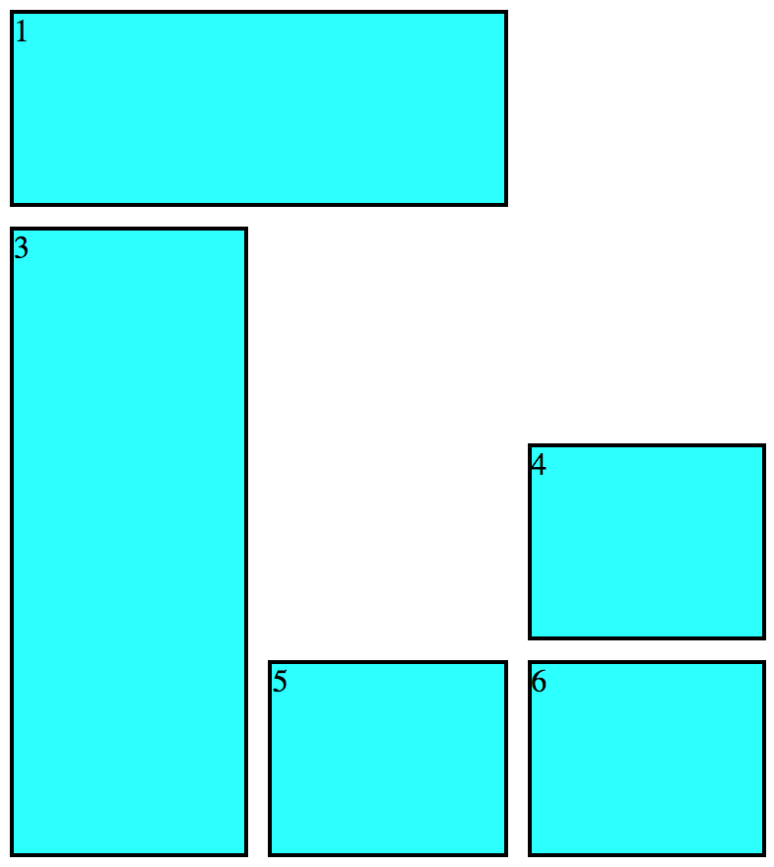
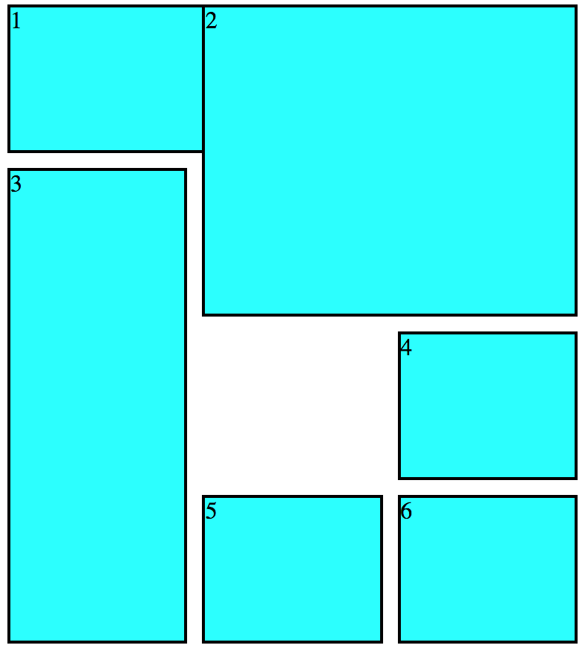
CSS Grid Layout Module
Offers a grid-based layout system, with rows and columns
HTML
CSS
<div class="grid-container">
<div class="one">1</div>
<div class="two">2</div>
<div class="three">3</div>
<div class="four">4</div>
<div class="five">5</div>
<div class="six">6</div>
</div>
.grid-container {
display: grid;
grid-template-columns: repeat(3, 1fr);
grid-gap: 10px;
grid-auto-rows: minmax(100px, auto);
}
.one { grid-column: 1/3; grid-row: 1 }
.two { grid-column: 2/4; grid-row: 1/3 }
.three { grid-column: 1; grid-row: 2/5 }
.four { grid-column: 3; grid-row: 3 }
.five { grid-column: 2; grid-row: 4 }
.six { grid-column: 3; grid-row: 4 }
Notes:
The CSS Grid Layout Module offers a grid-based layout system, with rows and columns, making it easier to design web pages without having to use floats and positioning.
The left image shows the layout with div2 removed to show the rendering of div1.
The right image shows how div2 overlays div1.

Slide 20
CSS Grid Layout Module
There are 18 different properties that can be set for the CSS Grid Layout module:
There are 3 functions that can be used:
column-gap | grid-auto-rows | grid-row-start
gap | grid-column | grid-template
grid | grid-column-start | grid-template-areas
grid-area | grid-column-end | grid-template-columns
grid-auto-columns | grid-row | grid-template-rows
grid-auto-flow | grid-row-end | row-gap
fit-content() | minmax() | repeat()
Notes:
For more information on the CSS Grid Layout module, see:
https://developer.mozilla.org/en-US/docs/Web/CSS/CSS_Grid_Layout
Real world examples:
https://gridexamples.com/
https://cssgrid.design/
https://bashooka.com/coding/25-awesome-css-grid-layout-examples/
https://www.cssdesignawards.com/website-gallery?feature=grid
https://labs.jensimmons.com/

Slide 21


Grid Frameworks
No need to define all of the classes by hand
Several Responsive CSS Frameworks exist that already have the CSS classes defined along with many other useful features
All developer has to do is add correct classes to the HTML
Examples are Bootstrap and Foundation
Notes:
Real World Examples:
Bootstrap: https://getbootstrap.com/
https://getbootstrap.com/docs/4.5/examples/
Zurb Foundation:
https://foundation.zurb.com
Material Design:
https://materializecss.com/
Review Questions:
Modern websites often based on a grid-view pages are divided into how many equal columns?
(usually 12)
2) For Responsive Grids, how do we nsures padding and border are included in total width and height of elements?
* { box-sizing: border-box; }
3) What is CSS Grid Layout Module ?
The CSS Grid Layout Module offers a grid-based layout system, with rows and columns, making it easier to design web pages without having to use floats and positioning.
4) What are some of the most popular CSS frameworks?
Bootstrap and Foundation

Slide 22
Quick Lab 12 - Grids
Add CSS classes to HTML elements to utilise a provided CSS grid system.

Slide 23
Flex Box
Responsive Web Design

Slide 24
Flex Box
Enables easy design of responsive layout structure without using float or positioning
Requires a flex container
Element becomes flex container by setting display property to flex
.flex-container { display: flex; }

Slide 25
Flex Container Properties
Flex containers can have the following properties:
Property | Description | Common Values
flex | Specifies how flex item will grow or shrink to fit the container – shorthand to set flex-grow, flex-shrink and flex-basis | auto, initial, none, <+ve num>
flex-grow | Specifies how much of available space should be assigned to the item | <+ve num>
flex-shrink | Specifies how items will shrink to fit container when default size is larger than flex container | <+ve num>
flex-basis | Specifies the initial main size of a flex item (determines size of content-box unless box-sizing is defined) | <width> (% or units), auto, fill, max-content, min-content, fit-content, content, unset
Notes:
flex-direction: https://developer.mozilla.org/en-US/docs/Web/CSS/flex-direction

Slide 26
Flex Container Properties
Flex containers can have the following properties:
Property | Description | Common Values
flex-direction | Defines direction the container stacks the flex items | row, row-reverse, column, column-reverse
flex-wrap | Specifies if the flex items will wrap if necessary | nowrap, wrap, wrap-reverse
flex-flow | Shorthand property to set flex-direction and flex-wrap | As above
justify-content | Defines how browser distributes space between and around content along main axis of container | center, end, flex-end, flex-start, left, right, start, norm, space-between, space-around, space-evenly, stretch, safe center, unsafe center, unset
Notes:
flex-direction: https://developer.mozilla.org/en-US/docs/Web/CSS/flex-direction
flex-wrap: https://developer.mozilla.org/en-US/docs/Web/CSS/flex-wrap
flex-flow: https://developer.mozilla.org/en-US/docs/Web/CSS/flex-flow
justify-content: https://developer.mozilla.org/en-US/docs/Web/CSS/justify-content

Slide 27
Flex Container Properties
Flex containers can have the following properties:
Property | Description | Common Values
align-items | Sets align-self value on all direct children as a gourp | normal, stretch, baseline, self-start, self-end, flex-start, flex-end, end, center, start
align-content | Specifies how browser distributes space between and around content items along cross axis of their container | As above
align-self | Aligns flex items of current flex line overriding align-items – ignored if any item’s cross-axis margin is auto | auto, as above
order | Specifies order used to lay out flex or grid item in flex or grid container | <integer>
Notes:
align-items: https://developer.mozilla.org/en-US/docs/Web/CSS/align-items
align-content: https://developer.mozilla.org/en-US/docs/Web/CSS/align-content
align-self: https://developer.mozilla.org/en-US/docs/Web/CSS/align-self
order: : https://developer.mozilla.org/en-US/docs/Web/CSS/order

Slide 28
Flex Container Properties
Flex containers can have the following properties:
Property | Description | Common Values
place-content | Shorthand property to set align-content and justify-content Note: If second value is not provided, first value is used for both Note: If invalid value is used in declaration, whole declaration is invalid | As for align-content and justify-content
Notes:
place-content: https://developer.mozilla.org/en-US/docs/Web/CSS/place-content

Slide 29
Quick Lab 13 – Flex Box
Create a flex-container and experiment with flexbox attributes and settings.

Slide 30
Responsive Images
Responsive Web Design

Slide 31
What are Responsive Images
A method for providing the browser with multiple image sources depending on display density, size of the image element in the page, or any number of other factors. -- Jason Grigsby
Responsive images refer to one or more methods for providing browsers with the correct image based on attributes of the user’s device
Such as display density, image and page size or any number of factors.
General principles for performance
Avoid images wherever possible
Use vector formats where possible: SVG or icon fonts
Use the lowest possible resolution and quality
Use the right format for the image type: WebP, PNG, JPEG
Notes:
Before we jump into specifics we’ll take a bird’s eye view of how to use responsive images.
The goal here is to increase performance.
Avoid using images wherever possible. Before using an image, ask yourself whether the image is really necessary or useful. Maybe the same effect could be achieved with simple text and CSS. We can now do gradients and rounded corners and blended backgrounds directly with CSS rather than using images to accomplish the same effect.
Depending on the purpose and the type of image it may be better to use vector graphic formats instead of raster images like PNG, WebP, JPG or GIF. Vector graphics are usually smaller and easier to compress. Again, depending on the purpose, you may want to use icon fonts instead of raster graphics; there are some arguments against icon fonts, but they are beyond the scope of this presentation.
It makes no sense to send a 1MB image to a mobile device… it’s important to use the lowest resolution and quality for each device you’re trying to target.
Different image formats are better for different things:
GIF images are better for animations and images with a limited color palette (256 colors). You can also make animated GIFs
JPG images are better for photographs. Does not support transparencies
PNG images take the best of JPG and GIF. It supports same colors as JPG and also support transparencies like GIF
WebP images are generally smaller than equivalent JPG or PNG images. It also supports animations and some people have considered a replacement for animated GIFs
Which format you use will depend on your needs. As we’ll discuss later we can have multiple formats in the same image delivered depending on browser support or the current size of the content.

Slide 32
The <picture> and <source> elements
<picture> and <source> elements enable us to provide alternative sources for the same resource
Holds two different tags: one or more <source> tags and one <img> tag
<source> element has the following attributes
srcset (required) - defines the URL of the image to show
media - accepts any valid media query that would normally be defined in a CSS
sizes - defines a single width descriptor
type - defines the MIME type
<picture> <source media="(min-width: 1024px)" srcset="kitten-large.png"> <source media="(min-width: 667px)" srcset="kitten-medium.png"> <img src="kitten-small.png" alt="Cute kitten"> </picture>
Notes:
The picture and source elements enable us to provide alternative sources for the same resource.
The browser will stop and load the first source element that it understands and load that image. If the browser can’t read the files specified in the source elements or if the browser doesn’t support the picture and source elements the default image will be loaded.
The source elements can include different file formats. In this example we use WebP first and then JPG and provide the same JPG file as the default image in the img element.

Slide 33
The width descriptor
Sizes attribute
Tells the browser the size or sizes of the element the srcset is attached to so that the browser can use the appropriate image
sizes="50vw": telling the browser that the image will be displayed at 50% of the viewport width
w unit : width of each image in pixels, enabling the browser to choose the right image to retrieve, depending on the screen pixel density and the viewport size
<img src="small.jpg" srcset="kitten-small.png 500w, kitten-medium.png 1000w, kitten-large.png 1500w" sizes="50vw" alt="cute kitten" />
Notes:
For a browser, there's a Catch-22 when it comes to choosing which image to download: the browser needs to know the dimensions of each image, but it can't know that without downloading each image to check.
Enter the w unit...
The w unit *tells* the browser the width of each image in pixels, thereby enabling the browser to choose the right image to retrieve – depending on the screen pixel density and the viewport size.
Note:
We can't specify both a pixel density and width descriptor in the same srcset. It must be all pixel densities or all width descriptors.

Slide 34
Combining Media Queries and srcset
Combining media queries and srcset to specify images for different viewports
Also providing different images for different pixel densities
Tools like responsivebreakpoints.com will generate the images and the corresponding code for you so you don’t have to do
<picture>
<source media="(min-width: 1024px)" srcset="kitten-large.png 1x, kitten-large_2x.png 2x">
<source media="(min-width: 667px)" srcset="kitten-medium.png 1x, kitten-medium_2x.png 2x">
<img src="kitten-small.png" alt="Cute kitten">
</picture>

Slide 35
Quick Lab 14 - Responsive Images
Add images to HTML that respond to the device/screen that is being used to view them.

Slide 36
Learning Objectives
Understand why mobile first and responsive web design
Be able to apply responsive design principles
Be able to use Media Queries
Understand and implement grid systems
Understand flexbox
Be able to create and use responsive images

Slide 37
Hackathon – QA Cinemas
You have a brief for a website to be set up using the skills, knowledge and understanding of HTML, CSS and RWD gained on the course
The brief has a number of user stories to tackle
You are expected to:
Have a planning meeting to decide how the work will be distributed
Create the website
Have a review meeting to demonstrate the website to your trainer
Hold a retrospective to review what has been learnt as part of the process

