Slide 1
Python Coding Schools
1st lesson: HelloWorld
Seed Academy

Slide 2
Agenda
wk1. Installing Python, HelloWorld
wk2. Arithmetic Operators
wk3. Data Types : Integer, Floating point, Boolean, String
wk4. Data Structures: List
wk5. Data Structures: Set, Tuples
wk6. Data Structures: Dictionary

Slide 3
Agenda
wk7. Control flows: IF statement
wk8. Loops
wk9. Function
wk10. Class
wk11. Data Visualization

Slide 4
Class materials
https://github.com/TaeheeJeong/seedacademy
https://github.com/TaeheeJeong/SummerCoding2023

Slide 5

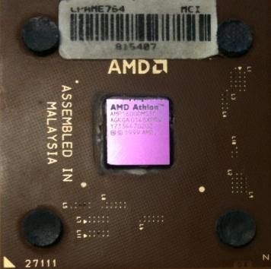
Computers...
Computers are built for one purpose - to do things for us
But we need to speak their language to describe what we want done
Someone already put many different programs (instructions) into the computer and users just pick the ones they want to use
What
Next?
What
Next?
What
Next?
What
Next?
What
Next?
What
Next?
What
Next?
Source: Python for Everybody, Charles Severance, University of Michigan School of Information

Slide 6
Users vs. Programmers
Users see computers as a set of tools - word processor, spreadsheet, map, to-do list, etc.
Programmers use computer languages to build new tools for lots of users to automate a task
Source: Python for Everybody, Charles Severance, University of Michigan School of Information

Slide 7
User
Computer
Hardware + Software
Programmer
Data
Information
Networks
....
Programmers build the software.
Source: Python for Everybody, Charles Severance, University of Michigan School of Information

Slide 8
What is Code? Software? A Program?
A sequence of stored instructions
- It is a piece of our intelligence in the computer
A piece of creative art
- particularly when we do a good job
Source: Python for Everybody, Charles Severance, University of Michigan School of Information

Slide 9
Python language
Python was created by Guido Van Rossum, and released on February 20, 1991.
Van Rossum’s vision for Python:
To be an easy and intuitive language that is just as powerful as those of the major competitors
The ability for anyone to contribute to its development by being open source
For the language to be easily understandable as plain English
That the language be suitable for everyday tasks and allow for short development time
Source: https://flatironschool.com, Python Popularity by Anna Johnson

Slide 10
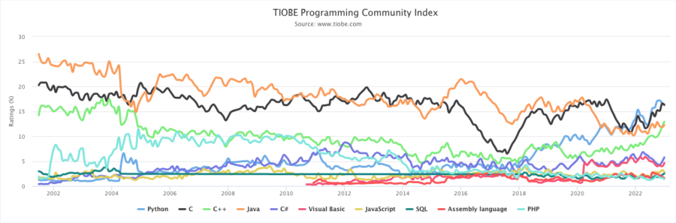
Python Popularity Over The Years
Python’s rise in popularity because it is an intuitive, accessible, and versatile language.
Source: https://flatironschool.com, Python Popularity by Anna Johnson

Slide 11
Why Is Python So Popular?
Beginner-Friendly
Versatility of Use
Active and Supportive Community
Libraries and Frameworks
Python Works with Artificial Intelligence
Source: https://flatironschool.com, Python Popularity by Anna Johnson

Slide 12
Interactive versus Script
Interactive
- You type directly to Python one line at a time and it responds
- Jupyter Notebook, Spyder
Script
- You enter a sequence of statements (lines) into a file using a text editor and tell Python to execute the statements in the file
- As a convention, we add “.py” as the suffix on the end of these files to indicate they contain Python.
Source: Python for Everybody, Charles Severance, University of Michigan School of Information

Slide 13
Installing Python
Method1. Installing Anaconda
Method2. Installing Miniconda
Method3. Installing Python
Method4. Google Colab

Slide 14
Installing Anaconda
Installing on Windows
https://docs.anaconda.com/free/anaconda/install/windows/
Installing on MacOS
https://docs.anaconda.com/free/anaconda/install/mac-os/
Installing on Linux
https://docs.anaconda.com/free/anaconda/install/linux/

Slide 15
Installing Miniconda
Installing on Windows
https://docs.conda.io/projects/conda/en/latest/user-guide/install/windows.html#
Installing on MacOS
https://docs.conda.io/projects/conda/en/latest/user-guide/install/macos.html
Installing on Linux
https://docs.conda.io/projects/conda/en/latest/user-guide/install/linux.html

Slide 16
Installing Python
https://www.python.org/downloads/
Need a text editor: notepad++
https://notepad-plus-plus.org/downloads/
Jupyter notebook
> pip install notebook
> jupyter notebook

Slide 17
Text editors and Tabs
Atom automatically uses spaces for files with ".py" extension
Most text editors can turn tabs into spaces - make sure to enable this feature
- NotePad++: Settings -> Preferences -> Language Menu/Tab Settings
- TextWrangler: TextWrangler -> Preferences -> Editor Defaults
Python cares a *lot* about how far a line is indented. If you mix tabs and spaces, you may get “indentation errors” even if everything looks fine
Source: Python for Everybody, Charles Severance, University of Michigan School of Information

Slide 18
Google Colab
https://colab.research.google.com/
Colab notebook

Slide 19
“Hello, World!”
# Task:
Print "Hello, World!"
# In Jupyter notebook
print('Hello, World!’)
# Using a text editor, make a file “hello.py”
In the terminal, $python hello.py

