Slide 1
Python Coding Schools
11th Lesson: Data Visualization
Seed Academy

Slide 2
Agenda
wk1. Installing Python, HelloWorld
wk2. Arithmetic Operators
wk3. Data Types : Integer, Floating point, Boolean, String
wk4. Data Structures: List
wk5. Data Structures: Set, Tuples
wk6. Data Structures: Dictionary

Slide 3
Agenda
wk7. Control flows : IF statement
wk8. Loops: While, For
wk9. Function
wk10. Class
wk11. Data Visualization

Slide 4
Class materials
https://github.com/TaeheeJeong/seedacademy
https://github.com/TaeheeJeong/SummerCoding2023

Slide 5
Matplotlib
Matplotlib is an amazing visualization library in Python for 2D plots of arrays.
Matplotlib consists of several plots like line, bar, scatter, histogram etc.
Pyplot is a Matplotlib module that provides functions that interact with the figure i.e. creates a figure, decorates the plot with labels, and creates a plotting area in a figure.
python -mpip install -U matplotlib
import matplotlib.pyplot as plt
Source: https://www.geeksforgeeks.org/matplotlib-tutorial/

Slide 6
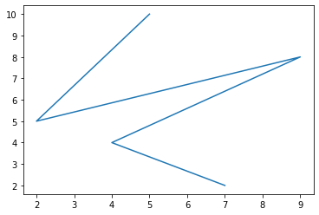
Line plot
# x-axis values
x = [5, 2, 9, 4, 7]
# Y-axis values
y = [10, 5, 8, 4, 2]
# Function to plot
plt.plot(x,y)
# function to show the plot
plt.show()
Source: https://www.geeksforgeeks.org/python-introduction-matplotlib/

Slide 7
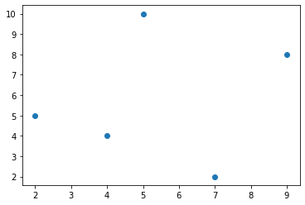
Scatter plot
# x-axis values
x = [5, 2, 9, 4, 7]
# Y-axis values
y = [10, 5, 8, 4, 2]
# Function to plot
plt.scatter(x,y)
# function to show the plot
plt.show()
Source: https://www.geeksforgeeks.org/python-introduction-matplotlib/

Slide 8
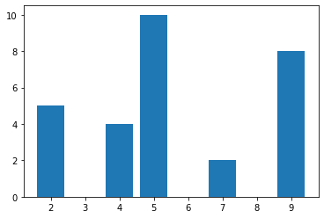
Bar plot
# x-axis values
x = [5, 2, 9, 4, 7]
# Y-axis values
y = [10, 5, 8, 4, 2]
# Function to plot
plt.bar(x,y)
# function to show the plot
plt.show()
Source: Source: https://www.geeksforgeeks.org/python-introduction-matplotlib/

Slide 9
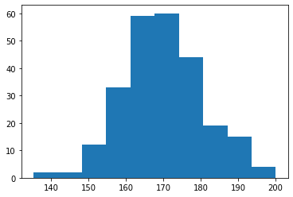
Histogram
# importing numpy module
import numpy as np
# values
x = np.random.normal(170, 10, 250)
# Function to plot
plt.hist(x)
# function to show the plot
plt.show()
Source: https://www.w3schools.com/python/matplotlib_histograms.asp

Slide 10
Color Reference
Color Syntax | Description
'r' | Red
'g' | Green
'b' | Blue
'c' | Cyan
'm' | Magenta
'y' | Yellow
'k' | Black
'w' | White
Source: https://www.w3schools.com/python/matplotlib_markers.asp

Slide 11
Line Reference
Line Syntax | Description
'-' | Solid line
':' | Dotted line
'--' | Dashed line
'-.' | Dashed/dotted line
Source: https://www.w3schools.com/python/matplotlib_markers.asp

Slide 12
Marker Reference
Marker Syntax | Description
'o' | Circle
'*' | Star
'.' | Point
',' | Pixel
'x' | X
'+' | Plus
's' | Square
'd' | Diamond
Marker Syntax | Description
'p' | Pentagon
'h' | Hexagon
'v' | Triangle Down
'^' | Triangle Up
'<' | Triangle Left
'>' | Triangle Right
Source: https://www.w3schools.com/python/matplotlib_markers.asp

Slide 13
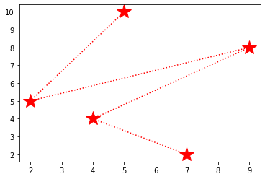
Adding markers
# x-axis values
x = [5, 2, 9, 4, 7]
# Y-axis values
y = [10, 5, 8, 4, 2]
# Function to plot
plt.plot(x,y, color='r', linestyle = 'dotted', marker='*', ms=20)
# function to show the plot
plt.show()

Slide 14
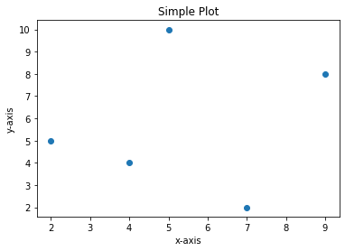
Adding title and labels
# x-axis values
x = [5, 2, 9, 4, 7]
# Y-axis values
y = [10, 5, 8, 4, 2]
# Function to plot
plt.scatter(x,y)
# Adding the title
plt.title("Simple Plot")
# Adding the labels
plt.ylabel("y-axis")
plt.xlabel("x-axis")
# function to show the plot
plt.show()

Slide 15
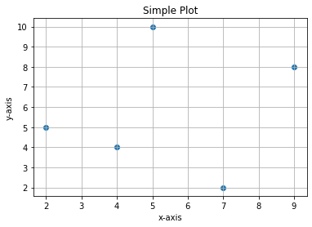
Adding grid
# x-axis values
x = [5, 2, 9, 4, 7]
# Y-axis values
y = [10, 5, 8, 4, 2]
# Function to plot
plt.scatter(x,y)
# Adding the title
plt.title("Simple Plot")
# Adding the labels
plt.ylabel("y-axis")
plt.xlabel("x-axis")
# Adding the grid
plt.grid()
# function to show the plot
plt.show()

Slide 16
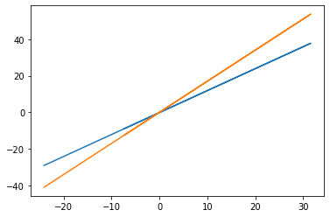
Multiple plots
# importing modules
import matplotlib.pyplot as plt
import numpy as np
# generate sample data
x = np.random.normal(1, 10, 250)
y1 = 1.2 * x + 0.1* np.random.normal(0,1)
y2 = 1.7 * x + 0.1* np.random.normal(0,1)
# Function to plot
plt.plot(x,y1)
plt.plot(x,y2)
# function to show the plot
plt.show()

Slide 17
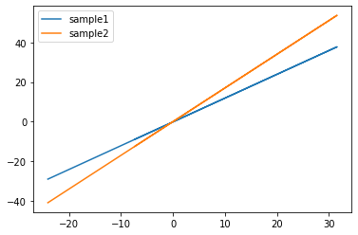
Adding legends
# Function to plot
plt.plot(x,y1, label='sample1')
plt.plot(x,y2, label='sample2')
# adding legends
plt.legend()
# function to show the plot
plt.show()

Slide 18
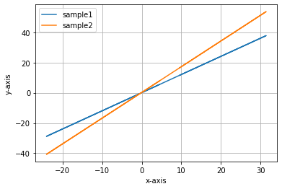
Adding labels and grid
# Function to plot
plt.plot(x,y1, label='sample1')
plt.plot(x,y2, label='sample2')
# adding legends
plt.legend()
# Adding the labels
plt.ylabel("y-axis")
plt.xlabel("x-axis")
# Adding the grid
plt.grid()
# function to show the plot
plt.show()

Slide 19
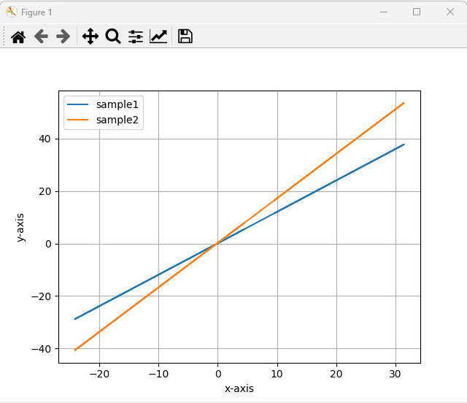
Interactive mode
%matplotlib
# Function to plot
plt.plot(x,y1, label='sample1')
plt.plot(x,y2, label='sample2')
# adding legends
plt.legend()
# Adding the labels
plt.ylabel("y-axis")
plt.xlabel("x-axis")
# Adding the grid
plt.grid()
# function to show the plot
plt.show()

