Slide 1
Python Coding Schools
5th lesson: Set, Tuples
Seed Academy

Slide 2
Agenda
wk1. Installing Python, HelloWorld
wk2. Arithmetic Operators
wk3. Data Types : Integer, Floating point, Boolean, String
wk4. Data Structures: List
wk5. Data Structures: Set, Tuples
wk6. Data Structures: Dictionary

Slide 3
Agenda
wk7. Control flows: IF statement
wk8. Loops
wk9. Function
wk10. Class
wk11. Data Visualization

Slide 4
Class materials
https://github.com/TaeheeJeong/seedacademy
https://github.com/TaeheeJeong/SummerCoding2023

Slide 5
Today’s topic: Tuples & Set
Data structure
List
Tuples
Set
Dictionary

Slide 6
Tuples Are Like Lists
Tuples are another kind of sequence that functions much like a list
They have elements which are indexed starting at 0
>>> x = ('Glenn', 'Sally', 'Joseph')
>>> print(x[2])
Joseph
>>> y = ( 1, 9, 2 )
>>> print(y)
(1, 9, 2)
>>> print(max(y))
9
Source: Python for Everybody, Charles Severance, University of Michigan School of Information

Slide 7
but... Tuples are “immutable”
Unlike a list, once you create a tuple, you cannot alter its contents - similar to a string
List
Tuple
String
>>> x = [9, 8, 7]
>>> x[2] = 6
>>> print(x)
>>>[9, 8, 6]
>>> z = (5, 4, 3)
>>> z[2] = 0
Traceback:'tuple' object does
not support item
Assignment
>>> y = 'ABC'
>>> y[2] = 'D'
Traceback:'str' object does
not support item
Assignment
Source: Python for Everybody, Charles Severance, University of Michigan School of Information

Slide 8
Things not to do With Tuples
>>> x = (3, 2, 1)
>>> x.sort()
Traceback:
AttributeError: 'tuple' object has no attribute 'sort’
>>> x.append(5)
Traceback:
AttributeError: 'tuple' object has no attribute 'append’
>>> x.reverse()
Traceback:
AttributeError: 'tuple' object has no attribute 'reverse'
Source: Python for Everybody, Charles Severance, University of Michigan School of Information

Slide 9
Tuples are More Efficient
Since Python does not have to build tuple structures to be modifiable, they are simpler and more efficient in terms of memory use and performance than lists.
When we are making “temporary variables” we prefer tuples over lists.
Source: Python for Everybody, Charles Severance, University of Michigan School of Information

Slide 10
Tuples and Assignment
We can also put a tuple on the left-hand side of an assignment statement
We can even omit the parentheses
>>> (x, y) = (4, 'fred')
>>> print(y)
fred
>>> (a, b) = (99, 98)
>>> print(a)
99
Source: Python for Everybody, Charles Severance, University of Michigan School of Information

Slide 11
Tuples are Comparable
The comparison operators work with tuples and other sequences.
If the first item is equal, Python goes on to the next element, and so on, until it finds elements that differ.
>>> (0, 1, 2) < (5, 1, 2)
True
>>> (0, 1, 2000000) < (0, 3, 4)
True
>>> ( 'Jones', 'Sally' ) < ('Jones', 'Sam')
True
>>> ( 'Jones', 'Sally') > ('Adams', 'Sam')
True
Source: Python for Everybody, Charles Severance, University of Michigan School of Information

Slide 12
Tuples and Lists
Lists are convenient to use and used in most cases compared to Tuples.
Tuples are used in a specific case because of its efficiency.

Slide 13
Set
Lists and tuples store values in a sequence.
Sets are another data type that also store values.
Sets are a mutable collection of distinct (unique) immutable values that are unordered.
The major difference is that sets, unlike lists or tuples, cannot have multiple occurrences of the same element and store unordered values.
Source: https://www.datacamp.com/tutorial/sets-in-python

Slide 14
Advantage of Set
Because sets cannot have multiple occurrences of the same element,
Set can efficiently remove duplicate values from a list or tuple.
Set can perform unions and intersections.
Source: https://www.datacamp.com/tutorial/sets-in-python

Slide 15
Create a Set
You can initialize an empty set by using set().
>>> emptySet = set()
To initialize a set with values, you can pass in a list to set().
>>> dataScientist = set(['Python', 'R', 'SQL', 'Git', 'Tableau', 'SAS’])
>>> dataEngineer = set(['Python', 'Java', 'Scala', 'Git', 'SQL', 'Hadoop'])
Source: https://www.datacamp.com/tutorial/sets-in-python

Slide 16
Create a Set
Sets containing values can also be initialized by using curly braces.
>>> dataScientist = {'Python', 'R', 'SQL', 'Git', 'Tableau', 'SAS’}
Curly-braces {} can only be used to initialize a set containing values.
using curly-braces without values is one of the ways to initialize a dictionary and not a set.
>>> emptySet = set()
>>> emptyDict = dict()
>>> emptyDict = {}
Source: https://www.datacamp.com/tutorial/sets-in-python

Slide 17
Add Values from Sets
Initialize set with values.
>>> graphicDesigner = {'InDesign', 'Photoshop', 'Acrobat', 'Premiere', 'Bridge’}
You can use the method add to add a value to a set.
>>> graphicDesigner.add('Illustrator')
Source: https://www.datacamp.com/tutorial/sets-in-python

Slide 18
Remove Values from Sets
Option 1: remove method removes a value from a set.
>>> graphicDesigner.remove('Illustrator’)
Option 2: discard method removes a value from a set. There is no error message even though the value is not in the set.
>>> graphicDesigner.discard('Premiere’)
Option 3: pop method removes and returns an arbitrary value from a set.
>>> graphicDesigner.pop()
Source: https://www.datacamp.com/tutorial/sets-in-python

Slide 19
Remove Duplicates from a List
>>> list(set([1, 2, 3, 1, 7]))
Source: https://www.datacamp.com/tutorial/sets-in-python

Slide 20
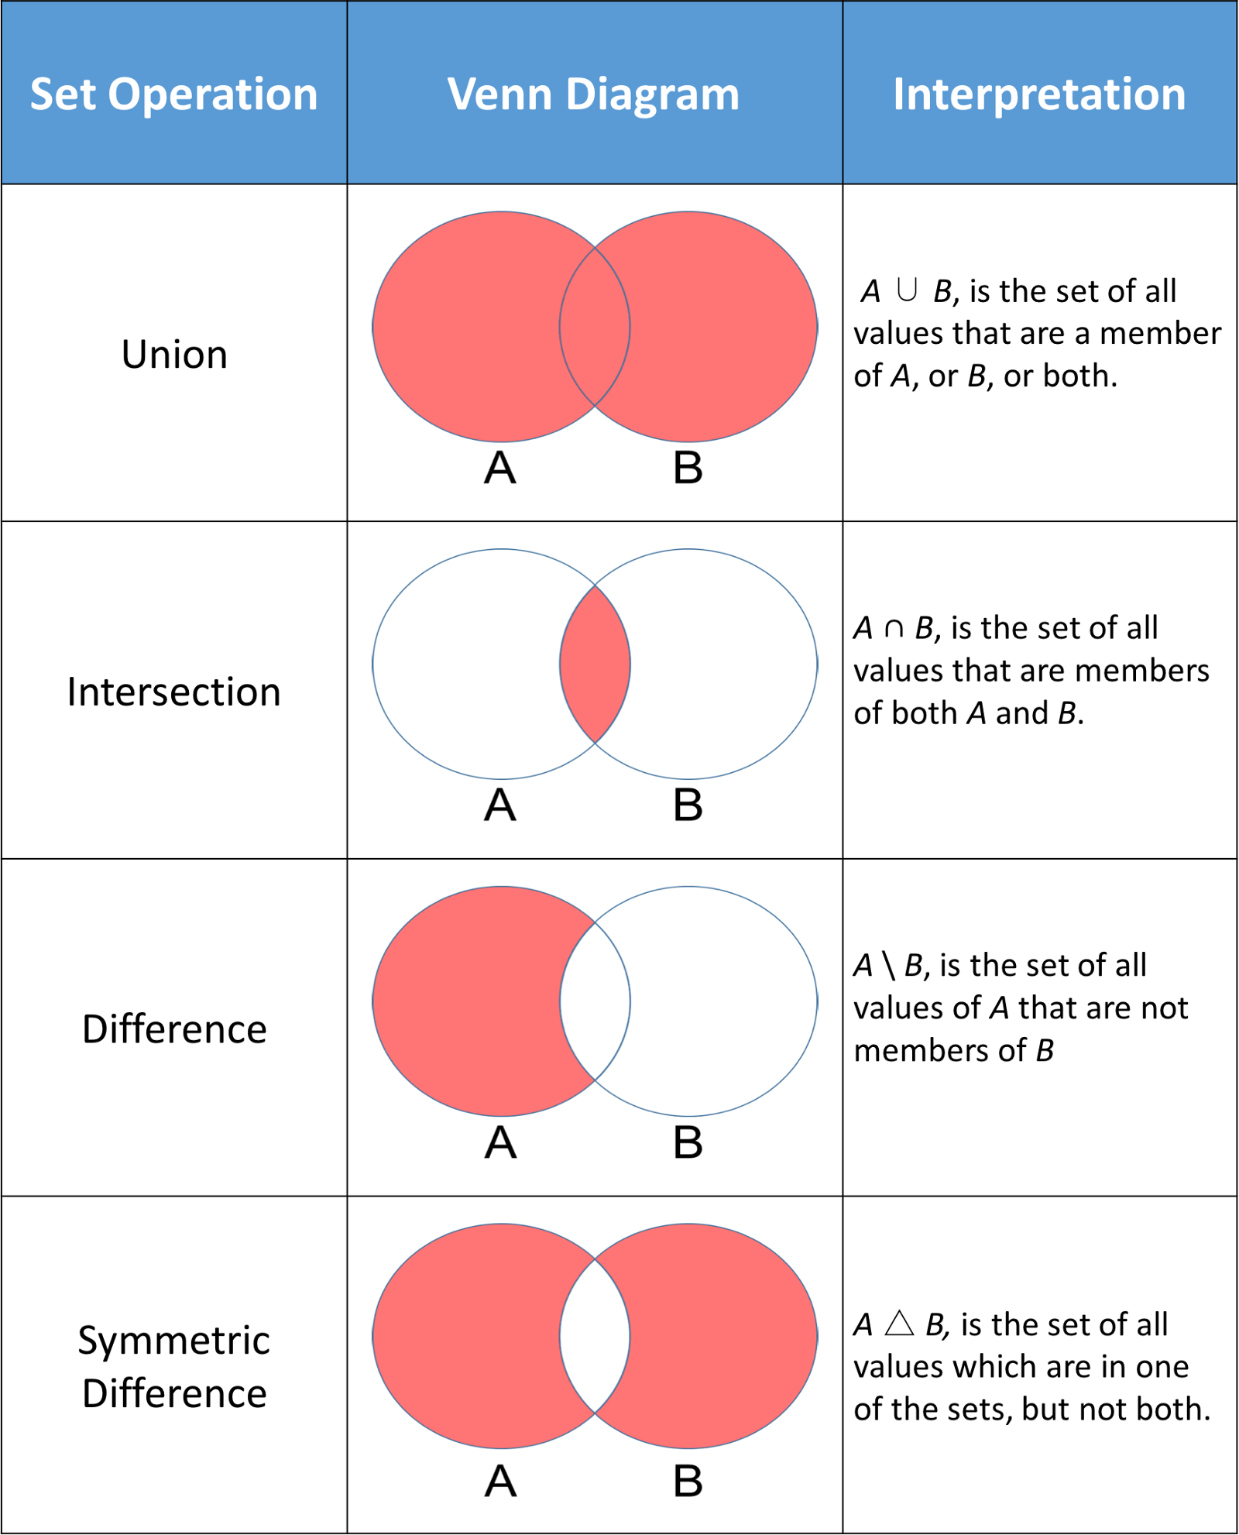
Set Operations
Source: https://www.datacamp.com/tutorial/sets-in-python

Slide 21
Set Operations
dataScientist = set(['Python', 'R', 'SQL', 'Git', 'Tableau', 'SAS'])
dataEngineer = set(['Python', 'Java', 'Scala', 'Git', 'SQL', 'Hadoop’])
dataScientist.union(dataEngineer)
dataScientist.intersection(dataEngineer)
dataScientist.difference(dataEngineer)
dataScientist.symmetric_difference(dataEngineer)
Source: https://www.datacamp.com/tutorial/sets-in-python

Slide 22

Acknowledgements / Contributions
These slides are Copyright 2010- Charles R. Severance (www.dr-chuck.com) of the University of Michigan School of Information and made available under a Creative Commons Attribution 4.0 License. Please maintain this last slide in all copies of the document to comply with the attribution requirements of the license. If you make a change, feel free to add your name and organization to the list of contributors on this page as you republish the materials.
Initial Development: Charles Severance, University of Michigan School of Information
Modification: Taehee Jeong, San Jose State University

