Slide 1
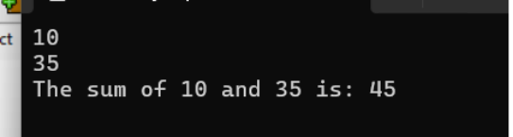
✅ Day : Basic Input/Output and Operators (2-8-2025)
1. Write a C program to add two integers.
IPO
INPUT TWO INTEGERS
PROCESS ADD THE TWO INTEGERS: SUM= A+B
OUTPUT DISPLAY THE RESULT OF THE ADDITION:SUM
#include <stdio.h>
int main()
{
int a, b, sum;
scanf("%d%d", &a,&b);
sum = a + b;
printf("The sum of %d and %d is: %d\n", a, b, sum);
return 0;
}

Slide 2
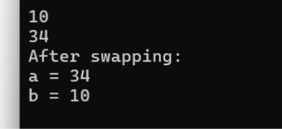
2. Write a program to swap two numbers using a temporary variable.
IPO
INPUT TWO INTEGERS
PROCESS USE A TEMPORARY VARIABLE TO SWAP THE VALUES OF A AND B
OUTPUT DISPLAY TWO VALUES OF A AND B AFTER SWAPPING
#include <stdio.h>
int main()
{
int a, b, temp;
scanf("%d%d", &a,&b);
temp = a;
a = b;
b = temp;
printf("After swapping:\n");
printf("a = %d\n", a);
printf("b = %d\n", b);
return 0;
}

Slide 3
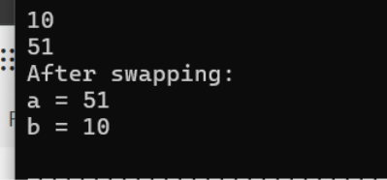
3. Write a program to swap two numbers without using a temporary variable.
IPO
INPUT TWO INEGERS
PROCESS SWAP USING ARITHMETIC OPERATION
A=A+B
B=A-B
A=A-B
OUTPUT DISPLAY TWO VALUES OF A AND B AFTER SWAPPING
#include <stdio.h>
int main()
{
int a, b;
scanf("%d%d", &a,&b);
a = a + b;
b = a - b;
a = a - b;
printf("After swapping:\n");
printf("a = %d\n", a);
printf("b = %d\n", b);
return 0;
}

Slide 4
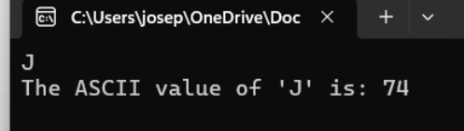
4. Write a program to find the ASCII value of a character. ​
IPO ​
INPUT A CHARACTER ​
PROCESS CONVERT THE CHARACTER TO ITS ASCII USING (int)ch ​
OUTPUT DISPLAY THE ASCII VALUE OF THE CHARACTER ​
#include <stdio.h> ​
int main() ​
{ ​
char ch; ​
int ascii; ​
scanf("%c", &ch); ​
ascii = (int)ch;
​
printf("The ASCII value of '%c' is: %d\n", ch, ascii); ​
return 0; ​
}

Slide 5
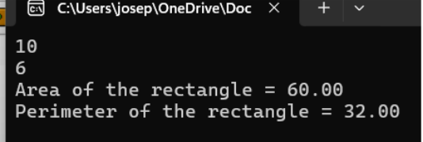
5. Write a program to calculate the area and perimeter of a rectangle.
IPO
INPUT LENGTH AND BREADTH OF THE RECTANGLE
PROCESS AREA = LENGTH X BREADTH
PERIMETER =2(LENGTH+BREADTH)
OUTPUT DISPLAY AREA AND PERIMETER
#include <stdio.h>
int main()
{
float length, breadth, area, perimeter;
scanf("%f%f", &length,&breadth);
area = length * breadth;
perimeter = 2 * (length + breadth);
printf("Area of the rectangle = %.2f\n", area);
printf("Perimeter of the rectangle = %.2f\n", perimeter);
return 0;
}

Slide 6
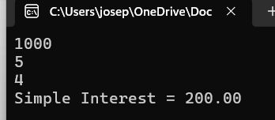
6. Write a program to compute the simple interest.
IPO
INPUT PRINCIPAL (P),RATE OF INTEREST (R),TIME (T)
PROCESS SIMPLE INTEREST=(P*R*T)/100
OUTPUT DISPLAY THE CALCULATED SIMPLE INERSET
#include <stdio.h>
int main()
{
float principal, rate, time, interest;
scanf("%f%f%f", &principal,&rate,&time);
interest = (principal * rate * time) / 100;
printf("Simple Interest = %.2f\n", interest);
return 0;
}

Slide 7
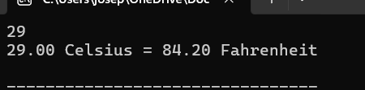
7. Write a program to convert temperature from Celsius to Fahrenheit.
IPO
INPUT TEMPERTURE IN CELSIUS
PROCESS FAHRENHEIT=(CELSIUS x9/5)+32
OUTPUT DISPLAY THE TEMPERTURE IN FAHRENHEIT
#include <stdio.h>
int main()
{
float celsius, fahrenheit;
scanf("%f", &celsius);
fahrenheit = (celsius * 9 / 5) + 32;
printf("%.2f Celsius = %.2f Fahrenheit\n", celsius, fahrenheit);
return 0;
}

Slide 8
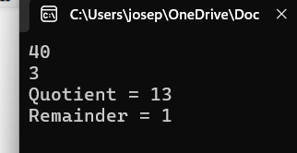
8.write a program to find the quotient and remainder of two integers.
IPO
INPUT TWO INTEGERS: DIVIDEND AND DIVISOR
PROCESS QUOTIENT =DIVIDEND/DIVISOR
REMAINDER =DIVIDEND % DIVISOR
OUTPUT DISPLAY QUOTIENT AND REMAIDER
#include <stdio.h>
int main() {
int dividend, divisor, quotient, remainder;
scanf("%d%d", &dividend,&divisor);
quotient = dividend / divisor;
remainder = dividend % divisor;
printf("Quotient = %d\n", quotient);
printf("Remainder = %d\n", remainder);
return 0;
}

Slide 9
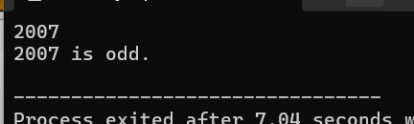
9. Write a program to check whether a number is even or odd.
IPO
INPUT AN INTEGER
PROCESS IF NUM%2==0 IS EVEN OR ODD
OUTPUT DISPLAY THE INTEGER IS EVEN OR ODD
#include <stdio.h>
int main() {
int num;
scanf("%d", &num);
if (num % 2 == 0) {
printf("%d is even.\n", num);
} else {
printf("%d is odd.\n", num);
}
return 0;
}

Slide 10
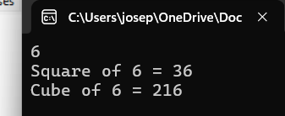
10. Write a program to calculate the square and cube of a number.
IPO
INPUT A NUMBER
PROCESS SQUARE=NUM x NUM
CUBE = NUM x NUM x NUM
OUTPUT DISPLAY THE SQUARE AND CUBE OF THE NUMBER
#include <stdio.h>
int main()
{
int num, square, cube; scanf("%d", &num);
square = num * num; cube = num * num * num;
printf("Square of %d = %d\n", num, square);
printf("Cube of %d = %d\n", num, cube);
return 0;
}

