Slide 1

Erd presentation

Slide 2
PublicPulse
Group Members:
Avin Kapolkar
Giselle Fernandes
Joseph Fernandes

Slide 3
PublicPulse ERD Breakdown
The ERD for PublicPulse includes the following entities: USER, FEEDBACK, DEPARTMENT, and COMPLAINT. The USER entity has a specialization into ADMINISTRATOR and CITIZEN, which is a partial and disjoint relationship. Next we will see a detailed explanation of each entity, its attributes, and the relationships.

Slide 4
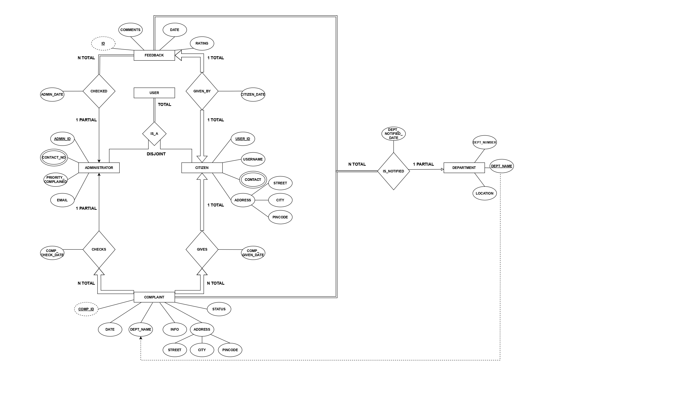

Slide 5
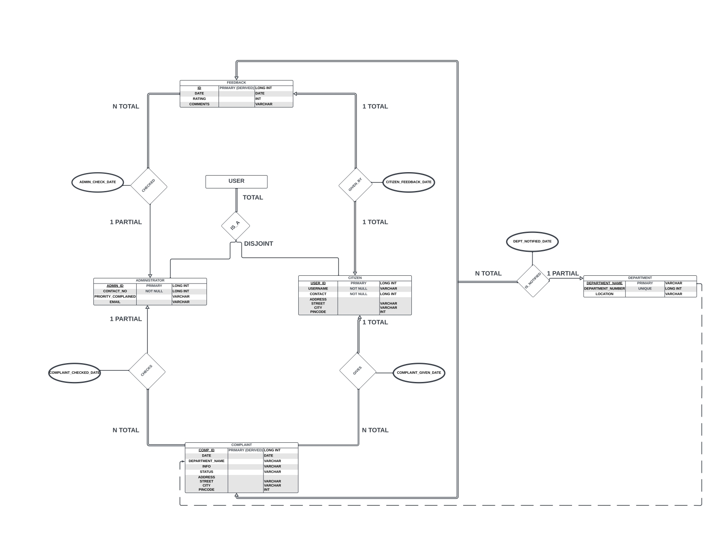

Slide 6
ERDs created using
LUCIDchart https://lucid.app/lucidchart/c6fa1d3a-e28c-4b44-8f33-5707807c329e/edit?page=0_0&invitationId=inv_33218b40-dd2f-4842-98f3-75023b3bd46a#/link
DRAW.IO https://app.diagrams.net/#G14SsBgfWVzCLqabN2-_3m_pobOh8aS3Y5#%7B%22pageId%22%3A%22OW8rCGvSUznDIYREvSvy%22%7D

Slide 7
Entities and attributes
FEEDBACK
ID: Primary key (INT) - Unique identifier for each feedback.
DATE: Date (DATE) - The date when the feedback was given.
RATING: Rating (INT) - A numerical rating provided by the user.
COMMENTS: Comments (VARCHAR) - Textual comments provided by the user.
USER
For the USER entity, there is a specialization where it is divided into ADMINISTRATORS and CITIZENS. This is a partial relationship for both, and they are disjoint.

Slide 8
Entities and attributes
ADMINISTRATOR (Specialization of USER)
ADMIN_ID: Foreign key (LONG INT) - Links to USER_ID in USER.
CONTACT_NO: Contact number (LONG INT, NOT NULL) - The administrator's contact number.
PRIORITY_COMPLAINED: Priority of complaints handled (VARCHAR) - Indicates the priority level of complaints the administrator handles.
EMAIL: Email address (VARCHAR) - The administrator's email address.
CITIZEN (Specialization of USER)
USER_ID: Primary key (LONG INT) - Unique identifier for each user.
USERNAME: Name (VARCHAR, NOT NULL) - The name of the user.
CONTACT: Contact number (INT) - The user's contact number.
ADDRESS: Address details (STREET, CITY, PINCODE) (VARCHAR) - The user's address.

Slide 9
Entities and attributes
COMPLAINT
COMP_ID: Primary key (LONG INT) - Unique identifier for each complaint.
DATE: Date (DATE) - The date when the complaint was lodged.
DEPARTMENT_NAME: Department related to the complaint (VARCHAR) - Foreign key referencing DEPARTMENT_NAME in DEPARTMENT.
INFO: Information (VARCHAR) - Details about the complaint.
STATUS: Status (VARCHAR) - The current status of the complaint (e.g., pending, resolved).
ADDRESS: Address related to the complaint (PINCODE) (VARCHAR, INT) - The address related to the complaint.
DEPARTMENT
DEPARTMENT_NUMBER: Department number (INT) - Unique identifier for each department.
DEPARTMENT_NAME: Name (VARCHAR) - The name of the department.
LOCATION: Location (VARCHAR) - The location of the department.

Slide 10
relationships
FEEDBACK to CITIZEN
1 FEEDBACK, a CITIZEN can give.
Relationship: GIVEN_BY
Cardinality: 1 to 1( One FEEDBACK is given by One CITIZEN).
CITIZEN to COMPLAINT
An CITIZEN can give multiple COMPLAINTs.
Relationship: GIVES
Cardinality: 1 to N (One CITIZEN can give many COMPLAINTs).
ADMINISTRATOR to COMPLAINT
An ADMINISTRATOR checks multiple COMPLAINTs.
Relationship: CHECKS
Cardinality: 1 to N (One ADMINISTRATOR can check many COMPLAINTs).

Slide 11
relationships
FEEDBACK TO ADMINISTRATOR
Multiple FEEDBACKs can be checked by 1 ADMINISTRATOR
Relationship: CHECKED
Cardinality: N to 1 (Multiple FEEDBACKs can be checked by One ADMINISTRATOR).
DEPARTMENT to COMPLAINT
A DEPARTMENT can be notified with multiple COMPLAINTs.
Relationship: IS_NOTIFIED
DEPARTMENT_NAME in DEPARTMENT is a foreign key in COMPLAINT.
Cardinality: 1 to N (One DEPARTMENT can have many COMPLAINTs).

Slide 12
Conclusion
The PublicPulse ERD efficiently structures key entities—USER, FEEDBACK, DEPARTMENT, and COMPLAINT—with clear attributes and relationships. It specializes USER into ADMINISTRATOR and CITIZEN for role-specific data. Defined relationships and use of primary and foreign keys ensure data integrity and streamlined handling, making it a robust framework for managing interactions and responses within the portal.

Slide 13
Thank you

