Slide 1
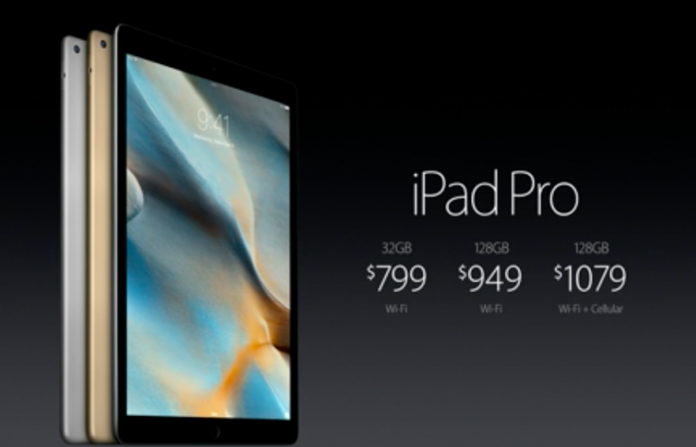
Pics
News
Upload
Technology
Login
Sign
Notes:
Home page

Slide 2


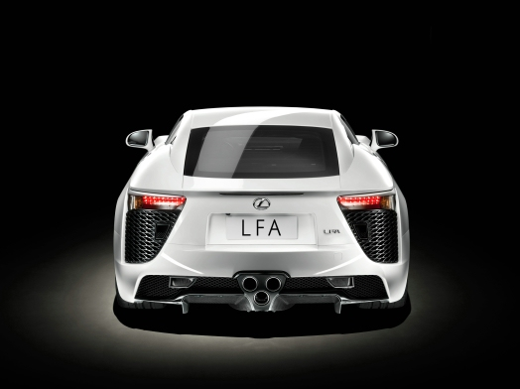

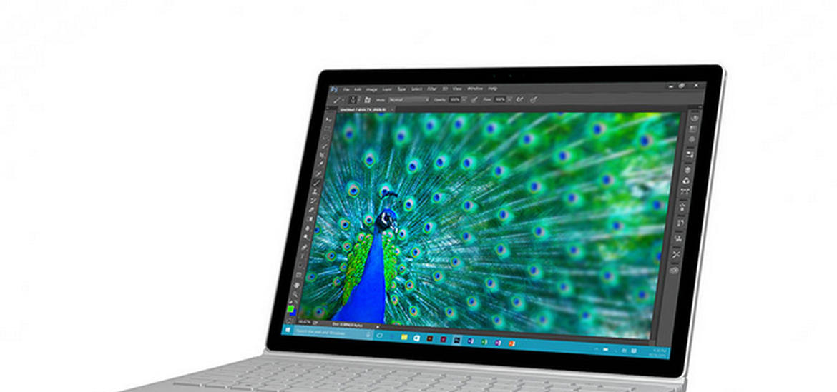

Pics
News
Upload
Technology
Notes:
User’s home page

Slide 3
Pics
News
Upload
Technology
News
Article 1
Article 2
Article 3
Article 4
Article 5
Notes:
News

Slide 4
Pics
News
Upload
Technology
Upload your photos here!
Browse
Notes:
Upload photos

Slide 5
Pics
News
Upload
Technology
Technology
Technology used on this website….
Notes:
Technology

Slide 6
Pics
User Name
Password
Sign In
Or
Create Account
Notes:
Sign in screen

Slide 7
Pics
Login
Create an Account
Choose your username
Create a password
Confirm your password
Create
Notes:
Sign up

