Slide 1
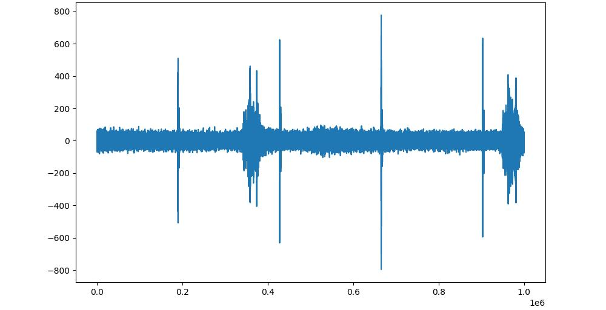
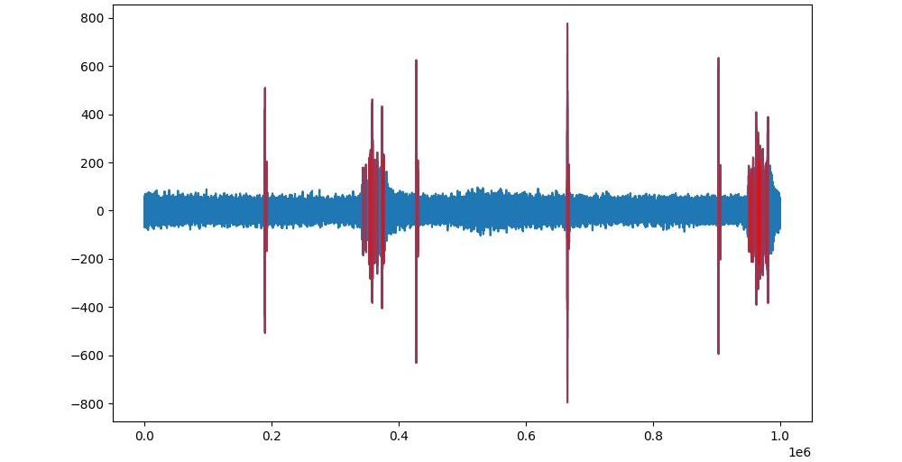
Raw data (blue):
Raw data (blue) & detections (red)

