Slide 1

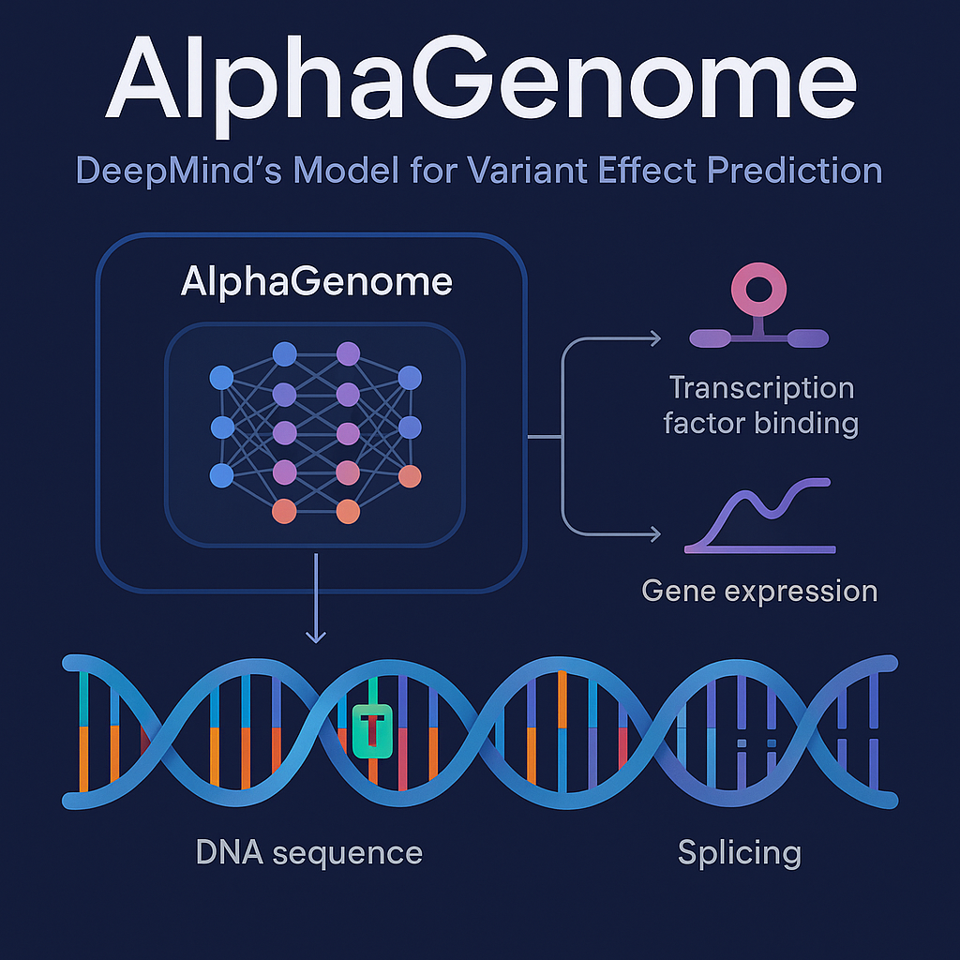
AlphaGenome
From Paper to Practice
DII Bioinformatics Club
Luxembourg Institute of Health
Joseph & Oliver
Notes:
Welcome everyone to the DII Bioinformatics Club session on AlphaGenome. Three parts: paper, Python tutorial, and hands-on app demo.

Slide 2



Session Overview
2 hours · 3 components · No prior coding or reading required
PART 1 · 30 MIN
The Paper
How the model was built, what it predicts, and why it matters for variant interpretation
PART 2 · 30 MIN
Python Tutorial
Walk through the getting-started script focusing on variant effect prediction with the SDK
PART 3 · 30 MIN
App Demo & Exploration
Hands-on with the AlphaGenome Explorer app — run predictions across all four modules
DII Bioinformatics Club | Luxembourg Institute of Health
Notes:
Overview of the three session parts. Emphasise no prior reading or coding needed.

Slide 3

PART 1 · THE MODEL
The Paper
Understanding how AlphaGenome was built and what it predicts

Slide 4
The Challenge
Non-coding = hard to interpret
>98%
Variants can affect chromatin, expression, splicing, TF binding, 3D structure — all in tissue-specific ways
Experimental validation is slow
of human genetic
variants are
non-coding
Can't functionally test every variant in every tissue; computational prediction is essential
Existing models face trade-offs
Halldorsson et al., Nature 2022
Long context OR high resolution OR multi-modality — pick two. No model unified all three before AlphaGenome
Avsec, Latysheva, Cheng et al. Nature (2026)
DII Bioinformatics Club | Luxembourg Institute of Health
Notes:
Key context: >98% variants non-coding. Existing models trade off length vs resolution vs modalities.

Slide 5
The Trade-off Landscape Before AlphaGenome
Model | Input Length | Resolution | Modalities | Limitation
SpliceAI | 10 kb | 1 bp | Splicing only | Short context, single modality
Enformer | 200 kb | 128 bp bins | Multi-modal | Coarse resolution
Borzoi | 500 kb | 32 bp bins | Multi-modal | Still binned, no splicing junctions
ChromBPNet | ~2 kb | 1 bp | Chromatin only | Very short, single modality
AlphaGenome | 1 Mb | 1 bp | 11 output types | Unified — all three
AlphaGenome is the first model to unify long-range context (1 Mb), base-pair resolution, and broad modality coverage in a single framework.
DII Bioinformatics Club | Luxembourg Institute of Health
Notes:
Walk through each row. Key takeaway: AlphaGenome is the first to unify all three dimensions.

Slide 6
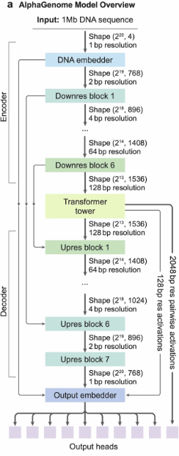
Model Architecture
INPUT
ENCODER
1 Mb DNA
sequence
+ species ID
→
U-Net
downsampling
131 kb chunks
→
DECODER + HEADS
→
TRANSFORMER
U-Net upsampling
→ task-specific
output heads
Cross-device
attention
(long-range)
Predicted Output Types (5,930 human tracks / 1,128 mouse tracks)
DII Bioinformatics Club | Luxembourg Institute of Health
Notes:
Key: U-Net + Transformer architecture. Sequence parallelism splits 1Mb into 131kb chunks. Multiple resolution output heads.

Slide 7
What is a Neural Network? Where Does the Transformer Fit?
AlphaGenome is a neural network — software that learns patterns from data. Here's its overall shape:
ENCODER
TRANSFORMER
DECODER
1 Mb DNA sequence
(raw A, T, G, C)
Convolutional layers
(local pattern detection)
Downsample
(compress sequence)
Transformer
(long-range connections)
Upsample
(expand back out)
Convolutional layers
(refine predictions)
Predicted tracks
(RNA-seq, DNASE, etc.)
→
→
→
→
→
→
Encoder (Convolutions)
Transformer (Attention)
Decoder (Convolutions)
Scans the DNA in small windows, detecting local patterns like transcription factor binding motifs. Compresses the sequence down to a smaller representation — like summarising a book chapter by chapter.
Works on the compressed representation. Lets every part of the sequence "look at" every other part and learn which distant regions influence each other. This is where long-range regulatory logic is captured.
Expands the representation back to full resolution (up to 1 base pair) and produces the final predictions — one track value per position per assay type and tissue.
The Transformer sits in the middle of the network, working on a compressed view of the full 1 Mb sequence. This is where the model learns which distant parts of the genome influence each other.
DII Bioinformatics Club | Luxembourg Institute of Health
Notes:
Frame the network as three stages: compress, reason, expand. Convolutions = local pattern scanning (like reading nearby words). Transformer = long-range reasoning (connecting ideas across a whole book). Decoder = reconstructing the full-resolution output. The Transformer sits in the middle, on a compressed representation.

Slide 8
How Does Attention Work?
Each node in the Transformer can connect its output to nodes covering any other part of the sequence
Without Attention — Local Connections Only
With Attention — Every Node Connects to All
Output
nodes
Output
nodes
Each node only sees its close
neighbours. A node at position 1
cannot directly influence the
output at position 7.
Every output node can draw
on information from every
input position. The model
learns which connections
matter from the data.
Input
positions
Input
positions
pos 1
pos 2
pos 3
pos 4
pos 5
pos 6
pos 7
pos 1
pos 2
pos 3
pos 4
pos 5
pos 6
pos 7
In AlphaGenome, the 1 Mb input is split into chunks. The Transformer's attention lets nodes covering one chunk connect to nodes covering a distant chunk — so a regulatory element far from a gene can still influence the prediction at that gene.
DII Bioinformatics Club | Luxembourg Institute of Health
Notes:
Key point: in the left panel, each output node only receives information from its immediate neighbours. In the right panel, every output node can receive information from ALL input positions. The model learns WHICH connections are important by training on real experimental data. The teal highlighted lines show that position 1 and position 7 — representing distant parts of the genome — can directly influence each other's outputs. This is how AlphaGenome captures long-range regulatory interactions.

Slide 9
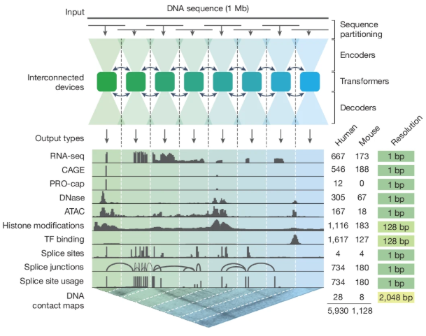
Model Architecture
INPUT
ENCODER
1 Mb DNA
sequence
+ species ID
→
U-Net
downsampling
131 kb chunks
→
DECODER + HEADS
→
TRANSFORMER
U-Net upsampling
→ task-specific
output heads
Cross-device
attention
(long-range)
Predicted Output Types (5,930 human tracks / 1,128 mouse tracks)
DII Bioinformatics Club | Luxembourg Institute of Health
Notes:
Key: U-Net + Transformer architecture. Sequence parallelism splits 1Mb into 131kb chunks. Multiple resolution output heads.

Slide 10
Model Architecture
Predicted Output Types (5,930 human tracks / 1,128 mouse tracks)
Output Type | Category | Resolution | Output Type | Category | Resolution
RNA-seq | Gene expression | 1 bp | ChIP-TF | TF binding | 128 bp
CAGE | Transcription start | 1 bp | Splice sites | Splicing | 1 bp
DNASE | Chromatin access. | 1 bp | Splice junctions | Splicing | 1 bp
ATAC | Chromatin access. | 1 bp | PRO-cap | TSS initiation | 1 bp
ChIP-Histone | Epigenomics | 128 bp | Contact maps | 3D structure | 2048 bp
DII Bioinformatics Club | Luxembourg Institute of Health
Notes:
Key: U-Net + Transformer architecture. Sequence parallelism splits 1Mb into 131kb chunks. Multiple resolution output heads.

Slide 11

Benchmark Performance
25/26
22/24
variant effect
prediction tasks
genome track
prediction tasks
Best or matching best available model
State-of-the-art track accuracy
Highlights from the paper
Trained on human and mouse genomes simultaneously (GRCh38 + mm10)
Cross-modality analysis recapitulates known mechanisms at TAL1 oncogene locus
Quantile-calibrated scoring enables comparison across all assay types and tissues
DII Bioinformatics Club | Luxembourg Institute of Health
Notes:
25 of 26 variant effect tasks. Mention TAL1 case study briefly — shows cross-modality power.

Slide 12

PART 2 · THE CODE
Python Tutorial
Walking through the AlphaGenome SDK — focus on variant analysis

Slide 13


How Do We Talk to AlphaGenome?
The model runs on Google's servers — we send requests and get predictions back
Your Computer
DeepMind Server
What you need
✓ Python installed
✓ alphagenome
package
✓ An API key
(like a password)
Python notebook
running on your laptop
Sends a request:
"Predict RNA-seq for
this variant in colon"
API request →
Runs the full
AlphaGenome model
Processes 1 Mb of DNA
through the neural network
and returns track predictions
← predictions
https://deepmind.google.com/science/alphagenome/api
What is an API?
API = Application Programming Interface. Think of it like ordering at a restaurant:
You (the customer) write your order on the menu — "I'd like RNA-seq predictions for this variant in colon tissue"
The kitchen (DeepMind's server) does all the heavy computation — runs the neural network on massive hardware
The waiter (the API) carries your order to the kitchen and brings back the results — you never need to know how the kitchen works
DII Bioinformatics Club | Luxembourg Institute of Health
Notes:
Key message: you don't need a powerful computer. The heavy computation runs on Google's hardware. Your laptop just sends requests and receives results via the API. The API key authenticates you — like a login. The Python SDK wraps the API calls so you write simple Python functions instead of raw HTTP requests.

Slide 14

Activity: Work Through the Notebook
Open the notebook and run each cell one at a time — read the explanations as you go
1
Set up your environment
~3 min
Install Positron, VS Code, or another notebook IDE.
Then install Python if you don't have it already.
2
Open the notebook & install the SDK
~2 min
Open AlphaGenome_VariantAnalysis_Tutorial.ipynb
Run the first cell to install the alphagenome package.
3
Run cells one by one
~15 min
Work through Steps 1–5 in the notebook, running each
cell and reading the markdown explanations between them.
4
Explore the REF vs ALT plot
~3 min
When you reach the plot — pause and look at it.
Can you see the expression change? The exon skipping?
✦
Finished early? Experiment!
bonus
Try changing the gene, the variant position, or the tissue.
What happens if you predict for liver instead of colon?
💡 Don't worry about understanding every line of code — focus on what each step does biologically | 🙋 Raise your hand if you get stuck!
Notes:
This is the sit-on slide for ~25 minutes while participants work through the notebook. Walk around the room helping. Key issues that may come up: API key not set correctly, pip install failing (network issues), GTF download taking a while on first run. The predict_variant call takes ~30-60 seconds — reassure them this is normal. Step 6 (scoring) is currently not working so they can skip it. The bonus step is for faster participants — encourage them to try a different tissue or variant.

Slide 15

PART 3 · THE APP
AlphaGenome Explorer
Hands-on exploration with the DII app — no coding required

Slide 16
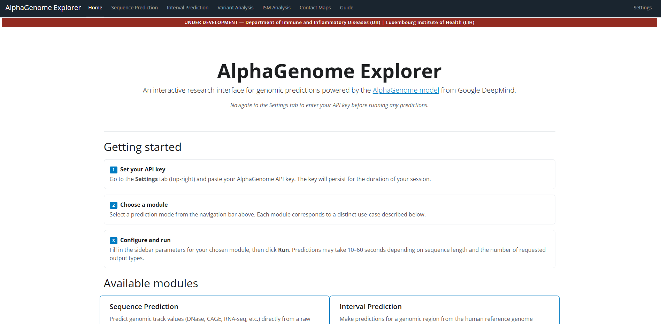
AlphaGenome Explorer — Overview
A no-code web interface wrapping the AlphaGenome API into four prediction modules
http://10.101.0.70:8080/
Notes:
Quick overview of 4 modules. Remind everyone to set the API key first in Settings.

Slide 17

AlphaGenome Explorer — Overview
A no-code web interface wrapping the AlphaGenome API into four prediction modules
First step: go to Settings tab → paste your API key → click Save Key. A green confirmation will appear.
Test It is working with a call with the Sequence Prediction tab.
Look at the guide page to see the training datasets.
Scoreable Output Types (usable in Variant Analysis & ISM)
Plot-only:
ATAC
CAGE
DNASE
RNA_SEQ
CHIP_HISTONE
CHIP_TF
SPLICE
SITES
SPLICE
SITE_USAGE
SPLICE
JUNCTIONS
PROCAP
DII Bioinformatics Club | Luxembourg Institute of Health
Notes:
Quick overview of 4 modules. Remind everyone to set the API key first in Settings.

Slide 18
Hands-On Group Exercise
4 groups · 1 module each · Explore, then teach the rest of us
Interval Prediction
Phase 1 · 10 minutes
1
Gene: RBM20 | Try different tissues
and output types
Which tissue/organ shows the strongest
expression for RBM20? Why might that matter?
Explore your module
Run the suggested example first,
then experiment — change tissues,
output types, parameters. Try to
understand what the output means.
Variant Analysis
2
chr22 : 36,201,698 A→C | RNA_SEQ
Colon Transverse | Explore scores table
What effect does this variant have on
gene expression? Which gene is affected?
▼
ISM Analysis
Phase 2 · 5 min × 4 groups
3
chr20 : 3,753,200 | DNASE | K562
256 bp | Context: 16 KB
Report back to the group
Which positions matter most? What might
the tall letters in the logo represent?
• What does this module do?
• What did you observe?
• How could an immunologist use this?
Contact Maps
4
Try A gene of interest
What does the model predict? What is Hi-C? What are the different output about?
Total: ~35 minutes
DII Bioinformatics Club | Luxembourg Institute of Health
Notes:
7 students, 4 groups (2+2+2+1). Each group gets one module. Phase 1: 15 min to explore — run the suggested example, then experiment with settings. Phase 2: 5 min per group to present what their module does, what they observed, and how an immunologist could use it. RBM20 is the interval prediction example — students saw this protein at the DII meeting. It's a splicing regulator highly expressed in heart, so they should discover heart/cardiac tissue shows the strongest signal.

Slide 19





AlphaGenome Explorer — Overview
A no-code web interface wrapping the AlphaGenome API into four prediction modules
Sequence
Prediction
Interval
Prediction
Variant
Analysis
ISM
Analysis
Contact Maps
Predict from raw DNA text.
No coordinates needed.
Predict for a gene or
genomic region (hg38).
Compare REF vs ALT
allele predictions + scores.
Saturate all bases to find
important positions.
Hi-C style chromatin maps
DII Bioinformatics Club | Luxembourg Institute of Health
Notes:
Quick overview of 4 modules. Remind everyone to set the API key first in Settings.

Slide 20
Thank You
Resources
Paper: nature.com/articles/s41586-025-10014-0
Docs: alphagenomedocs.com
Quick start notebook: alphagenomedocs.com/tutorials
DII Bioinformatics Club | Luxembourg Institute of Health
Notes:
Thank everyone. Point to resources. Remind about feedback / future sessions.

Slide 21
Two-Phase Training Strategy
Phase 1: Pretraining
Phase 2: Distillation
Train on experimental data
• Sample 1 Mb DNA intervals from cross-validation folds
• Augment with shifts + reverse complement
• Train against observed experimental targets (ChIP, RNA-seq, etc.)
• Produces fold-specific teacher models
Optimise for variant prediction
• Student model learns from frozen all-fold teachers
• Input sequences are mutationally perturbed (not just natural DNA)
• Student sees how predictions change with mutations
• Yields single model for variant scoring
→
Key insight: distillation with mutated sequences teaches the model how variants shift predictions — critical for clinical variant interpretation.
DII Bioinformatics Club | Luxembourg Institute of Health
Notes:
Two phases: pretrain on real data, then distill with mutations. Distillation is what makes variant scoring work well.

Slide 22
Key Figures from the Paper
These figures are best shown directly from the paper during the session.
Figure 1
Architecture & performance overview
Model architecture diagram, pretraining/distillation pipeline, and bar charts showing relative improvement over competing models
Figure 2
Track prediction examples
HepG2 multi-modal predictions (RNA-seq, ATAC, DNase, ChIP, contacts, splicing) aligned to a 1 Mb region
Figure 3–5
Modality deep-dives
Splicing (SpliceAI comparison), gene expression (eQTL benchmarks), chromatin accessibility (caQTL/dsQTL)
Figure 6
Cross-modality variant interpretation
TAL1 oncogene case study — variant effects visualised across all modalities simultaneously
Suggestion: open the paper side-by-side and walk through Figure 1a (architecture) and Figure 2a (HepG2 predictions) live.
DII Bioinformatics Club | Luxembourg Institute of Health
Notes:
Use this as a guide. Open the Nature paper and show these figures directly — much better than screenshots in slides.

