Slide 1

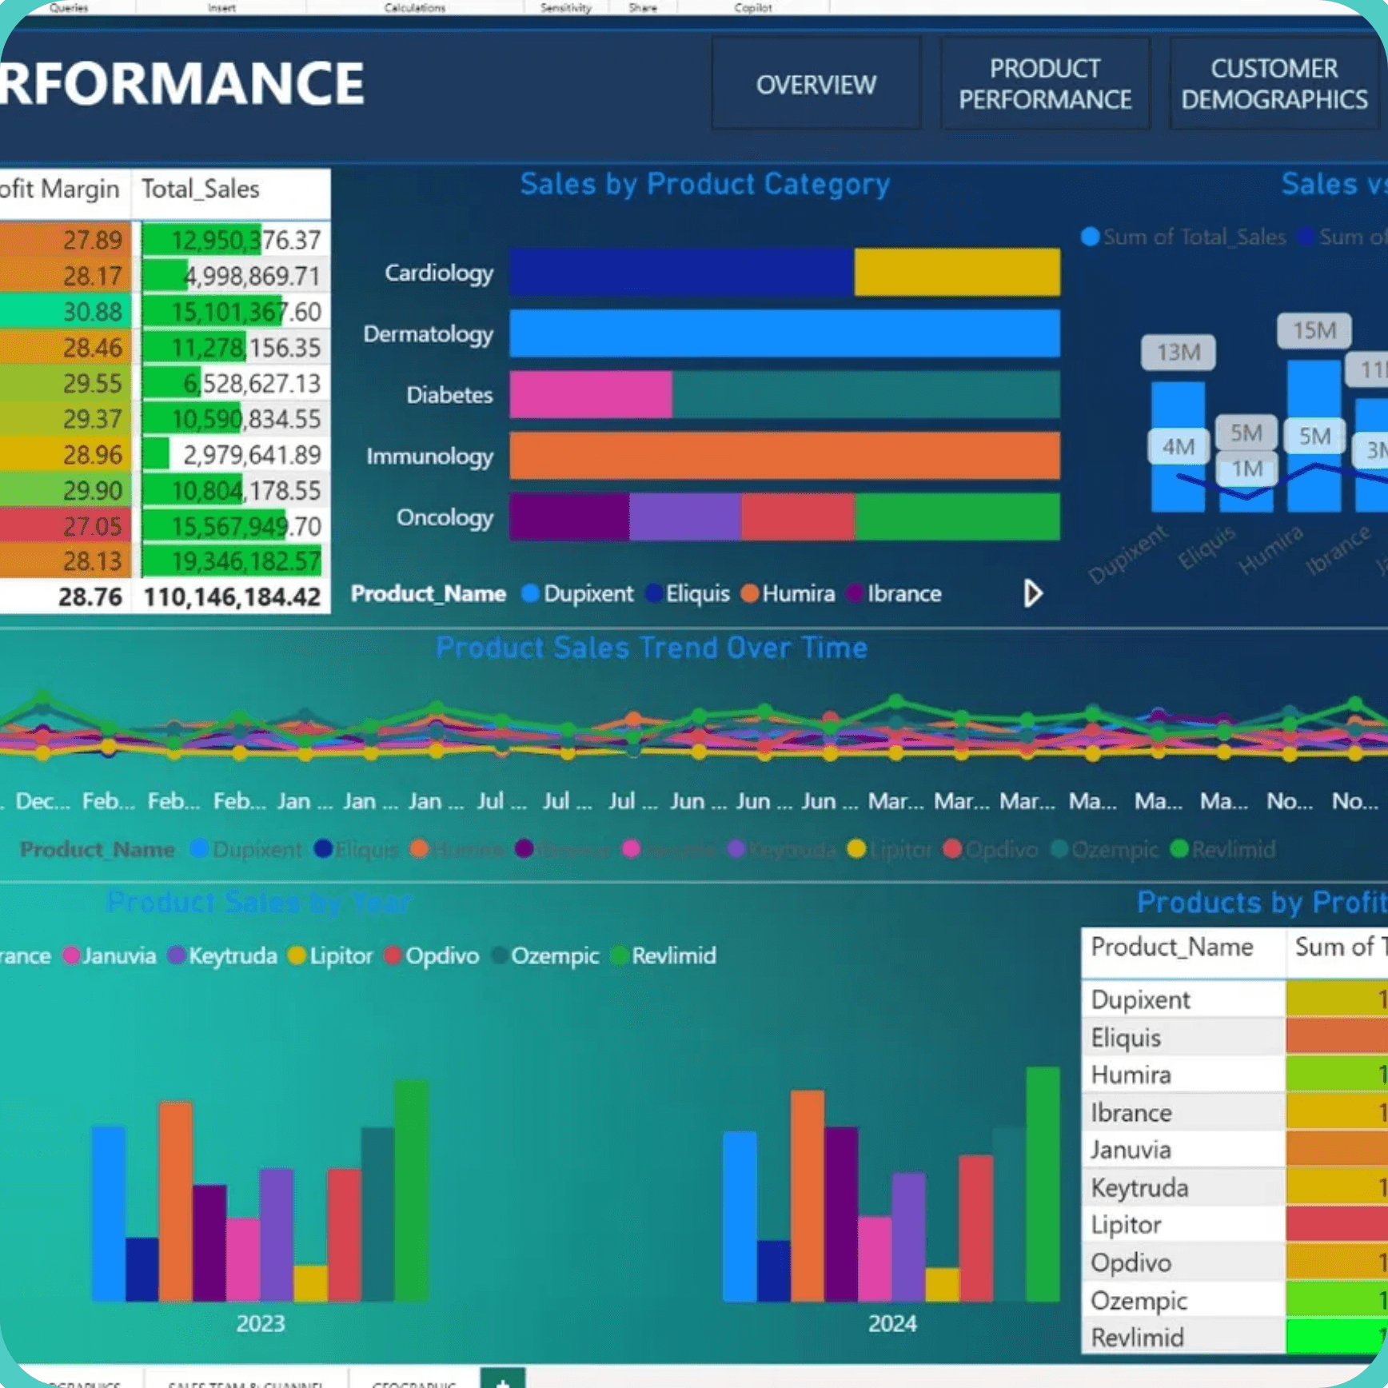
Pharmaceutical Sales Data Analysis
From Raw Data to Actionable Business Insights
A Graduation Project Presentation
Team Members:
Joseph Maher
Kholoud Rashad
Ahmed Ashraf
Yehia Elhaytham
Nourhan Hashad
Date: [Date]

Slide 2


Acknowledgement and Appreciation
This project was conducted under the guidance and support of the **DEPI Team**. We extend our sincere gratitude for the invaluable resources and framework provided.
A special thank you to our helpful and excellent instructor, Menna Selim, for her continuous mentorship and expertise throughout this graduation project.
- The Project Team

Slide 3

Presentation Outline: A Structured Approach to Data-Driven Insights
1
Pharmaceutical Sales Data Analysis (Title)
2
Acknowledgement (DEPI Team & Instructor)
3
Project Introduction & Objectives
4
Data Cleaning & Preparation (SQL)
5
Exploratory Data Analysis (Excel Pivot)
6
Visualizing Key Trends (Excel Charts)
7
Interactive Dashboards (Power BI)
8
Key Sales Insights & Summary
9
Conclusion & Future Work
10
Thank You and Discussion

Slide 4

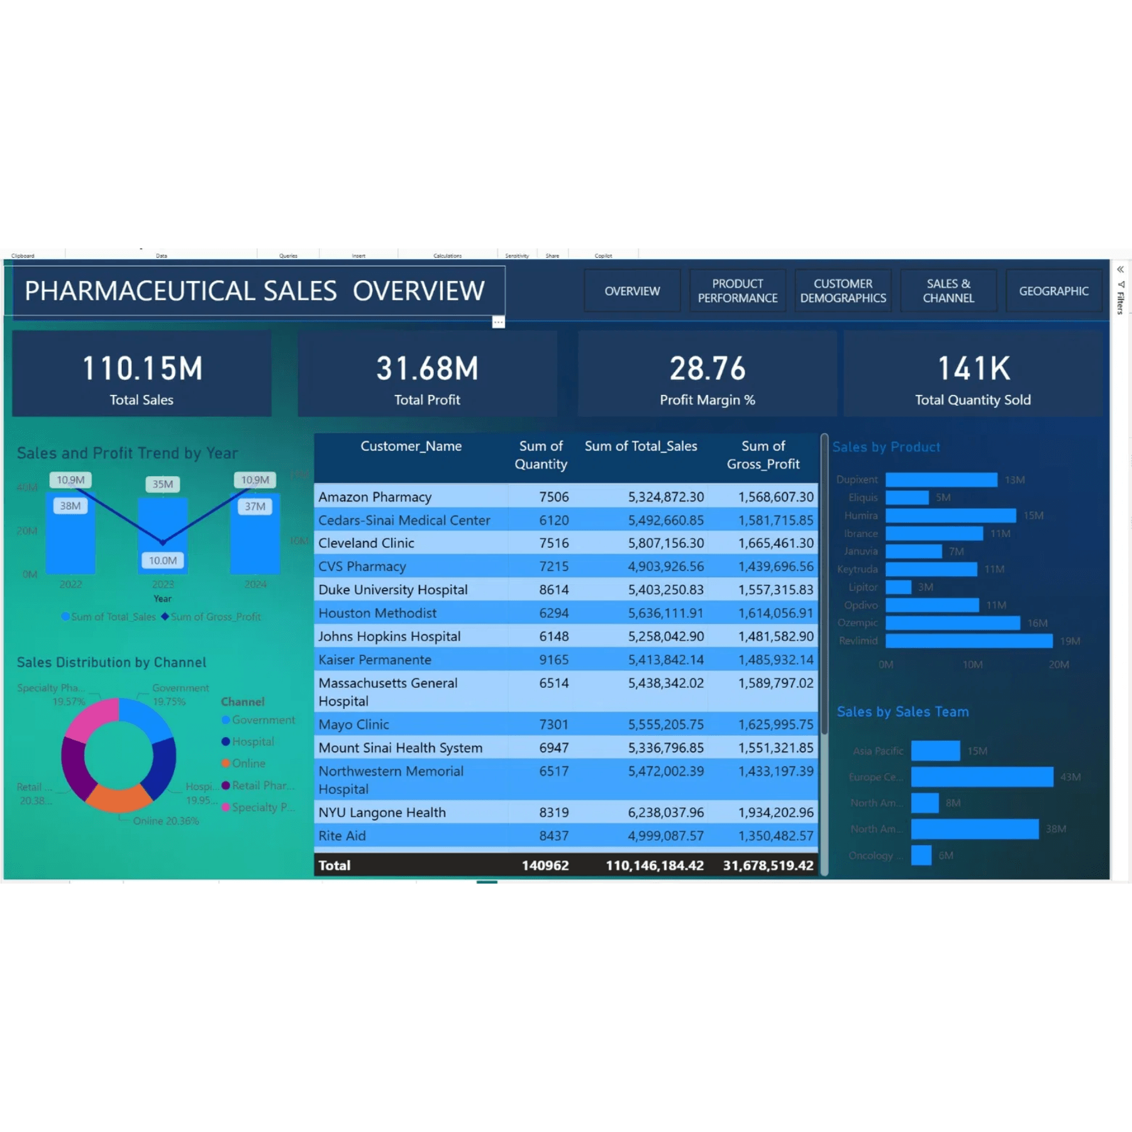
Project Introduction: Transforming Sales Data into Strategic Intelligence
The core objective of this project is to leverage advanced data analysis techniques to extract meaningful patterns from pharmaceutical sales data. This analysis aims to support strategic decision-making in areas such as inventory management, sales forecasting, and market penetration.
Key Objectives
Identify Sales Trends: Determine temporal and regional variations in product sales.
Optimize Data Quality: Implement robust cleaning procedures to ensure reliable analysis.
Develop Interactive Tools: Create dynamic dashboards for ongoing business intelligence.
Derive Actionable Insights: Provide evidence-based recommendations to enhance sales performance.

Slide 5

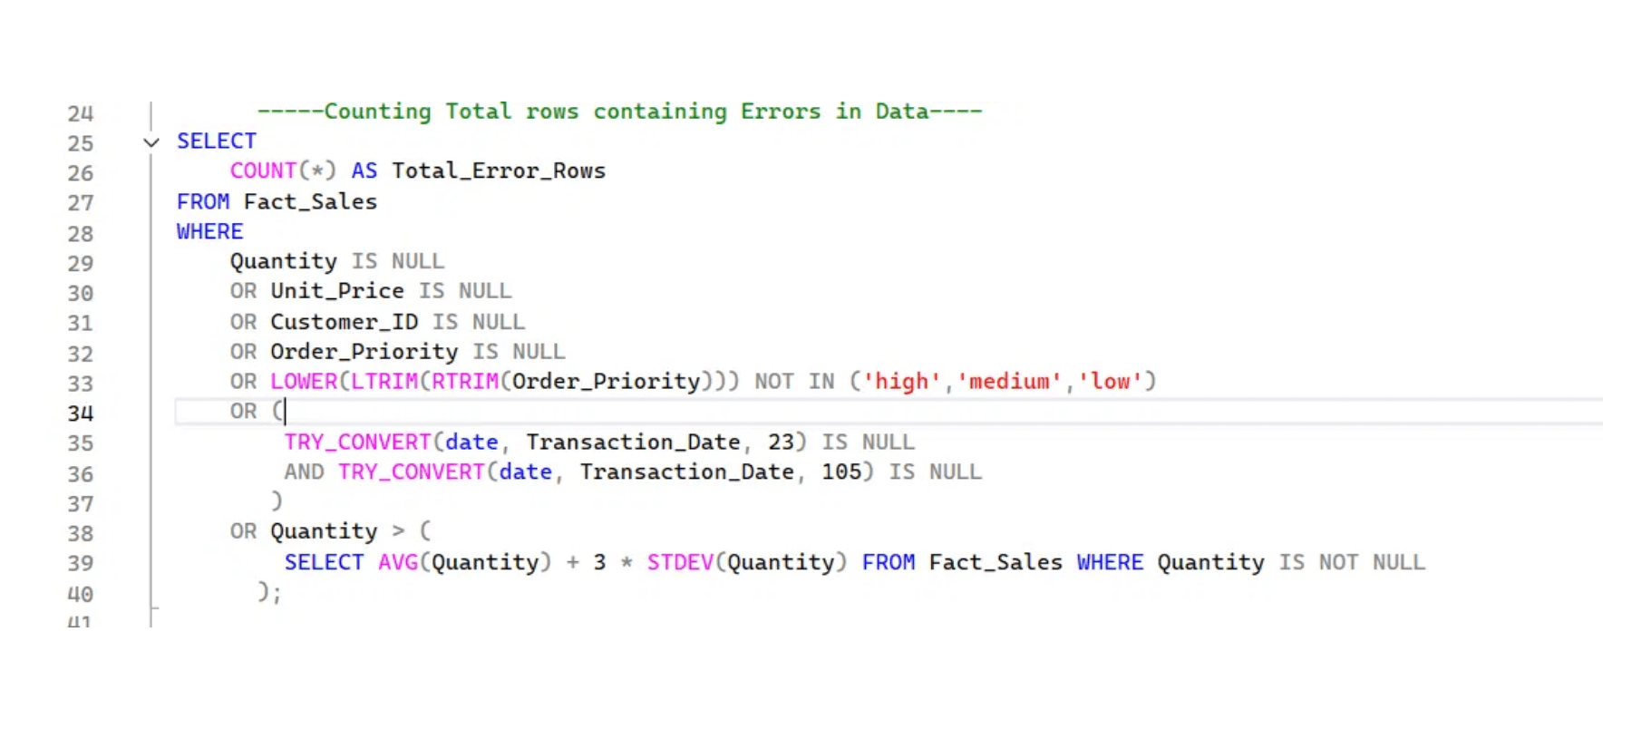
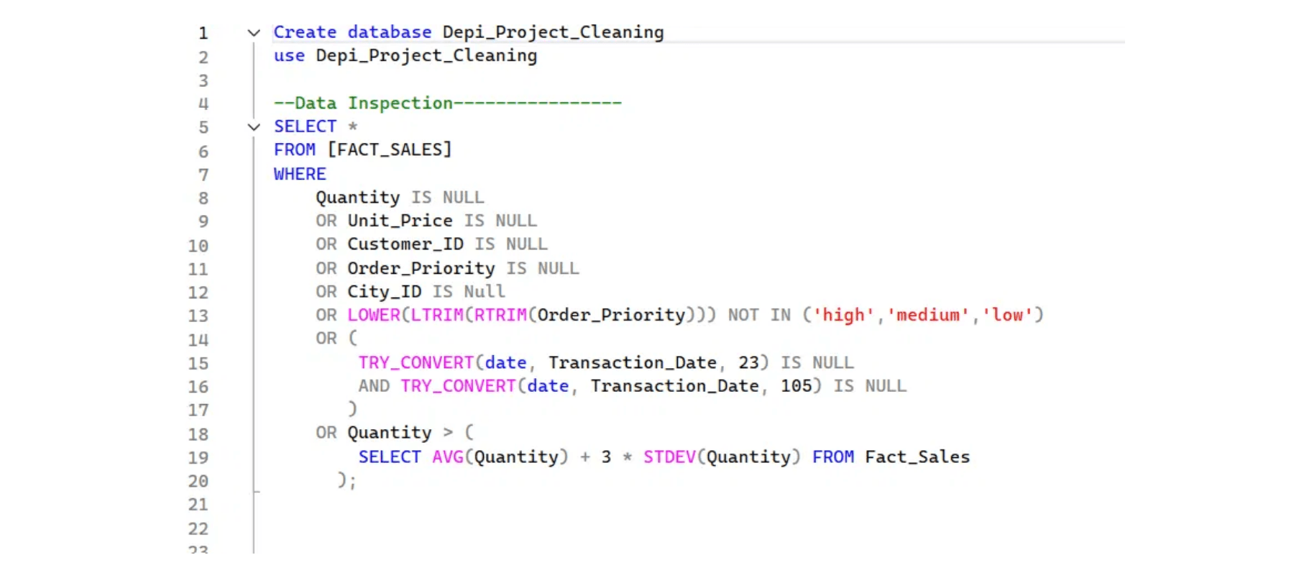
Stage 1: Data Cleaning and Integrity with SQL
Data integrity is paramount for reliable analysis. The initial phase involved utilizing SQL to systematically clean and prepare the raw sales data. This process ensures that all subsequent analyses are built upon a solid, consistent foundation.
Core SQL Operations
Standardization and Formatting: Ensuring consistency across date formats, product names, and unit measures.
Missing Value Imputation: Strategically handling null or missing entries to prevent bias.
Deduplication: Identifying and removing redundant records to maintain data accuracy.
Data Transformation: Creating new fields (e.g., calculating profit margins) essential for advanced analysis.

Slide 6

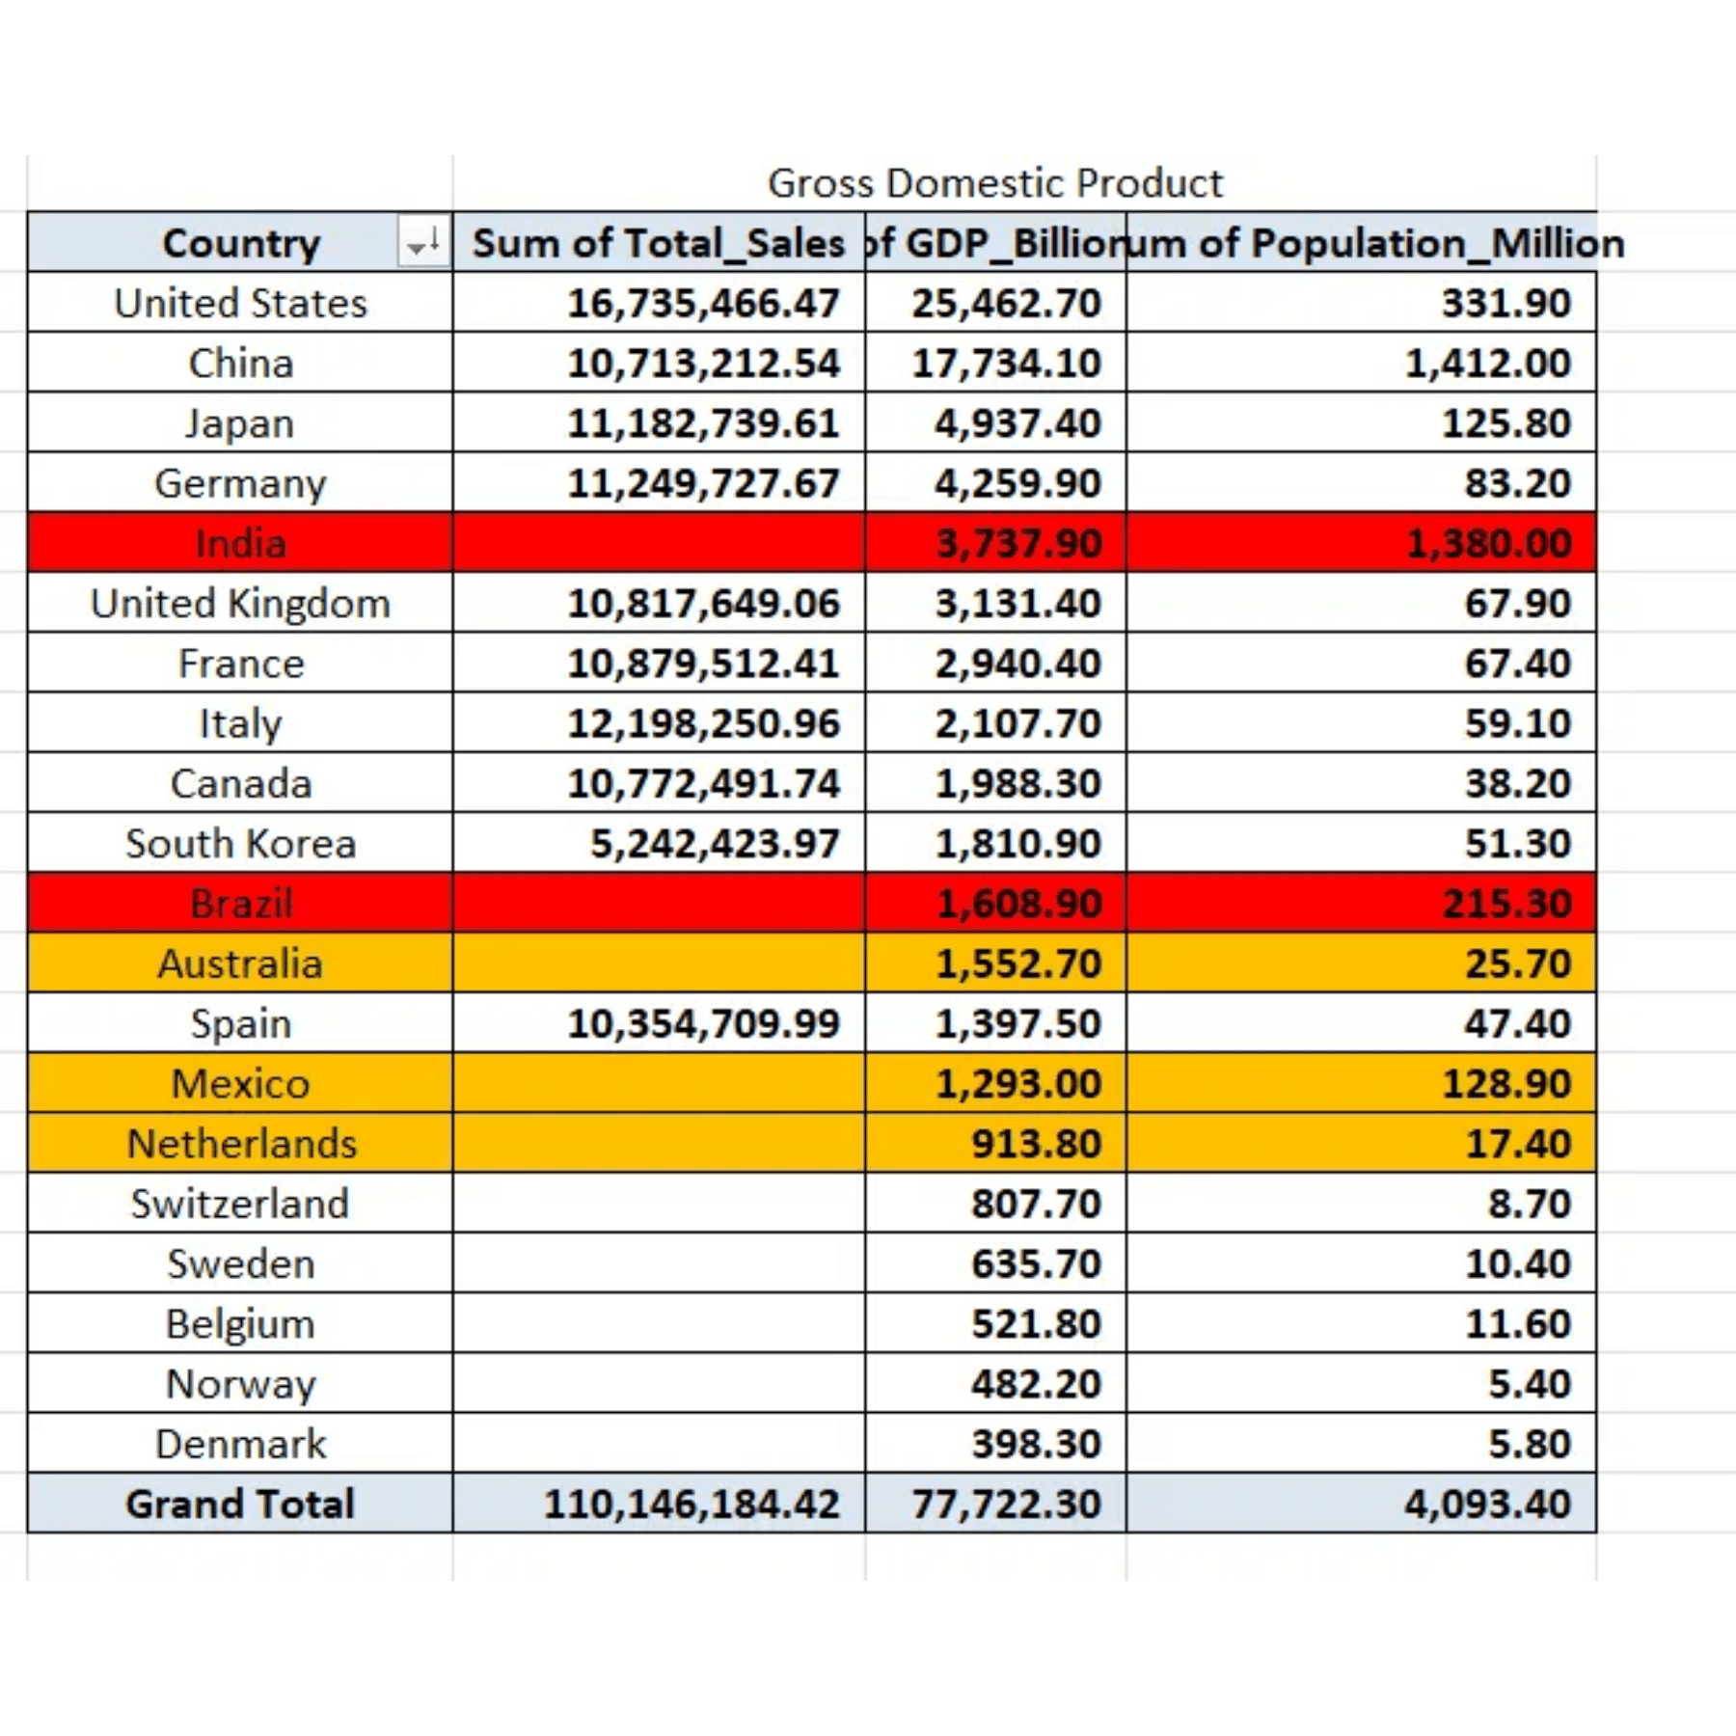
Stage 2: Exploratory Data Analysis and Aggregation in Excel
Following the cleaning phase, Microsoft Excel was employed for exploratory data analysis (EDA). This stage focused on rapid aggregation and summarization using **Pivot Tables** to uncover initial trends and anomalies in the pharmaceutical sales data.
Key Pivot Table Analysis
Sales by Category: Aggregating total sales and quantity sold across different pharmaceutical categories.
Regional Performance: Summarizing sales metrics for various geographical regions to identify top performers.
Time-Series Aggregation: Grouping data by month and quarter to observe seasonality and growth patterns.

Slide 7

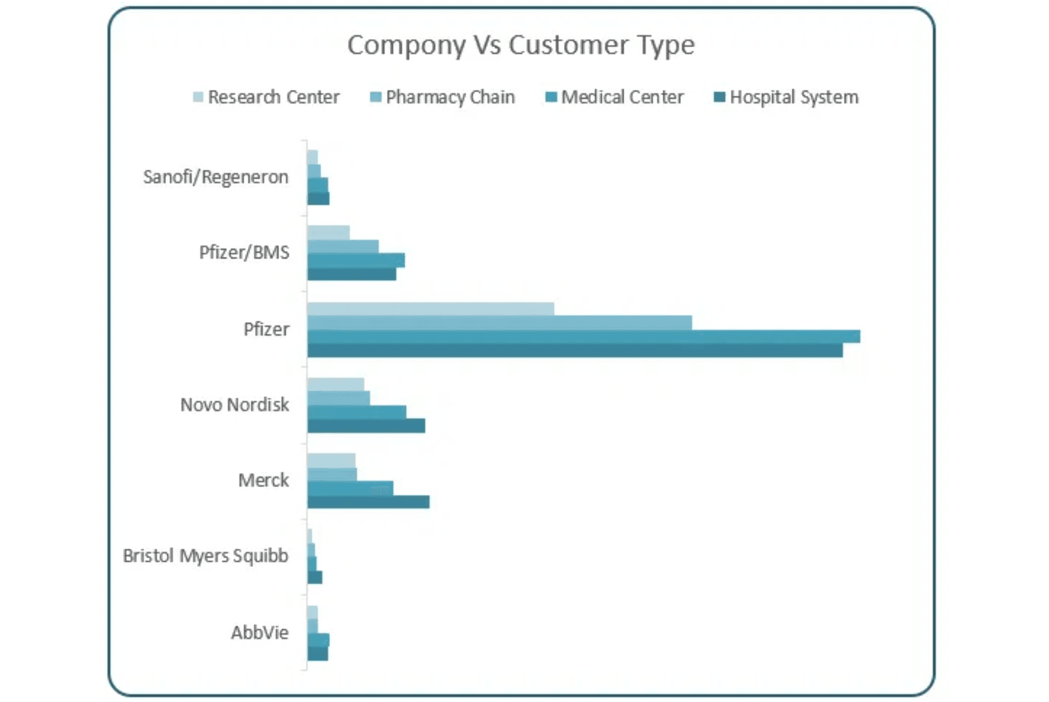
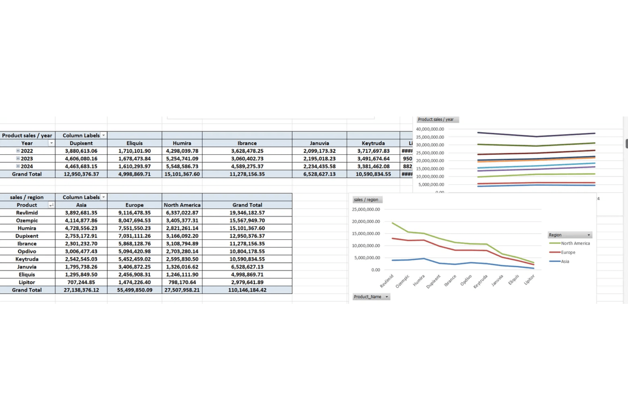
Stage 2: Visualizing Key Trends with Excel Charts and Dashboards
The exploratory data analysis phase culminated in the creation of static visualizations within Excel. These charts provided an immediate, intuitive understanding of the data's distribution and trends, serving as a precursor to the interactive dashboards.
Key Visualizations
Top-Selling Products
Monthly Sales Performance
Regional Contribution
Bar charts illustrating the products contributing
Line charts tracking sales over time to identify
Pie or map charts showing proportional sales
most to revenue.
peak periods.
contribution.
Excel Dashboard Overview
Product Performance Analysis

Slide 8

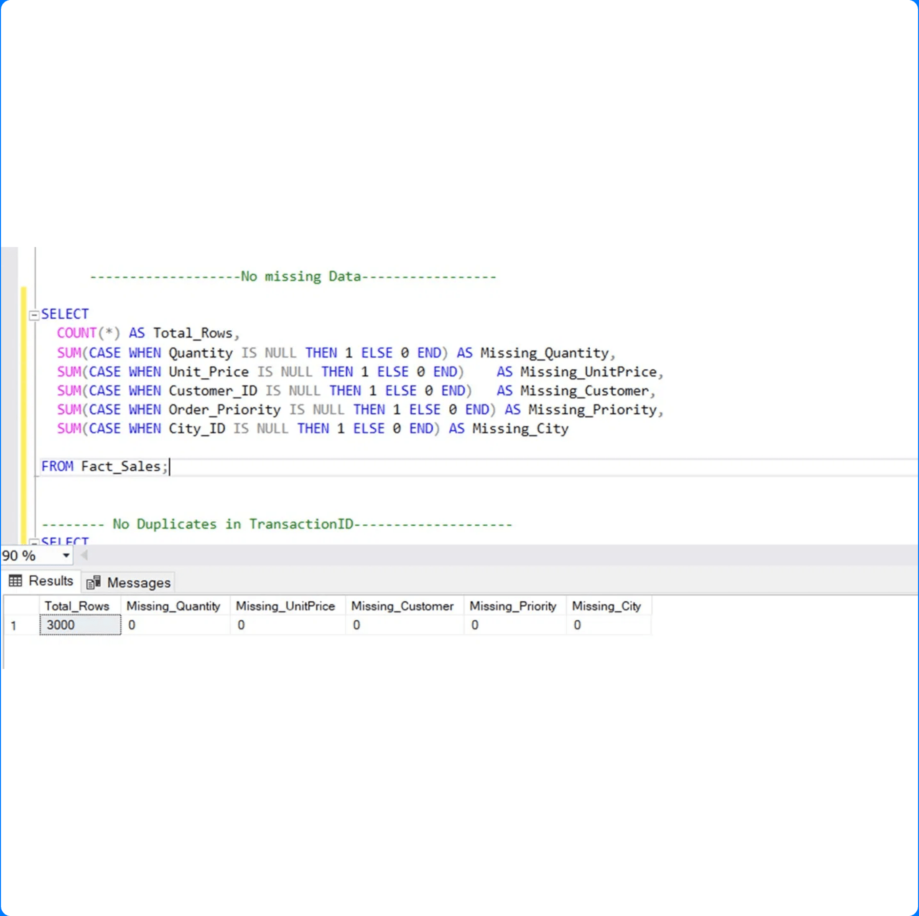
Stage 3: Interactive Business Intelligence with Power BI
The final stage of the data pipeline involved migrating the cleaned and structured data to Power BI to build a dynamic, interactive dashboard. This tool empowers stakeholders to perform self-service analysis and drill down into specific data segments.
Dashboard Features
Key Performance Indicators (KPIs): Real-time tracking of total sales, profit, and average transaction value.
Dynamic Filtering: Slicers allowing users to filter data by product, region, and time period.
Geographic Analysis: Visualizing sales performance on a map for regional comparison.
Drill-Through Capability: Enabling users to move from high-level summary to detailed transaction data.

Slide 9

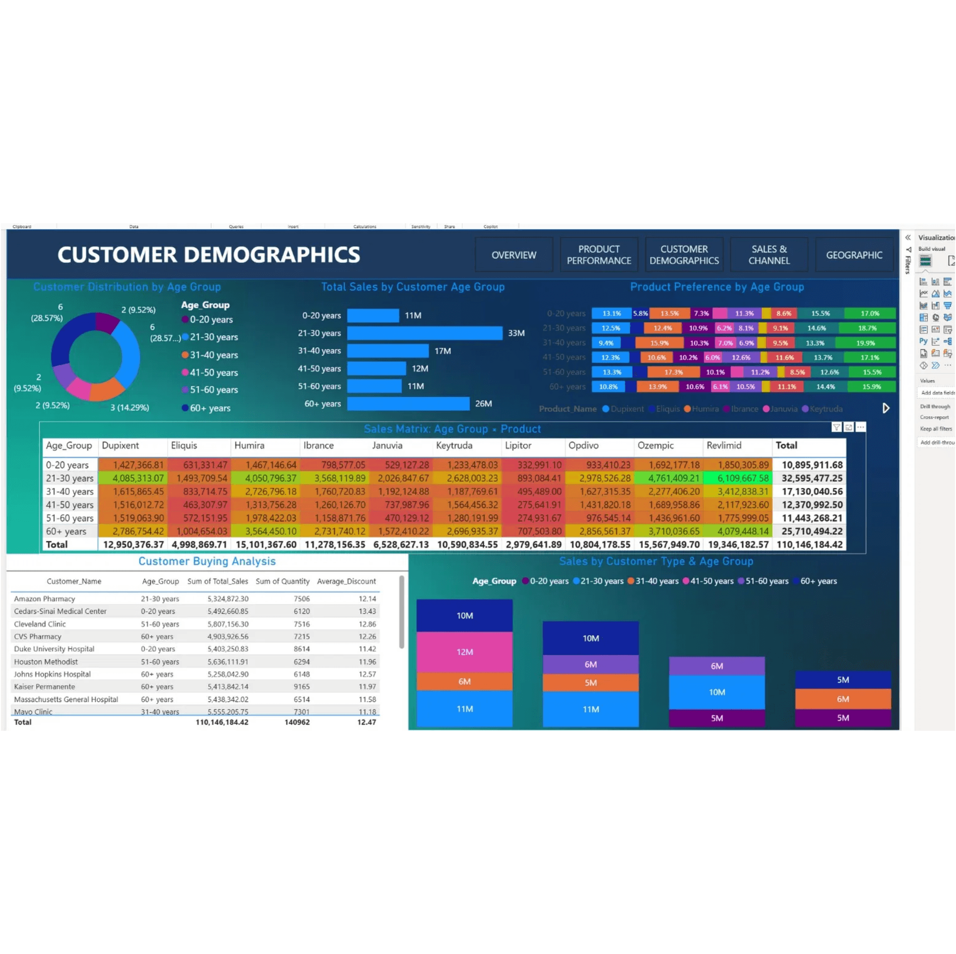
Key Sales Insights: Strategic Findings from the Analysis
High-Growth Segments (Specialty Drugs)
Highest year-over-year growth is concentrated in the Specialty Drugs category, mandating increased investment and inventory focus.
Regional Disparity (Region A Concentration)
Region A generates over 45% of total revenue, requiring targeted campaigns to elevate performance in underperforming regions.
Seasonal Demand Peaks (Q4 Surge)
Consistent sales surge in the fourth quarter necessitates proactive inventory and logistics planning during Q3 to prevent stockouts.
Inventory Optimization (Top 10 Products)
The top 10 products contribute to over 65% of total profit, making optimal stock levels for these high-value items critical.

Slide 10

Conclusion: A Robust Data Pipeline for Business Intelligence
Project Summary: Pipeline Success
Future Work Recommendations
This project successfully established a comprehensive, multi-tool data pipeline, transforming raw pharmaceutical sales data into actionable strategic intelligence. By rigorously applying **SQL for data cleaning**, **Excel for exploratory analysis and visualization**, and **Power BI for interactive business intelligence**, we have demonstrated a complete, end-to-end solution for data-driven decision-making. The process has yielded four critical insights that can immediately inform sales and inventory strategies.
Predictive Modeling: Implement time-series forecasting models to predict future sales volumes and optimize inventory levels proactively.
Real-Time Reporting: Integrate the data pipeline with live data sources to enable near real-time performance monitoring and anomaly detection.
External Data Integration: Incorporate external factors such as economic indicators, competitor data, and public health trends for a more holistic market analysis.

Slide 11
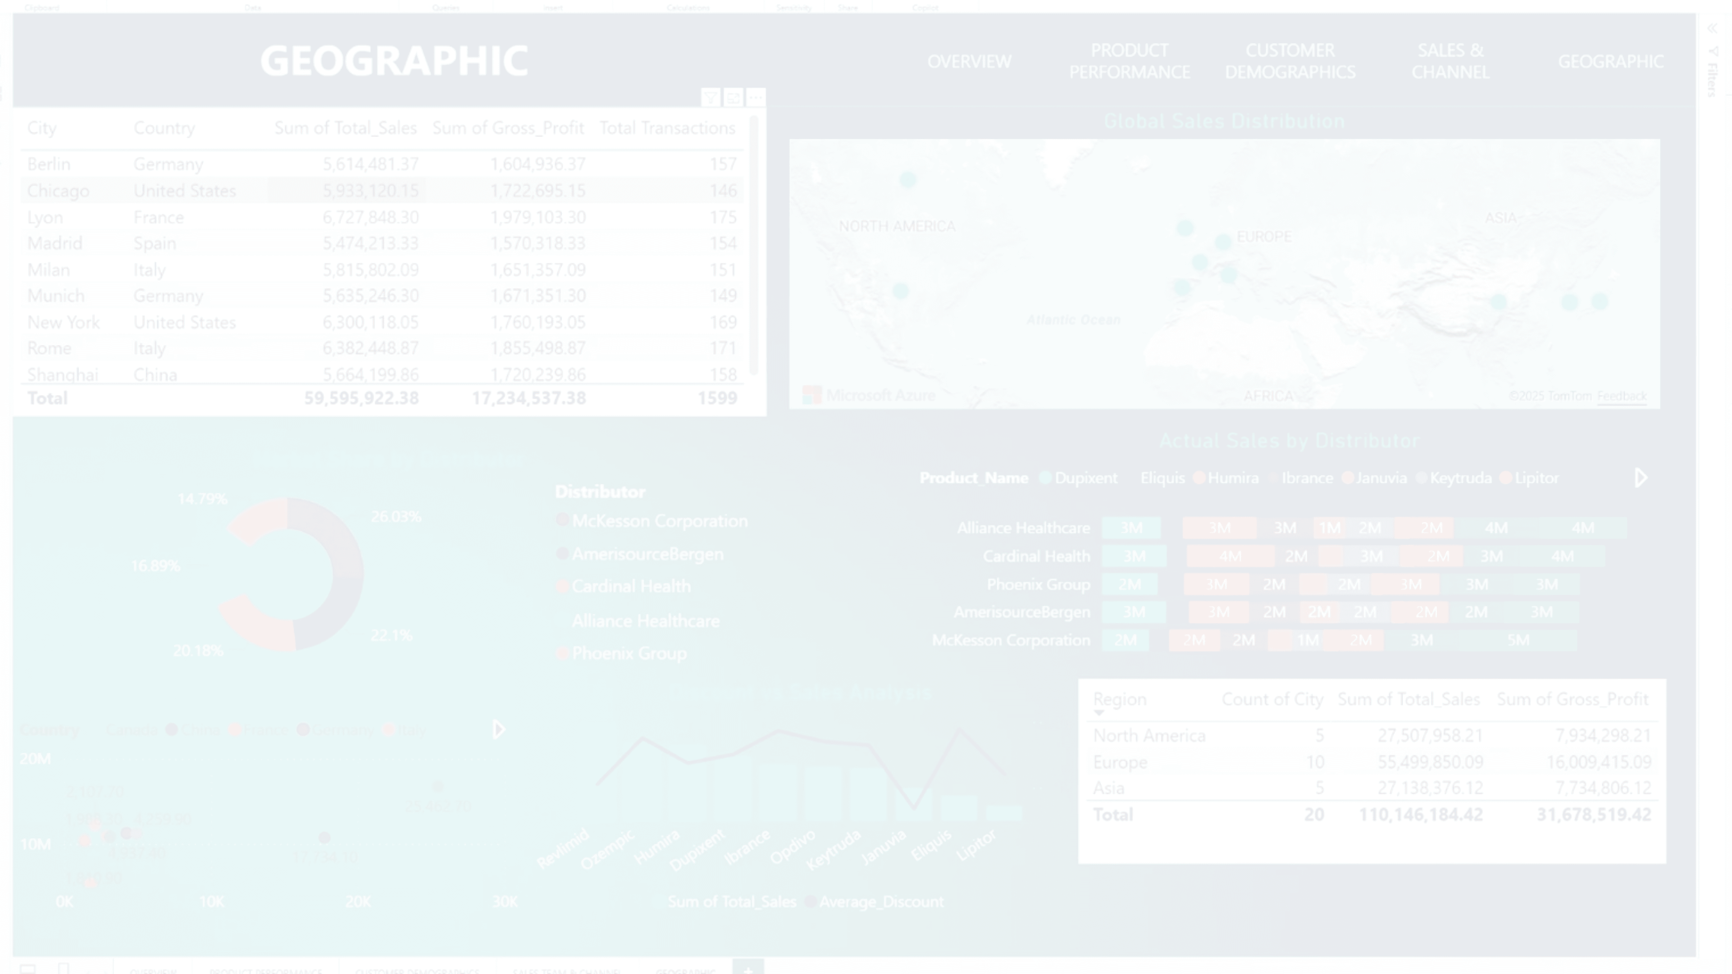


Thank You
Questions & Discussion
[Group Email Address]
[Project Repository Link]
Joseph Maher | Kholoud Rashad | Ahmed Ashraf | Yehia Elhaytham | Nourhan Hashad

