Slide 1
Analysis of Selection of Query
Joseph Martinsen

Slide 2
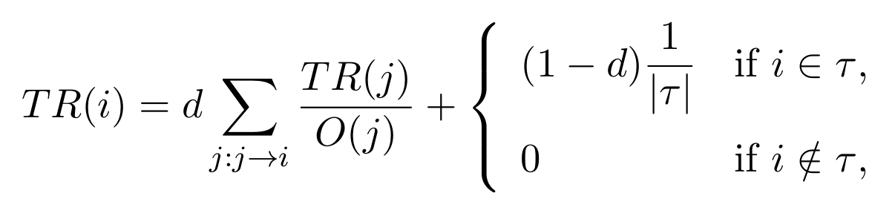
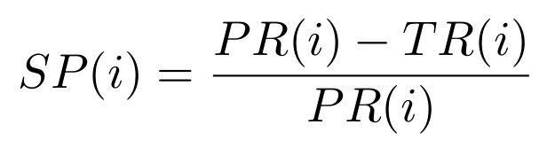
Algorithm Description
“Objective of a search engine is to investigate good superiority resultant pages” (Dr. Jyoti Pruthi)
Biggest Issue for returning Correct Results is Spam
Top 10 Results are Most Important
No Spam = Happy Life

Slide 3
Algorithm In Action
Yahoo! Research Web Data Set UK-2007 used
  100,000,00 pages
  114,529 hosts
  6% spam
Queries included top 100 Spam keywords
Trust Rank + Page Rank Algorithm Results Returned the Best Top 10 Results

Slide 4
References
Mitchell, Gareth. How Much Data Is on the Internet? Science Focus. Immediate Media Co, 23 Jan. 2013. Web. 24 Jan. 2017.
Pruthi, Dr. Jyoti. Selection of Query - Utilize Trust-Based Algorithms to Propagate Trust. India: 2016 International Conference on Computing for Sustainable Global Development (INDIACom), 2016
Yahoo! Research. Web Collection UK-2007. http://barcelona.research.yahoo.net/webspam/datasets/uk2007.

