Slide 1
Adlez
Team Palindromes

Slide 2
Team Palindromes
Project Lead - Michael Arroyo
Technical Lead - Joseph Massie
Programmer - Michael Carpenter
Programmer - Kimpee Go

Slide 3
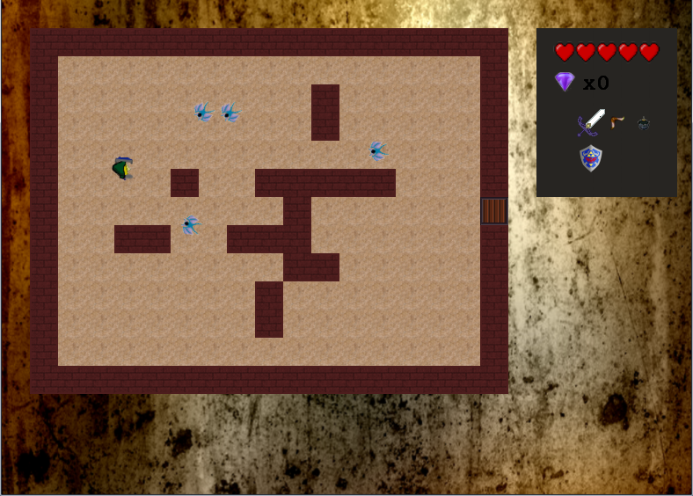
Adlez
Zelda clone
Top down
Dungeon/room based map

Slide 4
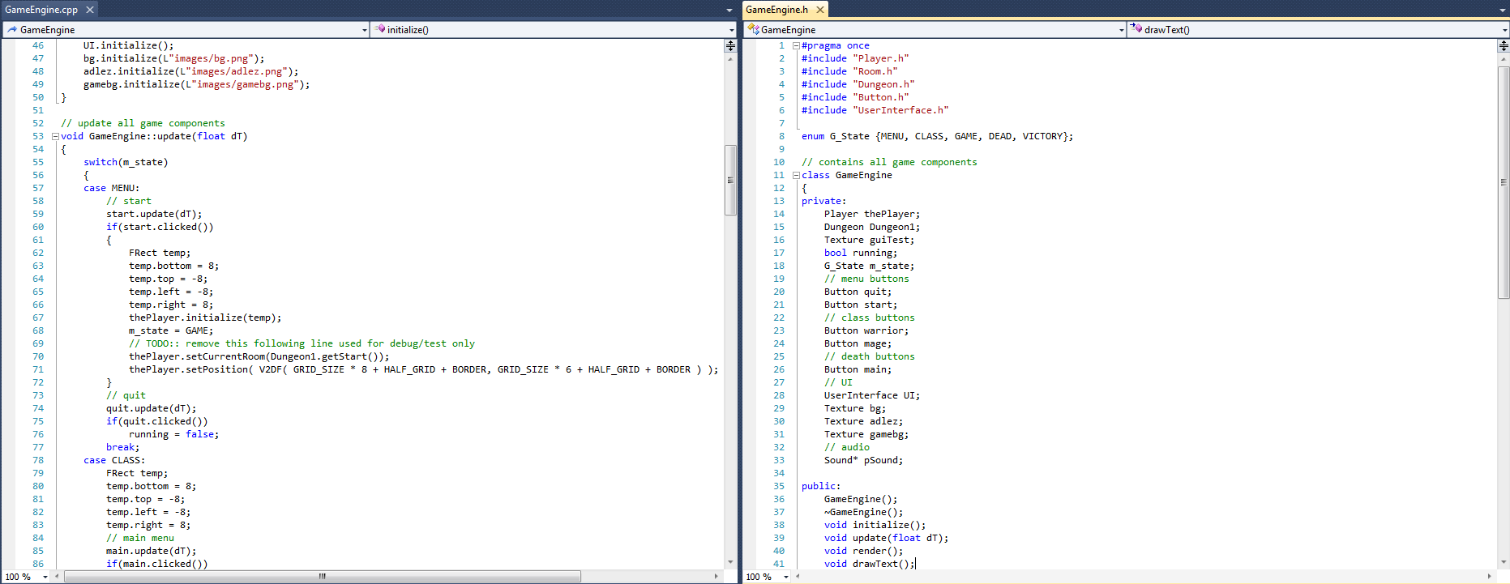



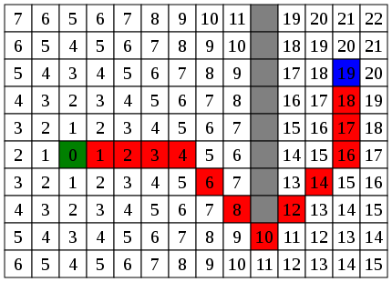
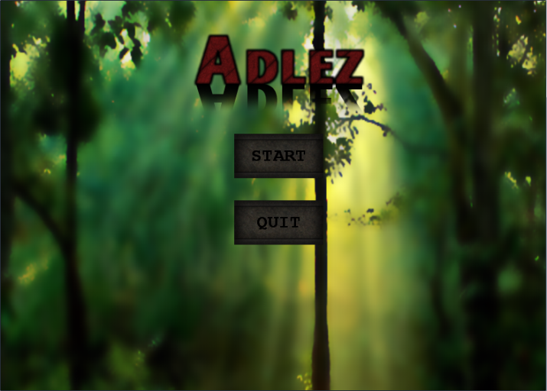
Member Contributions

Slide 5

Demo

Slide 6

Lessons Learned

